Slide 1
WP3.12: Integrated assimilation of the CCI+
S-3 AOD and S-5P ozone retrievals in the IFS
A. Benedetti & R. Dragani (ECMWF)

Slide 2
WP3.12: Integrated assimilation of the CCI+ S-3 AOD and S-5P ozone retrievals in the IFS
The aim is to perform an integrated assimilation of CCI+ O3 and CCI+ Aerosol products from the Sentinels in the IFS (CAMS configuration) and assess their impact and value.
Feedbacks important for CCI+ and for reanalysis (both in C3S & CAMS)
The experiments are performed using a typical incremental design:
Label | Active (CCI+) | Passive (CCI+)
Exp/CTRL | N/A | O₃, AOD
Exp/AOD | AOD | O₃
Exp/O3 (opt) | O₃ | AOD
Exp/O3_AOD | O₃, AOD | N/A

Slide 3
Experiment assessment:
Assessment:
Exp/AOD (Exp/O3) vs. Exp/CTRL [or Exp/O3_AOD vs. Exp/O3 (Exp/AOD)]:
Impact of CCI+ S3 AOD (S5P O3) on the aerosol (ozone) analyses and forecasts;
Synergistic assimilation of MODIS, and SLSTR AOD (various O3) products
Assessment of the consistency between the CCI data & existing assimilated datasets.
Exp/O3_AOD vs. Exp/CTRL:
Synergistic assimilation of O3 + AOD products
Comparisons against independent observations and available reanalyses (in particular the CAMS, and ERA5 reanalyses).

Slide 4
(Technical and) Scientific questions
Is the information provided sufficient? Are the quality information and flags available in the files and user friendly?
What is the quality of these products? Are they suitable for assimilation?
Are the data affected by a bias? What is its structure?
Is the uncertainty well characterized?
Is the information provided by each of the CCI+ products consistent with that available in the IFS?
Do the two ECVs provide consistent information?
Is there a synergy that can be exploited?

Slide 5
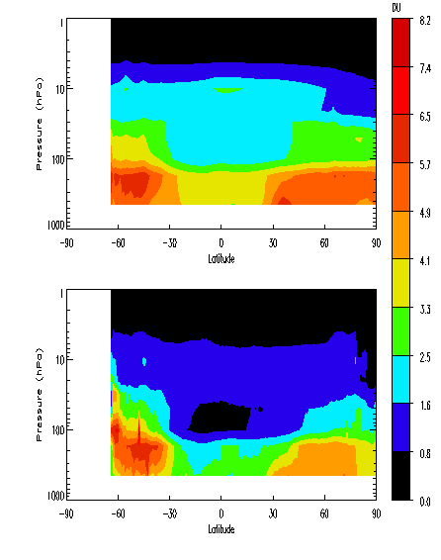
An example of uncertainty characterization
Observed uncertainty (σ_{o})
A DAS can be used to estimate (and thus evaluate) the data uncertainty.
Desrozier method to estimate the uncertainty of the CCI GOME-2 O3 profiles
Good structure in σ_{o} though values slightly overestimated:
Between 10-20hPa, O3C~50DU, σ_{o} - σ_{e} ~ 1DU ➔ ~2% overestimation
Pressure
Estimated uncertainty (σ_{e})
Pressure
Latitude

Slide 6
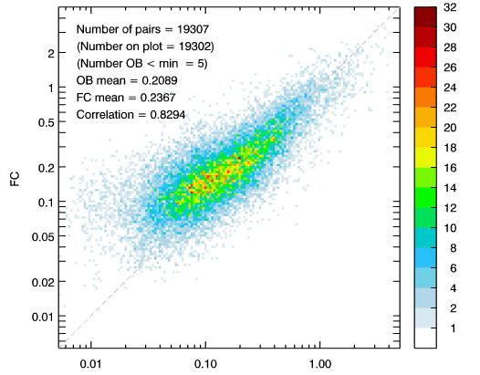
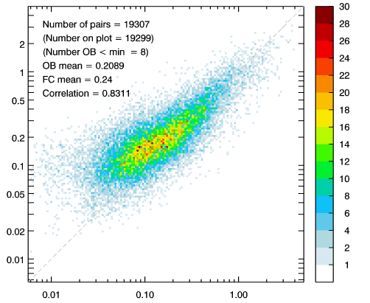
What to expect: experience from P2
CTRL
PERT=CTRL+SMR O3
IFS AOD FC
Ozone and aerosol were not used interactively in P2
AERONET Observations
Active | OZONE | AEROSOLS | GHG
 |  |  | CO2 | CH4
CTRL | SBUV SCIA TCO3 | MODIS | IASI | IASI
PERT | SBUV SCIA TCO3 SMR | MODIS | IASI | IASI
The assimilation of SMR O₃ impacts the quality of the AOD FC.
Improved agreement with AERONET data (+0.17%).

Slide 7
Consistency, synergy and complementarity
A Data Assimilation System (DAS) can be used to assess both the consistency between datasets of the same ECV and that across ECVs
A DAS can include a large number of interactive variables.
In CMUG P2, a study was performed to assess the consistency and synergy between CCI O3, aerosols, and GHG, as well as their ability to constrain their corresponding analyses.
A metric to measure synergy, consistency and complementarity using a DAS.
Control
Exp1 = Control + Dataset 1
Exp2 = Control + Dataset 2
Exp3 = Control + Dataset 1 + Dataset 2
Dataset 1
Dataset 2
>0 Synergistic
|Exp3 – Control| - |(Exp2-Control) + (Exp1-Control)|
Σ =
=0 Complementary
Control
<0 Consistent
No impact (redundant)

Slide 8
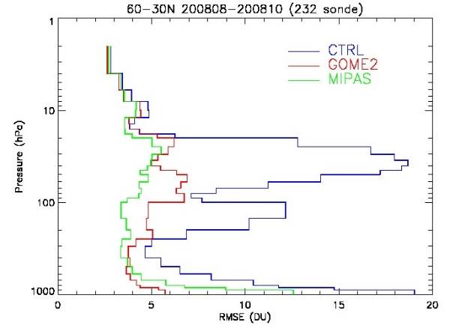
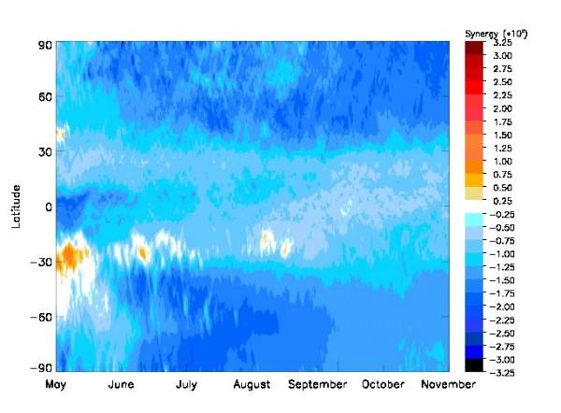
Consistency, complementarity and synergy
Σ =
|Exp3 – Control|-| (Exp2-Control) + (Exp1-Control) |
>0 ➔ Synergy
=0 ➔ Complementarity
Control
<0 ➔ Consistency
(➔ redundancy)
CTRL
CCI GOME2 NPO3
CCI MIPAS LPO3
 | GHG CO2
CTRL | IASI
EXP1 | IASI + SRFP TANSO
EXP2 | IASI + BESD SCIA
EXP3 | IASI + BESD SCIA + SRFP TANSO
Redundancy in DA ➔ Increase the robustness of the DAS.
Bold=CCI datasets

Slide 9
What are your experiment plans for working with CCI+ ECV data?
How will you interact with the relevant teams?
How will you address the integrated perspective for consistency between the ECVs, including identification of gaps?
How will you use uncertainties in products?
What mechanisms will you use to provide feedback to the ECV teams

