Slide 1
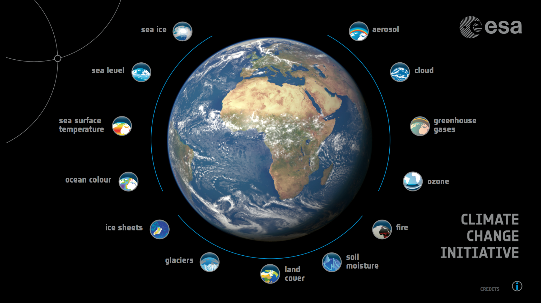







Why CMUG is important for CCI

Slide 2
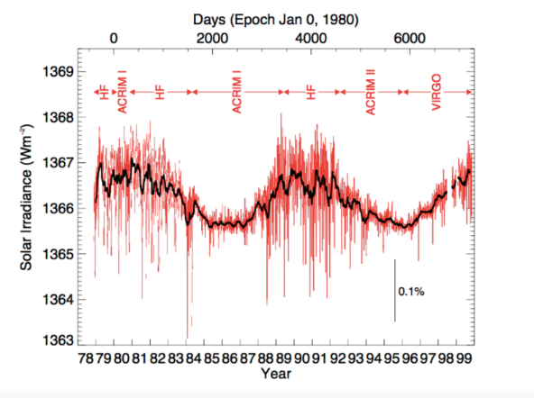
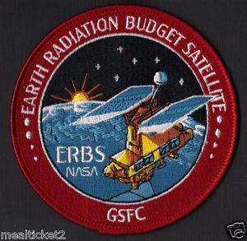
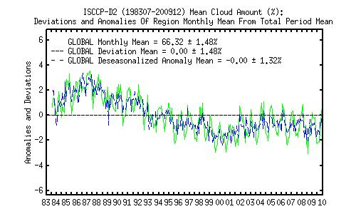

Some history:
First Satellite data used to validate climate models
Earth Radiation Budget Measurements
Nimbus-6 ERB 1975 → NOAA-20 CERES 2018
NASA
ISCCP Project started in 1982 but it took 15 years for modellers to use ISCCP data from Geo imagers 1983 – 2015 thanks to COSP
ISCCP simulator
ESA/NASA/JMA

Slide 3
Why was CMUG set up?
To ensure strong links between ECV teams and climate modelling centres (Hadley, MPI, DLR,MF, SMHI, IPSL, ECMWF)
Provide requirements of datasets for climate modellers
To assess CCI datasets with models
Develop tools to use datasets to validate models
Examine consistency between CCI ECV datasets

Slide 4
Why was CMUG set up?
To ensure strong links between ECV teams and climate modelling centres (Hadley, MPI, DLR,MF, SMHI, IPSL, ECMWF)
Provide requirements of datasets for climate modellers
To assess CCI datasets with models
Develop tools to use datasets to validate models
Examine consistency between CCI ECV datasets

Slide 5


Speaking the same language
Modellers and observationalists need to understand each other
The definition of variables has in the past been different for models and satellite product
We need to bridge the language gap between EO data providers and climate modellers
CMOR NetCDF is an example from the climate world which the satellite world should adopt
Satellite Climate
world world
Notes:
CMOR=Climate Model Output Rewriter
CMOR was not designed to serve as an all-purpose writer of CF-compliant netCDF files, but simply to reduce the effort required to prepare and manage MIP model output. Although MIPs encourage systematic analysis of results across models, this is only easy to do if the model output is written in a common format with files structured similarly and with sufficient metadata uniformly stored according to a common standard. Individual modeling groups store their data in different ways, but if a group can read its own data, then it should easily be able to transform the data, using CMOR, into the common format required by the MIPs. The adoption of CMOR as a standard code for exchanging climate data will facilitate participation in MIPs because after learning how to satisfy the output requirements of one MIP, it will be easy to prepare output for other MIPs.

Slide 6
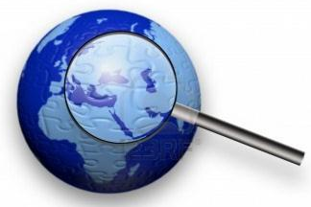
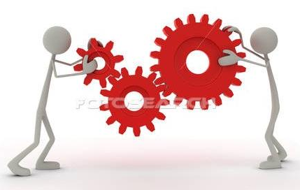
Climate dataset production an iterative process
Assess
version n
with models
CMUG
Feedback to
CCI team
Assess
version n+1
with models
CMUG
ECV team Climate
world
Reprocess
version n to n+1

Slide 7

Original CMUG linkages
Sea-ice
Sea-level
Sea surface temperature
Ocean Colour
Glaciers and ice caps
Land Cover
Fire disturbance
Cloud properties
Ozone
Aerosols
Greenhouse Gases
Climate
Modellers
Met Office Hadley Centre
Climate Modelling
NWP
HadGEM3, FOAM, HadSST
Reanalyses
ECMWF
Reanalyses
NWP
IFS (ERA-Interim)
MACC
MPI-Hamburg
Climate Modelling
MPI-M/ESM, JSBACH
MétéoFrance
Climate Modelling
NWP
Arpege, MERCATOR
CNRM-CM, MOCAGE

Slide 8
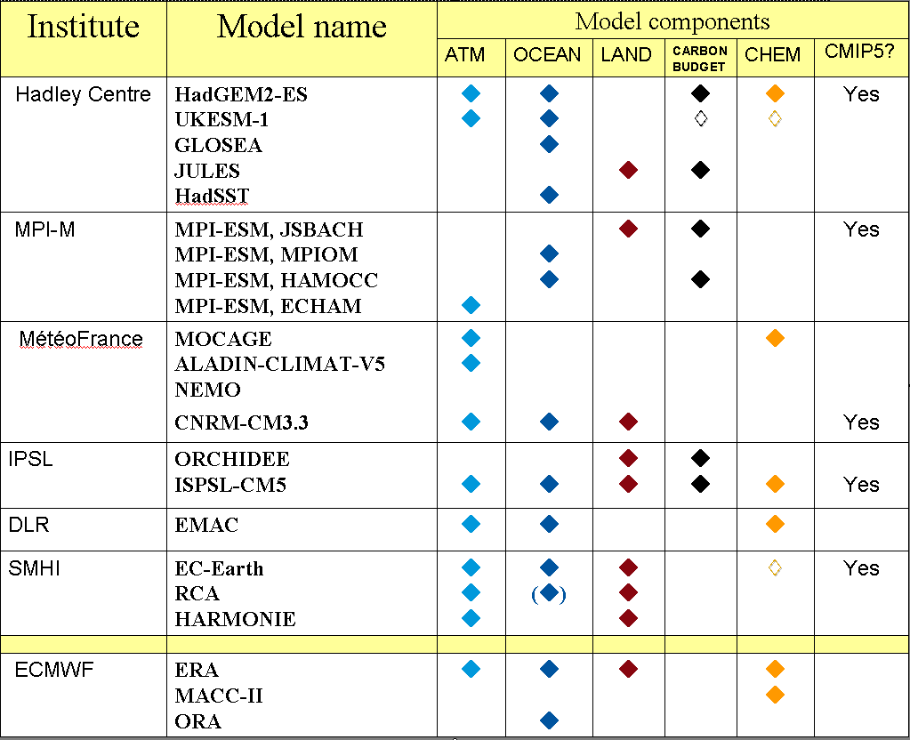
European Global
Climate Models

Slide 9
Why was CMUG set up?
To ensure strong links between ECV teams and climate modelling centres (Hadley, MPI, DLR,MF, SMHI, IPSL, ECMWF)
Provide requirements of datasets for climate modellers
To assess CCI datasets with models
Develop tools to use datasets to validate models
Examine consistency between CCI ECV datasets

Slide 10
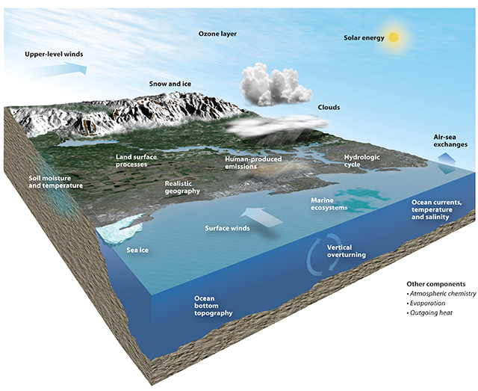
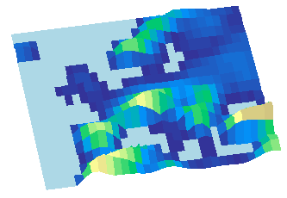


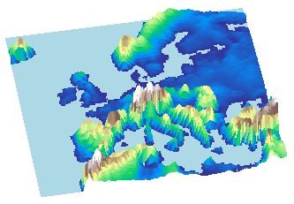
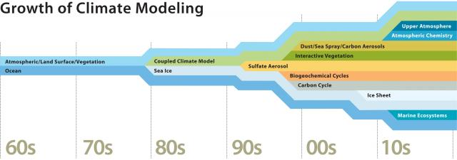
Models are increasing in complexity and resolution
- From AOGCMs to Earth System Models with biogeochemical cycles -
130 km resolution orography
Atmospheric Chemistry
25 km resolution orography
https://www2.ucar.edu/news/understanding-climate-change-multimedia-gallery

Slide 11
How do modellers use satellite climate datasets ?
Validating and improving parametrisations in climate models (e.g. radiation budget, hydrological cycle carbon cycle)
Assimilation in reanalyses (atmosphere, ocean or land)
Initialising seasonal to centennial model predictions
Provide observational constraint for model intercomparisons (e.g. CMIP)
Constraining climate model projections and attribution studies

Slide 12
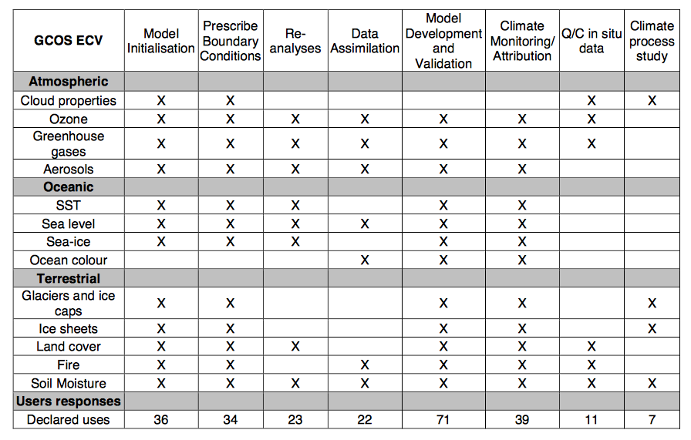
Applications of climate datasets

Slide 13
Implications for requirements
The new ECV datasets must have added value over existing ones and future proof for model evolutions
Datasets should have global coverage and for some applications >15 years
Be clear about applications for specific dataset as this drives the required accuracy:
  Climate monitoring high stability and accuracy
  Change detection high stability
  Evaluate processes in model high accuracy
  Model validation high stability
  Assimilation high accuracy and stability
Uncertainty estimates are as important as product itself for all applications. Correlation of errors in space/time also important

Slide 14
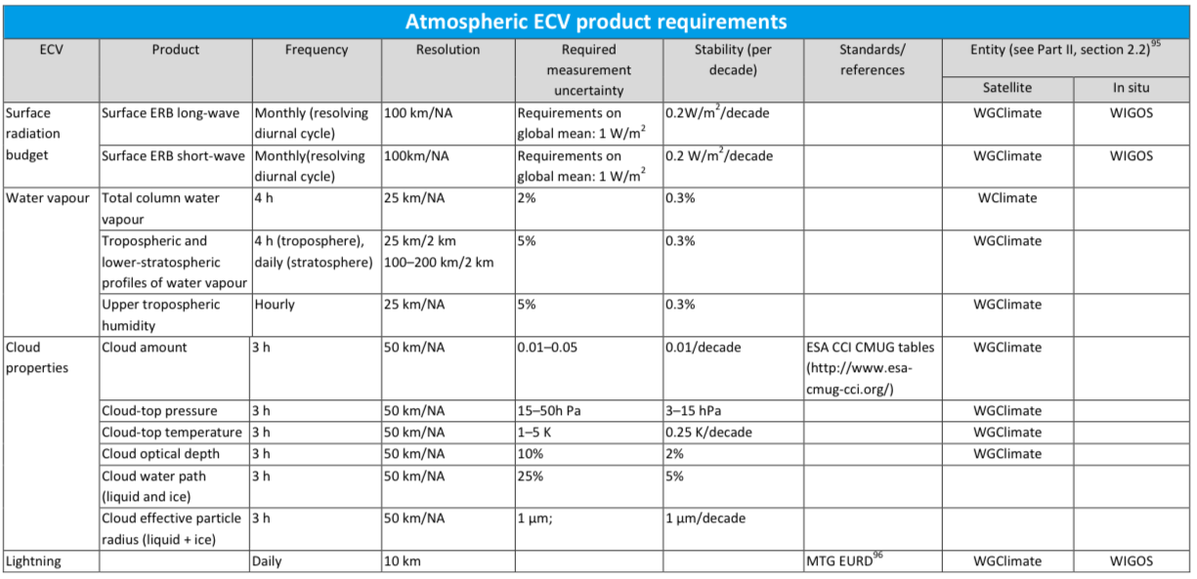
GCOS Requirements for Water Vapour & Clouds

Slide 15
Why was CMUG set up?
To ensure strong links between ECV teams and climate modelling centres (Hadley, MPI, DLR,MF, SMHI, IPSL, ECMWF)
Provide requirements of datasets for climate modellers
To assess CCI datasets with models
Develop tools to use datasets to validate models
Examine consistency between CCI ECV datasets

Slide 16
CMUG Assessments of CCI CDRs
Why does CMUG assess CCI datasets?
Provide an independent view of the datasets and associated uncertainties
Study consistency between ECVs
Demonstrate applications for climate modelling to accelerate use by the climate/reanalysis communities

Slide 17
Options for assessing CDRs
Data used to assess CDRs | Advantages | Drawbacks
Climate Model (single, ensemble) | Spatially and temporally complete | Model has uncertainties Not all variables available
Assimilation in Earth System Models | Spatially and temporally complete | Model has uncertainties Not all variables available
Precursors (e.g. GlobXXX) | Comparing like with like | Some precursors may have large uncertainties
Independent satellite or in situ measurements | Different ‘view’ of atmosphere/surface | May have much larger uncertainty than CDR, need to include representativity errors
Related observations (surface and TOA fluxes, temperature, water vapour) | Assures consistency with other model variables | May not be spatially or temporally complete

Slide 18
CMUG assessments in phase 1
Methodology used for assessment of ECVs | Assessment of CCI CDRs to date
Climate Model (single, ensemble) | SSH, O3, SIC, Clouds, SM, SST
Re-analyses | O3, Aerosol, GHG, Clouds
Precursor datasets | SST, OC, SSH, O3
Independent satellite or in situ measurements | SST, Aerosol, SIC, SM, Glaciers
Related observations (surface and TOA fluxes, temperature, water vapour) | SM
Assimilation | OC, O3, Aerosol, SIC, Glaciers

Slide 19
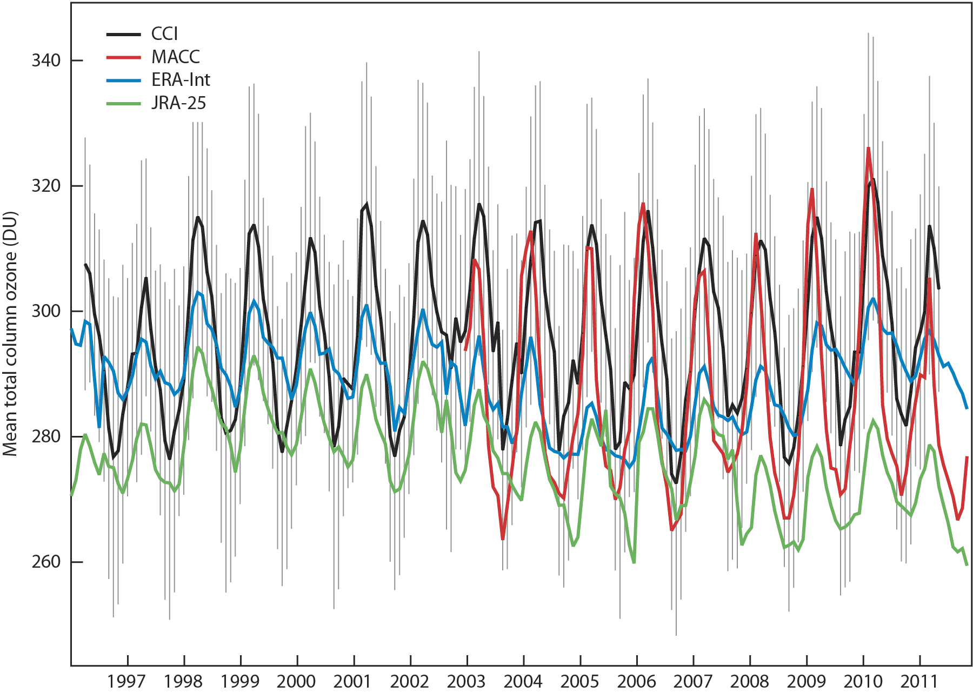
Global mean total column O₃
CCI Sdev
ERA-Interim is 10DU lower than MACC or CCI and annual cycle is much less.
MACC reduction in ozone in Autumn is more rapid than CCI.

Slide 20
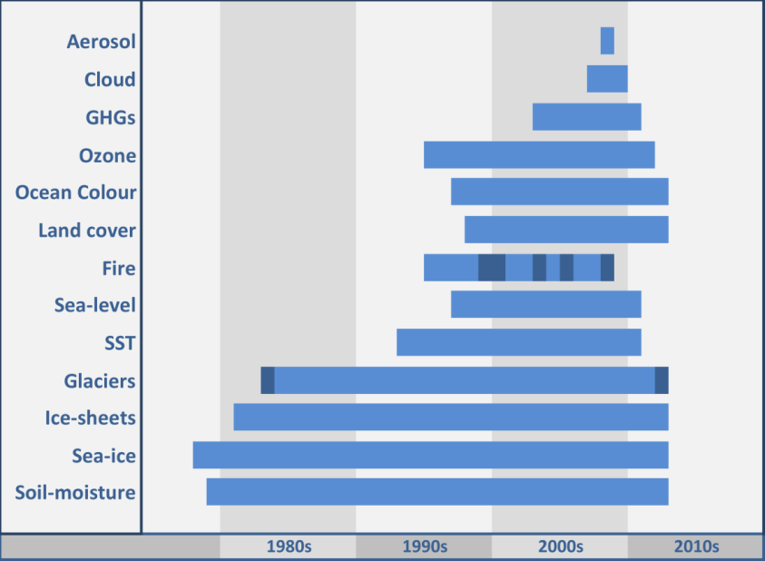
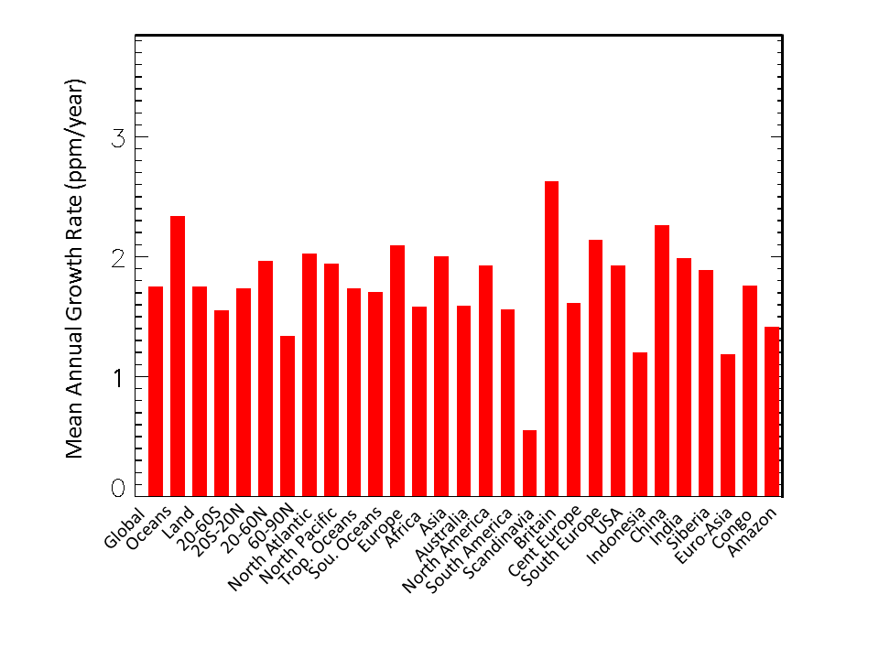
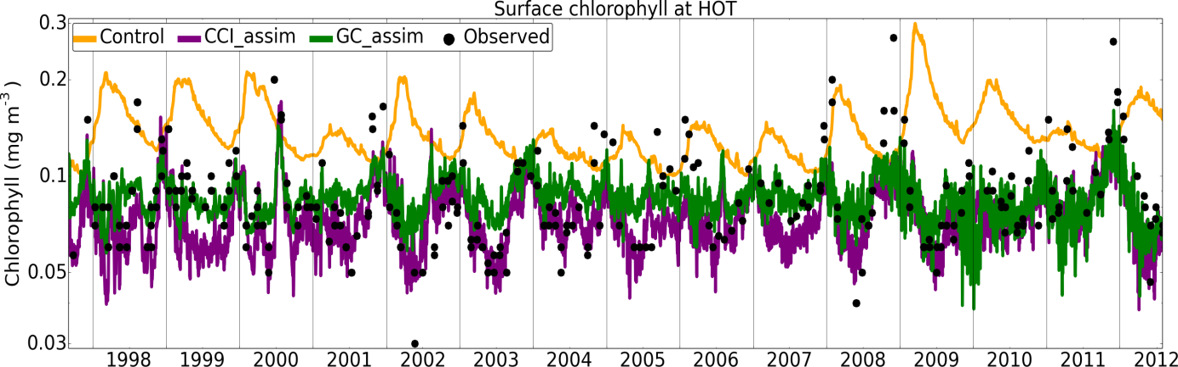
Where we are now: Better Trends
Global annual XCO₂ change (ppm)
 | BESD | NOAA
2004 | 1.52 | 1.81
2005 | 2.01 | 2.03
2006 | 1.77 | 2.13
2007 | 1.66 | 1.77
2008 | 1.59 | 2.08
2009 | 2.74 | 1.50
2010 | 1.61 | 2.29
2011 | 1.68 | 1.92

Slide 21
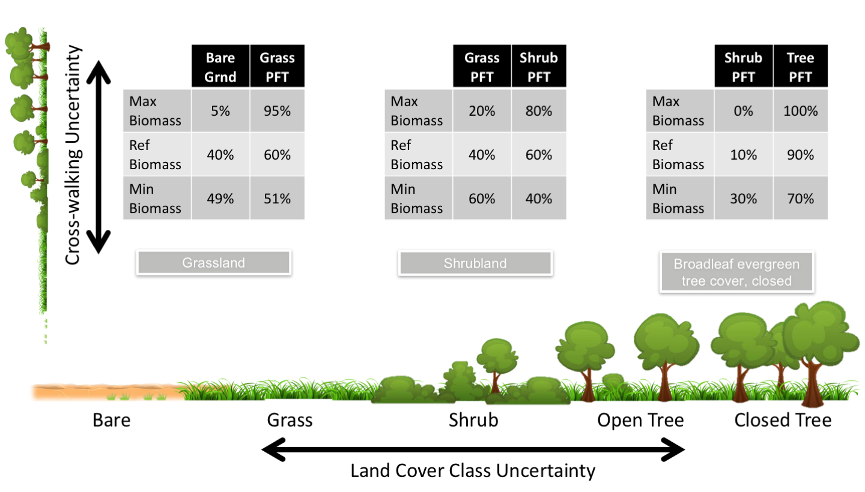
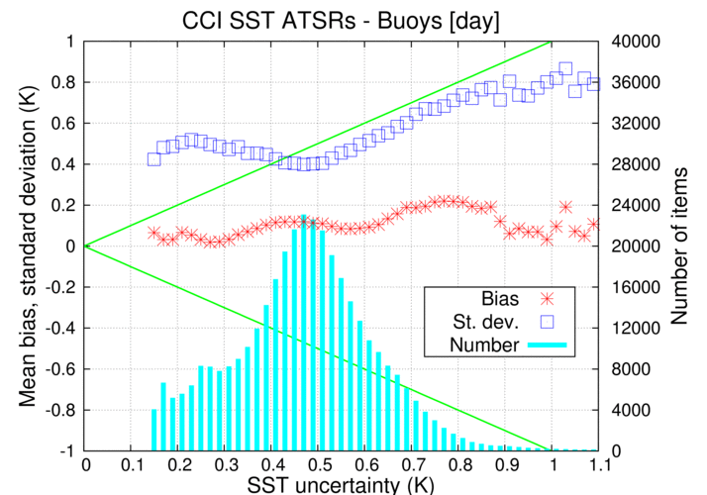
Where we are now: Better uncertainties
Hartley et al 2016 Uncertainty in plant functional type distributions and impact on land surface models
Submitted.
Notes:
Cross-walk is uncertainty in conversion from Land cover to PFT

Slide 22
Why was CMUG set up?
To ensure strong links between ECV teams and climate modelling centres (Hadley, MPI, DLR,MF, SMHI, IPSL, ECMWF)
Provide requirements of datasets for climate modellers
To assess CCI datasets with models
Develop tools to use datasets to validate models
Examine consistency between CCI ECV datasets

Slide 23
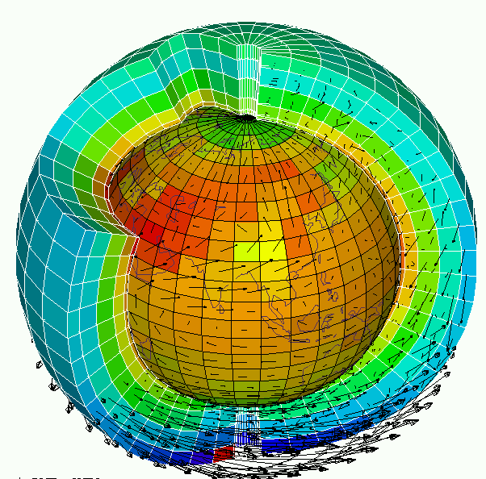
Model development & evaluation, improving parameterizations
Development of metrics for multi-model inter-comparisons
Testing benefit of increasing horizontal & vertical resolution
Seasonal to decadal prediction
Generation of model ensembles, e.g. SSTs, land cover, PFTs,…
Detection & attribution of climate change
Constraining climate projections, etc
Model validation
Many user needs
Long time series
Uncertainties
Consistency

Slide 24
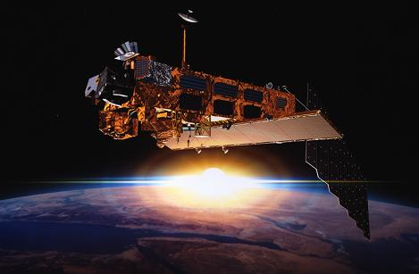
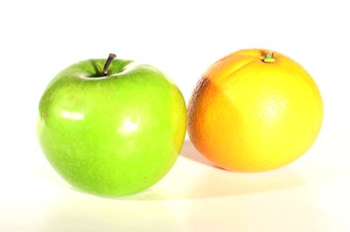
Need for Obs Simulators
?
Geophysical measurements
(e.g. radiance, bending angle)
Model grid variables
(e.g. temp, water vapour, wind, etc)
Retrieve model variables
Compare in model space

Slide 25
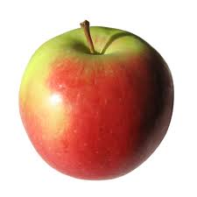
Need for Obs Simulators
?
Geophysical measurements
(e.g. radiance, bending angle)
Model grid variables
(e.g. temp, water vapour, wind, etc)
Compare measured and simulated measurements
Compute satellite measurements using simulator (e.g. COSP)

Slide 26
Need for Obs Simulators
?
Geophysical measurements
(e.g. radiance, bending angle)
Model grid variables
(e.g. temp, water vapour, wind, etc)
Both approaches are useful
depending on the ECV

Slide 27
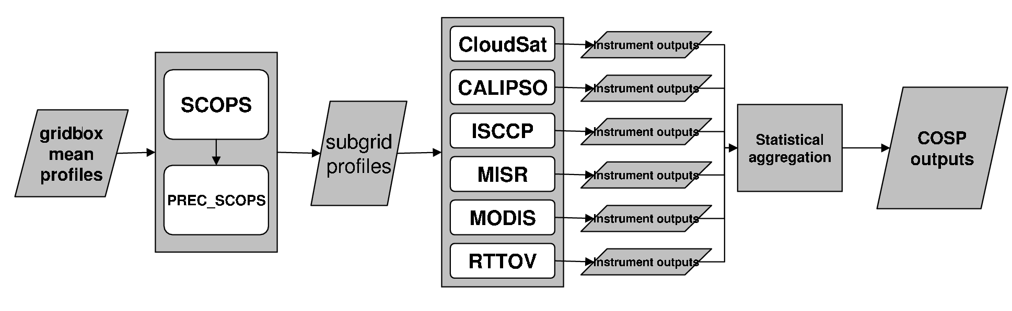
COSP
CFMIP Observation Simulator Package
Used in the CFMIP2 and CMIP5 experiments
STEP 1
STEP 2
STEP 3
CFMIP web: https://www.earthsystemcog.org/projects/cfmip/
User group: http://groups.google.com/group/cosp-user
Code: : https://github.com/CFMIP/
(Bodas-Salcedo et al., BAMS, 2011)

Slide 28
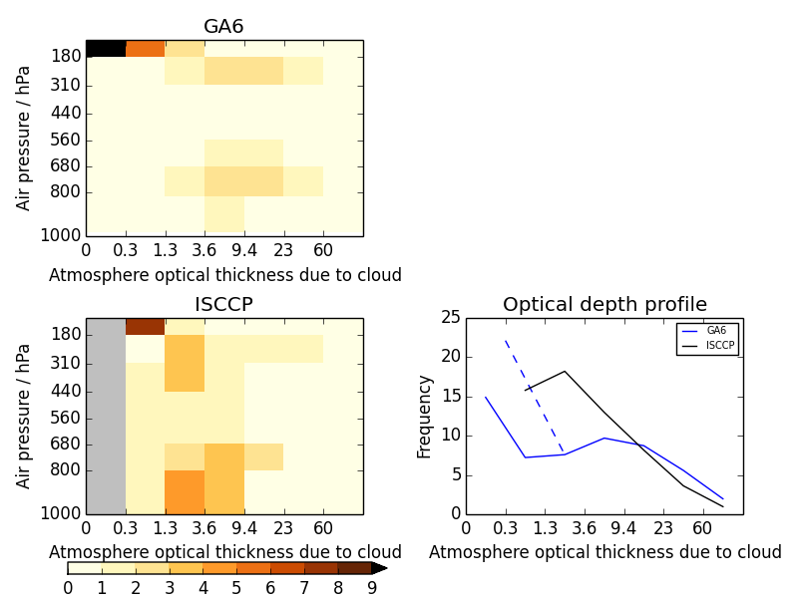
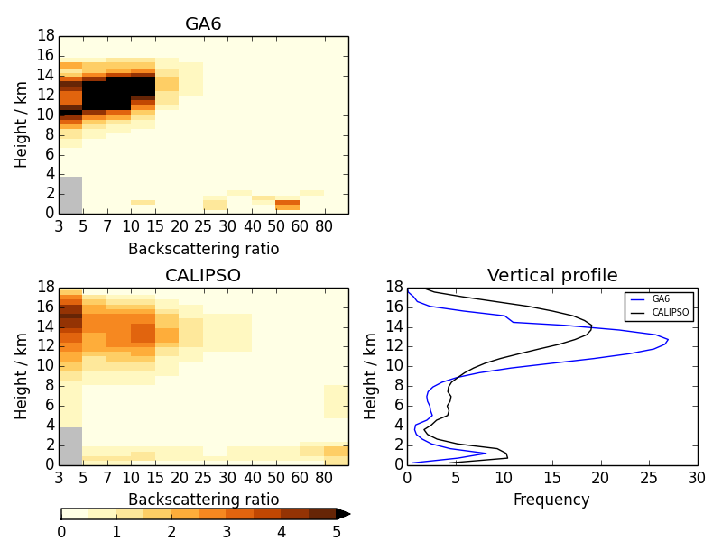
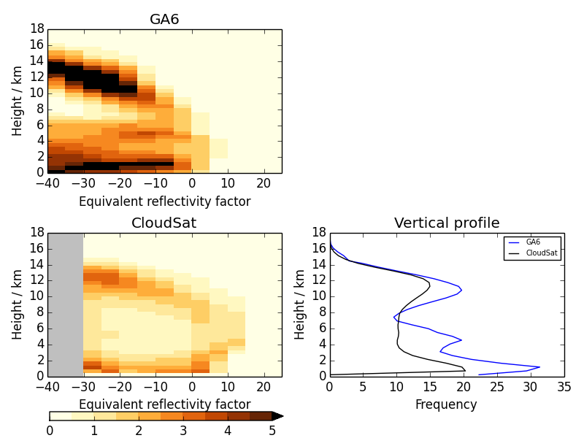
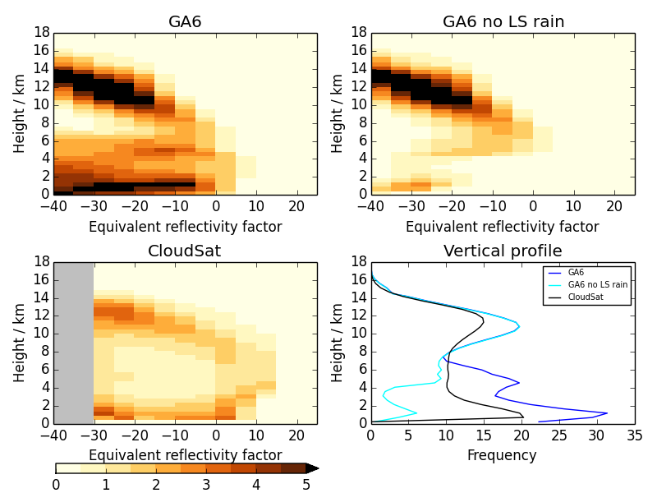
Comparison against satellite data over the tropics
ISCCP
CALIPSO
CloudSat
Too little medium brightness cloud
Excessive cirrus and too low
Excess hydro-meteor at low levels
MODEL +
COSP:
OBS:
(Courtesy K. Williams)
Excess “drizzle”

Slide 29
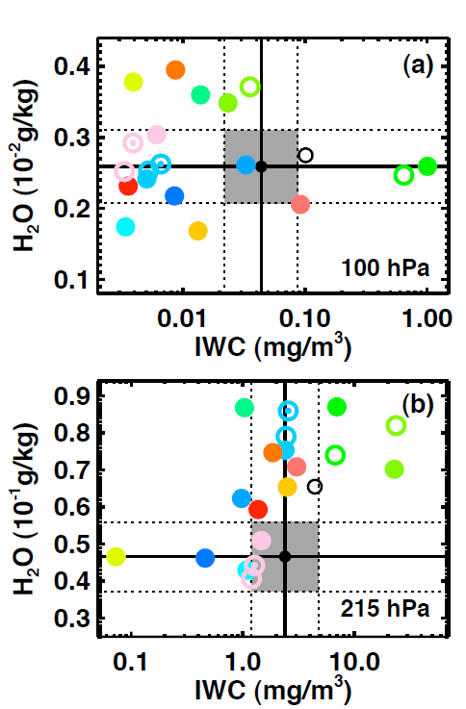
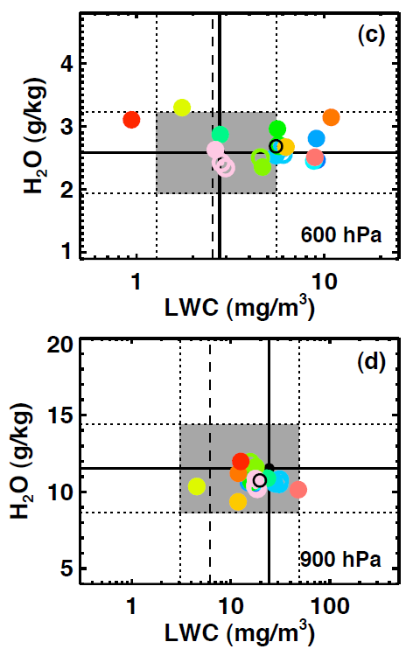
Evaluation of clouds and water vapour in CMIP5 models. J. Jiang et al., 2012, JGR
upper troposphere
lower troposphere
water vapour
cloud
ice/liquid

Slide 30
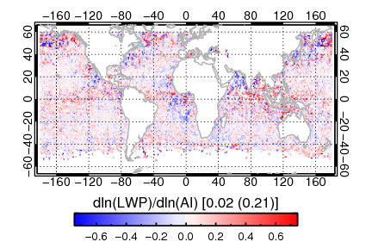
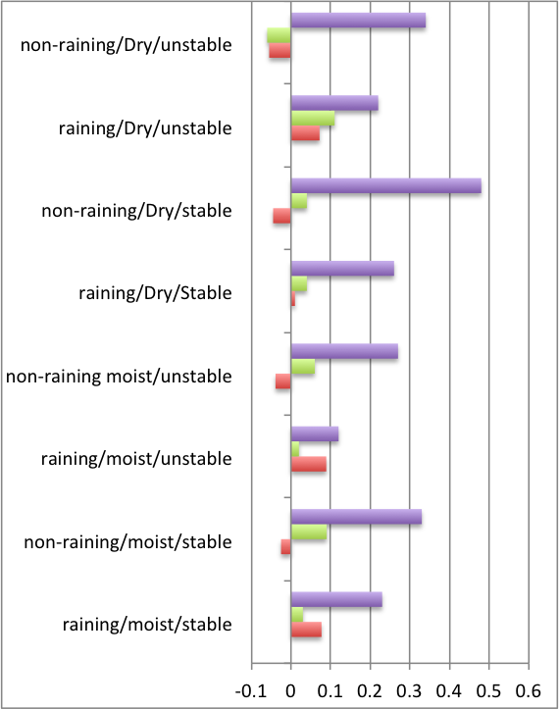
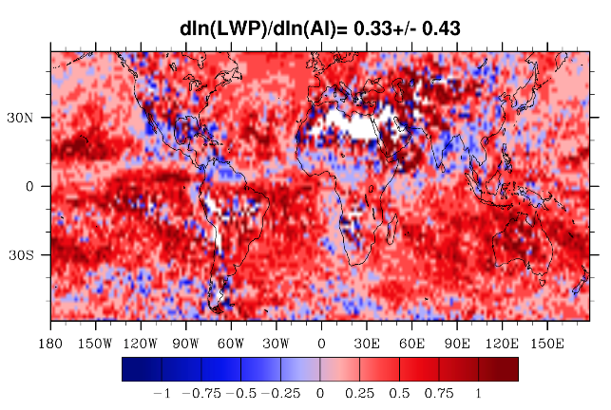
Aerosol-Cloud Interactions
Cloud Water Path Sensitivity Satellite-Model Comparisons
JJA 2008; 60S° – 60° N (Ocean only)
Satellite: AATSR
Global mean sensitivity ( ) by cloud regime
Main result
LWP sensitivity to increasing aerosols is significantly larger in the ECHAM6 model compared to AATSR observations.
Model derived aerosol indirect forcing is more than two times larger than satellite data (IPCC, 2013).
Feedbacks that reduce the LWP sensitivity (e.g., entrainment) are poorly parameterized in model simulated clouds which may explain the significant difference between model and satellite observations.
Model: ECHAM6 HAM 2
ECHAM6
AATSR
MODIS
Notes:
The focus of this slide is on changes in liquid water path. Changes in liquid water path profoundly affect the albedo of the clouds. We see very large differences between satellite and model derived estimates of the liquid water path sensitivity. These sensitivities were also binned by various meteorological and cloud regimes. Clouds were considered raining if the effective radius retrieval was greater than 14 um. Dry atmosphere is when the relative humidity at 850 hPa is less than 40%. Stable atmosphere is when the lower troposphere stability (e.g., potential temperature difference between 700 hPa and the surface) is greater than 18 K.
The strong LWP sensitivity in the model may explain why model derived aerosol indirect forcing estimates are so much larger than satellite derived estimates (Penner et al., 2012, PNAS).

Slide 31

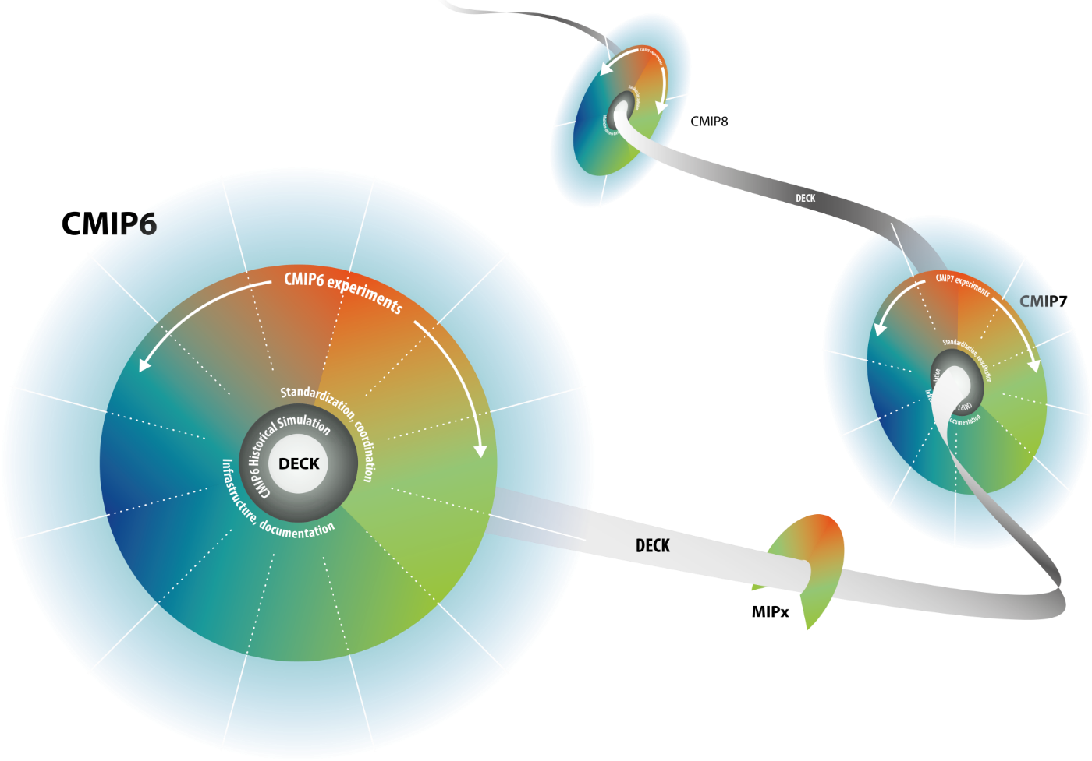
CMIP Continuity
A common suite of experiments for each phase of CMIP provides an opportunity to construct a multi-model ensemble using model output from various phases of CMIP
Eyring et al., GMD, in prep., 2015

Slide 32

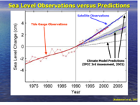
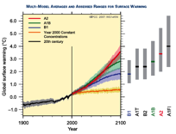
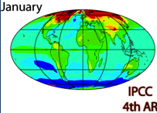
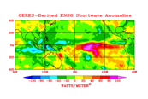
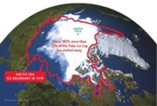
Observations for Model Intercomparison Projects (obs4MIPs)
WDAC Task Team on Observations for Model Evaluation
CMIP6
How to bring as much observational scrutiny as possible to the CMIP/IPCC process?
How to best utilize the wealth of satellite observations for the CMIP/IPCC process?
Obs4MIPs has defined a set of technical specifications and criteria for developing observational data sets that are technically aligned with CMIP model output (with common file format, data and metadata structure).
Over 50 datasets that conform to these standards are now archived on the ESGF alongside CMIP model output (Teixeira et al., 2014), including ESA CCI data
Data users have enthusiastically received Obs4MIPs

Slide 33
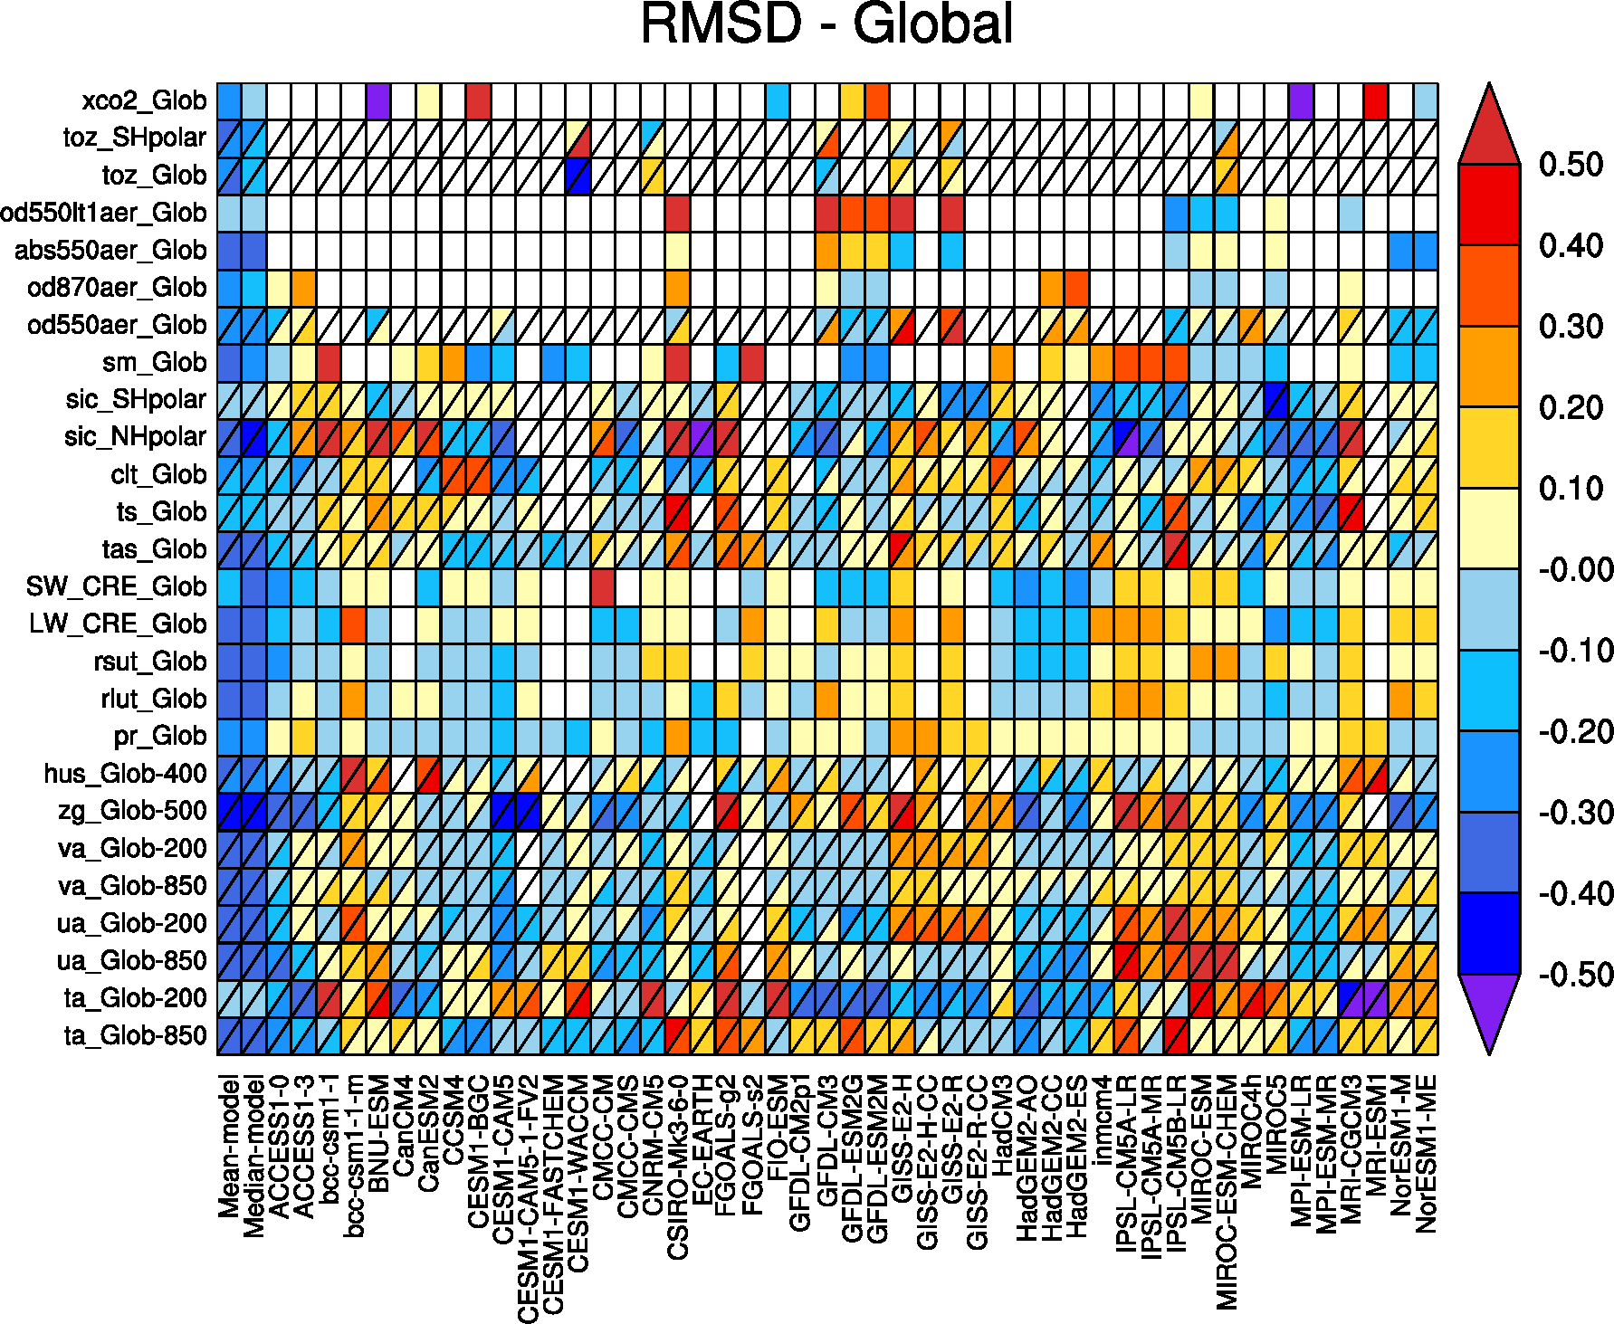
Where we are now: Model assessment
ESA CCI datasets
greenhouse gases
ozone
aerosol
soil moisture
sea ice
cloud
SST
Assessment of climate models using ESMVal tool for several CCI datasets
Climate models
From: Lauer et al. (2016), Remote Sensing of Environment

Slide 34
Why was CMUG set up?
To ensure strong links between ECV teams and climate modelling centres (Hadley, MPI, DLR,MF, SMHI, IPSL, ECMWF)
Provide requirements of datasets for climate modellers
To assess CCI datasets with models
Develop tools to use datasets to validate models
Examine consistency between CCI ECV datasets

Slide 35
Cross-ECV consistency
 | SST | SL | Cl | Sice | OC | Aero | GHG | LV | Fire | Ozone | Glaci | ISh | SM
SST |  | x | x | X | X | x |  |  |  | x
Sea level | x |  |  | x |  |  |  |  |  |  |  | X
Clouds | x |  |  | x | X | x | x | X | x | X
Sea ice | X | x | x |  | X |  |  |  |  | x | x
Ocean col | X |  | x | x |  | x
Aerosol |  |  | x |  | X |  |  | X | x | X | x
GHG |  |  | x |  |  | x |  |  | x | X
Landcover |  |  | x |  |  | x |  |  | x |  | x |  | x
Fire |  |  | x |  |  | x | x | X |  | x |  |  | x
Ozone |  |  | x |  |  | x | X
Glaciers |  |  |  | x |  |  |  | X |  |  |  | x
Ice Sheets |  | X |  |  |  |  |  |  |  |  | X
SoilM |  |  |  |  |  |  |  | x | x

Slide 36

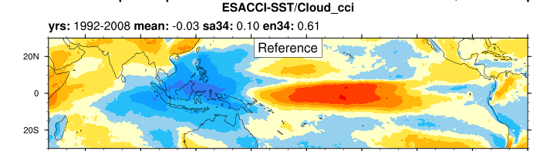
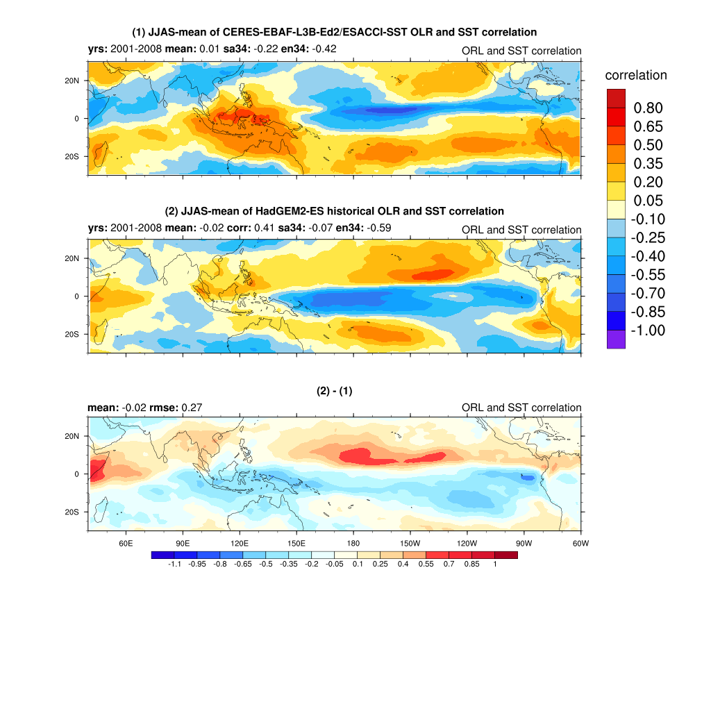
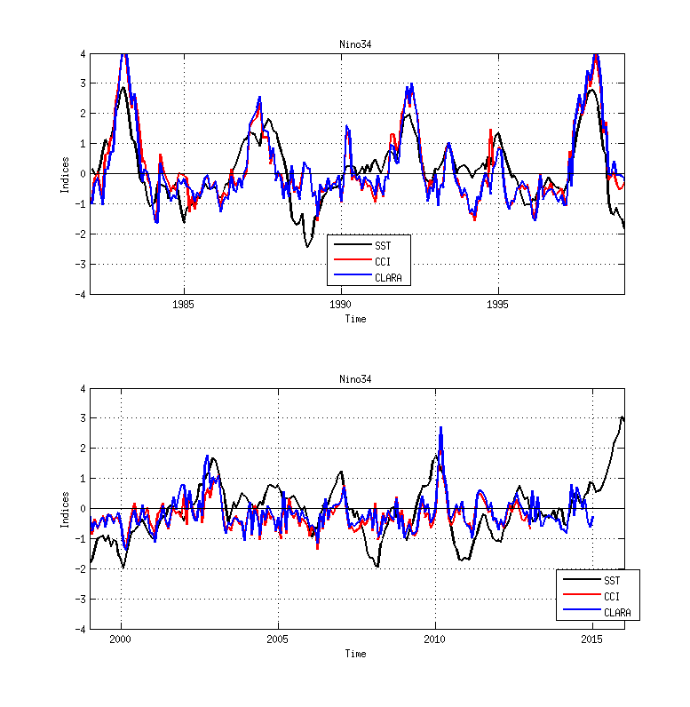
Cross-assessment of ECV's for global climate variability
1. Correlation CCI SST Nino3.4 timeseries and CCI Clouds globally
3. Mean Index for 5S/5N
Time/longitude
Hovmöller plots
2. Timeseries: Niño3.4 ( 5S-5N,190E-240E), X=SST, Clouds: Index=Anomaly(X)/std(X)
HadISST black, Cloud CCI red, Cloud CMSAF CLARA-A1 blue
1985 1990 1995 2000 2005 2010 2015
Notes:
36

Slide 37

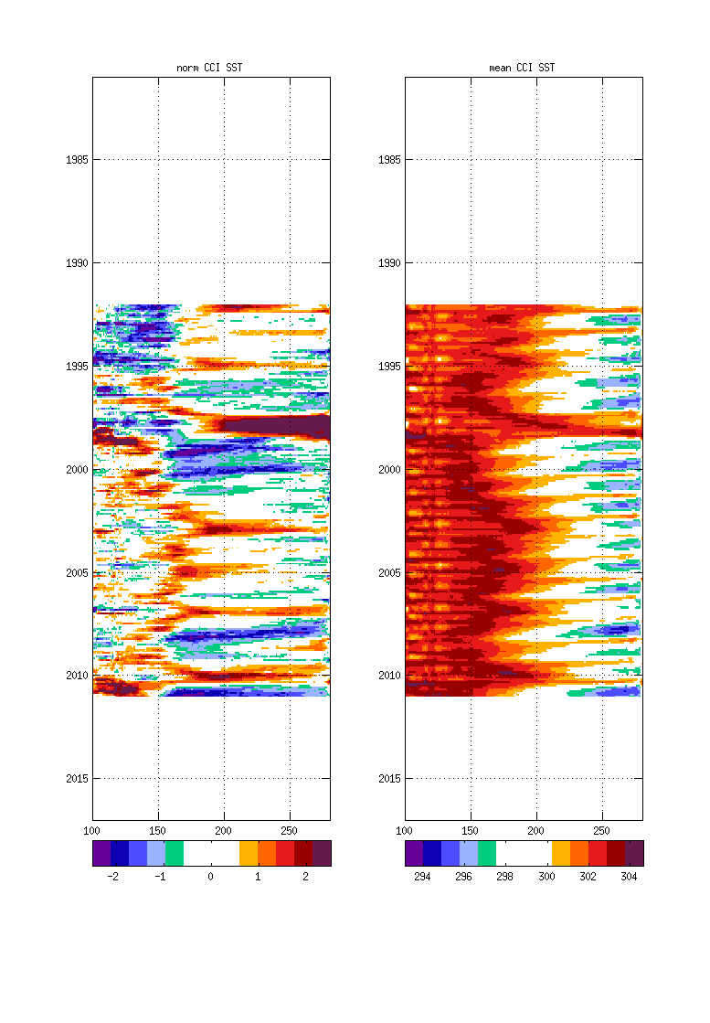
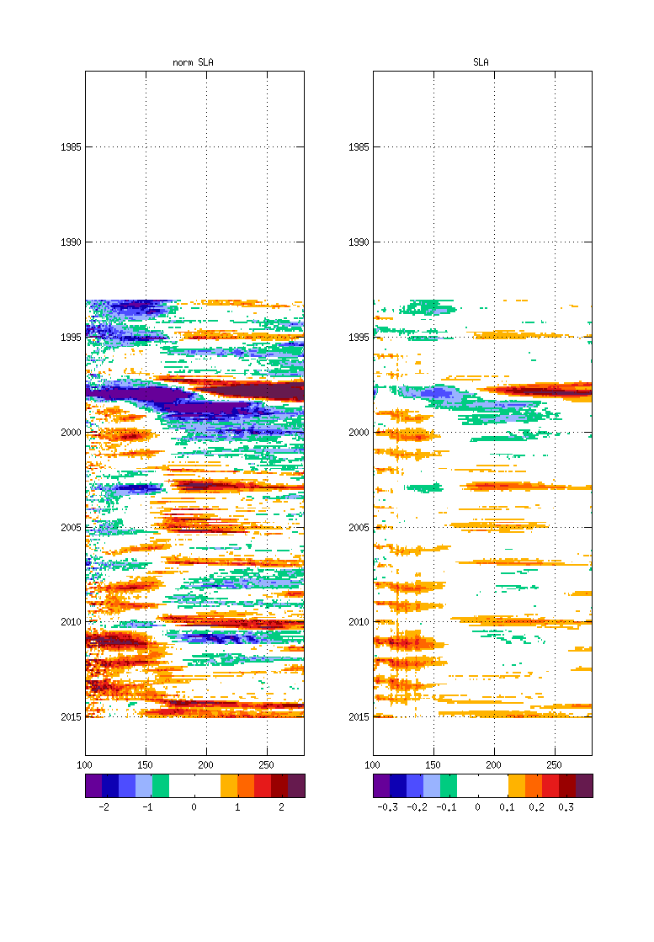
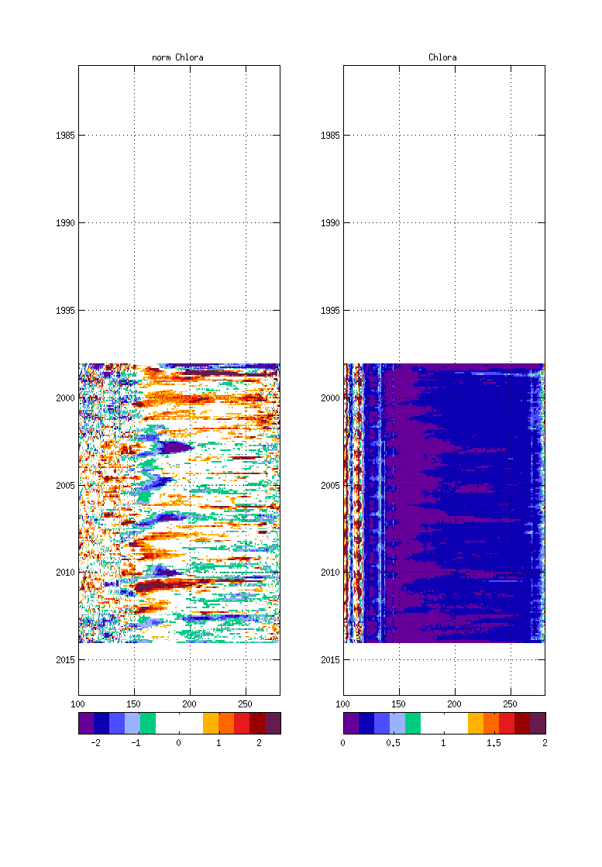
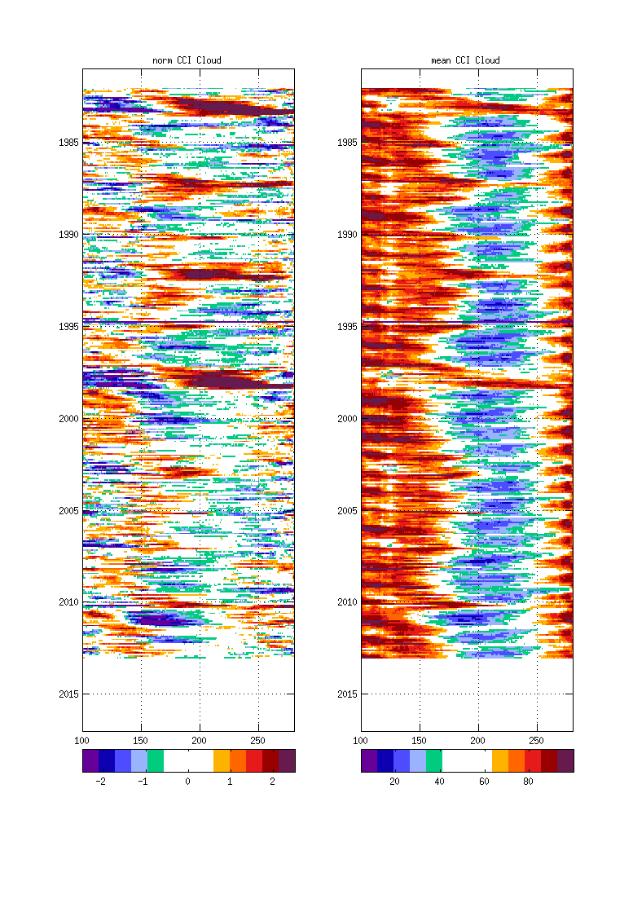
Hovmöller diagrams for Pacific Ocean 5S-5N normalized anomalies
for CCI SST, Sea Level, Chlorophyll and Cloud cover and longitudes between 100E to 270E
SST
Sea Level
Chlorophyll
Cloud

Slide 38
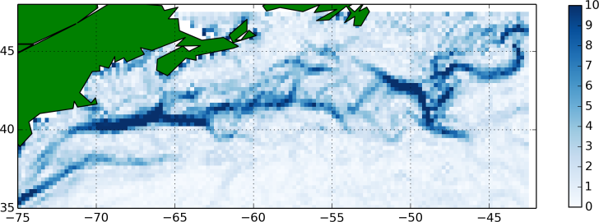
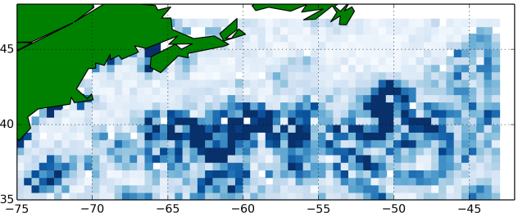
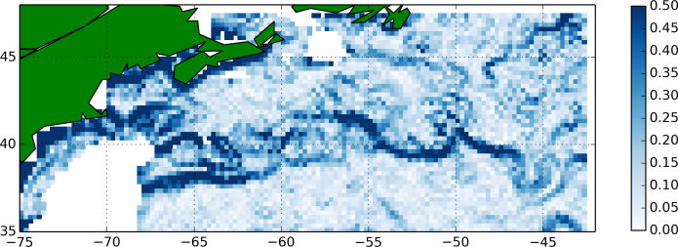






Where we are now: Better consistency
Horizontal gradients - June 2009
Calculated at binned observation locations
SST
SLA
log₁₀(chlorophyll)
Obs
Free
run
Assim
all
ECVs
0
10
0
0.5
0
0.5
Observed SST and SLA gradients seem consistent
Observed OC gradients likely consistent given expected nutrient concentrations, but further investigation needed
Model better matches observed gradients for all fields with assimilation

Slide 39

Lessons learnt from past
Recognise move of modellers to using fundamental measurements not products This is especially true for reanalyses
It took more than 15 years to get several satellite datasets used for climate model evaluation
Observation simulators are important for some satellite products to compare apples with apples (e.g. clouds ..) We need to extend this concept more widely

Slide 40
Some recommendations from CMUG
Advise on ECVs required for climate modelling
Observation simulators important to link measured ECV to model variable (e.g. COSP)
Accurate uncertainty estimates with observations (i.e. bias, rms, stability)
Consistency between ECV datasets important
Common formats easy to read (e.g. NetCDF-CF, Obs4MIPS)
Easy to use tools to assess the models (e.g. ESMValtool, AutoAssess, …)

Slide 41
Some recommendations from CMUG
INDEPENDENT assessment of CCI datasets by CMUG proved to be extremely valuable as picked up issues the CCI teams had not and prevented external users finding them.

Slide 42
Some things we could have done better
Align time of assessment of ECVs better, CMUG always waiting until last minute to get datasets to assess.
Better communications between CCI ECV teams and CMUG (e.g. CMUG attending ECV team meetings and good interactions at Integration Meetings)
Faster reformatting of data into Obs4MIPs

Slide 43
Any Questions?

