Slide 1
Martin Horwath and the SLBC_cci consortium
CCI Sea Level Budget Closure
or
How consistently can we observe climate system elements involved in sea level change?

Slide 2
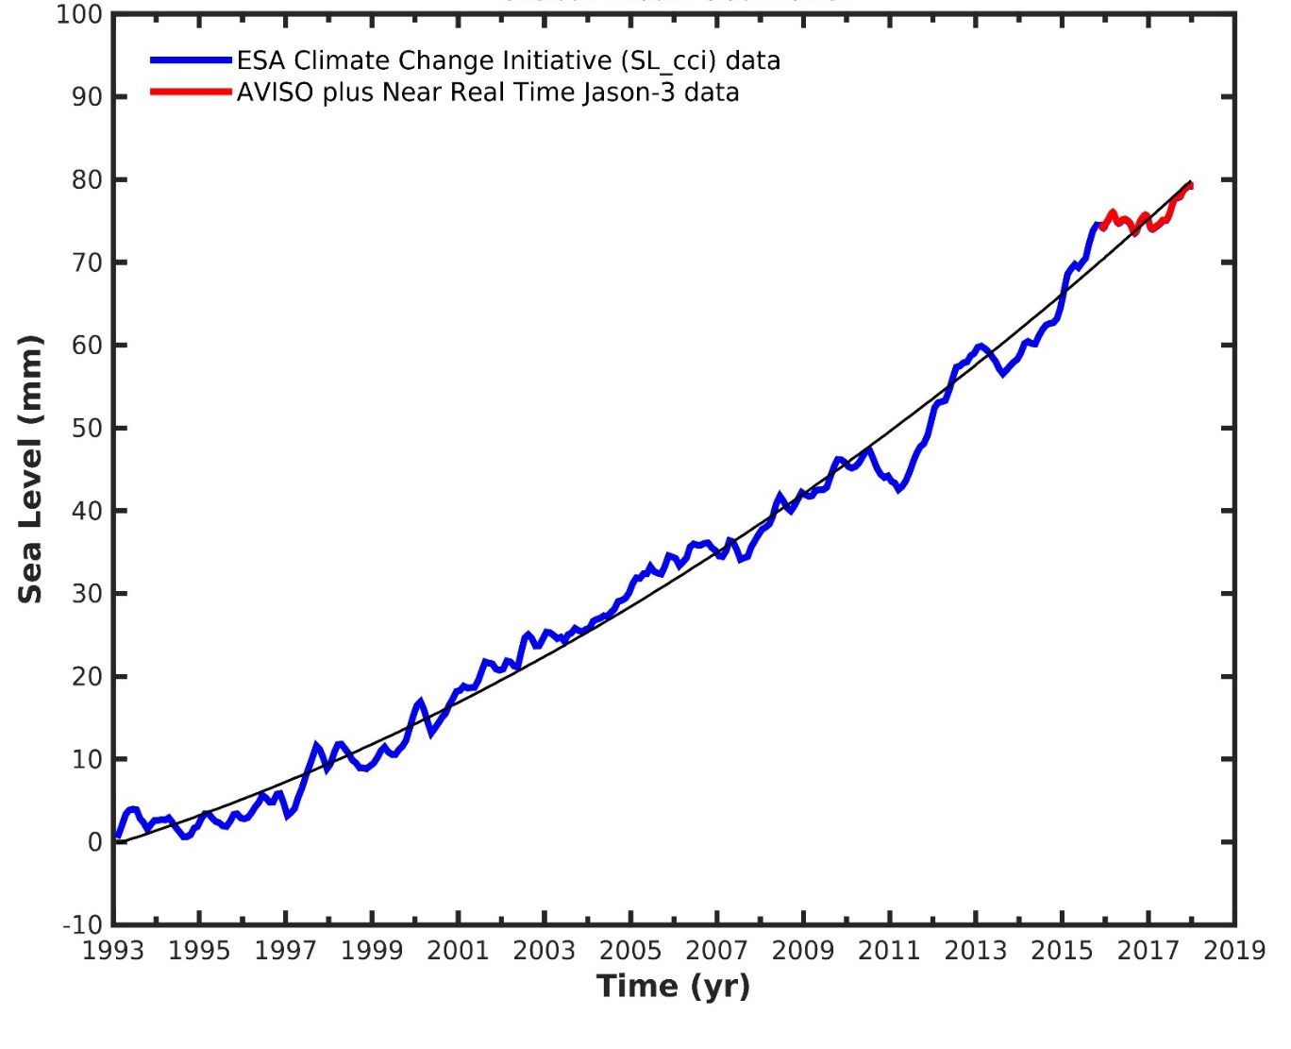





Introduction
Science questions
How well do we know and understand
sea level change and its causes?
CCI projects related to sea level
Sea level change [mm]
“CCI questions”
How useful are CCI products to answer the above
science question?
→ quality → consistency → uncertainty characterization

Slide 3
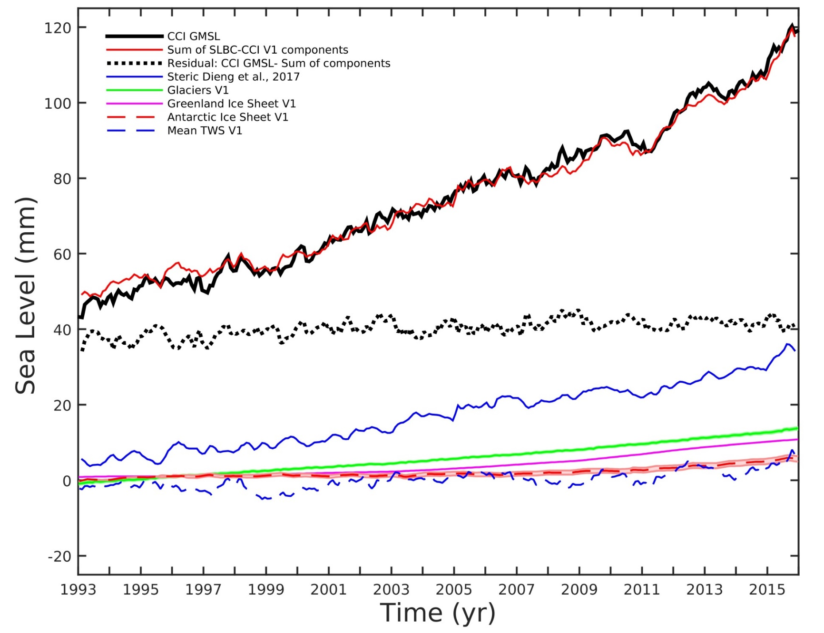
Sea level budget assessment: SLBC v1 1993-2015
Observed
Sum of
contributions
Misclosure
Steric
Glaciers
Greenland
Antarctica
Land water

Slide 4
Project objectives
Investigate in a coherent way the closure of the sea level budget
Thereby assess the quality of CCI products
Study and analyze the regional variability of sea level and its steric and mass components. The Arctic Ocean is chosen as study region.
Prepare the way to more comprehensive and more operational assessments of the global and regional sea level budget
2-year project 04/2017 – 03/2019
10 partners
ESA technical officer: Jérôme Benveniste

Slide 5




Provision of individual components with uncertainties
Satellite altimetry
Δ sea level
Anny Cazenave
Argo & other in-situ sensors
Chris Merchant
Δ steric sea level
Sea surface temperature
Karina
von Schuckmann
GRACE satellite gravimetry
Δ ocean mass
Martin Horwath

Slide 6







Provision of individual components with uncertainties
Open Global Glacier Model OGCM
Ben Marzeion
Glacier outlines,
mass balance obs.
Δ glacier mass
Frank Paul
Mass balance (GRACE)
Rene Forsberg
Δ ice sheet mass
Anna Hogg,
Andrew Shepherd
Mass balance (altimetry)
Global hydrology model WGHM
Δ land water & snow
Petra Döll
GRACE satellite gravimetry
Δ atmosph. water mass
Reanalysis data
Johnny Johannessen
Same sources as for global ocean
Arctic Ocean regional budget components
Ole Andersen
Ocean modeling

Slide 7




Budget closure assessment
individual components with uncertainties
Iteration
Assessment of budget closure/mis-closure
1993 – 2015 (altimetry period)
2003 – 2015 (“golden period”, with ARGO and GRACE)
based on monthly datasets:
long-term, inter-annual, and seasonal scales
Total sea level budget
Total ocean mass budget
Regional budgets: North of 66°N
Analyze mis-closure and its causes
Consider missing contributions
Re-assess uncertainties

Slide 8
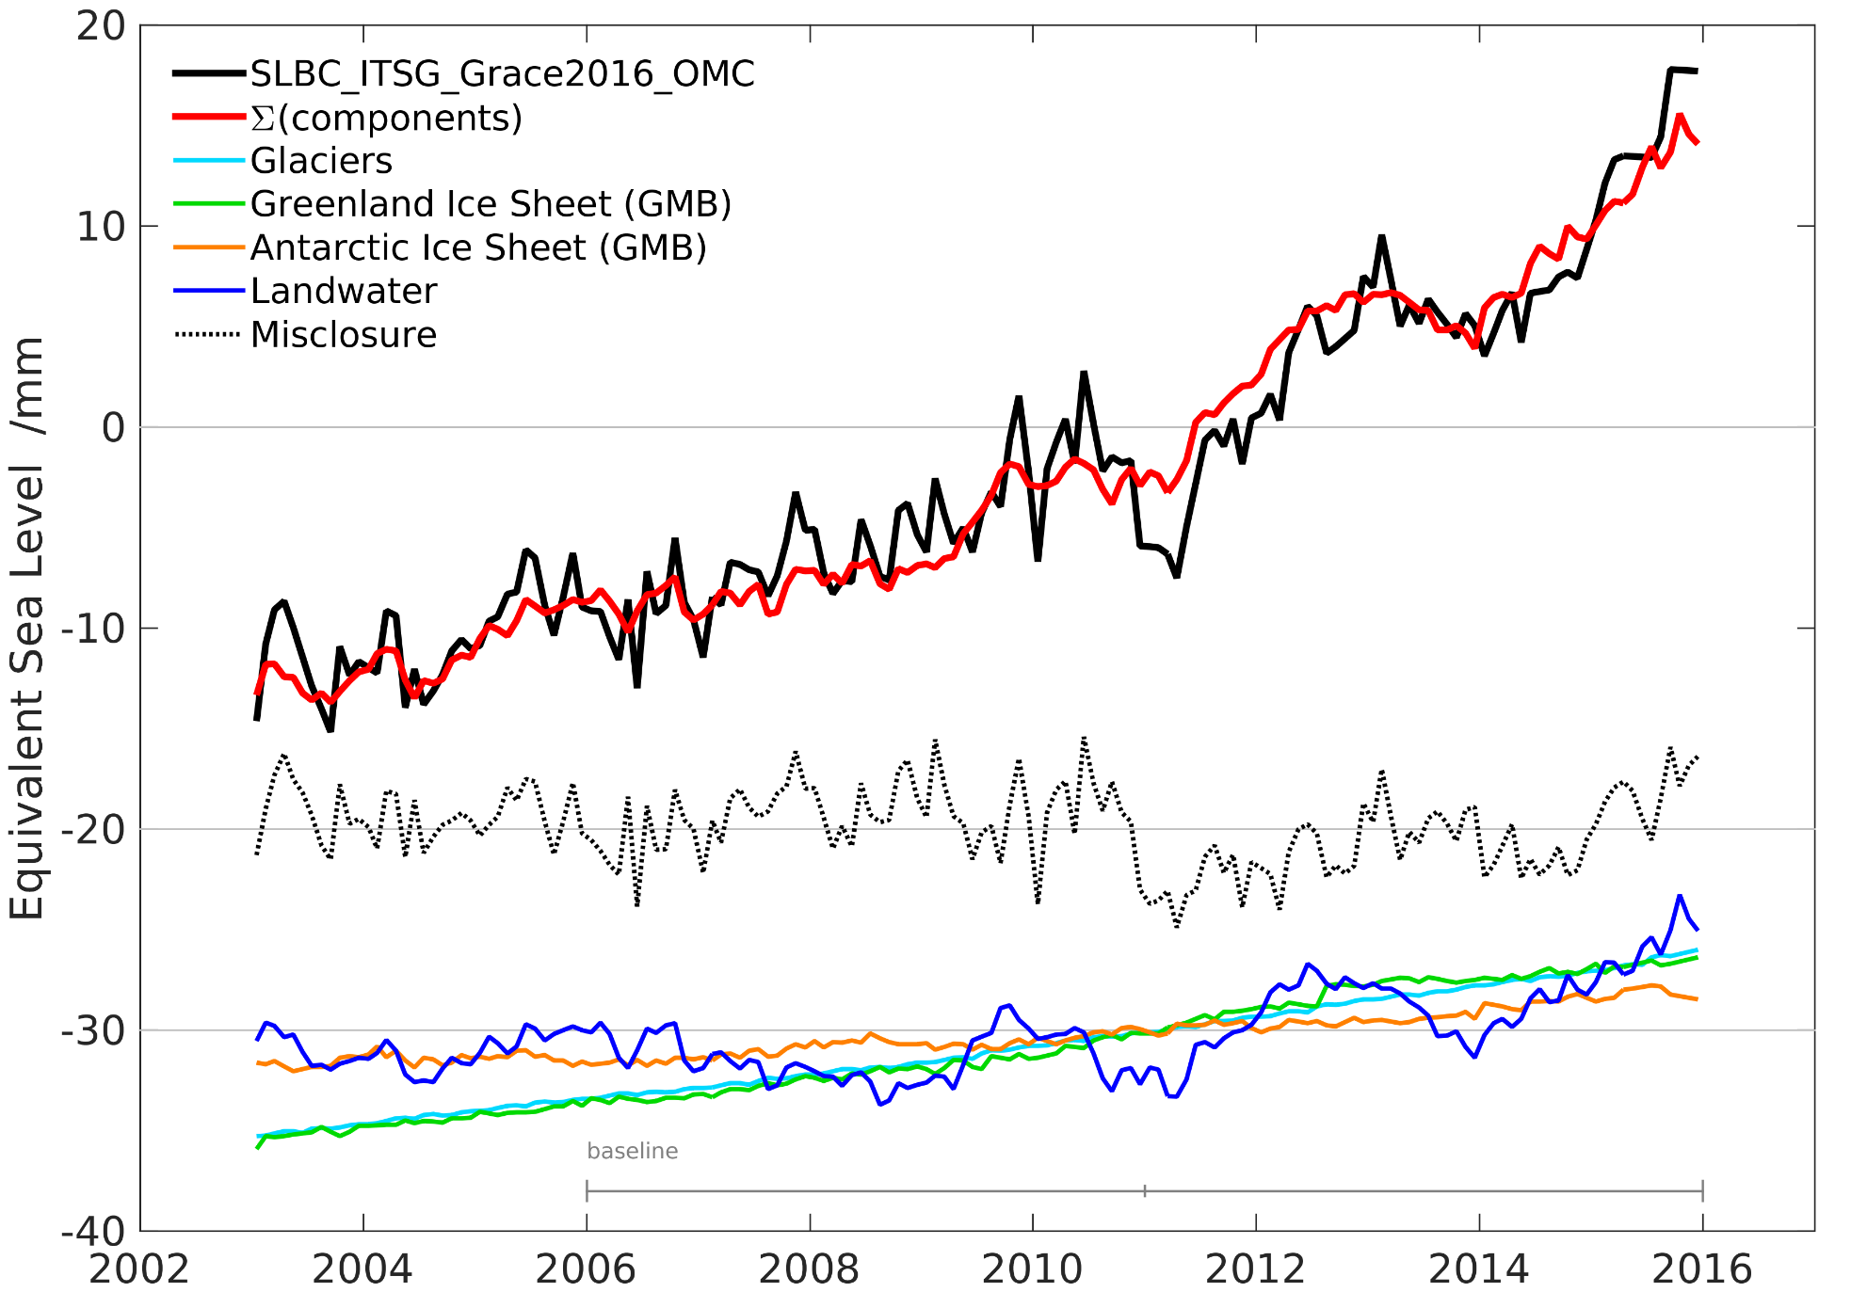
Ocean mass budget assessment: SLBC v1 2003-2015
Sum of components
Observed (GRACE)
Misclosure
Glaciers
Antarctica
Greenland
Land water

Slide 9
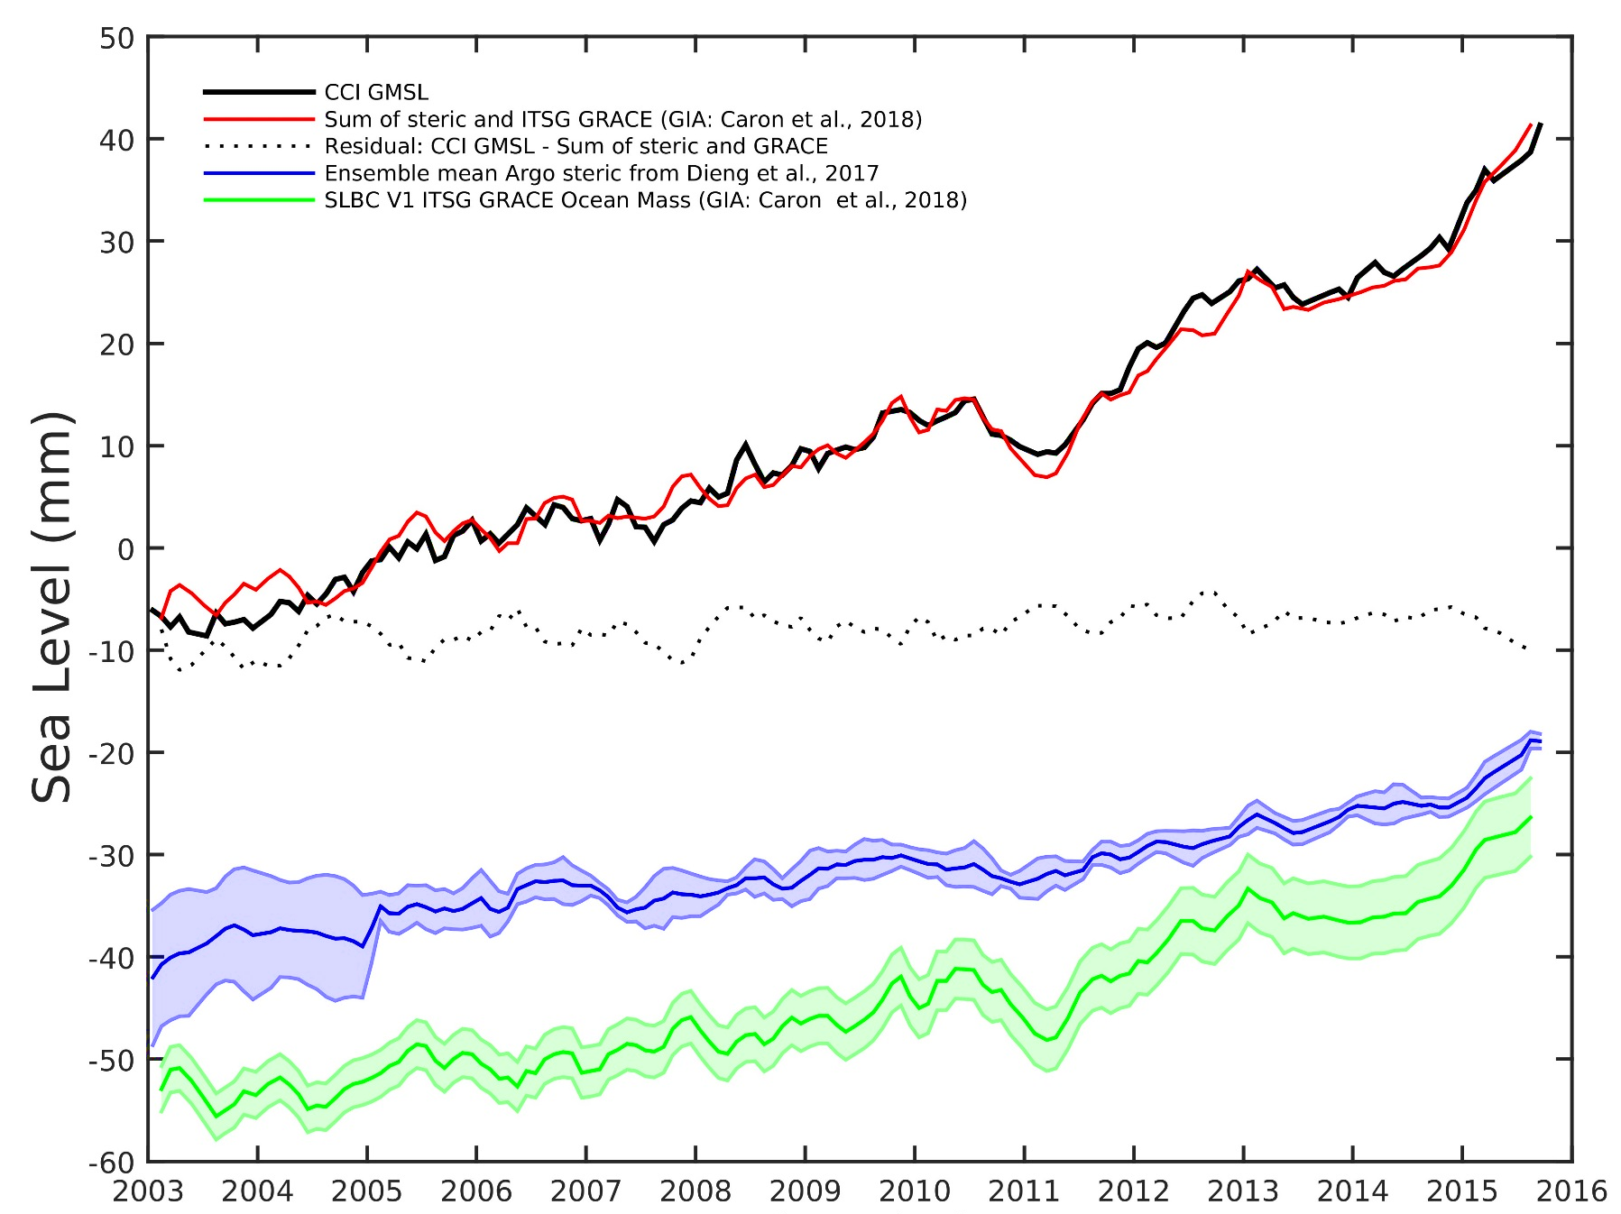
Global sea level budget assessment:
SLBC v1 2003-2015
Observed
Sum of steric and GRACE
Misclosure
Steric
GRACE-based Ocean Mass

Slide 10
Uncertainty characterization: Theory
Practice
Well-defined measurand (as a function of location and time)
Consider errors as a stochastic variable (multivariate)
Characterize uncertainty by second moments (variances and covariances)

Slide 11
Uncertainty characterization: Practice
Evolution of state (sea level, ocean mass, etc.)
w.r.t. to reference state (often defined implicitly)
(typical for altimetry-based sea level changes,
GRACE-based mass changes etc.)
Rate of change (to be cumulated in time to arrive at evolution of state)
(typical for glaciological modeling, hydrological modeling)
z(t)
z(t)
z(t)
0
0
0
z(t)
uncertainties
t₁
t₂
t₁
t₂
t₁
t₂
Time t
Time t
Time t

Slide 12
Uncertainty characterization: Theory
Practice
Well-defined measurand (as a function of location and time)
Consider errors as a stochastic variable (multivariate)
Characterize uncertainty by second moments (variances and covariances)

Slide 13
Uncertainty characterization: Practice
Very different approaches for the different sea level budget elements / different communities
Error correlations in time: two extremes
Uncertainty per epoch – uncorrelated in time (“noise”)
Uncertainty on linear trend – fully correlated in time
Typical example of overall error characterization
σ²_{total} (t) = σ²_{noise} (t) + ( σ_{trend}* (t-t₀) )²
Uncertainties of interannual components are less studied
Notes:
Some debate on whether treat GIA stochastically

Slide 14
Uncertainty characterization: Practice
Uncertainty per epoch
Uncertainty on linear trend
spread between time serie from different groups
assessments of geophys. corrections, instrument drifts etc.
Sea level from altimetry
Ocean mass change from GRACE
from assessing high-frequency variations of time series
statistical assessment per source
(GIA, Degree-1, C20, Leakage)
Assessment of measurement error and representation error
representation error has temporal correlation model.
Steric component
mass changes per epoch: "leave-one-glacier-out" model cross-validation
Cumulation in time assuming no correlation
Glaciers
GRACE: similar to Ocean mass change from GRACE
Ice sheets
Altimetry: e.g. cumulating uncertainties of change since 1992
Land water
from spread of ensemble with different climate input etc.
Notes:
may not pay justice to all

Slide 15
Trend budget 2003-2015
Total sea level 3.32 ± 0.30
Steric 1.23 ± 0.12
Ocean mass (GRACE) 1.92 ± 0.24
Sum of contributions 3.15 ± 0.27
Glaciers 0.70 ± 0.03
Antarctic IS: GRACE / Altim. 0.27 ± 0.10 / 0.32
Greenland IS: GRACE/ Altim. 0.75 ± 0.025 / 0.70
Land water: 0.33 ± 0.08 (?)
Sum of mass contributions 2.05 ± 0.13 / 2.05
Misclosure
(mass budget)
-0.13 ± 0.27
Sum of contributions 3.28 ± 0.18
Misclosure (total budget) 0.17 ± 0.40
Misclosure (total budget) 0.04 ± 0.35
Notes:
Nähkästchen-Plauderei

Slide 16
Views on Trends
(with implications for their uncertainties)
Average rates of change
well-defined
suited for budget assessments
including effects of interannual variability
high impact of errors at epochs
Regression line trends
assumes underlying long-term signal and attempts to detect it
traditionally used for budget assessments
correction (or averaging-out) of interannual variability
averaging-out of errors along whole time series

Slide 17
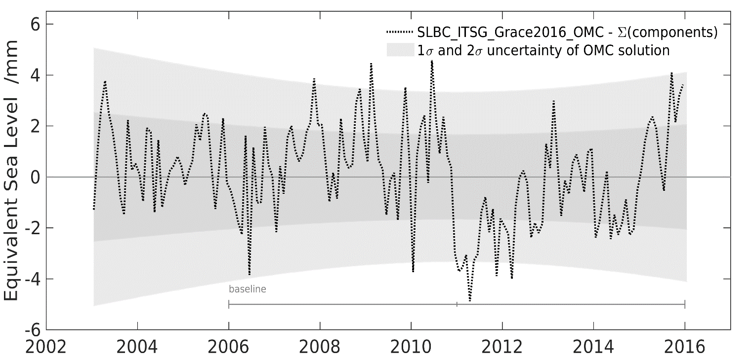
Conclusions
CCI Sea Level Budget Closure
Assessing datasets from CCI and beyond based on understanding of their generation and uncertainties.
Global mean sea level budget (1993-2015) and ocean mass budget (2003-2015) closed within uncertainties.
Uncertainties on trends of GLMS and some of its contributions are on the order of 0.3 mm/yr (1-sigma)
Good closure of interannual variations budget. Needs to be explored further
Work ongoing (never ending?) on consistent uncertainty characterization
Ocean mass budget misclosure
Perspectives (beyond current project)
assess geographic patterns (regional sea level) in the sea level budget framework
work towards signal detection and attribution
Ready to learn from CMUG

Slide 18
Thank you for your attention
Questions? Comments?

