Slide 1
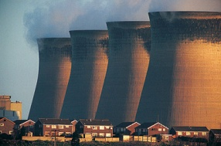

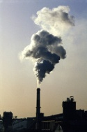
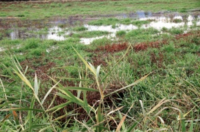












7th CCI-CMUG Meeting
GHG-CCI: Latest data products incl. characteristics, applications & more
Michael Buchwitz
Institute of Environmental Physics (IUP),
University of Bremen, Bremen, Germany
& the GHG-CCI team
The
Inversion
Lab

Slide 2
Outline
Strength and features of final data set
  CRDP#4, to be released end of Feb. 2017
Examples of data applications, including consistency & comparisons with other Earth observation data incl. other ECVs
Obs4MIPs status
Future possible research directions

Slide 3
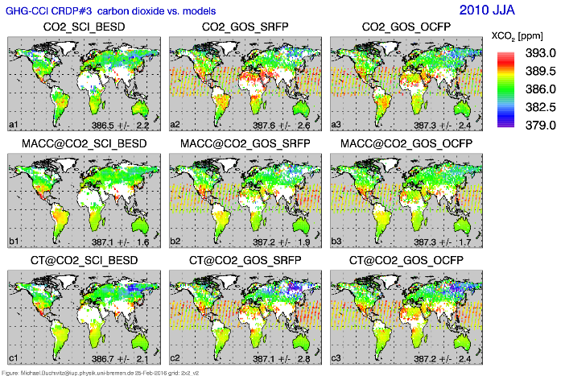
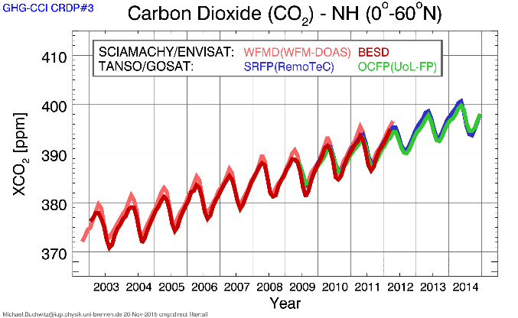
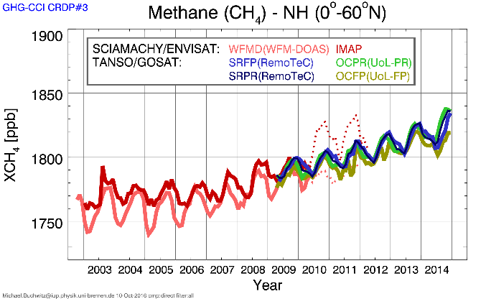
Data Set CRDP#3
Released March 2016
Buchwitz et al., RSE (in press), 2016

Slide 4
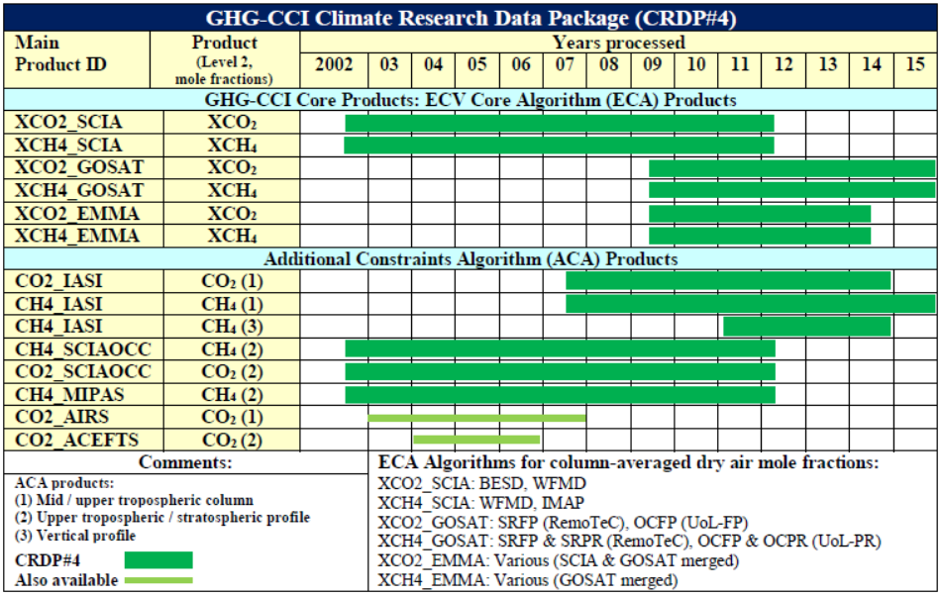
Data Set CRDP#4
Planned release: end Feb 2017

Slide 5
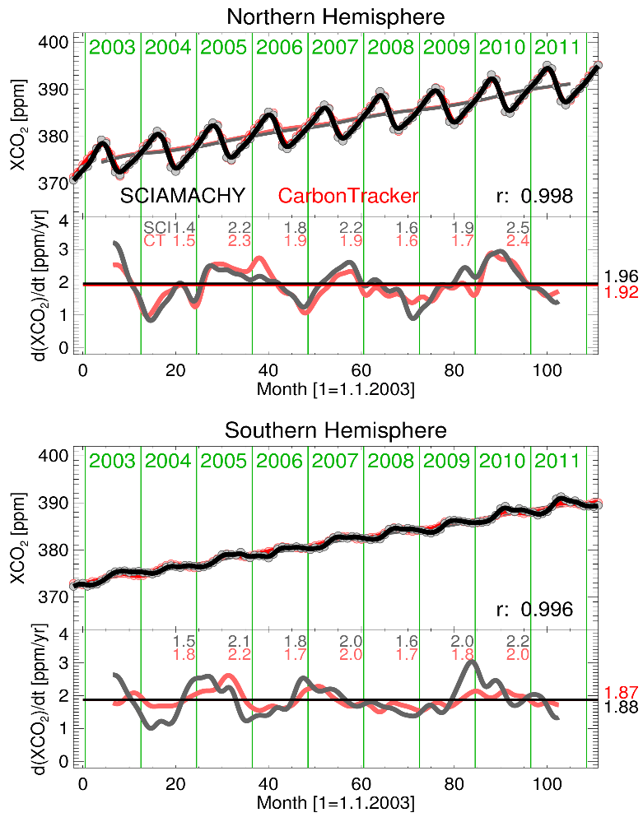
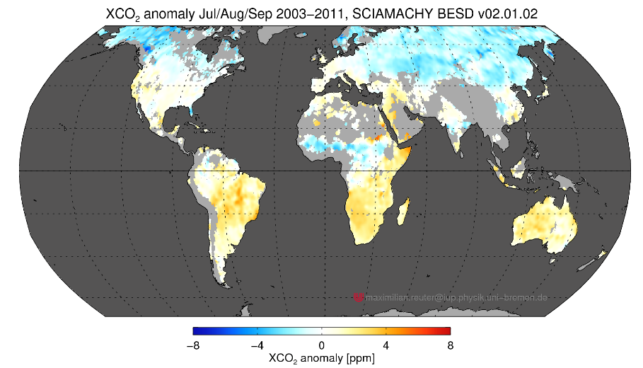
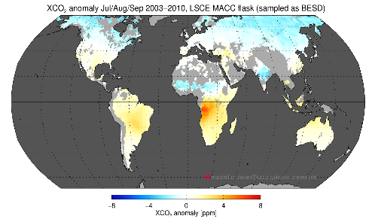
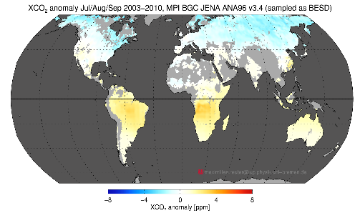
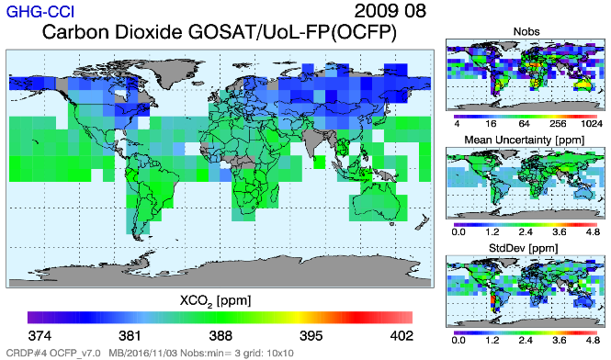
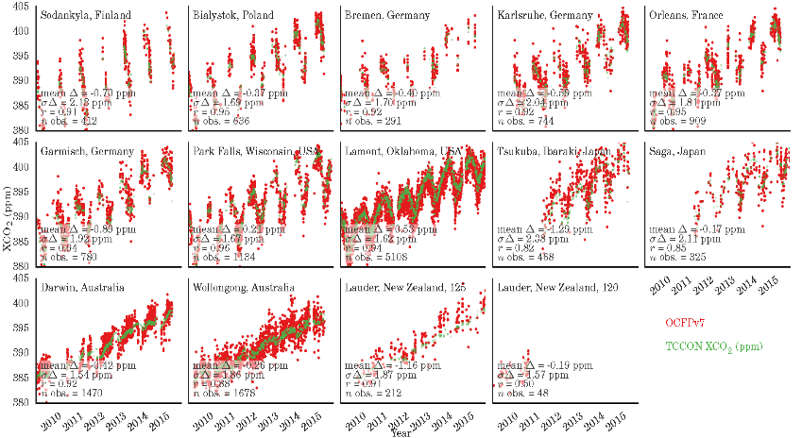
Maps & timeseries: XCO₂
CRDP#4

Slide 6
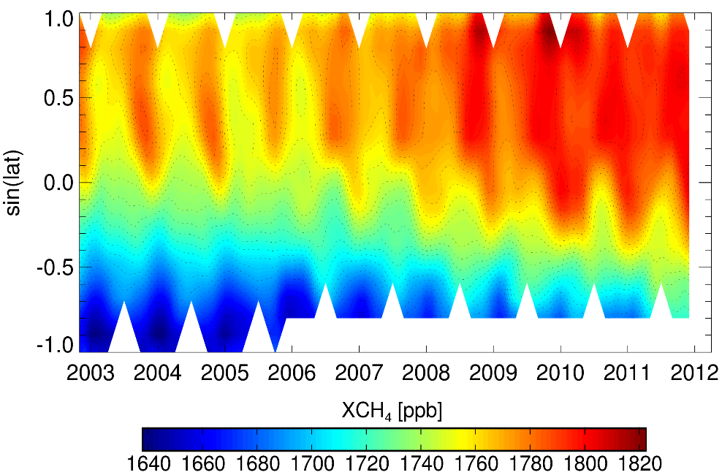
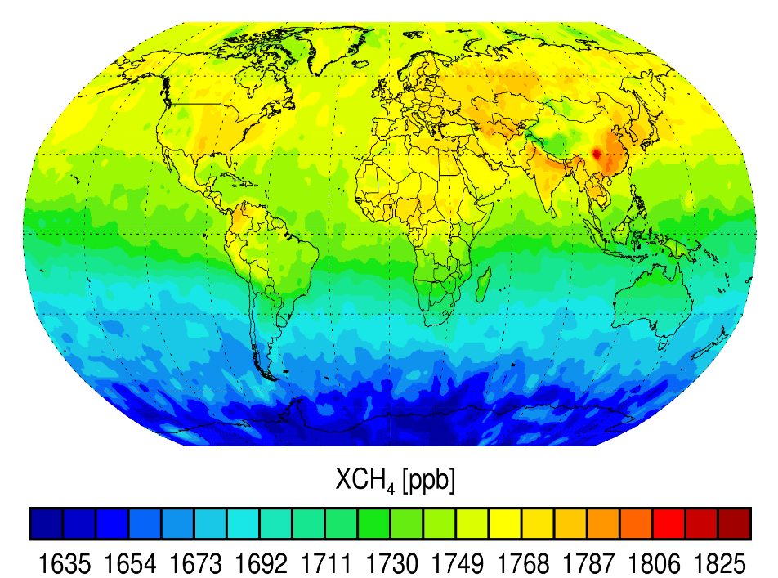
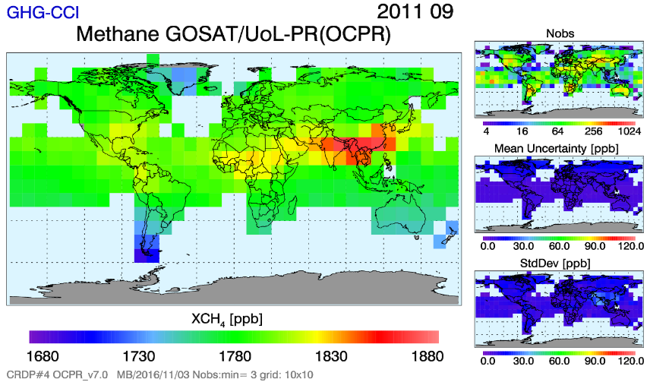
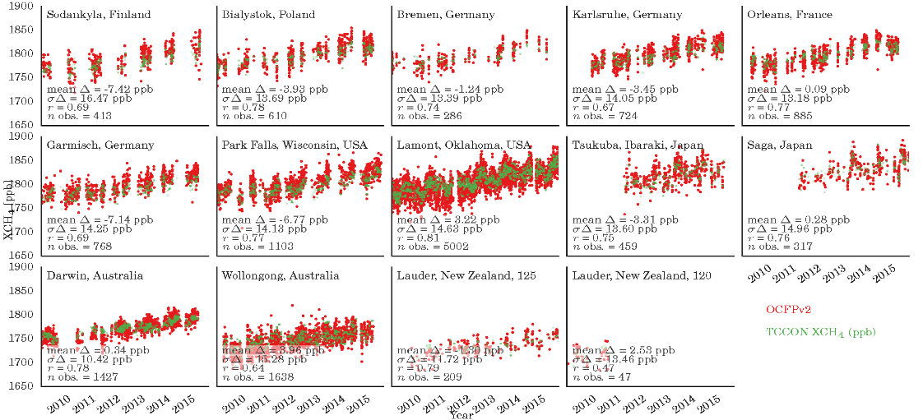
Maps & timeseries: XCH₄
CRDP#4

Slide 7
User requirements
New URDv2.1:
New: Stability: More demanding definition & numerical requirements:
http://www.esa-ghg-cci.org/?q=webfm_send/344

Slide 8
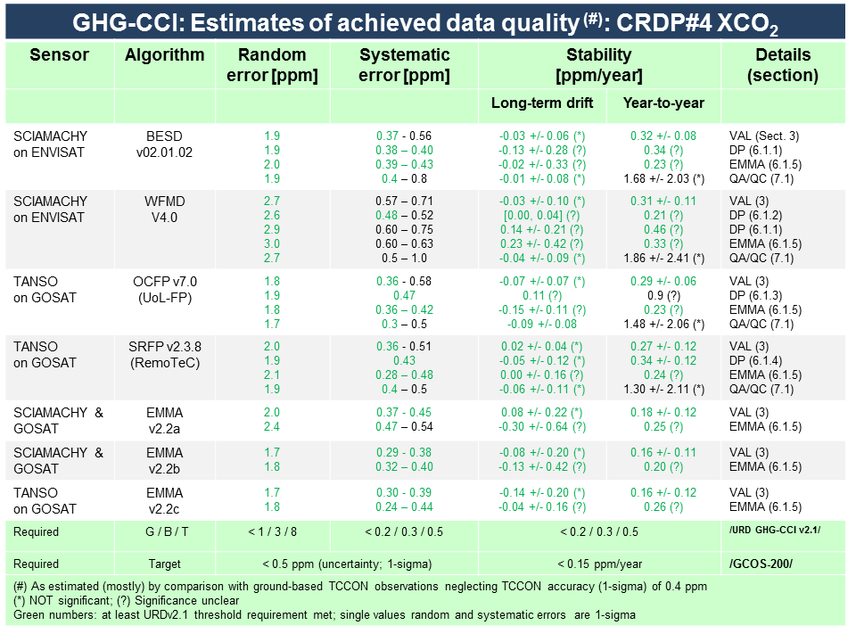
PVIRv5

Slide 9
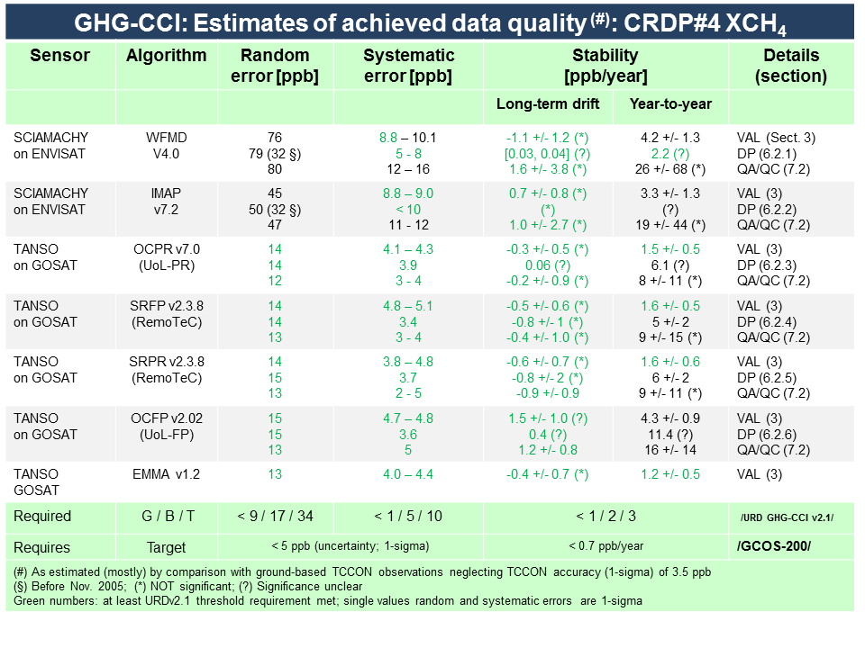
PVIRv5

Slide 10
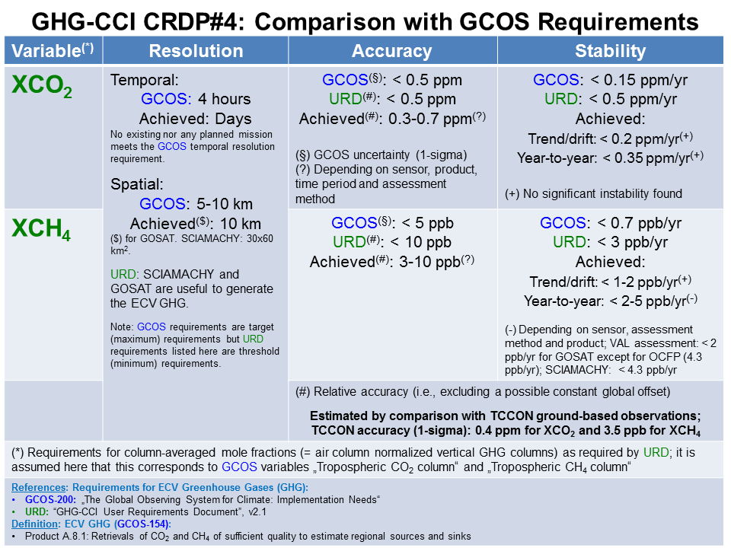
PVIRv5

Slide 11
Recent publication:
Comparison of various XCO₂ data sets
Kulawik et al., 2016

Slide 12
Recent publication:
Wetland emissions from XCH₄
Wetland methane emission trend
McNorton et al., GRL, 2016
Methane emissions

Slide 13
Recent publication:
CH₄ & CO₂ fluxes from retrieved ratios
Pandey et al., 2016
Regional CO₂ fluxes
Regional CH₄ fluxes

Slide 14
Recent publication:
US methane emissions from XCH₄
Turner et al., 2016

Slide 15
Recent publication:
Fire CO₂ emission from OCO-2 XCO₂
Heymann et al., GRL, 2017

Slide 16
New data use: XCO₂:
Comparison with climate models
Lauer et al., RSE (in press), 2017

Slide 17
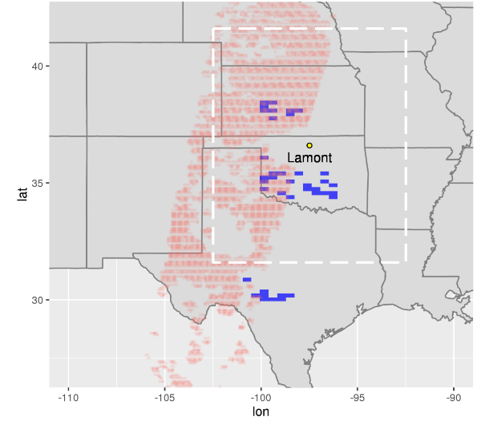
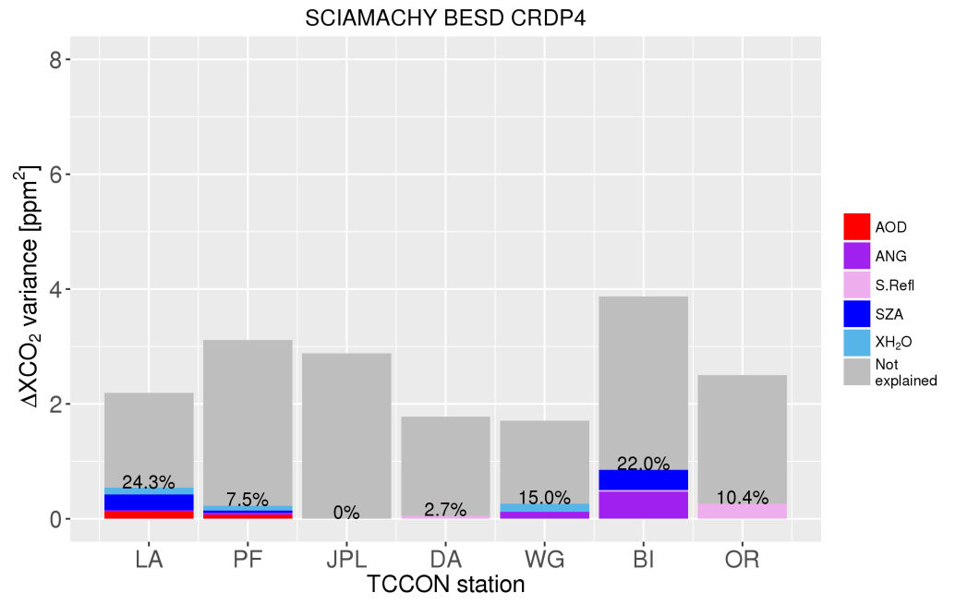
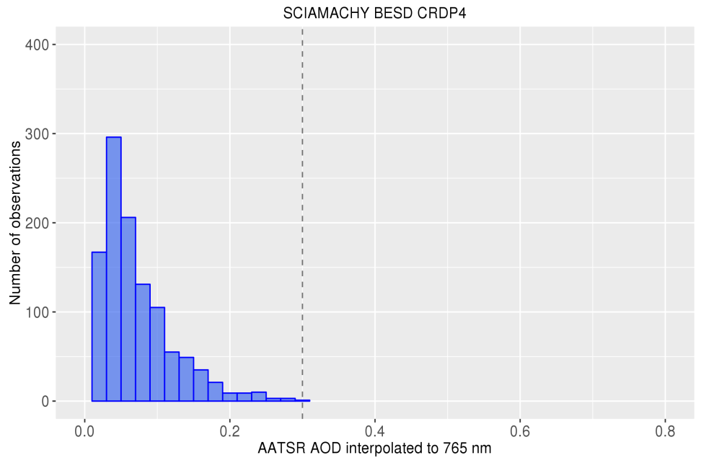
GHG-CCI: Cross-ECV activities
GHG-CCI & Aerosol-CCI
SCIAMACHY XCO₂ observations colocated with AATSR aerosol and surface reflectance observations to investigate
how well the algorithms filter out highly scattering aerosol scenes
to which extent systematic errors in satellite XCO₂ can be attributed to aerosols
SCIAMACHY BESD
AATSR
XCO₂ bias variances explained by the selected linear regression model at seven TCCON stations
AATSR
AATSR AOD distribution in the BESD XCO₂ ‘good quality’ pixels (at the surroundings of seven TCCON stations)
Multiple linear regression model to explain XCO₂ biases
SCIAMACHY XCO₂ biases (satellite – TCCON ) regressed against AATSR AOD, Angström coeff. & surface reflectance and other observations
Results showed that
algorithms filter out scenes with high AOD loading efficiently
aerosol contribution to the XCO₂ bias variance is low and mainly <0.2 ppm²

Slide 18
GHG-CCI: Cross-ECV activities
WP: 4ECVs (Inversion Lab, Lund University)
Improved information on carbon fluxes via CCDAS
CCI: GHG (CO₂), Fire (BA), Land cover (LC); FAPAR (JRC-TIP)
(use of additional ECVs possible & desirable, e.g., SM, clouds (CCI+?))

Slide 19
GHG-CCI: Obs4MIPs status
CRDP3 XCO₂ and XCH₄ (v1, 2003 - 2014):
  Ready since June 2016
  Data products & corresponding TNs approved
  DOIs & availability via ESGF (thanks to CCI portal team)
  Also available via http://www.esa-ghg-cci.org/ (-> CRDP (Data))
CRDP4 XCO₂ and XCH₄ (v2, 2003 - 2015):
  In preparation; planned release end of February 2017

Slide 20
GHG-CCI: Future research
Further improvement of data quality (e.g., bias reduction) and quantity (longer time series, adding other existing (e.g., OCO-2) and new (e.g., S5P) satellites)
Applications to obtain improved information on the various CO₂ and CH₄ natural and anthropogenic sources and sinks
  i.e., a stand alone and/or cross-ECV scientific „carbon application“
Studies related to Climate Model improvements (e.g., „Emerging constraints“)

Slide 21
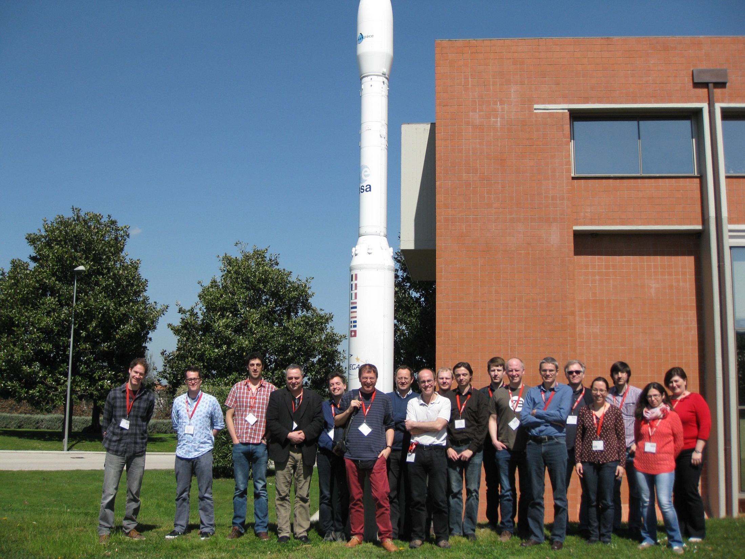
Thank you very much for your attention !
The GHG-CCI team

