Slide 1









Cloud_cci
R. Hollmann¹, C. Poulsen², U. Willen³, C. Stubenrauch⁴, M. Stengel¹, and the Cloud CCI consortium
¹Deutscher Wetterdienst, ² RAL Space, ³SMHI, ⁴LMD

Slide 2
Content
Available Data sets
  strengths and features of final data set(s)
consistency with other ECVs and other Earth observation data & examples of data applications
obs4MIPs status
future possible research directions

Slide 3
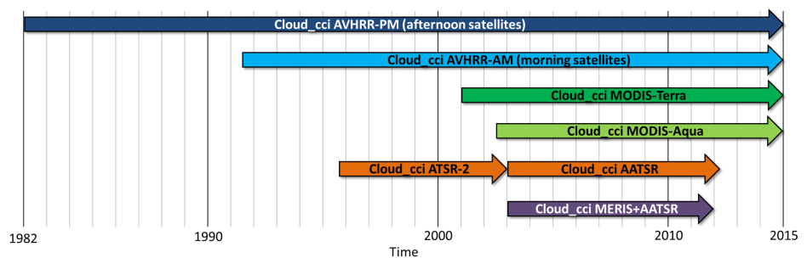
Cloud_cci: Available data phase 2
Two multi-decadal global data sets for the GCOS cloud property ECVs including uncertainty estimates.
  multi-decadal multi-instrument product from (A)ATSR – AVHRR – MODIS (1982 - 2014)
  decadal product that uses complimentary information from AATSR and MERIS on-board of ENVISAT (2002 - 2012)
Processing finalized, first example shown yesterday

Slide 4
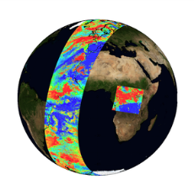
Cloud_cci: Available data
Examples of Cloud_cci cloud products.
Top: Pixel-based (Level 2),
bottom left : sampled on a global grid (Level 3U),
bottom right: averaged on a global grid (Level 3C)

Slide 5
Cloud_cci: Key strengths
Spectral consistency of derived parameters, which is achieved by an optimal estimation (OE) approach based on fitting a physically consistent cloud model to satellite observations simultaneously from the visible to the mid-infrared.
Uncertainty characterization, which is inferred from OE theory on pixel level, physically consistent, propagated into L3 data
  with uncertainties of the input data (e.g. measurements, a-priori)
  among the retrieved variables.
Potential to combine AVHRR-heritage datasets to achieve increased temporal resolution by including multiple polar-orbiting satellite instruments, which also allows for mature cloud property histograms on 0.5° resolution due to highly increased sampling rate.
Comprehensive assessment and documentation of the retrieval schemes and the derived cloud property datasets including the exploitation of applicability for evaluation of climate models and reanalyses.

Slide 6
Cloud_cci Phase 2 requirements
Global Climate Observing System Target Requirements:
Cloud Essential Climate Variables (2011 update, 2016 stilt valid)
Variable | Horizontal Res | Vertical Res | Temporal Res | Accuracy | Stability (/decade)
CA | 50km | N/A | 3hr | 0.01 – 0.05 | 0.003 – 0.03
CP | 50km | NA | 3hr | 15hPa – 50hPa | 3hPa -15hPa
CT | 50km | NA | 3hr | 1K – 5K | 0.2K – 1K
CWP | 50km | NA | 3hr | 25% | 5%
CRE | 50km | NA | 3hr | 5-10% | 1-2%
assuming cloud feedback similar to rad forcing of 0.3Wm⁻² (~ 20% of current GHG forcing)
radiative forcing depends on CAE (and not CA)
=> target ranges (opt thick/ low clouds - opt thin Ci (CEM=0.2) )
based on NISTIR 7047 report (March 2004)
Achieved uncertainties & accuracies ?

Slide 7
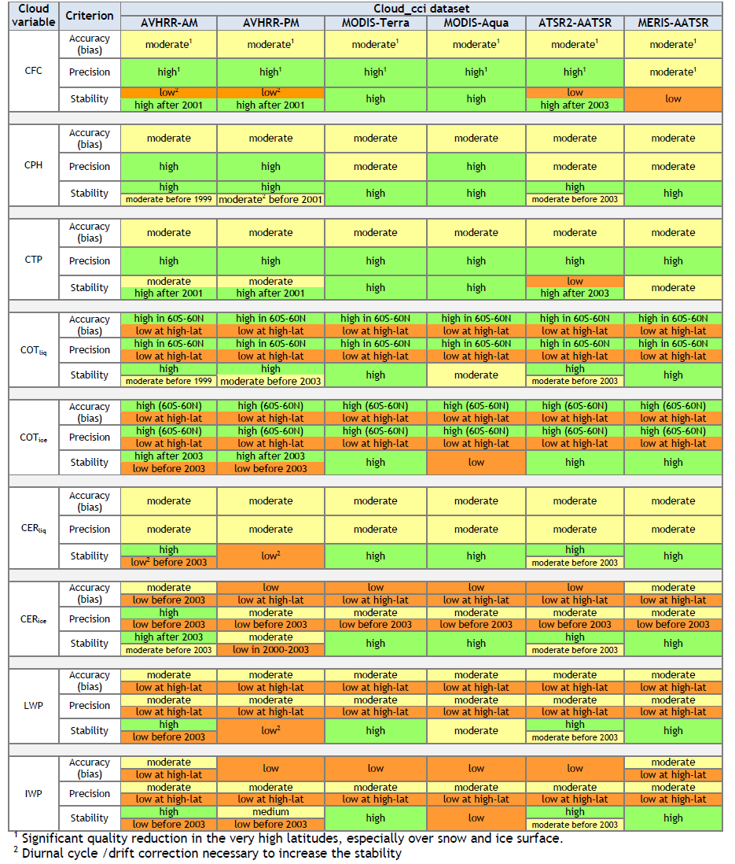
Cloud_cci: Validation results (i)
  Available data sets
  Confidence table for all Cloud_cci products assessed
  high-> high quality, high level of agreement to, but also among the reference data sets
  Moderate -> moderate agreement, larger spread in the comparison datasets
  Low -> disagreement, significant systematic and/or random errors, found bugs

Slide 8
Cloud_cci: Validation results (ii)
  Cloud mask: at least 80% of all clouds are correctly identified usually also 80% of all clear scenes, except at high latitudes, (snow and ice covered surfaces, nighttime). Twilight conditions remains challenging as well.
  Cloud top height: optically thick clouds vertically ok, low-level clouds biases of partly smaller than 150m. Optically thin clouds, (i.e. high-level clouds) are still difficult to handle, resulting in partly large biases (large underestimation of CTH by Cloud_cci).
  Cloud phase: >70% of all cloudy cases an agreement in cloud phase determination between Cloud_cci datasets and CALIOP is found.

Slide 9
Cloud_cci: Outlook 2017
  Cloud_cci User Workshop: 25/26. April 2017 in Hamburg
  Until end of 2017:
  Final reprocessing of AVHRR data incl. developed radiation scheme -> final Cloud_cci v3
  Final reprocessing of (A)ATSR data incl. developed radiation scheme -> final Cloud_cci v3

Slide 10
Cloud_cci 4 Obs4Mips
Cloud_cci contributed to Obs4Mips call
several cloud variables have
been submitted in March 2016
first response November 2016,
now green light for almost all variables (not COT)
Still discussion needed;
prep. Data Set Description Doc.
per variable, CMOR preparation,
submission of data to ESGF

Slide 11
Cloud_cci: cross-cutting themes
New cloud & Aerosol interactions
Started to investigate prototyping CDNC activities
Development of radiation scheme for TOA / Surface radiation

Slide 12
Cloud_cci: research directions
Improvements for SLSTR and OLCI and extend the time series, reprocess CC4CL data set
Earth Radiation Budget modules to derive physically consistent 3-D picture of clouds and the energy cycle
For ENVISAT no combined (“best”) cloud mask is available -> needs to be done for Sentinels
Taking advantage of IR sounders (e.g. IASI, AIRS, HIRS) in cloud top height with their sensitivity to cirrus
Continue assessments
Aerosol – Cloud – Radiation consistency

Slide 13



Thank you for your attention

