Slide 1
Cross-assessment of aerosol, cloud and radiation CCI ECVs (WP3.7)
Mattia Righi, Axel Lauer, Veronika Eyring, and Johannes Hendricks
Deutsches Zentrum für Luft- und Raumfahrt e.V. (DLR), Oberpfaffenhofen, Germany
CCI CMUG Integration 7 meeting
13 February 2017, Paris, France

Slide 2
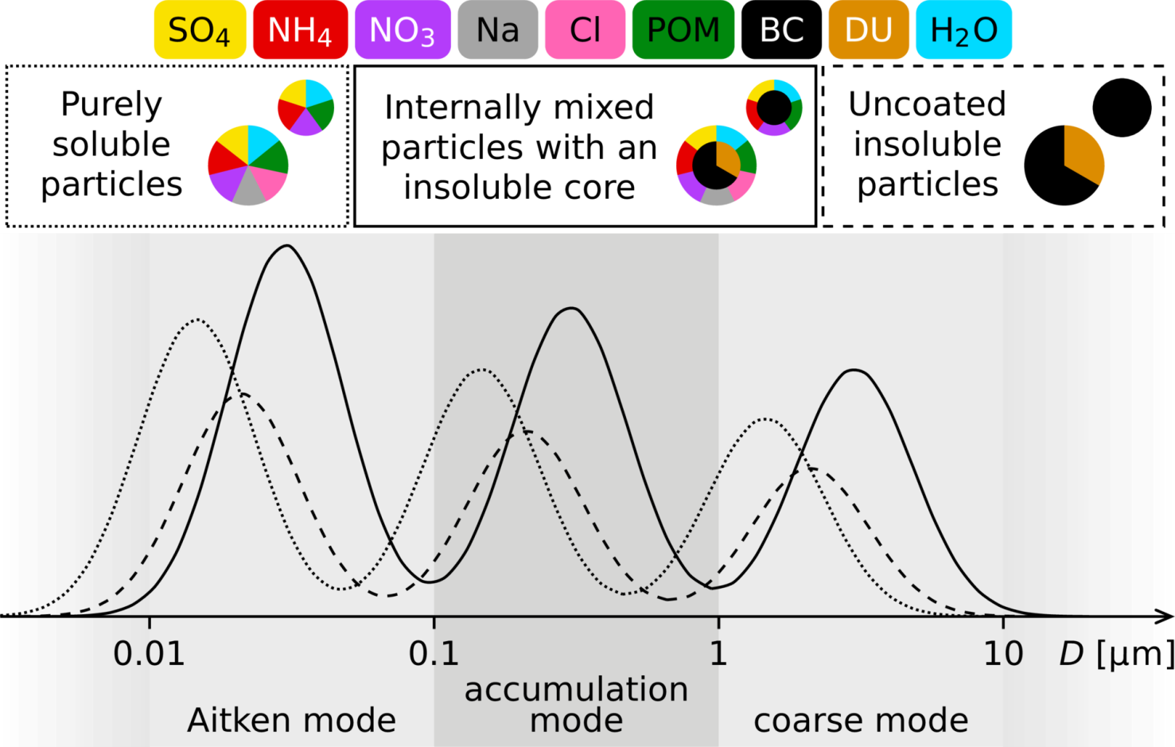
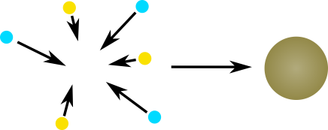
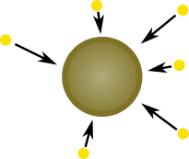
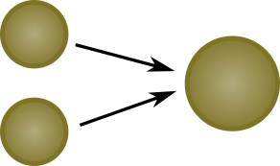
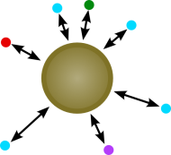
CMIP5 Models and EMAC (MADE3)
Many AOGCMs and ESMs participating in CMIP5 include the basic features of the sulfur cycle, but not necessarily a detailed aerosol treatment.
Aerosol process parameterization in EMAC (MADE3) is more detailed.
nucleation
condensation
coagulation
gas-aerosol- partitioning
Kaiser et al. (GMD, 2014)
Kaiser (PhD Thesis, 2016)
Notes:
The majority of Earth System models now include an interactive representation of aerosols, and make use of a consistent specification of anthropogenic sulphur dioxide emissions. However, uncertainties in sulphur-cycle processes and natural sources and sinks remain and so, for example, the simulated aerosol optical depth over oceans ranges from 0.08 to 0.22 with roughly equal numbers of models over- and under estimating the satellite-estimated value of 0.12.
The treatment of aerosol particles has advanced since the AR4. Many AOGCMs and ESMs now include thebasic features of the sulphur cycle and so represent both the direct effect of sulphate aerosol, along with some of the more complex indirect effects involving cloud droplet number and size. Further, several AOGCMs and ESMs are currently capable of simulating the mass, number, size distribution, and mixing state of interacting multi-component aerosol particles (Bauer et al., 2008b; Liu et al., 2012b). The incorporation of more physically complete representations of aerosol often improves the simulated climate under historical and present-day conditions, including the mean pattern and interannual variability in continental rainfall (Rotstayn et al., 2010; Rotstayn et al., 2011). However, despite the addition of aerosol– cloud interactions to many AOGCMs and ESMs since the AR4, the representation of aerosol particles and their interaction with clouds and radiative transfer remains an important source of uncertainty (see Sections 7.3.5 and 7.4).

Slide 3
Cross-assessment of aerosol, cloud and radiation
Strengths and weaknesses of the CMIP multi-model ensemble are investigated, by means of dedicated sensitivity experiments with the EMAC (MADE3) global aerosol model.
The first reference simulation with EMAC (MADE3) has been performed, covering the period 1980-2015, using a similar emission setup as the CMIP5 models.
The model simulation is evaluated using the ESA CCI products together with other datasets, in order to also characterize observational uncertainties.
Further simulation are currently being setup to explore additional aerosol-related issues: coupled version with clouds and radiation, role of mineral dust, higher model resolution, more detailed chemistry of aerosol precursors, etc.
Comparing the performances of the CMIP5 ensemble versus the results obtained with different configurations of EMAC (MADE3) will provide insights on the processes driving the representation of aerosol and related quantities in the climate system.

Slide 4
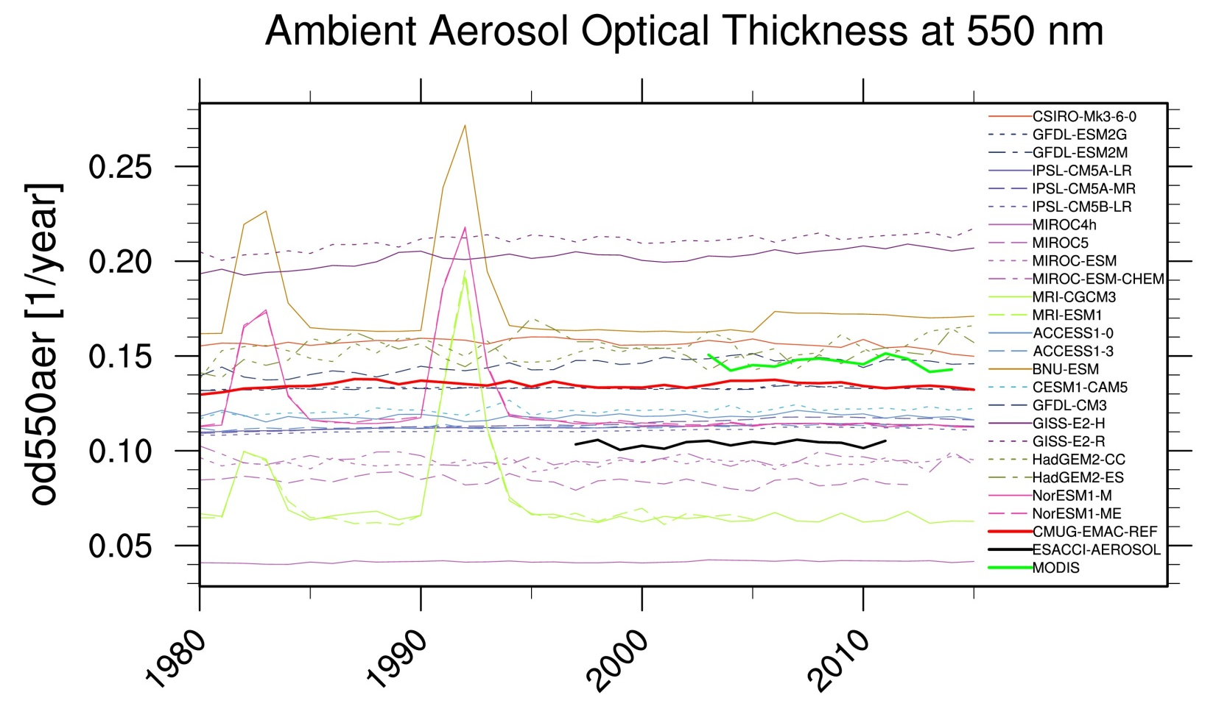
First results
OCEAN ONLY
MODIS
EMAC
ESACCI
The AOD global trend over the oceans is correctly represented (i.e., no trend)
Small bias (0.02 w.r.t. MODIS, 0.03 w.r.t. ESA-CCI), but within observational uncertainties
Notes:
Setup: T42 L19. 30 min time-step. Simplified chemistry scheme. Free running mode. No cloud/radiation coupling. Offline dust.
EMAC: red line
MODIS: green
ESACCI: black

Slide 5
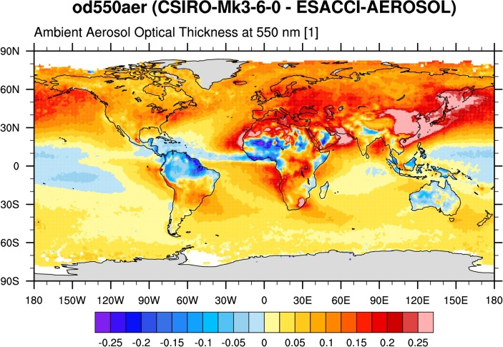
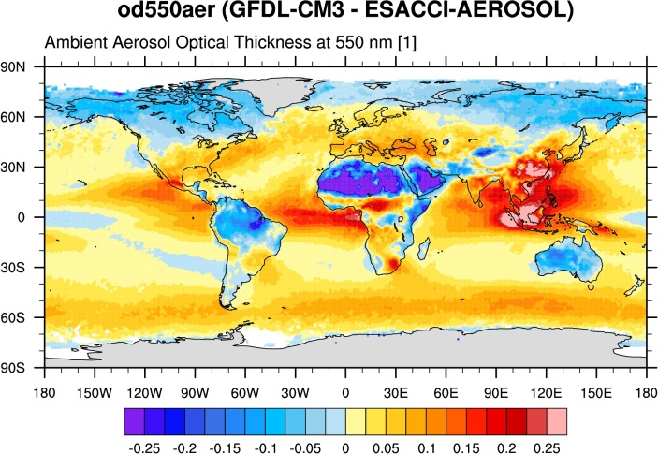
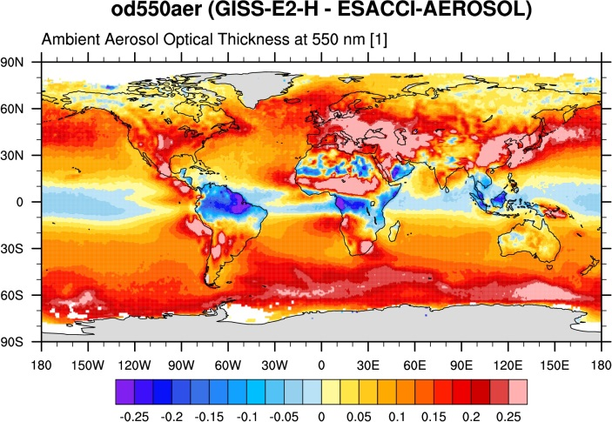
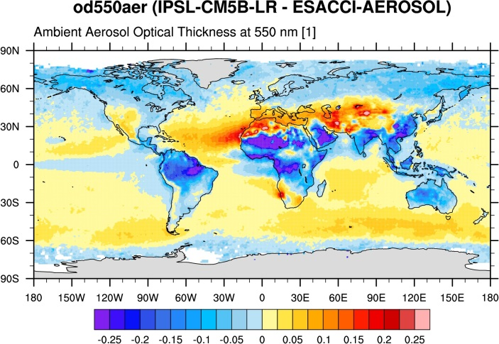
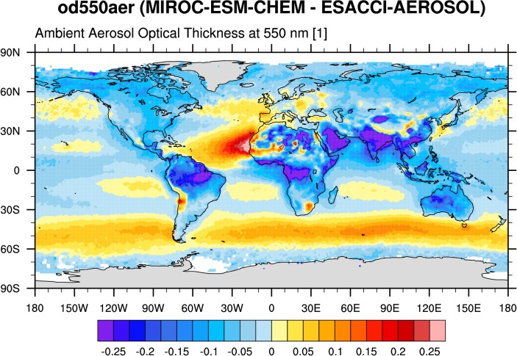
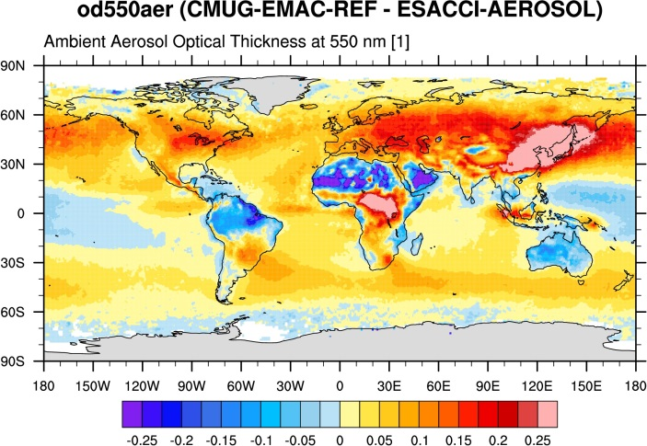
Role of mineral dust?
Common issue: AOD over Sahara (although partly amplified by overestimate in ESA-CCI product) → role of mineral dust to be further analyzed
Notes:
Here only the CMIP5 models with interactive aerosol are considered and multiple versions of the same model are excluded (as in Lauer et al., 2017).
The overlap period between MODIS L3 C6 and ESA-CCI is analysed.

Slide 6
Conclusions and outlook
CMIP5 model results of aerosol optical depth have been evaluated, also using the new ESACCI-AEROSOL products
In order to better understand the processes driving this quantity, simulations with a more detailed aerosol model (EMAC (MADE3)) have been performed
The first results show a globally better agreement of EMAC (MADE3) than most of the CMIP5 models
Further simulations are planned to investigate specific processes

