Slide 1
Climate Modelling and the new ECVs
ESA announced the following candidates to be considered for CCI+
  Ocean Salinity
  Sea State
  Lakes
  Above Ground Biomass
  Snow Cover
  Long-lived Greenhouse Gases
  Precursors Supporting the Ozone and Aerosol ECVs
  High-Resolution Land Cover
  Land Surface Temperature
  Water Vapour
  FaPAR, LAI?

Slide 2
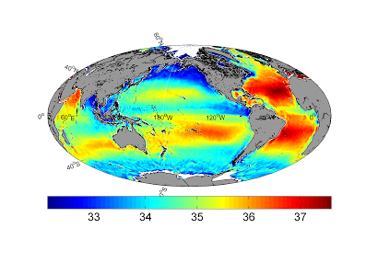
Climate Modelling and the new ECVs
Requirements by modellers:
  Ocean Salinity:
  Useful as a proxy for ocean circulation which feeds into initialisation of seasonal and decadal forecasts
  Monitor variations in the water cycle (e.g. precip over the ocean)
  Information on PCO₂ and O₂
Geostrophic flows are density not temperature dependent. Particularly high variability and strong gradients in semi-enclosed basins and shallow seas (Mediterranean, Baltic, N. Sea, Arabian Gulf), where changes in riverine and lateral boundary exchanges can lead to significant changes in salinity, with a strong coupling to climate effects (e.g. precip). Smaller gradients in the deeper ocean, but critical to understanding (and constraining) water masses and hydrological cycle.
Annual Average Sea Surface Salinity map at 0.25°x0.25° resolution deduced from SMOS satellite data for the year 2010

Slide 3
Climate Modelling and the new ECVs
Requirements by modellers:
  Sea State:
  This refers to variables relating to the height, direction, wavelength and time period of waves. Sea state close to the coast is important for flooding applications (inundation is caused by wave + surge effects) time series back to 1991. Altimeter, scatterometer and SAR all contribute
  The accuracy of NWP products is limited by the availability of validation and calibration data, and their utility is limited over the shallower coastal regions where the forecasts are needed.
  ERA40 made use of sea state estimates within its assimilation system.
  Sea-ice break up important
  The existing sea state reference buoys are limited in terms of global distribution and location
  Altimetry only provides significant wave height and wave period, and coverage is limited relative to synoptic scales of variability.
  SAR gives the most useful data but is rarely exchanged or available in a way that impacts estimates for climate

Slide 4
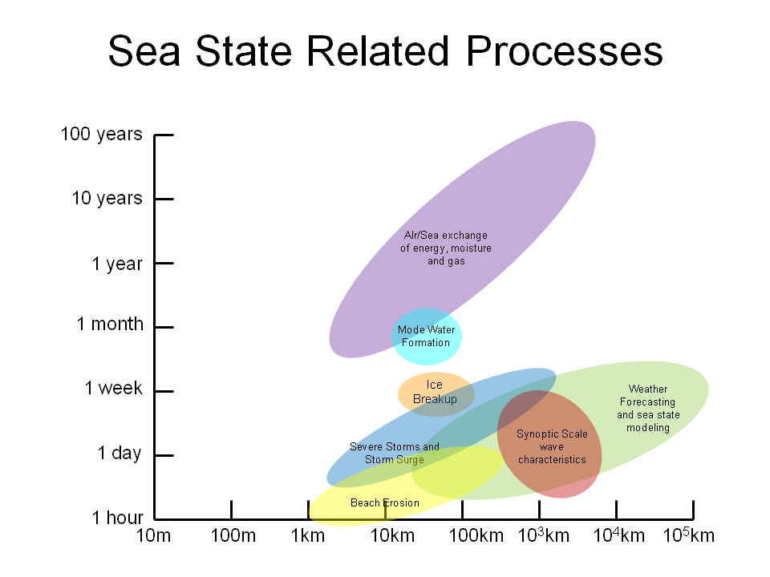
Climate Modelling and the new ECVs
Requirements by modellers:
  Sea State:
  This refers to variables relating to the height, direction, wavelength and time period of waves.
  The accuracy of NWP products is limited by the availability of validation and calibration data, and their utility is limited over the shallower coastal regions. ERA40 made use of sea state estimates within its assimilation system.
  The existing sea state reference buoys are limited in terms of global distribution and location
  Altimetry only provides significant wave height and wave period, and coverage is limited relative to synoptic scales of variability.
  SAR gives the most useful data but is rarely exchanged or available in a way that impacts estimates for climate

Slide 5
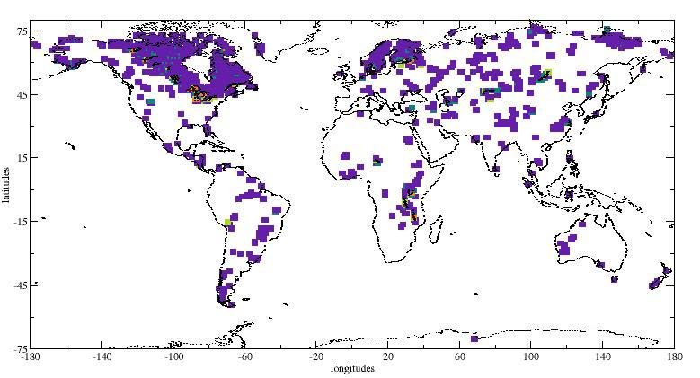
Climate Modelling and the new ECVs
Requirements by modellers:
  Lakes: GloboLakes is a precursor
  Includes water level/area, temperature, phase (water or ice), salinity and timing of phase changes, colour as proxy for water quality.
  Valuable as a lower boundary condition for NWP and climate models. Lakes down to a certain threshold size should be included.
  Climatology of lakes is of interest as a fingerprint of climate change

Slide 6
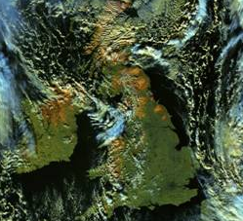
Climate Modelling and the new ECVs
Requirements by modellers:
  Snow Cover:
  Variables include fractional cover and snow water equivalent/depth. Is latter included?
  Important for lower boundary of models to define albedo, emissivity, surface energy budget.
  Also used for model validation.
  Snow age and albedo useful
  GlobSnow and H-SAF snow are
  precursors
Snow Cover over UK (brown colour) for 15 Jan 2016 as seen by VIIRS.

Slide 7
Climate Modelling and the new ECVs
Requirements by modellers:
  Long-Lived GHGs:
  Focus is on stratospheric chemistry
  Variables include CFC-11, CFC-12, CCl4, CH3Cl, ClO, N2O, HNO, and SF6
  Used to influence radiative transfer for climate model projections
  Long term monitoring of these gases are useful so their affects can be more accurately characterised in models.
  Identifying sources and sinks also of interest
  No future limb sounders is an issue

Slide 8
Climate Modelling and the new ECVs
Requirements by modellers:
  Precursors Supporting the Ozone and Aerosol ECVs:
  Focus is on troposphere
  Variables include NO₂, SO₂, HCHO, CO, and NH₃.
  Used to influence radiative transfer for climate model projections
  Biogenic pre-cursors produced by plants
  Application for air quality models

Slide 9
Climate Modelling and the new ECVs
Land Surface Temp Requirements:
Climate monitoring* and attribution: LST is very often closely coupled with near-surface air temperature and is a complementary metric to assess and attribute climate change.
Potentially consistent global coverage: provides observations in data-sparse regions with consistent observational method (in situ measurement practise varies between countries which can introduce non-climatic artefacts in air temp records). Using LST in its own right, or to help infill* gaps in current in situ network for air temp analyses (e.g. EUSTACE). Merge of IR and MW LST estimates but modelers prefer to keep them separate.
Climate and NWP* model evaluation (also other models: e.g. hydrological)
Evaluation of land surface models for estimating surface temperature spatially, temporally and for different land cover & vegetation types.
Improve understanding of vegetation-climate processes and feedbacks, particularly during drought events...when vegetation becomes de-coupled from atmosphere as stomatal conductance decreases drastically. Which regions, periods and vegetation types show most significant responses...resilience of vegetation to climate changes/extremes.
NWP* and reanalysis assimilation
Urban heat island analysis*, urban planning, thermal comfort*
Vegetation and land use and sea ice/snow temperature
Crop/vegetation health, spatial & temporal characterisation of freeze-thaw cycles, driver of veg phenology
Early and sensitive indicator of drought conditions and water availability; proxy indicator of soil moisture
Detection and consequences of land cover change. Ice sheets related to melt
Boundary layer/diurnal cycle
Provides detailed information on diurnal cycle (most in situ stations only report tmin/tmax/tmean)
Surface fluxes
Detection of low-intensity fires and burned area + geothermal anomalies and volcanic activity

Slide 10
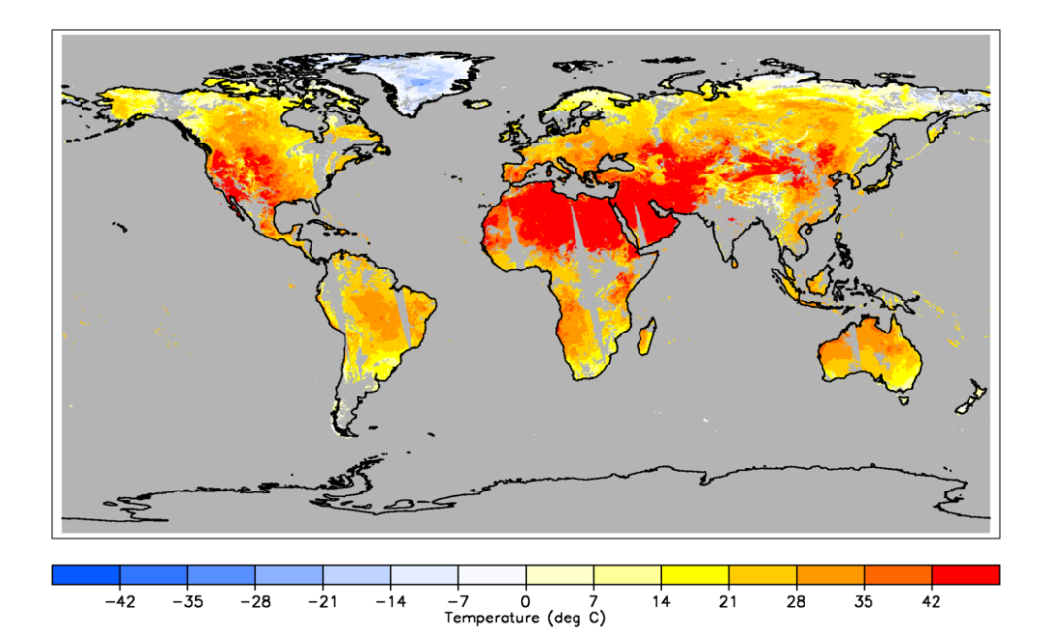
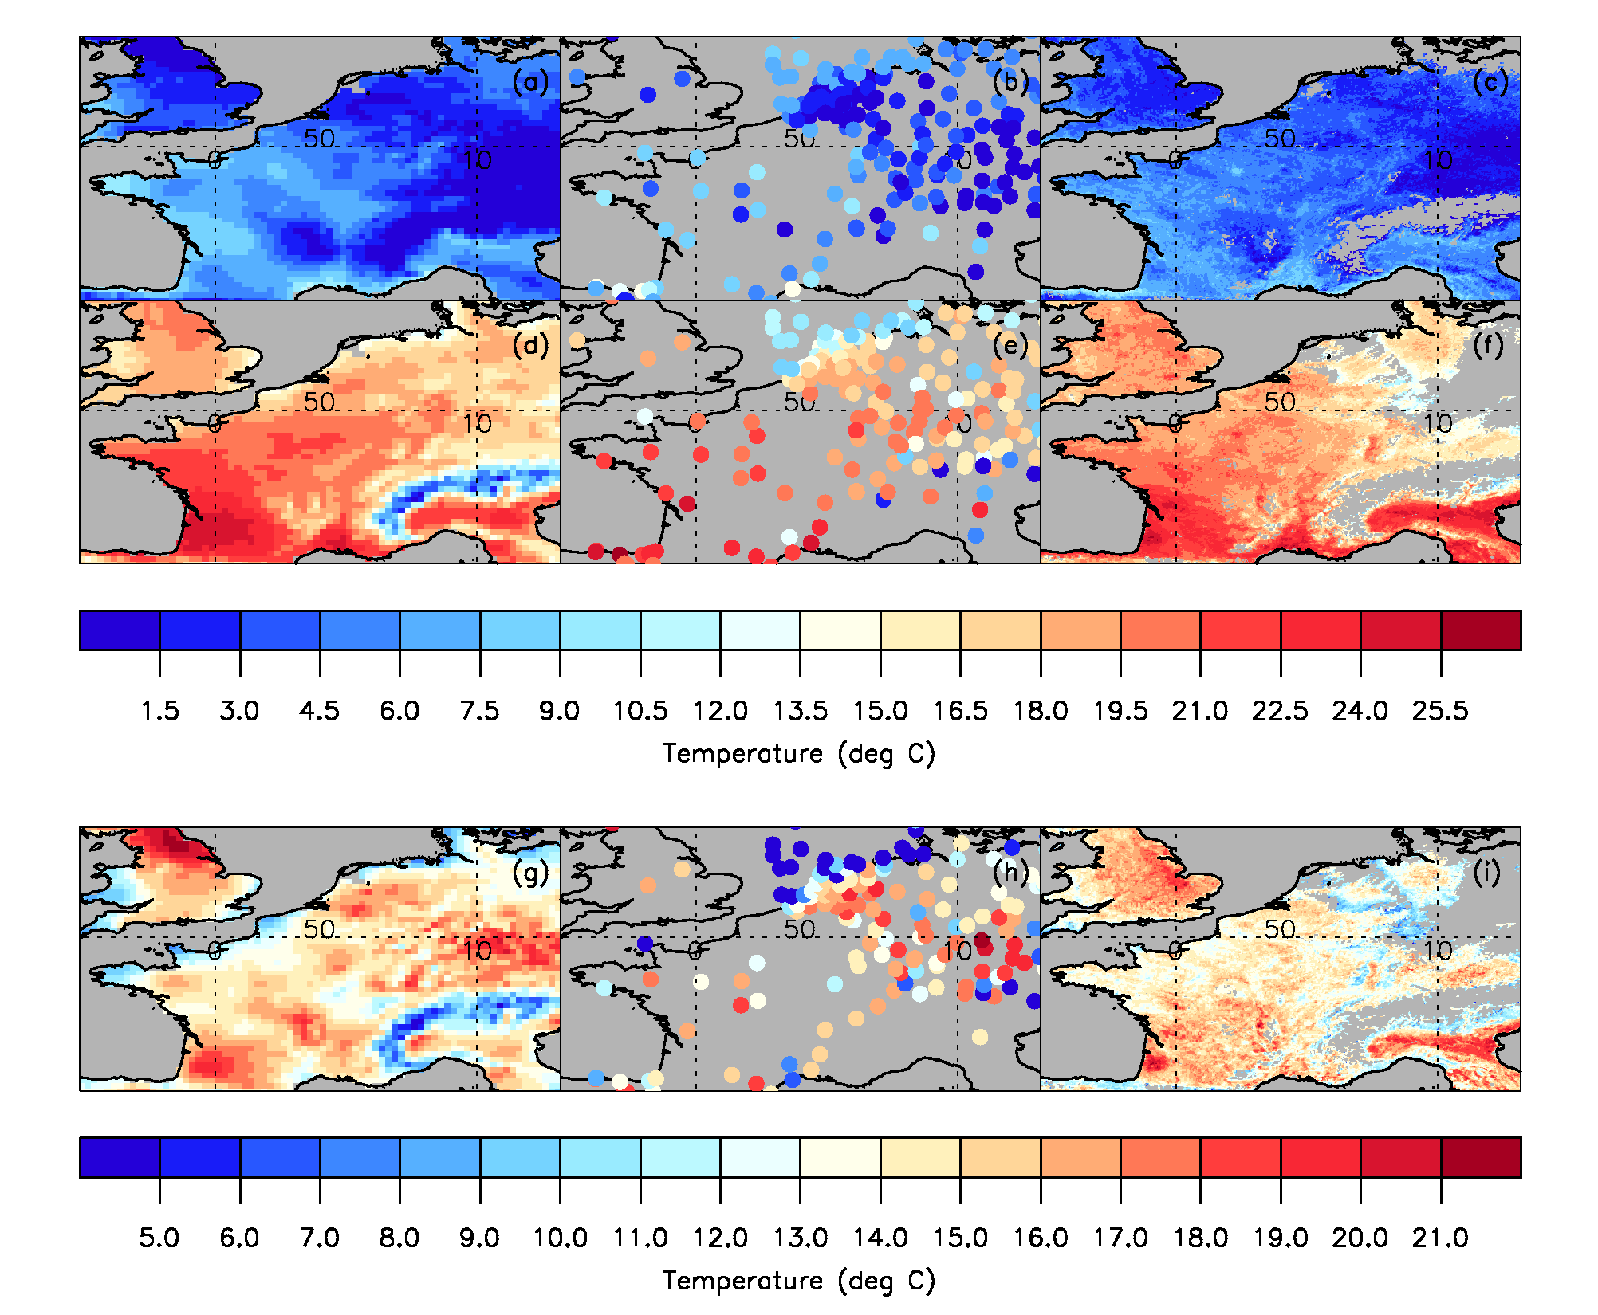
MODIS Aqua 27 June 2006 day time LST
Gridded Station
Station (ECA&D pub.)
Satellite
Tmin (top row) and Tmax (bottom row) over Paris on 27 March 2012. Satellite T2m estimated from empirical statistical model using SEVIRI LST. (from Good, 2015, JGR-Atmospheres)

Slide 11
Climate Modelling and the new ECVs
  Above Ground Biomass: (are there also associated data on vegetation height and canopy area?...these would be potentially useful for evaluating against modelled height and area, few measurements in tropics)
Improve surface vegetation estimates
Improve CO2 and water budgets
Evaluation of annual total above-ground biomass in land surface and earth system models (annual averages/climatologies covering the globe are needed)
Evaluation of seasonal cycles in biomass (monthly averages covering the globe are needed) to compare with vegetation indices ie. NDVI, LAI…Not sure if its possible to look at crop dynamics also using this measure? To compare with or estimate observed and estimated crop yield
Fuel load for fire and proportion of biomass burnt after fire
Lidar useful for canopy heights

Slide 12
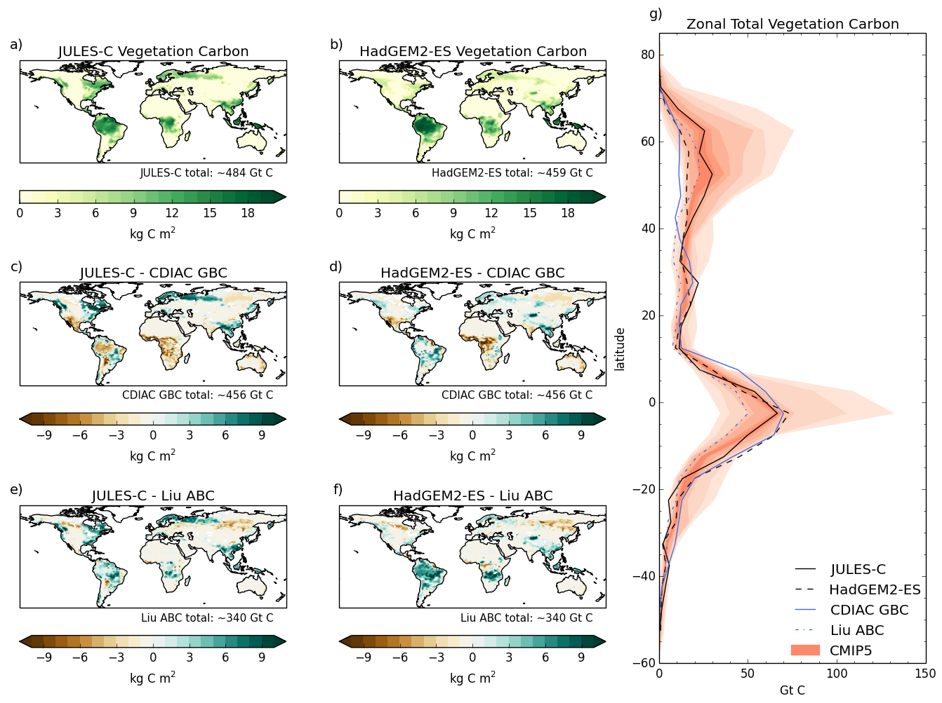
Above Ground Biomass
Vegetation carbon stocks simulated by a) JULES-C and b) HadGEM2‑ES, expressed as 20-year means for the period 1981-2000. The difference between these models and the observational data are given in the middle (CDIAC GCB) and bottom (Liu AGB) rows for JULES‑C (c and e) and HadGEM2‑ES (d and f). Global total carbon for each data set is displayed below the maps. In the case of the difference plots, the total carbon for the observational data set is given. g) shows zonal totals in 5 degree latitudinal bands for each of the data sources. Models are in black (solid: JULES‑C; dashed: HadGEM2‑ES) and observations in blue (solid: CDIAC GBC; dotted: Liu ABC). For reference, the Coupled Model Intercomparison Project phase 5 (CMIP5) ensemble (17 models) is also displayed, with colour saturation indicative of ensemble spread.

Slide 13
Climate Modelling and the new ECVs
  High resolution land cover:
  Better definition of surface fields and rate of change
  Improve land cover mapping particularly in areas that are currently highly uncertain
  Improve the mapping of fractions of Plant Functional Types used in models, relative to the land cover classifications (via cross-walking table)
  Proposal is to have updates every year
  This is needed for climate convention.

Slide 14
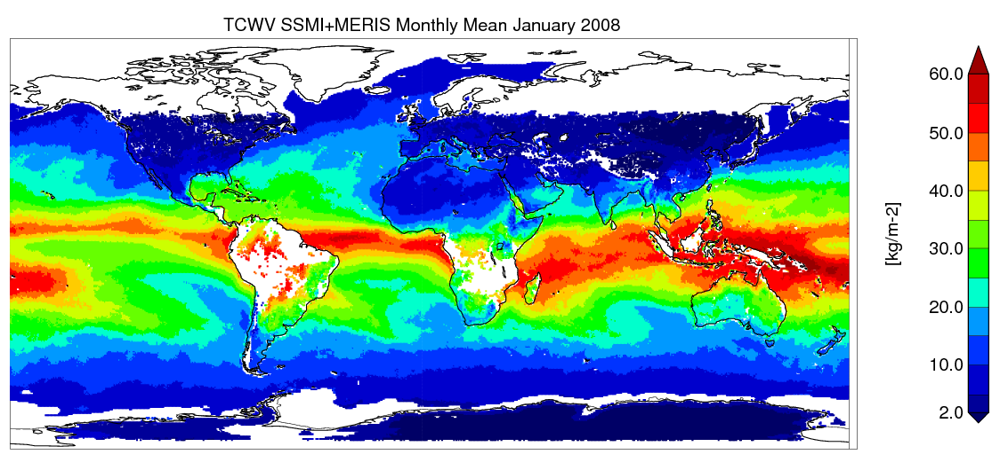
Climate Modelling and the new ECVs
Water Vapour:
  EUMETSAT provide CDR for ocean (SSM/I)
  ESA provide CDR for land (MERIS/OLCI)
  Need to combine (e.g. GlobVapour)
  Assimilation in reanalyses
  What about upper tropospheric humidity?
  Improving hydrological cycle in models (wv, cloud, rainfall) and radiation budget
  Validating climate models

Slide 15
Climate Modelling and the new ECVs
Water Vapour:
  EUMETSAT (CMSAF) provide CDR for ocean (SSM/I)
  ESA provide CDR for land (MERIS/OLCI)
  Need to combine (e.g. GlobVapour)
  What about upper tropospheric humidity? Different sensors and being done by CMSAF.
  Assimilation and validation of reanalyses
  Improving hydrological cycle in models (wv, cloud, rainfall) and radiation budget
  Validating climate models
  Sea Level CCI need better water vapour estimates
  Also important for process studies

