Slide 1

Seasonal forecasting
Omar Bellprat, Francois Massonet, Chloé Prodhomme, Virginie Guemas, Francisco Doblas-Reyes (BSC)
Mathias Gröner and Ulrika Willén (SHMI)
15 March 2016
DLR, 2016

Slide 2
Questions from seasonal forecasting
Initial conditions: Do the newly developed CCI products improve the skill of climate (seasonal) predictions?
Forecast verification: Can verification seasonal predictions inform about observational quality?

Slide 3
CMUG Work Packages
WP 4: Exploiting CCI products in AMIP experiments: Verification of high-resolution seasonal predictions
WP 3: Cross-assessment of SST, SI, ocean colour and sea-level data for seasonal and decadal predictions and CCI4MIP simulations

Slide 4
CMUG Work Packages
WP 4: Exploiting CCI products in AMIP experiments: Verification of high-resolution seasonal predictions
WP 3: Cross-assessment of SST, SI, ocean colour and sea-level data for seasonal and decadal predictions and CCI4MIP simulations

Slide 5
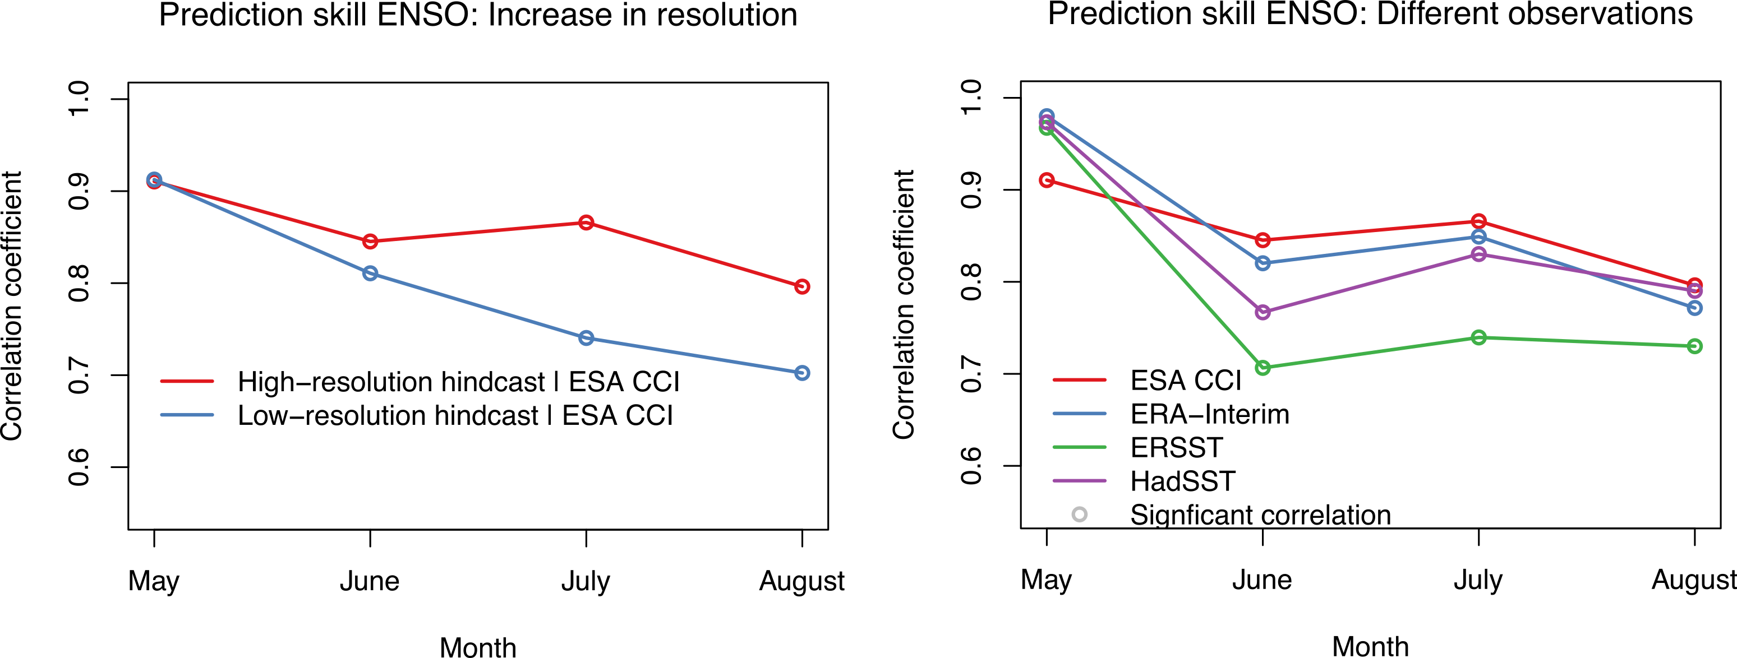
High-resolution and ENSO
ENSO prediction improves with increased horizontal resolution. Observational uncertainty similar – yet surprisingly systematic.
Bellprat et al., 2015

Slide 6
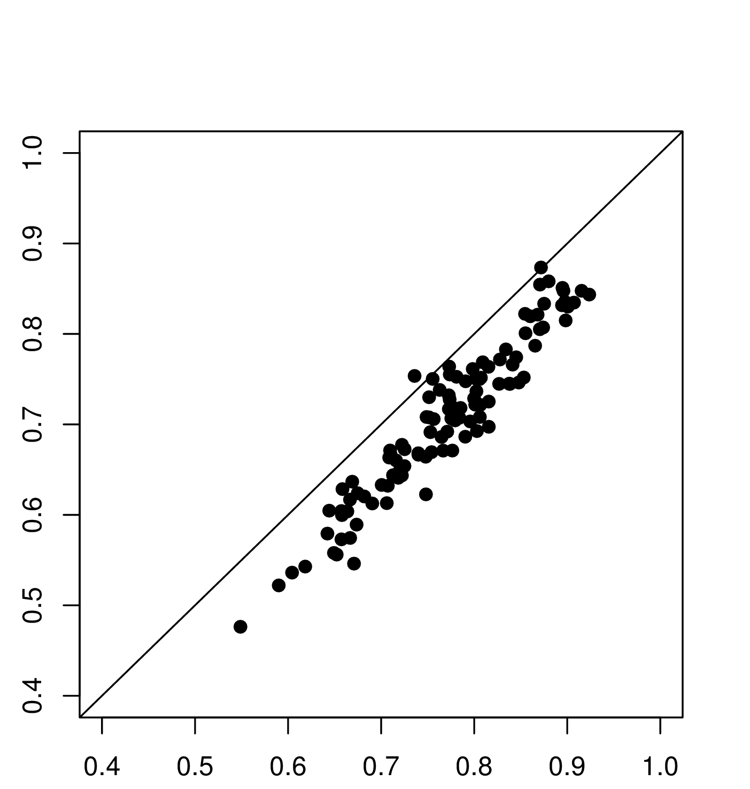
Observational quality
Interannual correlation skill systematically higher in CCI SST
August ENSO Skill
11 seasonal forecast systems
Correlation when using ERSST
Correlation when using CCI SST

Slide 7
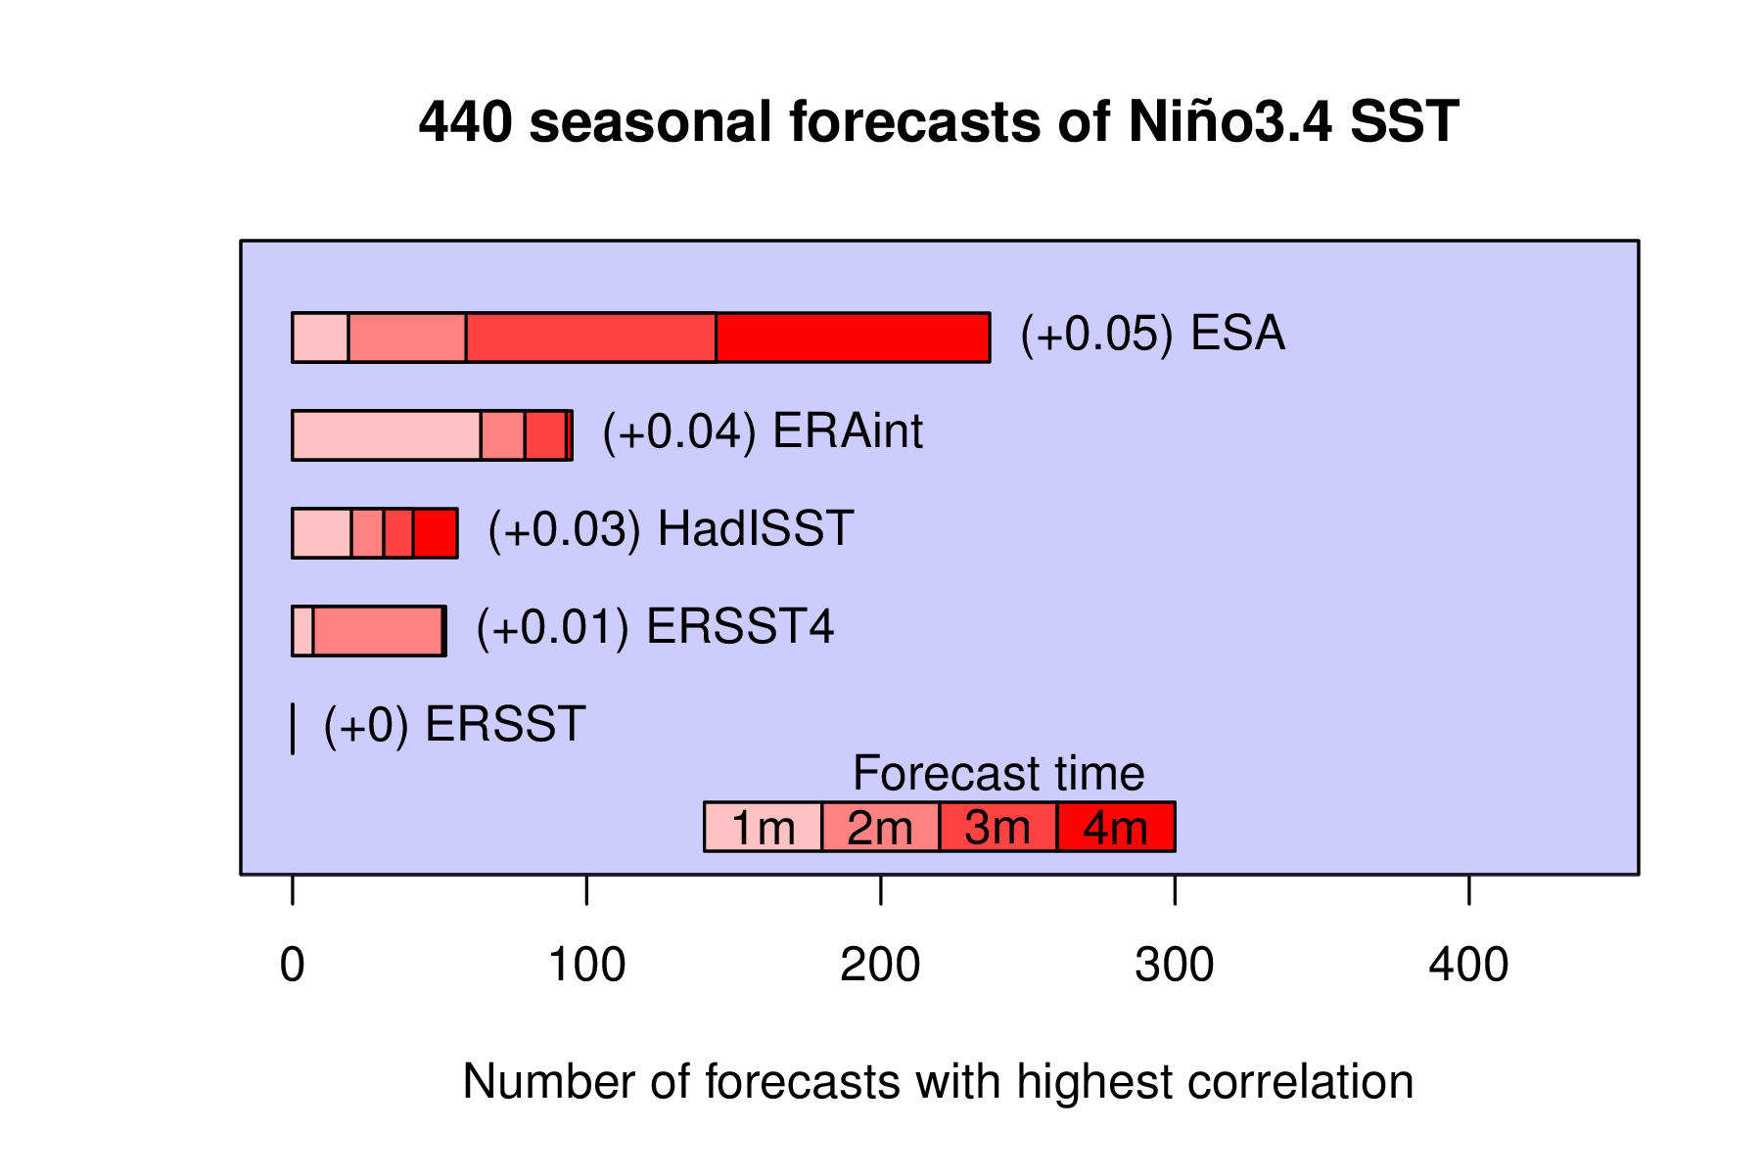
Best observation?
ESA CCI SST gives the highest correlation scores on average. ERA-Interim the highest in the first month – initialization?

Slide 8
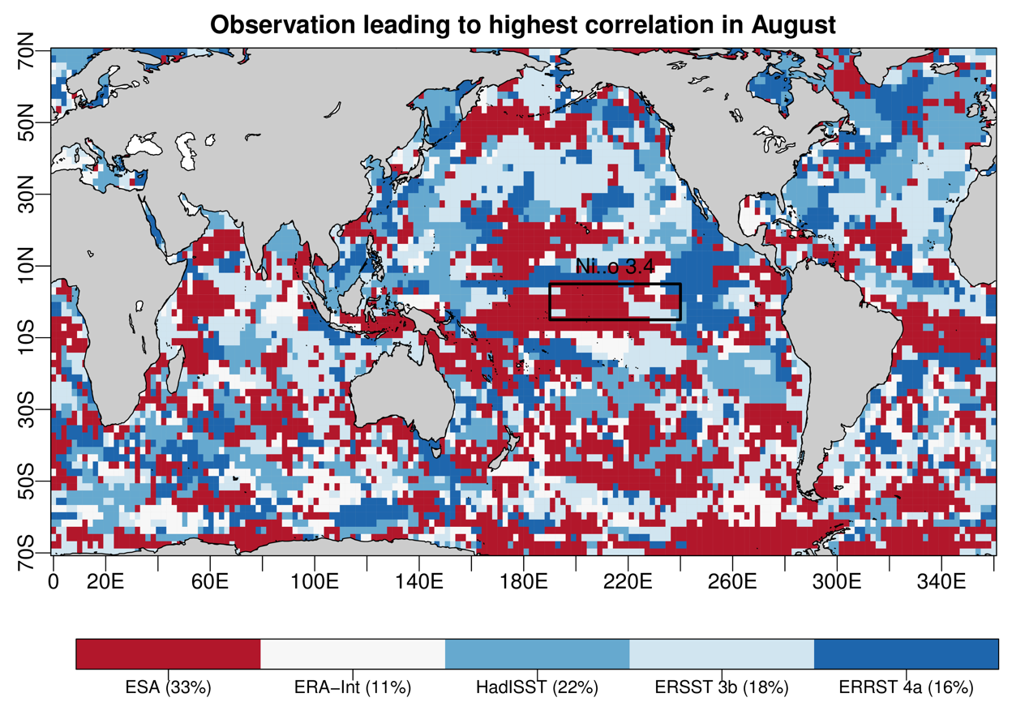
Best observation spatially
ESA CCI leads spatially to highest correlation, yet spatial variability is large.
Shipping routes?
Satellite
In-situ

Slide 9
Propagation of model error
Observational errors need to be propagated to model scales (monthly, spatial average) – what approach to follow?
Red-noise decay | Different Observations | Triple allocation
L = 100 km / 1d Merchant et al., (2014) | 5 Observational datasets Bellprat et al., (2014) | Janssen et al. (2006)
Niño 3.4 SST uncertainty = 0.01 K | Niño 3.4 SST Uncertainty = 0.1 K | ?

Slide 10
CMUG Work Packages
WP 4: Exploiting CCI products in AMIP experiments: Verification of high-resolution seasonal predictions
WP 3: Cross-assessment of SST, SI, ocean colour and sea-level data for seasonal and decadal predictions and CCI4MIP simulations

Slide 11
Coupled data assimilation at BSC
Ensemble Kalman Filter assimilation in a coupled model system.
Assimilation of SIC and SST in EC-Earth.
Atmosphere updated implicitly after each time-step
Standard deviation of sea ice concentration of a 25-member ensemble in September 1983. As the figure suggests, observational information will be particularly valuable around the ice edge, i.e. where the model is uncertain.
francois.massonet@bsc.es

Slide 12
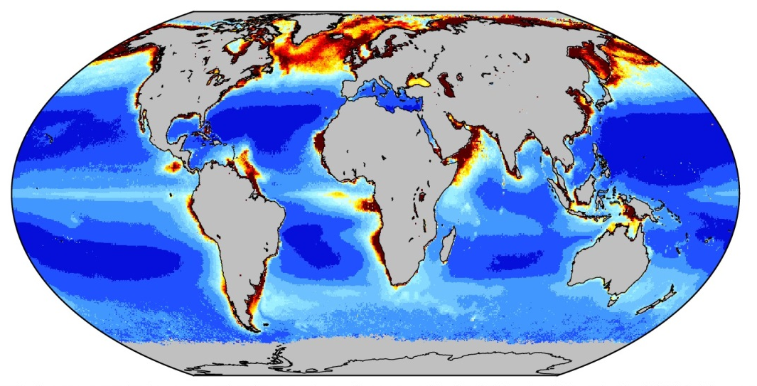
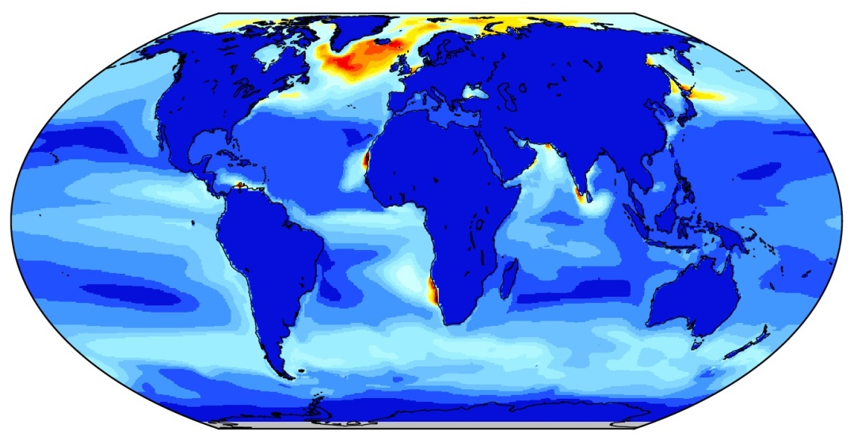

SMHI, Matthias Gröger has made ocean stand alone simulations with EC-Earth ocean model, NEMO, including newly installed bio-geochemistry model, PISCES.
How well does the ocean and bio-geochemistry components of EC-Earth compare to observations and to the CCI ocean colour, sea-ice and sea-level data?
Surface distribution of summer Chlorophyll-alpha
Observations: CCI occci-v2
Climatology, JJA 1997-2013
Models: EC-Earth NEMO-PISCES
Spinup 100yrs, mean JJA 1990-2010
mgChl_a/m3
Large-scale pattern is reproduced by the model:
* Low chlorophyll in subtropical gyres, oligotropic open ocean regions
* High chlorophyll in the North Atlantic and Arctic along coastal upwelling zones (e.g. west Africa)
Coastal high productivity is underestimated due to lacking Riverine nutrient loads (will be included soon)
Notes:
12

Slide 13

Conclusions
Climate predictions systems allow to inform about observational quality – CCI SST leads overall to highest correlation values
Propagation of observational uncertainty to model scales is a large cap for current practice in verification and data assimilation

Slide 14
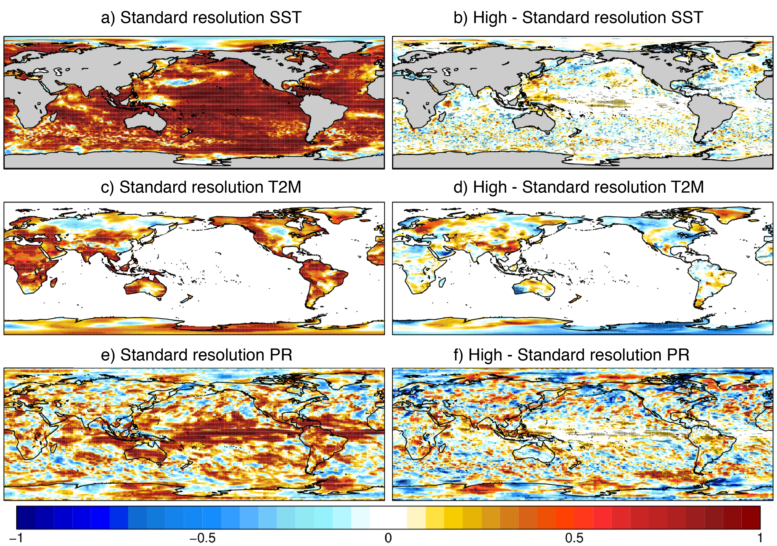
Atlas of high-resolution predictions
ENSO and mid-latitude variability (NAO, blocking) improved
CCI
SST
1° Ocean
80km Atm.
0.25° Ocean
40km Atm.
correlation
Prodhomme et al., (2016)

