Slide 1


ESA CCI Soil Moisture
Wouter Dorigo, Wolfgang Wagner,
and the rest of the CCI SM team

Slide 2
Overview - Available coarse resolution data
The CDR makes best use of existing European and international programmes
Notes:
Active and passive microwave sensors used for the generation of the ECV soil moisture data sets. Although the Soil Moisture Active Passive (SMAP) and Aquarius missions will not yet be considered in the products generated within phase 2 of the project, they are already included in this diagram to highlight their potential inclusions in the ECV production in the future. SAR data from Envisat and Sentinel-1 will not be directly integrated into the merged ECV products but be used for improved characterisation of errors and sub-pixel heterogeneity of the coarse-scale products.

Slide 3
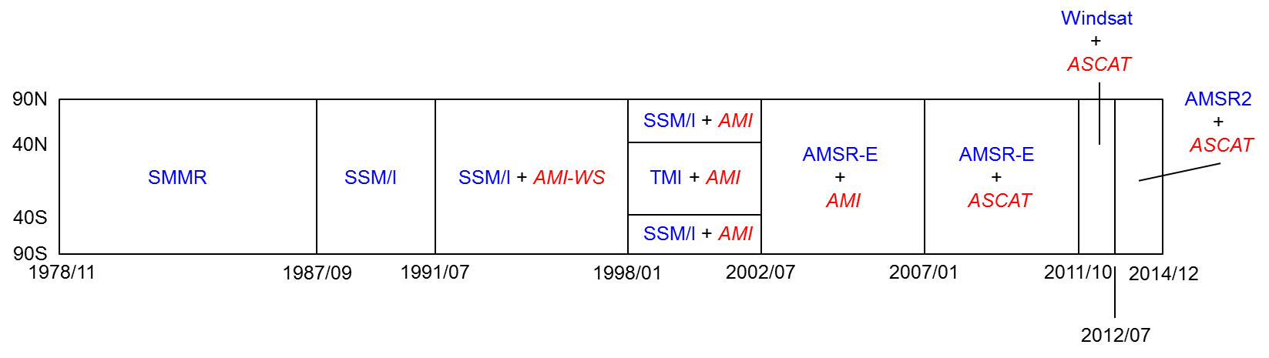
Specification - v02.2 (latest public version)
Temporal extent from Nov 1978 – Dec 2014 (Global Product 36 Years)
Input data volume size ~ 200 GB from 9 satellite sensors
0.25°
Daily files (not necessarily coverage)
Generates 3 products:
  Passive Product: 1978/11-2014/12, ~ 33 GB
  Active Product: 1991/07-2014/12, ~ 23 GB
  Combined Product : 1978/11-2014/12, ~ 27 GB

Slide 4
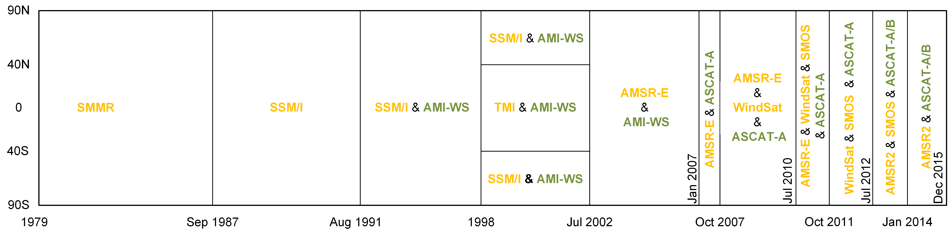
Specification - v03.0 (internal release soon)
Temporal extent from Nov 1978 – Dec 2015 (Global Product 37 Years)
Input data from 11 satellite sensors (NEW: SMOS, MetOp-B ASCAT)
NEW: Processing in Python
Generates 3 products:
  Passive Product: 1978/11-2015/12, ~ 33 GB
  Active Product: 1991/07-2015/12, ~ 23 GB
  Combined Product : 1978/11-2015/12, ~ 27 GB

Slide 5
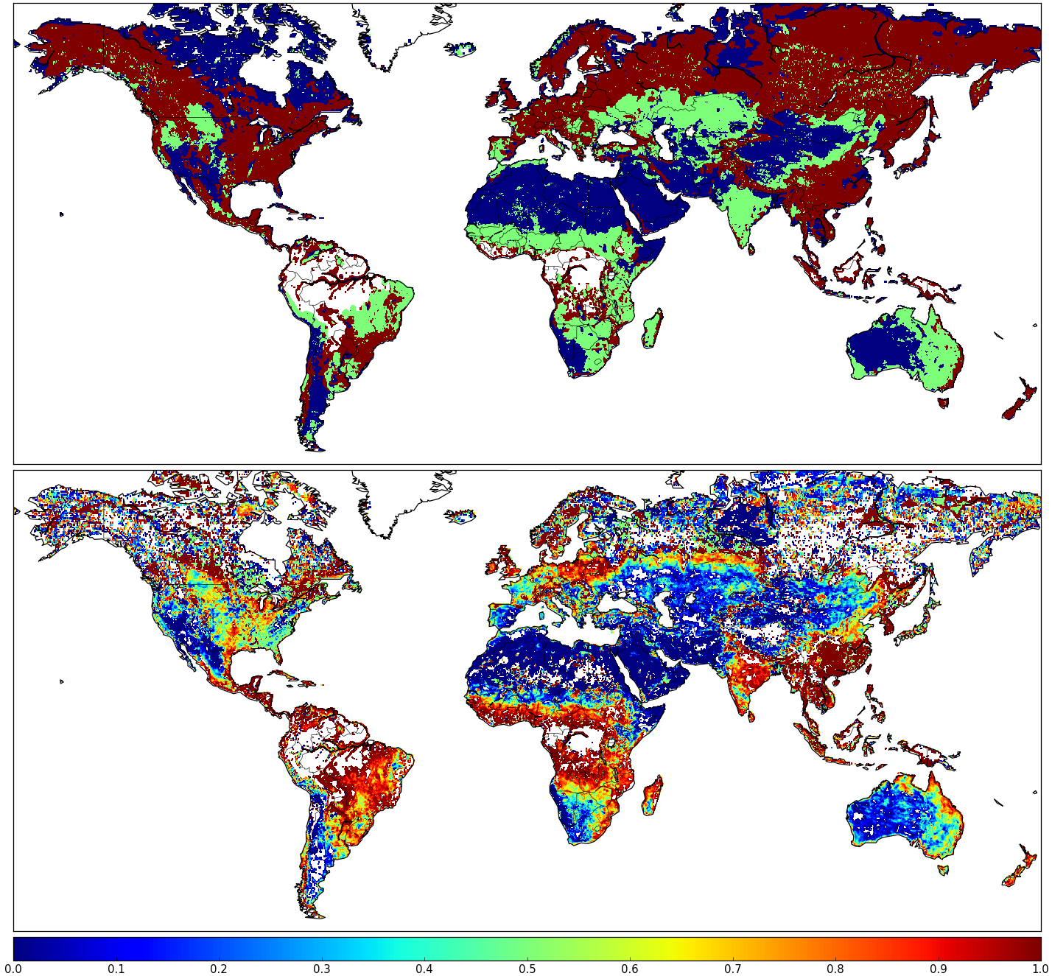

Scientific improvements:
merging active and passive
So far: based on correlation between active / passive data (deliniation of transition zones) and vegetation optical depth (selection of either active or passive data)
NEW: weighted average based on the signal-to-noise ratio of the input data sets
Weights assigned to ASCAT: Significant differences mostly in transition regions → gradual changes instead of sharp boundaries

Slide 6
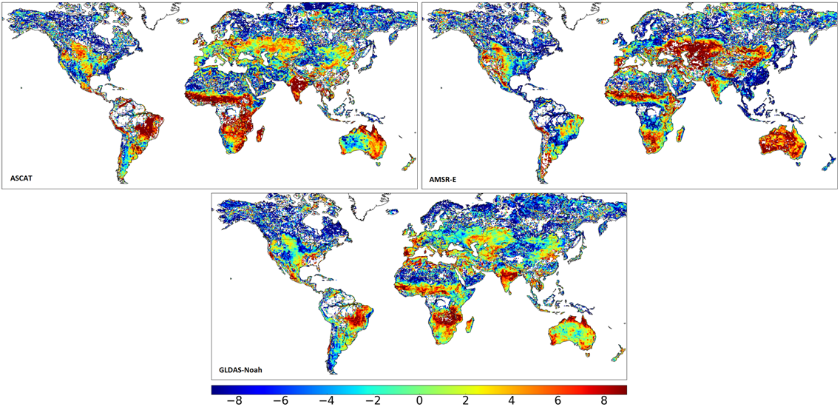
Scientific improvements:
Merging active and passive
NEW: Signal-to-noise ratio computed with triple collocation
Quality of land surface model (LSM) data often comparable to the quality of satellite data
Global SNR estimates [dB] for ASCAT, AMSR-E and GLDAS-Noah

Slide 7
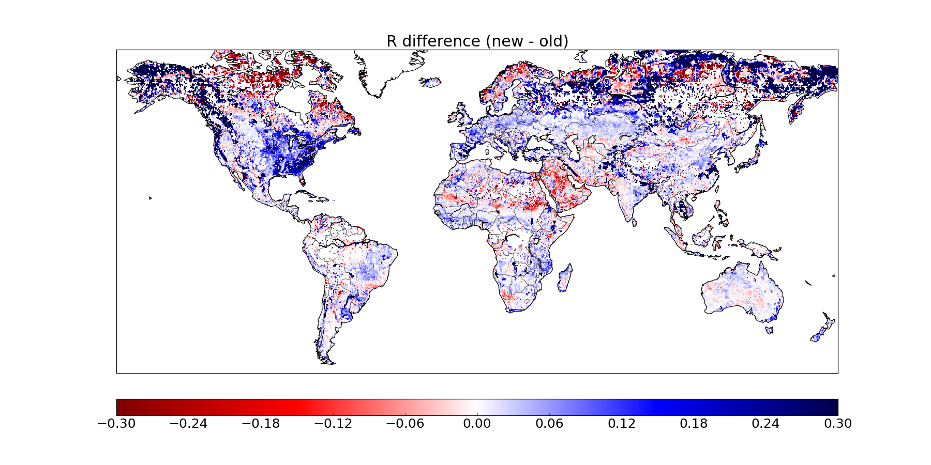
Scientific improvements
Correlation improvement (absolute) between old and new blending scheme for the ASCAT / AMSR-E period (reference: ERA-Land)

Slide 8
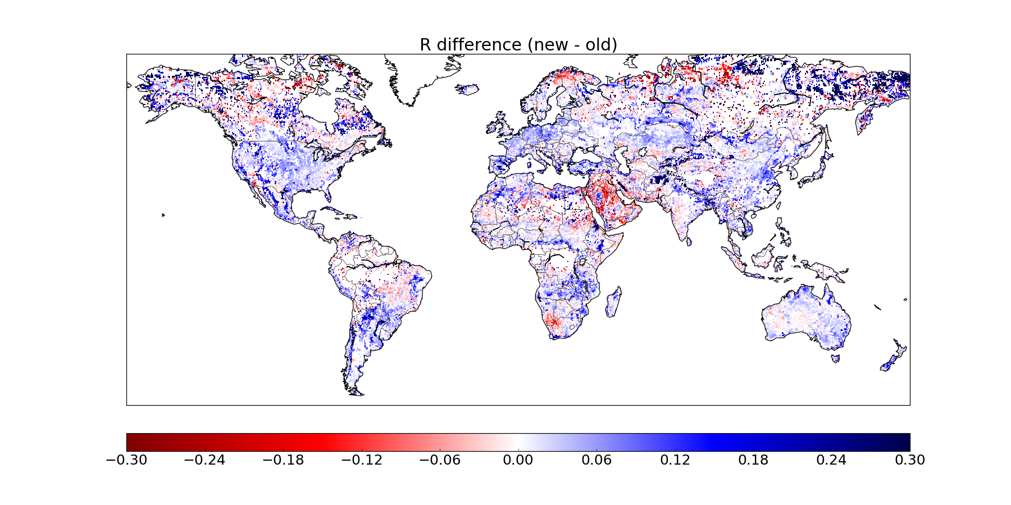
Scientific improvements
Correlation improvement (anomalies) between old and new blending scheme for the ASCAT / AMSR-E period (reference: ERA-Land)

Slide 9
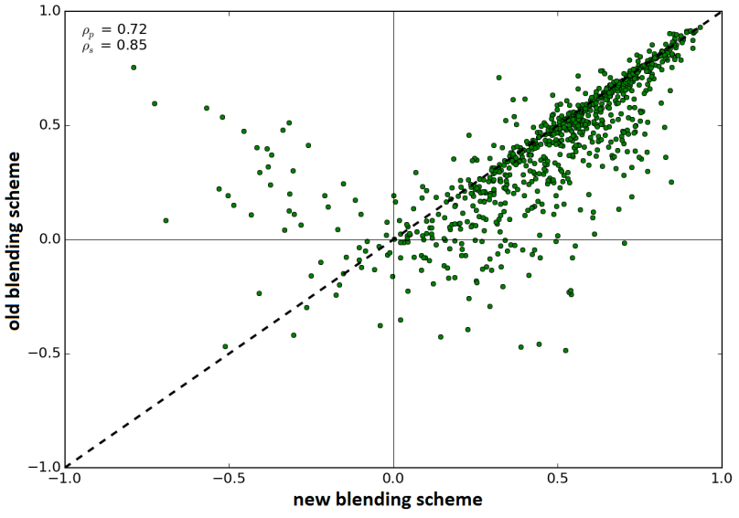
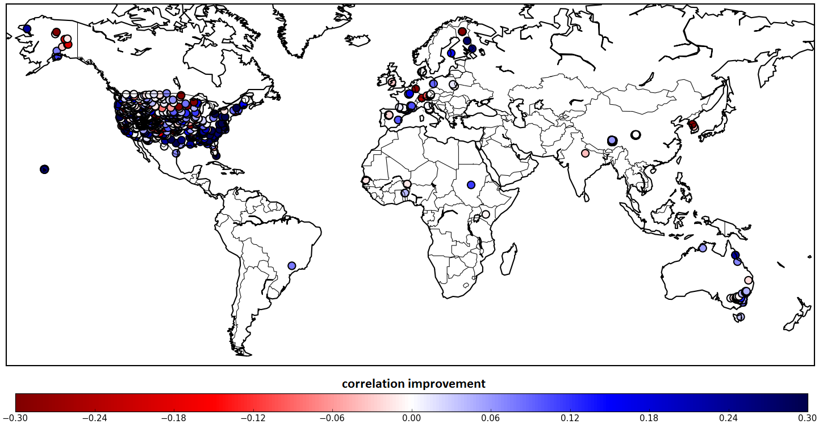
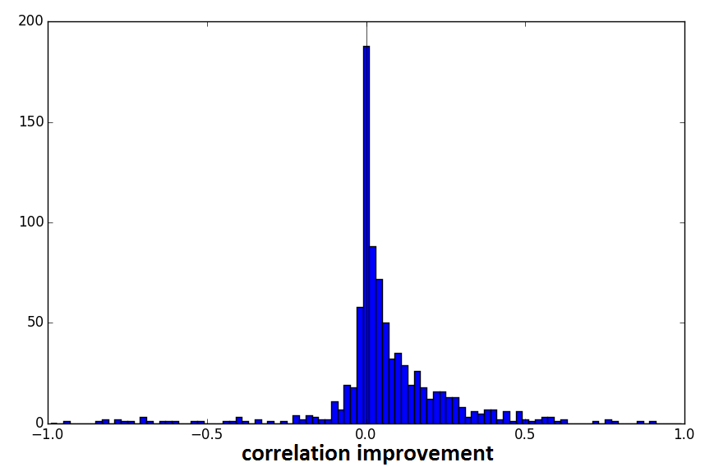
Scientific improvements
Correlation improvement (absolute) between old and new blending scheme for the
ASCAT / AMSR-E period (Reference: ISMN-all available stations)
  Notice: inhomogeneous station distribution!

Slide 10
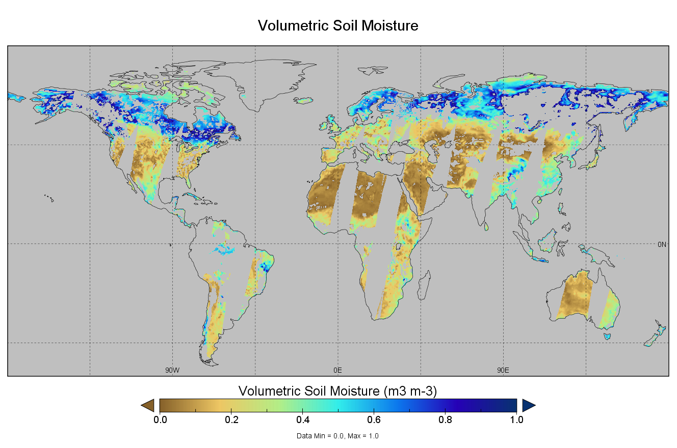
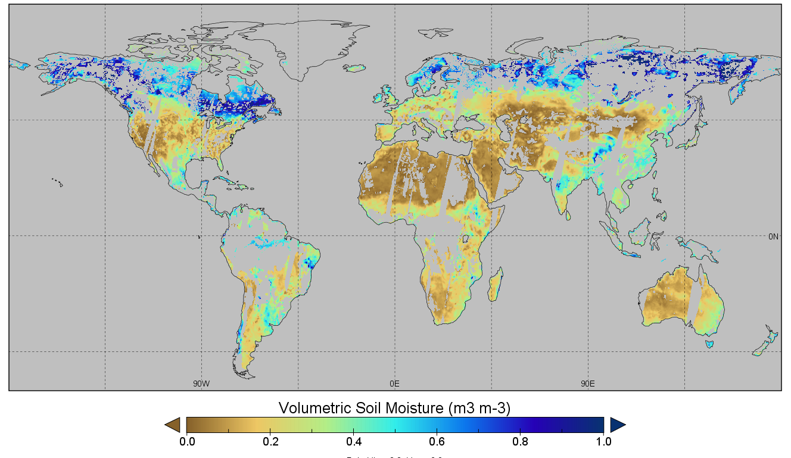
Improved coverage
NEW: Example: introduction SMOS
V02.2
V03.0

Slide 11

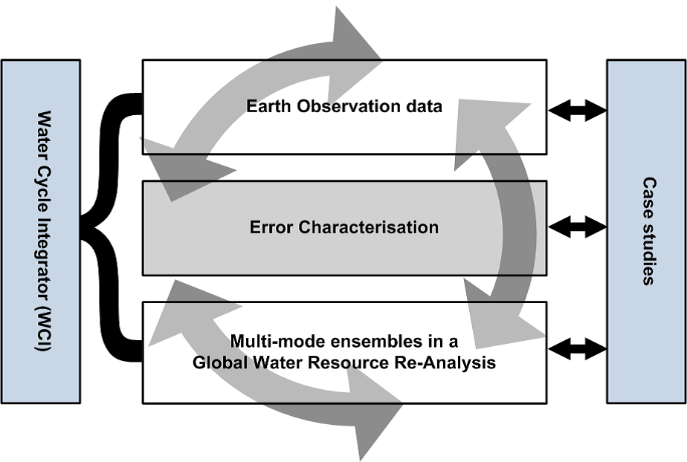
Cross-project activities: Earth2Observe
Water cycle reanalysis based on improved EO products (SM, P, snow, etc.)
Ensemble model benchmarking
Hydrological models HTESSEL-CaMa, JULES, LISFLOOD, ORCHIDEE, PCR – GLOBWB, SURFEX-TRIP, WaterWorld, SWBM, W3RA, WaterGAP3

Slide 12
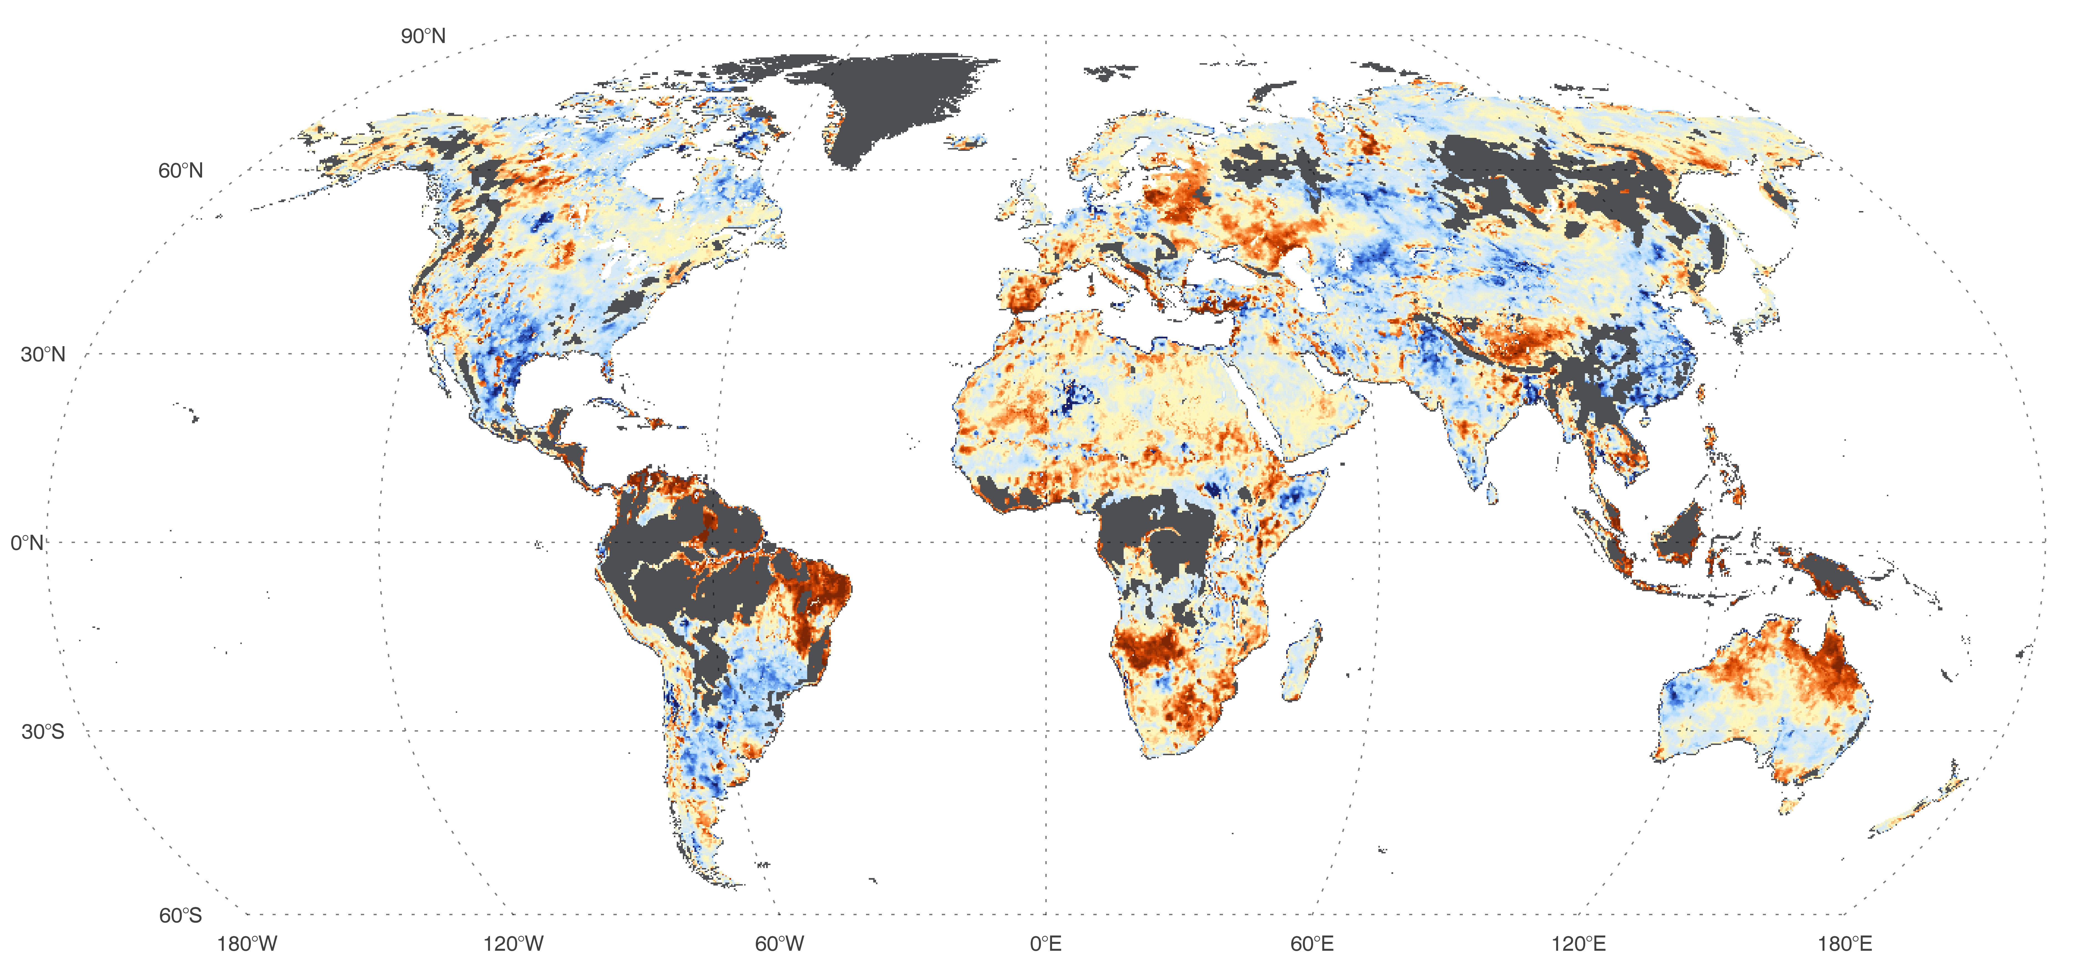
Current and planned applications – International initiatives
GEWEX Data and Assessment panel: benchmark activities to produce reference dataset of satellite soil moisture (similar as GPCP, Seaflux, landflux, etc.)
Obs4MIPs (planned for March 2016)
Fix contribution to yearly BAMS State of the Climate Report (since 2010)
[Dorigo et al., 2016, BAMS State of the climate in 2015]

Slide 13
Plans for product updates
Integration of SMAP and reprocessed historical datasets
Novel missions used for error characterisation: SMAP
Improved characterisation of errors and product improvements through novel methods: triple collocation, SM2RAIN, data assimilation
CCI SM products completely independent of land surface model estimates (currently GLDAS-Noah is being used as scaling reference)
Root-zone soil moisture product from CCI SM

Slide 14
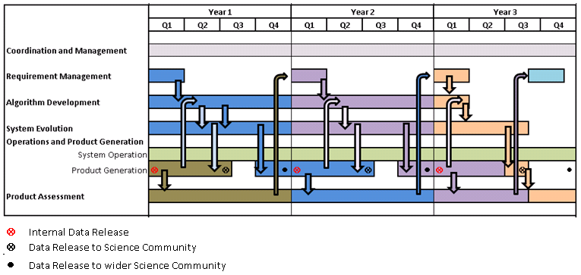
Plans for delivery
Cyclic workflow of phase 2
Key users with early access: CNR IRPI, Met Office Hadley Centre, MPI Meteorology, Meteo-France, ECMWF, MPI-BGC, Ghent University, LSCE, CRU, Wageningen University, University of Melbourne

Slide 15
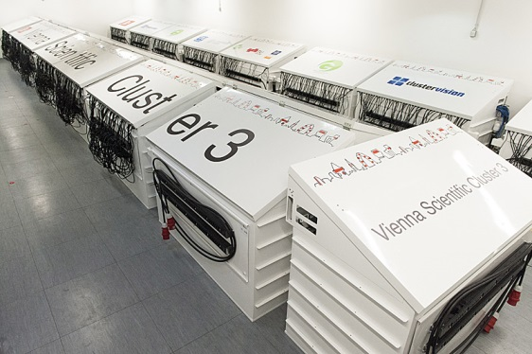

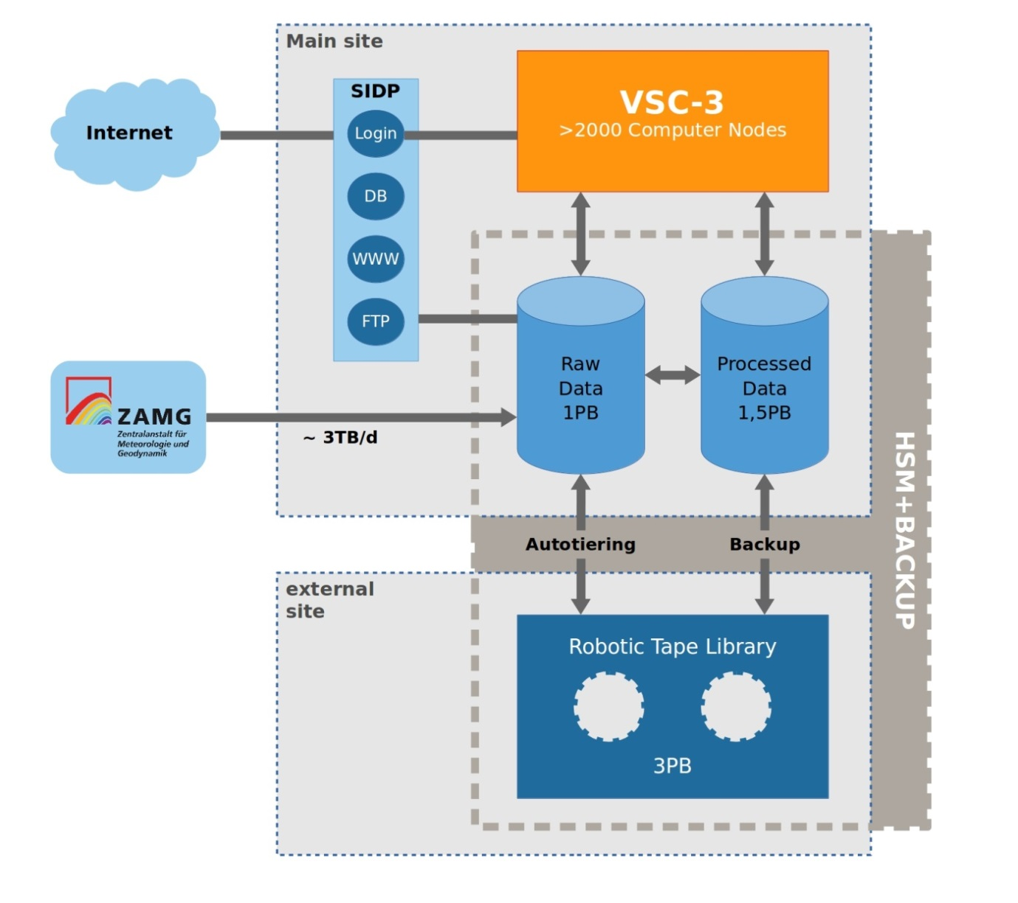
Future CCI SM production on EODC
VSC-3
Worldwide Rank 85
Cooperation for Earth Observation
Operate ECV production system on the EODC cloud platform hosted by TU Wien
  Virtual machines for R&D
  Petabyte-scale data storage
    Scatterometers & multi-frequency radiometers
    Sentinel-1, ENVISAT, …
  Supercomputer VSC-3

Slide 16
Engaging with climate research community
Total registered users as of today: 2190

Slide 17
Engaging with climate research community
Release v0.1 June 2012
Release v02.0 July 2014
Release v02.2 January 2016
New
Data Release!
User statistics as of 16.02.2016

Slide 18



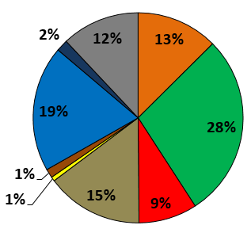
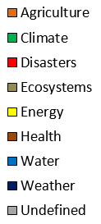
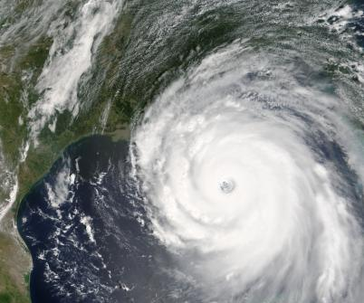

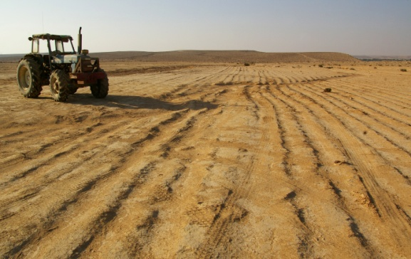


GEO Societal Benefit Areas
Water
Ecosystems
Climate
Disasters
Weather
Agriculture
Health
Energy

Slide 19

Special issue on soil moisture in JAG
26 contributions in total, separated into two parts:
Part 1 primarily focuses on single sensor soil moisture retrievals and product validation (www.sciencedirect.com/science/journal/03032434/45/part/PB)
Part 2 focuses on soil moisture applications, in particular those using the long-term ESA CCI Soil Moisture dataset. (www.sciencedirect.com/science/journal/03032434/48)

Slide 20
Latest user requirements (2015/16)
Still, regional applications lead (57%), followed by global (33%) and local (10%)
Data usage is still mainly for Trend analysis and comparison with own product, followed by validation (new!).
Unit of soil moisture: mm (new!) is now preferred over m3/m3 followed by % of saturation
Clear interest in Root Zone Soil Moisture product (80%) was confirmed
Knowledge of product accuracy and stability gets more important
Daily is the preferred temporal resolution
Higher spatial resolution (1 km and 0.1 degree) would be welcomed
Delivery via Online Catalogue and Server is of interest besides the FTP provision

Slide 21
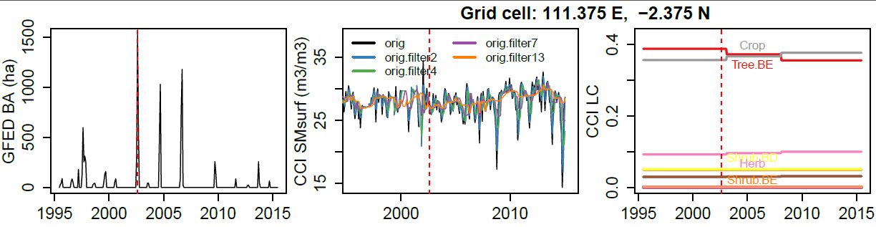
Cross-CCI/ECV interactions
ESA CCI Living Planet fellowship by Matthias Forkel / Wouter Dorigo
CCI4SOFIE: CCI data for assessing SOil moisture controls on FIre Emissions
  CCI Soil Moisture
  CCI fire / burnt area
  CCI aerosol, CCI greenhouse gases
  CCI land cover
  DUE GlobEmission,
  STSE BIOMASAR
  Vegetation productivity data (LAI, fAPAR, VOD)
  LPJml-SPITFIRE

Slide 22
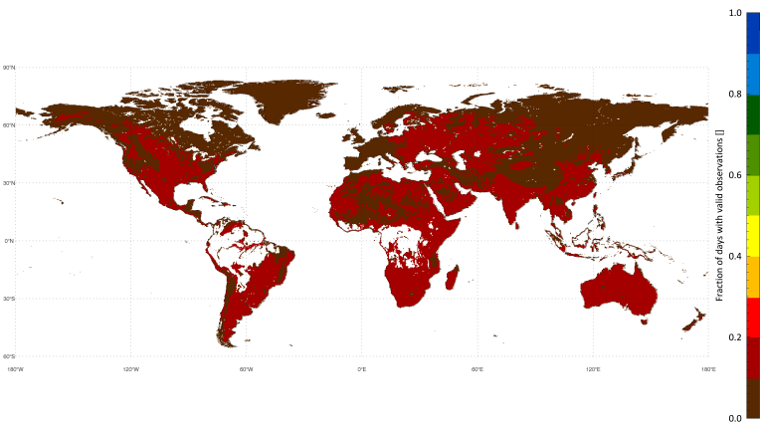
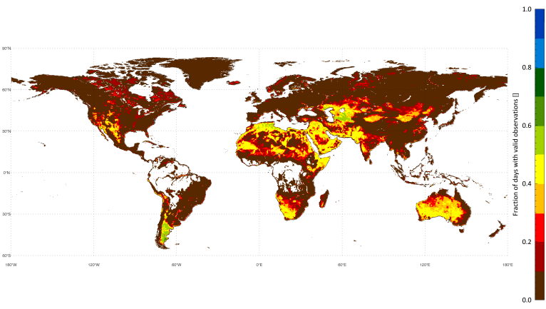
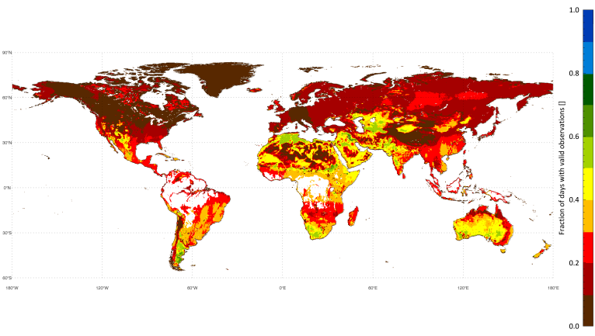
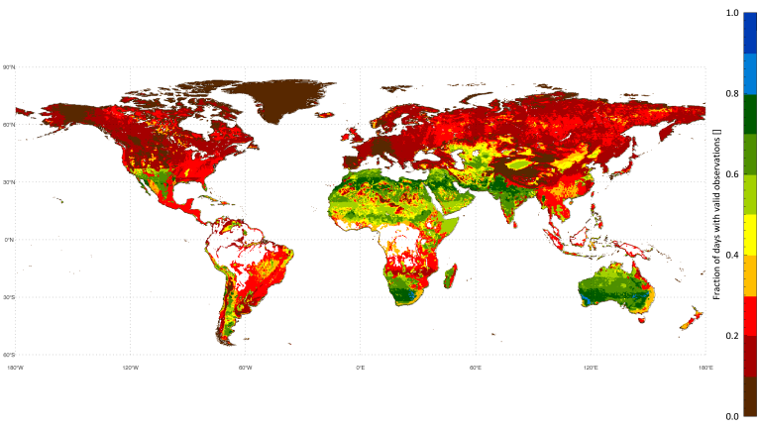
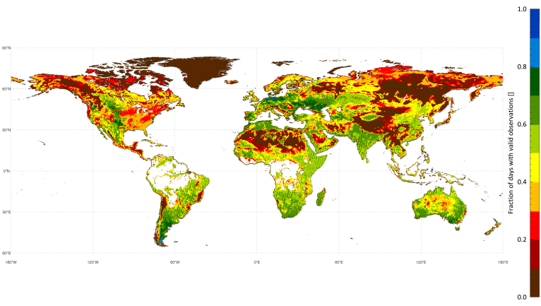
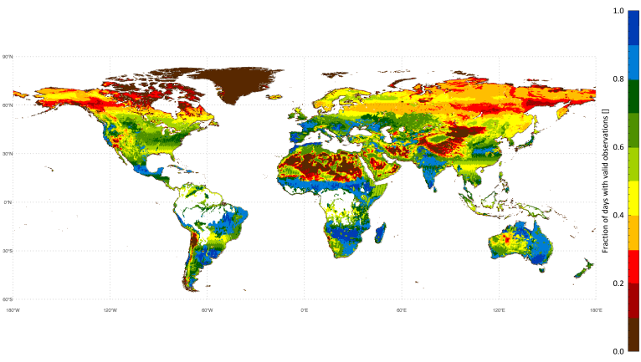
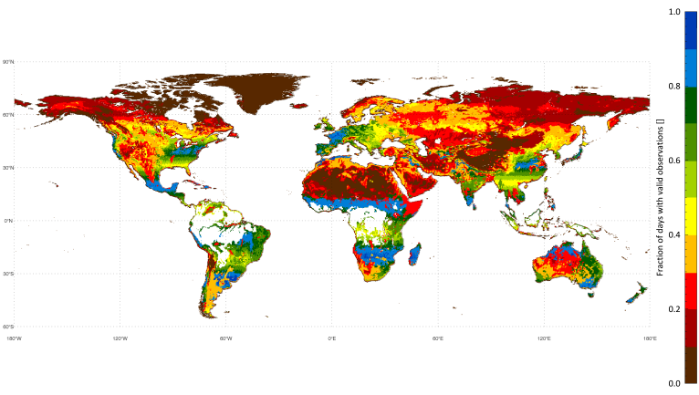
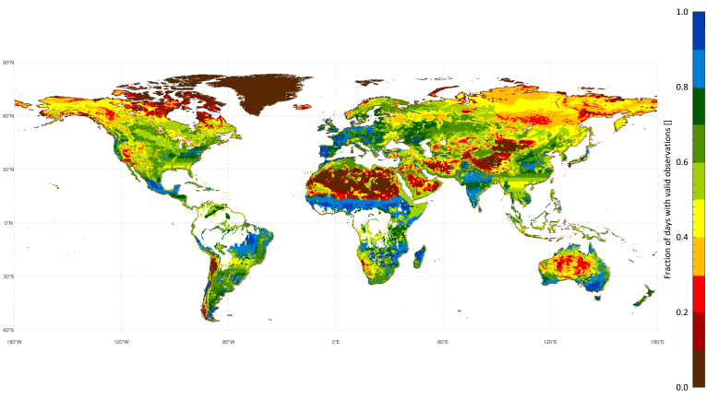
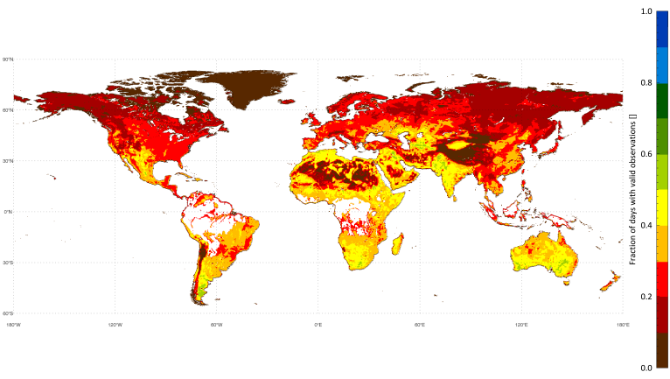
Specification – spatiotemporal coverage
1978/11– 1987/08
1987/09 – 1991/06
1991/087– 1997/12
1998/01-2002/06
2002/07 – 2006/12
2007/01 - 2011/10
2011/11 - 2012/07
2012/08 - 2014/12
1978/11 - 2014/12

Slide 23
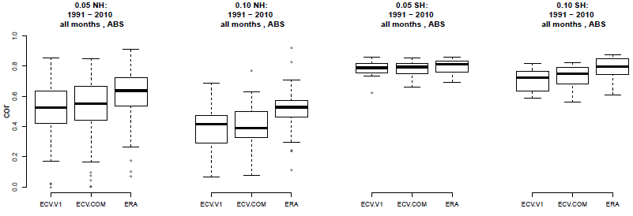
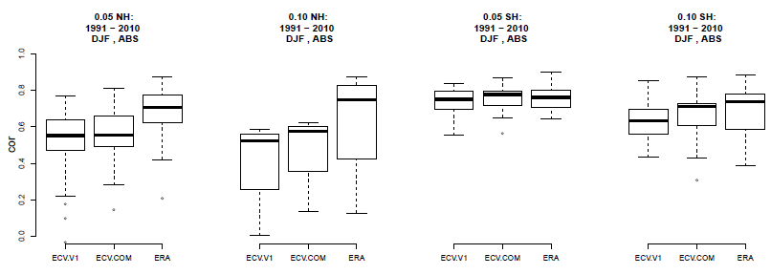
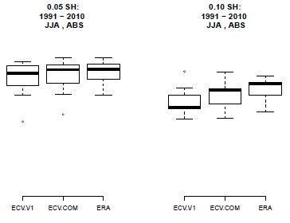
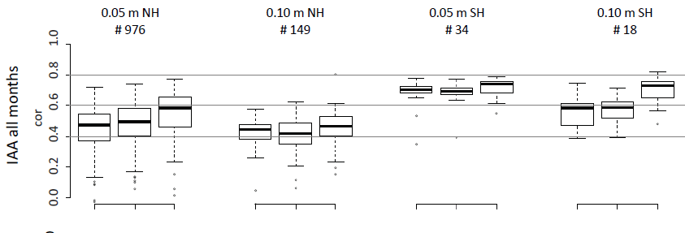
Validation – in situ: different product versions
0.05 m NH
# 976
0.10 m NH
# 149
0.05 m SH
# 34
0.10 m SH
# 18
(# stations)
cor
0.0 0.2 0.4 0.6 0.8 1.0
ABS all months
ECV SM
ECV SM02.0
ERA Land
ECV SM
ECV SM02.0
ERA Land
ECV SM
ECV SM02.0
ERA Land
ECV SM
ECV SM02.0
ERA Land
cor
0.0 0.2 0.4 0.6 0.8 1.0
ABS winter
[Mittelbach et al., in prep]

Slide 24

Current and planned applications –
National initiatives
Key dataset in EOWAVE poject (Science Award Vienna University of Technology): role of soil moisture in driving ecosystem dynamics in past, present, and future
Key dataset in SAT-EX project (Belgian Space Office): impact of climate extremes on vegetation growth
TU Wien has recently joined

