Slide 1
Fire_cci phase 2 progress.
Interactions with other ECVs
Phase 2 of the Climate Change Initiative
Fire_cci project
Emilio Chuvieco
University of Alcalá

Slide 2
Context
Soil erosion
Shifting
agriculture
Greenhouse gas
emissions
Cyclical
Fire
effects
Fire
uses
Grazing
Vegetation
succession
Deforestation
Run-off alteration
Arson
Loss of lives and
properties
Fire factors
Climate
changes
Fire policy:
suppression
Land
use changes
Population
dynamics
Increase
Decrease

Slide 3
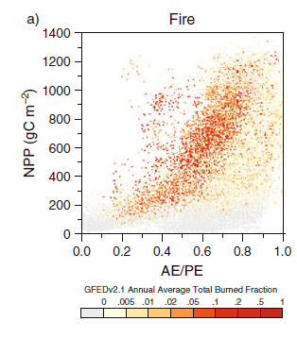
Fire factors:
It needs biomass and dryness
Harrison, S. P., J. R. Marlon y P. J. Bartlein (2010): Fire in the Earth System, en Changing Climates, Earth Systems and Society (editado por J. Dodson). Springer Netherlands: 21-48.

Slide 4
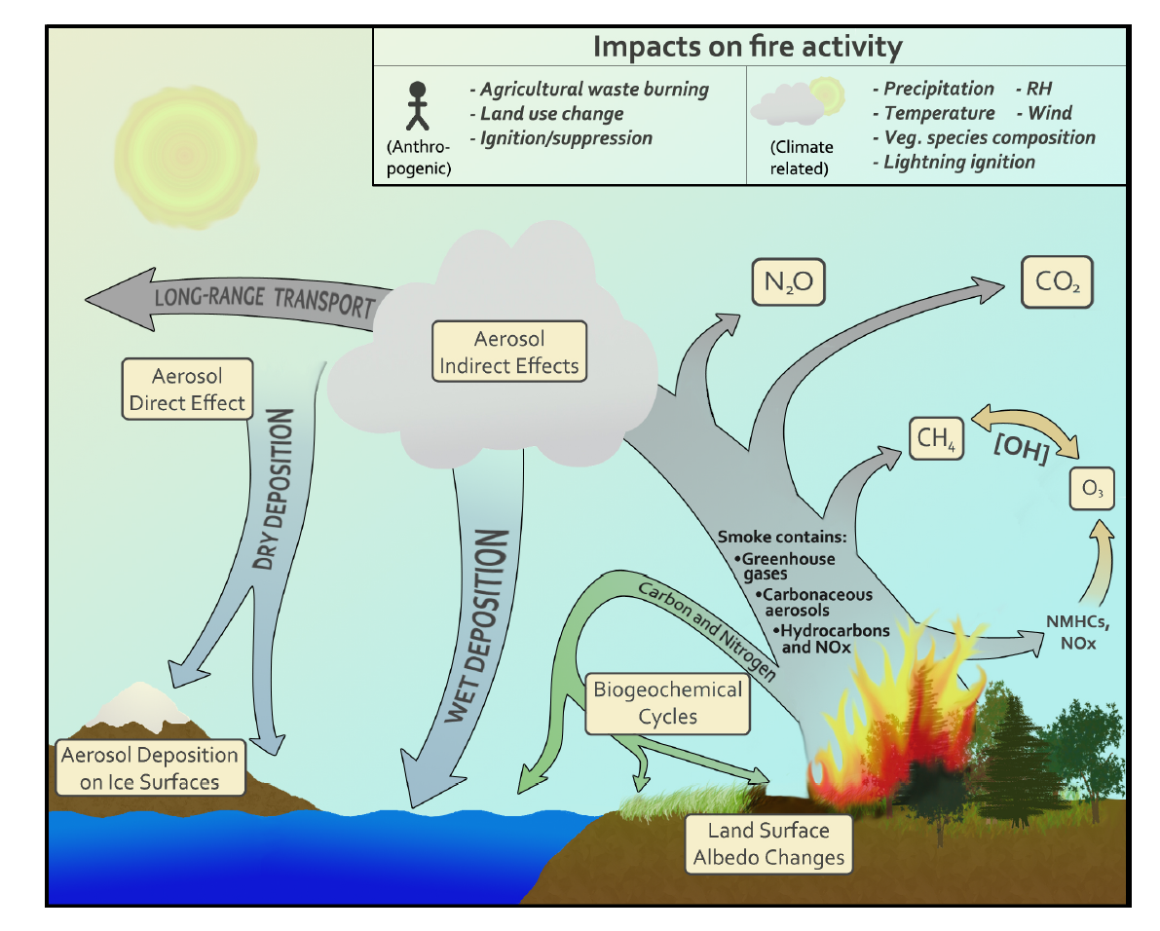
Fire impacts
Source: Ward et al., 2012

Slide 5
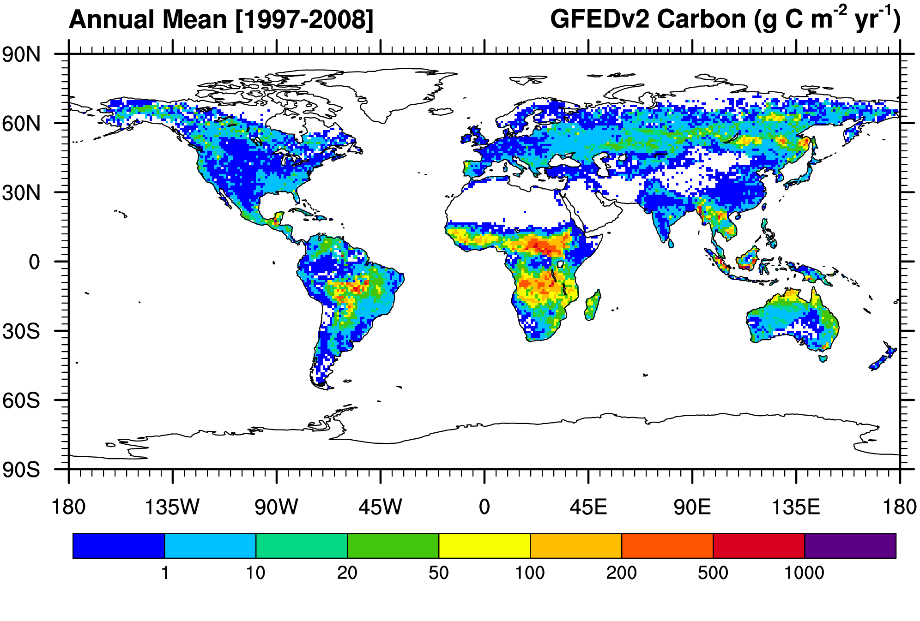
Annual mean fire emissions 1997-2008
(GFED v3)
g C m⁻² yr⁻¹
Global fire emissions: ~2.3 Pg C/yr
~ 1/4 of total occurs at the deforestation frontier
Van der Werf et al., 2010

Slide 6
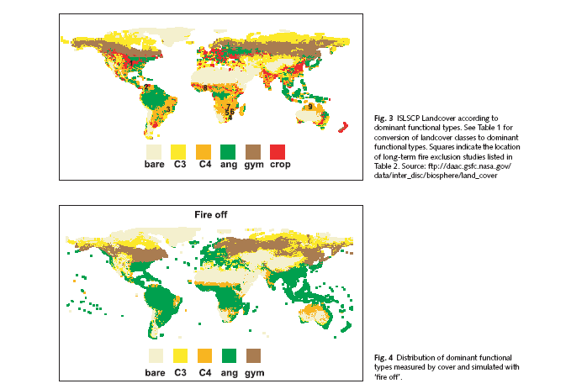
Impacts of fire on vegetation composition
Without fire C4 PFT will increase from 27% to 56% while reducing C3.
Bond, et al. 2005

Slide 7
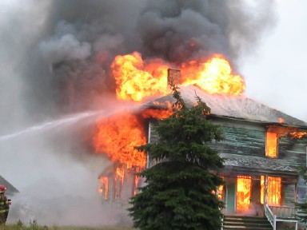
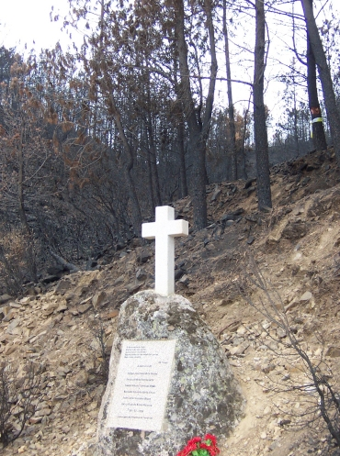
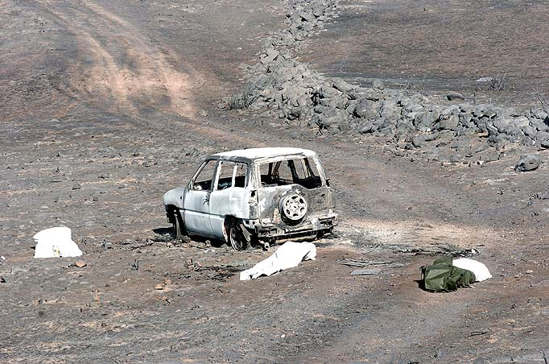
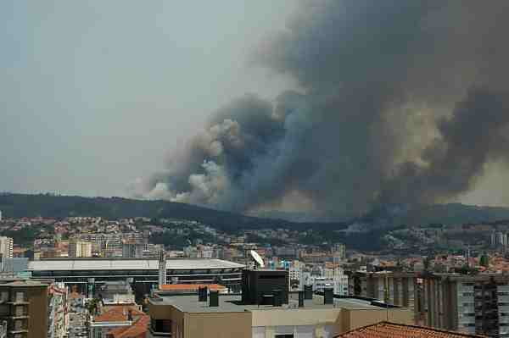
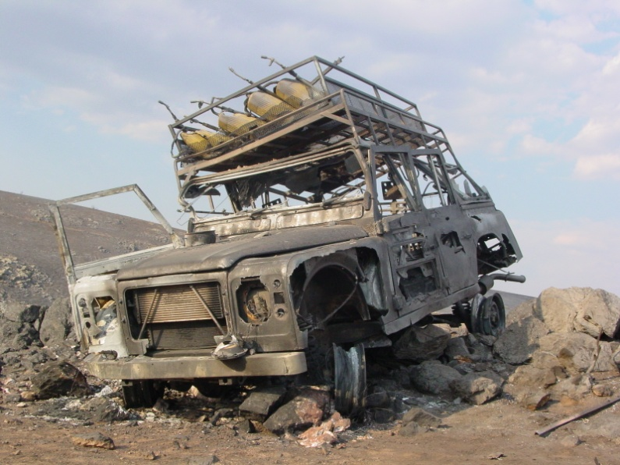
Effects on human lives and properties

Slide 8
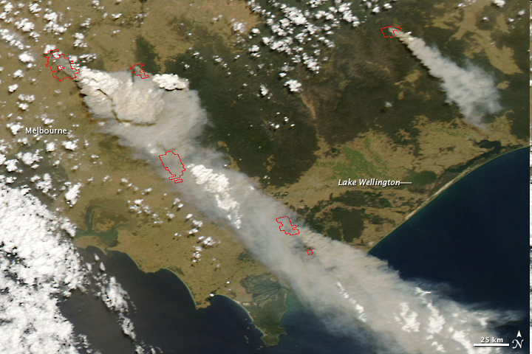
Australia, 2009
MODIS Images: visibleearth.nasa.gov
173 people died and 7,562 people were displaced. Over 3,500 structures destroyed
450,000 ha were burned

Slide 9
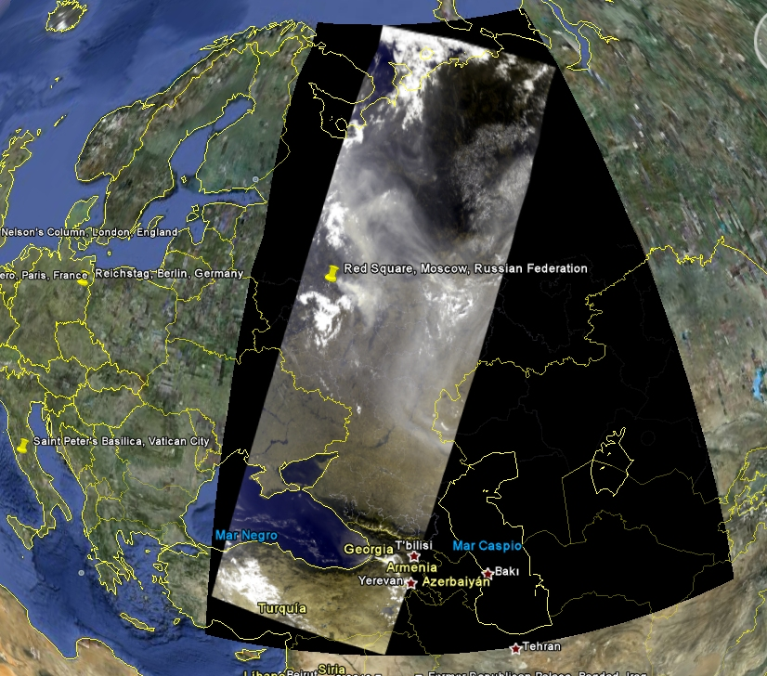
Russia, 2010
MERIS images. August, 2010 Courtesy DLR
50 people were killed. Over 2,500 houses in 150 villages and towns were destroyed
6 m ha burned

Slide 10
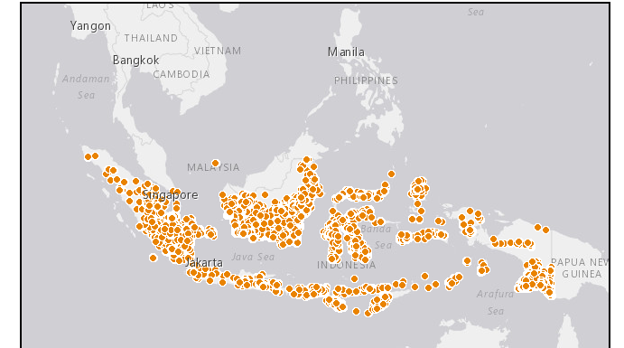
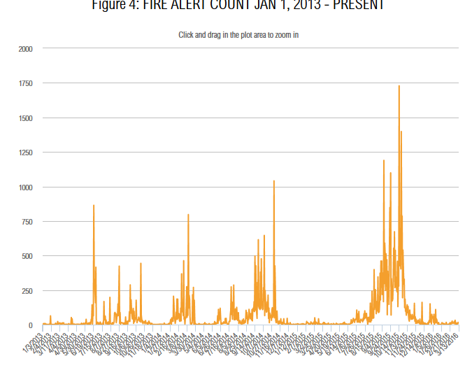
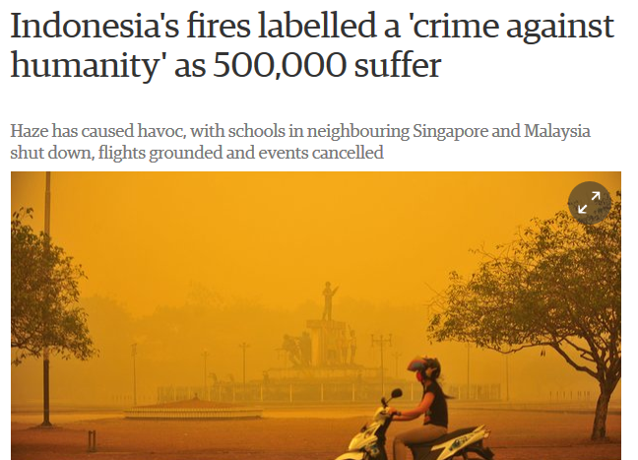
Indonesia, 2015
http://fires.globalforestwatch.org

Slide 11
Uses of BA information
GCOS:
  Estimation of emissions of trace gases and aerosols from vegetation fires.
  Provision of inputs to climate and carbon-cycle models
  Parameterization of climate-driven models for simulating BA.
Other potential benefits:
  Civil-protection: fire risk assessment.
  Ecological impacts: Soil erosion, hydrological cycle

Slide 12
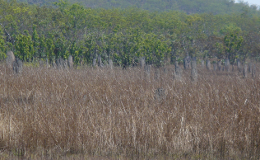
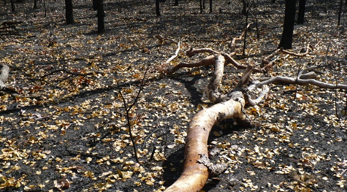
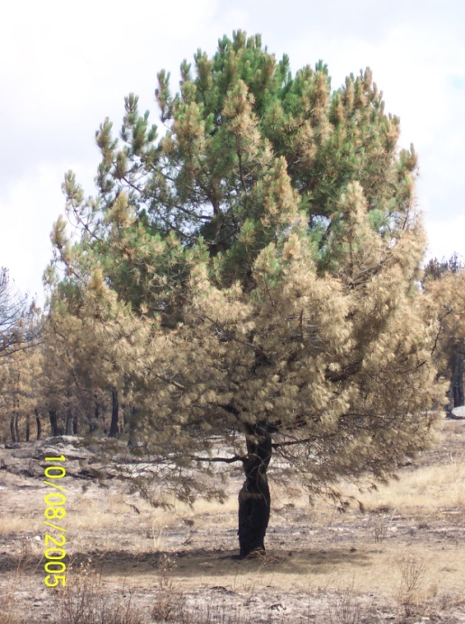
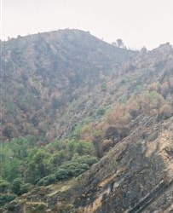
Challenges for global burned area detection
Different BA conditions:
  Different land covers.
  Different proportions burned.
  Different combustion completeness.
Sensor suitability.
Consistency of the time series:
  Different sensors / calibration issues.

Slide 13
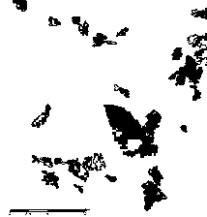
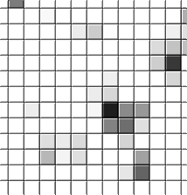
Fire CCI BA products
Pixel product:
  3 variables: date of detection, uncertainty, and burned land cover.
  Monthly files, continental tiles, GeoTiff format.
Grid product:
  22 variables: total burned area, standard error, % observed area, number of patches and burned area of each land cover.
  15-day files at 0.25 x 0.25 degree.
  NetCDF4 format.

Slide 14
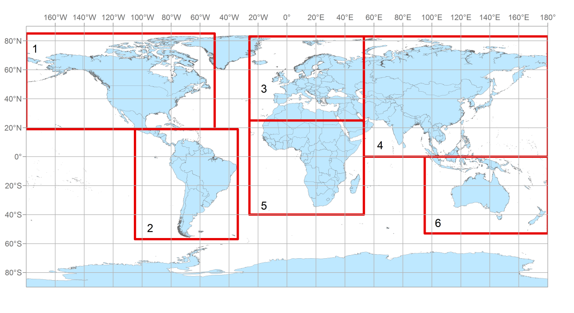
New tile distribution
Geotiff format, multilayer file

Slide 15
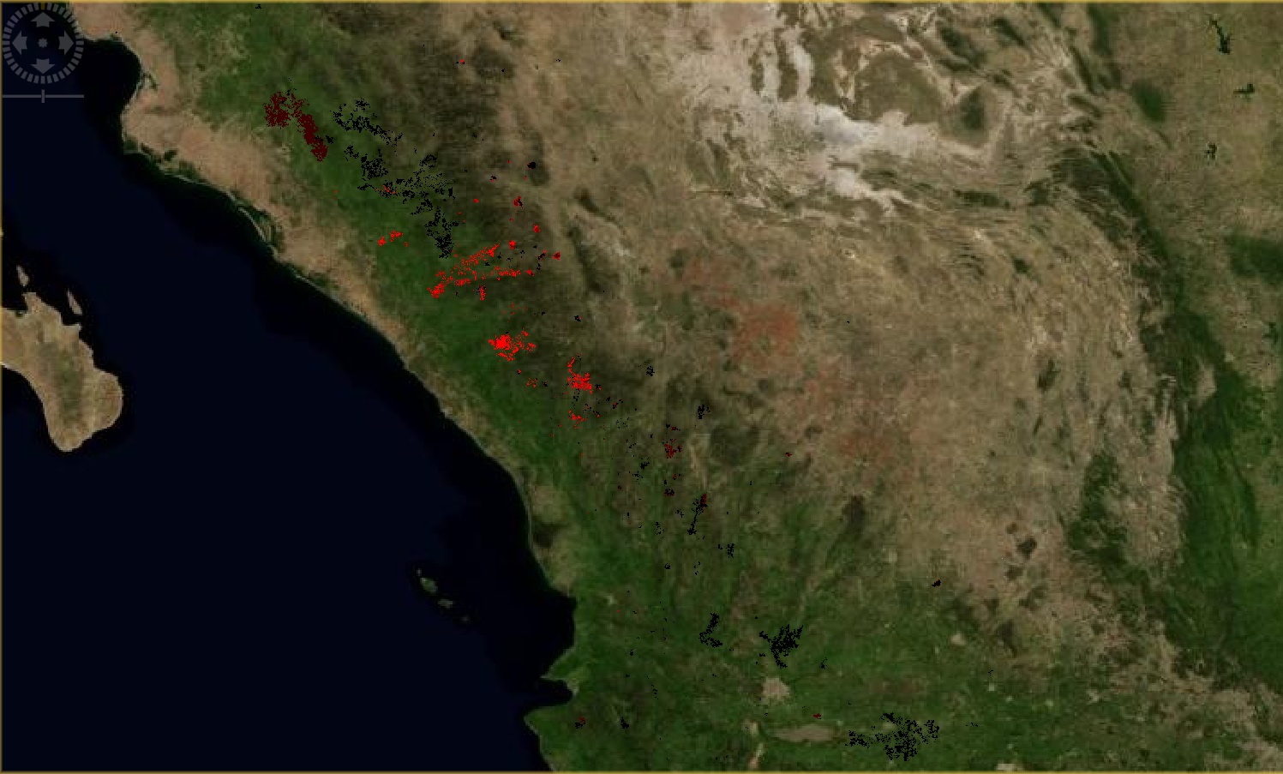
California BA @ 300m, June 2008

Slide 16
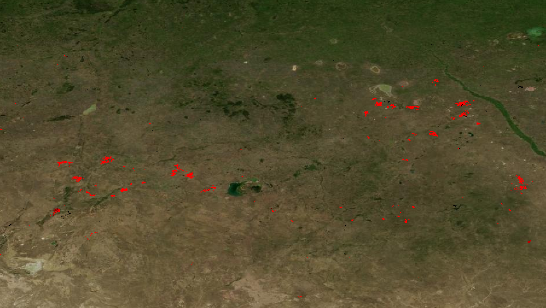
Central Asia BA @ 300m, June 2008

Slide 17
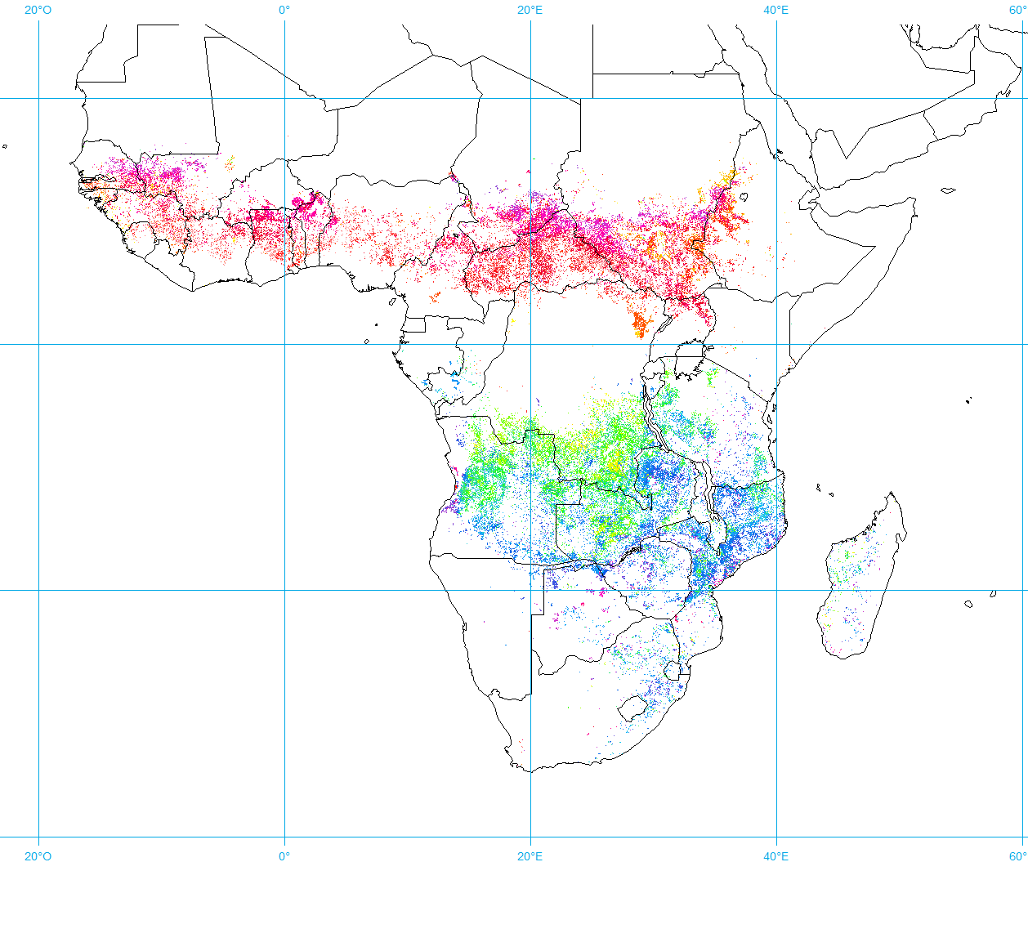
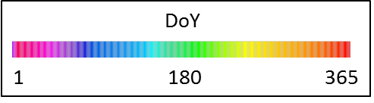
Day of the Year of BA detection
MERIS (2008) v3

Slide 18
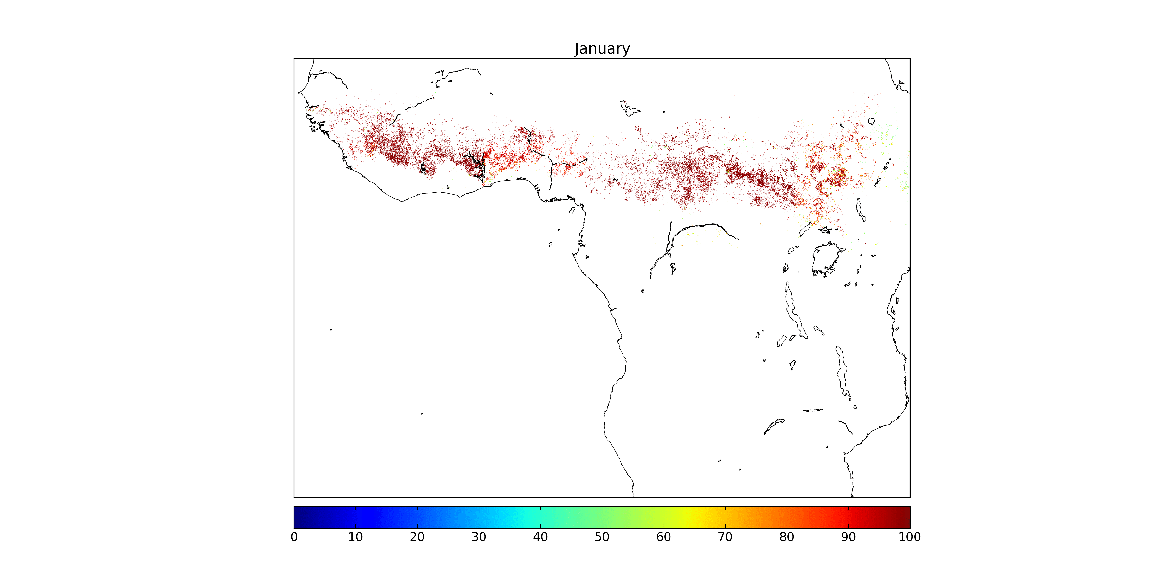
Uncertainty characterization: Monthly confidence level (%)

Slide 19
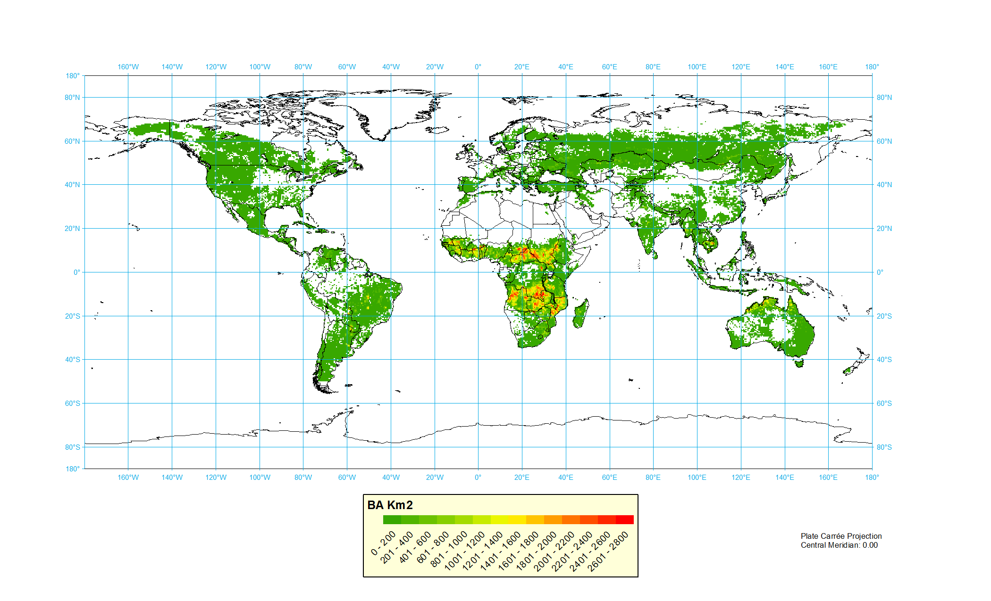
Grid product: total yearly BA
MERIS fire_cci estimation
3.5-3.7 million km2
(Chuvieco et al., 2016, GCB)

Slide 20
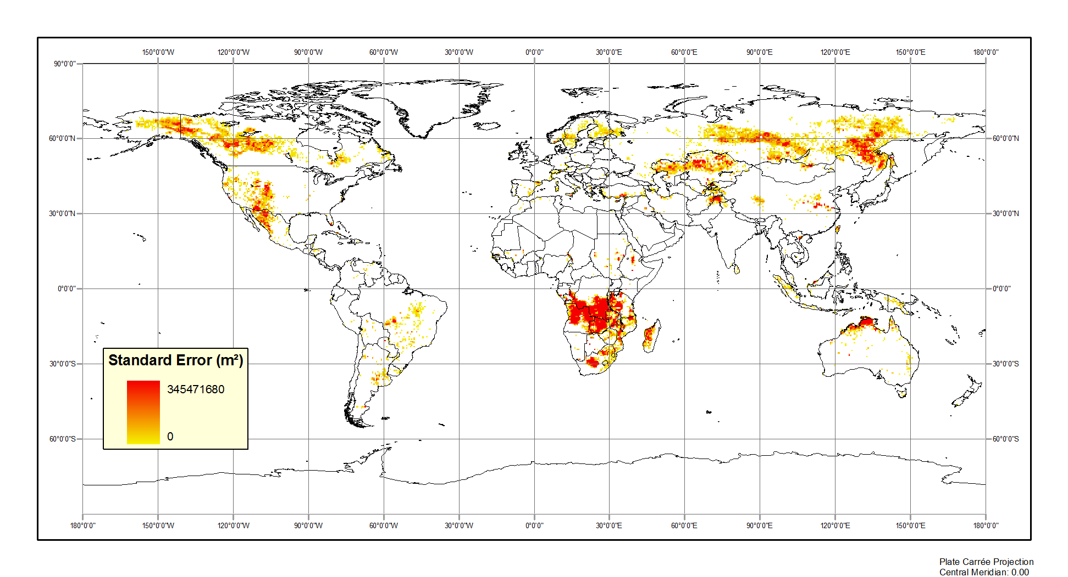
Standard error from
(2008/06/22)
Burned Area

Slide 21
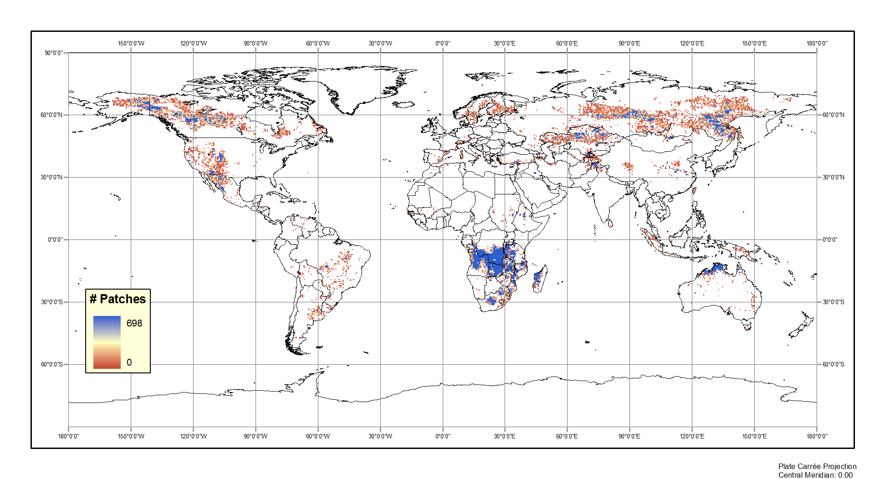
Number of patches from
(2008/06/22)
Burned Area

Slide 22
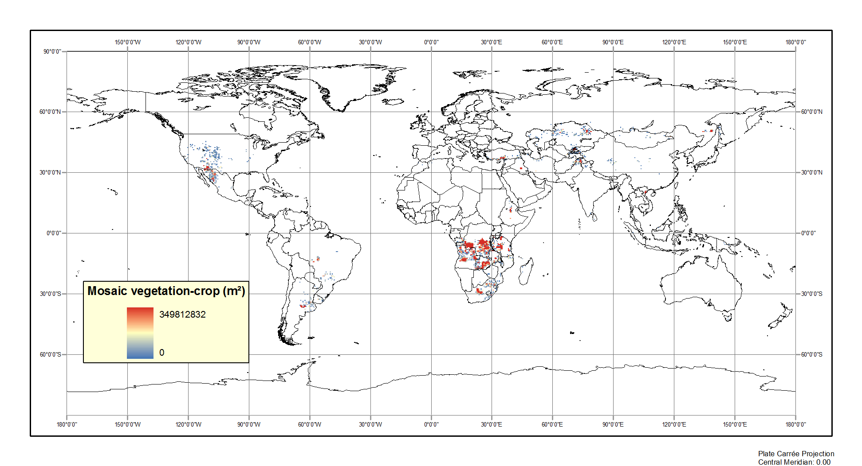
Land cover from
(2008/06/22)
Burned Area

Slide 23
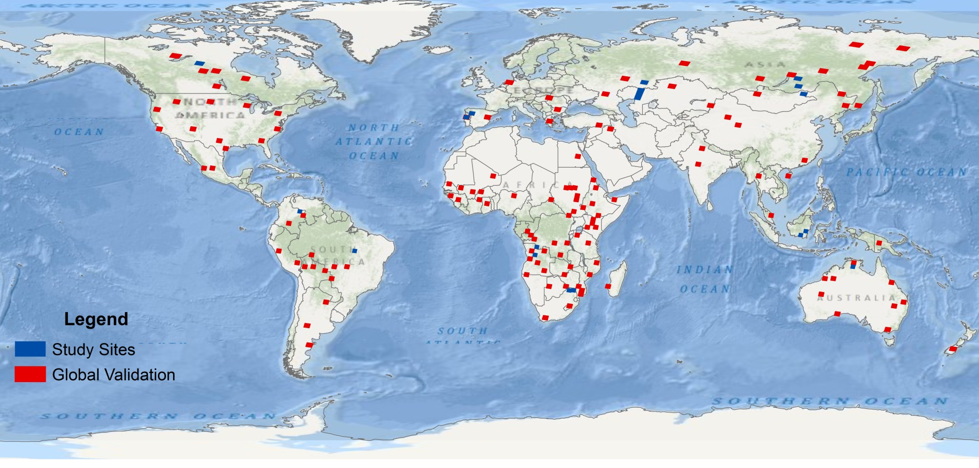
Validation
242 pairs of Landsat TM/ETM+ images.
130 sites for spatial validation from 2008 (red)
112 pairs for temporal validation (blue).

Slide 24
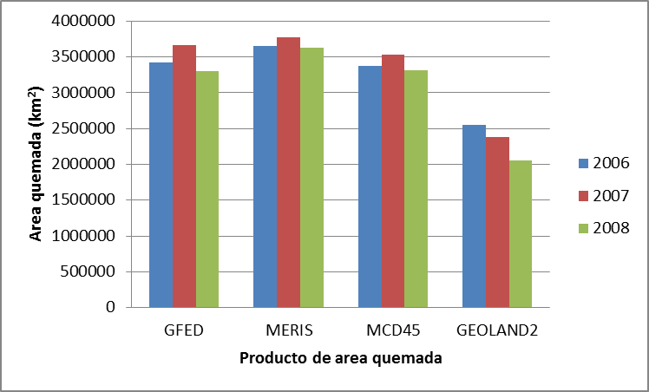
Intercomparison: total burned area
Burned Area Sq km

Slide 25
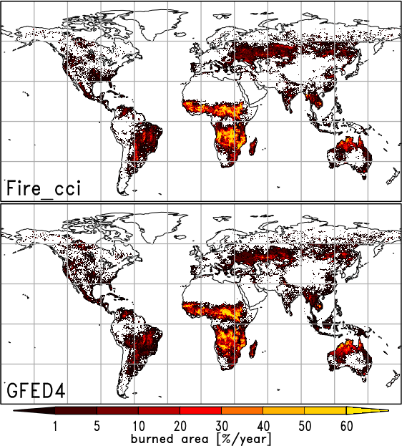
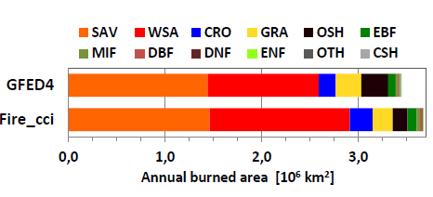
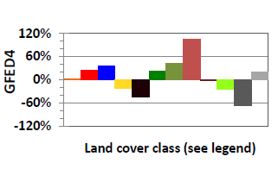
Differences with GFED4
Chuvieco et al., 2016, GEB

Slide 26
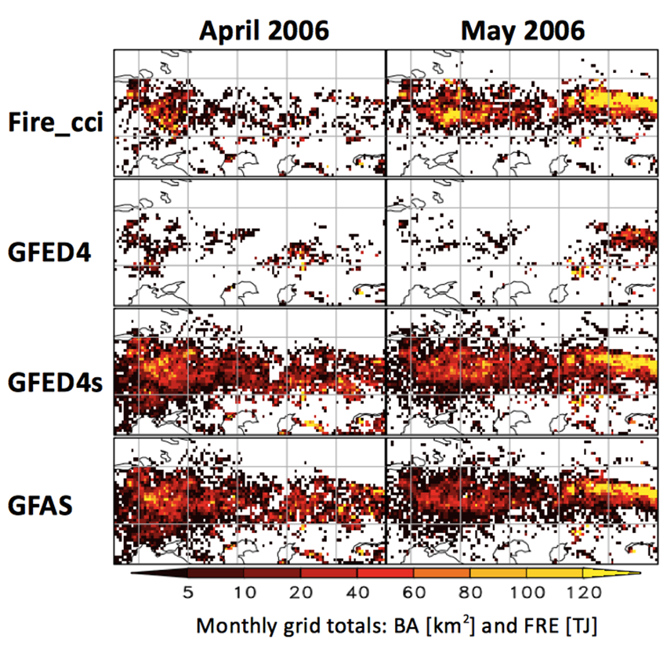
Regional differences
Chuvieco et al., 2016, GEB

Slide 27
Fire patch analysis
Chuvieco et al., 2016, GEB

Slide 28
Gas emissions:
Bottom-up approach
Emission
BA
(Burned Area)
Fuel
Loads
CC
(Combustion Completenes)
EF
(Emission Factor)
ESA fire_cci
fase 1 &2
DVM
ESA fire_cci Fase 2
Lab Measurements

Slide 29
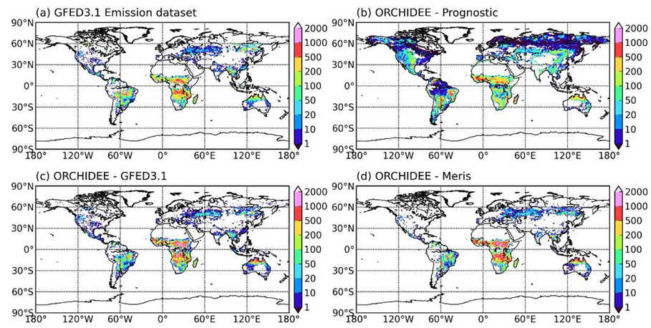
Mean annual CO2 emissions (GgC yr-1)
(a) GFED3.1 emission dataset, emissions from the GFED3.1 data; (b) ORCHIDEE - prognostic, emissions by ORCHIDEE prognostic simulation; (c) ORCHIDEE - GFED3.1, ORCHIDEE simulation with BA being forced by GFED3.1 burned area data; (d) ORCHIDEE - MERIS, ORCHIDEE simulation with BA being forced by ESA MERIS burned area product Chao et al., 2014

Slide 30
Emission comparisons
 | Burned area (Mha yr⁻¹) | CO emissions (TgCO yr⁻¹) | Carbon emissions (PgC yr⁻¹)
GFED4 data set | 346 | 258 | 1.6
ORCHIDEE – GFED4 | 346 | 329 | 2.0
ORCHIDEE – Prognostic | 232 | 346 | 2.0
ORCHIDEE – Fire_cci | 369 | 351 | 2.1
ORCHIDEE – Fire_cci - HIGH | 528 | 470 | 2.9
ORCHIDEE - Fire_cci - LOW | 206 | 219 | 1.3
GFED3.1 data set | 346 | 334 | 1.9
Chuvieco et al., 2016, GEB

Slide 31
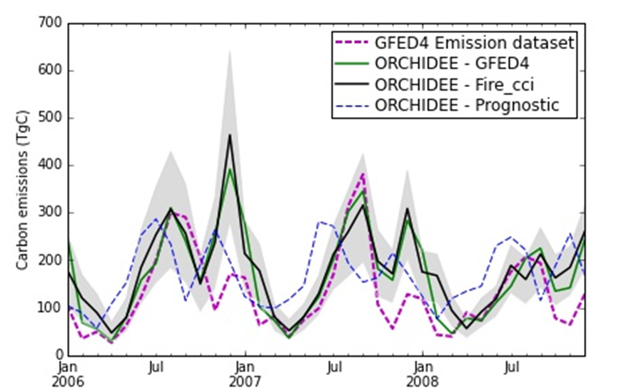
Seasonal trends in carbon emissions
Chuvieco et al., 2016, GEB

Slide 32
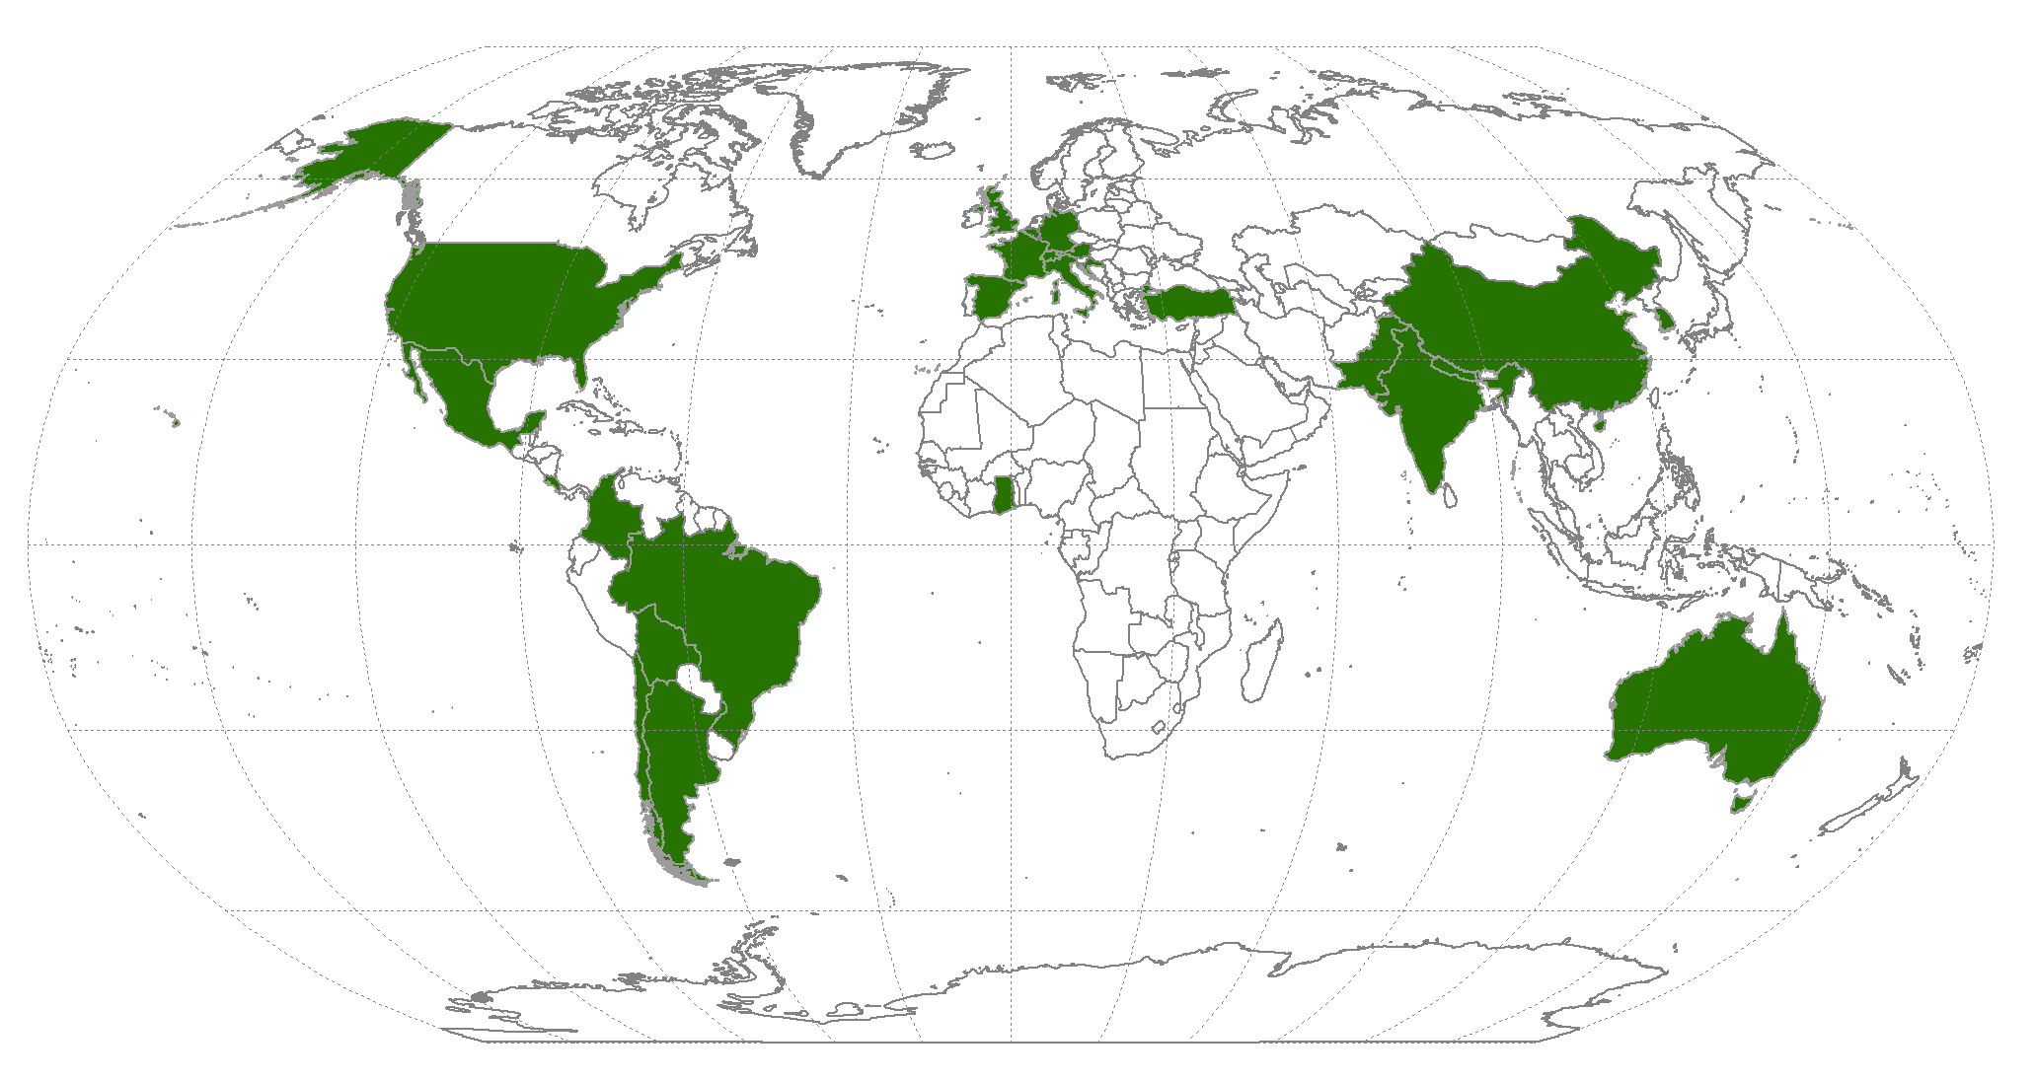
Product Downloads (v3.0)
63 researchers from 26 countries (+ESA, JRC, FAO)
DGVM, fire risk, fire behavior, emissions, terrestrial ecology, fire ecology, fire management

Slide 33
Phase 2 Processing status
Processing the Fire_cci product over the full temporal coverage of MERIS:
  Adaptation and improvements on the MERIS BA algorithm.
  Implementation at BC.
  Global processing (2003-2012).
Next tasks:
  Complete temporal series with MODIS, S-3 (2000-2016). Potential extension to 1980 (AVHRR option): LTDR.
  Small-fire database from Sentinel-2 & Prova-V (Africa).

Slide 34
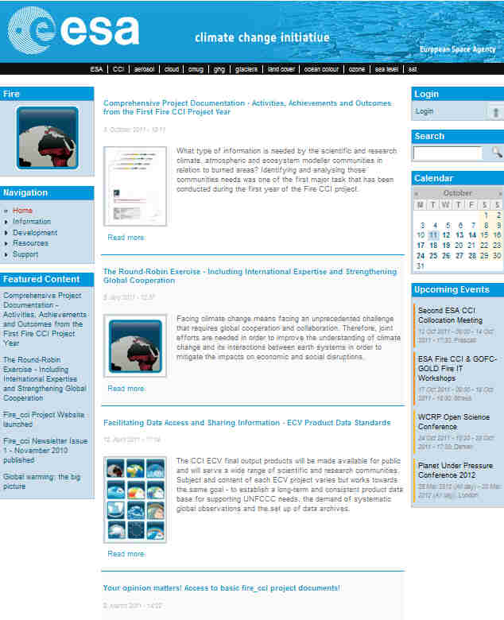
¡Thank you!
emilio.chuvieco@uah.es
http://www.esa-fire-cci.org/

