Slide 1
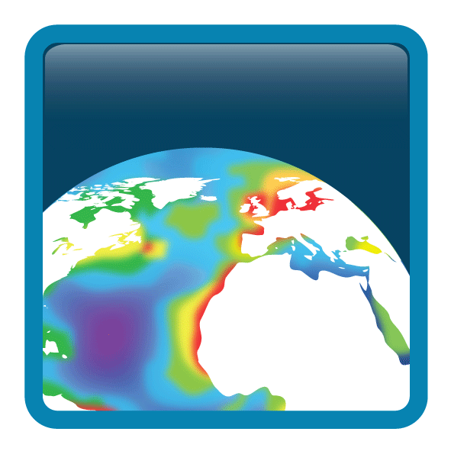
Ocean Colour Climate Change Initiative
CCI Integration Meeting
Munich, 2016

Slide 2
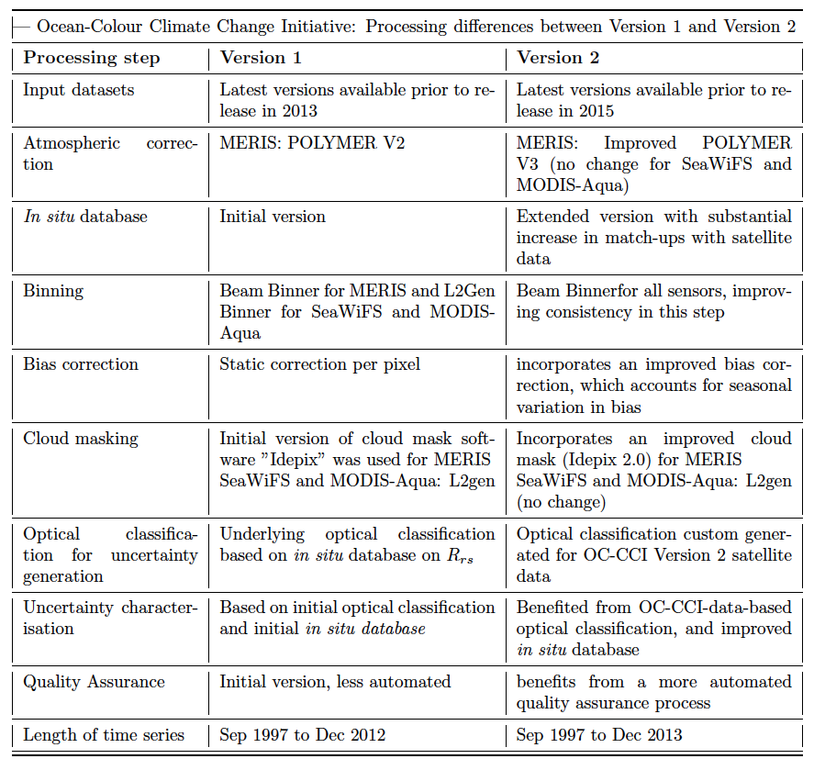

Slide 3
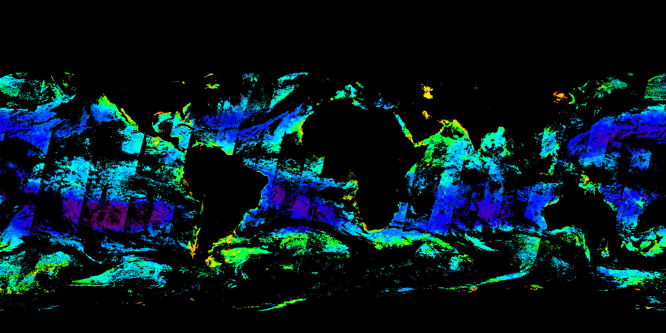
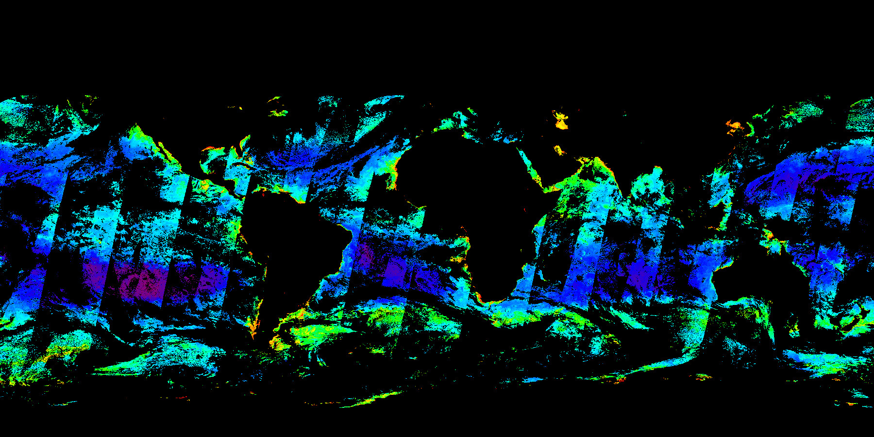

OC-CCI Versions
Version 1 released in Dec 2013
Version 2 released in Apr 2015
Version 3 Release planned for April-May 2016
Anticipated improved
coverage due to:
- Use of SeaWiFS LAC data
- Improved bias correction
- Inclusion of VIIRS data
- MODIS Polymer Processing
Version 1
Version 2
Version 3

Slide 4
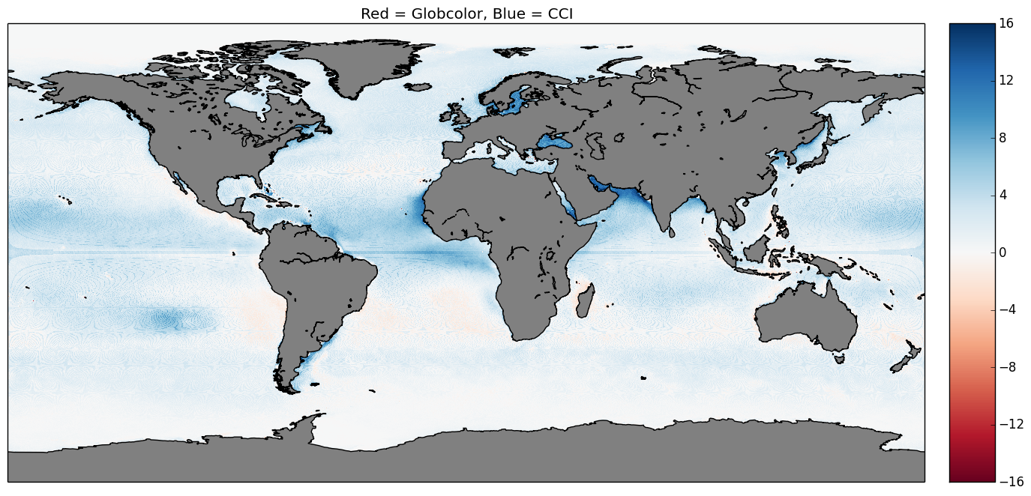
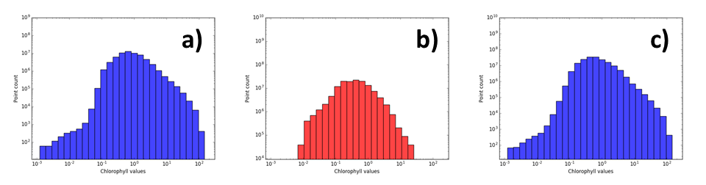
Improved Coverage from OC-CCI data
 | Peak
Only OC-CCI | 0.522
All OC-CCI | 0.339

Slide 5
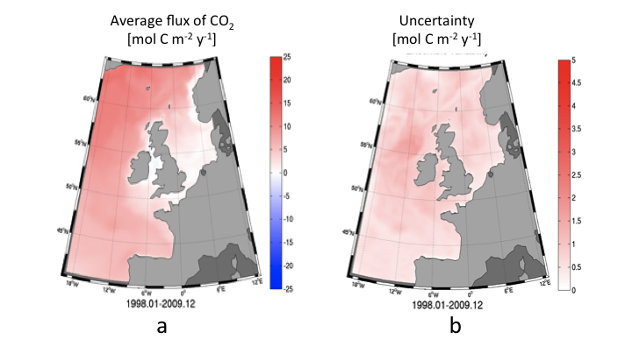
Data Assimilation
Ciavatta et al. (2016) Journal of Geophysical Research. Editor’s Choice

Slide 6
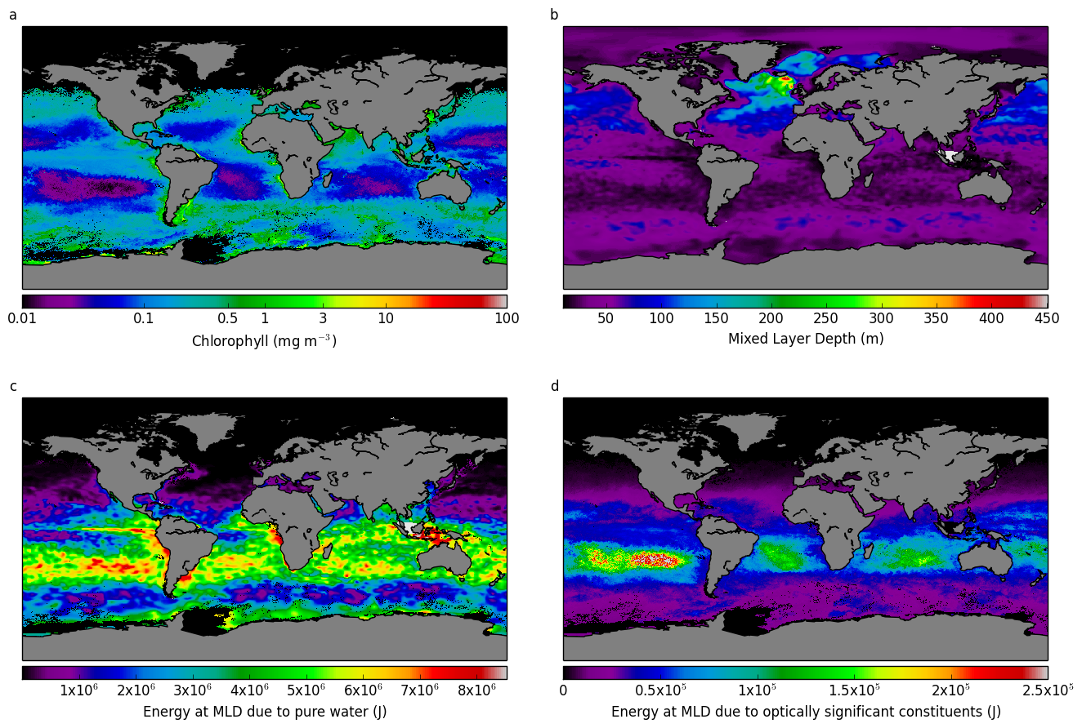
Solar Heating below the mixed layer
OC-CCI contribution to ESA Ocean Heat Flux Project

Slide 7
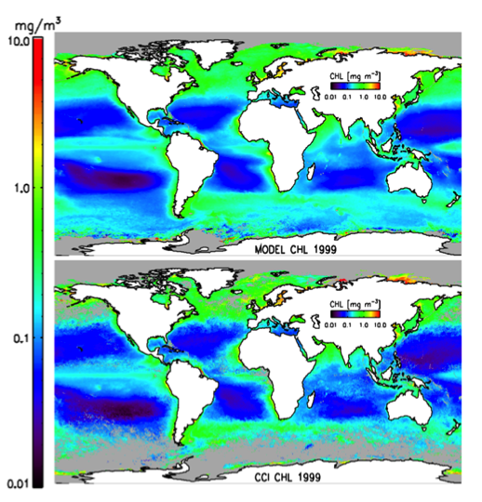
Hindcasting chlorophyll distribution using
SST, SSH and PAR
ESA Fellowship to Bob Brewin

Slide 8
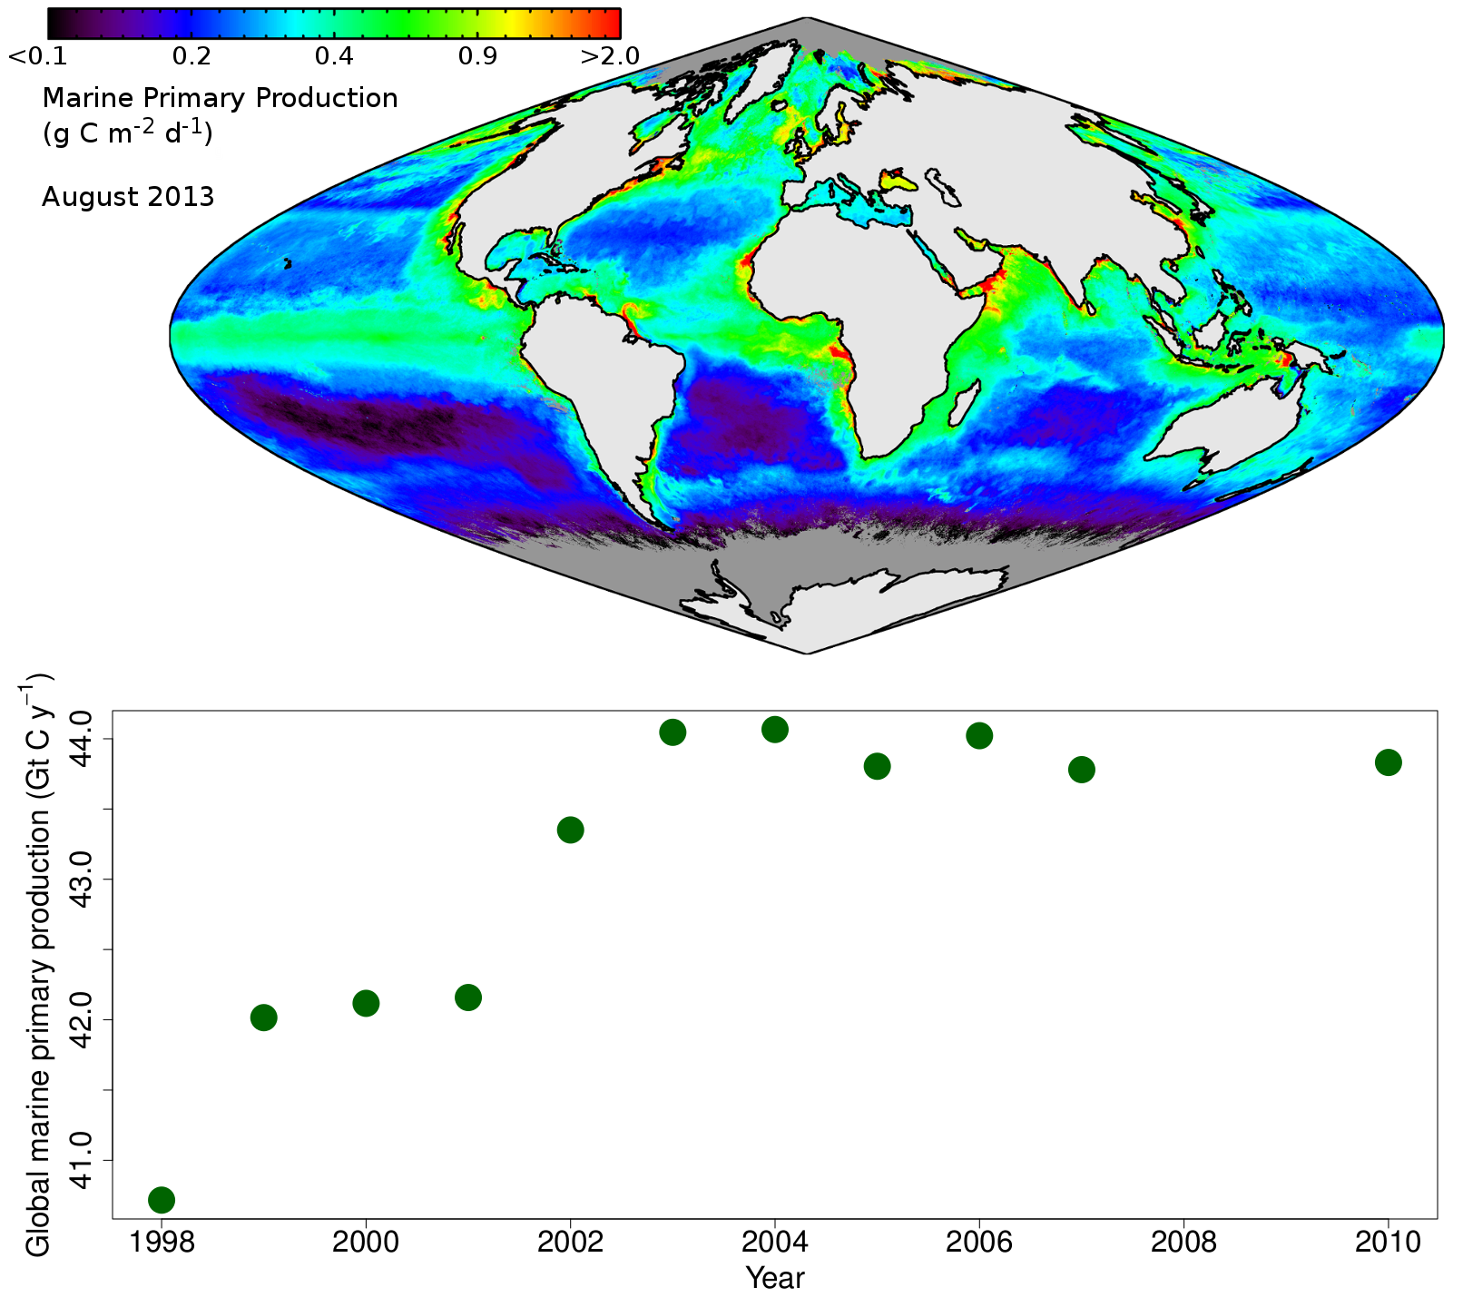
Remote sensing of primary production at global scales
Phytoplankton responsible for fixing some 50 GT carbon per year, globally, through photosynthesis
Net production comparable to terrestrial production
Inter-annual variability can be high, especially at regional levels

Slide 9
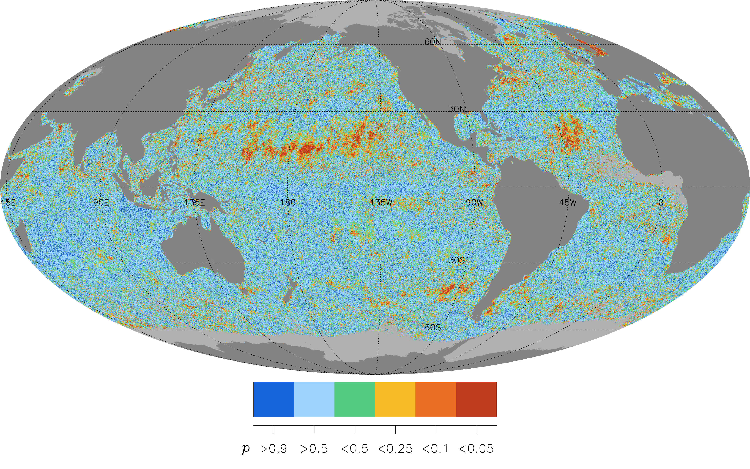
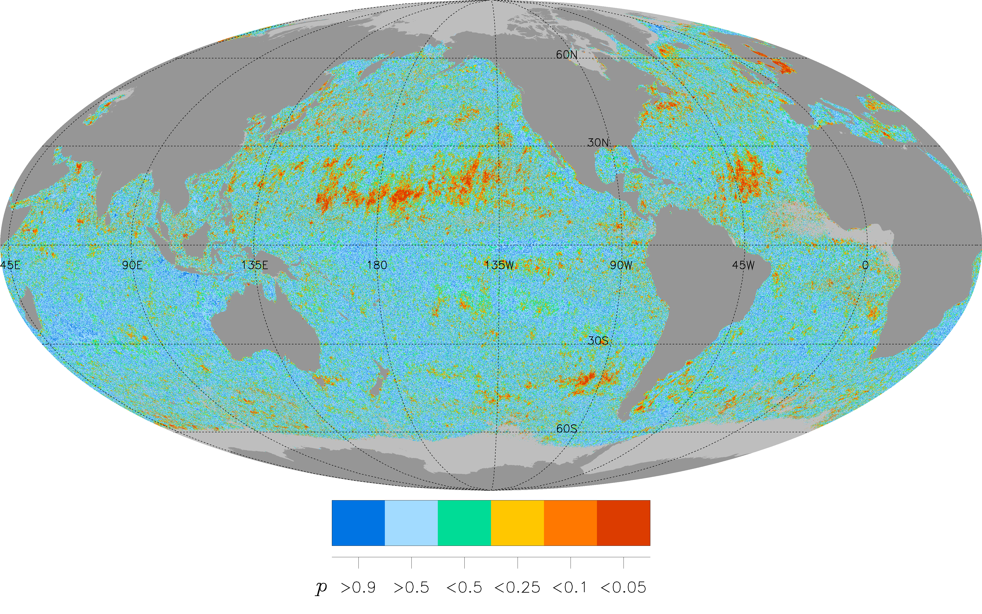
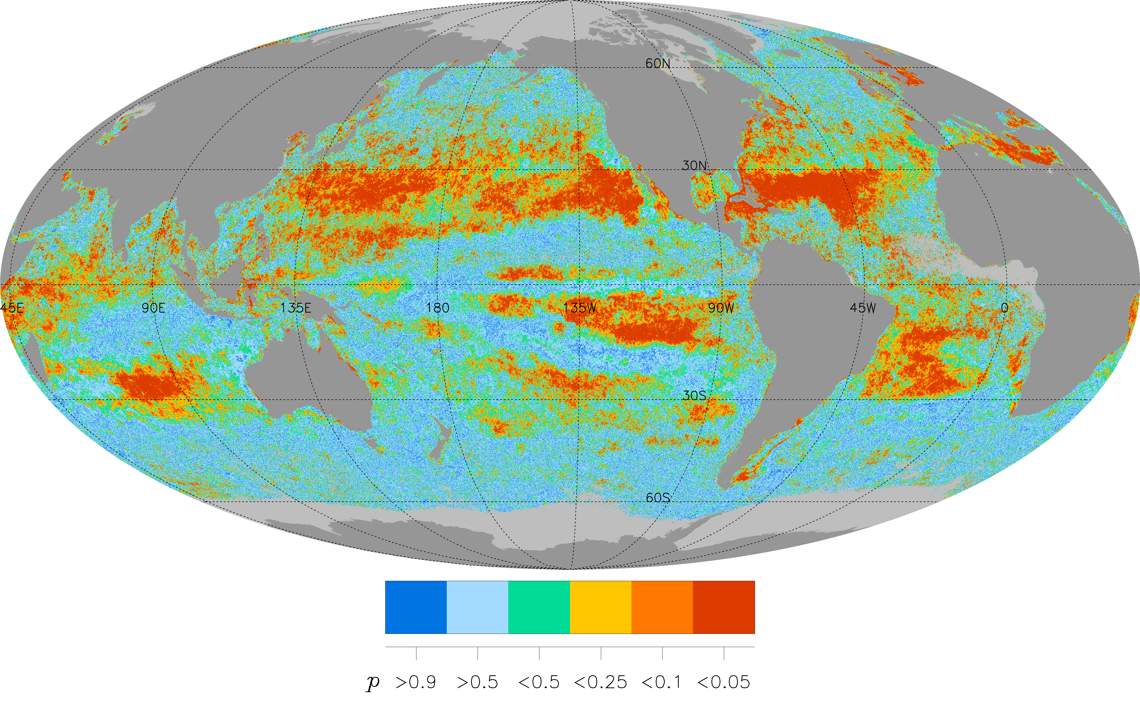
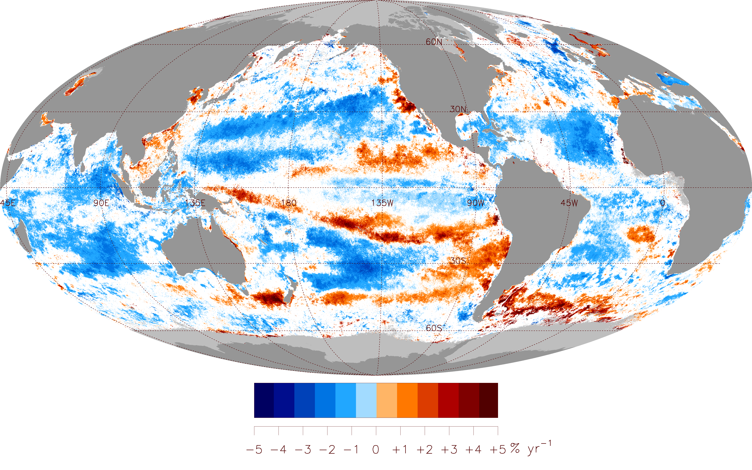
Comparison MODIS & MERIS trends
Aug 2002 – July 2011
Comparison MODIS & OC-CCI trends
Aug 2002 – July 2011
Comparison MODIS & GlobColour-GSM trends Aug 2002 – July 2011
OC-CCI trends
Oct 1997 – Sep 2013
Frédéric Mélin, JRC

Slide 10
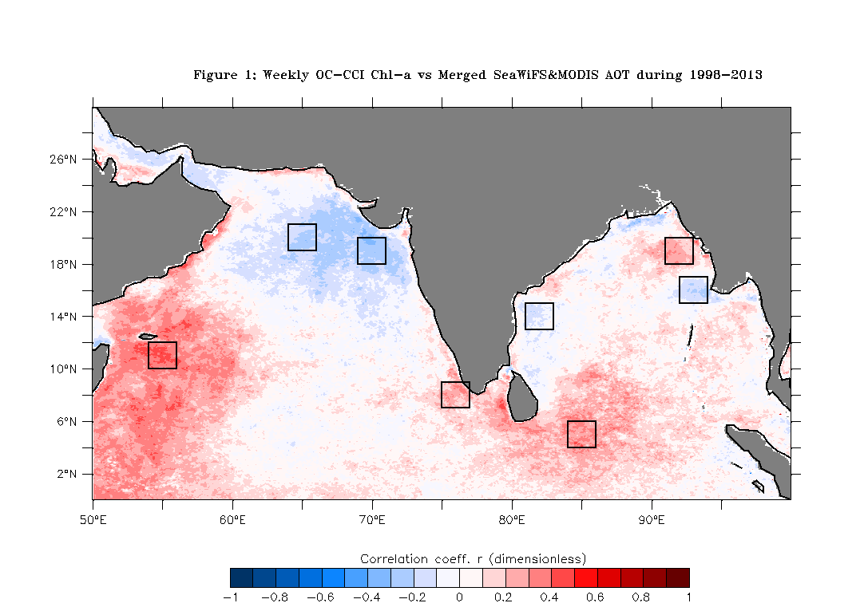
Correlation between Chlorophyll-a concentration and Aerosol Optical Thickness (AOT) at 865 nm in the Northern Arabian Sea
Time Step: 8 days
Period: 1998 – 2013 (16 years)
Chl: OC-CCI (merged SeaWiFS, MERIS and MODIS-A)
AOT: Merged SeaWiFS and MODIS
NC Arabian Sea
NE Bay of Bengal
2
3
Gujarat Coast
Off Myanmar
Off Chennai
1
Off Somalia
4
SW Coast of India
East of Sri Lanka
Correlation Coefficient

Slide 11
Cross Correlation with lag between chlorophyll-a concentration and Aerosol Optical Thickness (AOT) at 865 nm
Time Step: 8 days Chl: OC-CCI (merged SeaWiFS, MERIS and MODIS-A)
Period: 1998 – 2013 (16 years) AOT: Merged SeaWiFS and MODIS
Off Somalia
SW Coast of India
Chl lags AOT by 1-2 weeks
Chl lags AOT by 1 week
Cross Correlation Function
Cross Correlation Function
Lag (in 8-day weeks)
Lag (in 8-day weeks)
East of Sri Lanka
NE Bay of Bengal
Zero lag between Chl and AOT
Chl leads AOT by 4 weeks

Slide 12
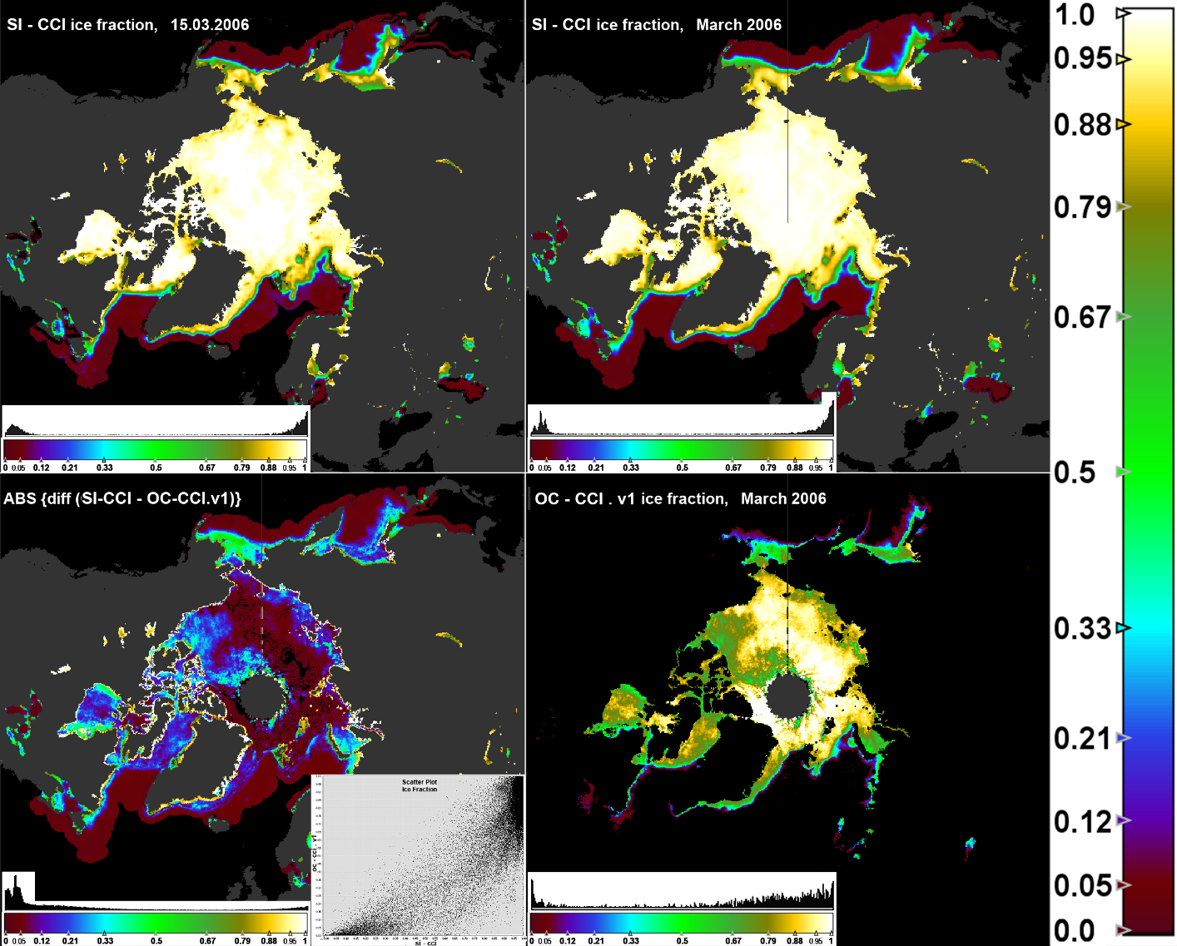
Sea Ice Workpackage
Objectives:
  To improve the consistency of the sea ice mask across Ocean Colour, SST and Sea Ice CCI projects,
  To improve the quality of the OC ECVs (water leaving radiance and Chl) in the specific area of the marginal ice zone
Comparison March 2006

