Slide 1
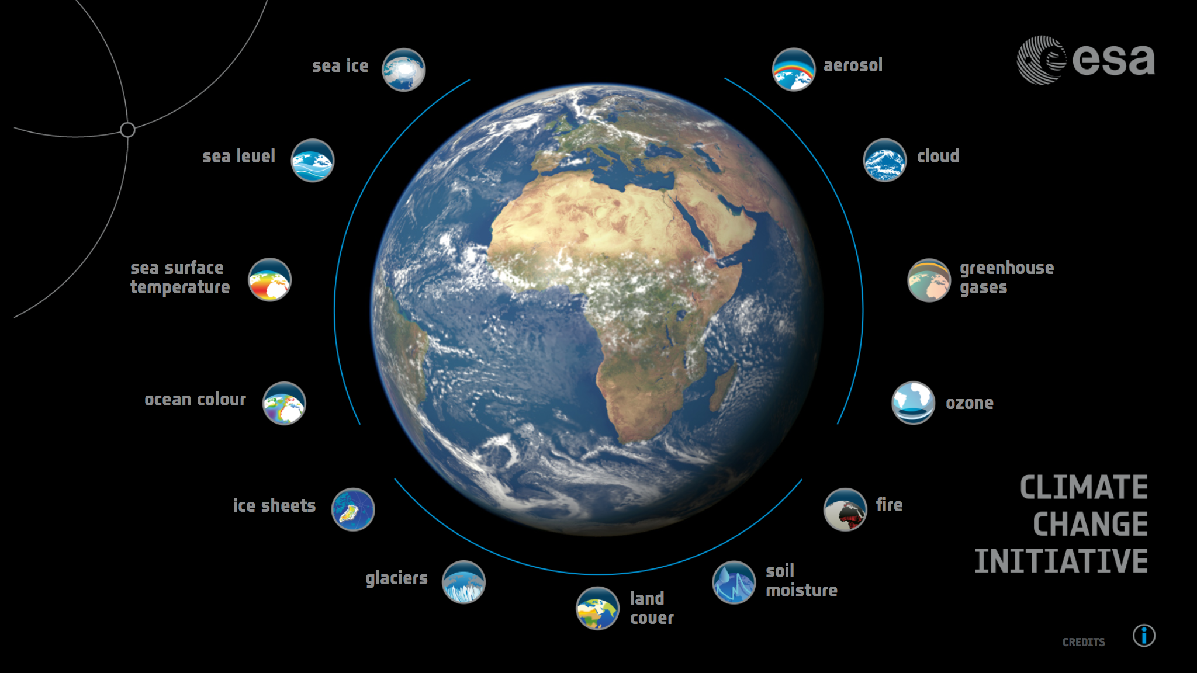
CCI-CMUG 6th Integration Meeting

Slide 2
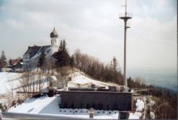
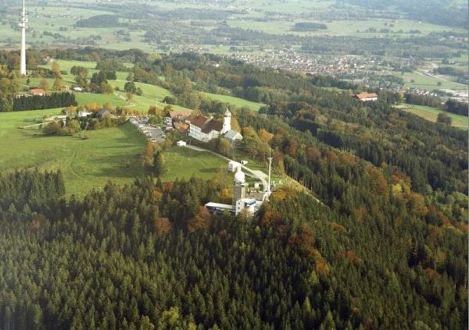
CCI-CMUG 6th Integration Meeting
Hohenpeißenberg has maintained a continuous meteorological record since 1781, when it was a station of the Societas Meteorologica Palatina. Today the mountain hosts a meteorological observatory of the Deutscher Wetterdienst and is a basis station of the Global Atmospheric Watch

Slide 3
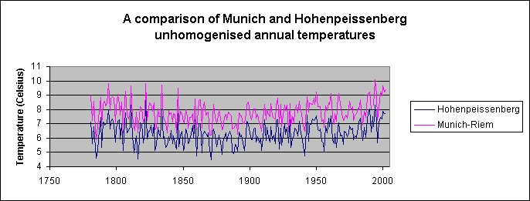
CCI-CMUG 6th Integration Meeting
Hohenpeißenberg has maintained a continuous meteorological record since 1781, when it was a station of the Societas Meteorologica Palatina. Today the mountain hosts a meteorological observatory of the Deutscher Wetterdienst and is a basis station of the Global Atmospheric Watch

