Slide 1
Results from the SST CCI User Workshop on Uncertainty
John Kennedy and Nick Rayner
(Chris Merchant, Gary Corlett, Jon Mittaz, Claire Bulgin, Chris Atkinson, Simon Good)

Slide 2
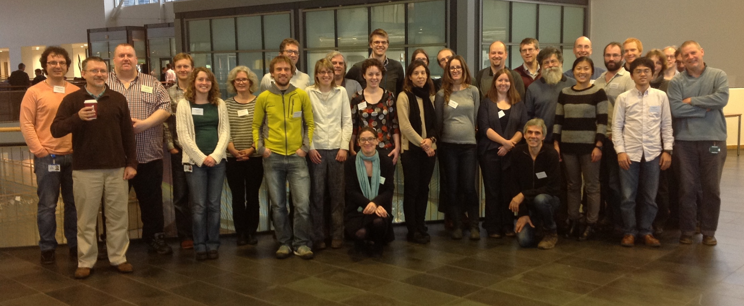
Thanks to all the participants

Slide 3
Aims of the workshop
Exchange information about uncertainties in SST observations
Create new expert SST users who, through publication of their work, can inspire others to take uncertainty information into account
Source requirements from SST users on uncertainty information and other aspects of the Climate Data Records
Spread best practice through a follow-on meeting report or journal article.

Slide 4
A two-way discussion between SST data providers and users…
…to create a common understanding of:
  where this uncertainty comes from;
  how to talk about it;
  how well the uncertainty information that is provided addresses users´ needs; and
  how to practically use such uncertainty information.
It achieved this through a mixture of oral and poster presentations, activities and group discussions.

Slide 5
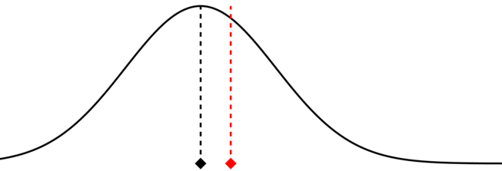
Consistent Terminology is important
Error: Result of measurement imperfections, random and systematic effects
Uncertainty: Doubt you have in the measurement
Correction: There will always be an unknown residual error which adds to the uncertainty
Traceability
Measured Value
True Value

Slide 6
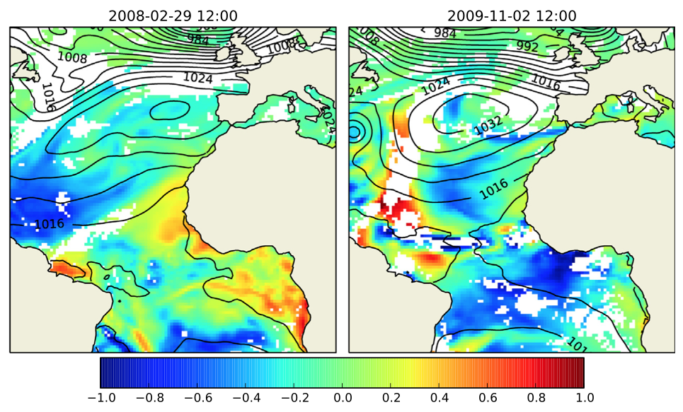
Sources of error
Calibrations
Geolocation
Software issues
Data corruption
Instrument noise
Instrument degradation
Synoptic-scale retrieval error
Imperfect cloud detection
Simulation of intrinsic SST retrieval error on two different days. Although errors arise because of atmospheric variability, there is no simple relationship or correction.
Merchant, C. J. and Embury, O. (2014) Simulation and inversion of satellite thermal measurements. In: Zibordi, G., Donlon, C. J. and Parr, A. C. (eds.) Optical radiometry for ocean climate measurements. Experimental methods in the physical sciences, 47 (47). Academic Press, pp. 489-526. ISBN 9780124170117 doi: 10.1016/B978-0-12-417011-7.00015-5
Notes:
But there are also uncertainties arising from locally systematic effects such as weather-related impacts on the retrieval. These can be modelled, as in the figure here which depicts the different size of such uncertainty on different days. For example, the total column water vapour in each location will vary from place to place. This has an impact on the quality of the SST retrieval. Because we don’t have perfect knowledge of this quantity on any particular day from numerical weather prediction or dynamical reanalyses, this introduces a locally systematic uncertainty into the retrieval.
Our challenge is to come up with an approach to estimate these uncertainties which works for surface temperature retrievals over all surfaces: land, ocean, ice and lakes.

Slide 7
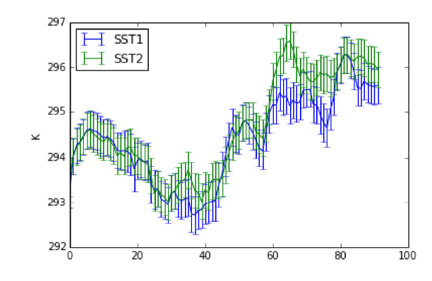
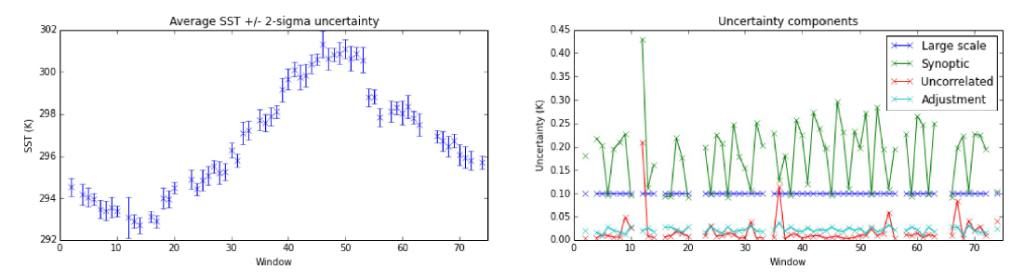
Practicals
A series of short practical sessions – practical and full, worked solutions are available with the full workshop report
Working with prepared subsets of the SST CCI data
Allowed users to get to grips with the data
Allowed the organisers to see users getting to grips with the data

Slide 8
Uses of uncertainty information
Reanalyses using ensembles of SST as boundary conditions
Detection and attribution
High-resolution SST ensembles to investigate air-sea interactions in the Bay of Biscay
SST assimilated into ocean analyses for seasonal forecasting
Used to characterise uncertainty and error in in situ measurements
Assessment of climate model simulations
To produce ensembles of gridded global surface temperature data sets
Sensitivity of ensemble weather forecasts to different SST analyses
Creation of gap-filled SST analyses
Reanalyses of regional and global oceans assimilating SST and uncertainty

Slide 9
What would you like to do now ignoring technical challenges?
Example: Assessment of climate model simulations, Alistair Sellar
  Compare different versions of model to observations
  Currently, observational uncertainty assessed using two different data sets
  Would like to make use of well validated uncertainty estimates and full error covariances

Slide 10
Future landscape
Resolution and timeliness
  Real time processing
  Information about the daily cycle
  Smaller grids e.g. 1km
Diverse and better characterised observing system
  Better metadata and more specific information about buoys
  A wider variety of instruments: Argo, wave gliders, etc.
  Citizen measurements
More computing power
  Better treatment of uncertainty and deal with uncertainty analytically
  Easier to send and process lots of data
Coupled reanalyses with observational error correlation in data assimilation
NWP: ensemble systems, diurnal SST variability, coupled ocean/atmosphere

Slide 11
Summary of Discussions

Slide 12
Provision of Ensembles
Ensemble size 10-1000
  A single central member, preferred by the data producer
  A randomly-ordered set of ensemble members so that users can pick at random
Start ensemble generation from Level 1 (radiances) in order to include the structural uncertainties
Clearly stated underlying assumptions
Ensemble produced on 0.05 degrees and coarser
An operationally available ensemble or
An operationally available best estimate with the ensemble later
Updates must truly belong to the same ensemble member
Clear, non-confusing terminology e.g. are members “equally likely”?

Slide 13
Provision of Covariance Information
Ensembles not always the best way to present uncertainty information
Explicitly forming covariance matrix can be prohibitive
Parameterize covariance instead
Provide guidance and clear examples
What shape are the error distributions?
  “are they close enough to Gaussian?”
  “is the distribution symmetric?”
  For analysing extremes, the shape of the tails can be important.
Parameterize the distribution shapes too
Provide examples of the shapes of the distributions
Guidance on the strengths, limitations and characteristics of the methods is needed as well as how to interpret “features” and their relationship to estimated uncertainties.

Slide 14
Provision of web-based tools
Common tasks e.g. sub-setting, aggregating, applying flags
Some of these reduce the data volume so it makes sense to do this before the data are served to the user.
A web interface connected to a large data store with sufficient computing power (such systems exist or are planned)
Timeliness. Some tasks will take longer than a typical web session
  What is acceptable? A day, yes. A month, no.
  System should work faster than the user could.
  A priority system would support users who need data in a timely manner e.g. for a scheduled research cruise.
  Provide email alerts so that users know their data are ready
Formats.
Cache frequent or common requests
System would also output example code for reading data

Slide 15
Provision of web-based tools continued
Bring users’ code to the data, rather than data to the users.
Functionality to generate match-ups between satellite and in situ data
To extract/interpolate along a ship track
Upload a specific area over which data could be aggregated
Extend usefulness of tools by designing them to run on users’ systems
Build modular tools so that users can incorporate them into their own systems.

Slide 16
Other requirements
Timeliness
Propagation of uncertainty can be complex – tools would help
Provide more information
  Flags – quality flags are a popular way of handling uncertainty
  Documentation – to help users interpret and understand what uncertainties are telling them
Climate users need long (>30 year) records, ensembles are a good way to handle very different characteristics of satellite and in situ data consistently
Need for more reference data to produce validated uncertainties
CF conventions need to be updated to describe rich spectrum of uncertainty information

Slide 17
What happens next?
A set of draft user requirements has been created
These will be analysed and incorporated, as appropriate, into the next revision of the SST CCI User Requirements Document due late 2015
The full report is on the SST CCI web site
http://www.esa-sst-cci.org/PUG/workshop.htm
A summary of the meeting report will be published shortly in EOS

