Slide 1











CCI CMUG 5th Integration Meeting
SMHI, May2015
Land Cover CCI Phase 1 Phase 2
Results & Plans
Hartley A., Defourny P., Brockmann C., Achard F., Boettcher M., Bontemps S., Gamba P., Hagemann S., Kirches G., Lamarche C., Lisini G., MacBean N. , Pathe C., Peylin P., Poulter B., Radoux J., Riedel T., Santoro M., Schmullius C., Van Bogaert E., Wegmüller U., Zuehlke M., Ramoino F., Arino O.

Slide 2
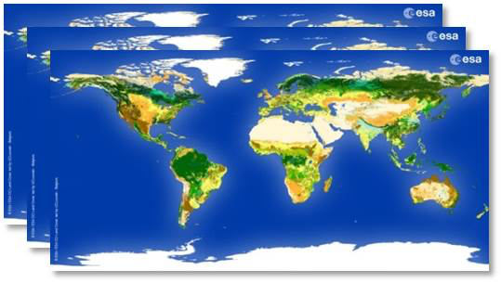
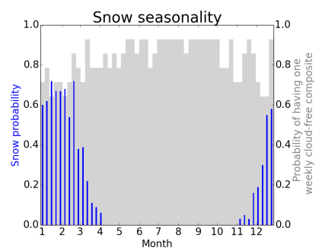
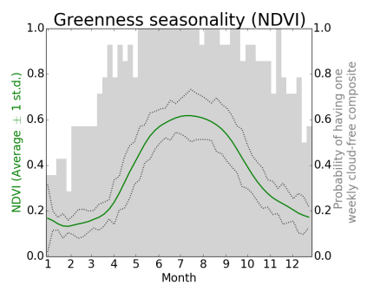
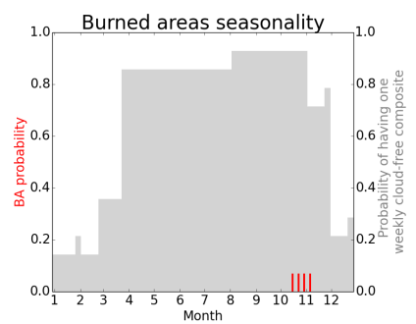
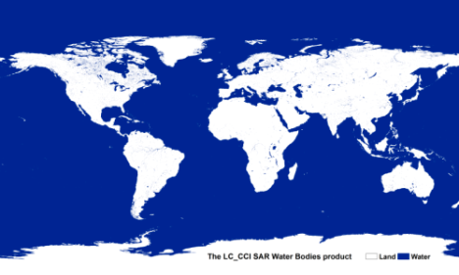
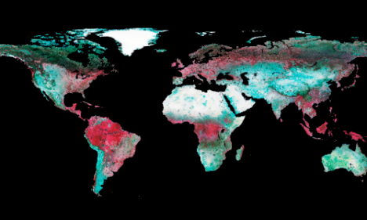
Datasets currently available
Land cover state for 3 ‘epochs’:
  2000: (1998-2002)
  2005: (2003-2007)
  2010: (2008-2012)
Land surface Condition:
  NDVI
  Burnt area
  Snow cover
Water bodies mask
MERIS Surface Reflectance
User tool

Slide 3
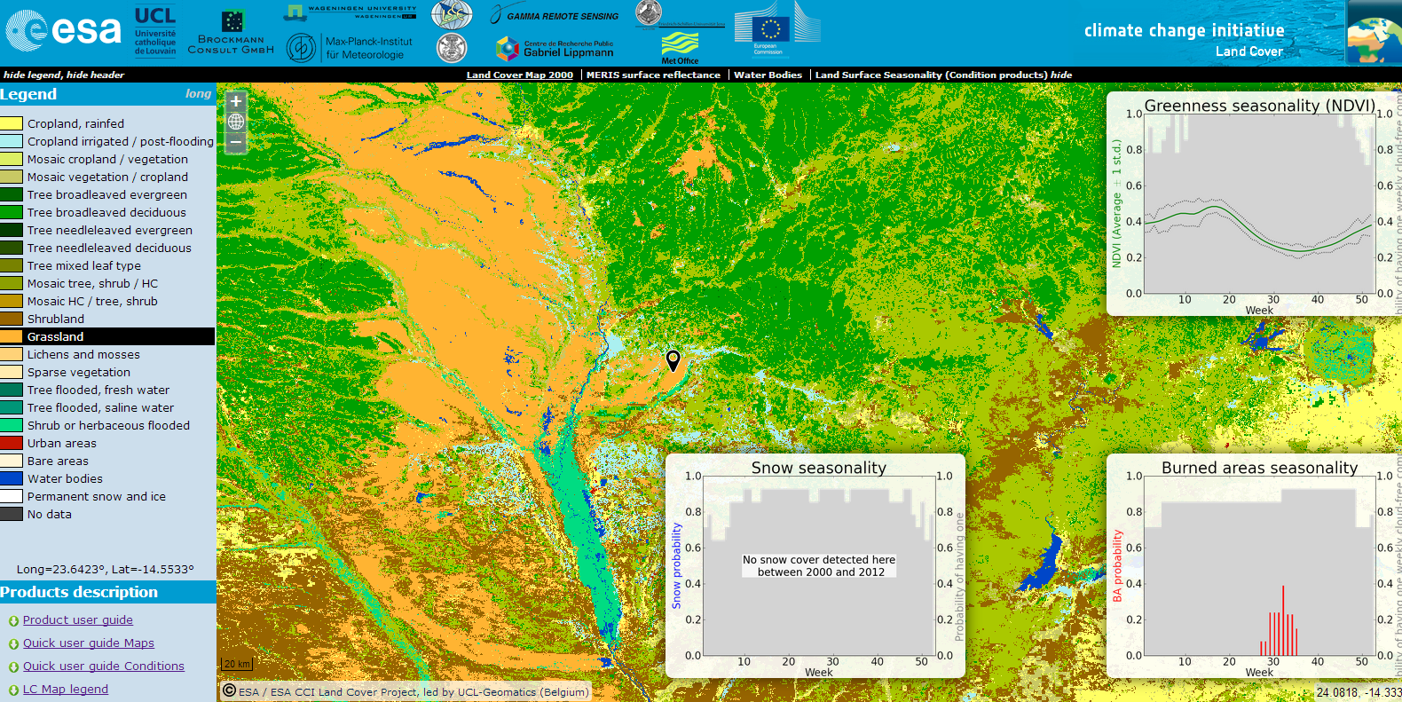
CCI LC maps accessible on-line
with 3 land surface seasonality TS + user tool
http://maps.elie.ucl.ac.be/CCI/viewer/index.html

Slide 4
On-going activities and forthcoming outputs
Upgraded version of a new CCI LC 2000/2005/2010/2015 products
  improved MERIS FR & RR pre-processing chain (better MERIS QA, cloud mask)
  upgraded classification processing chain (transition areas, error characterization)
  extension to PROBA-V time series for 2015 epoch
CCI LC 1990 product
  algorithm development and preprocessing of the 1992-1999 AVHRR 1km archive
  classification development for 1990 epoch land cover
Water bodies mapping
  ESA Workshop Mapping WB from Space (March 2015)
  Sentinel-1 exploitation test going on for water surface dynamics
Uncertainty impact assessment on model outputs (albedo, LST)
  coordinated runs across models by the 3 climate groups
Additional feasibility studies (incl. 1980’s AVHRR, ET, SAR urban detection)
User tool v 3.7
Submission of the new products version to Obs4Mips

Slide 5
Phase 1 Results Revisited
ESA - REF

Slide 6
Phase 1 Results Revisited
(a)
(b)
(c)

Slide 7
Phase 2 Workplan
Climate User Group: Uncertainty assessment
  Cross-walking uncertainty
  Land cover class uncertainty
Individual WPs:
  Model evaluation using land surface condition (LSCE)
  Testing LC_CCI in NWP models (MOHC)
  Testing new wetlands scheme (MPI)
Plans (yr2 & 3):
  Transient land use change experiment
  Further region-specific case studies

Slide 8
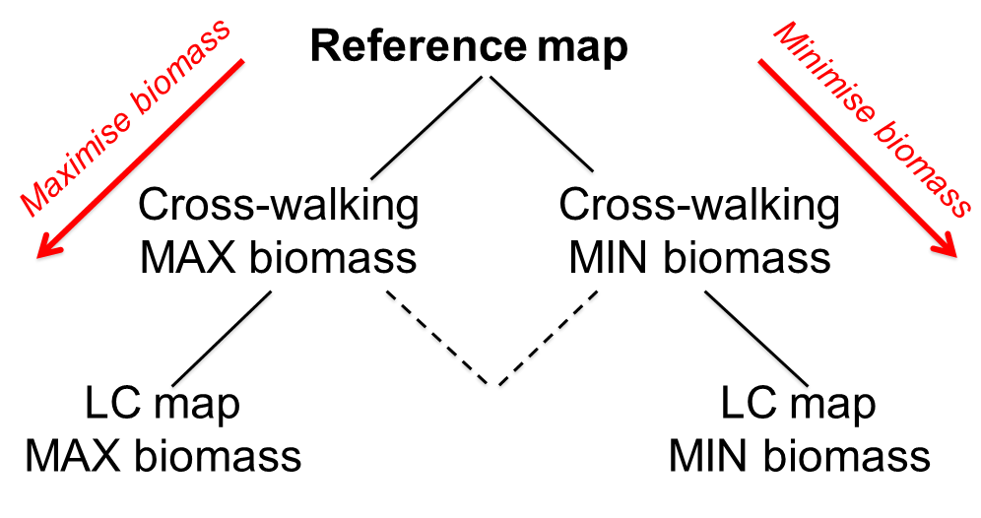
LC and PFT conversion uncertainty impacts on model input and output
4 different perturbations of PFT fractions generated using 2 levels :
- Land cover uncertainty with alternative classes selected only when
  (i) biomass is minimised , (ii) biomass is maximised
- Cross walking table uncertainty with fractions adjusted to
  (i) minimise biomass, (ii) maximise biomass

Slide 9
Sources of Uncertainty
Land cover classification
  Aim: to assess impacts of extreme cases of uncertainty in the land cover classification on land surface models (LSMs)
  Can we use alternative land cover class to determine:
    Max possible forest extent
    Max possible bare soil extent
    Other classes?
  Result: Better understanding of where to focus efforts for improving LC classification

Slide 10
Sources of Uncertainty
Cross-walking table
  Aim: to assess impacts of extreme cases of uncertainty in the land cover cross-walking table
  Based on LCCS ranges (e.g. NL deciduous closed >40% cover -> 70% NLDe)
  To include:
    Max possible forest fraction
    Min possible forest fraction
  Result: Spatially varying, evidence based cross walking table

Slide 11
Cross-walking uncertainty
Notes:
Here, again focusing on bare soil and tree cover fraction, we aim to use the LCCS description of a land cover class in order to calculate the minimum and maximum permissible fractions of surface types. We will split “mix classes” into different fraction including grass/tree/bare soil
11

Slide 12
Results – cross-walking uncertainty
Scenario
MIN biomass
Reference
MAX biomass
PFT
Bare soil
Grass
Shrub
Tree
Notes:
12

Slide 13
Sources of Uncertainty
Climate classification
  Aim: to assess impacts of ancillary dataset choice on LSMs
  C3/C4 grass approaches:
    Still et al. (2003) C4 distribution
    Koeppen-Geiger climate classification
  Tropical / temperate / boreal biomes:
    Tropical / temperate BLE tree cover
    Sensitivity to choice of climate data
  Result: Consistent approach to the identification of C4 grass and forest biomes

Slide 14
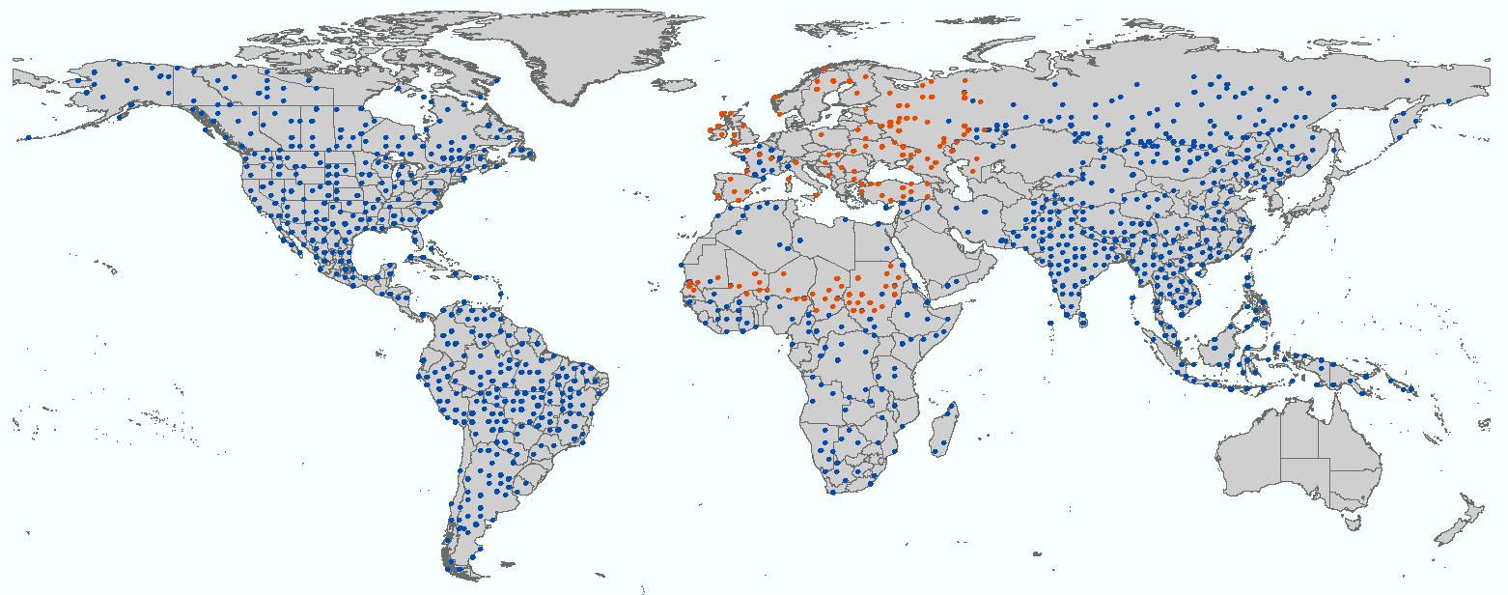
Completion of the multi-epoch CCI LC Validation database
19 experts; 150-200 point by expert => 3277 points proposed to experts
=> 2591 interpreted points for each epoch (2000/2005/2010)
(expert confidence : 64% certain, 30% reasonable, 6 % doubtful)

Slide 15
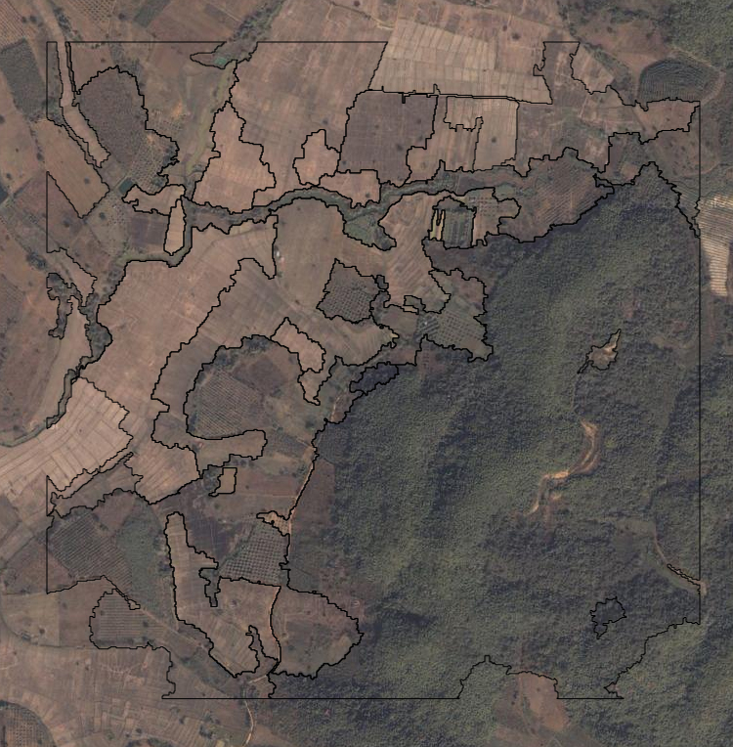
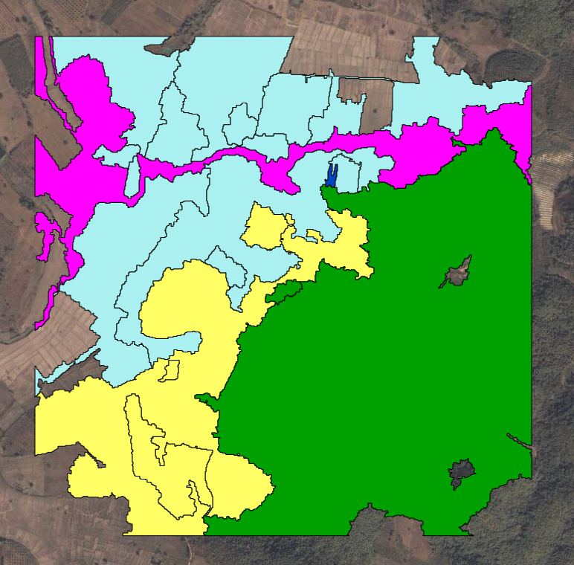
Example of validation sample for an given epoch

Slide 16
Current and planned CCI LC applications
Increasing products downloads and users interactions :
ex. : interactions with the FP7-LUC4C
Combined effort with FP7-Sigma project for cropland class
Converging strategy between Sentinel-2 CCI LC product and EU-CEOFAC project (Congo Basin Forest Observatory)
Submission of H2020 Sentinet proposal

Slide 17
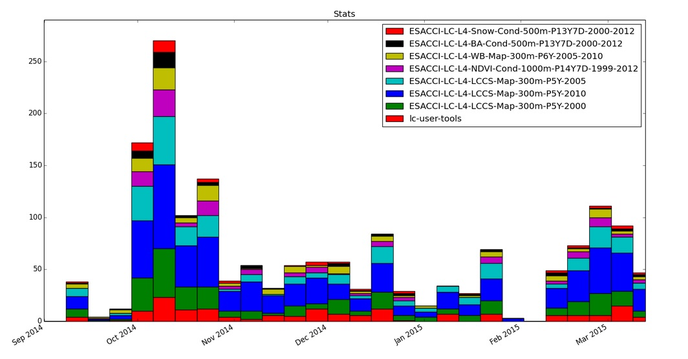
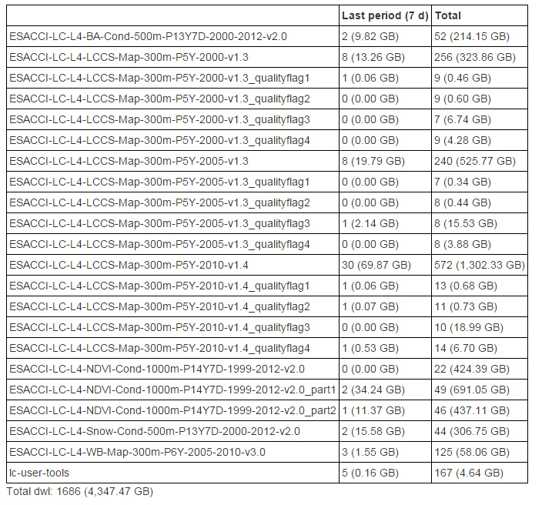
CCI LC Products downloads : 572 LC 2010
1181 products (> 4300 Gb) and 167 tools
1181 CCI_LC Maps downloaded at full resolution (2211 GB)
167 User tool (5 GB)
117 NDVI LSS (1552 GB)
52 BA LSS (214 GB)
44 Snow LSS (307 GB)

Slide 18
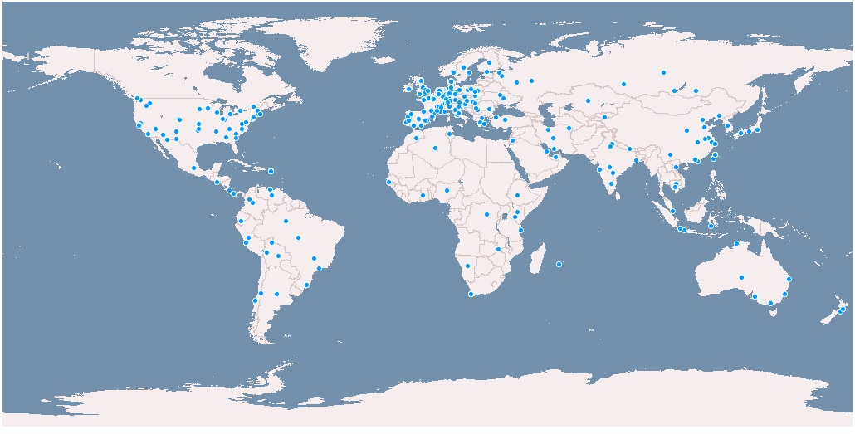
CCI LC Products downloads :
IP localisation

Slide 19
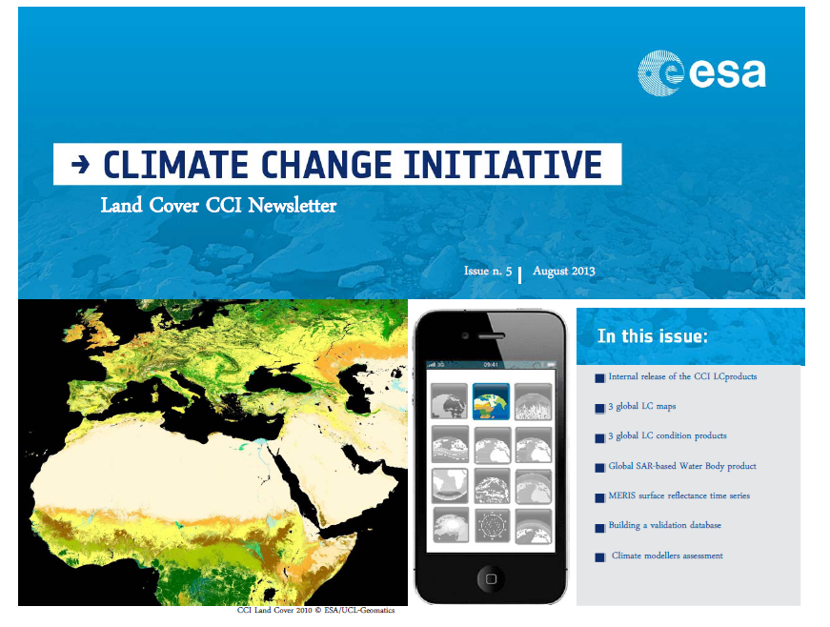
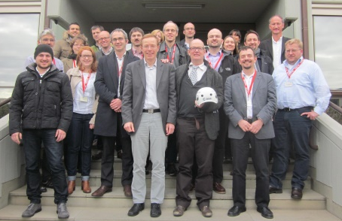
Thank you for attention

Slide 20
Points for discussion
Alternative approaches to assessing uncertainty?
Applications of land cover in other CCIs?
Comments / suggestions?

