Slide 1


Using CCI data in the SPECS research project
Omar Bellprat and the Climate Forecasting Unit
26 May 2015
SMHI, 2015
http://ic3.cat/wikicfu
Notes:
I’m going to give you an overview on research being done in the SPECS FP7 project in particular with regard to activities being pursued in the climate forecasting unit of IC3. The climate forecasting unit is currently merging with the barcelona super computing centre where will be in the future the earth’s science department at BSC.

Slide 2
Overview
Seasonal-to-decadal forecasting
Open fronts: The SPECS project
Some successful examples
Opportunities from exploiting new observations provided by CCI
Notes:
This is the overview of my talk. I’d like to give a brief introduction on seasonal-to-decadal forecasting on which we are working. Second give an overview on the challenges which are set by SPECS and then give some successful examples. Finally I want to elude where new opportunities emerge from CCI data that are particularly relevant at the s2d scale.

Slide 3
Overview
Seasonal-to-decadal forecasting
Open fronts: The SPECS project
Some successful stories
Opportunities from CCI

Slide 4
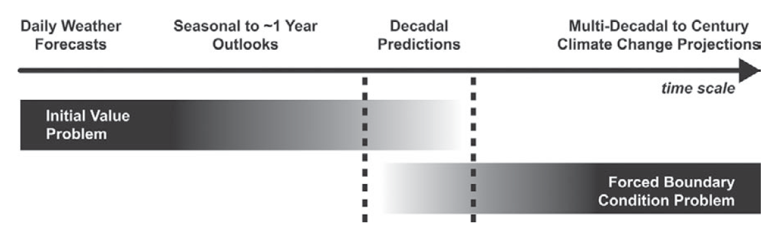
Climate timescales and climate prediction
Focus on sub-seasonal, seasonal, interannual and decadal timescales
Meehl et al. (2009)
Notes:
Weather forecasts – dominated by memory of initial state
Climate projections – dominated by external radiative forcings
Near-term climate predictions : need for good initialization, external forcings and models of highest complexity

Slide 5
Climate system predictability
Memory on interannual to centennial timescales in the ocean
Memory on seasonal to interannual timescales in the sea ice and land surface
External radiative forcings (solar activity, greenhouse gases, aerosols)
ECVs: SST, SIC, SIT, SM, Snow, GHG, Aerosols
Notes:
Efforts targeted on ocean, sea ice and land initialisation, specification of radiative forcings and model improvements

Slide 6
Methodology
… until 2009
Example for a decadal prediction
5-member prediction started 1 Nov 1960
1960
2005
Observations

Slide 7
Methodology
Example for a decadal prediction
5-member prediction started 1 Nov 1965
5-member prediction started 1 Nov 1960
1960
2005
Observations

Slide 8
Methodology
… until 2009
Example for a decadal prediction
5-member prediction started 1 Nov 1970
5-member prediction started 1 Nov 1965
5-member prediction started 1 Nov 1960
1960
2005
Observations

Slide 9
Methodology
… until 2009
Example for a decadal prediction
5-member prediction started 1 Nov 2005
5-member prediction started 1 Nov 1970
… every 5 years …
5-member prediction started 1 Nov 1965
5-member prediction started 1 Nov 1960
1960
2005
Observations

Slide 10
Methodology
… until 2009
Example for a decadal prediction
5-member prediction started 1 Nov 2005
5-member prediction started 1 Nov 1970
… every 5 years …
5-member prediction started 1 Nov 1965
5-member prediction started 1 Nov 1960
Focus on averages over forecast years 2 to 5
1960
2005
Observations

Slide 11
Methodology
… until 2009
Example for a decadal prediction
5-member prediction started 1 Nov 2005
5-member prediction started 1 Nov 1970
… every 5 years …
5-member prediction started 1 Nov 1965
5-member prediction started 1 Nov 1960
Focus on averages over forecast years 2 to 5
Ensemble-mean
1960
2005
Observations

Slide 12
Methodology
… until 2009
Example for a decadal prediction
As many values as hindcasts for both the model and the observations to compute skill scores. Ex : correlations
1960
2005

Slide 13
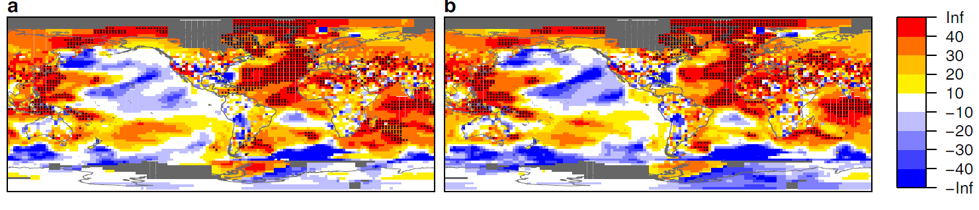
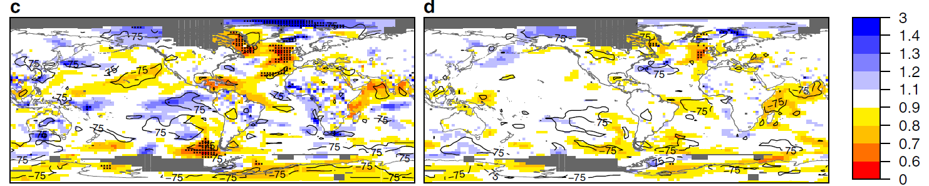
Decadal forecast skill: IPCC AR5
Decadal Skill 2-5 years (a) and 6-9 years (b) (RMSS)
Added-value from initialisation
Added-value from initialisation
Doblas-Reyes et al. (2013) Nature Communications
Notes:
Best skill in the Atlantic : ocean thermohaline circulation, Worst skill in the Pacific : Pb with turbulent ocean mixing
(Top row) Root mean square skill score (RMSSS) of the ensemble mean of the initialised predictions and (bottom row) ratio of the root mean square error (RMSE) of the initialised and uninitialised predictions for the near-surface temperature from the multi-model CMIP5 experiment (1960-2005) for (left) 2-5 and (right) 6-9 forecast years. Five-year start date interval.
13

Slide 14
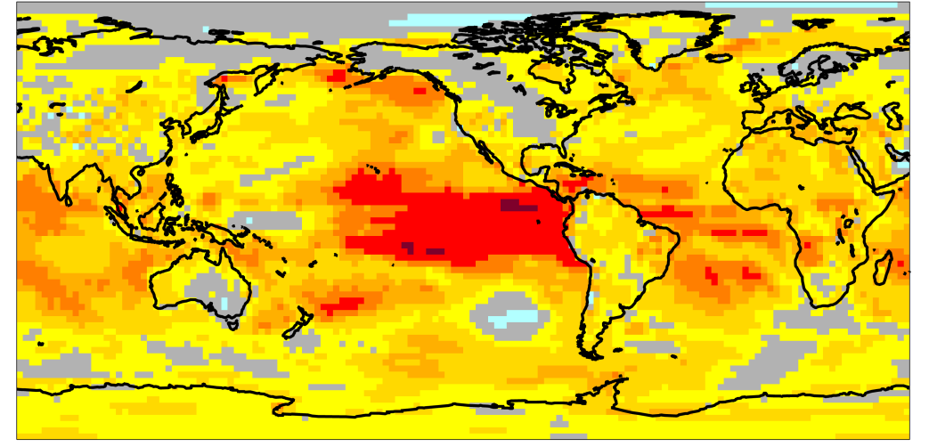
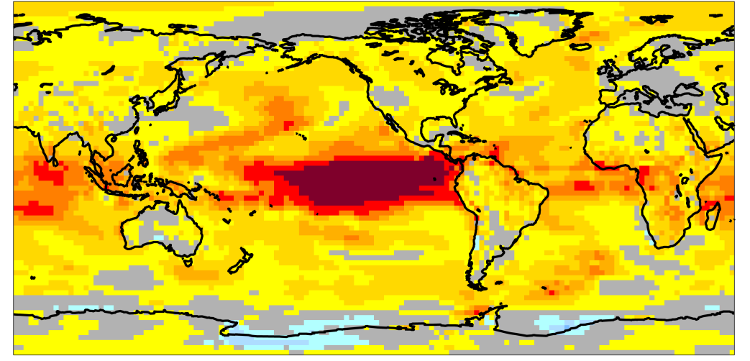
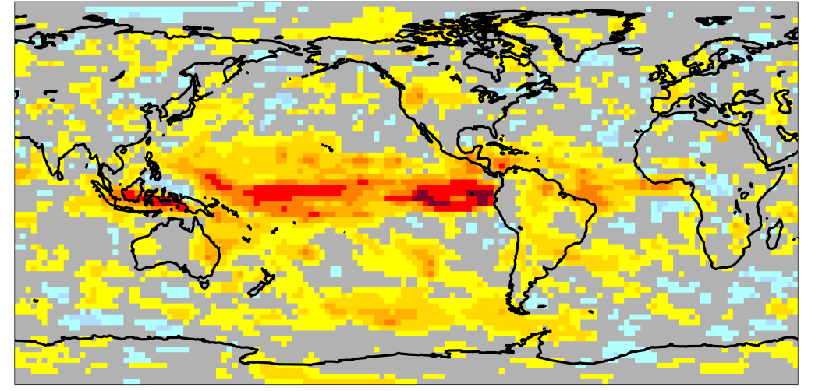
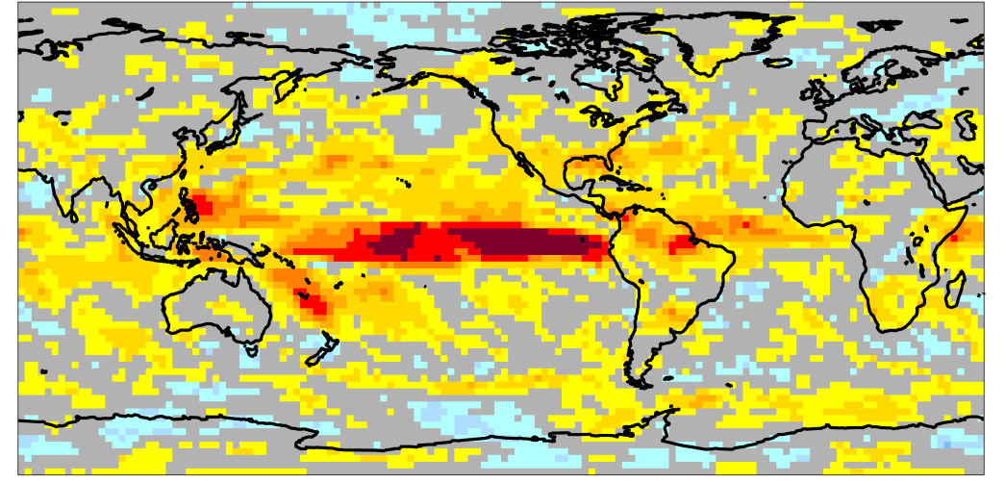

Seasonal forecast skill: ENSEMBLES
Correlation of seasonal forecasts for multi-model ensemble
T2m JJA
T2m DJF
Prec JJA
Prec DJF
Doblas-Reyes et al. (2013) WIREs Climate Change
Notes:
Best skill in the Tropical Pacific : ENSO

Slide 15
Overview
Seasonal-to-decadal forecasting
Open fronts: The SPECS project
Some successful stories
Opportunities from CCI

Slide 16
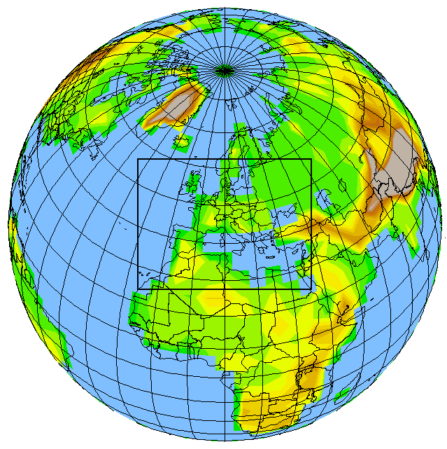
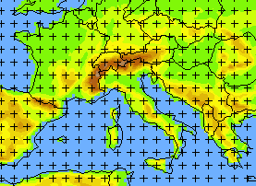
SPECS: Seasonal-to-decadal climate Prediction for the improvement of European Climate Services
IC3 role: Partner, WP leader and energy case study representative
Call: FP7 Environment and Climate
Description: Deliver a new generation of European climate forecast systems, with improved forecast quality and efficient regionalisation tools.
Timeframe: 2012-2016
Notes:
16
16
Project is starting, so more a description

Slide 17
SPECS Open Fronts
Work on initialisation: generate initial conditions (e.g. for sea ice, ocean). Compare different initialisation techniques (e.g. full field versus anomaly initialisation)
Improving model processes: Inclusion and/or testing of model components (biogeochemistry, vegetation, aerosols, sea ice) or new parameterizations, model parameter calibration, increase in resolution
Calibration and combination: empirical prediction (better use of current benchmarks), local knowledge.
Forecast quality assessment: scores closer to the user, reliability as a main target, process-based verification, attribution of climate events with successful predictions, diagnostics of model weaknesses with failing predictions
More sensitivity to the users’ needs: going beyond downscaling, better documentation (e.g. use the IPCC language), demonstration of value and outreach.

Slide 18
Overview
Seasonal-to-decadal forecasting
Open fronts: The SPECS project
Some successful examples
Opportunities from CCI

Slide 19

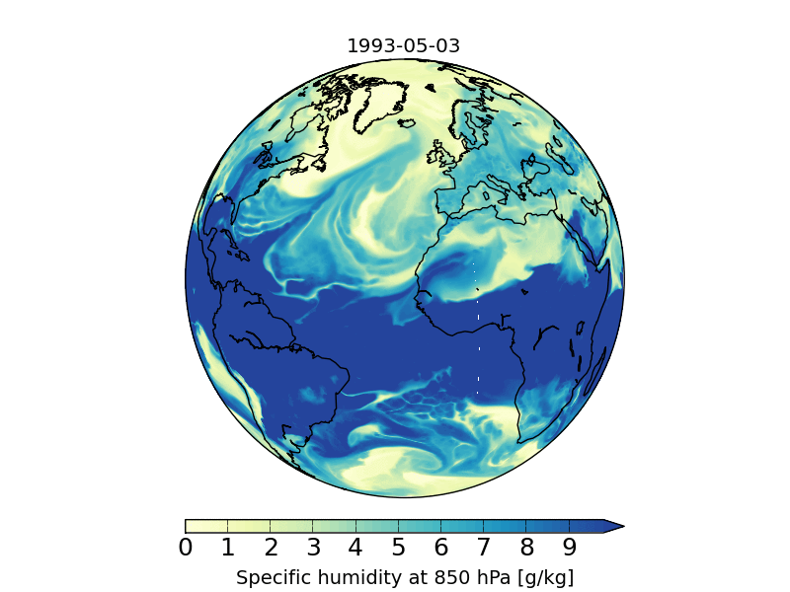
IC3: Earth system modeling
EC-Earth v2.3, 3.0.1, 3.1
Standard resolution T255ORCA1
Intermediate resolution T511ORCA1
High-resolution T511ORCA0.25
~ 40 km atmosphere
~ 25 km ocean

Slide 20
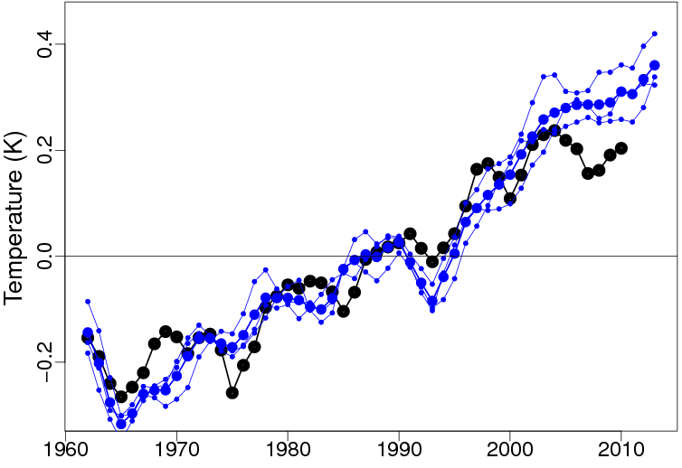
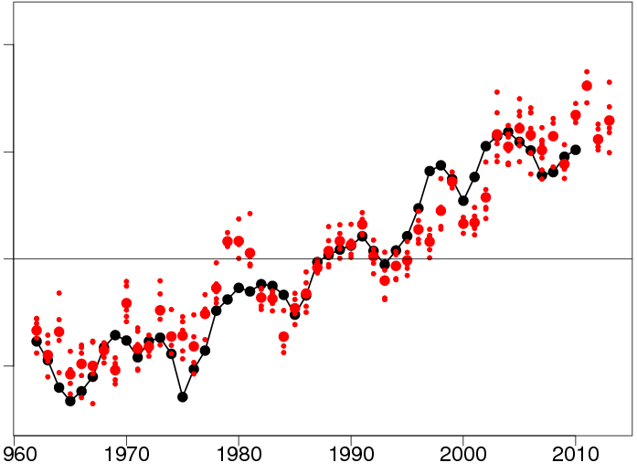
Predictions of the XXIst century hiatus
Crucial role of initialization from observations in capturing the plateau
EC-Earth historical simulations starting from 1850 preindustrial control simulations
Forecast years 1 to 3 from EC-Earth climate predictions initialized from observations
Observations
Guemas et al (2013) Nature Climate Change
Notes:
Initialization from observations (red better than blue) allows to capture the plateau in terms of anomaly as shown here but also in terms of tendency along the forecasts (not shown)

Slide 21
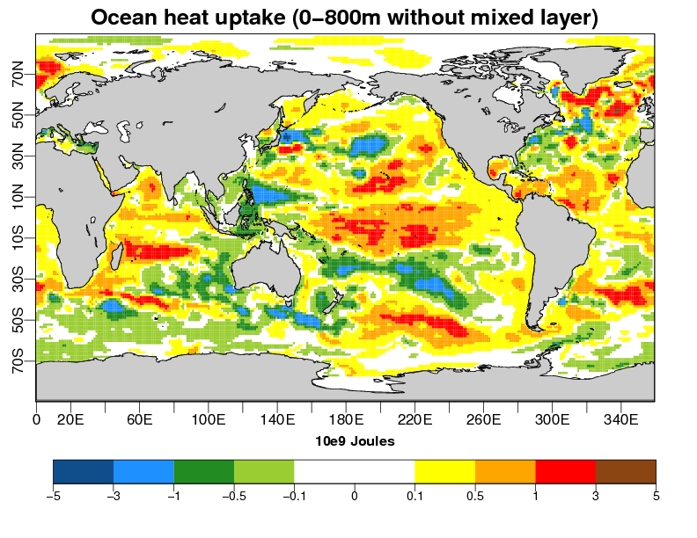
Predictions of the XXIst century hiatus
Plateau explained by increased ocean heat uptake
Ocean heat uptake (0-800m excluding the mixed layer) at the onset of the plateau
Guemas et al (2013) Nature Climate Change
Notes:
Analysis of the heat budget in EC-Earth2.3 decadal predictions : where does the excess energy stored due to GHG go in the climate system ? In the top 800m of the ocean below the mixed layer, mainly in the Tropics and North Atlantic as shown here.

Slide 22
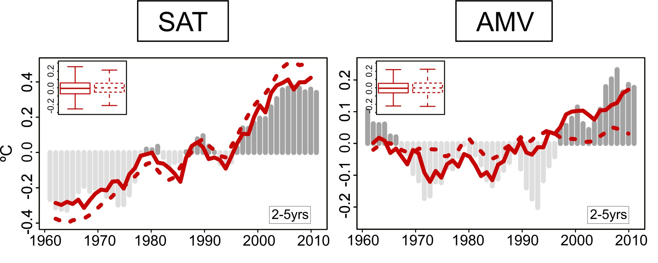
Impact of initialization: CMIP5 decadal predictions
CMIP5 decadal predictions. Global-mean 2m temperature and AMV against GHCN/ERSST3b for forecast years 2-5.
Global mean surface atmospheric temperature
Atlantic multidecadal variability (AMV)
Predictions
Historical simulations
Observations
Doblas-Reyes et al. (2013) Nature Communications
Notes:
Independent forecasts are joined by a continuous line here for the predictions !!!
Initialization allows for better capturing long-term trend which is corrected in the initial conditions and for better capturing part of the superimposed interannual variability

Slide 23
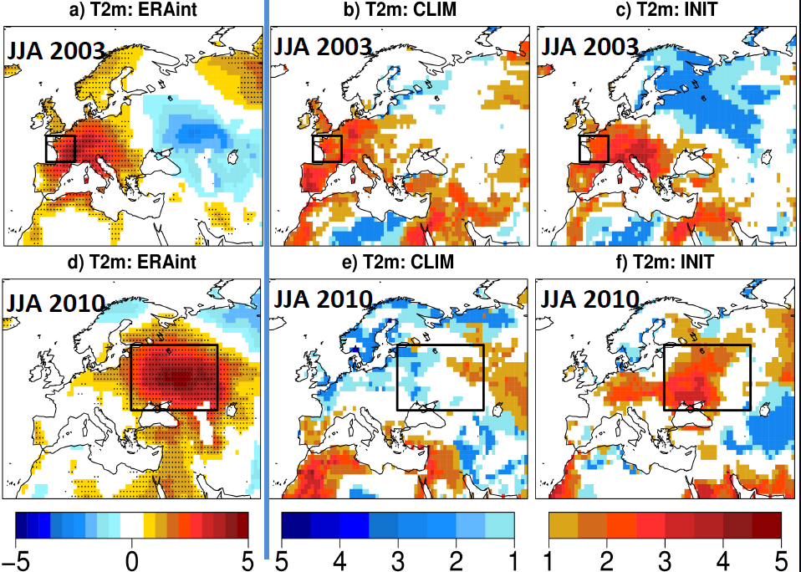
Impact of land surface initialization
Predictions of 2003 and 2010 heat waves improve
Odd ratio
Prodhomme et al (2015) In preparation
Notes:
Effect of soil moisture less important for the 2003 heat wave than previously suggested. Both predictions are able to predict the heatwave.

Slide 24
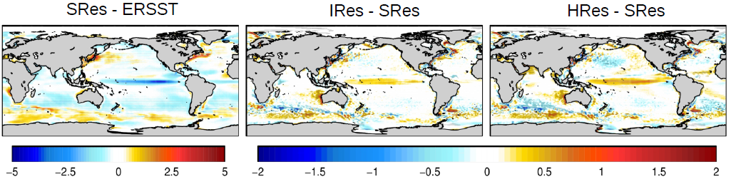

Impact of increasing the resolution
Decrease of cold tongue in equatorial Pacific with high model resolution
SRes - Standard resolution IRes – Intermediate resolution HRes – High resolution
Prodhomme et al (2015) In preparation

Slide 25
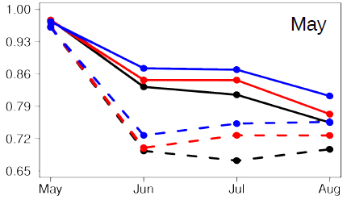
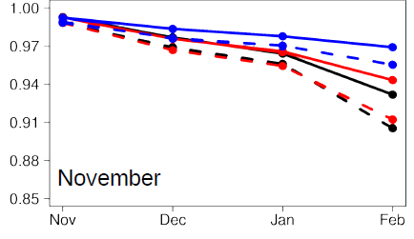
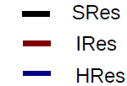

Impact of increasing resolution
Increase of ENSO prediction skill with high model resolution
Correlation
Correlation
Prodhomme et al (2015) In preparation

Slide 26
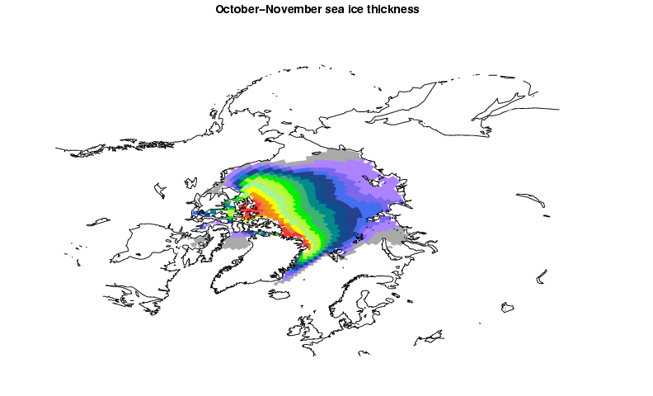
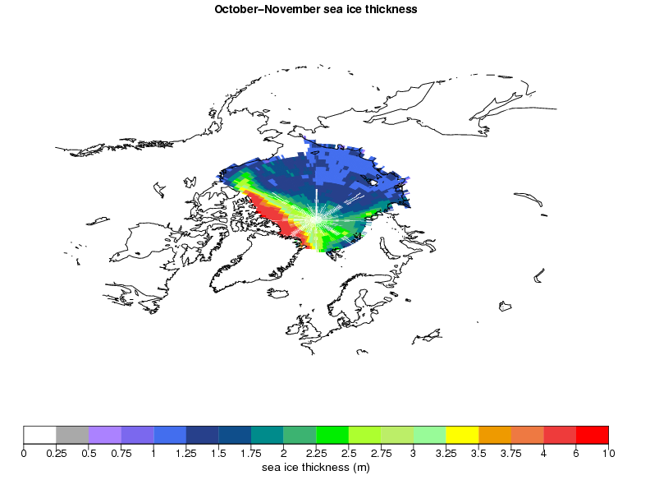
In-house sea ice reconstructions
2003-2007 October-November Arctic sea ice thickness
Reconstruction
IceSat
Assimilation now extended using an Ensemble Kalman Filter in a coupled ocean-atmosphere-ice mode for higher inter-variable consistency (F.Massonet)
Guemas et al (2014) Climate Dynamics
Notes:
IceSat = satellite observations of sea ice thickness available only from 2003 to 2007, reasonable agreement of mean state, also in terms of variability (not shown) How long is the reconstruction?

Slide 27
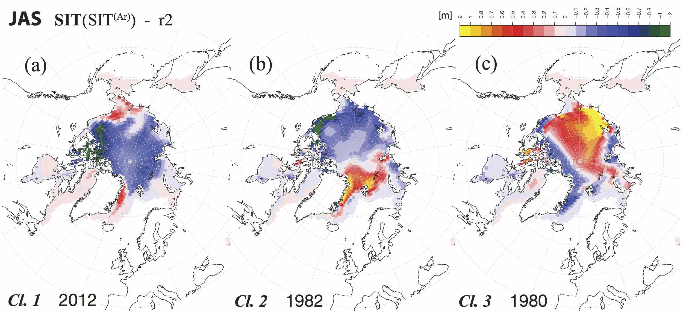
Inter-annual sea-ice variability
k-means cluster analysis of reconstructed sea ice thickness (SIT)
Clustering methods more robust than EOF analysis + account for nonlinearities.
Fučkar et al (2015) Climate Dynamics
Notes:
Ice observations are used apart from initialization also to study interannual variability. Fuckar et al., recently determined the three leading modes of variability for arctic sea ice thichkness using a clustering algorithm which is more robust than EOFs. 3 modes of sea ice variability obtained for each season.
central Arctic thinning (CAT)
Atlantic-Pacific dipole (APD)
the Canadian-Siberian dipole (CSD)

Slide 28
The climate prediction drift issue
Observed world
BIAS
Retrospective prediction ( hindcast ) affected by a strong drift, need for a-posteriori bias correction
Predicted Variable (ex. Temperature)
Biased model world
Time
Danila Volpi
Notes:
Climate model biases cause climate drift of predictions initialized from observations and makes it compulsory to apply a-posteriori bias correction

Slide 29
The climate prediction drift issue
Observed world
BIAS
Retrospective prediction ( hindcast ) affected by a strong drift, need for a-posteriori bias correction
Predicted Variable (ex. Temperature)
Biased model world
Time
Retrospective prediction with anomaly initialization
Danila Volpi
Notes:
Hope to reproduce better the observed climate variability when the model is initialized in its biased world with observed anomalies

Slide 30
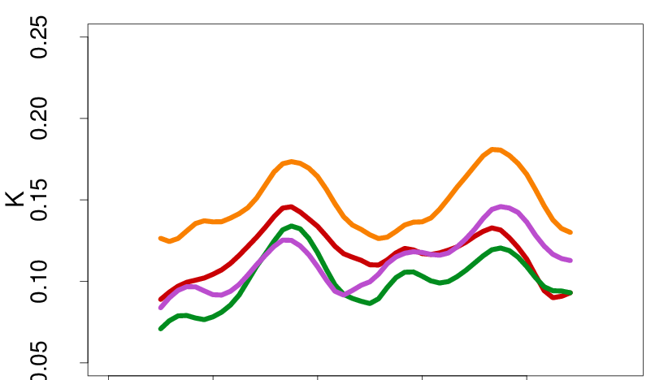
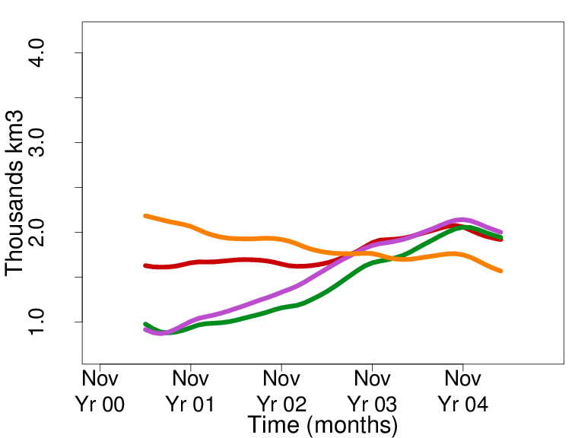
Anomaly versus full-field initialization
Anomaly initialisation mostly beats full-field initialisation
RMSE AMO. Ref: ERSST
RMSE sea ice volume. Ref: Guemas et al (2014)
NOINI
OSI-AI
FFI
FFI
OSI-AI
NOINI
rho-OSI-wAI
rho-OSI-wAI
NOINI: No initialisation FFI: Full-field initialisation
OSI-AI: Anomaly Initialisation (Ocean+Sea-ice)
rho-OSI-AI: Weighted Anomaly Initialisation (Ocean+Sea-ice)
Danila Volpi
Notes:
General improvement of FFI over NOINI and OSI-AI over FFI
Better skill in AMO and PDO the first year, SIA the first 2 years, SIV the first 3 years with the most advanced AI technique

Slide 31
Overview
Seasonal-to-decadal forecasting
Open fronts: The SPECS project
Some successful stories
Opportunities from CCI

Slide 32

Climate change initiative: Opportunities
So far mainly used in NWP, similar opportunities for climate forecasting: short periods are retrospectively predicted
independence from in-situ observations which have been used for model tuning
very high-resolution necessary to cope with the increasing resolution
high quality with an estimate of the observational uncertainty
generation of new model re-analysis for initial conditions
Notes:
Satellite remote sensed (SRS) observations have already played an important role in weather prediction, yet only a moderate one for the evaluation of climate models. A main reason for this is the relatively short records of SRS datasets which are subject to large natural variations. The prediction of these variations is, though, a main motivation of climate forecasting and thus a large potential lies in exploiting SRS datasets. The new CCI datasets are specifically relevant as they come for some essential climate variables (ECV) with an unprecedented length of the records and with a major effort to avoid inhomogeneities between the different satellite missions.

Slide 33
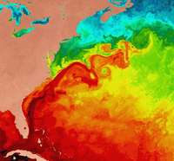
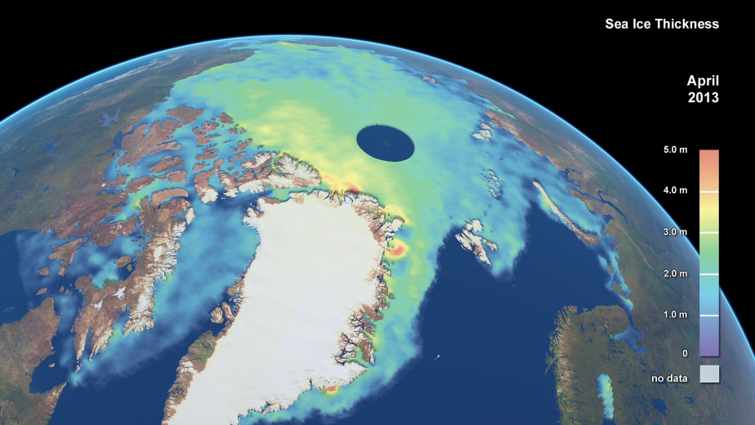
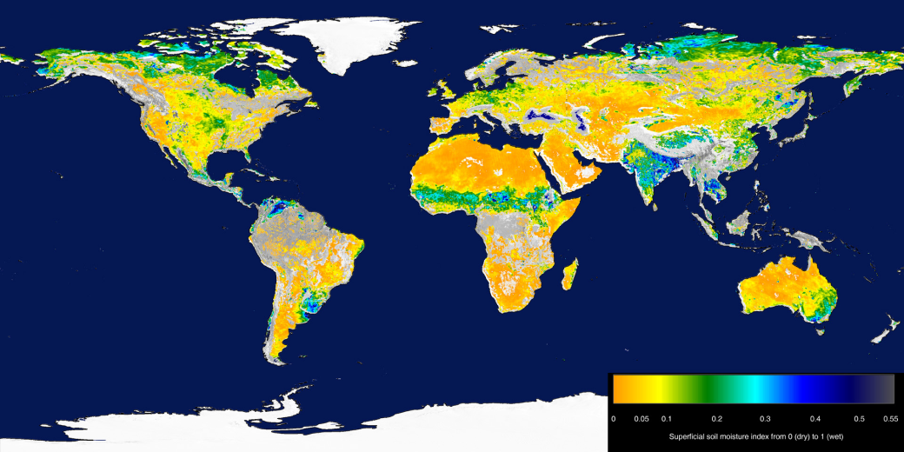
CCI for sources of predictability
Verifying and assimilating sources of predictability
Sea-surface temperatures
1983-2010
Ice sheets and sea-ice
1976-2010
Soil moisture and snow
1978-2010

Slide 34
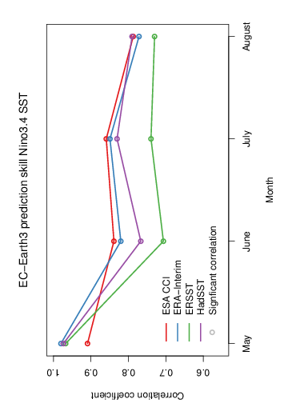
Observational uncertainty
Observational uncertainty currently not taken into account
in forecast quality assessment

Slide 35
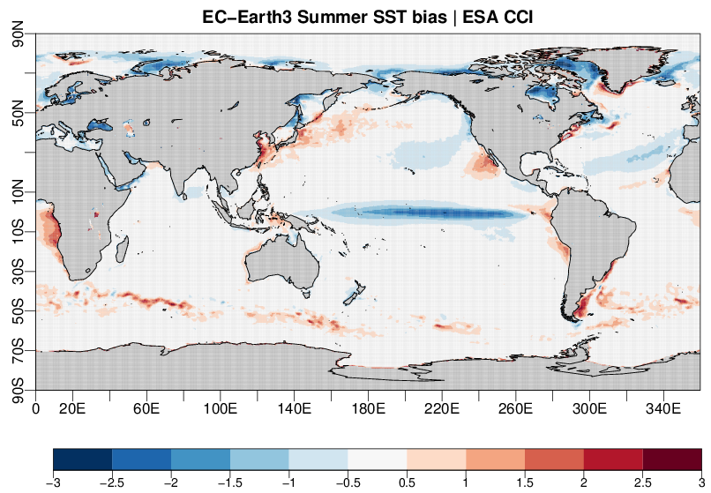
High-resolution verification
ESA CCI currently only data set to verify at high-resolution
K

Slide 36
SPECS Open fronts: Questions?
Work on initialisation: more advanced data assimilation (ex: EnKF, coupled assimilation) to generate initial conditions, use of new observations and reanalyses, better ensemble generation.
Improving model processes: Impact of aerosols, interactive vegetation, prediction of biogeochemistry, more efficient use of computing resources, drift reduction, leverage knowledge from modelling at other times scales
Calibration and combination: estimation of uncertainty
Forecast quality assessment: attribution of climate extremes (drought, sea ice minima and maxima), analysis of ocean, sea ice and land sources of predictability, role of external forcings
More sensitivity to the users’ needs: going beyond downscaling, better documentation (e.g. use the IPCC language), demonstration of value and outreach.

Slide 37
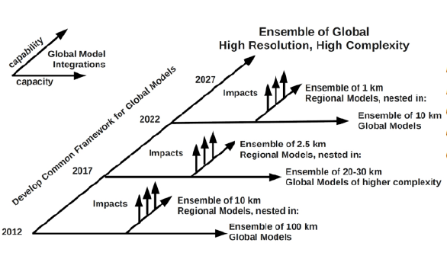
Foresight of resolution increase
ESA CCI SST
BSC EC-Earth
2019
IC3 EC-Earth
high-resolution

Slide 38
Advanced assimilation using EnKF
1. Model forecasts
The ensemble Kalman filter: a multivariate data assimilation method for smoother initialization
2. Analysis
Observations (e.g., ice concentration only)
Francois Massonnet
Notes:
There may be several drawbacks of initializing separately the ice and the ocean, namely shocks between the two components at initialization time. One way to overcome this is to use so-called multivariate data assimilation methods, and the ensemble Kalman filter is one of them. The method works in two steps: first, an ensemble of simulations is forwarded in time so that a structure emerges in the ensemble. For instance, members that created more ice than others will naturally have higher salinities, and conversely. At this stage, an observation is injected in the system. This observation may be limited in space and restricted to one variable, for example sea ice concentration. The second and final step is the « analysis », where not only ice concentration but also salinity is updated in the model, based on the relationship between these two variables. This cycle is reproduced as many times as needed.

Slide 39
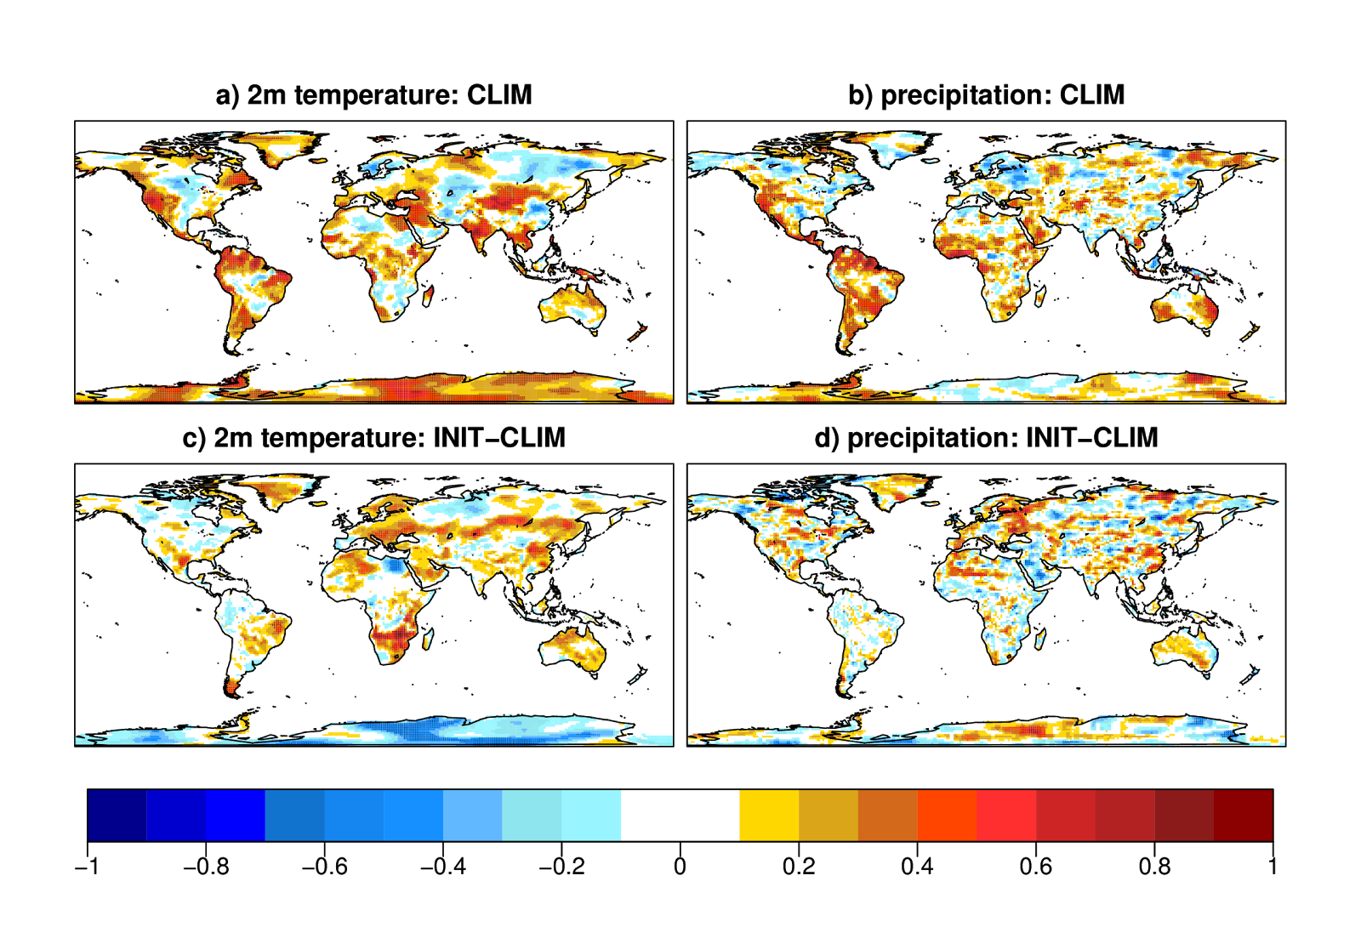
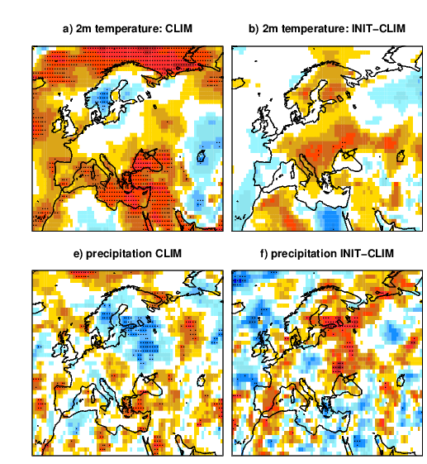
Impact of land surface initialization
Realistic land-surface (INIT), climatological conditions (CLIM) taken from ERA-Land re-analysis (same soil model)
Temperature CLIM
Correlation increase
Temperature CLIM
Temperature INIT - CLIM
Precipitation CLIM
Precipitation INIT - CLIM
Prodhomme et al (2015) accepted in Climate Dynamics
Notes:
Low T2m skill in northern central europe with clim improved with initialisation
Low P skill in northern and eastern europe with clim improved with initialisation
Difference in the correlation of the ensemble-mean near-surface temperature (top) and precipitation (bottom) from two experiments (JJA), one using a realistic and another a climatological land-surface initialisation. Results for EC-Earth2.3 started every May over 1979-2010 with ERAInt and ORAS4 initial conditions and our sea-ice reconstruction.

