Slide 1
Climate models and their applications at SMHI:
GCMs, RCMs and observations
Erik Kjellström
CCI-CMUG Integration meeting, SMHI, Norrköping, 26 May 2015

Slide 2
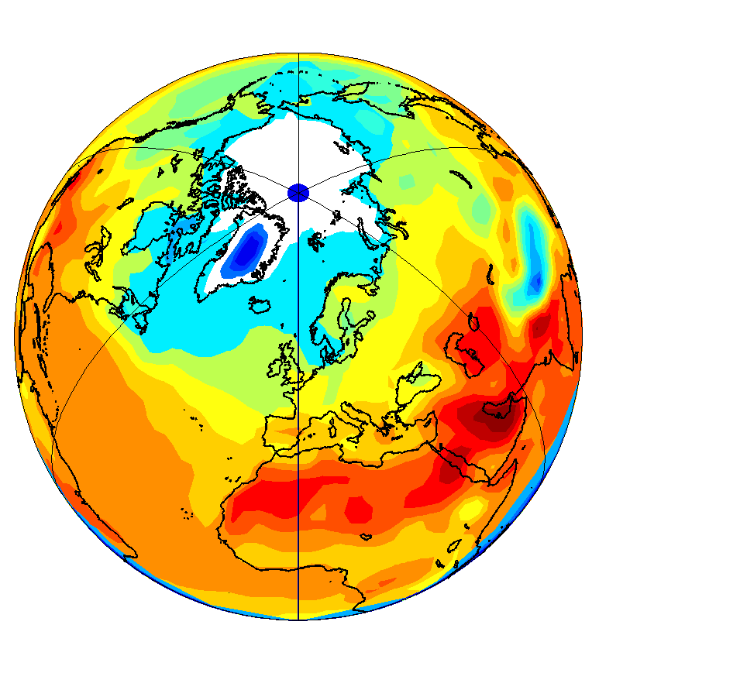
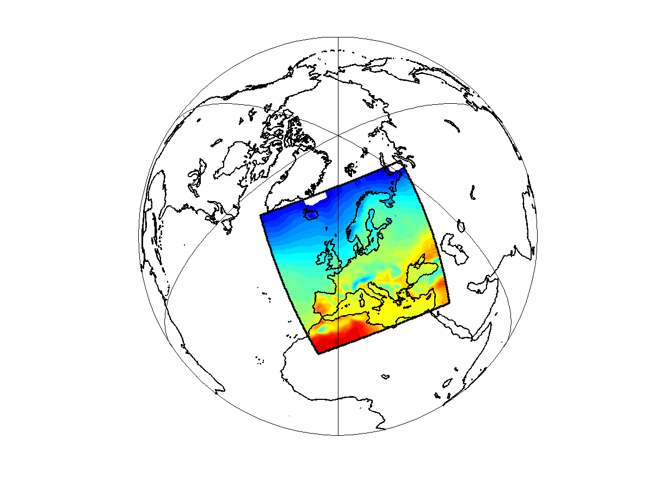
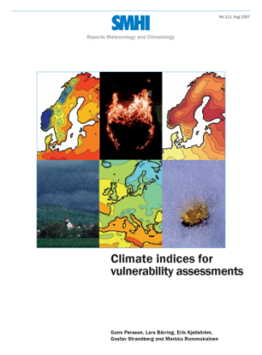
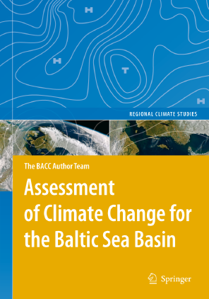
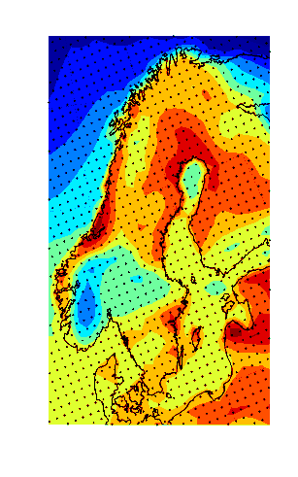
Activities at the Rossby Centre
Understanding climate and its predictability
Developing numerical climate models
Production and analysis of climate scenarios
Support for impact studies and work on climate adaptation
Global climate modeling
Regional downscaling
Analysis and further use of our climate scenarios
Notes:
Model development has been a major effort, by all of SWECLIM
Theoretical and analytical studies have helped in putting it all into proper perspective.

Slide 3
Global climate modelling

Slide 4
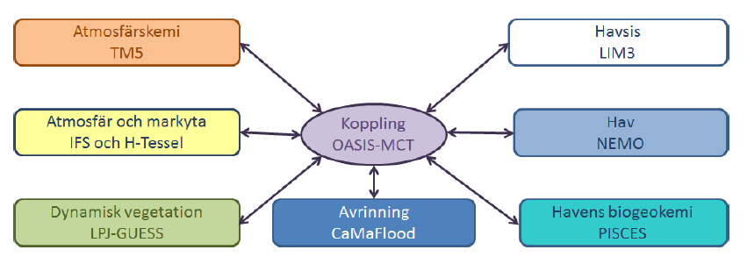
Global Earth System Modeling
New global Earth system model (EC-EARTH 3)
Atmospheric chemistry
TM5
Sea-ice
LIM3
Atmosphere and land surface
IFS and H-Tessel
Coupling
OASIS-MCT
Ocean
NEMO
Dynamical vegetation
LPJ-GUESS
Ocean biogeochemistry
PISCES
New version EC-EARTH 3 to be used in CMIP6 starting in 2016
New components of the climate system requires new observational
data for model validation – SMHI will contribute to CMUG with
work on clouds, soil moisture, aerosols, ozone, GHGs, SSTs

Slide 5
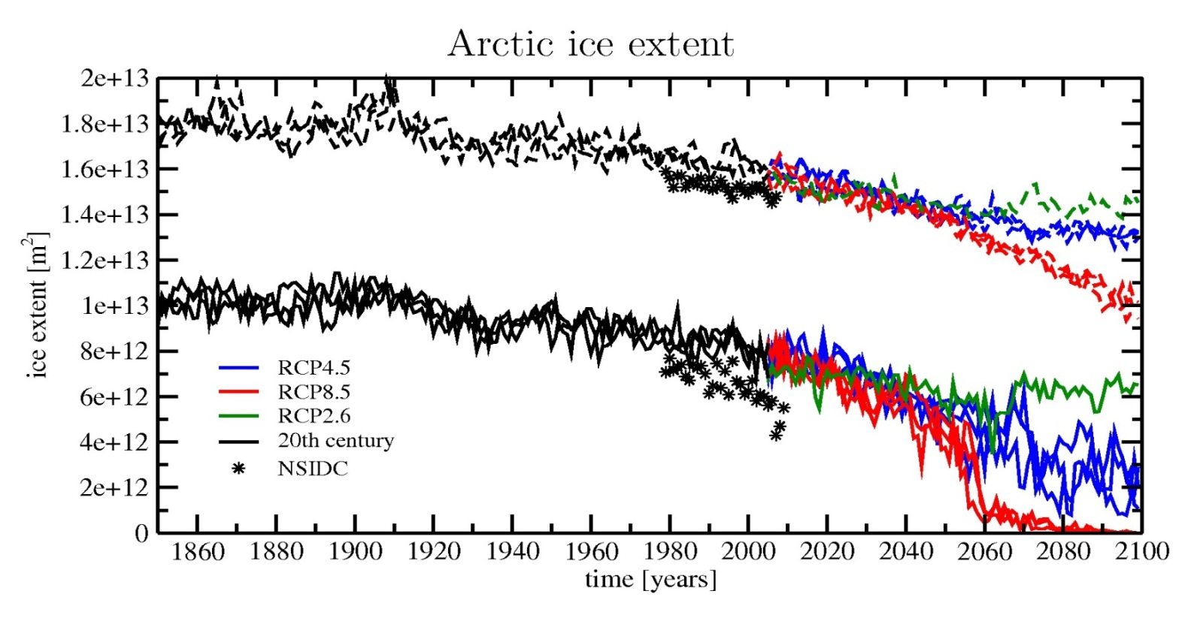
Validation of GCMs
IPCC, AR5 (2013):
“There is very high confidence that climate models reproduce the observed large-scale patterns and multi-decadal trends in surface temperature, especially since the mid-20th century.
Confidence is lower on sub-continental and smaller spatial scales.
Precipitation and sea ice cover are not simulated as well as surface temperature, but improvements have occurred since the AR4.”
March
Observed sea-ice
decline (black dots)
faster than all
EC-Earth simulations
September
Koenigk et al. 2013

Slide 6
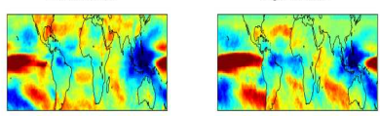
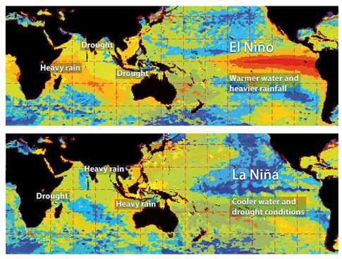
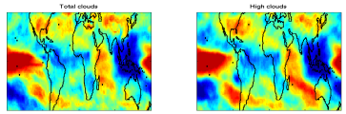

Improving climate models
AMIP-type experiments with prescribed SSTs and sea-ice conditions
allows for more straight-forward comparison to observations
Correlation El Nino Southern Ocean ENSO index & Clouds
SST anomalies
CLARA-A1 1982-2009, 50km
(CM SAF cLoud, Albedo and RAdiation dataset from
AVHRR data)
EC-Earth AMIP run
1982-2009, T159(125km)
Devasthale and Willén 2013
A similar study investigating variability and correlations between ESA-CCI clouds, aerosols, SST, soil moisture, greenhouse gases, ozone and other observations and in CMIP5 models will be done for CMUG

Slide 7
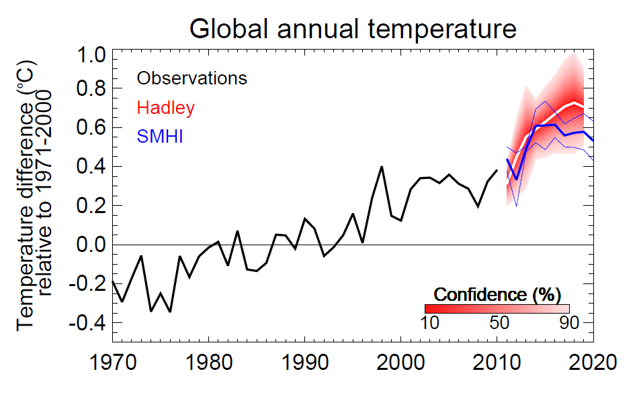
Decadal prediction with EC-Earth
We need a reliable and consistent observational data set for initialization
of the ocean – sea ice system. ESA-CCI SST and Sea-Ice will be used in CMUG

Slide 8
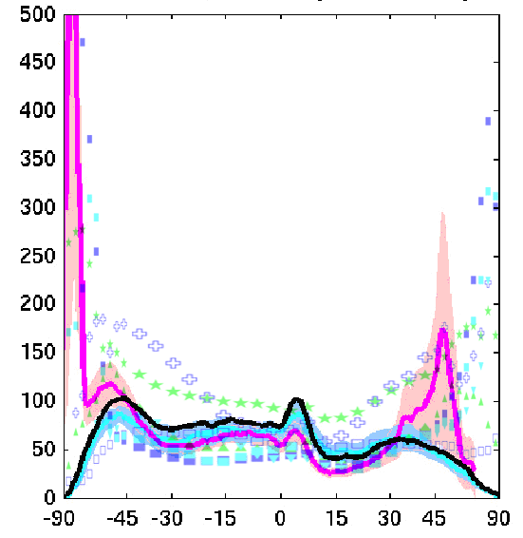
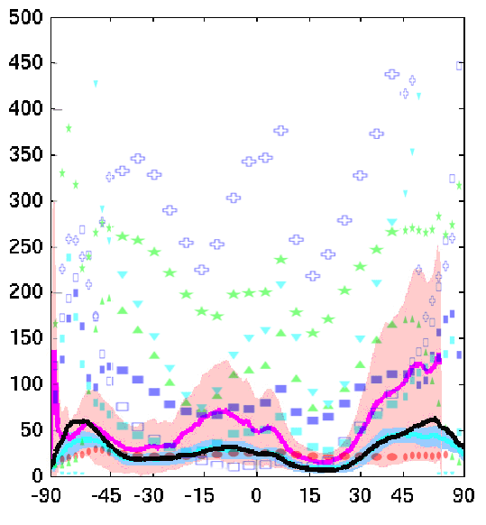

Comparison of CCI and GEWEX cloud data with EC-Earth and ERA-Interim from Cloud-CCI CRG
Liquid Water Path (g/m2) January
Ice Water Path (g/m2)
LWP
IWP'
Using several datasets as reference -> uncertainty in data
CCI inluding uncertainties helpful...
8
From Ulrika Willén

Slide 9
Regional climate modelling

Slide 10
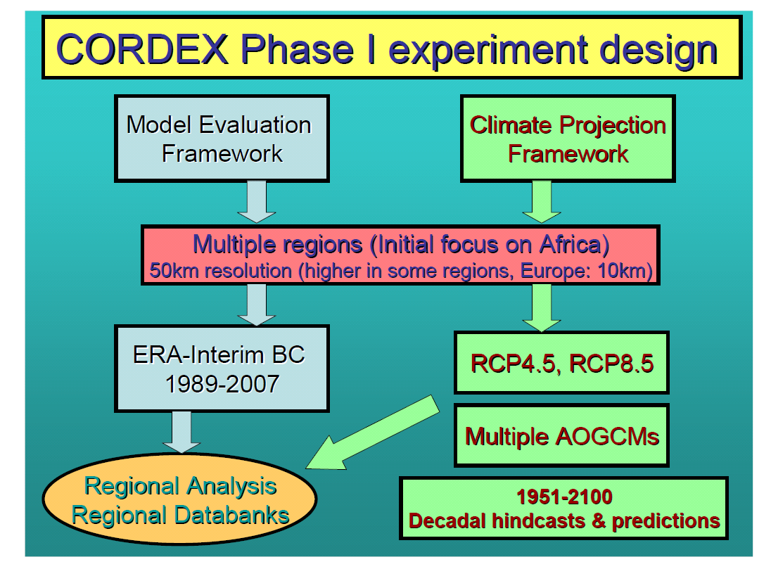
The coordinated regional downscaling experiment (CORDEX)
Colin Jones, Mistra-SWECIA seminarium, 2011-04-01

Slide 11
CORDEX domains

Slide 12
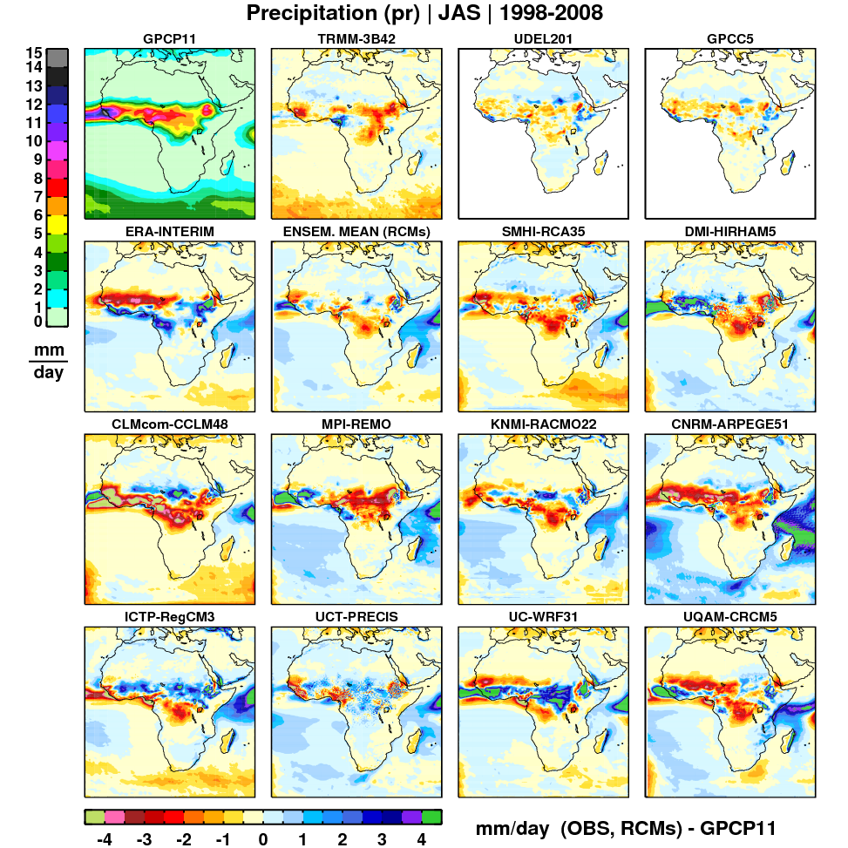
CORDEX: Model validation
4 different sets of observational data
10 RCMs downscaling
ERA-interim (reanalys)
1989-2008
Horisontal resolution 50km
Nikulin et al., J. Clim. (2012)

Slide 13
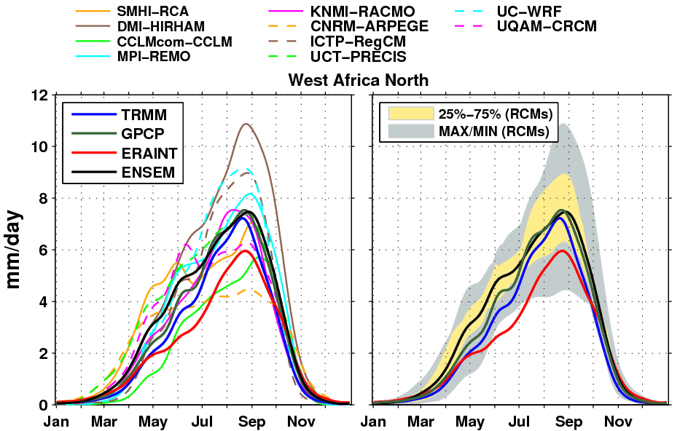
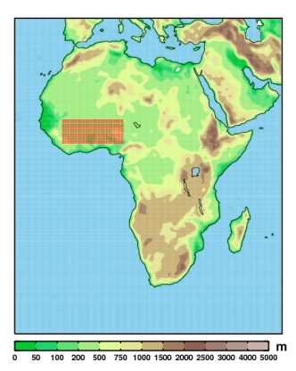
Annual cycle over West Africa
50-day low-passed precipitation (1998-2008)
RCMs show a wide spread around the observed annual cycle
several RCMs and particularly the ensemble mean improve ERA-Interim
ensemble mean accurately represents the observed annual cycle (bias cancellation)

Slide 14
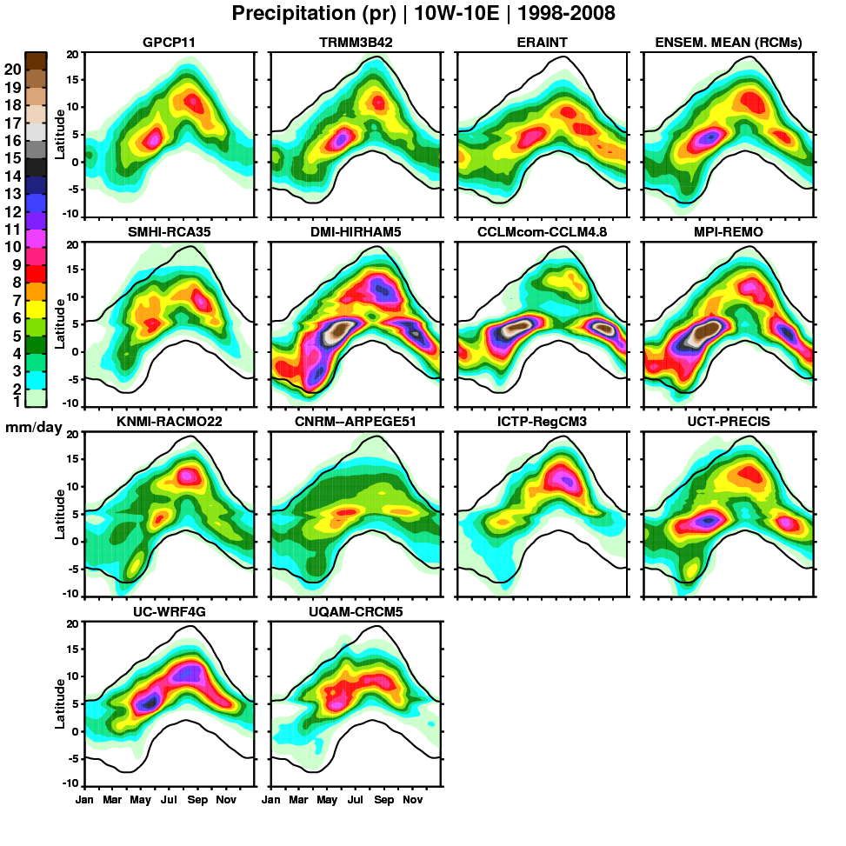
WAM seasonal progression
50-day low passed precipitation (10ºW-10ºE, 1998-2008)
most RCMs capture the
two rainfall maxima
although the positioning,
intensity and duration
differ
ERA-Interim and some
RCMs fail to propagate
precipitation far enough
north
the multi-model average
smoothes diverse biases
and present the best
simulated WAM rainfall
1 mm/day GPCP

Slide 15
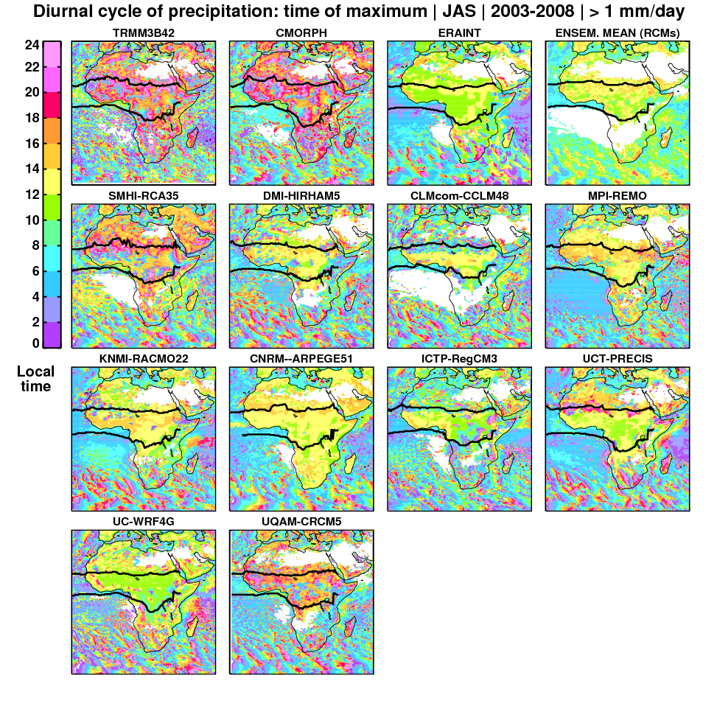
Diurnal cycle: time of maximum
JAS (2003-2008) only days > 1 mm/day
TRMM/CMORPH
maximum between late
afternoon and midnight
ERAINT and the majority
of RCMs
precipitates too early
around the local noon
RCA35 and CRCM5
capture to some degree
the observed phase;
both employ the Kain-
Fritsch convective
scheme, although WRF
as well
ITCZ rain belt

Slide 16
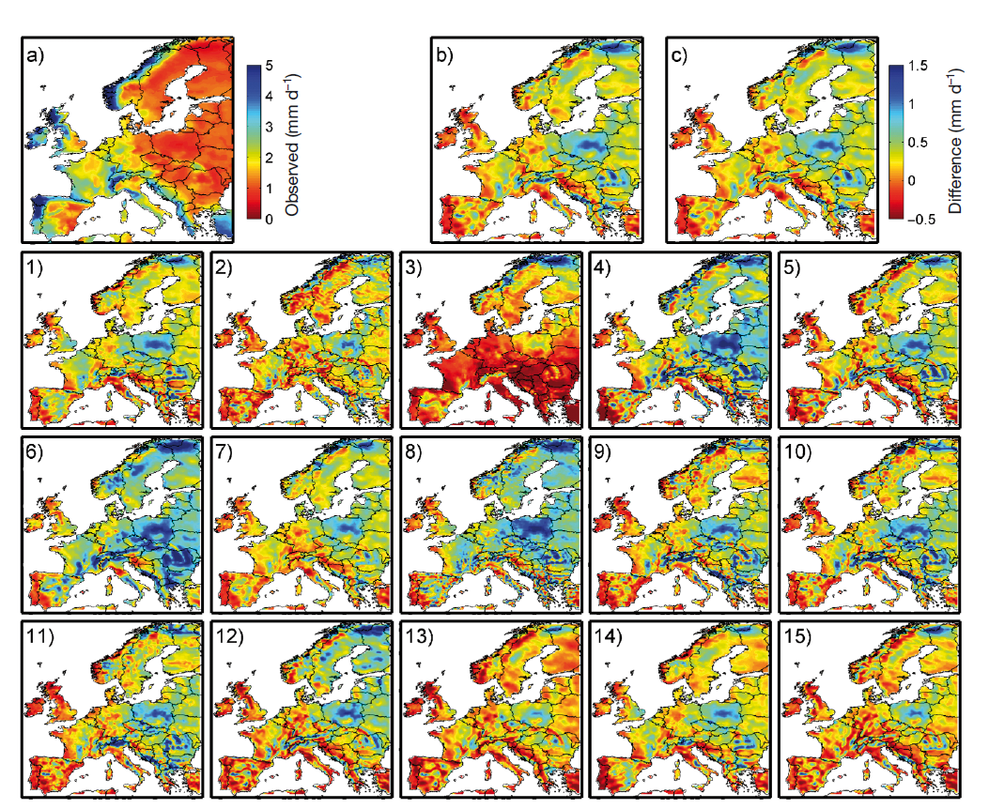
Models can help identifying problems with observations
Winter (DJF) precipitation in
E-OBS2.0 …
… and in
15 RCMs downscaling ERA-Interim
Christensen
et al. (2010)

Slide 17
CORDEX results as input to Swedish climate services

Slide 18
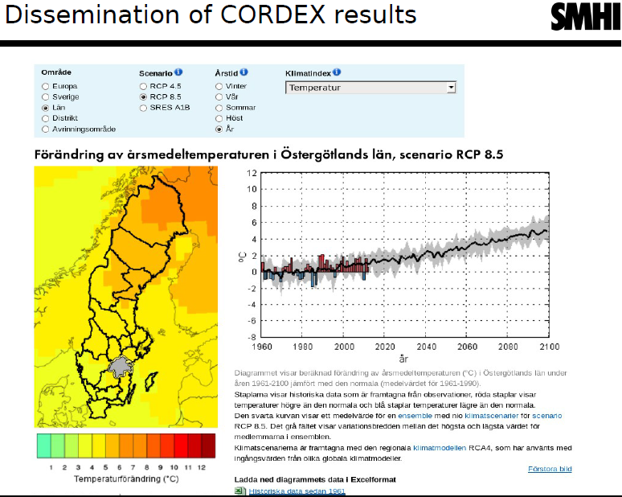
Dissemination of the CORDEX results

Slide 19

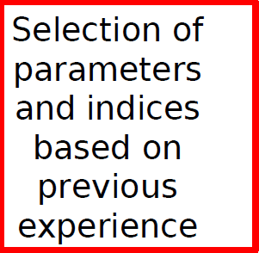
Dissemination of the CORDEX results

Slide 20

Dissemination of the CORDEX results

Slide 21

Dissemination of the CORDEX results

Slide 22
Dissemination of the CORDEX results
Linking to the observed climate

Slide 23
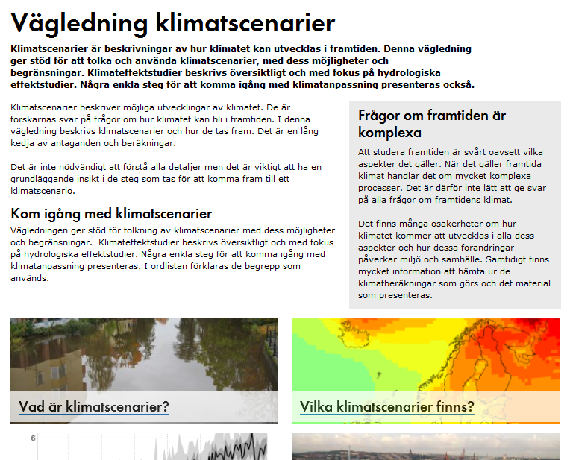
Guidance (in Swedish)

Slide 24
Developing a new regional climate model

Slide 25
The HARMONIE climate model
HARMONIE = Hirlam Aladin Regional Mesoscale Operational NWP In Europe
IFS dynamical core. Here applied in a hydrostatic version for climate applications in the ”grey-zone” with the ALARO physics
First long-term simulations conducted at 6.25 and 15 km horizontal resolution and 60 vertical levels for 1998-2007 with boundary conditions from ERA-Interim.
Curvilinear grid with a conformal Lambert projection. 300x320 (15km) and 720x800 (6km) grid points. 360 (15km) and 180 (6km) s time step
Some features of the model:
Land surface scheme SURFEX (Le Moigne, 2012)
Convection 3MT (Gerard et al. 2009)
Radiation 2-stream scheme (Ritter and Geleyn, 1992)
Boundary conditions Following Davies (1976) with 8-point relaxation zone
Notes:
Varför hydrostatisk version?
Stämmer det att säga att Konvektions-parametrisering på men bättre representerad för tillämpningar för ”gråskalan”

Slide 26
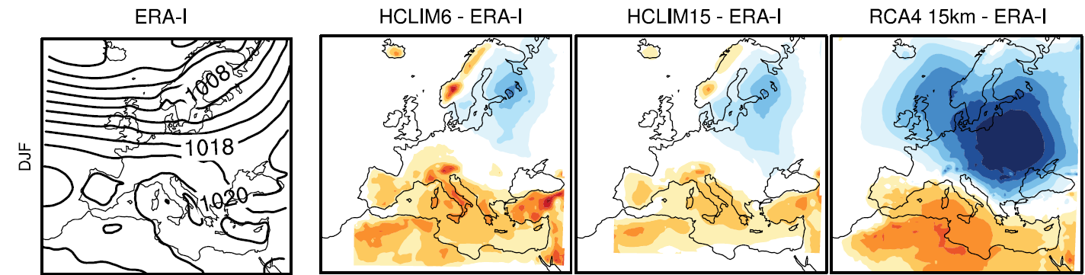

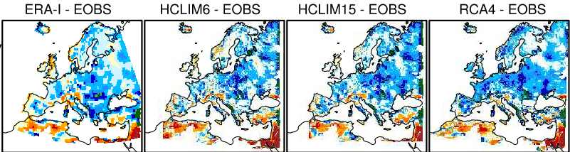

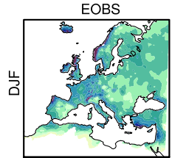
General features of the Harmonie runs
Winter (DJF) performance for MSLP (upper) and precipitation (lower)
Lindstedt et al. 2015 Tellus

Slide 27
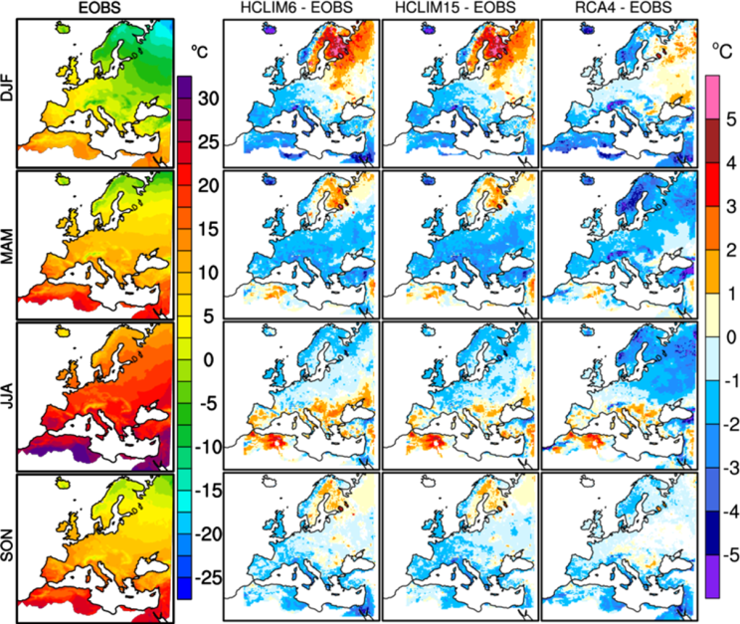
General features of the Harmonie runs
Main errors and biases:
Wintertime warm temperatures in the north
Overestimated cloud cover and precipitation
Next version:
Thermodynamic sea-ice
model
Lake model (Flake)
Updated land surface (SURFEX7.3)
Corrections snow/soil
Allowing for changing GHGs over time (new radiation scheme in ALARO – ACRANEB2)

Slide 28
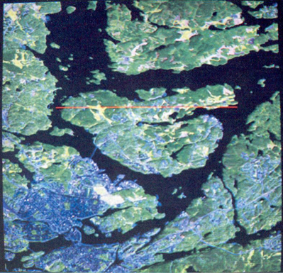
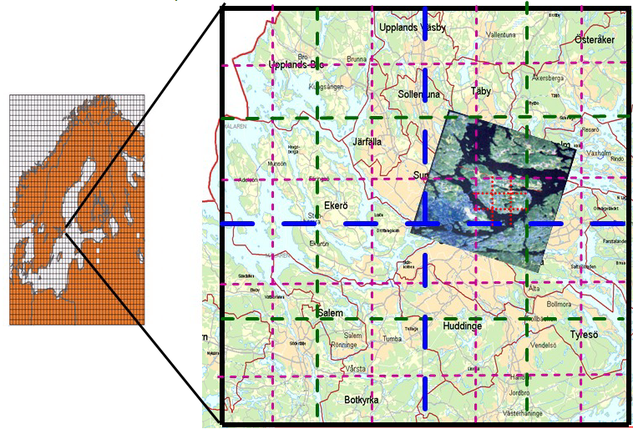
Towards higher resolution
PRUDENCE (50km)
ENSEMBLES (25km)
EURO-CORDEX (12.5km)
Grey zone (6km)
Convective permitting (2km)
Notes:
Stockholm
Tullinge
Bromma
Stormyra
Värtan
Adelsö
Beckomberga
Barkarby
Röskär (Bogesundslandet)

Slide 29
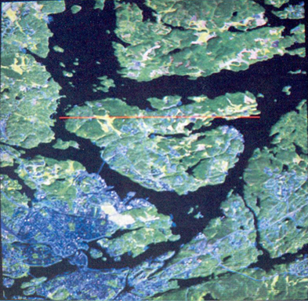
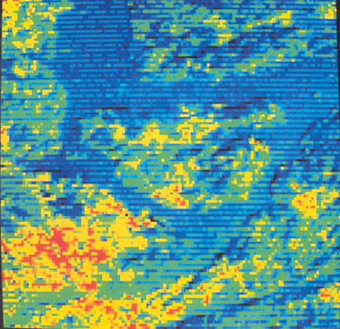
Towards higher resolution
PRUDENCE (50km)
ENSEMBLES (25km)
EURO-CORDEX (12.5km)
Grey zone (6km)
Convective permitting (2km)
Notes:
Stockholm
Tullinge
Bromma
Stormyra
Värtan
Adelsö
Beckomberga
Barkarby
Röskär (Bogesundslandet)

Slide 30
Towards higher resolution
Highly dependent on availability and quality of evaluation data
In Europe, where relatively good data exists, E-OBS provides the best pan-European
data set of surface data with a temporal resolution of 1 day and
a horizontal resolution of 25 km
Notes:
Stockholm
Tullinge
Bromma
Stormyra
Värtan
Adelsö
Beckomberga
Barkarby
Röskär (Bogesundslandet)

Slide 31
Towards higher resolution
Highly dependent on availability and quality of evaluation data
In Europe, where relatively good data exists, E-OBS provides the best pan-European
data set with a temporal resolution of 1 day and a horizontal resolution of 25 km
In this Stockholm area 9 stations representing urban and rural sites – how
representative are these for the model grid at different resolution?
Notes:
Stockholm
Tullinge
Bromma
Stormyra
Värtan
Adelsö
Beckomberga
Barkarby
Röskär (Bogesundslandet)

Slide 32
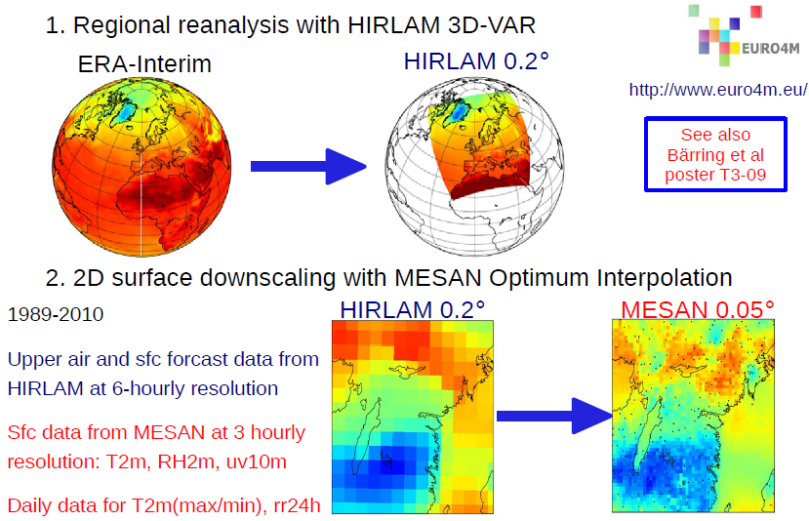
A new high-resolution reference data set
Dahlgren et al., submitted
Landelius et al., submitted

Slide 33
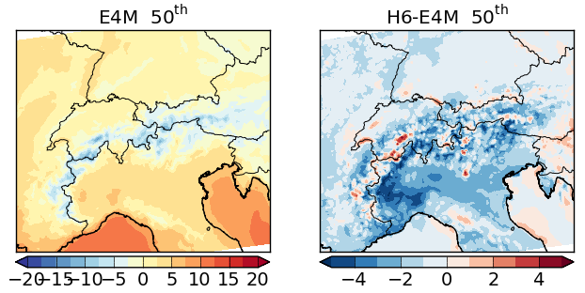
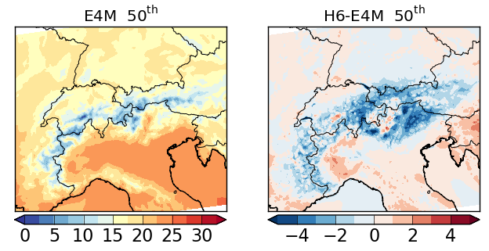
Validating a high-resolution RCM
HARMONIE-Climate
at 6 km forced by
ERA-Interim
Diurnal mean T2m (˚C)
Lindstedt et al. (2015)
DJF
JJA

Slide 34
Validating a high-resolution RCM
HARMONIE-Climate
at 6 km forced by
ERA-Interim
Diurnal mean T2m (˚C)
Lindstedt et al. (2015)
Lakes
DJF
Lakes
JJA

Slide 35
Validating a high-resolution RCM
HARMONIE-Climate
at 6 km forced by
ERA-Interim
Diurnal mean T2m (˚C)
Lindstedt et al. (2015)
DJF
Mountain tops and ridges
JJA

Slide 36
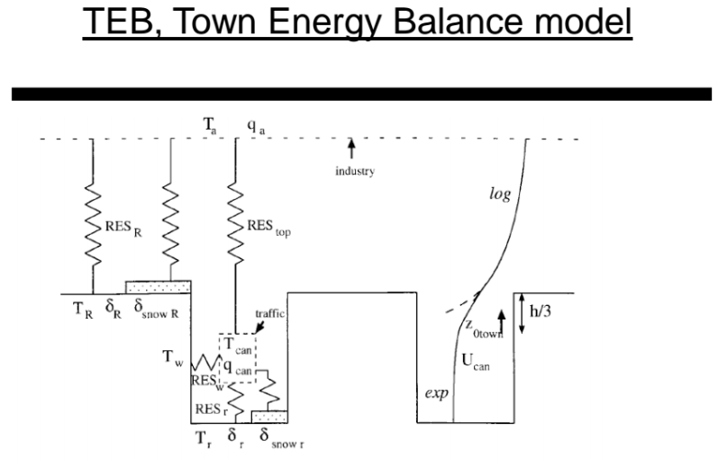
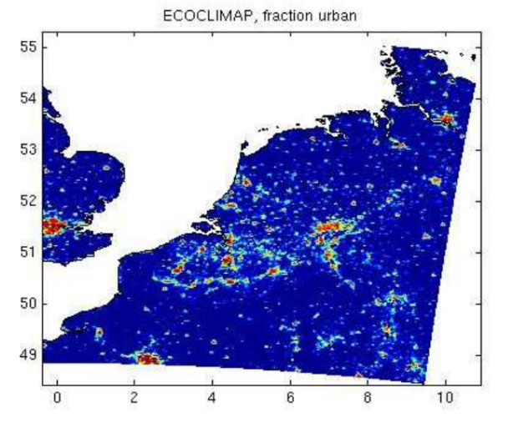
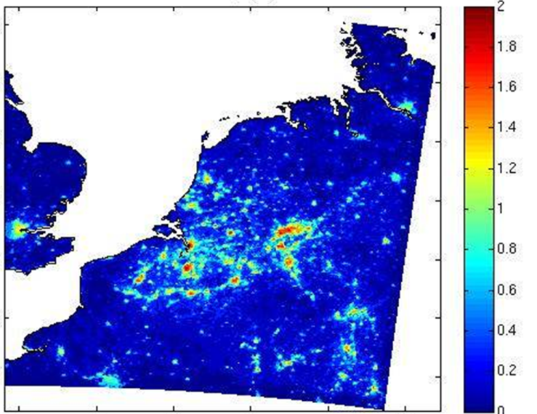
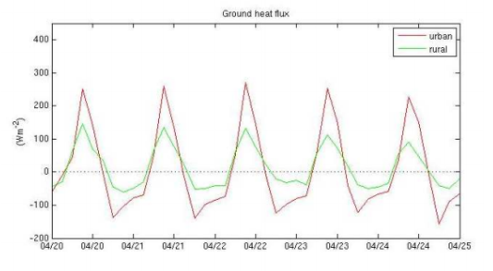
Need for high-resolution observations: Focus on urban applications
The ground scheme includes a module that describes cities implying that the model can simulate the effect of cities on climate
Gives differences in climate:
Here illustrated as monthly mean temperature for April and differences in fluxes between the atmosphere and the ground:

Slide 37
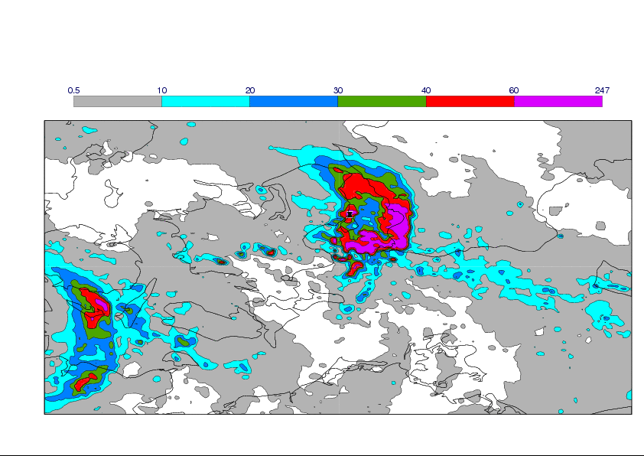
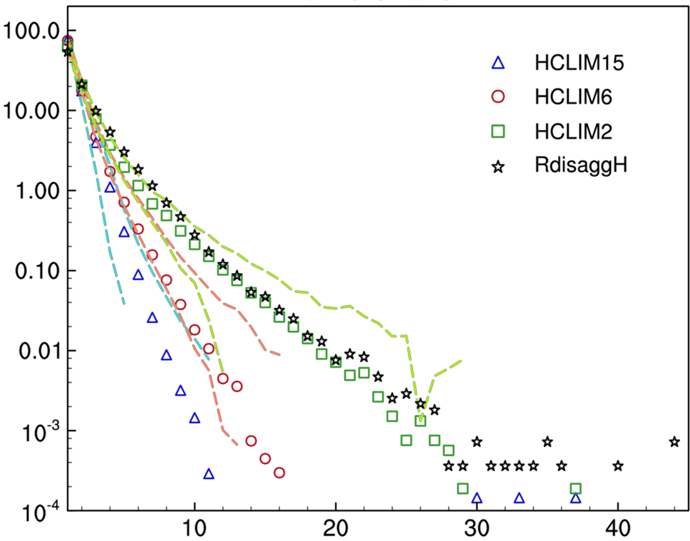
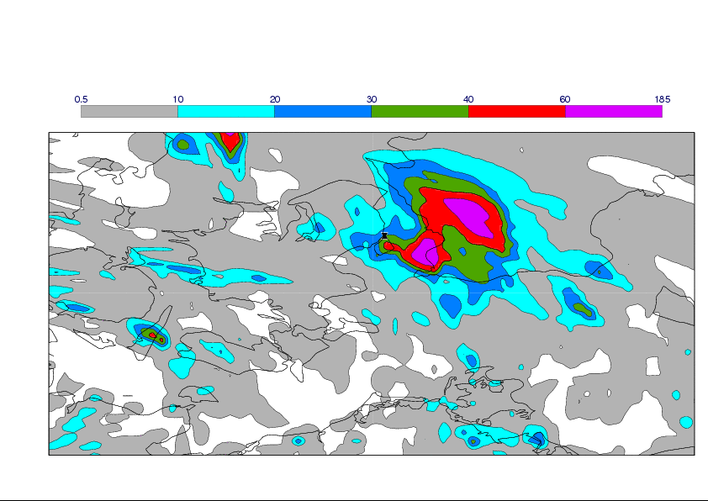
Need for high-resolution observations: Focus on intense precipitation
Precipitation from a weather radar
The diagram shows improved agreement to
observations for intense precipitation in
Switzerland with increasing resolution
Frequency
Forecast from HARMONIE (NWP)
(2.5 km resolution)
Precipitation amount (mm/day)
Kjellström et al., GEWEX Newsletter (2014)
Lind et al., in preparation (2015)

Slide 38
Concluding remarks
High-quality observational data sets needed for model validation, detection/attribution studies and for monitoring of climate change
Earth-system models require new data sets – also on regional scales
Existing observational products somteimes differ considerably
Climate models can to some extent be of use for quality-checking observational data
Future very high-resolution regional climate models will increase demands for high-resolution observational data

Slide 39
Thanks for your attention!

Slide 40

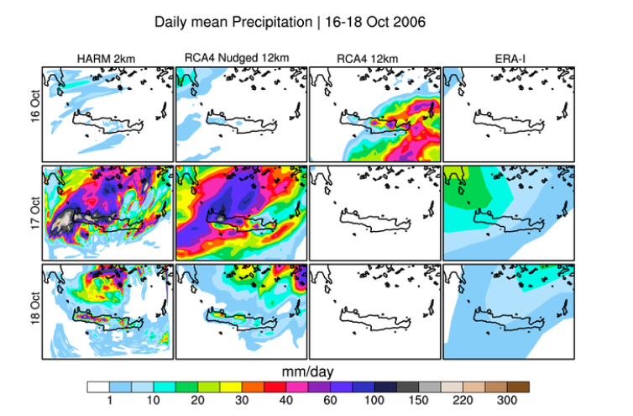
HARMONIE – catching extreme events
Maximum observed precipitation 200 mm/day, station in Western Crete, 17th Oct

Slide 41
Examples of previous studies/papers done at SMHI which are similar to what will be done with the ESA-CCI data

Slide 42
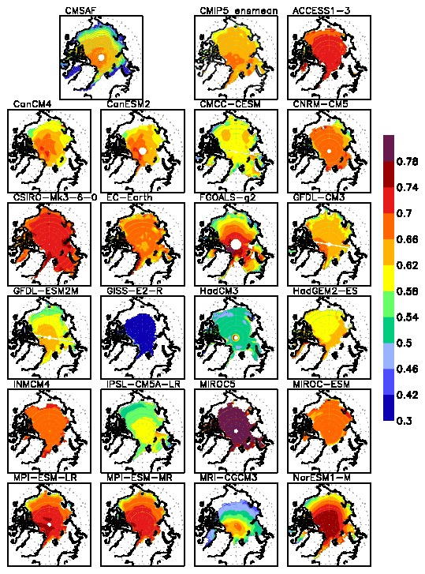
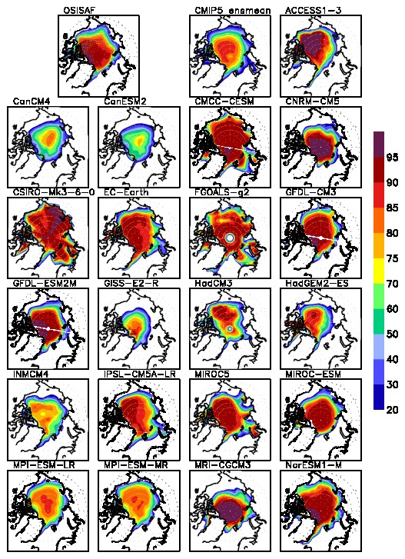

EC-Earth (7 scenarios): Arctic ice extent/albedo study
Rossby Centre and Remote sensing group
Sep sea ice concentration 1982-2005
JJA ice albedo 1982-2005
Observed
Observed
Koenigk et al. 2014
March
(
September
Observed sea-ice
decline (black dots)
faster than all
EC-Earth scenarios
Medium CO2
High CO2
Low CO2
Simulations with observed CO2
Sea-Ice Observations
Koenigk et al. 2013
Notes:
One important apsect of the changing Arctic climate is the decline in sea-ice.
Most CMIP5 models and EC-Earth fail to simulate the fast sea-ice decline that has been
observed during the last 20 years.
This figure show 7 simulations with EC-Earth for different emissions scenarios
(RCP2.6, RCP4.5 and RCP8.5, low medium, high CO2 emissions). The bottom figure show
the sea-ice decline from 1850 to 2100. The model capture the decline but it is not as fast as
observed (the black dots).
The top row show that the sea-ice extent is too large (LHS) and that the summer time
albedo is too high (RHS) in EC-Earth.
The model is too cold for the present day (not shown), therefore the rapid sea-ice
decline for EC-Earth does not occur until about 2040.

Slide 43
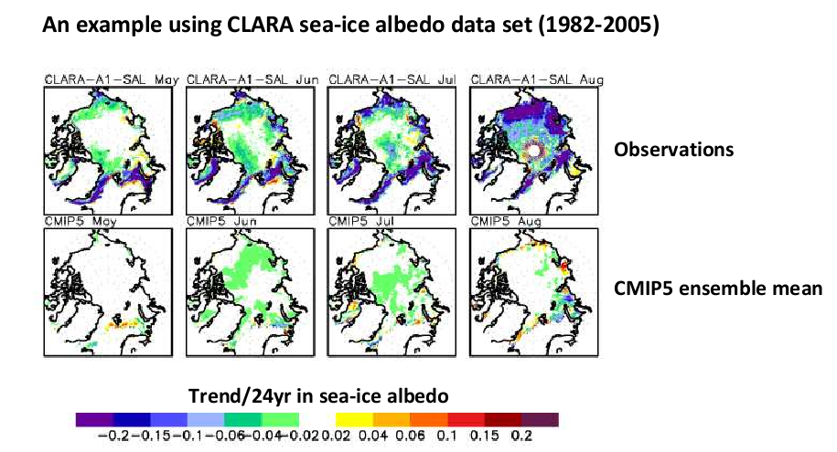
Can CMIP5 models show the decreasing trend in sea-ice albedo?
Königk et al 2014
A similar study investigating trends and corrrelations between sea-ice and cloud changes in observations and CMIP5 models will be done at SMHI

Slide 44
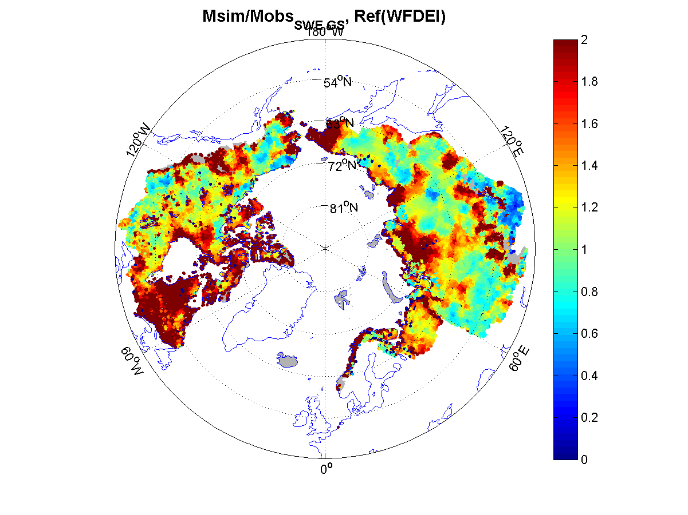
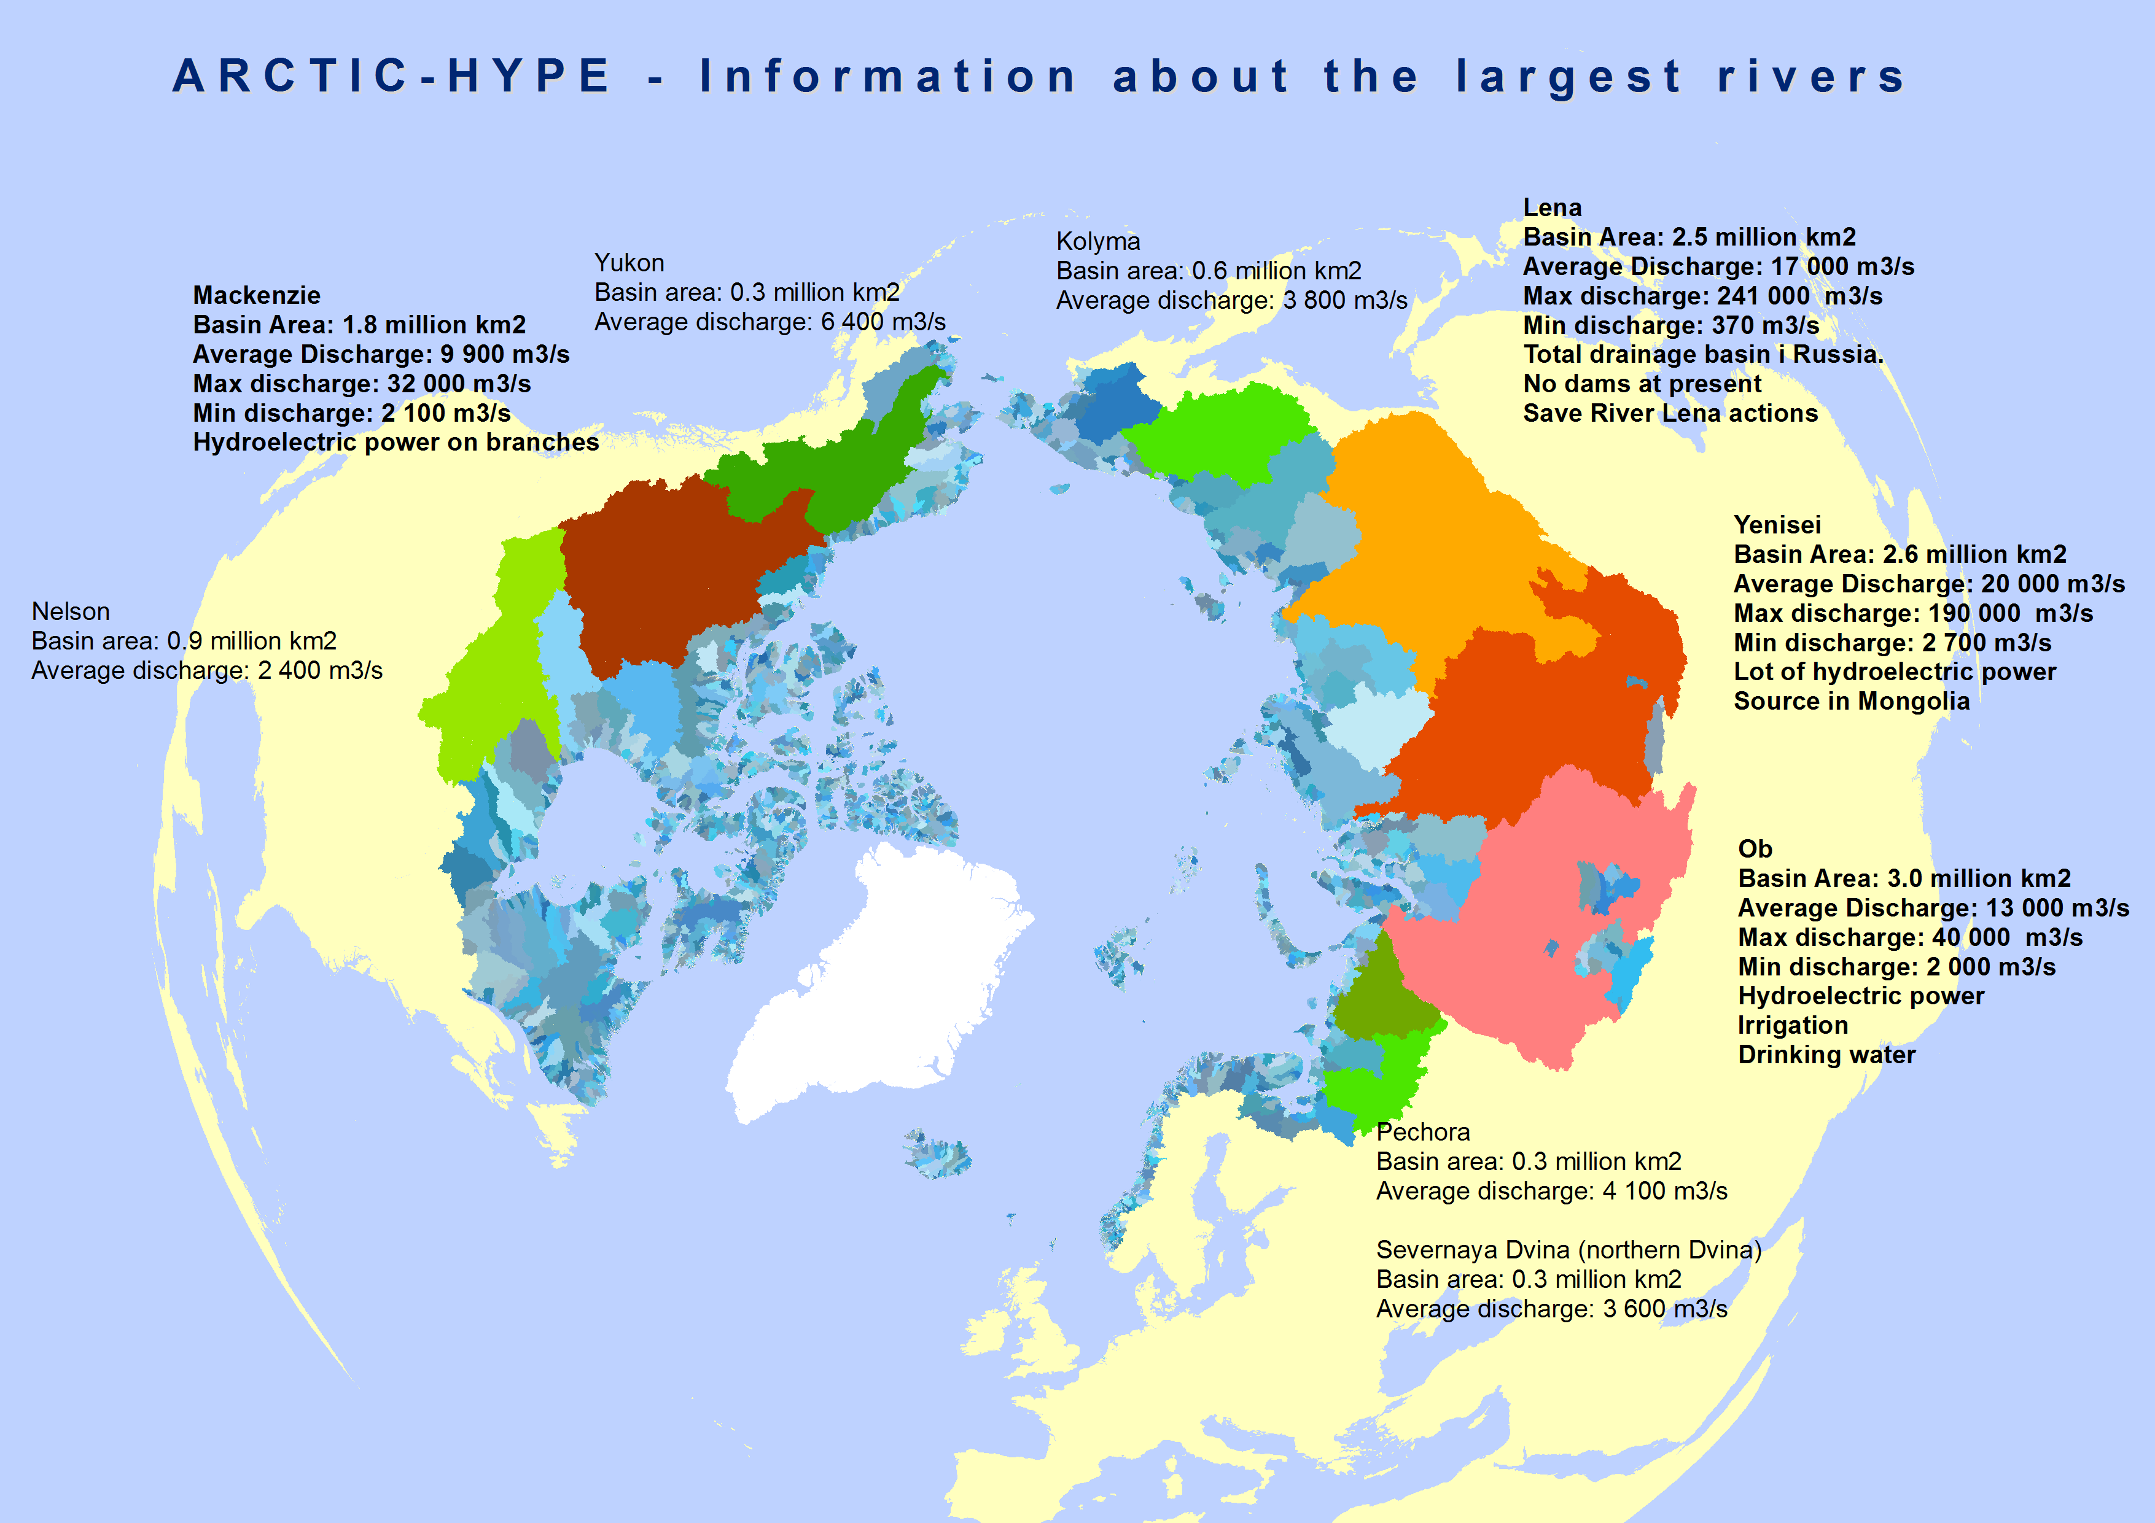
Arctic-HYPE model domain and example of evaluation of snow
GlobSnow satellite based snow water equivalent SWE calibration/evaluation:
Arctic HYPE (Multi-basin large scale
hydrological modelling)
Total Area: 23 x 106 km2
Number of subbasins: 30 777
Discharge to sea: 3300 outlets
Average area of subbasins: 756 km2
Number of individ. lakes: 1800
Glacier data will be cf. to corresponding data in Arctic-HYPE & used in the model parameterization. Land cover will be cf. to changes in simulated river runoff.
Sea level variations will be cf. to simulated and observed river runoff for CMUG
Notes:
VäUpp: observerad SWE, MittUpp: Modellera före uppdatering, HöUpp uppdaterad snö
Vä Ner: Korrektionen, mitt ner Nederbördskorrektion, höger ner, tempkorrektion
44

Slide 45
ESA-CCI CMUG WPś at SMHI

Slide 46


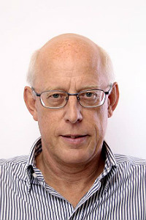



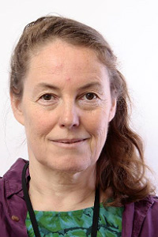

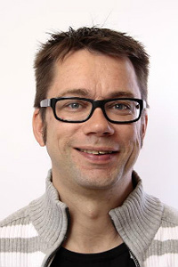













SMHI & ESA CMUG
Director SMHI
Rolf Brennerfeltt
Professional
Services
Core
Services
Research
Pontus Matstoms
Finance
Personel
IT
Stefan
Nilsson
Anneli
Arkler
Madeleine
Benderyd
Esa
Falkenroth
Remote
Sensing
Anke Thoss
Air Quality
Meteorology
Rossby Centre
Erik Kjellström
Oceanography
Hydrology
WP3.8 Regional climate variability
Patrick, Christer, Grisha, David, Petter
Models: CORDEX, RCA, H-CLIM
ECV's: Clouds, SM, SST
WP3.9 Arctic
hydrology
David G, Kristina
Model: Arctic HYPE
ECV's Glacier, LC, SSH
WP3.4 Global climate variability
Abhay, Ulrika, Klaus
Models: CMIP, ECEarth
ECV's: Aerosols, GHG. SM, SST, Clouds
WP4.2 CCI4MIP
Torben, Klaus
Model: ECEarth
ECV's: SST&SIC
IC3 Spain
Omar, Virginie
WP5.1 ESMvaltool
Martin, Ulrika
Notes:
Model development has been a major effort, by all of SWECLIM
Theoretical and analytical studies have helped in putting it all into proper perspective.

Slide 47
WP 3.8: Cross assessments of clouds, soil moisture, water vapour and radiation for regional climate models
- Regional climate variability especially the South American monsoon system (SAMS), the West African monsoon (WAM)
CORDEX existing simulations - Grigory
RCA sensitivity experiments @ 50 km and 12km - Patrick
HCLIM: HARMONIE non-hydrostatic Climate model @ 15 and 5km – David L
Other data: Radiation: CERES-EBAF, CM-SAF, Precipitation: GPCP, TRMM, Temp: HadISST&CRU,Water vapour ATOVS, SSM/I and GPS, Reanalysis data
How do the CORDEX regional climate models simulate cloudiness and soil moisture for the West African and South American regions?
Are observed soil moisture and extreme precipitation relationships captured by CORDEX/ HCLIM simulations at different horizontal resolutions?
Investigate local moisture related feedbacks which are important in the African and South American monsoon development.
Identify key processes in regional climate models affecting the simulated WAM/SAMS that can lead to improvements in representation of the WAM/SAMS in climate simulations. (Metrics in WP O5.1)

Slide 48
WP3.9: Assessment of ESA CCI glacier, land cover and sea level data for hydrological modelling of the Arctic ocean drainage basin
Arctic-HYPE – David Gustafsson
ESA GlobSnow SWE and SE products, R-Arctic Net river discharge
and river temperature, WGMS glacier mass balance
Glacier data will be cf. to corresponding data in Arctic-HYPE & used in the model parameterization.
Land cover will be cf. to changes in simulated river runoff.
Sea level variations will be cf. to simulated and observed river runoff.
Can the CCI Glacier data improve hydrological modelling and the simulated river runoff to the Arctic Ocean?
Is there a relation between changes in observed land cover and the simulated river runoff?
Are the sea level and runoff observations correlated?

Slide 49
WPO3.4 Cross assessment of cloud, soil moisture, aerosols, ozone, GHG, SST, water vapour and radiation global climate variability and trends
Ulrika Willén, Klaus Wyser, Abhay Devastahle, Grigory Nikulin, Torben Königk, Martin Evaldsson
EC-Earth T159, T255 and T511
CMIP5/CMIP6 models
Benchmarking/ comparisons
Process oriented evaluation studies, Statistical analysis
Develop metrics
Metrics used in this study that are not already part of ESMvaltool will be installed there.
Evaluate teleconnection (ENSO, IOD, NAO) patterns in observations using CCI ECVs and other ECVs, investigating known relationships such as between SST and rainfall and new ones derived from the observational data.
Evaluate occurrence and intensity of teleconnection patterns and relationships between ECVs in atmosphere only CMIP5 runs. (Produce metrics for ESMvaltool)
Investigate impact of using higher horizontal resolution on model teleconnection skills.
Investigate impact of using ESA CCI surface boundary conditions (CCI4MIP runs in Task 4) on model teleconnection skills.

Slide 50
WPO4.2 Exploiting CCI products in AMIP experiments
Assessing CCI SST and Sea-Ice data sets
as boundary conditions in CMIP5-like atmosphere-only simulations – CCI4MIP
Klaus
Wyser
Torben
Königk
Ulrika
Willén
Virginie
Guermas
IC3
EC-Earth 128km-50km, T159, T255, T511, AMIP simulations with prescribed SST and Sea-Ice
Seasonal (decadal) prediction runs using CCI SST and Sea-Ice as initial conditions
What is the impact of CCI surface boundary fields on AMIP (atmosphere-standalone) global simulated mean climate and variability?
What is the sensitivity of the impact of the CCI forcing on EC-Earth simulations at different horizontal resolutions?
How are the SST and SI best made consistent to be used for AMIP simulations?
How do the prediction scores vary whether one uses the CCI SST or the ERSSTv3b as reference data set? IC3
Notes:
50

Slide 51

Large-scale circulation (DJF)
Large-scale circulation in RCA4 is close to that in the driving ERA-Interim
MSLP

Slide 52
Large-scale circulation (DJF)
Large-scale circulation in RCA4 driven by GCMs is different to that in ERA-Interim
MSLP

Slide 53
Large-scale circulation (DJF)
Biases originate from underlying GCMs
MSLP

Slide 54

Large-scale circulation (DJF)
-
=
Pronounced anomalies in RCA4 driven by GCMs
over Europe
MSLP

Slide 55
Large-scale circulation (DJF)
-
=
Too strong and too weak westerlies over
the North Atlantic
MSLP

Slide 56
Large-scale circulation (DJF)
-
=
Too strong and too weak westerlies over
the North Atlantic
MSLP

Slide 57
Large-scale circulation (DJF)

Slide 58

2m temperature (DJF)
˚C

