Slide 1


Quality Assurance
Measurement of
Atmosphere climate variables
www.qa4ecv.eu
Measurement of
Land climate variables
Folkert Boersma - CCI CMUG Fourth Integration Meeting, Exeter, 3 June 2014

Slide 2
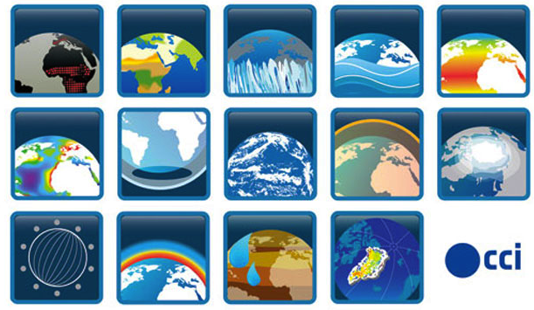
Inspired by CCI logo’s

Slide 3
















Involved partners
Quality Assurance for Essential Climate Variables
K. Folkert Boersma (boersma@knmi.nl)
Co-ordinator
(Precursor GHG)
Jan-Peter Muller (j.muller@ucl.ac.uk) Deputy
Co-ordinator (Land)
FP7-SPACE-2013-1
Project No. 607405
Notes:
Welcome to the kick-off meeting for FP7 project QA4ECV.
We have seen Virginia

Slide 4
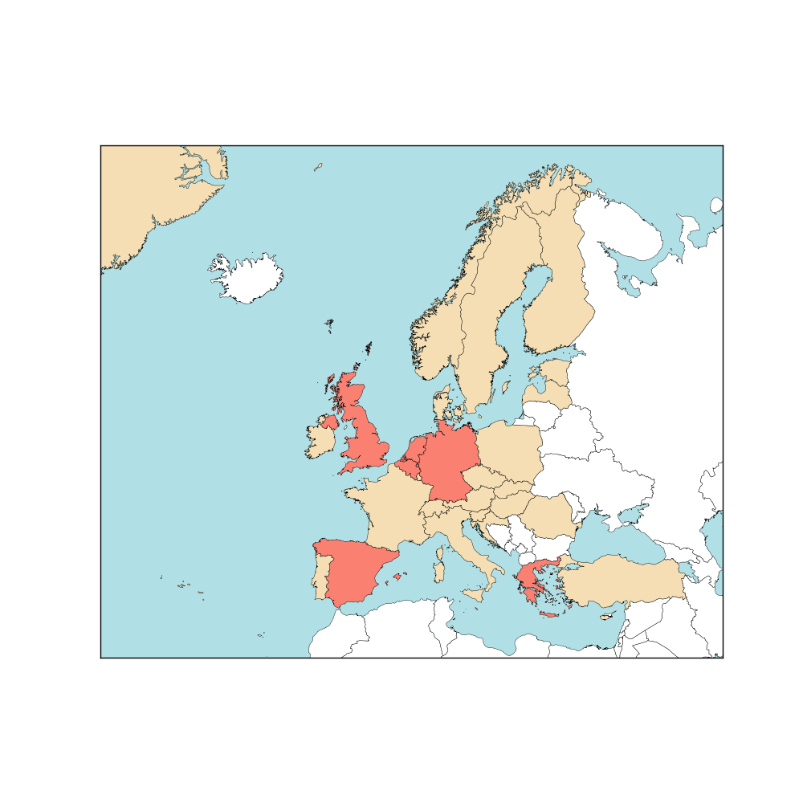
Involved partners
Land experts
Atmosphere experts
QA4ECV is a partnership of:
European scientists
data providers
developers of future climate services
national standards institute
international organisations
17 partners
6 European countries
UK: 3
Netherlands: 3
Belgium: 3
Germany: 4
Spain: 1
Greece: 1
International: 2
Notes:
Welcome to the kick-off meeting for FP7 project QA4ECV.
We have seen Virginia

Slide 5

For Land: data providers often use different instruments and different algorithms to produce the same parameter
Case: Albedo for a single location
N.B. All EO albedos agree with each other BUT disagree with
tower measurements. This is unusual but not uncommon

Slide 6
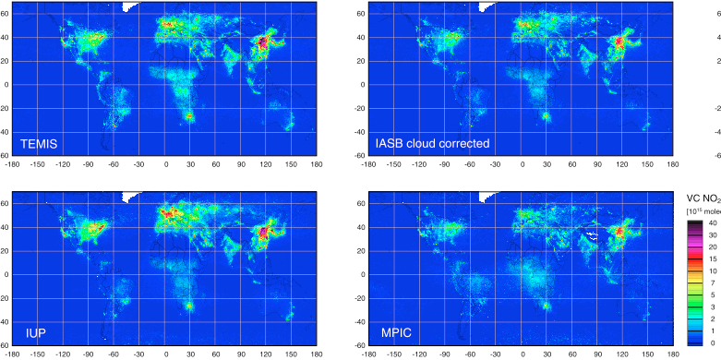
For Atmosphere
Data providers use same instrument but different algorithms
Case: NO₂
Huan Yu, BIRA
5. WP4 Harmonised ECV retrievals & records – QA4ECV Kick-off meeting, 6-7 February 2014, De Bilt
Notes:
Users = scientists, public and commercial customers
Some records are suitable for one particular application, but not for others

Slide 7
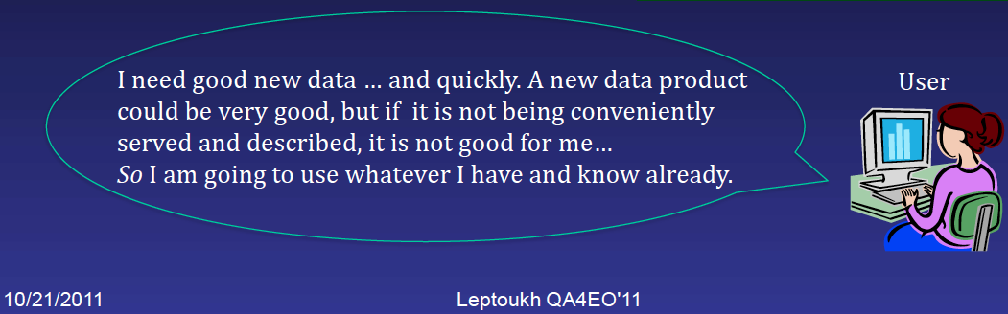
User perspective
This is where QA4ECV comes in
3. Review of the project objectives – QA4ECV Kick-off meeting, 6-7 February 2014, De Bilt
Notes:
Users = scientists, public and commercial customers
Some records are suitable for one particular application, but not for others

Slide 8
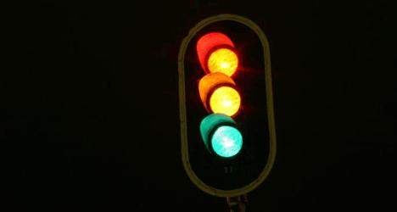
Why QA4ECV is necessary
Users need clear info on validity of EO/climate data sets
Unique records available, but need info on strength/weakness
Need guidance
Need objective system
web portal
Quality Assurance System
Provides traceable quality info on EO/climate data
Tied to international standards
QA tools to support user community in tracing quality
Multi-decadal records for atmosphere/terrestrial ECVs
Maturity | Software readiness | Validation
1 | Under development | …
2 | Minor changes | …
3 | … | Continuous cross-checking
There is a need for quality-assured long-term climate data records
Notes:
Users = scientists, public and commercial customers
Some records are suitable for one particular application, but not for others

Slide 9
QA4ECV project objectives
QA4ECV will show how trustable assessments of satellite data quality can facilitate users in judging fitness-for-purpose of the ECV Climate Data Record.
QA4ECV will provide quality assured long-term Climate Data Records of several ECVs relevant for policy and climate change assessments.
QA4ECV Kick-off meeting, 6-7 February 2014, De Bilt
Notes:
Users = scientists, public and commercial customers
Some records are suitable for one particular application, but not for others

Slide 10
3 Land ECVs and 3 Atmosphere precursors
Land ECVs
Spectral albedo, LAI & FAPAR
Surface and vegetation state
Indicators for land use change, biosphere activity
Measured since 1980s
Evaluate carbon cycle & water cycle in climate models
Atmosphere ECVs
NO₂, HCHO & CO
Air pollutants
Drive ozone and aerosol formation
Measured since 1995/2000
Evaluate atm. chemistry modules in climate models
Provide info on effectiveness of policies, trends in fires etc.
ECV sets do exist to some extent, but they are not necessarily coherent and not quality assured.
Notes:
LAI, FAPAR: VEGETATION, MISR, MERIS, GOES, METEOSAT

Slide 11
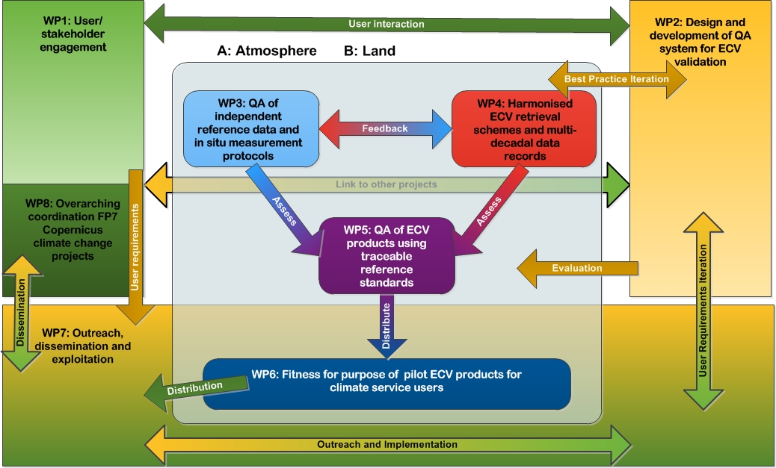
Work flow of QA4ECV
Objective 2
Objective 1
Objective 3
Objective 4

Slide 12
QA framework and tools: based on best practices to facilitate harmonization, evaluation and demonstration of ‘traceability’
Visualisation of status of end to end traceability of process chain enabling robust consistent propagation of uncertainties
  Detailed examples for 6 ECV case studies + top-level for other CCI ECV’s
Harmonisation (bias removal) of sensor-sensor TOA Level 1 data
Prototype a top-level (Copernicus) QA framework to facilitate user confidence in data and information (‘metrological traceability’)
  Means for data providers, including in-situ validation, to evidence QA of data & algorithms reducing duplication of effort of ECV service providers
    Evaluate potential of ‘certification’ process (not ISO but community specific)
  Support for ‘Self’ and ‘external’ audit of traceability and QA
  Identification and means to deliver common ‘international reference standards’
  Guidance, templates, case studies, on uncertainty evaluation, comparisons…
Generalise key principles (e.g. QA4EO) but recognise and demonstrate different implementation methods for different ECV services
      Means for customers to assess ‘fitness for purpose’ (input to maturity matrix)
      Web based interfaces to provide full accessibility of QA information

Slide 13
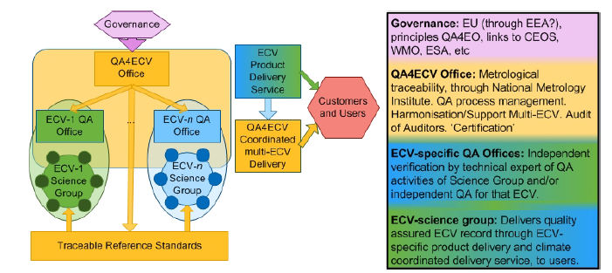

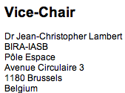
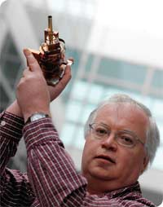
Outline of prototype QA Service to support Copernicus / ESA CCI
Variety of service specific QA implementation routes
Embedded National Metrology Institute to ensure SI traceability
of input data, validation data and delivered information
Forum to share best practise and provide guidance on uncertainties and documenting evidence
‘One-stop-shop’ for ECV QA information/stds

Slide 14
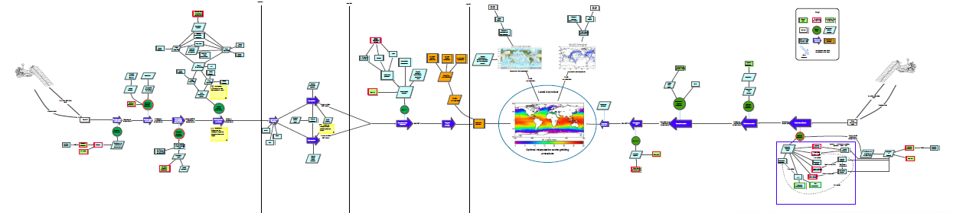
Top-level tool: visualization of traceability
e.g for SST
Tools / support to create web based diagrams showing end to end traceability
  Layers of detail (top level through to detail in a single process)
  Status of metrological traceability: strong, medium, weak
  Type of reference standards
      Embedded links of documentary evidence
  Underpinning equations to propagate uncertainty

Slide 15
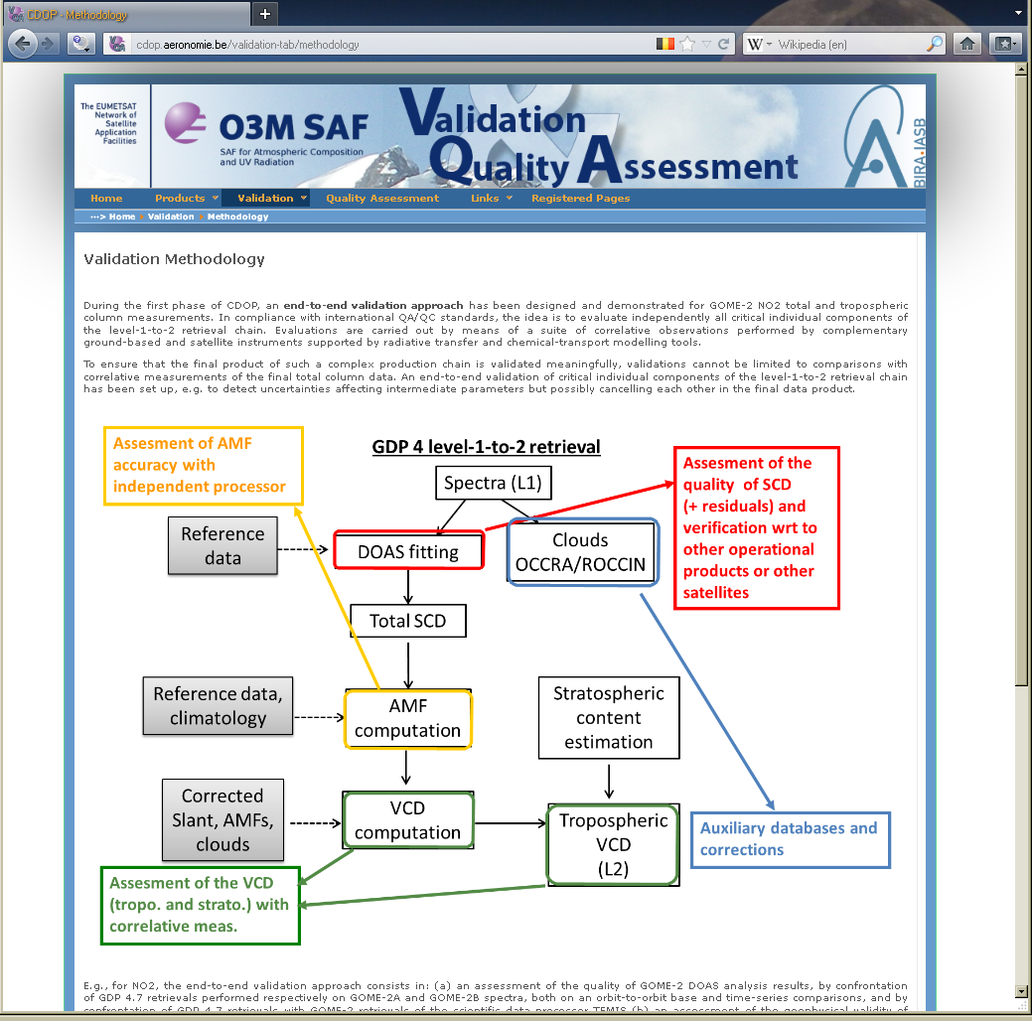
End-to-end validation of the retrieval chain
http://cdop.aeronomie.be

Slide 16
Use of Quality Assurance system
General usage
How to document ECV to demonstrate QA in consistent manner will all be useable by any ECV
Methods and processes to bias correct/harmonise L1 sat data will be useable by all
The framework and methods can be used with minor adaptation of details
Reference standards that can be used to support all ECVs and how they can be made 'traceable'.
Prospective
a Copernicus service (prototype at end of project) is to provide support and review to data providers (to help them deliver QA)
Also service to enable users to independently 'audit' data providers.
Notes:
they will all need their own specific inputs and potentially support to implement but this is all intended to be available.
(although the methods may need to have minor adaptation to suit other than optical domains.
as opposed to the principle on how to ensure in-situ data is QA

Slide 17
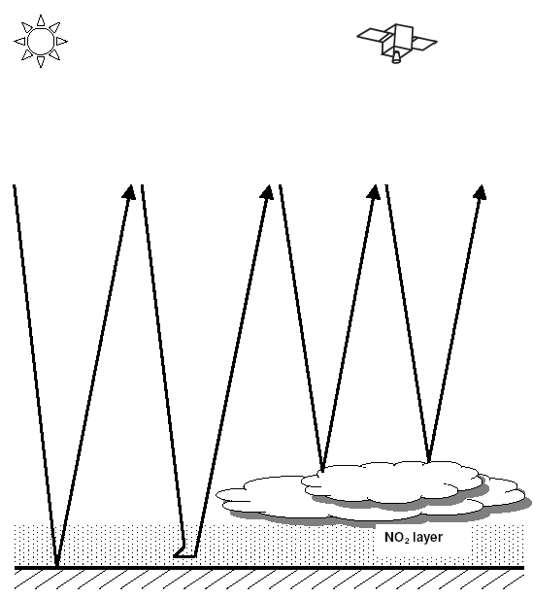
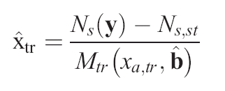
Multi-decadal ECV generation
It is our ambition to:
Produce ECVs based on the community’s best practices
‘State-of-science’
Step-by-step analysis of all components
Per-pixel uncertainty estimate
Example for Atmosphere case
N_{s}, N_{s,st}, M_{tr} are all error sources

Slide 18
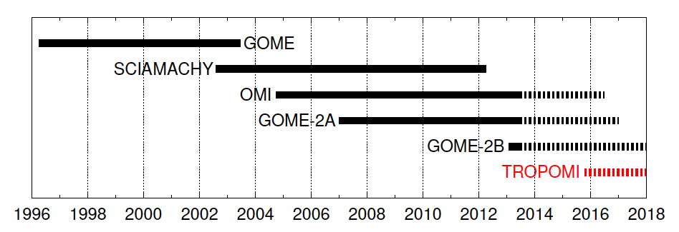
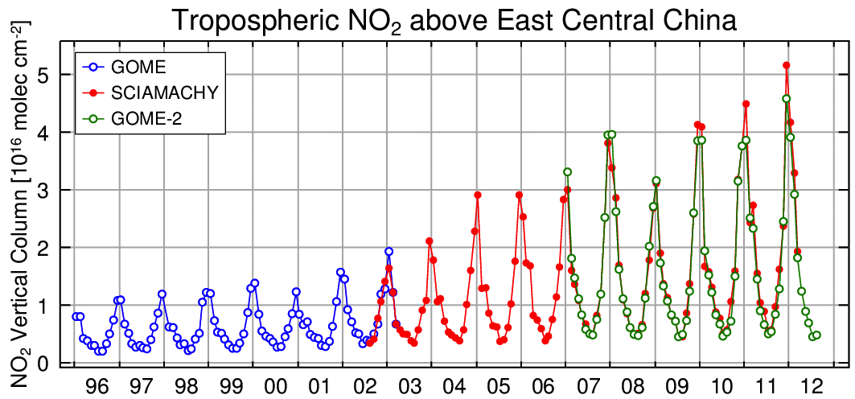
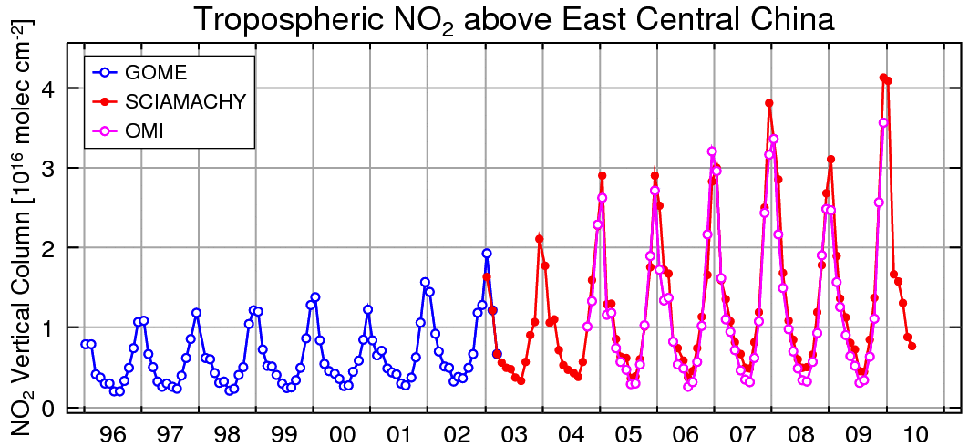
Multi-decadal Atmosphere precursors
NO₂ and HCHO from UV/Vis sensors
A. Richter, IUP Bremen

Slide 19
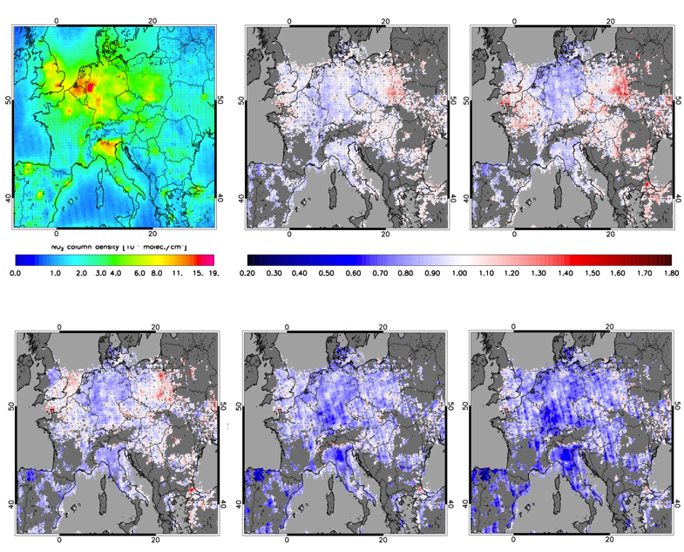
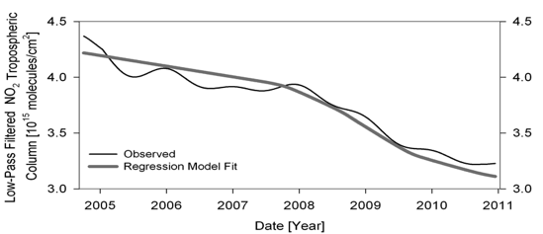
Policy control with OMI NO₂ retrievals over Europe
2005
2006/2005
2007/2005
Continuous reduction (2004-2010): -2% to -5%
Recession Change (2008-2009): -15% to -30%
Castellanos and Boersma, Sci. Rep., 2012
2008/2005
2009/2005
2010/2005
Notes:
Nice picture: but how valid? Did clouds change? Instrument degradation?

Slide 20
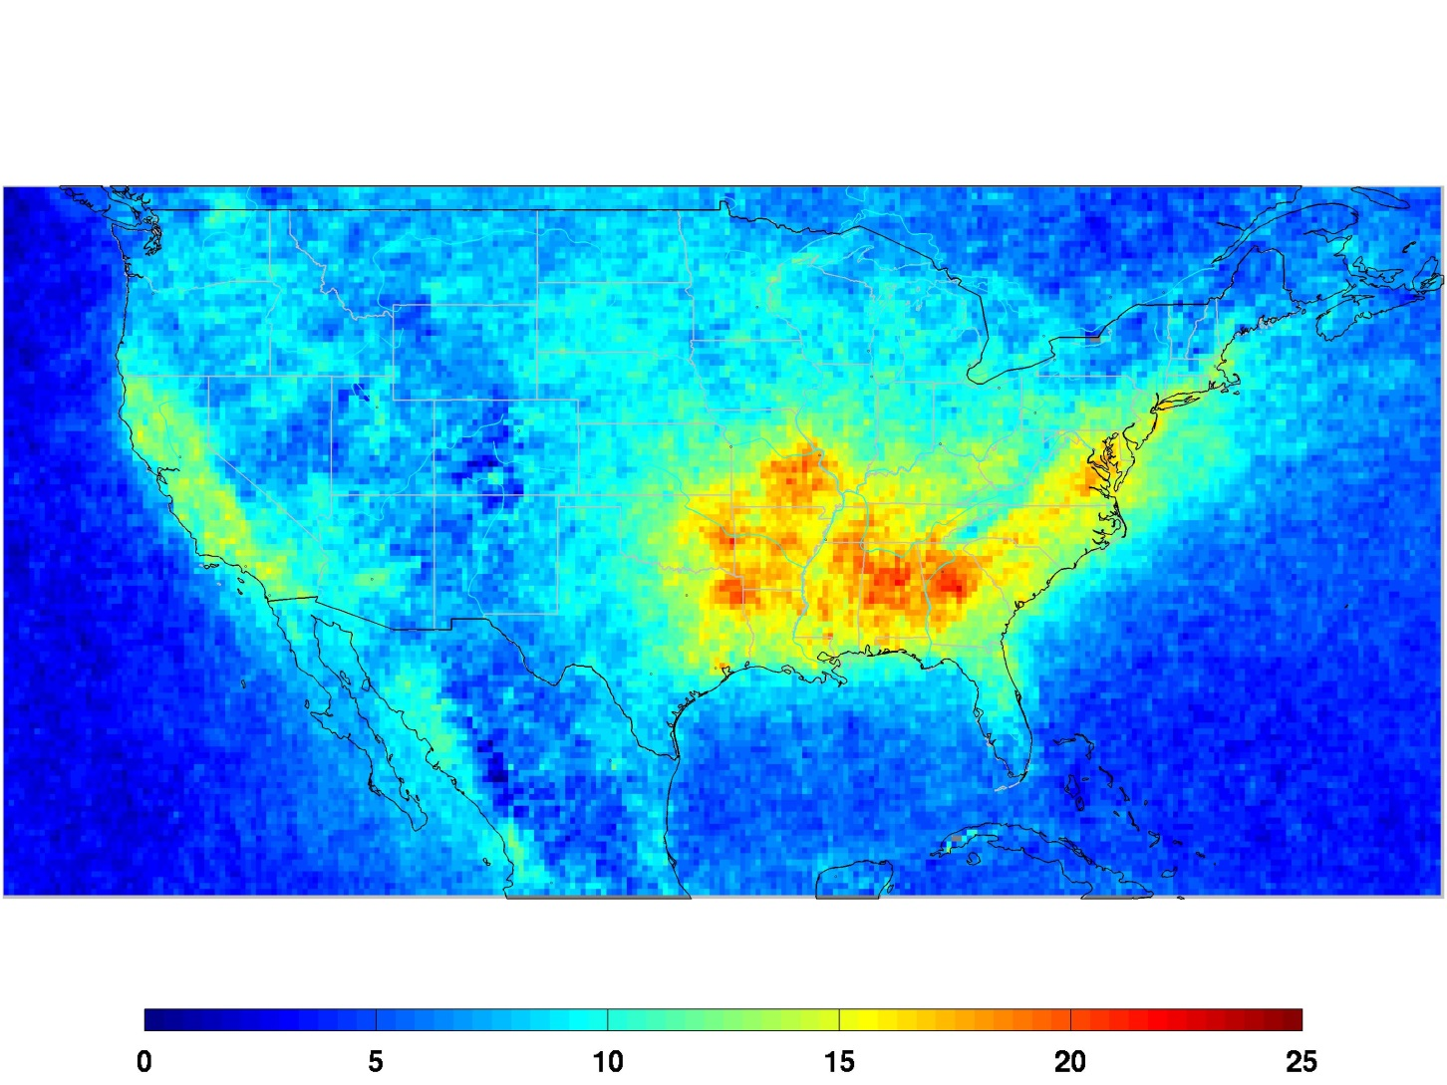
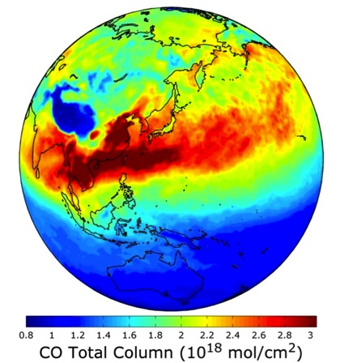
Formaldehyde and CO from space
Formaldehyde signature from vegetation
LOW OZONE CONDITIONS
CO from fires
x10¹⁶ molec.cm⁻² - JJA
De Smedt, BIRA

Slide 21
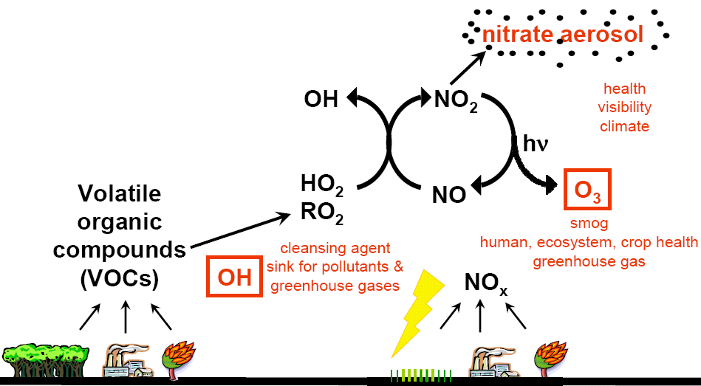
Atmosphere precursors
CO
CO & VOC emissions (HCHO precursor)

Slide 22
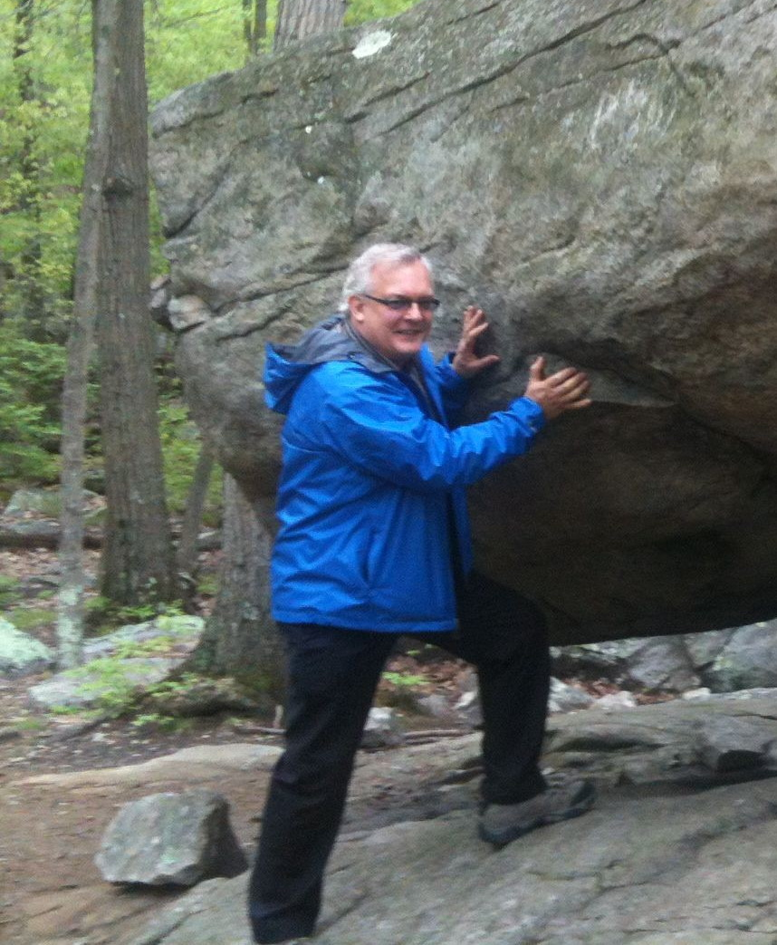
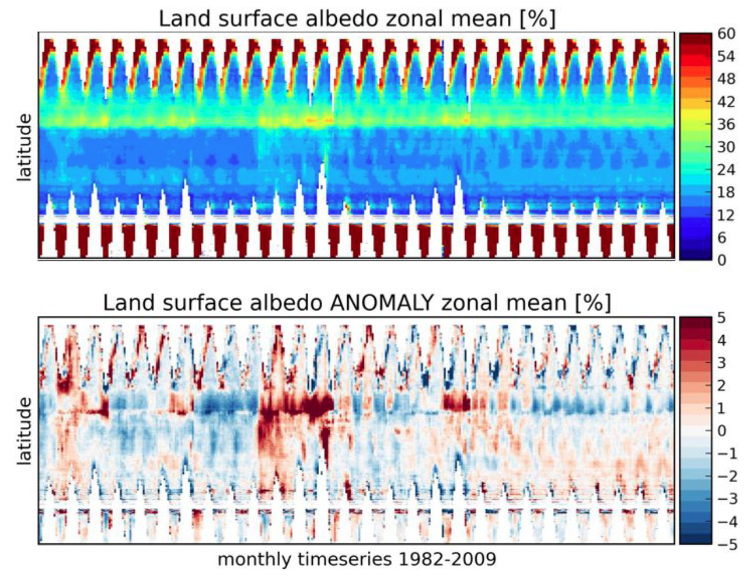
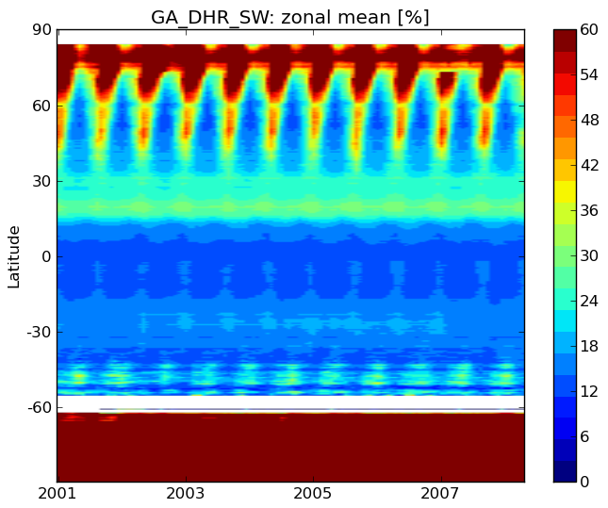
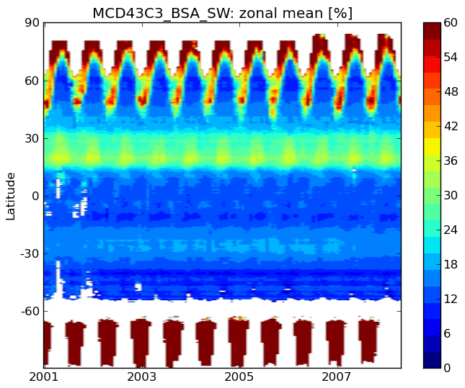
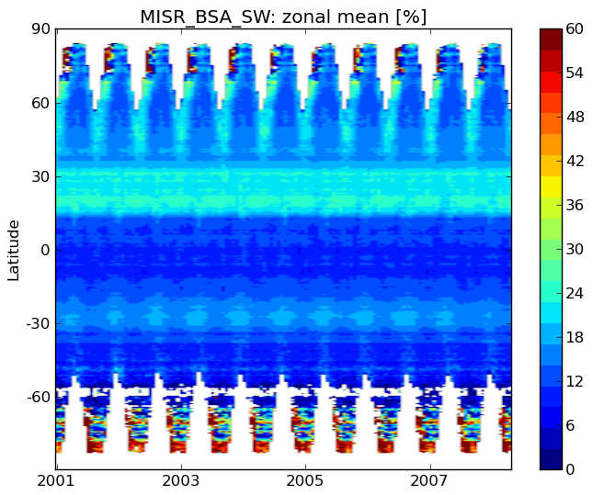
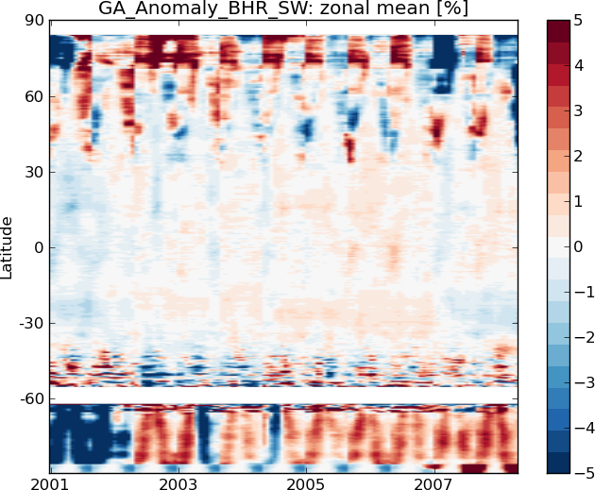
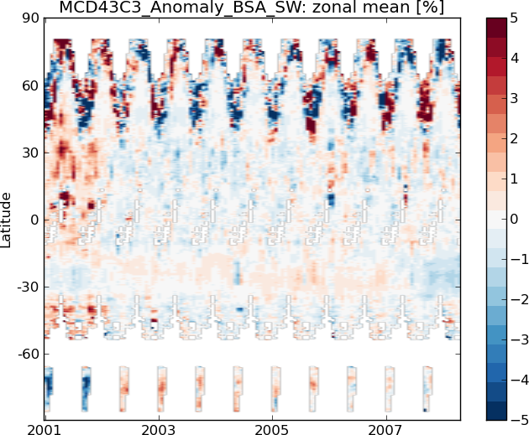
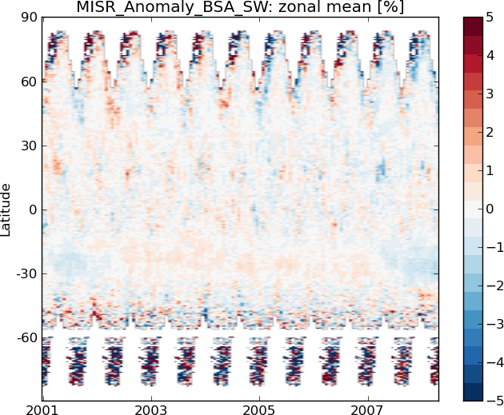
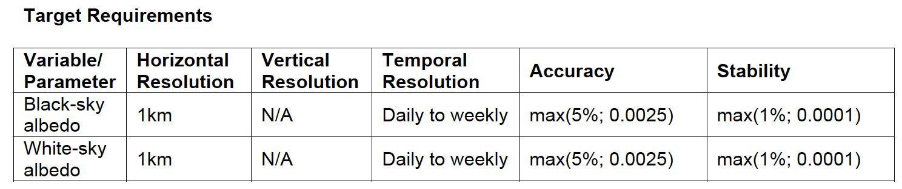
Spectral + broadband albedo (1982 - )
LAI, FAPAR derived from there
CLARA/SAL Plot - Courtesy of
Alexander Loew, MPI
GlobAlbedo
MODIS
MISR
What we need is the fusion of different sensor radiances to provide a consistent albedo output.

Slide 23
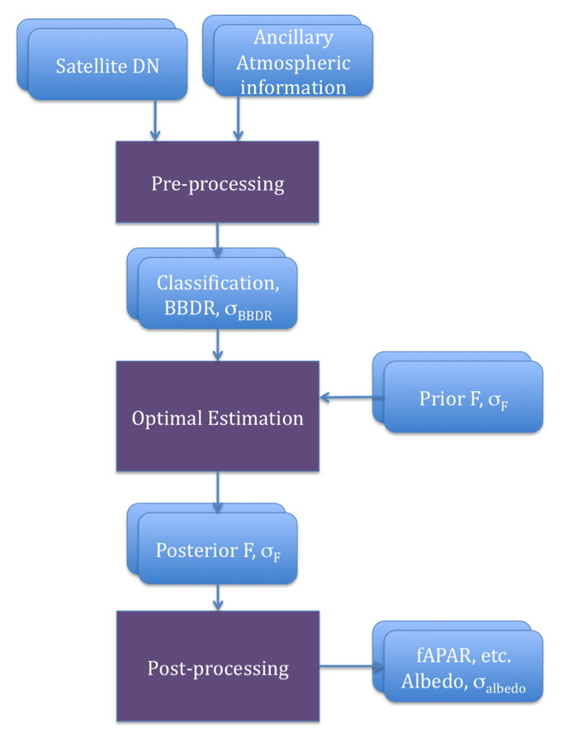
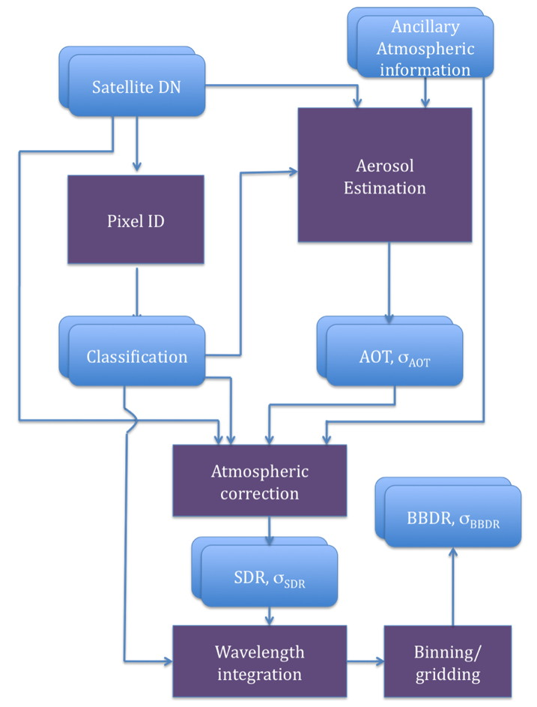
Example of harmonisation : GlobAlbedo (broadband)
Fusion of multiple EO sensors using an optimal estimation framework
Per pixel uncertainty
BBDR consistency between different sensors
Fapar/LAI derived from albedos
QA4ECV will fuse more sensors including GEO to obtain more BRF samples
BC SU
FUB
MERIS, VGT
MODIS
Prior
UCL

Slide 24
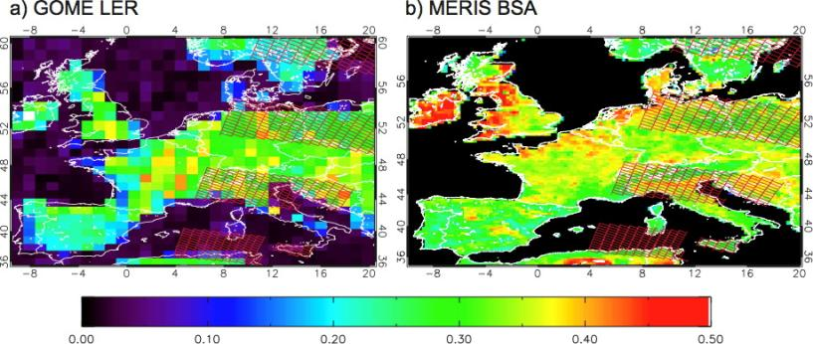
Atmosphere benefits from Land efforts
Surface albedo is a key input parameter in NO₂ and HCHO AMFs
Improved spectral (BRDF) albedo leads to better knowledge of the a priori state vector in Atmosphere ECV retrievals
1º x 1º GOME-LER at 758nm cf 0.25º x 0.25º MERIS AlbedoMap (Muller et al., IGARSS07) for July 2006 showing SCIAMACHY pixels superimposed
Notes:
they will all need their own specific inputs and potentially support to implement but this is all intended to be available.
(although the methods may need to have minor adaptation to suit other than optical domains.
as opposed to the principle on how to ensure in-situ data is QA

Slide 25
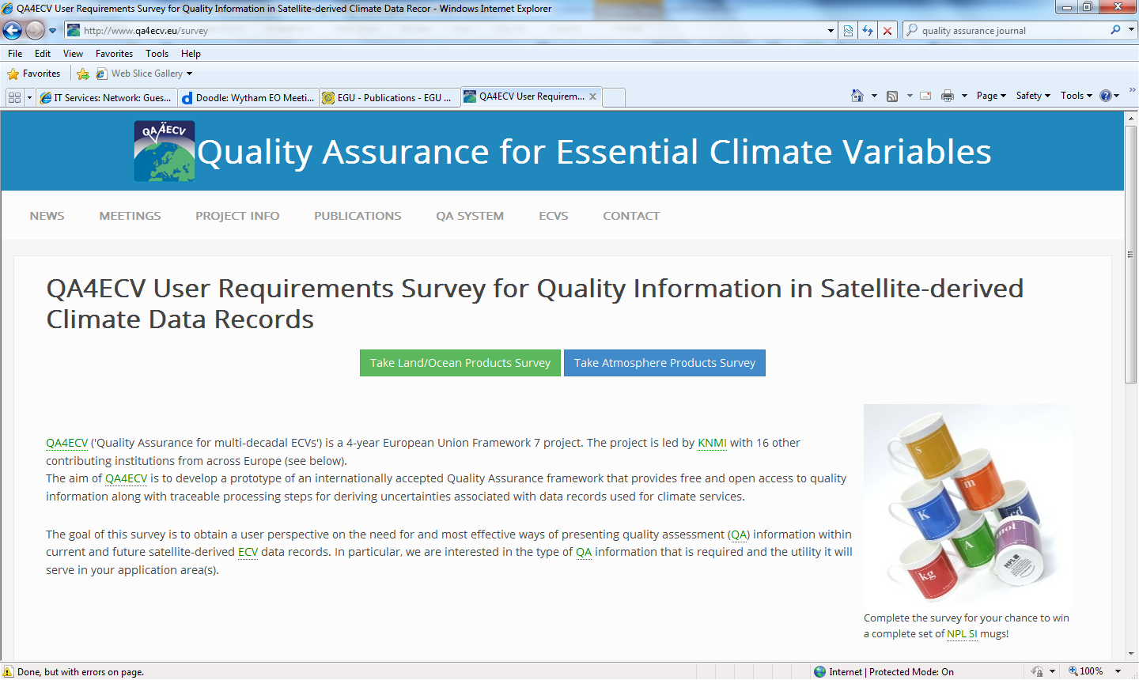
QA4ECV user requirements survey: preliminary results
User requirements of quality assurance for atmosphere and land satellite data products
Link sent to >10,000 people- ~2% response rate
www.qa4ecv.eu/survey

Slide 26
QA4ECV user requirements survey: preliminary results
Quality assurance
Traceability
Uncertainty
Quality flags
Validation
Focused on four aspects of quality assurance:
Notes:
Survey looked at four areas of quality assurance
Quality flags- happiness of the data, does your product have them, are they good enough, what would you like provided?
Tracability- do you known the processing chain of you data? Is the information easily accessible? Would it be useful if you could obtain it?
Validation- testing by independent means
Uncertainty- are there uncertainty values, are they easily accesible,

Slide 27
Quality flags
http://www.qa4ecv.eu/survey
Do the products you use contain quality flags?
Land products
Atmosphere products

Slide 28
Traceability
http://www.qa4ecv.eu/survey
90% of users say that it is important/very important to known the processing chain
Is the processing
chain information
easily accessible?
95% of users would use the data if it were accessible

Slide 29
Are the products you use validated?
http://www.qa4ecv.eu/survey
Validation
Land products
Atmosphere products

Slide 30
Do the products you use include uncertainty values/statement of confidence?
http://www.qa4ecv.eu/survey
Uncertainty
Land products
Atmosphere products

Slide 31
Preliminary conclusions from user survey
If quality assurance information is readily available it would be useful.
Uncertainty and traceability information are the least readily accessible quality assurance components.
Although quality flags are contained in many products these are often insufficient for the application.
Quality assurance in atmospheric products appears better than for land products

Slide 32
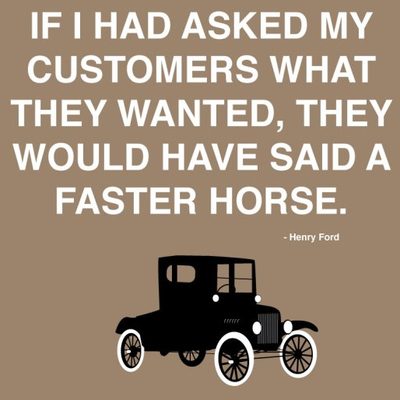
Possible conclusion from supplier survey

Slide 33
Detailed objectives of QA4ECV
1. Rigorous QA methodologies for satellite ECV products
  QA framework applicable to many ECVs
  SW tools for ‘do-it-yourself’ QA
  SI standards as in QA4EO (through NPL)
2. Multi-decadal satellite-derived global ECV records
  3 Terrestrial and 3 Atmospheric ECVs w/ global coverage
  Not yet covered by ESA or EUMETSAT activities; 20-30 yr
3. Traceable QA applied to ECV retrievals and products
  QA4ECV approach applied to independent reference data, ECV retrievals, and final products
4. Information on quality and fit-for-purpose nature of datasets
  QA Office to audit ECV records against GCOS, WMO crit.
  Assess impact of ECV records for applications
Notes:
Applications include model evaluation, trend analysis, variability analysis, inverse modelling, emission monitoring

Slide 34

Validation and User Requirements
HARMOZ L2 | Total uncertainty |  |  |  |  |  |  |  |  | Stability |  |  | Ex-ante rnd error | Consistency representation
 | UTLS |  |  | LS |  |  | MA |  |  | UTLS | LS | MA
 | Trop | Mid | Pol | Trop | Mid | Pol | Trop | Mid | Pol | Network | Network | Network |  | Bias | Comp. spread | Drift
User req. | – |  |  | 8–15% |  |  |  |  |  | – | 1–3% / decade |  | – | –
GOMOS |  |  |  | < 30 hPa | < 50 hPa | high S |  |  | high S |  | < 30 hPa |  | low |  | < 50 hPa
MIPAS |  |  |  | < 50 hPa | < 80 hPa | high S |  |  |  |  |  |  | low | Trop. UTLS | < 50 hPa
SCIA |  |  |  | < 50 hPa | < 70 hPa | high S |  |  |  |  |  | 4–10 hPa | high | Trop. UTLS | < 50 hPa
OSIRIS |  |  |  | < 50 hPa | < 70 hPa | high S |  |  |  |  |  | > 4 hPa | low | Trop. UTLS | < 50 hPa
SMR | no data |  |  | single profile noise > 20% |  |  |  |  |  | no data |  | > 8 hPa |  |  | < 50 hPa
ACE-FTS | – |  |  | – | < 80 hPa | high S | – |  |  |  |  | – | low |  | < 50 hPa
Compliant with user requirements? | YES | UTLS | TP ± 3km | Tropics | 0–30°
 | PARTIAL | LS | TP – 25km | Mid | 30–60°
 | NO | MA | > 25km | Polar | 60–90°
Courtesy D. Hubert, ESA Ozone_cci Final Review

Slide 35
Validation and User Requirements
NADIR L2 | Part atmos. | URD / PVP | GOME (1997) | GOME-2 (2007-2008)
Filtering |  |  | ~ 3 % | ~ 10 %
Geographical sampling |  |  | SAA and mid-Asia missing | SAA missing
DFS |  |  | 5 to 5.5 | 5 to 6
Vertical resolution (resolving length estimate) | TS | 6 km to TS-col. | > 50 km | > 50 km
 | UT/LS | 3 to 6 km | 10 to 20 km | 10 to 20 km
 | MA | 3 to 10 km | > 50 km | > 50 km
Height registration offset | TS | / | 5 to 20 km (SZA dep.) | 5 to 20 km (SZA dep.)
 | UT/LS |  | negligible | negligible
 | MA |  | -10 to -30 km | -10 to -30 km
Accuracy (bias) | TS | / | -10 to -30 % (-5 DU) | 7 to 8 % (1 DU)
 | UT/LS |  | -5 to 15 % (-2 to 5 DU) | 1 to 4 % (1 DU)
 | MA |  | -15 to 0 % (-3 to 0 DU) | -15 to 0 % (-3 to 0 DU)
Temporal dependence |  | / | Hardly any | Increased bias around and below TP for northern hemisphere winter
Meridian dependence | 60-90 | / | Negative bias around and below TP, small positive around ozone maximum | Negative bias around and below TP, positive around ozone maximum
 | 30-60 |  | Negative bias below TP | Negative bias below TP
 | 0-30 |  | Increased bias below TP | Increased bias below TP, related to bias for small SCD values
SCD dependence |  |  | Relation with meridian dependence less clear | Clearly related to meridian dependence
CF dependence |  |  | Slightly decreasing (more negative) bias with CF | Slightly decreasing (more negative) bias with CF
Comparison spread | TS | / | 10 to 15 % (2 to 5 DU) | 30 to 35 % (4 to 5 DU)
 | UT/LS |  | 5 % (3 DU) | 5 % (3 DU)
 | MA |  | 5 to 10 % (0 to 3 DU) | 5 to 10 % (0 to 3 DU)
Satellite random uncertainty | TS | / | 10 to 40 % | 10 to 30 %
 | UT/LS |  | ~5% | ~5%
 | MA |  | 3 to 5 % | 3 to 5 %
Total uncertainty | TS | 10% | 14 to 50 % | 12 to 36 %
 | UT/LS | 8% | 7 to 16 % | 5 to 7 %
 | MA | 8% | 3 to 18 % | 3 to 18 %
Courtesy A. Keppens, ESA Ozone_cci Final Review

Slide 36
How will QA4ECV reach its objectives?
Step 1: Develop a Quality Assurance System
Use of QA tools and methods for any ECV?
QA tools and methods useful for Copernicus Climate Service?
Demo of best practices in QA4ECV useful to Copernicus Services
The top-level tools developed: traceability assessment & visualisation
(uncertainty propagation), templates for evaluating and presenting
uncertainty, best practise on QA of validation data (comparisons how to
run/analyse etc) . How to document ECV to demonstrate QA in consistent
manner will all be useable by any ECV, they will all need their own
specific inputs and potentially support to implement but this is all
intended to be available.
Notes:
NPL has a strong connection with the project leads for the ESA CCIs on Sea Surface Temperature (SST) and Ocean Colour (OC)
Initial discussions have already begun with ESA’s Climate office to look at how they might recommend the interaction of QA4ECV with the phase 2 of CCI.
We can start a dialogue with all the CCI projects now and encourage inclusion of options to aid engagement with QA4ECV within their projects.

Slide 37
How will QA4ECV reach its objectives?
Step 1: Develop a Quality Assurance System
Use of QA tools and methods for any ECV?
QA tools and methods useful for Copernicus Climate Service?
Demo of best practices in QA4ECV useful to Copernicus Services
The top-level tools developed: traceability assessment & visualisation
(uncertainty propagation), templates for evaluating and presenting
uncertainty, best practise on QA of validation data (comparisons how to
run/analyse etc) . How to document ECV to demonstrate QA in consistent
manner will all be useable by any ECV, they will all need their own
specific inputs and potentially support to implement but this is all
intended to be available.
Notes:
NPL has a strong connection with the project leads for the ESA CCIs on Sea Surface Temperature (SST) and Ocean Colour (OC)
Initial discussions have already begun with ESA’s Climate office to look at how they might recommend the interaction of QA4ECV with the phase 2 of CCI.
We can start a dialogue with all the CCI projects now and encourage inclusion of options to aid engagement with QA4ECV within their projects.

Slide 38
Maturity Matrix
Notes:
Users = scientists, public and commercial customers
Some records are suitable for one particular application, but not for others

