Slide 1
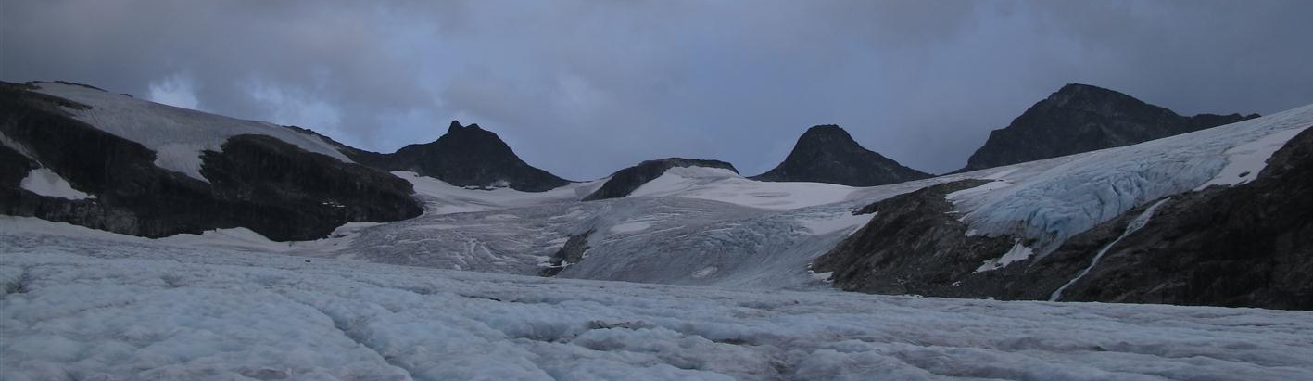
Glaciers
Liss M. Andreassen
Section for glaciers, snow and ice
Norwegian Water Resources and Energy Directorate
lma@nve.no

Slide 2
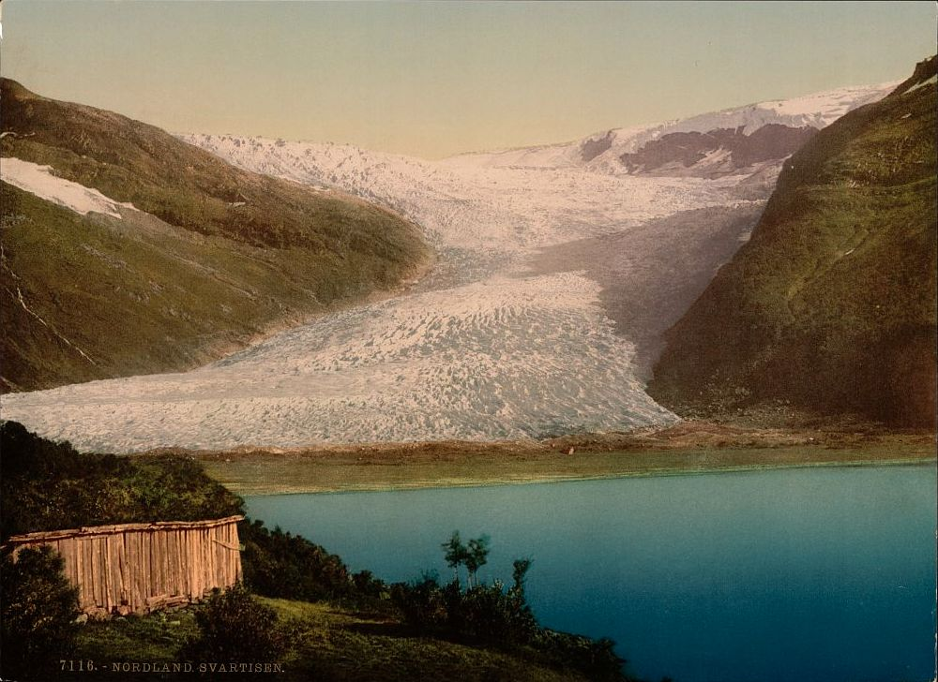
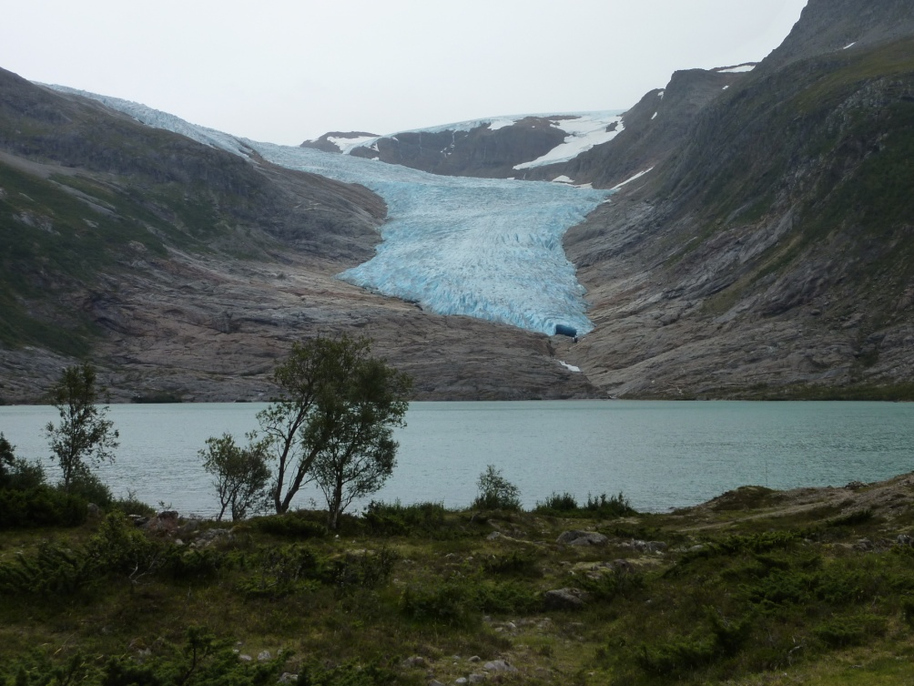
Glaciers in Norway are changing too
Engabreen
~1900: Library of congress
2011: Hallgeir Elvehøy

Slide 3
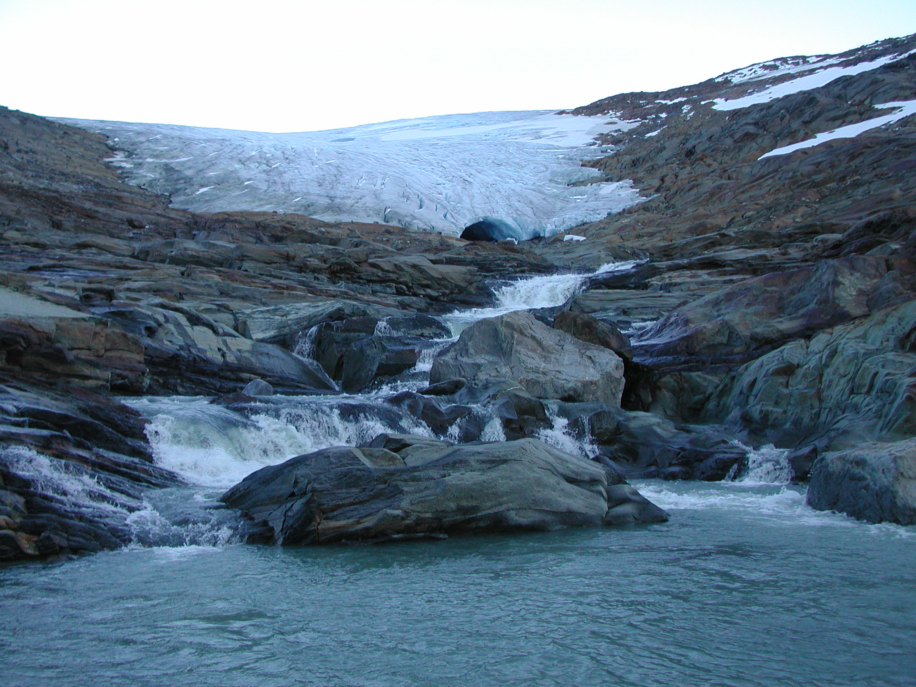
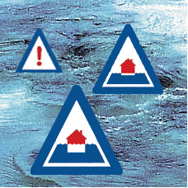
About NVE
NVE is a directorate under the Ministry of Petroleum and Energy with responsibility for the management of the nation’s water and energy resources
NVE central in flood and accident control planning and responsible for maintaining the national power supply
National flood warning services
Rundvassbreen. Photo: M. Jackson
Research & Development
Ensure that NVE is a major R&D force in
the energy and water resource sector
Hydrology Department carries out research within field of expertise
    Section for glaciers, snow and ice responsible for snow avalanche forecasting, snow, ice & glacier monitoring +++
Figure: NVE

Slide 4
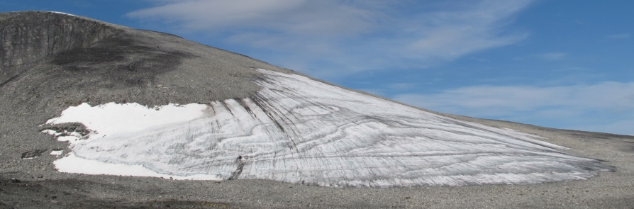
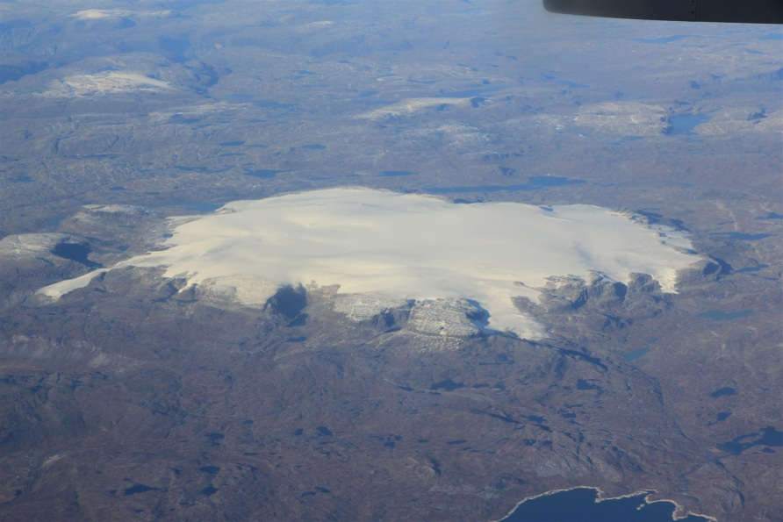
Glaciers in mainland Norway
Motivation
Glaciers have importance for hydropower and tourism
Glaciers are sensitive climate indicators (IPCC, 2007; 2013)
Glaciers can be dangerous: outburst floods & ice falls
Facts
Glacier cover 0.7% of land area, 2692 ± 81 km²
(Andreassen & Winsvold, 2012, CryoClim)
Total of 2534 (3143) glaciers
Glacier types: small ice patches >> large ice caps
Ice patch Juvfonne. Photo: L.M. Andreassen
Ice cap Hardangerjøkulen. Photo: Bjorstad/Flatmo

Slide 5
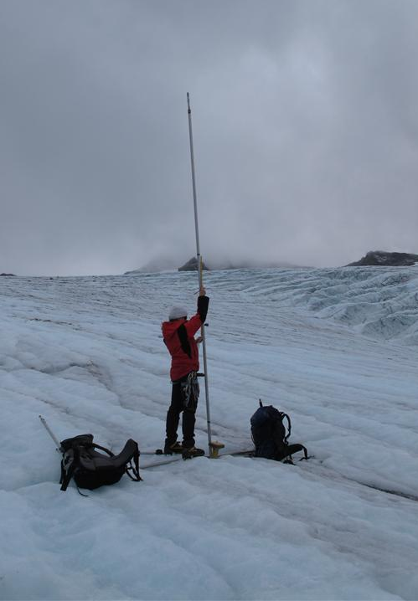
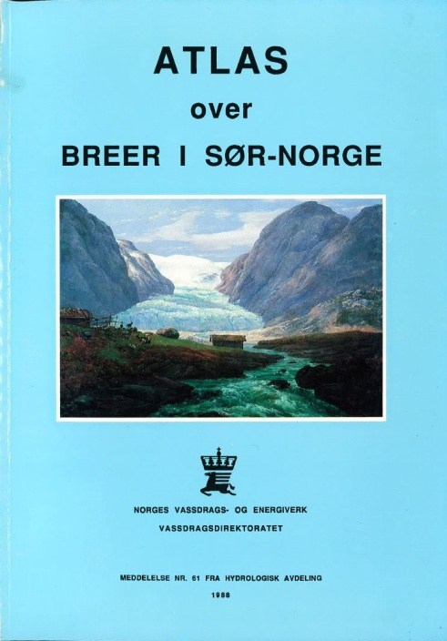

Glacier monitoring
mass balance (since 1949)
length change (since 1899)
map surveys of selected glaciers
special investigations
(ice velocity, thickness, hydrology etc)
Glacier inventories
Inventories South (1969, 1988) North (1973)
Data tables exist digitally, but not outlines.
-> Need of a new updated digital inventory
Updated survey of glaciers (GLIMS)
Change assessments (area and length)
Map glacier lakes -> possible GLOF sites
Baseline for modelling & access future changes

Slide 6

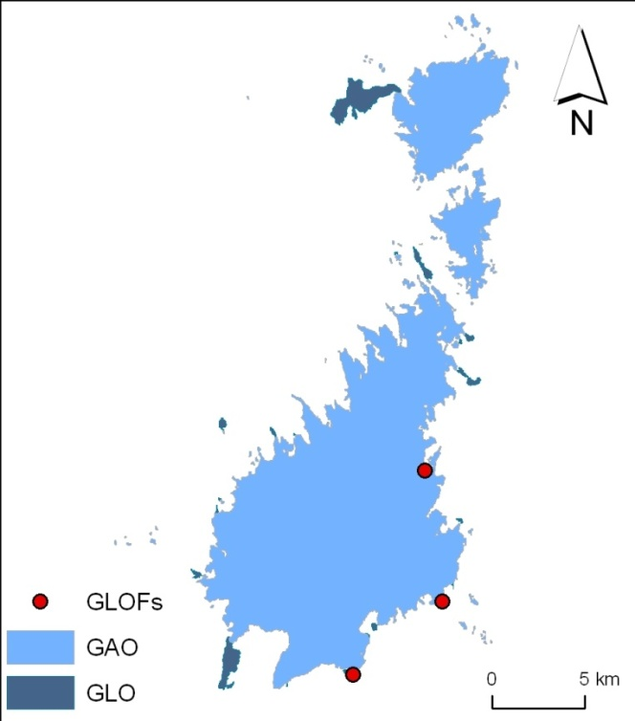
Glacier products
Glacier Area Outline - GAO
(wms, shape, 3 (4) data sets)
Glacier Lake Outline – GLO
(wms, shape, 2 data sets)
Glacier Lake Outburst Flood - GLOF
(wms, points & web application)
Climate Indicator products – CI
(web application)
  Surface mass balance
  Glacier length
  Glacier area
Folgefonna

Slide 7
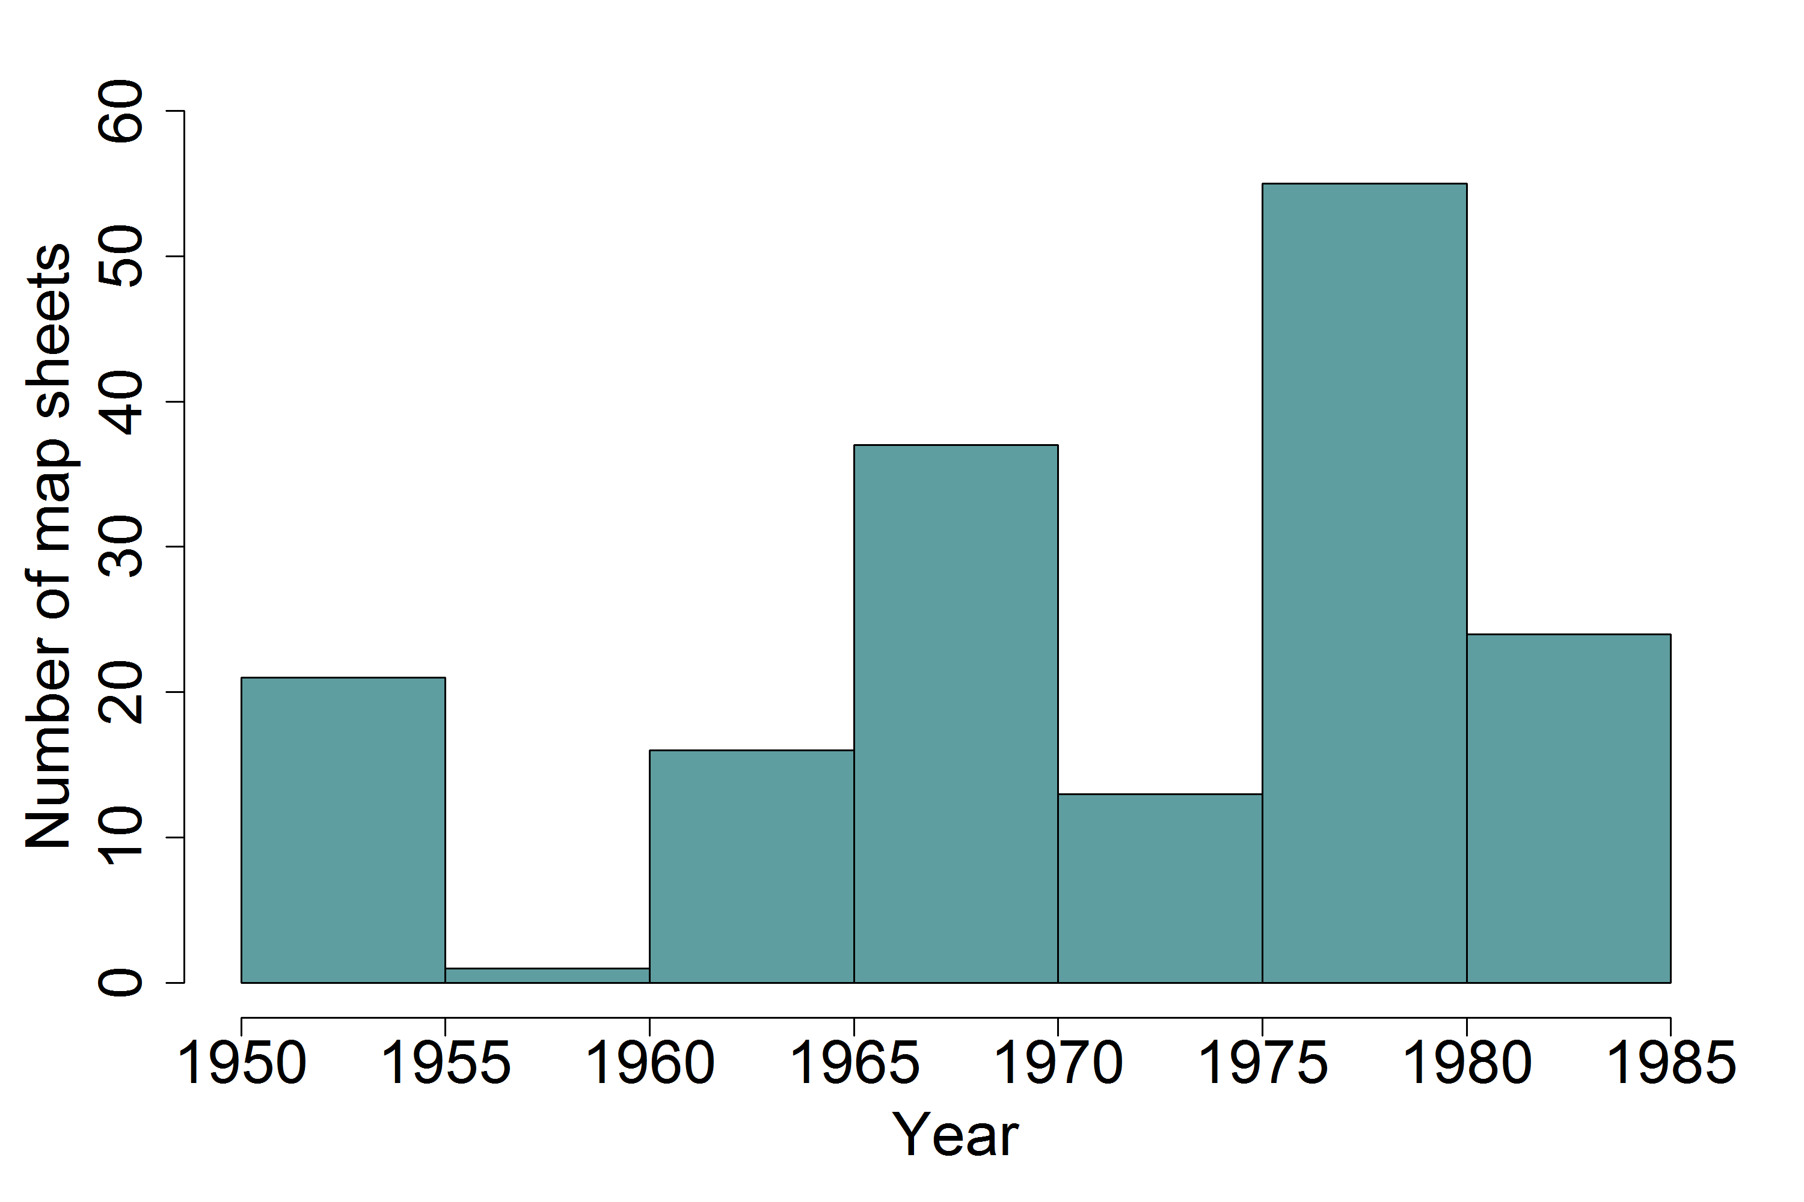
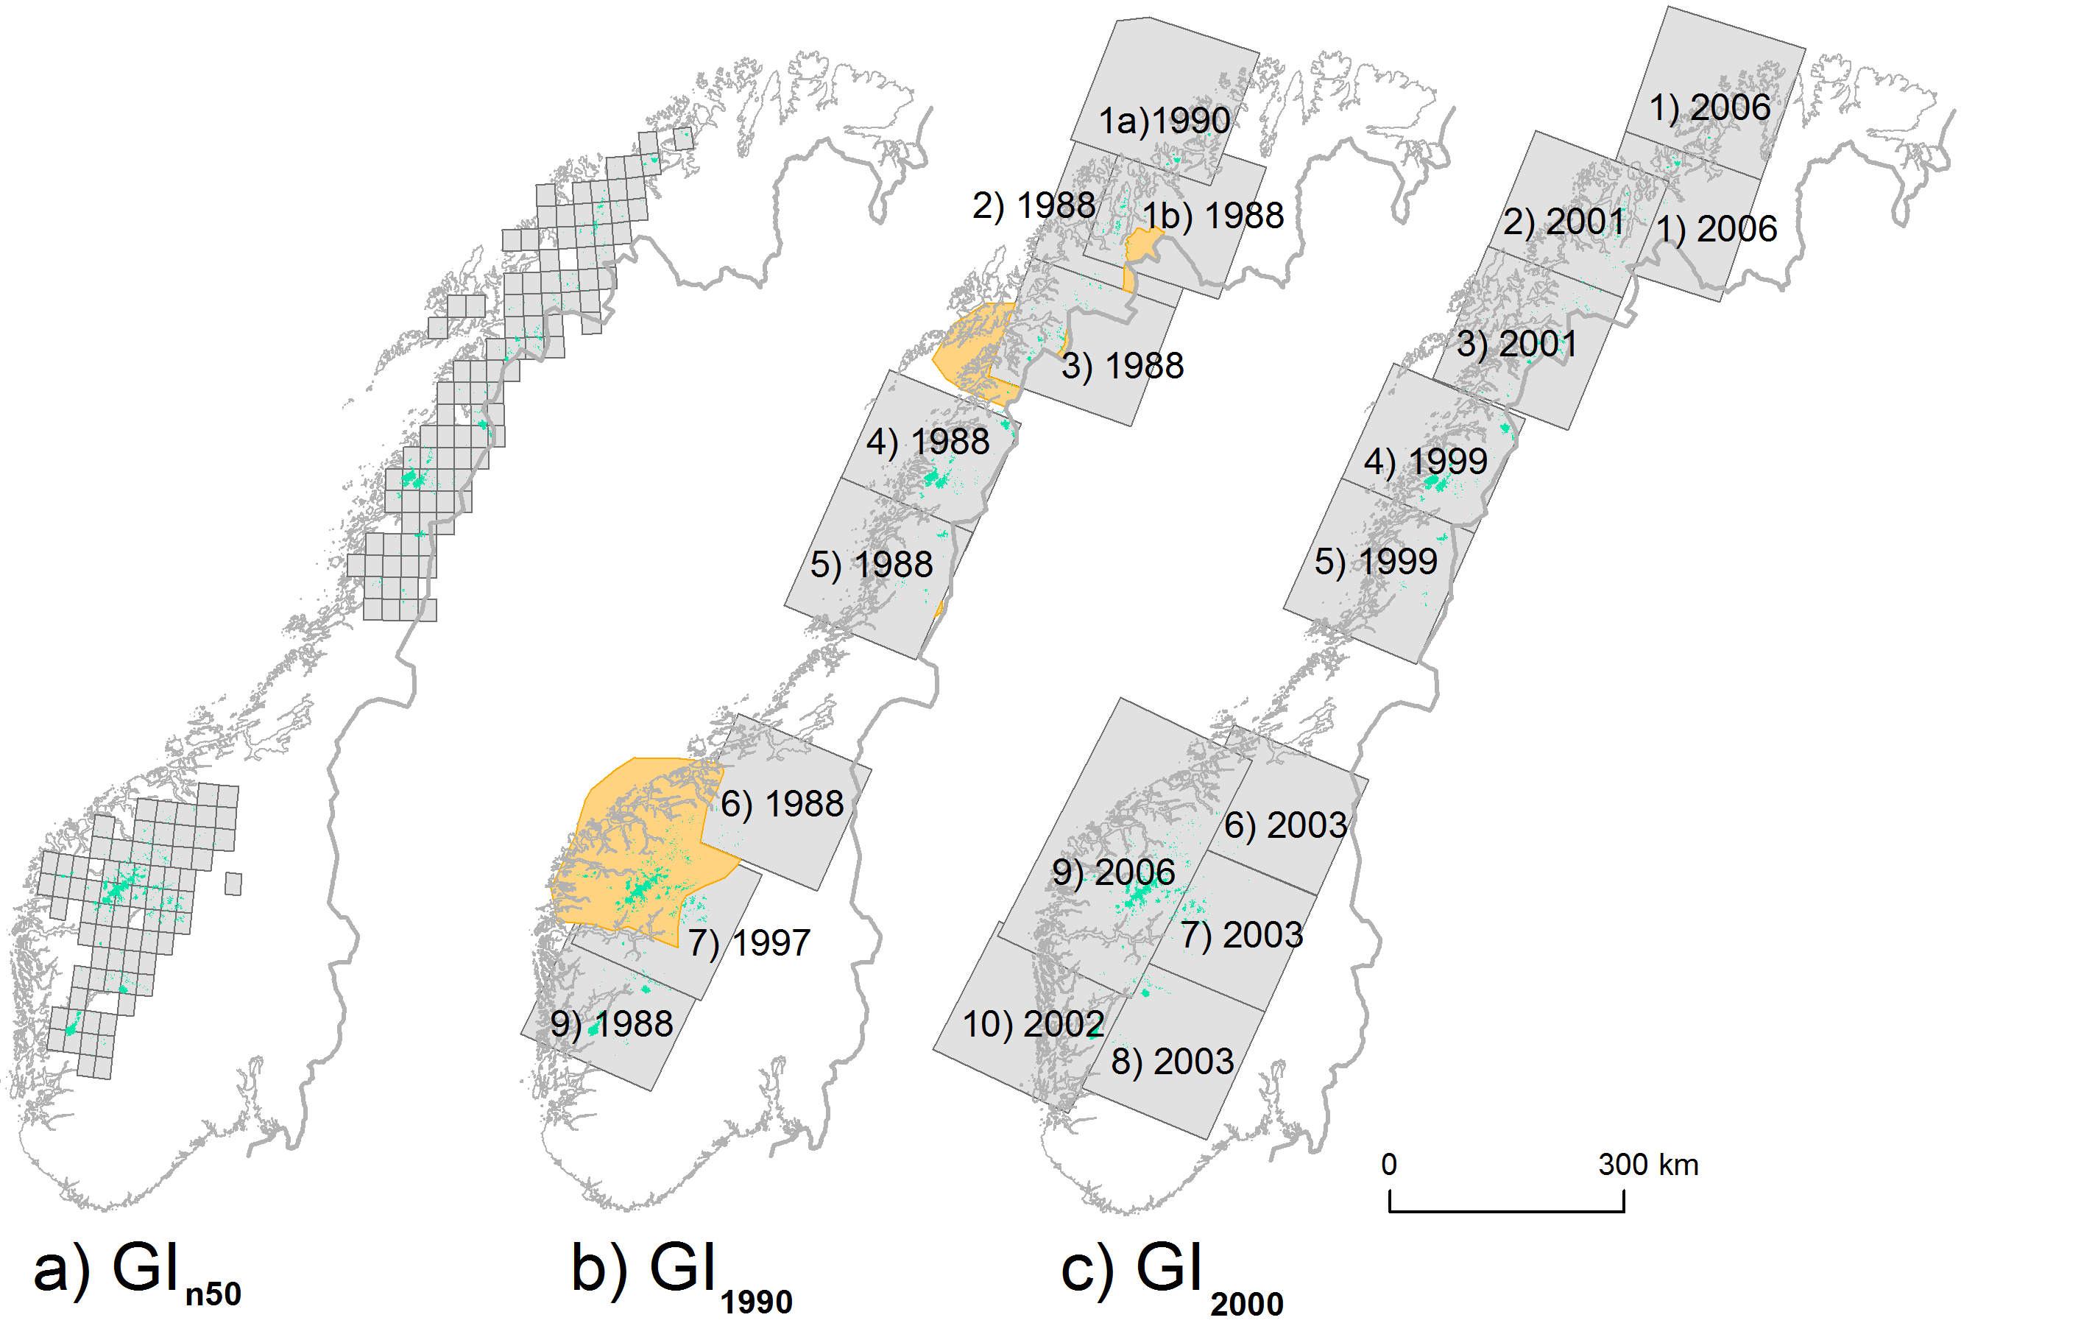
GAO and GLO time series Norway
1950-
1985
1988-
1997
1999-2006

Slide 8
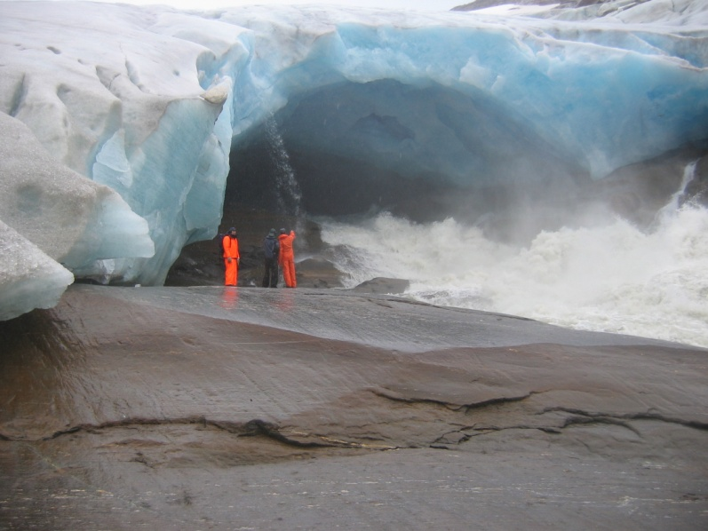
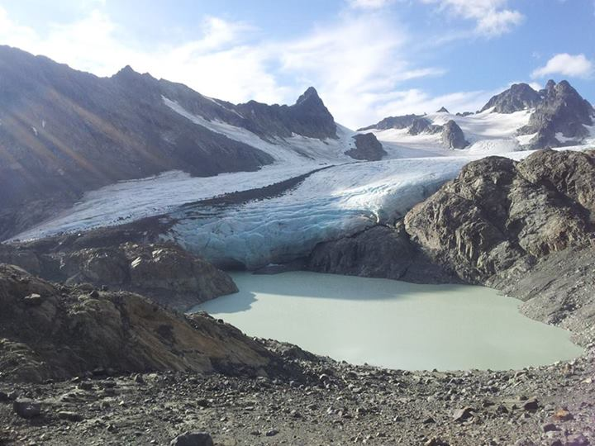
Jøkulhlaups, outburst floods (GLOF)
Jøkulhlaups from 12 different glaciers in Norway
12 known fatalities from Jøkulhlaups
First known incident in 1736 from Demmevatn (glacier-dammed lake), Hardangerjøkulen
-> monitor lakes & their changes & detect possible new sites
Blåmannsisen. Photo: Hans M. Hjemaas
Koppangsbreen. Photo: Siw Hege Isaksen

Slide 9
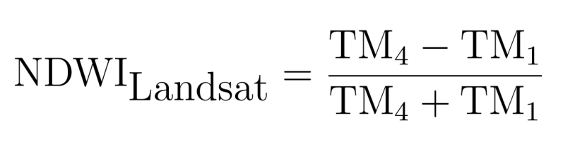
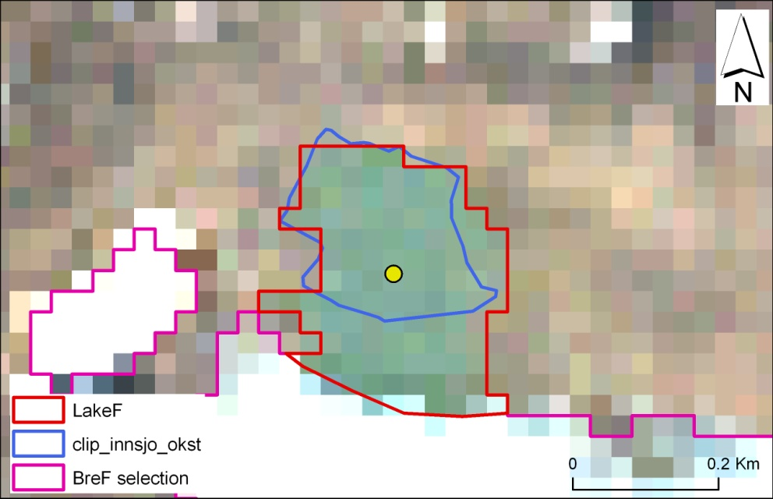
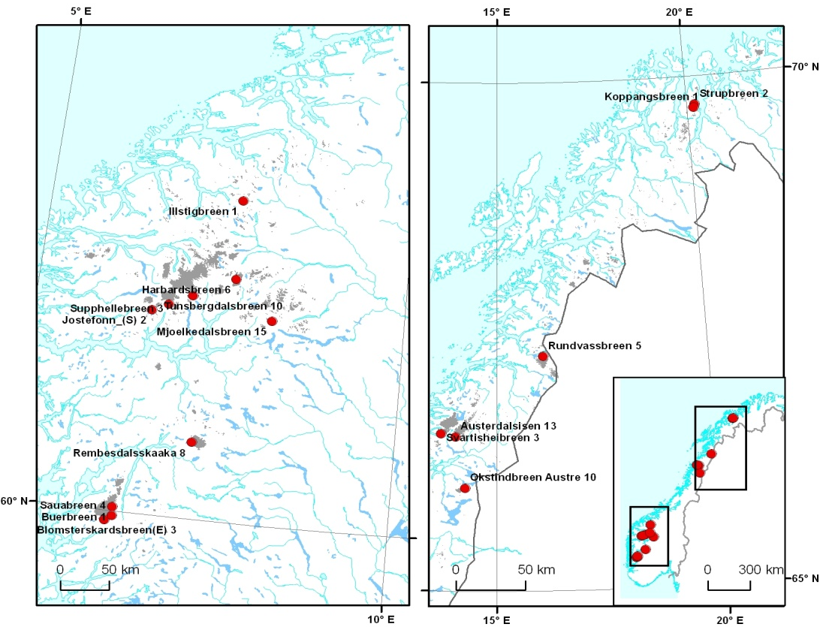
Glacier lake outlines
& GLOFs
Glacier lakes: defined as water bodies that intersected or within 50 m of GAO
GLO 1999-2006: NDWI
(Normalized Difference Water Index)
GLO 1988-1997: man. digitization (Only locations where glacier lakes were detected in GLO 1999-2006)
Point layer of observed GLOFs

Slide 10
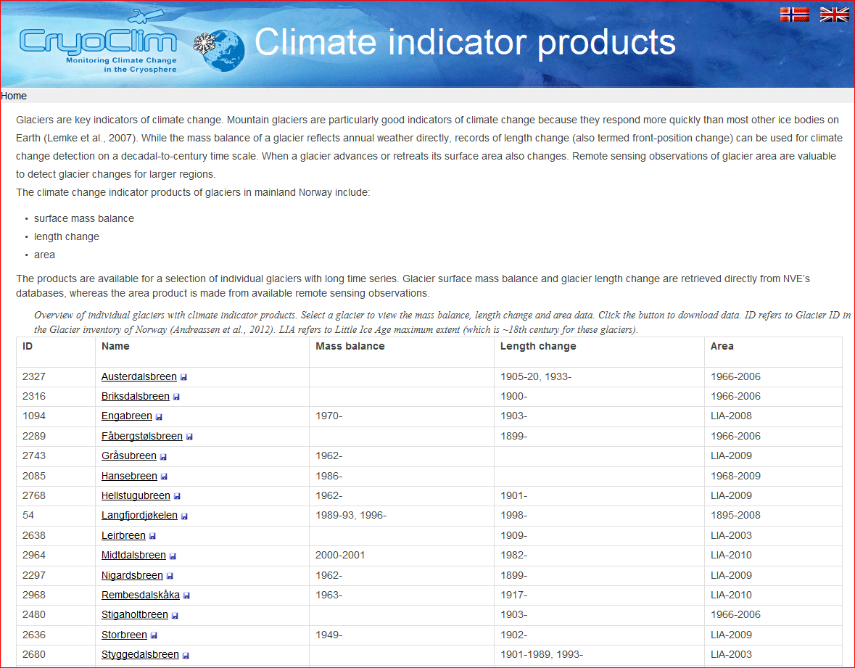
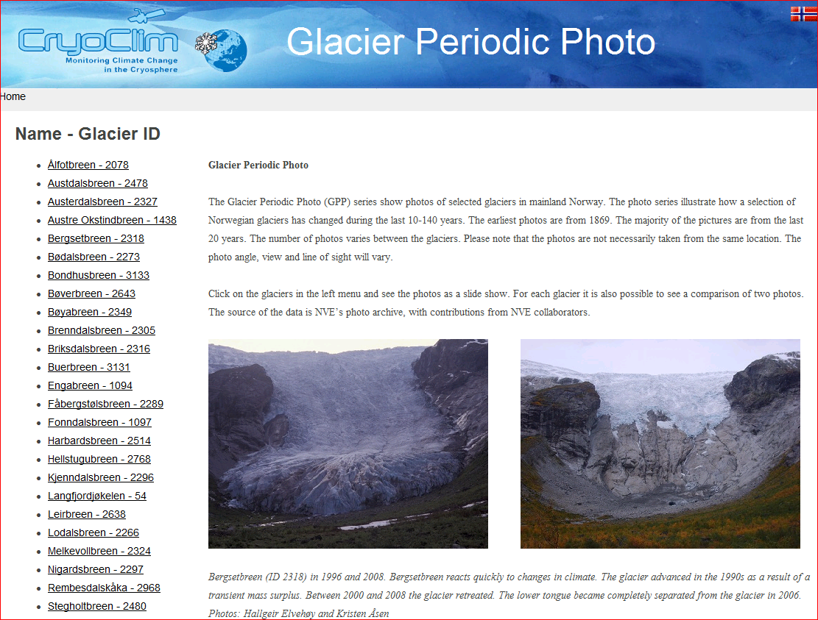
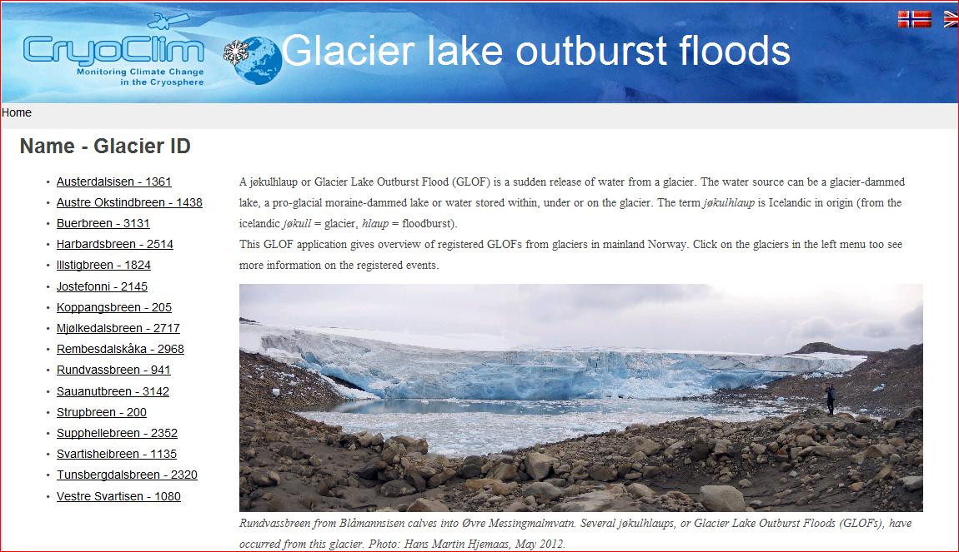
CryoClim applications
Climate indicators
Glacier periodic photos
Glacier lake outburst floods
http://glacier.nve.no/viewer/CI/en/cc
http://glacier.nve.no/viewer/GPP/en/cc
http://glacier.nve.no/viewer/GLOF/en/cc

Slide 11
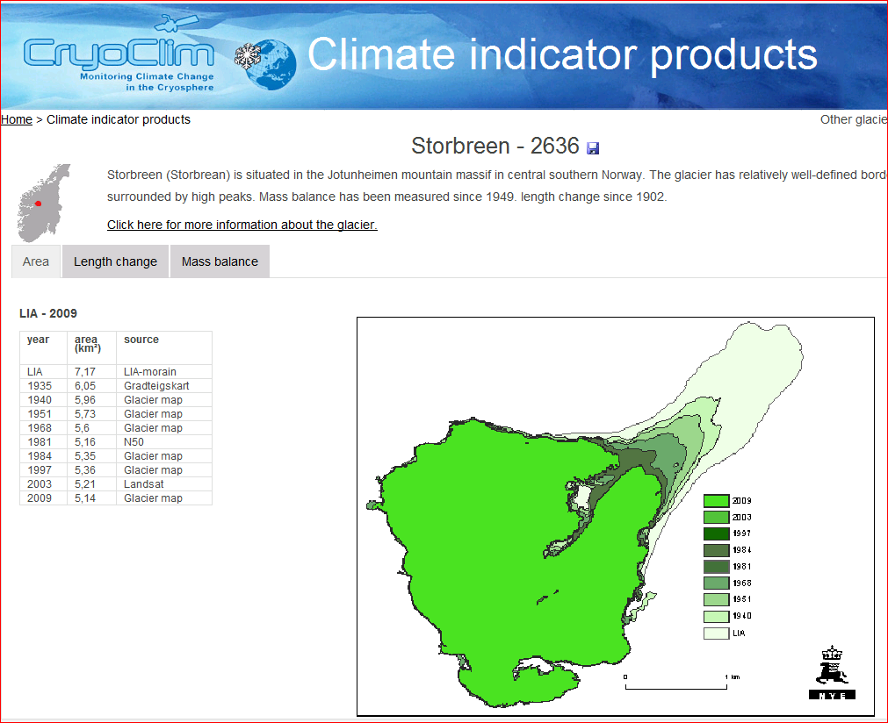

Slide 12
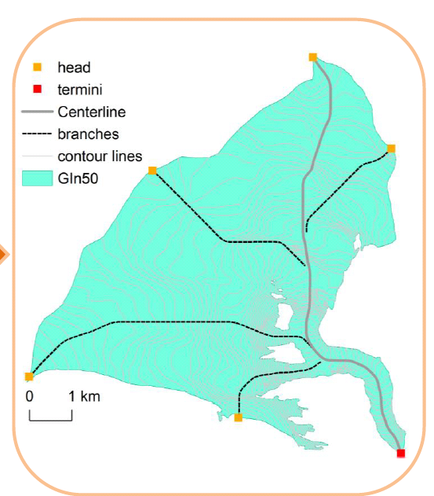
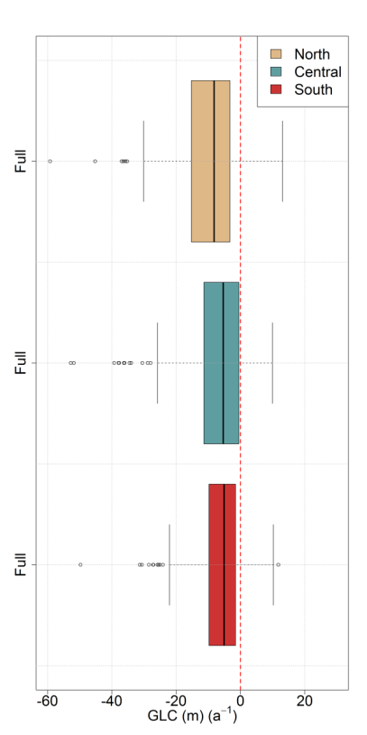
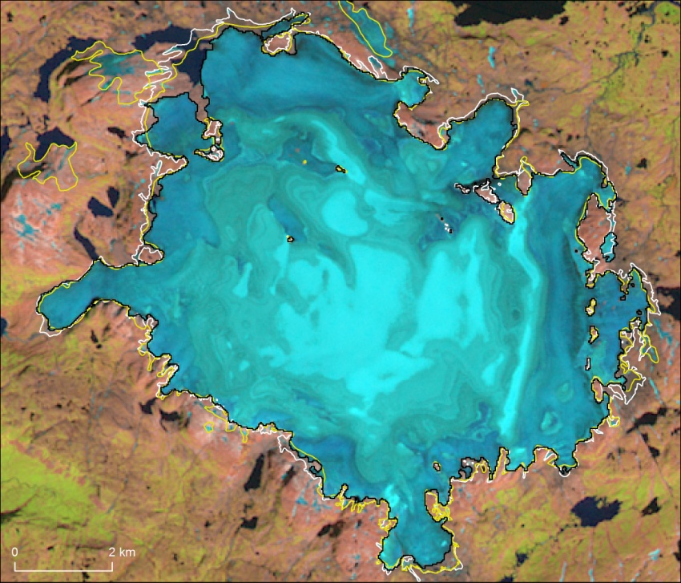
Example 1: Area & length changes
Considerable interest from hydropower companies: Present extent and changes, future changes. Outlines
Change assessments
Andreassen et al 2008, Paul and Andreassen, 2009, Paul et al., 2011, Andreassen et al, 2012; 2014; Winsvold et al. subm
Length determination
Length change
Area change Hardangerjøkulen
Winsvold, Andreassen & Kienholz submitted.

Slide 13
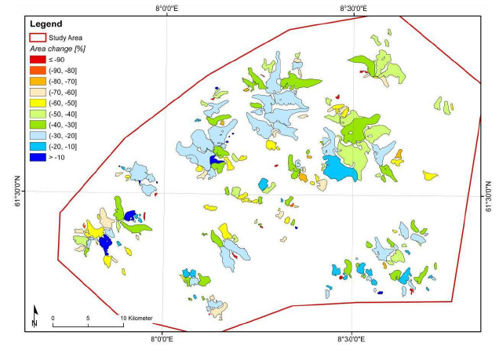
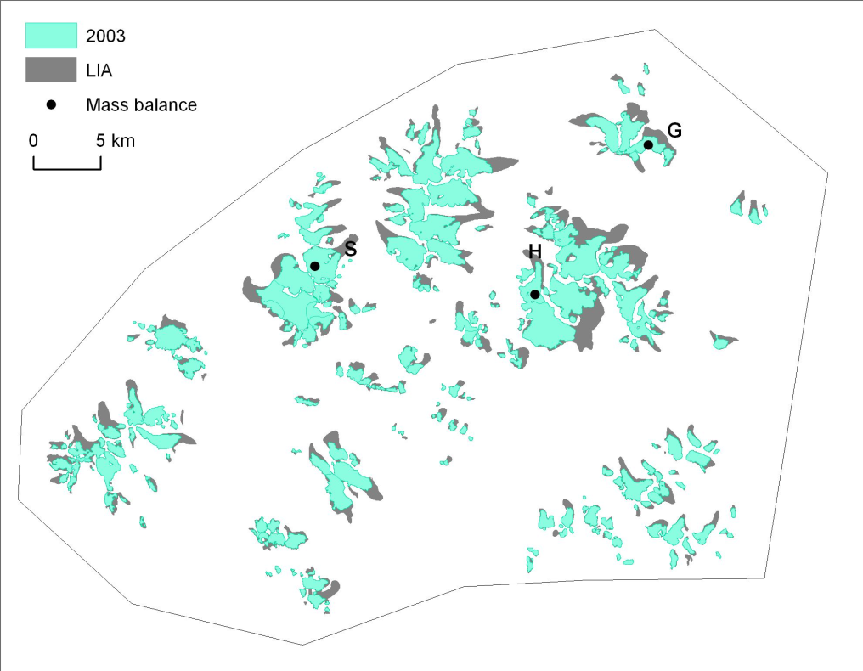
Example 2. Little ice age mapping
Satellite imagery can be an efficient tool for mapping of maximum LIA extents of glaciers on a regional scale
A Landsat image from 2003 were used to map LIA maximum extent (~1750) -> area and length shrank by 35% and 34% from LIA to 2003
Baumann, Winkler & Andreassen, TC, 2009

Slide 14
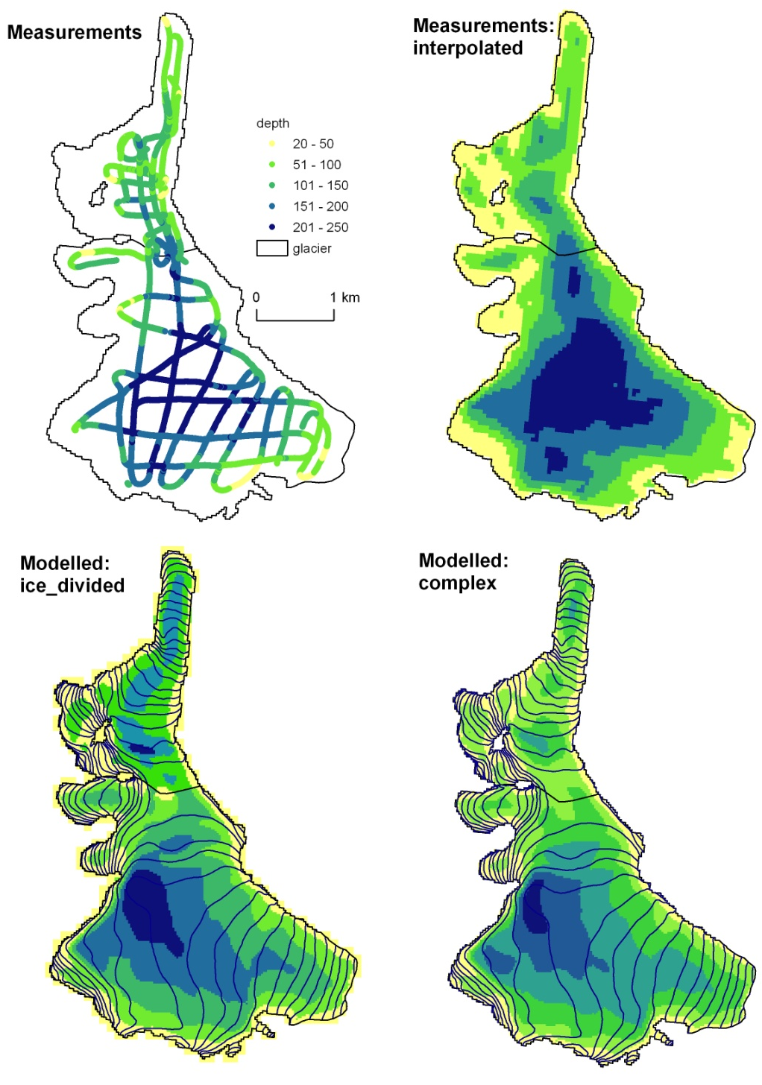
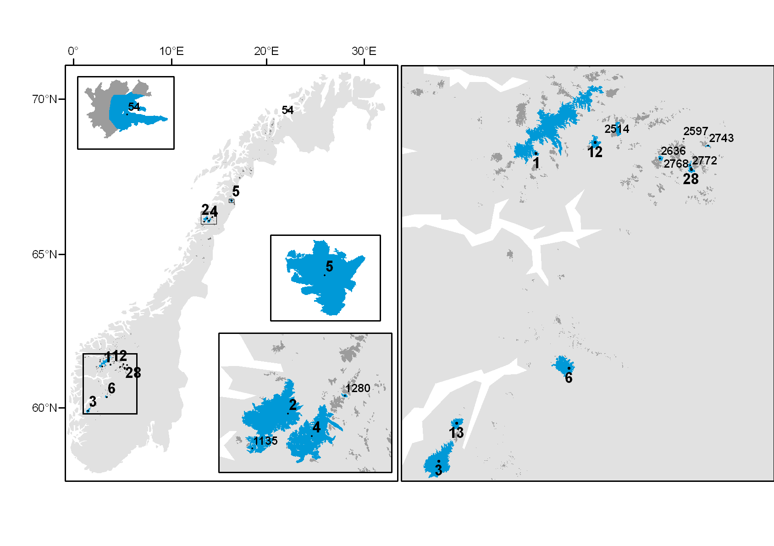
Example 3:
Ice volume modelling
Use distributed model (Huss and Farinotti, 2012)
Calibrated with ice thickness data for Norway
Input data: glacier outlines (inventory data 1999-2006) & national elevation model
Ice thickness data in Norway
Andreassen, Huss, Melvold, Elvehøy, Winsvold in prep.

Slide 15
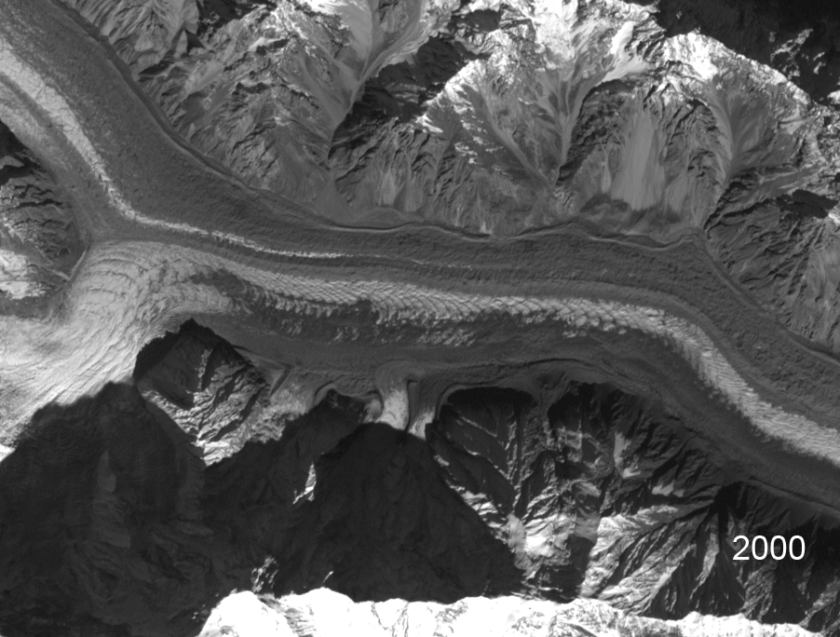
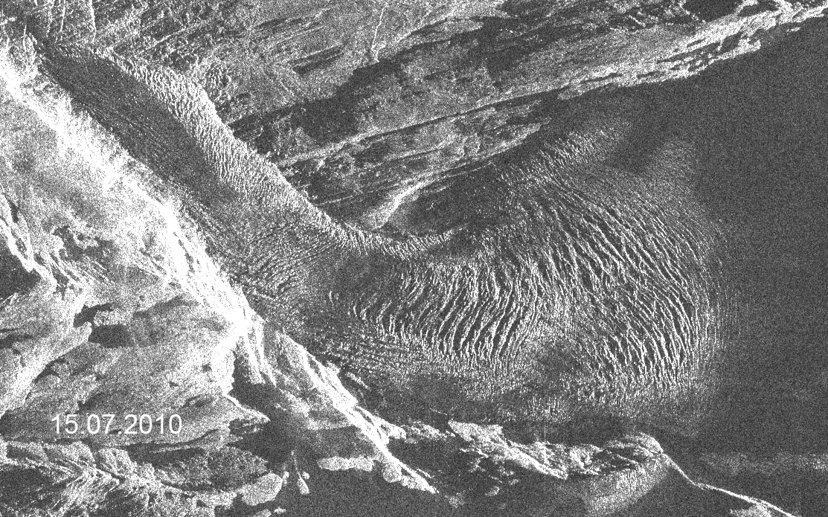
Glacier velocity & ice divides
important (climate, surges, hazards)
Engabreen / Radarsat-2
Batura Glacier / Landsat
Courtesy:
Andreas Kääb, UiO

Slide 16
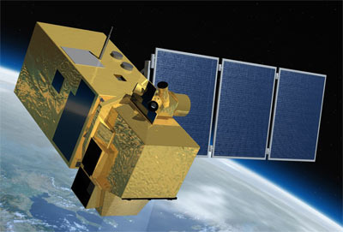
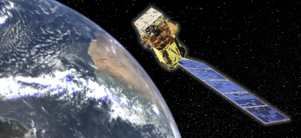
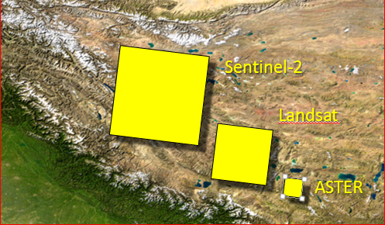
Future glacier survey
Sentinel-2
Optical satelites
  Sentinel-2 (2015)
  Landsat 8 (2013)
Improved spatial, temporal and radiomeric resolution
Glacier outlines: repeat surveys
-> Change assessment
Glacier lakes: focusing on GLOF sites
-> Monitor development of lakes
End-of-season snow line:
-> Mass balance
(if annual imagery)
Ice velocity & ice divides ++
Landsat 8

Slide 17
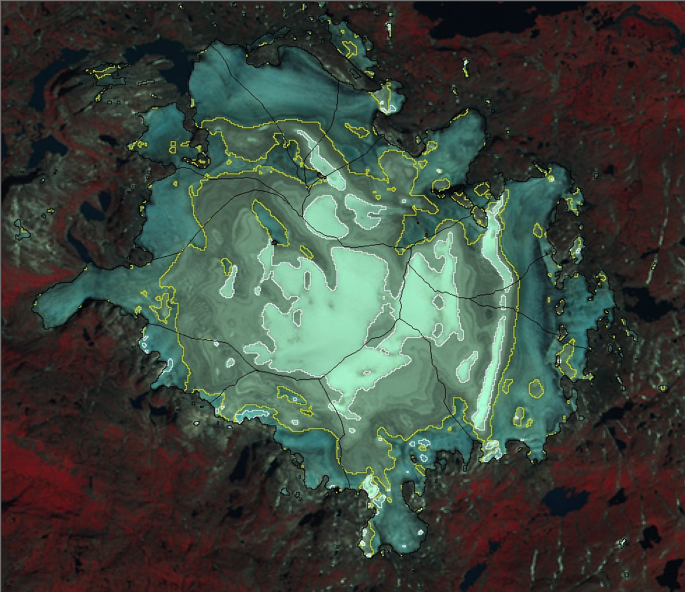
Mapping end-of-season snowline
End-of-season snowline ‘=‘ equilibrium line altitude (ELA)
Annual series -> mass balance estimate of unmeasured glaciers
So far: lack of imagery to provide such a product (clouds, frequency)
Future: Both optical (L-8, S-2) and radar (S-1) can be used

Slide 18
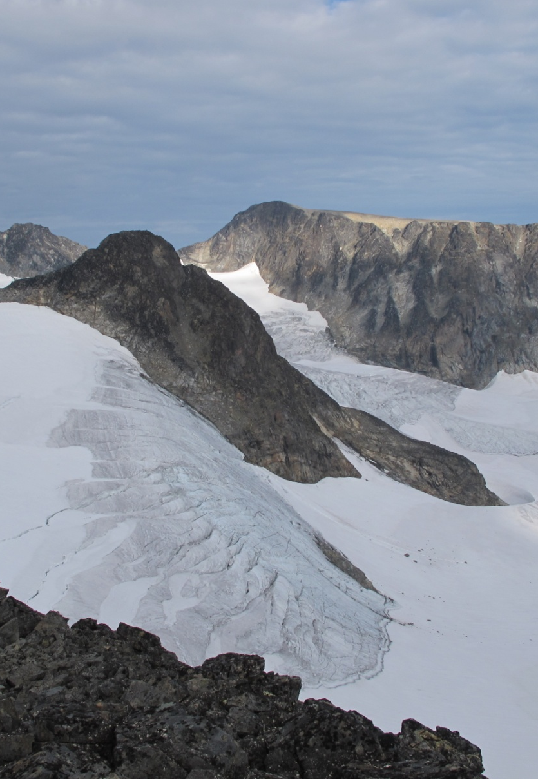
Conclusions
Glacier satellite derived products
valuable for local, regional,
national and global scales:
  Inventories of land ice
  Glacier changes (area, length)
  Ice thickness modelling
  Glacier lake detection / surveys
  Ice dynamics / ice divides
Collaboration with Frank Paul &
Glaciers_cci (state of the art)
very useful for NVE’s work

Slide 19
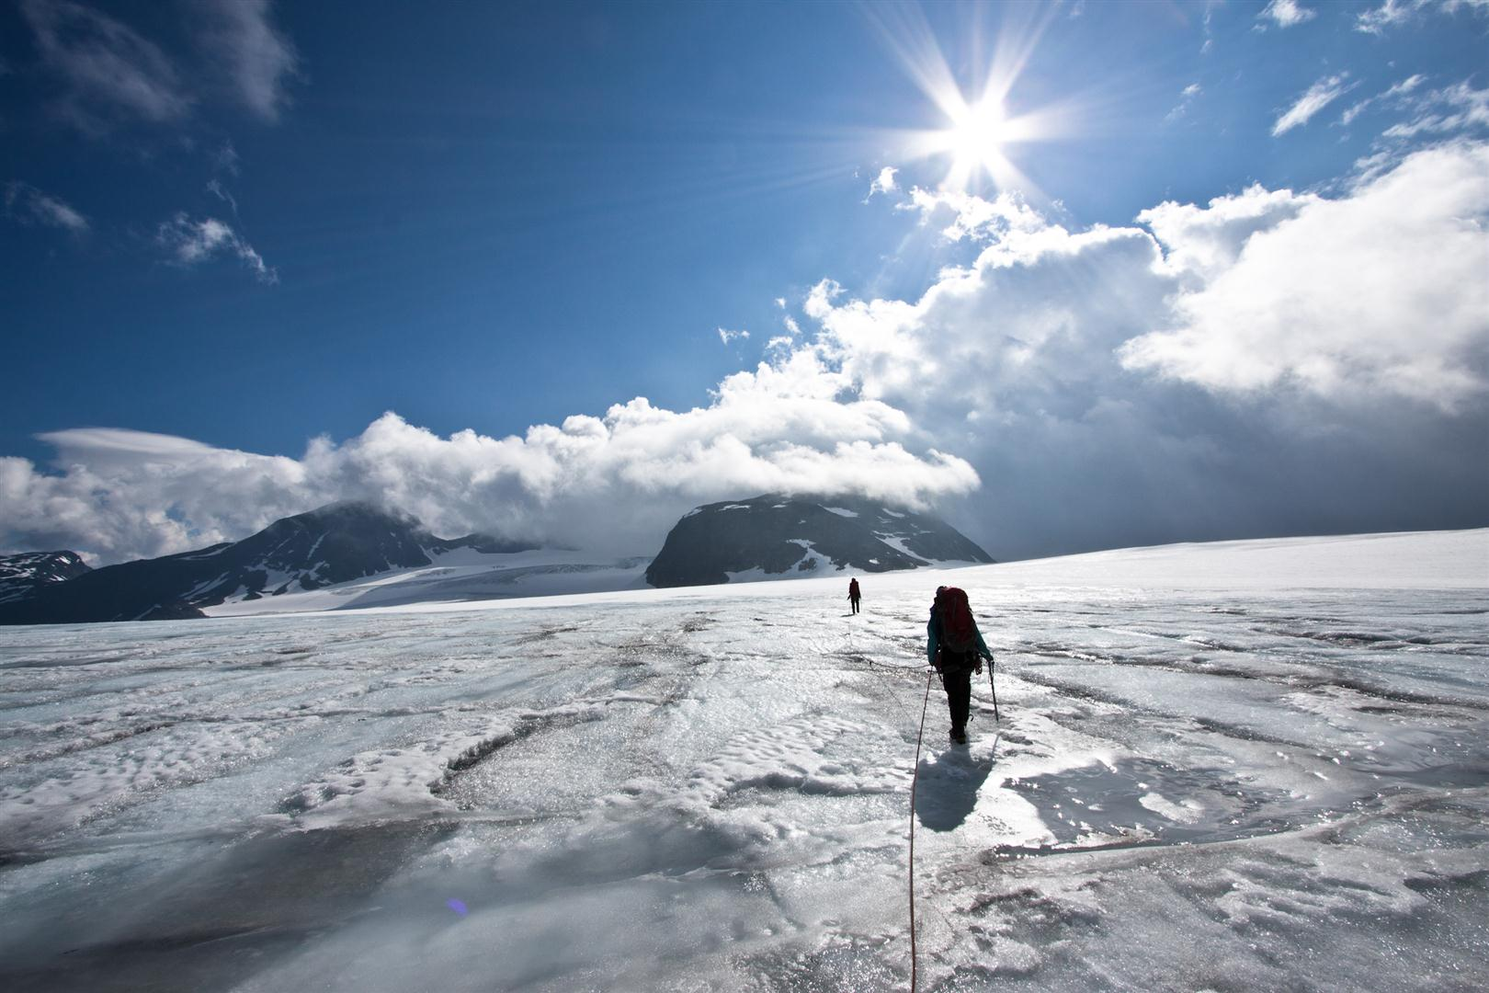
Photo: Ragnar Ekker
Thank you for the attention

