Slide 1











CCI CMUG 4th Integration Meeting
Exeter, June 2014
Land Cover CCI
Phase 1 Results & Phase 2 Plans
Defourny P., Hartley A., Brockmann C., Achard F., Boettcher M., Bontemps S., Gamba P., Hagemann S., Khlystova I., Kirches G., Lamarche C., Lisini G., MacBean N. , Mayaux P., Pathe C., Peylin P., Poulter B., Radoux J., Riedel T., Santoro M., Schmullius C., Van Bogaert E., Verhegghen, A., Wegmüller U., Zuehlke M., Ramoino F., Seifert F-M., Arino O.

Slide 2
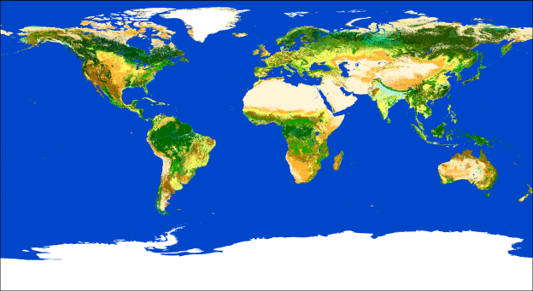
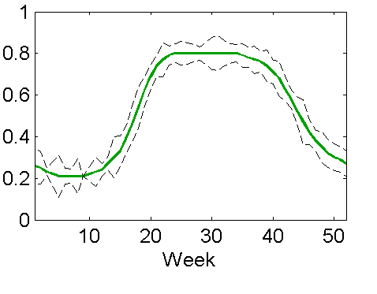
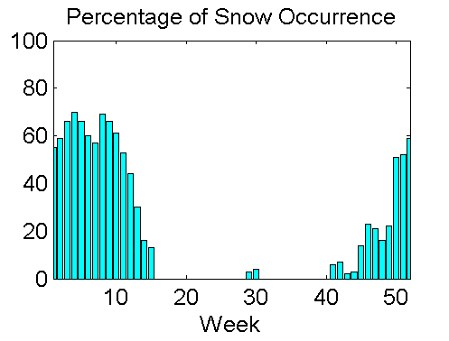
Revisited land cover concept
Land cover can not be the (observed) physical and biological cover on the terrestrial surface (LCCS 2005; GTOS ECV 2009) ...
and remains stable and consistent over time (as requested by climate modelers)
Mapping land cover state and 3 land cover conditions
NDVI
Average
Inter-annual variability
Snow
Burnt Areas
Occurrence Probability
  LC consistency over time and across conditions

Slide 3
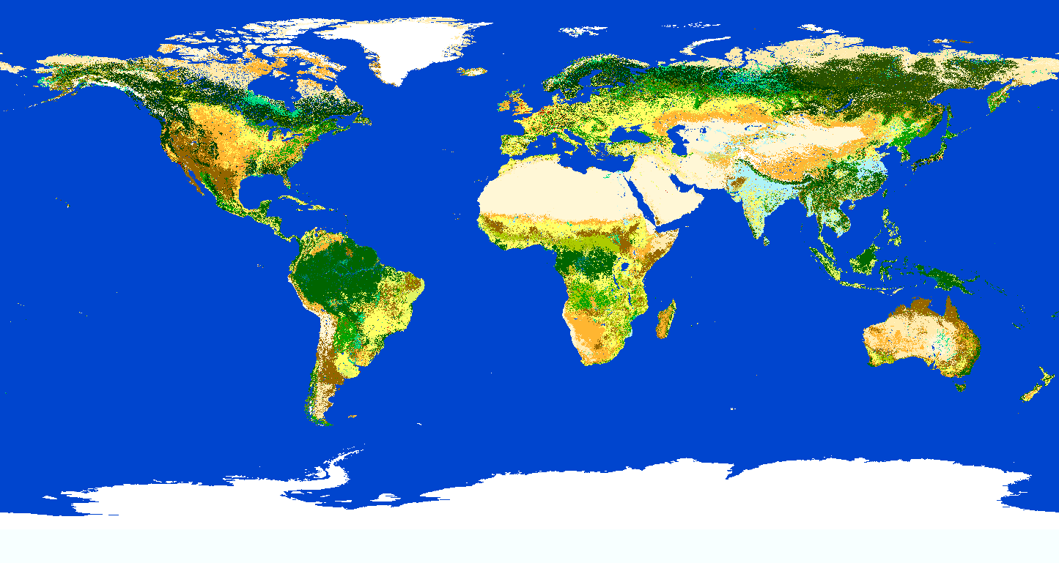


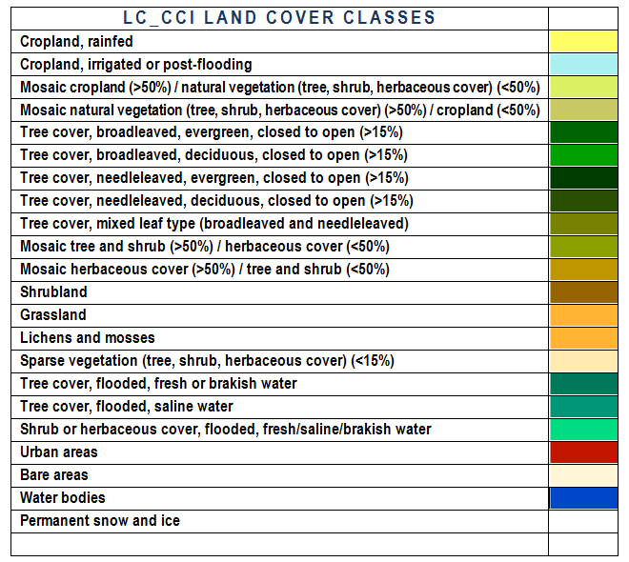
Consistent land cover state products
CCI LC map - 2000 epoch
LC_CCI Products
accessible
on line
CCI LC map - 2005 epoch
CCI LC map - 2010 epoch
+ quality flags and metadata

Slide 4
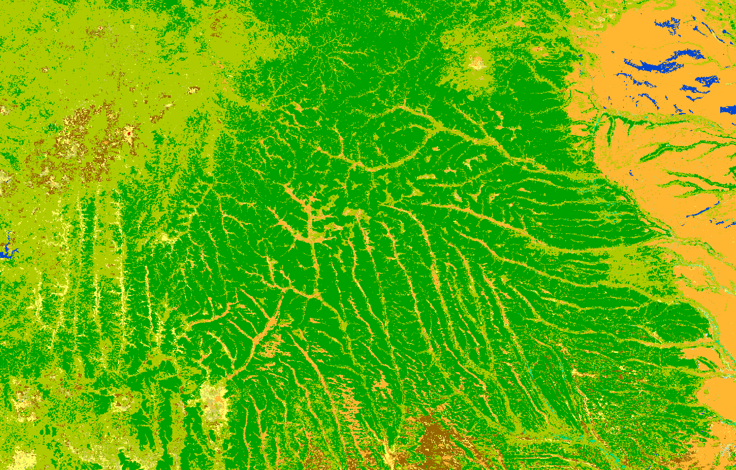
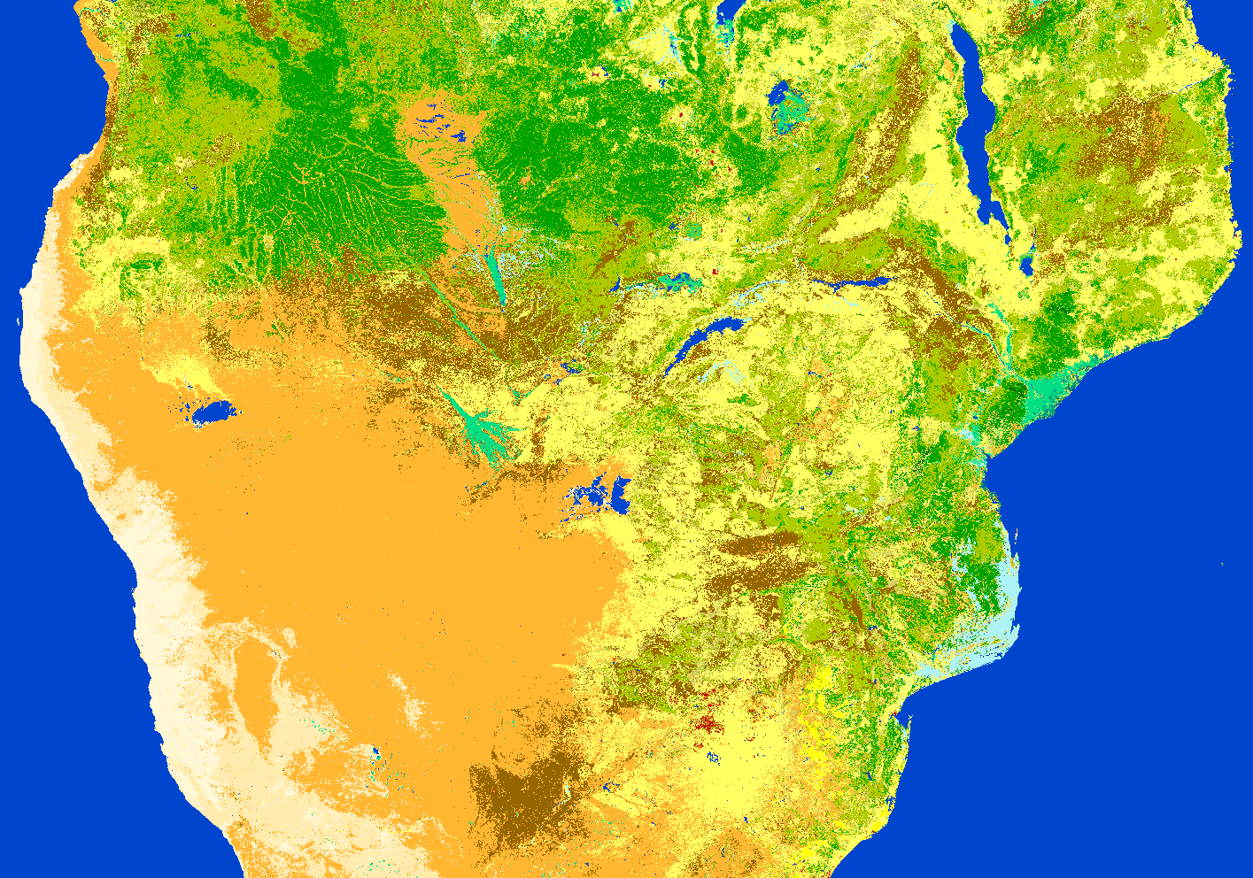
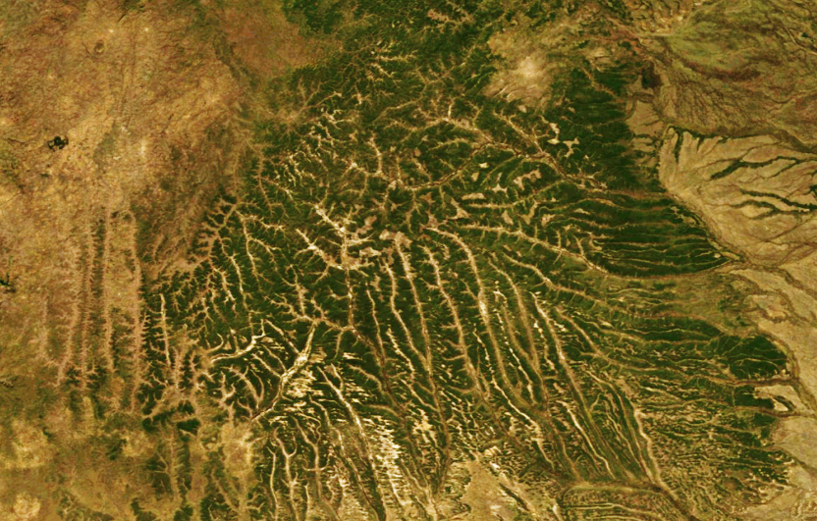
2010 Epoch – South Africa
CCI LC 2010

Slide 5
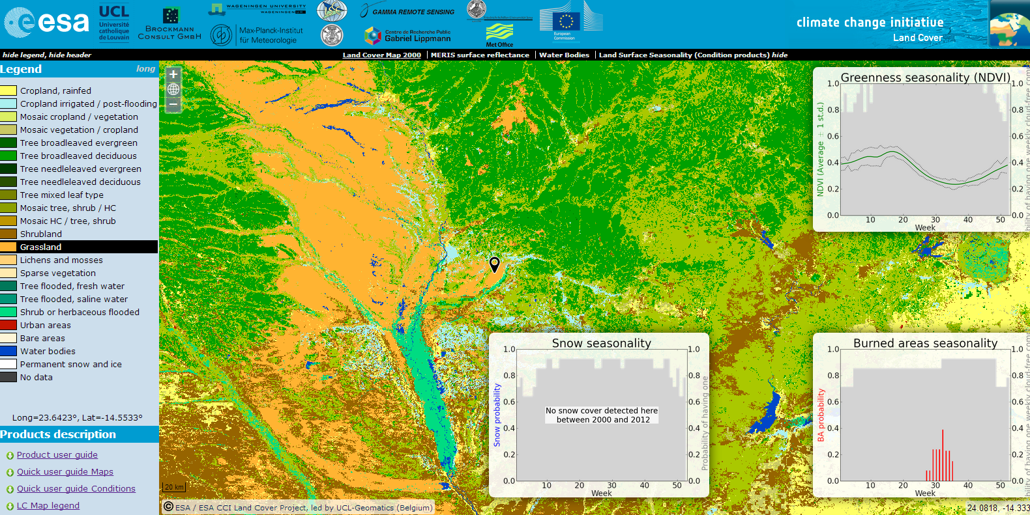
LC_CCI maps accessible on-line
with 3 associated consistent conditions
http://maps.elie.ucl.ac.be/CCI/viewer/index.html

Slide 6
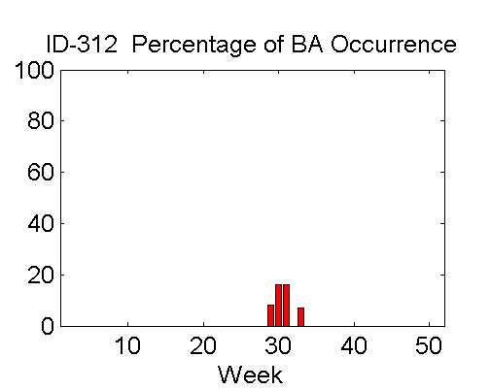
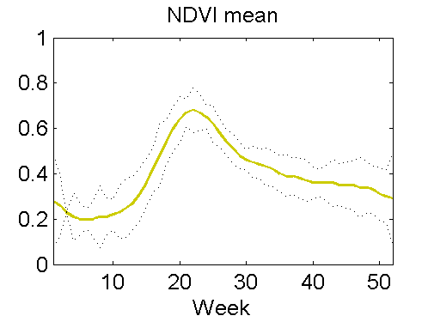

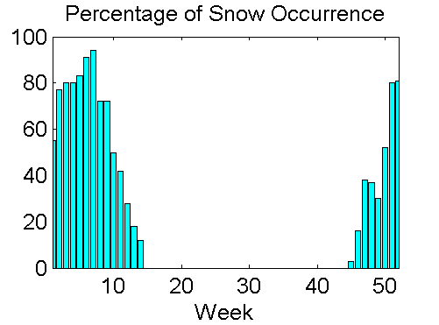
Consistency between the dynamic components
7-day resolution for
‘climatological’ data set
(from 12 years of data)

Slide 7
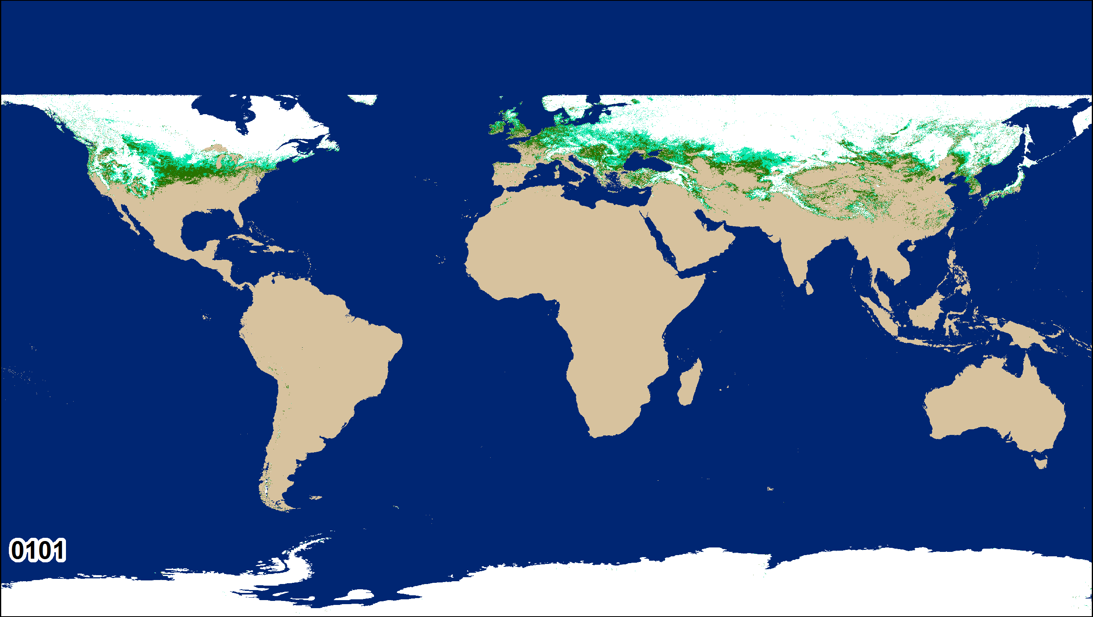
Dynamic snow cover

Slide 8
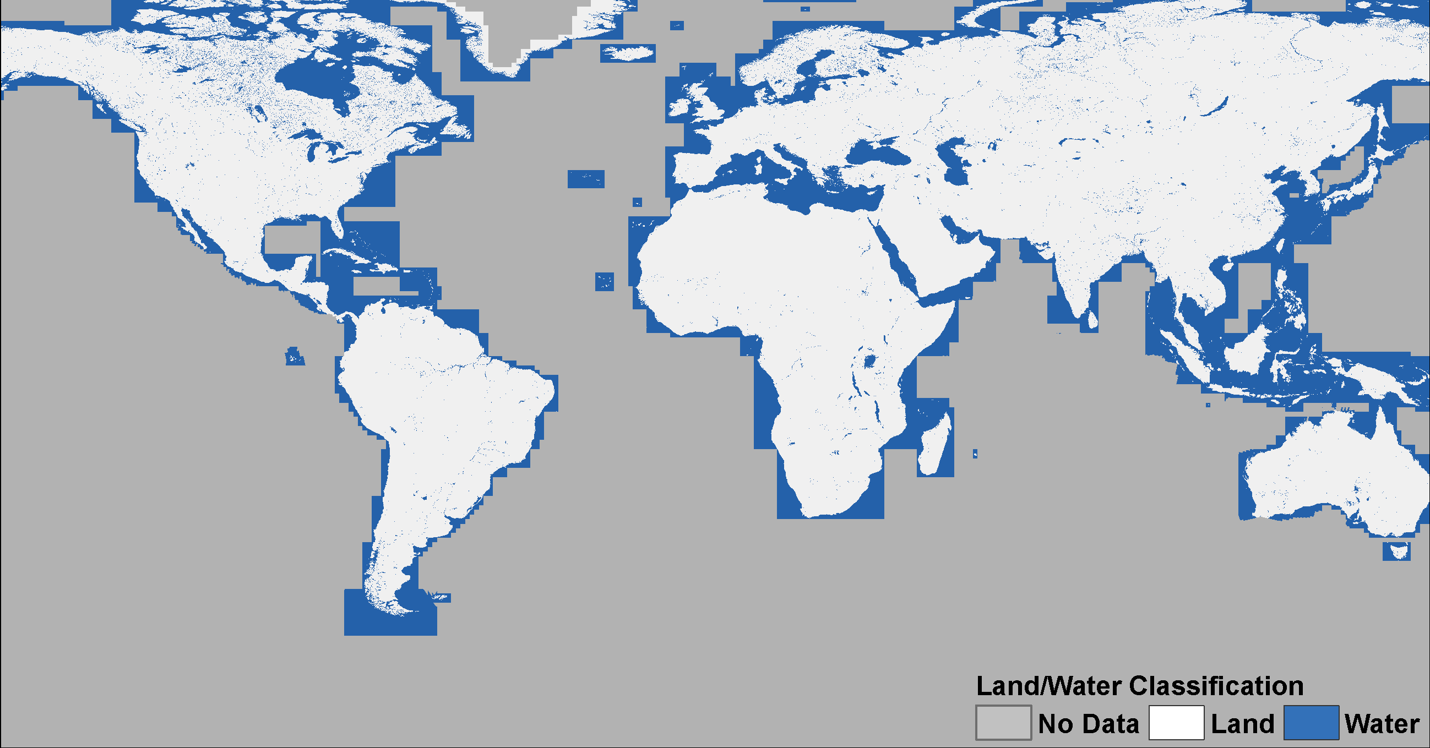

Global 300 m Land-Water mask
LC_CCI Products

Slide 9
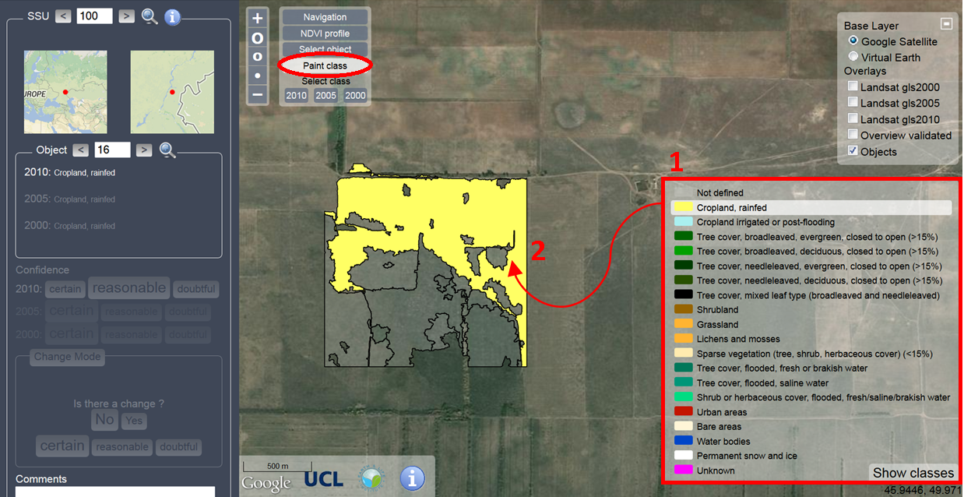
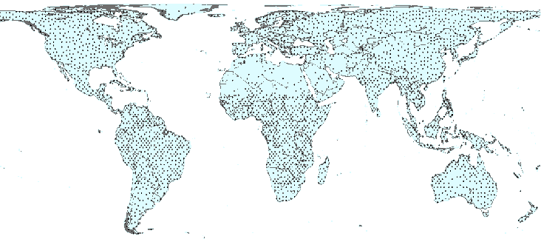
On-line Land Cover validation system
Notes:
A land cover class has to be assigned to each object
9

Slide 10
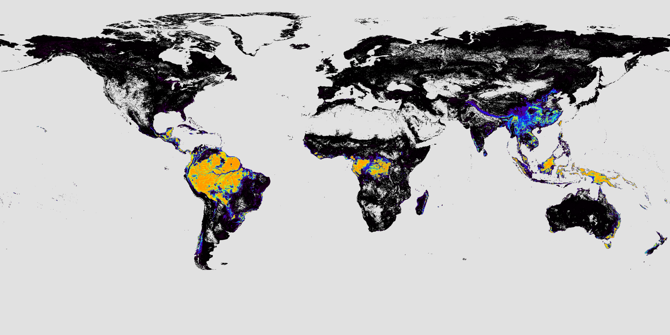
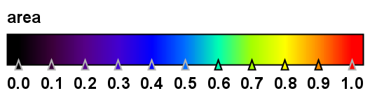
Plant Functional Type maps
Land cover aggregation tool
LC_CCI Products
Tree broadleaf evergreen
at 9,8 km for 2003-2007
Notes:
Aggregation LAT/LON
PFT conversion : user defined conversion table

Slide 11
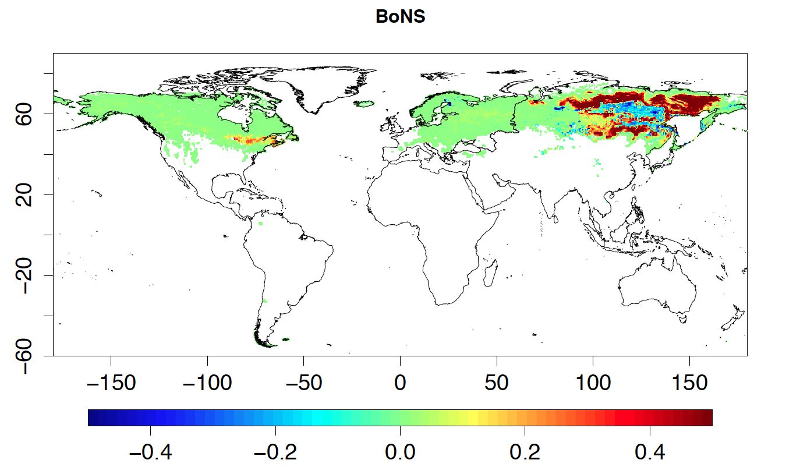
LC_CCI assessment using 3 climate models
Impact on PFT map distribution
w.r. to the default one for each model
Modeling Team | Offline |  |  | Online coupled with GCM
 | Original land cover | LC_CCI land cover | Dynamic vegetation | Original land cover | LC_CCI land cover
LSCE-ORCHIDEE | ✔ | ✔ | ✔ | ✔ | ✔
MOHC-JULES | ✔ | ✔ | ✔ (CRU-NCEP) | ✔ | ✔
MPI-JSBACH | ✔ (CRU-NCEP) | ✔ (CRU-NCEP) | ✗ | ✔ | ✔
Notes:
Same climate forcing for offline simulations (WATCH WFDEI 1979-2009), transient atmospheric CO₂
LC_CCI Epoch (2010) – defined climate zones from Peel et al. 2007… (next slide)
3000 year spin-up recycling years 1979-1988 with 280 ppm CO₂. Transient run from 1860 with observed CO₂
No land cover change or harvest or fire fluxes
Joint climate modeling experiments running on ORCHIDEE, JS BACH, JULES :
- impact of LC_CCI on PFT distribution maps
- offline simulation using same climate forcing with and without LC_CCI
- simulation using GCM coupled with land surface model with(out) LC_CCI
- simulation in prognostic dynamic vegetation model coupled to land surface

Slide 12
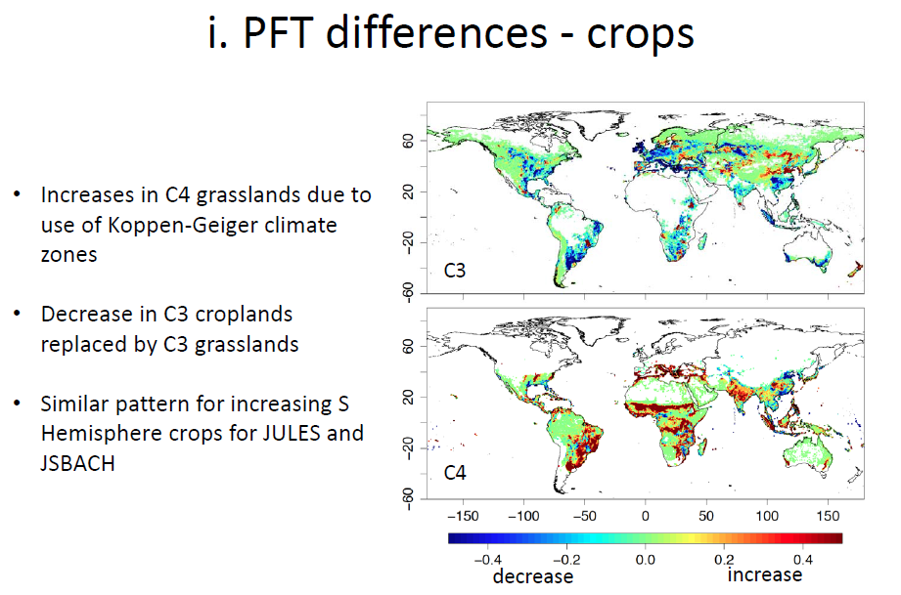
LC_CCI assessment using 3 climate models
Poulter B., GV2M - 2014

Slide 13
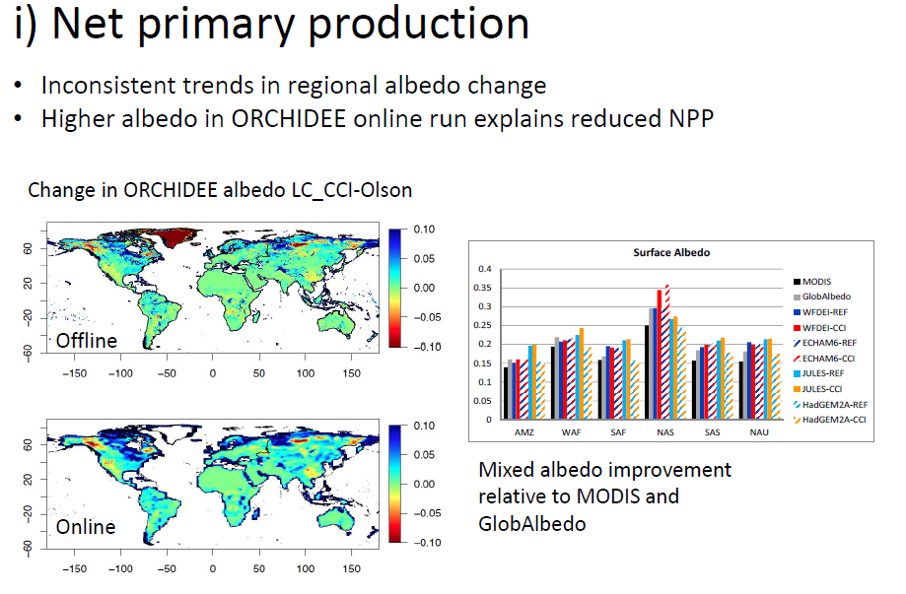
LC_CCI assessment using 3 climate models
Poulter B., GV2M - 2014

Slide 14
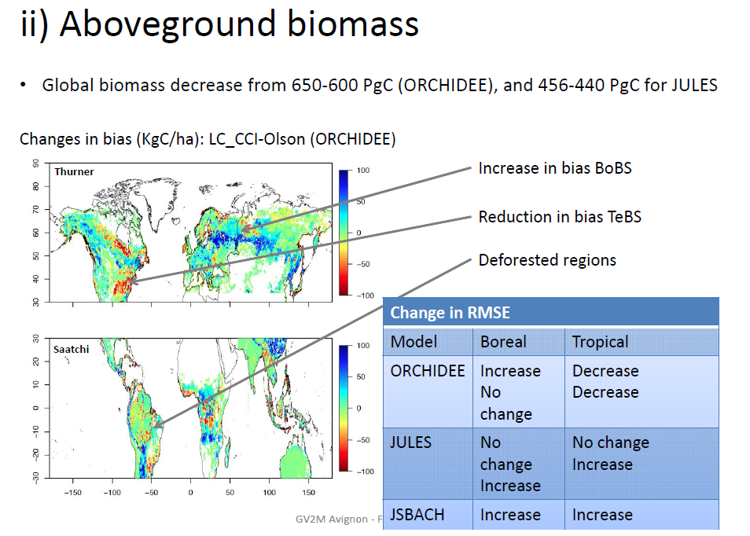
LC_CCI assessment using 3 climate models
Poulter B., GV2M - 2014

Slide 15
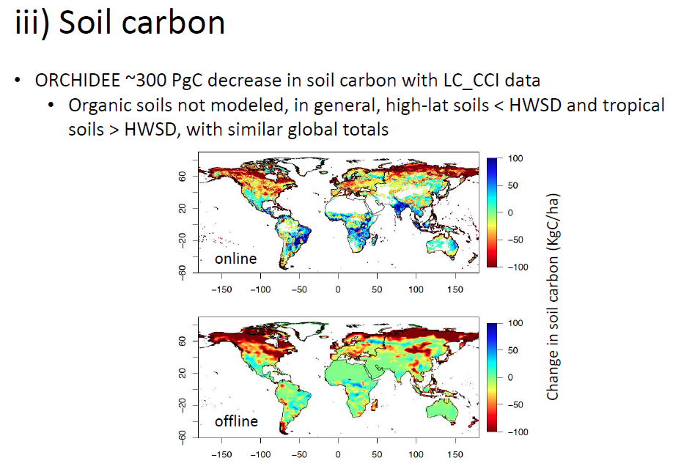
LC_CCI assessment using Orchidee

Slide 16
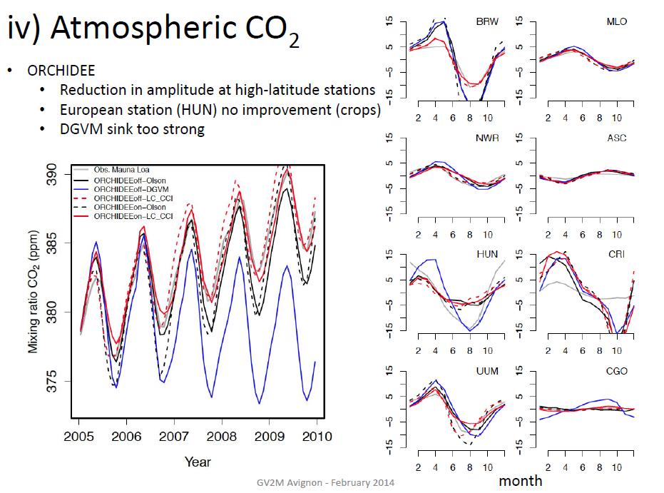
LC_CCI assessment using Orchidee

Slide 17
MPI-M Assessment
Largest changes in water and energy fluxes over high northern latitudes and West Africa, Sahel, Congo
Improved representation of 2m air temperature and surface albedo in some regions
A general improved behaviour of JSBACH with CCI data is difficult to quantify due to data uncertainty, small changes, and model biases (tropical ET).
For Amazon and Congo, the albedo is increasing from the earliest epoch 2000 to the latest in 2010
→ indication of large-scale deforestation of tropical rainforest

Slide 18
MPI-M Assessment
Changes induced by the LC_CCI data lower than expected
Models: PFT distribution based on the CCI data, but with PFT specific parameters (1) and background data (2) from standard setup that are inconsistent to the LC_CCI data.
  1) e.g. min. and max. LAI and vegetation ratio, vegetation roughness length, vgt height, forest ratio, stomata conductance parameters, etc.
  2) e.g. soil water holding capacity and background albedo for bare soil
  and vegetated parts of a gridbox.
Implementation of fully consistent changes of land cover
(i.e. PFT distributions) and these LC characteristics
would lead to a larger impact of LC_CCI data.

Slide 19
Increased bare soil fraction
Leads to:
  increased albedo
  reduced sensible heat flux
Located in:
  Northern high latitudes (e.g. N Russia)
  Arid areas (Sahel, central Asia, central Australia)
Coincides with:
  Reduced extreme temperatures (improvement)
  Reduced extreme precipitation in some
  cases (some improvement)
Example point located in the Sahel

Slide 20
Changes between vegetated surface types
West Africa:
  C3 grass and BL tree to C4 grass
  Increase in GPP, decrease in veg carbon, increase in ET
  Coincides with earlier monsoon peak
Northern Russia:
  C3 grass to NL tree
  Reduced surface albedo during winter
  Increased latent and sensible heat in spring
  Coincides with increased extreme temperatures in spring
Example point located in the Northern Russia

Slide 21
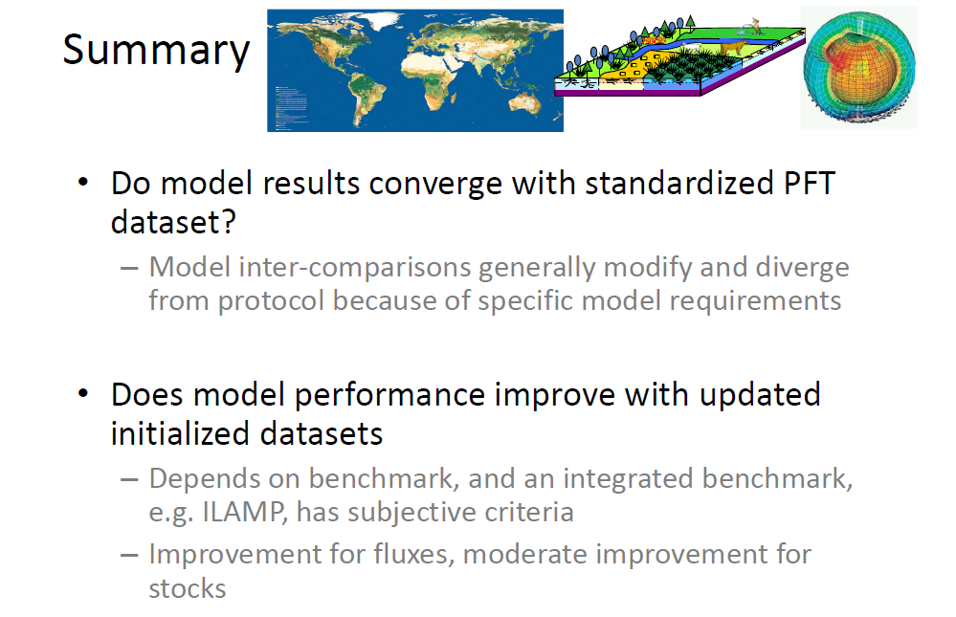
LC_CCI assessment using 3 climate models
Poulter B., GV2M - 2014

Slide 22
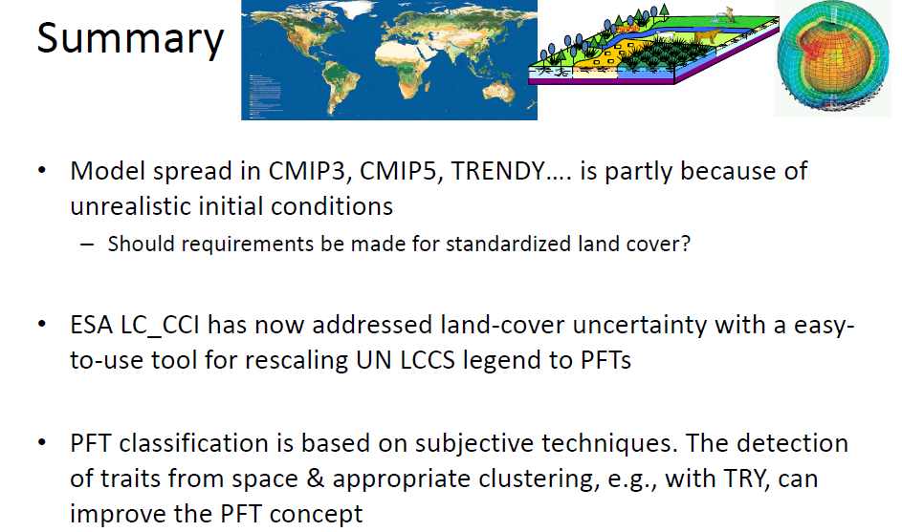
LC_CCI assessment using 3 climate models
Poulter B., GV2M - 2014

Slide 23
LC_CCI Phase 2 – 2,5 iterative cycles
WP 5101/5102 Products validation (using cycle 1 / cycle 2 products)
WP 1101/1102 Requirements collection
(from Phase I experience / from cycle 1 products)
WP 5201/5202 ECV acceptance process and inter-comparison
(using cycle 1 / cycle 2 products)
WP 1201/1202 Products specification
(from URD v1 / URD v2)
WP 5301/5302 Error characterization and analysis (using cycle 1 / cycle 2 products)
WP 1301/1302 Data access requirement
(from URDv1 & PSDv1 / URDv2 & PSDv2)
WP 5401/5402 Products consistency assessment (using cycle 1 / cycle 2 products)
WP 5501/5502/5503 Products assessment for climate needs with LSCE models (using phase 1 / cycle 1 / cycle 2 products)
WP 1401/1402 Comprehensive error characterization
(for products described in PSDv1 / PSDv2)
WP 5601/5602/5603 Products assessment for climate needs with MOHC models (using phase 1 / cycle 1 / cycle 2 products)
WP 2101/2102/2103 Pre-processing algorithms development
(for MERIS FR and RR, Spot-VGT P, MODIS,, AVHRR / AVHRR, MODIS (VIIRS), PROBA-V, Sentinel-1 and -3 / Sentinel-1,-2,-3, Landsat 8)
WP 5701/5702/5703Products assessment for climate needs with MPI-M models (using phase 1 / cycle 1 / cycle 2 products)
WP 1000 (Task 1)
Requirements management
WP 5801/5802/5803 Inter-comparison of climate modellers’ product assessment (using phase 1 / cycle 1 / cycle 2 products)
WP 2201/2202/2203 Classification algorithms development
(from MERIS, Spot-VGT P, MODIS, SAR, AVHRR, GIMMS / GIMMS, MODIS, AVHRR, Proba V, Sentinel-1 / Sentinel-1,-2,-3, Landsat 8)
WP 5000 (Task 5)
Products validation and user assessment
Year 1 (= Full Cycle 1)
Year 2 (= Full Cycle 2)
Year 3 (Prototyping or production effort)
WP 2000 (Task 2)
Algorithm development
WP 2301/2302 LC condition generation algorithm development
(NDVI, snow, fire, water, Evapotranspiration / LAI, albedo)
WP 4000 (Task 4)
Operational product generation
WP 3000 (Task 3)
System evolution
WP 2400 Land cover change from high spatial resolution data (Sentinel-2, Landsat 8)
WP 2500 Development of a permanent validation database concept
WP 4101/4102/4103 Generation of SR and SAR time series
(MERIS FR and RR, SPOT-VGT, MODIS, AVHRR / cycle 1 + PROBA-V, MODIS (VIIRS) / Sentinel-3 time series)
WP 3101/3102 System specification
(cycle 1 / cycle 2)
WP 4201/4202/4203 Generation of global LC products
(1990, 2000, 2005, 2010 epochs, SAR-based WB product / cycle 1 + 2015 epochs / Update of 2015 epoch based on Sentinel-3)
WP 3201/3202 Production system development
(cycle 1 / cycle 2)
WP 3301/3302 User services, interfaces, and tools
(cycle 1 / cycle 2)
WP 4301/4302 Generation of LC condition products
(NDVI, snow, fire, water / cycle 1 + LAI, albedo )
WP 3401/3402 System assessment
(cycle 1 / cycle 2)
WP 4400 Validation dataset collection + tool maintenance
WP 3500 Long-term system evolution
WP 6000 (Task 6) Project management

Slide 24
Phase 2 objectives
Consolidate and extend long-term (1980 ? - 1990 – 2015) consistent, global land surface data exploiting the full range of available EO datasets
Specific objectives:
  Improvement / extensions of the Phase I outcomes in terms of products, systems and validation
  Extension of climate modelling assessment and cross-analysis
  Building a cross-ECV consistency
Rely on continuous interactions with Climate Modeling Groups
Develop more interactions with other CCI teams

Slide 25
Increased involvement of climate research group
CRG involved since the very beginning of the project
Further discussion (Climate-Climate & Climate-EO) and development of cross-walking procedure
Further improvement of the impact assessment of new CCI-LC maps (and uncertainty) with all models (Phase 1)
Models optimization w.r.t. new CCI-LC maps
Focus on coherence with other products (fire, albedo, etc.)
Use of CCI-LC condition products for dynamic component

Slide 26
Cross-ECV consistency
Assess the consistency between terrestrial variables through the LC condition products (LC, NDVI, fire, snow, water, albedo ,LAI or fAPAR)
Between CCI components
  CCI Glaciers already included in Phase 1 products
  Use of CCI Fire products is planned in Phase 2
  Use of CCI Ice-sheet could be investigated in Phase 2
  Global WB product submitted to other CCI teams for visual assessment as a candidate for a common Land-Water mask
  Cross-activity with CCI Soil Moisture
  Sharing (user, visualisation, etc.) tools between projects

Slide 27
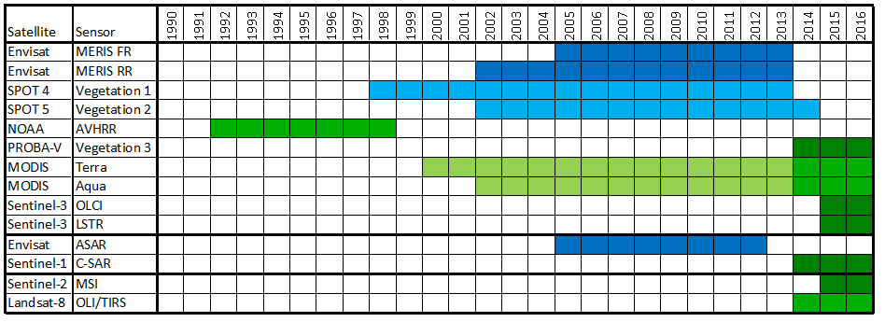
LC_CCI Phase II EO data input
7 different instruments including Sentinel-1, 2 and 3, and PROBA-V
2005
2010
1990s
2000
SR time series + LC maps
2015
2000
WB product
Proto-type

Slide 28
Phase 1 Users Consultation
 | Threshold requirement | Target requirement
Temporal sampling | Best/stable map and regular updates | Monthly data on vegetation dynamics and change
Temporal extent | 1-2 years, most recent | 1990 (or earlier)-present
Horizontal resolution | 1000 m | 30 m
Precision | Thematic land cover detail to meet modelling needs | Thematic land cover detail to meet future model needs
Accuracy | Higher accuracy than existing datasets | Errors of 5-10% per class or as overall accuracy
Stability | Higher stability than existing datasets | Errors of 5-10% per class or as overall accuracy
Error Characteristics | Independent one-time accuracy assessment | Operational and independent multi-date validation
HR LC map relevant for Impact Assessment Model and mitigation strategy

Slide 29
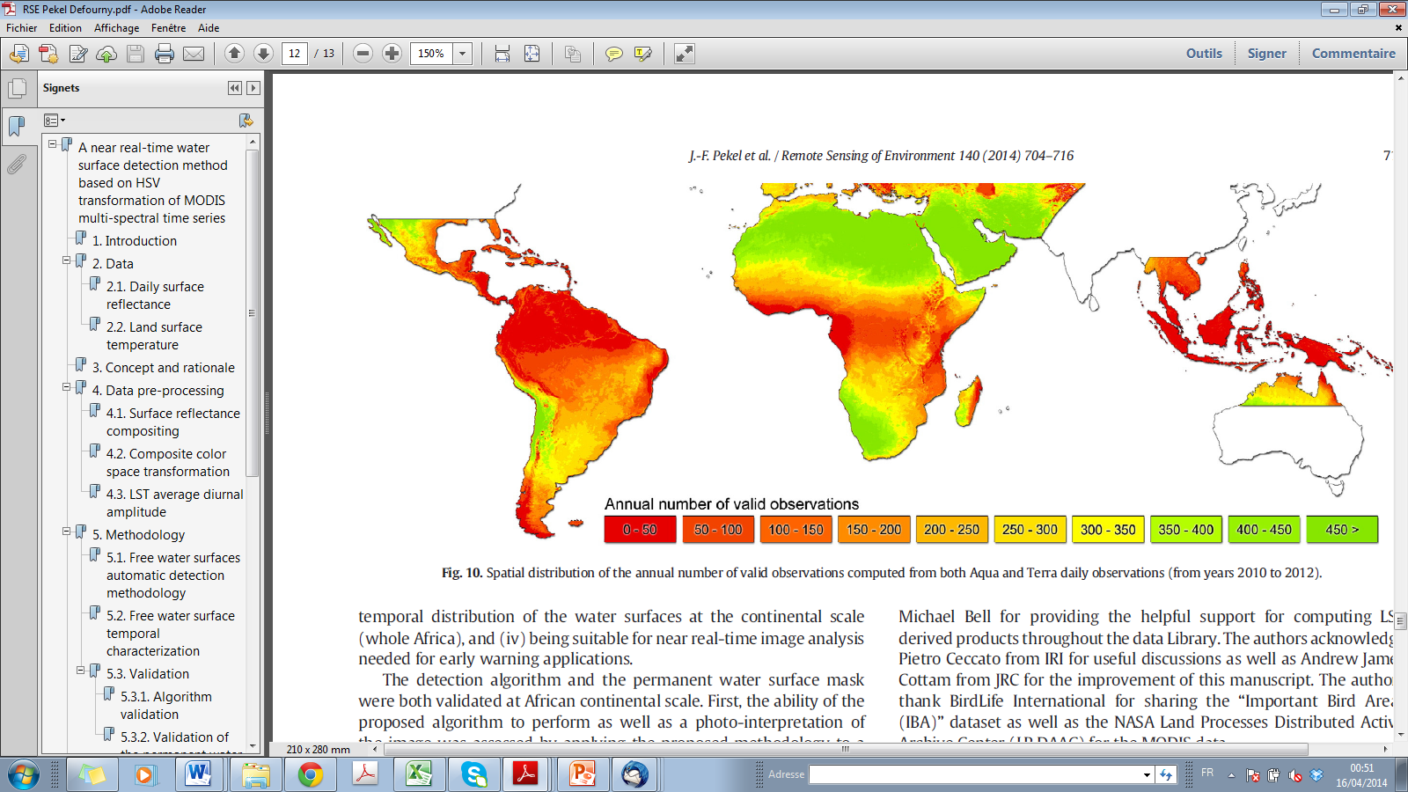
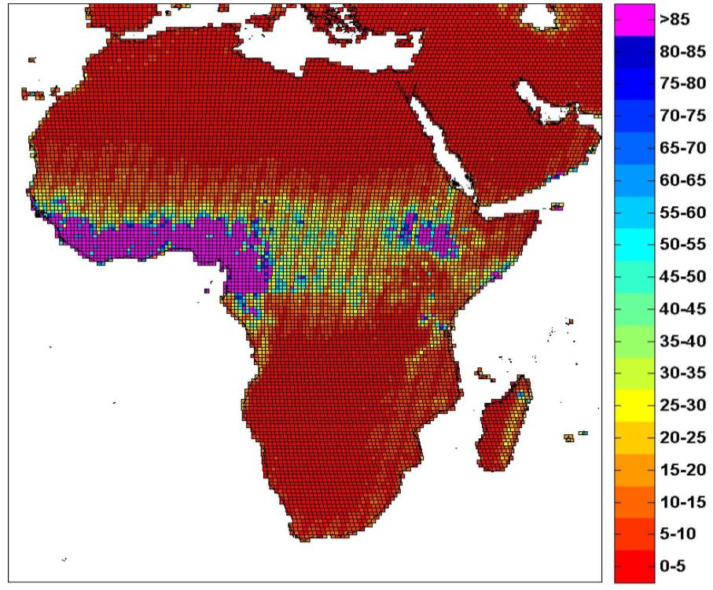
Sentinel-2 data time series for 10 m LC continental scale mapping (Africa)
Cloud free obs. with 2 overpass /day
MODIS on Aqua and Terra
Sentinel 2 - annual coverage with 2 sat.
(Pekel et al. , RSE 2014)

Slide 30
Sentinel-2 for Africa in LC-CCI Phase II
~ 2 months processing time
on a 72 nodes/300 cores Calvalus cluster
MERIS L1B
SR 7-day comp.
10 years, global
~ 160 TB
10 years, global
~36 TB
MERIS
pre-processing
300m, 15 bands+error
60-100 GB/composite
expected ~3 months processing time
(more complex adjacency corr., terrain corr.)
S2 MSI L1
SR 15-day comp.
Sentinel 2
pre-processing
1 year, Africa
~165 TB
1 year, Africa
~72 TB
10-20 m, 13 bands+e.
3-4 TB/composite
Assumptions:
~750 TB L1 / platform / year
S2A data available in 2016
Africa is ~22% of the global land surface
Acquisition strategy proportional to area
Notes:
This slide shows the data volume and expected processing times for one year of S2 data over Africa in comparison with MERIS full mission.

Slide 31
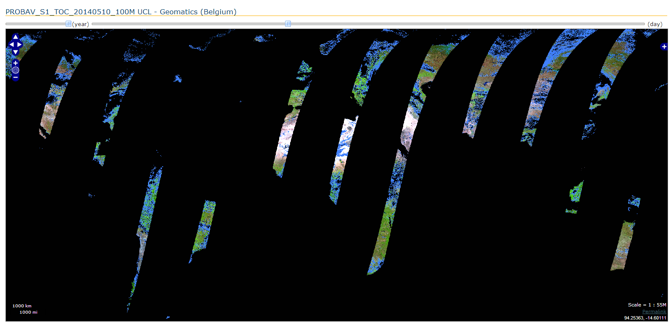
100 m PROBA-V imagery for LC mapping
100-m daily global observation – 10 May 2014

Slide 32
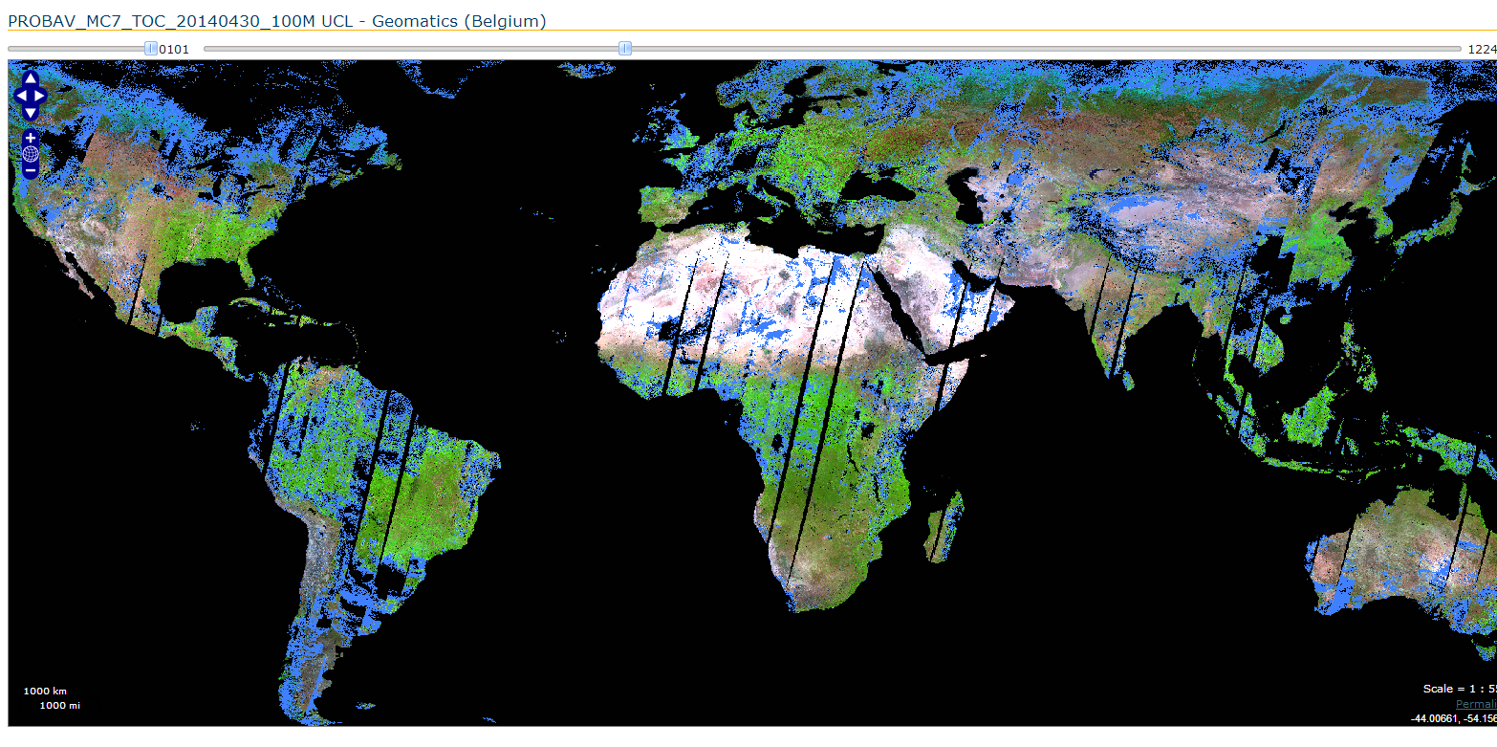
1st global 100 m PROBA-V mosaic
100-m 7-d global composite – 1st week of May 2014

Slide 33
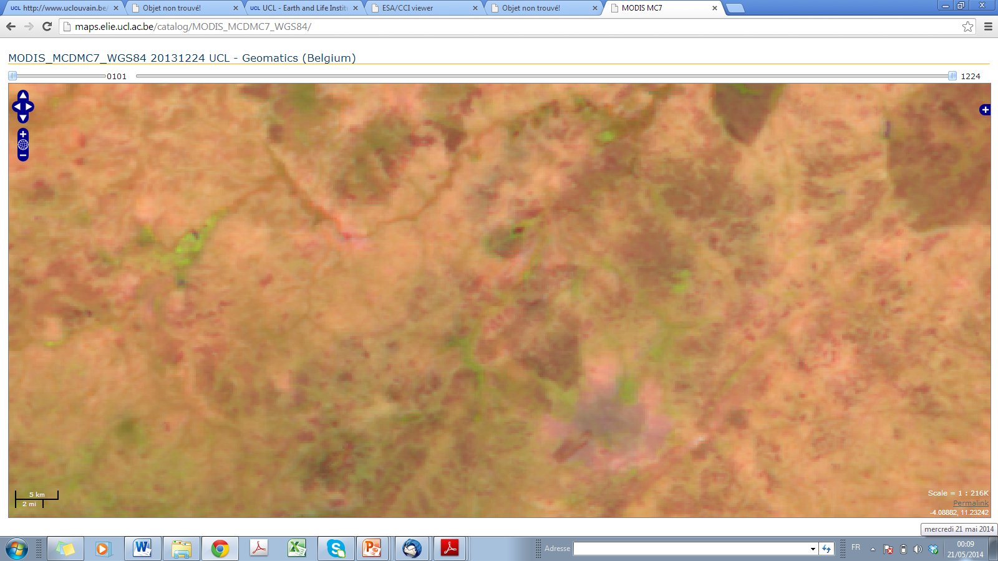
MODIS MC7 250 m

Slide 34
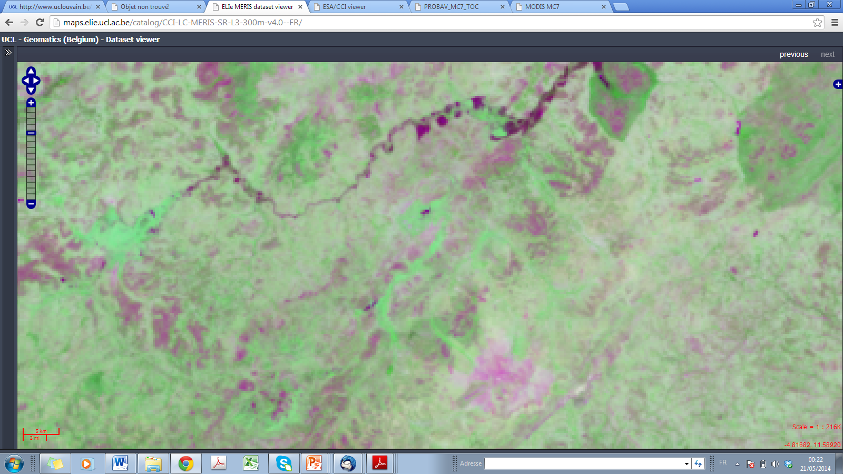
MERIS MC7 300 m

Slide 35
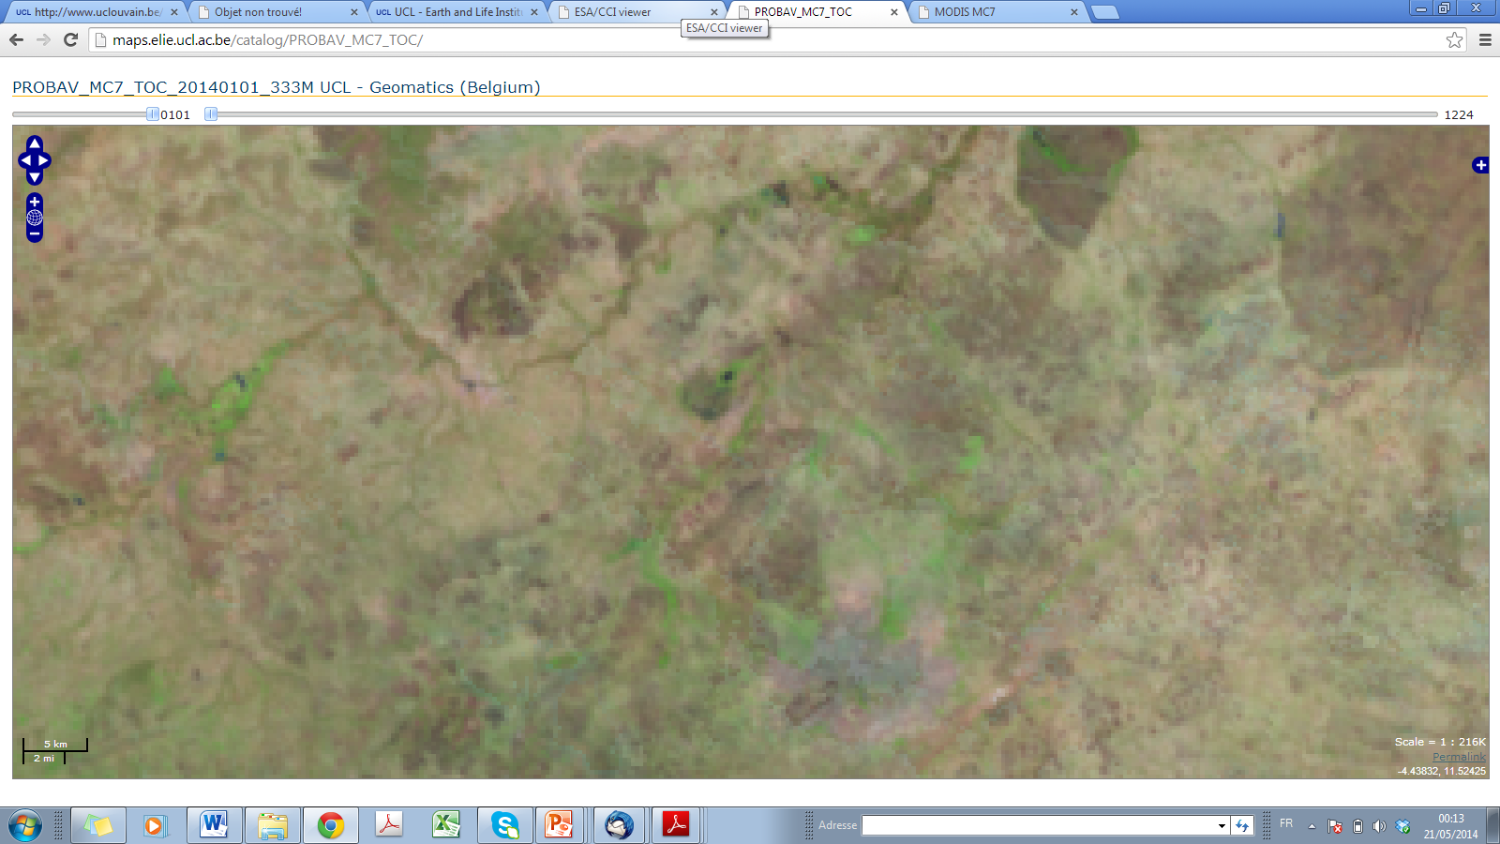
Proba-V MC7 333 m

Slide 36
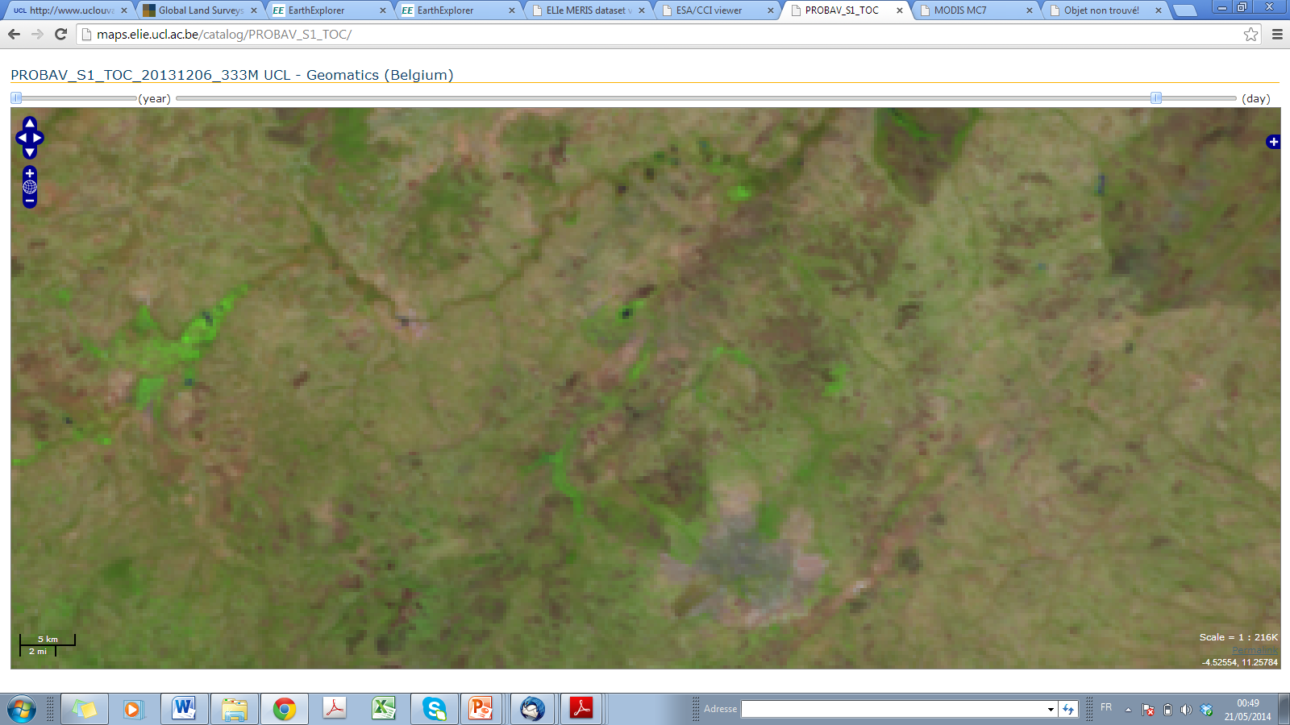
Proba-V daily 333 m

Slide 37
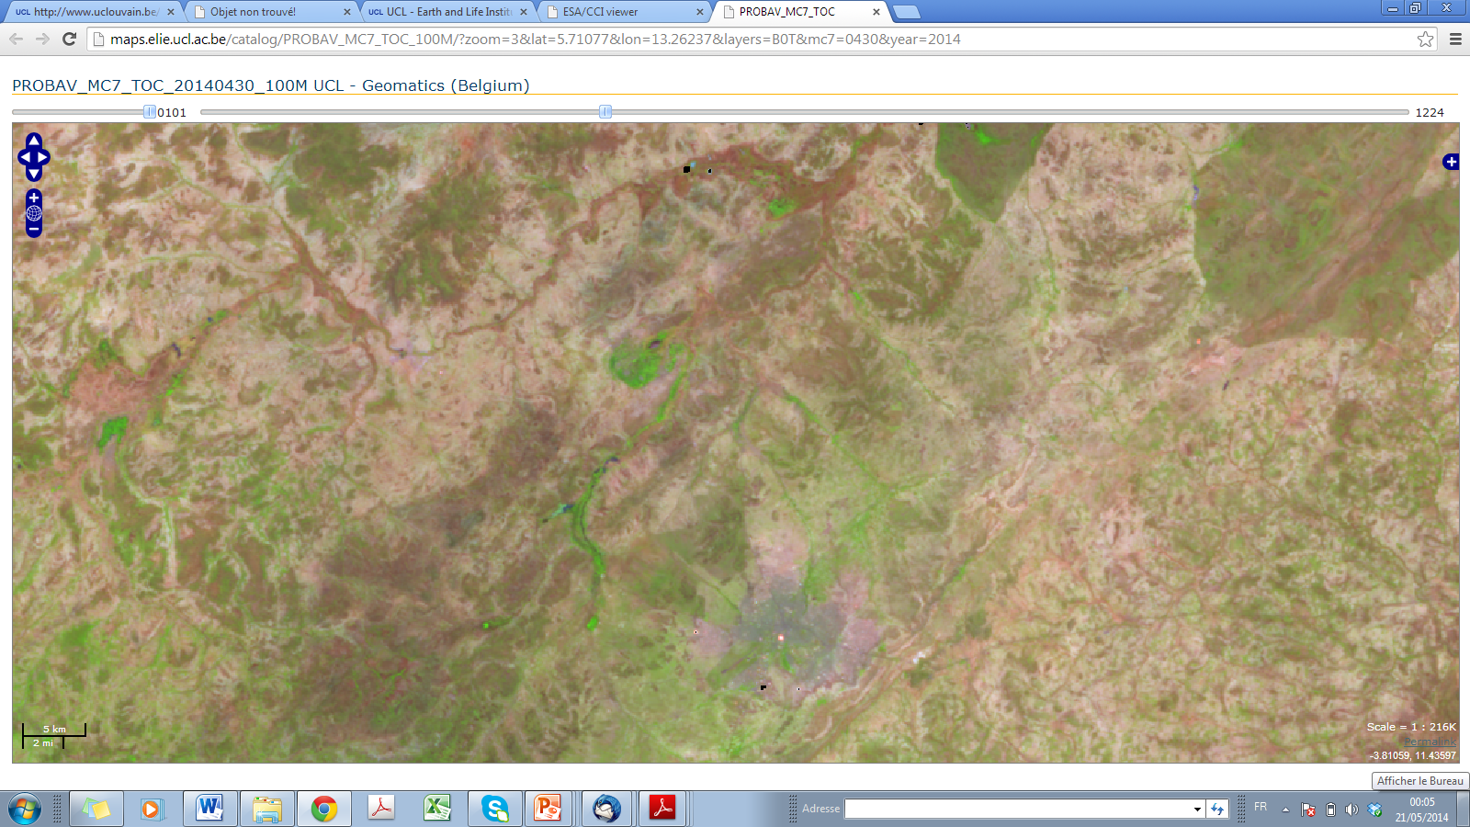
Proba-V MC7 100 m

Slide 38
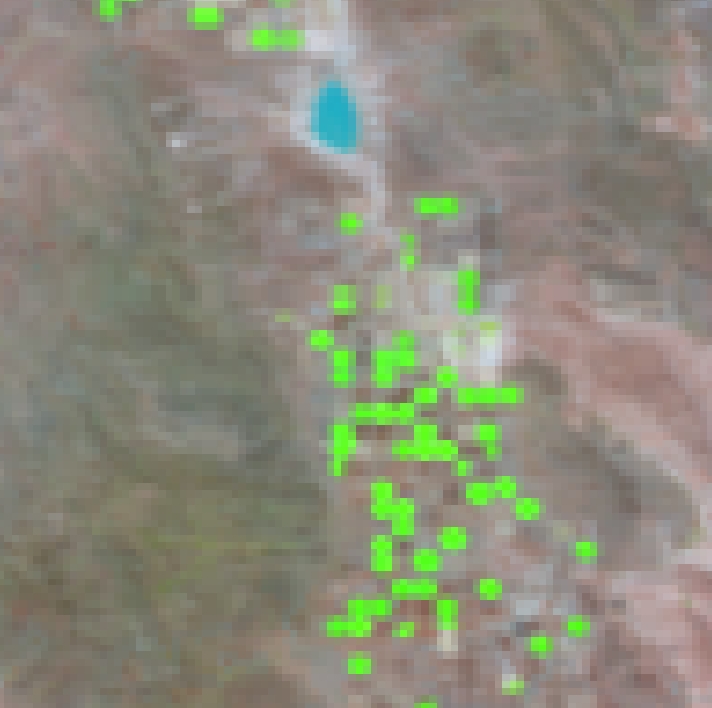
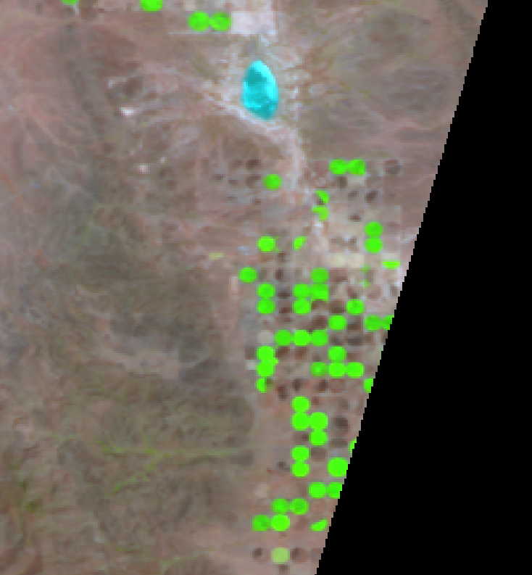
PROBA-V 333 m versus 100 m

Slide 39
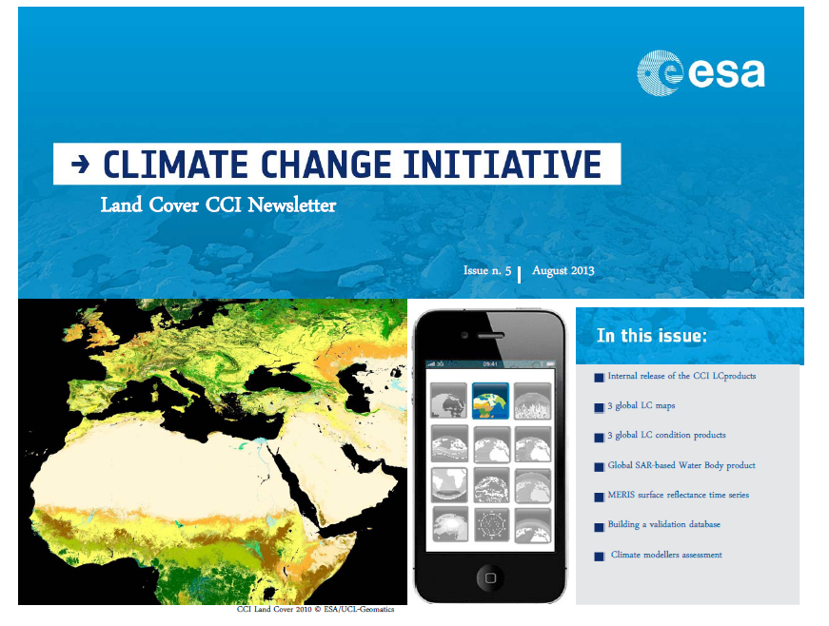
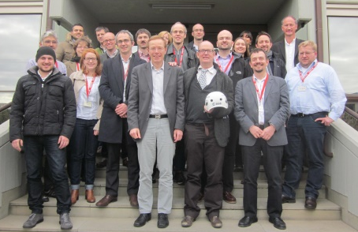
Thank you for attention

