Slide 1








Land Cover_CCI
Pierre Defourny et al.
Univ.cath. de Louvain

Slide 2
Land Cover: 3 main uses in climate com.
Users requirements analysis considered the diversity of LC applications by climate modeling communities
  As proxy for a suite of land surface parameters that are assigned based on PFTs
  As proxy for human activities in terms natural versus anthropogenic, i.e. land use affecting land cover (land cover change as driver of climate change)
  As datasets for validation of model outcomes (i.e. time series) or to study feedback effects (land cover change as consequence of climate change)
Notes:
2

Slide 3
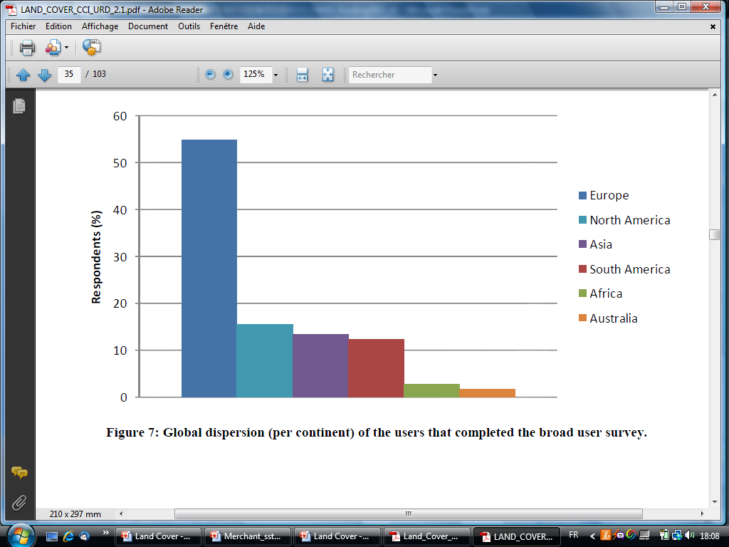
Users Consultation Mechanisms
4 levels of users surveys
Land Cover Data
User Community
Climate User
Community
Broad assessment of ESA GLOBCOVER Users
4,6 % (372/8000)
Key user surveys:
MPI-M, LSCE, MOHC
Global users distribution
Associated user survey
17,6% (15/85)
Scientific literature review
Notes:
100 pages document by Wageningen Univ.
3

Slide 4
Output example :spatial resolution requirements
Median
Minimum
Notes:
Look at the current use, resolution required to improve current modesl and resolution in new model (5y)

Slide 5
Users Requirements Survey findings
UR1 – Need for long term consistency of land cover and for a dynamic component
UR2 - Consistency among the different surface parameters of model is often more important than accuracy of individual datasets
UR3 - Providing information on natural versus anthropogenic vegetation and track land use and anthropogenic land cover change
UR4 - Land cover products should provide flexibility to serve different scales and purposes both in terms of spatial and temporal resolution;
UR5 - Variable importance of different LC class accuracies depending on relationship with the ‘climatically’ relevant surface parameters
UR6 - Further requirements for temporal resolution : monthly and inter-annual dynamic but also for periods beyond the remote sensing era
UR7 - UN LCCS classifiers suitable and compatible with PFT concepts
UR 8 - Quality of land cover products need to be transparent by using quality flags and controls
Notes:
=> initialization/boundary conditions of climate models
5

Slide 6
 | Threshold requirement | Target requirement
 | Coverage and sampling
Geographic Coverage | Global | Global with regional and local specific products
Temporal sampling | Best/stable map and regular updates | Monthly data on vegetation dynamics and change
Temporal extent | 1-2 years, most recent | 1990 (or earlier)-present
 | Resolution
Horizontal Resolution | 1000 m | 30 m
 | Error/Uncertainty
Precision | Thematic land cover detail sufficient to meet current modelling user needs | Thematic land cover detail sufficient to meet future model needs
Accuracy | Higher accuracy than existing datasets | Errors of 5-10% either per class or as overall accuracy
Stability | Higher stability than existing datasets | Errors of 5-10% either per class or as overall accuracy
Error Characteristics | Independent one-time accuracy assessment | Operational and independent multi-date validation
Notes:
6

Slide 7
Land Cover CCI : an opportunity to revisit the land cover concept
Rationale
Land cover can not be the (observed) physical and biological cover on the terrestrial surface (LCCS, 2005; GTOS ECV, 2009),
….and remains stable and consistent over time (as requested by users and by climate modellers)
LC is organized along a continuum of temporal and spatial scales.
A given LC is defined by a characteristic scale of observation and a time period of observation.
LC CCI relies on satellite remote sensing, the only data source regularly available providing global coverage
=> a set of ‘instantaneous’ EO are interpreted in ‘stable’ LC classes
Notes:
7

Slide 8
Land Cover CCI Product Specification
Mapping land cover state and land cover condition
through the use of land surface feature
The land cover change corresponds to a ‘permanent’ modification of the land cover state (not systematically mapped by CCI)
a stable ensemble of land surface features described by:
- feature type (tree, shrub, water, built-up areas, permanent snow, etc.)
- feature structure (veg. height, veg. density, building density, etc.)
- feature homogeneity (mosaic/patterns of different features as urban fabric)
- feature nature (level of artificiality, C3/C4 plant, etc).
Notes:
8

Slide 9
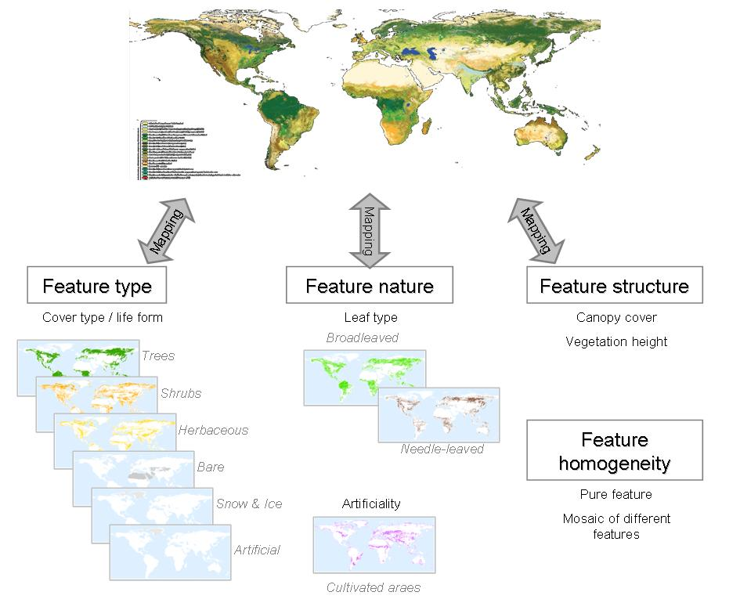
Product Specification : land cover state
Land cover state based on UN LCCS classifiers
Easy to translate in Plant Functional Types
Class | PFT Description
1 | Broadleaved, evergreen
2 | Broadleaved, deciduous
3 | Needleleaved, evergreen
4 | Needleleaved, deciduous
5 | Shrubs
6 | Grassland
7 | Cropland, irrigated
8 | Cropland, non-irrigated
9 | Wetland
10 | Barren land or sparse vegetation
11 | Urban
12 | Water
13 | Snow & Ice
Notes:
9

Slide 10
Product Specification : land cover condition
Mapping land cover state and land cover condition
Consistency between land cover state and condition
to be verified by cross-checking and with LST dataset
set of annual time series describing the land surface status along the year:
- green vegetation phenology (NDVI, other VI ?)
- snow occurrence (duration, starting date)
- inland water presence (flooding, irrigation timing)
fire occurrence (and burnt areas - tbc)
albedo (whenever available)
LAI (whenever available)
+ associated inter-annual variance for each land cover condition item
Notes:
Note – not all LC condition item applied to each land surface feature
10

Slide 11
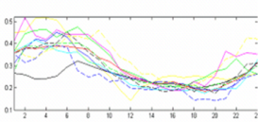
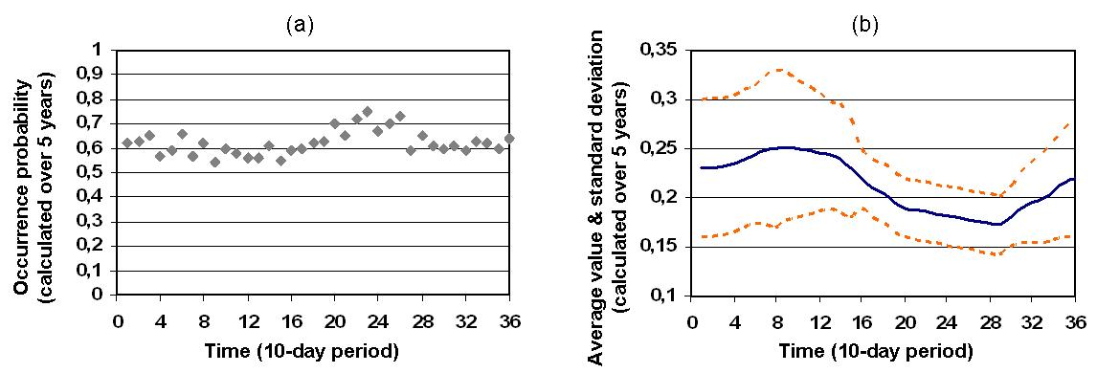
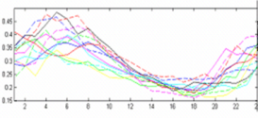
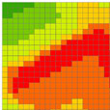

Land Cover CCI Product Specification
Land Cover State
Land Cover Condition
annual
NDVI
Albedo
LAI
inter-annual
per object
per pixel
Occurrence
Probability
Snow
Water
Active Fire
Burnt Areas
Map combining
the classifiers
(or feature charact.)
in LC state class
Detection algo
or products
+ Uncertainty information at class level

Slide 12
Matching the GCOS – CMUG – CCI requirements
>85%
Best stable map
90% -
95 %
80%- 85%
80%
>85%
>90%
>95%
-
>95%
300m - 1km
-
Land Cover CCI product: consistent land cover on the long term with some intra-annual dynamic information,
change only for major hot spot areas, and
internal consistency focus in model surface parameters perspective
Notes:
12

Slide 13
Land Cover CCI Product Specification
10-day surface reflectance time series for 2 different periods based on MERIS FR and MERIS RR and associated metadata
  from 2003 to 2007 (and possibly the 5-y average around 2005)
  from 2008 to 2012 (and possibly the 5-y average around 2010)
Global land cover databases for 3 different periods with an overall accuracy > 80 % and a temporal stability of 80-85%
CCI Land Cover product | Reference period | Source
Land Cover 2000 | 1998-2002 | SPOT- VEGETATION daily images
Land Cover 2005 | 2003-2007 | Envisat MERIS (FR & RR) daily images SPOT VEGETATION daily images
Land Cover 2010 | 2008-2012 | Envisat MERIS (FR & RR) daily images SPOT VEGETATION daily images
Notes:
13

Slide 14
Product Specification : satellite data sources
Satellite data | Source | Technical specifications
ENVISAT MERIS FRS_1P | ESA | 300-m resolution full swath 15 spectral bands in visible and near infrared Global coverage Output of 3rd re-processing required From 2003 on
ENVISAT MERIS RR_1P | ESA | 1.2-km resolution full swath 15 spectral bands in visible and near infrared Global coverage Output of 3rd re-processing required From 2001 on
SPOT-VGT (S1 or P products) | CNES (VITO) | 1-km spatial resolution 4 spectral bands (blue, red, NIR and SWIR) Daily synthesis (for S1 products) Global coverage 2nd re-processed version required (the VGT2 drift) From 1998 on
Envisat ASAR ASA_WSM_1P | ESA | 75-m spatial resolution Full swath products C band Global coverage From 2002 on
MODIS global surface reflectance daily products 250m | NASA | Daily images 2 spectral bands (red, NIR) MOD09GQ for TERRA and MYD09GQ for AQUA Global coverage Collection 5 required
MODIS global surface reflectance daily products 500m and 1km | NASA | Daily images 7 spectral bands (visible to SWIR) MOD09GA for TERRA and MYD09GA for AQUA Global coverage Collection 5 required

Slide 15
Product Specification : dissemination tool
Flexibility and very large data volume handling thanks to a
web-based tool and interface to be developed by BC for:
- subset of the products
- geographic region of interest
- cartographic projection
- format (NetCDF, HDF, Geotiff)
Where to host such large data archive to serve the users communities ? CMUG initiative ?

Slide 16
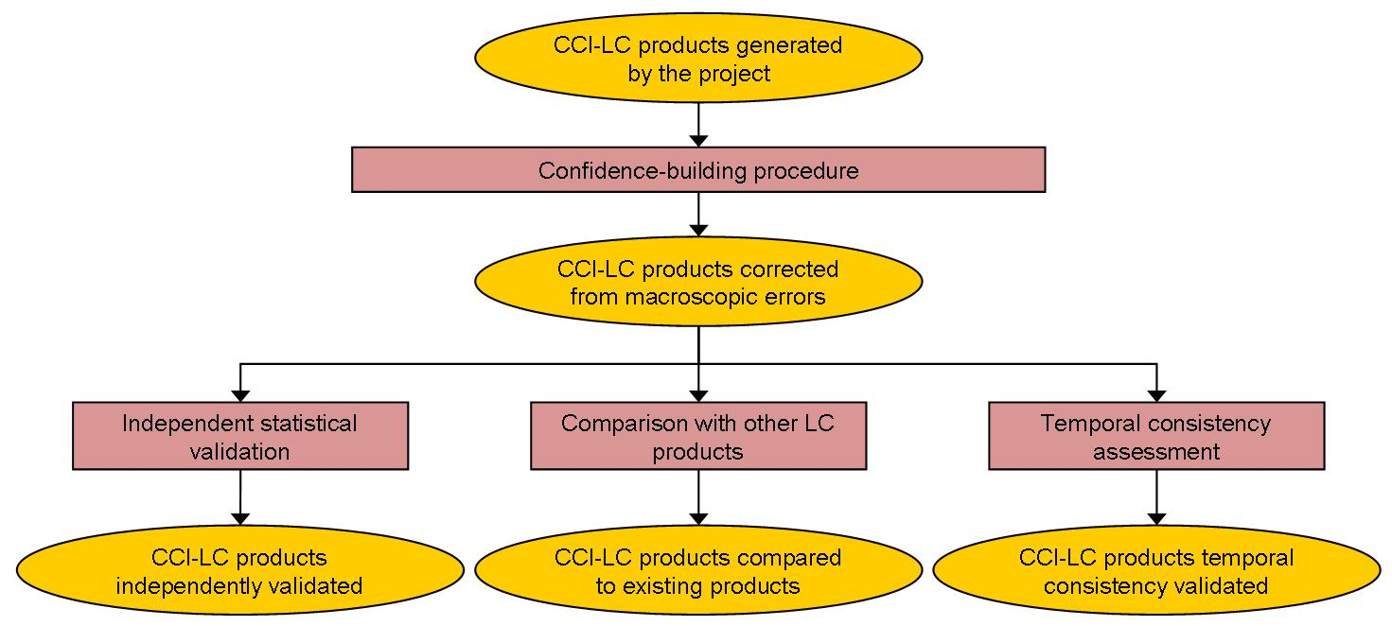
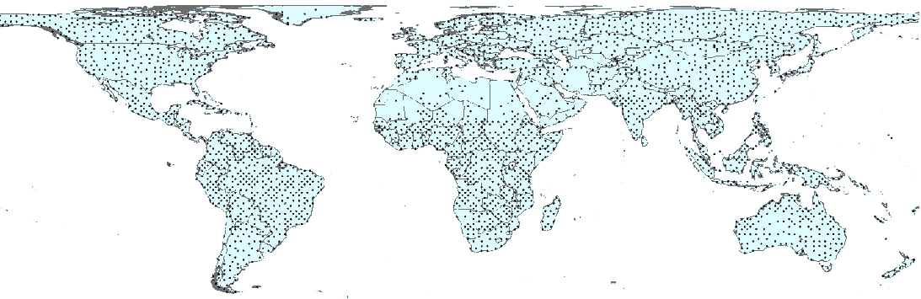
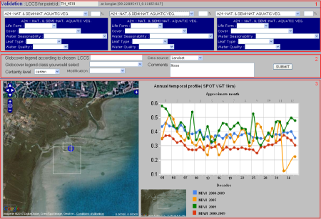
Uncertainty Characterisation
2 main sources:
  quality control output, variables and flags from pre-processing (level 2 and 3) and classification chains (level 4)
  3 validation processes including stability analysis (see PVP)

Slide 17
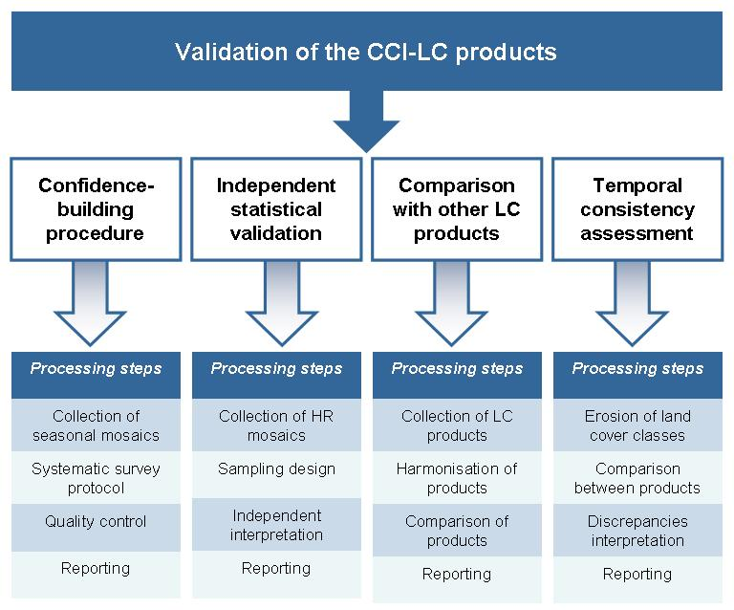

Slide 18
Uncertainty use
Uncertainty information to be used in the classification algorithms
Uncertainty related to reference information taken into account for the accuracy assessment
Land cover error interpretation for PFT mapping
 |  | 1 | 2 | 3 | 4 | 5 | 6 | 7 | 8 | 9 | 10 | 11 | 12
 | Generalized Land Cover Legend | Evergreen Needleleaf Trees | Evergreen Broadleaf Trees | Deciduous Needleleaf Trees | Deciduous Broadleaf Trees | Mixed / Other Trees | Shrubs | Herbaceous Vegetation | Cultivated and Managed Veg. | Urban / Built-up | Snow and Ice | Barren | Open Water
1 | Evergreen Needleleaf Trees
2 | Evergreen Broadleaf Trees | 87.1
3 | Deciduous Needleleaf Trees | 74.5 | 75.8
4 | Deciduous Broadleaf Trees | 67.6 | 78.0 | 85.4
5 | Mixed / Other Trees | 70.7 | 73.5 | 89.7 | 89.9
6 | Shrubs | 54.2 | 59.1 | 78.1 | 80.0 | 78.6
7 | Herbaceous Vegetation | 45.0 | 50.6 | 70.5 | 71.5 | 72.7 | 89.7
8 | Cultivated and Managed Veg. | 52.5 | 61.5 | 75.3 | 82.9 | 80.0 | 92.3 | 87.4
9 | Urban / Built-up | 34.2 | 33.2 | 53.1 | 48.3 | 55.3 | 58.9 | 65.9 | 55.4
10 | Snow and Ice | 21.7 | 15.6 | 39.4 | 32.4 | 42.1 | 50.6 | 58.2 | 45.6 | 69.1
11 | Barren | 36.6 | 30.5 | 54.3 | 47.3 | 57.0 | 65.5 | 73.1 | 60.5 | 78.5 | 85.1
12 | Open Water | 30.6 | 24.0 | 48.2 | 40.6 | 50.1 | 57.7 | 65.1 | 53.1 | 75.6 | 88.9 | 89.7
dissimilarity matrix for 9 model paramaters

Slide 19
Integrated perspective of ECVs
Partly embendded in the Land Cover product specification through the land cover condition
Spatial consistency between Ocean/Land ECVs:
for a global land / sea mask
Benefit from other ECVs:
AEROSOL : participation to progress meeting for info exchange
CLOUDS : in support of cloud screening at pixel level (level 2)
GLACIERS : still to be investigated – possible input for LC product
Spatio-temporal consistency with FIRE ECV

Slide 20
Need for ECMWF data
Total Ozone Content for 1998 to 2012
for atmospheric correction to retrieve surface reflectance

Slide 21
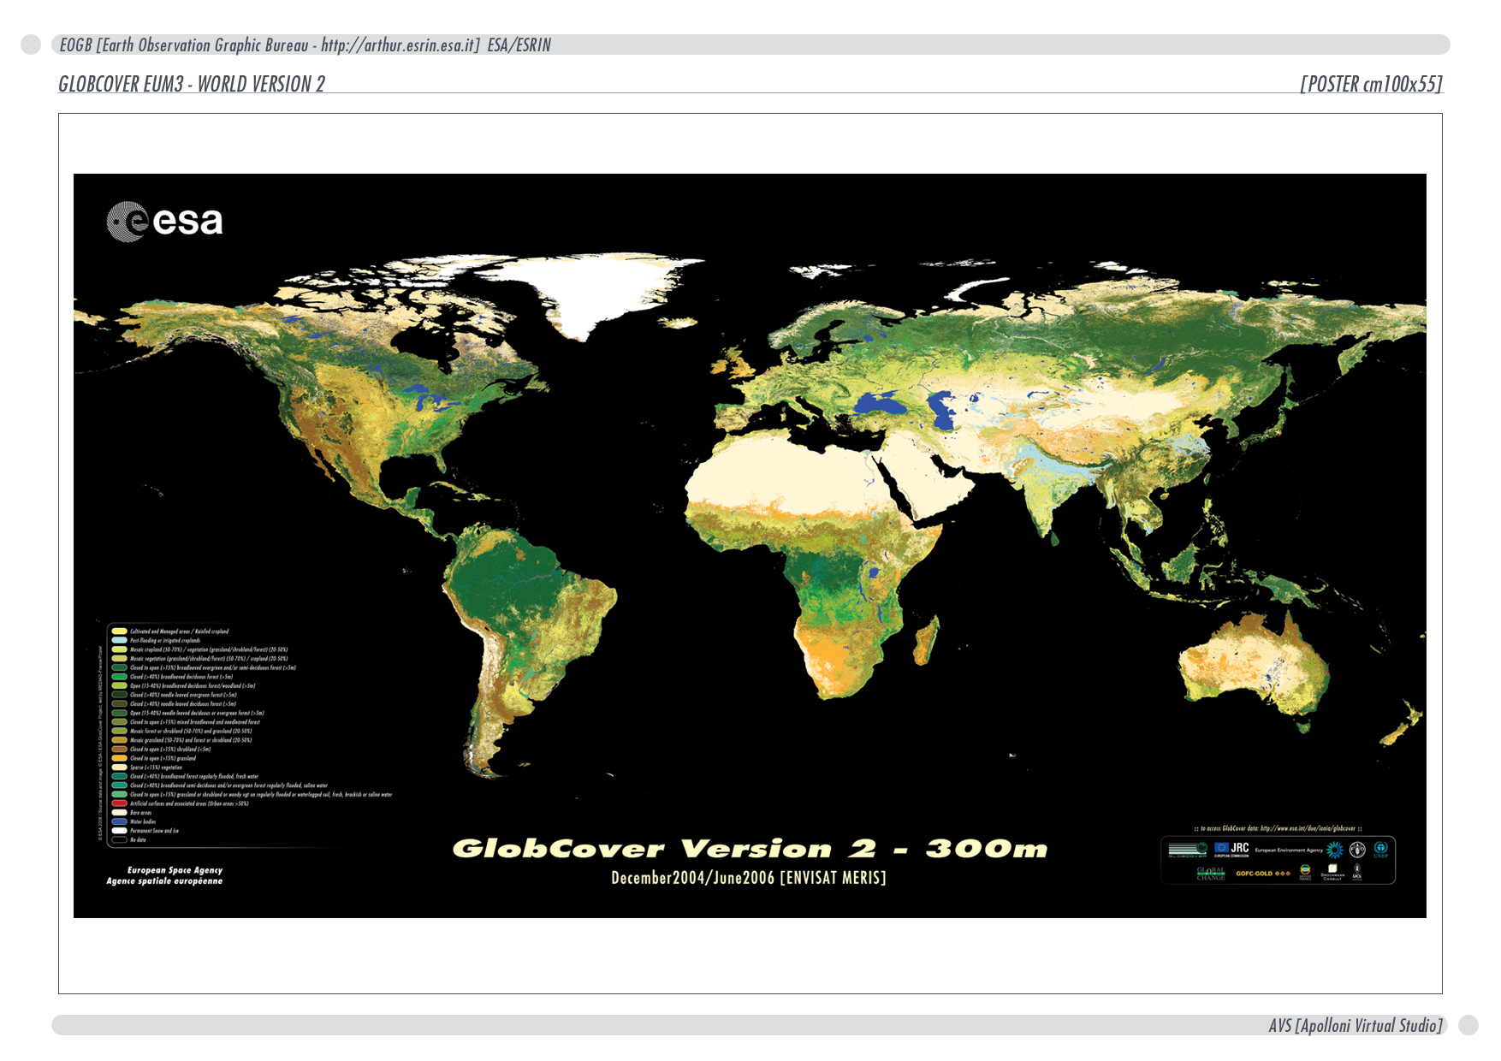
Thank you for attention

