Slide 1

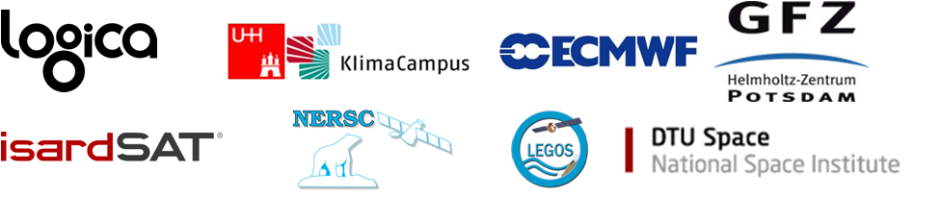

ESA Climate Change Initiative
Sea-level-CCI project
A.Cazenave (Science Leader), G.Larnicol /Y.Faugere(Project Leader),
M.Ablain (EO),J.Dorandeu (CLS), M.Balamaseda (ECMWF)

Slide 2
Overview
Objectives:
Description of user requirements (URD): consistency with GCOS and CMUG requirements
Description of product specifications (PSD) for FCDR and ECV
Description of validation strategy (PVP) : focus on uncertainties
Description of ECMWF data used (DARD)
Integrated perspective for consistency between the ECVs

Slide 3
1) Description of URD
To perform the sea-level URD, requirements have been analyzed in details from:
Global Climate Observing System (GCOS)
World Climate Research Program (WCRP)
Global Ocean Observing System (GOOS)
Climate Modelling User Group (CMUG)
Analysis of requirements coming from altimetry community and the climate research group have been also performed thanks to a questionnaire

Slide 4
1) Description of URD
Analysis of GCOS requirements for sea-level:
GCOS TARGET REQUIREMENTS described in2006 report
ACCURACY | 1 cm
SPATIAL RESOLUTION | 25 km horizontal resolution
TEMPORAL RESOLUTION | Daily observing cycle
STABILITY | 0.5 mm/decade
These requirements will be extremely hard to satisfy for existing altimetry missions and for the future missions in the coming decade:
=> Currently, the stability is 6 mm/decade
Issue of global coverage in area covered by ice is very challenging
Therefore, we pointed out that the GCOS requirements have been to refined

Slide 5
1) Description of URD
Analysis of GCOS requirements for sea-level:
Requirements are also expressed in terms of 5 criteria: quantity, horizontal resolution, observing cycle, delay of availability, accuracy
Requirements are also defined by type of applications: Coastal sea level change and Ocean dynamic topography
do not really cover the needs for climate application
Requirement from GCOS | Parameter name | Coastal sea level change | Ocean dynamic topography
Horizontal resolution | Goal | 25 km | 25 km
 | Breakthrough | 100 km | 50 km
 | Threshold | 1000 km | 250 km
Observing Cycle | Goal | 24 h | 1 day
 | Breakthrough | 50 h | 3 days
 | Threshold | 240 h | 30 days
Delay of availibity | Goal | 1 h | 0.125 day
 | Breakthrough | 3 h | 0.25 day
 | Threshold | 24 h | 1 day
Accuracy | Goal | 1 cm | 1 cm
 | Breakthrough | 2 cm | 15 cm
 | Threshold | 10 cm | 5 cm
Confidence | CF_NAME | Reasonable | Firm
Application | Use | OOPC | OOPC

Slide 6
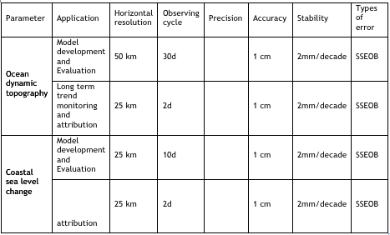
1) Description of URD
Analysis of CMUG requirements for sea-level:
More precise since applications areas have been defined

Slide 7
1) Description of URD
We have tried to define the requirements taking into account several temporal and spatial scales in order to fulfill more accurately the requirements by application areas
2 kinds of ocean surface topography signal have been identified:
Global Mean Sea level
Regional Mean Sea Level
For each of these categories, User requirements have been proposed.
The current status of the ocean surface topography is also proposed.
We also tried to follow the recommendations of the colocation meeting to identify requirements in term of stability, precision and accuracy

Slide 8
1) Description of URD
A. Cazenave proposed new requirements to the last GCOS steering meeting (Geneva, 2011) in agreement with those described in the URD
Global mean sea level | Accuracy | 2-4 mm over an orbital cycle
 | Stability | Long-term drift precision : < 0.3 mm/yr Annual time scale : <0.5 mm over 12 months
Regional sea level | Spatial resolution | 25-50 km
 | Temporal resolution | weekly
 | Precision | 1 cm (over a grid mesh of 50-100 km)
 | Stability | <1mm/yr for a grid mesh of 50-100 km

Slide 9
1) Description of URD
At the moment, the CCI URD and GCOS requirements are the same
We are still working on them in order to propose a revisited version further in the project
to formalize better the spatial and temporal scales
to refine the requirements: precision, accuracy
to add others applications which could also impact the climate as the mesoscale or the ocean circulation
 |  | Global Mean Sea Level | Regional mean sea level
Spatial resolution |  | - | 25-50 km
Temporal resolution |  | 1 month | 1 month
Stability |  | 0,3 mm/yr | 1 mm/yr (over a grid mesh of 50 km)
Precision | over 1 month | 1 mm | 1 cm (over a grid mesh of 50 km)
 | over 1 year | 0,5 mm | ?
 | over interannual period | 0,5 mm | ?
Accuracy |  | - | -

Slide 10
2) Description of PSD
2 products have been specified:
  FCDR products: Fundamental Climate Data Records
  ECV products: Essential Variable Climate
FCDR product
It is a mono-mission product generated from altimeter level-2.
It contains:
the along-track sea level height (SSH) over ocean
a quality control indicator to remove spurious measurements
the altimeter standards applied in the SSH calculation as the geophysical corrections, the mean sea surface, etc...
information derived from multi-mission cross-calibration in order to remove the global SSH bias and to homogenize long spatial scale errors
Data will be produced along the tracks of the different altimeters, with a resolution of 1Hz corresponding to a ground distance close to 6km.

Slide 11
2) Description of PSD
ECV product
The sea Level ECV products are composed of 3 categories:
Time data series of sea level anomaly (SLA): correspond to the global and regional time data series:
  Global MSL: 1-dimension vector of monthly averaged SLA
  Regional MSL: 2-dimension grids of monthly SLA grids calculated after merging all the altimetric mission together.
Ocean indicators: correspond to statistic information estimated over all the altimeter period from the SLA time data series. Several indicators are provided as the trend of the global and the regional MSL, the amplitude and phase of the main periodic signals (annual, semi-annual)
Errors of oceanic indicators: correspond to the errors of the oceanic indicators (error on the global MSL trend for instance).

Slide 12
2) Description of PSD
FCDR and ECV products are stored using the NetCDF (Network Common Data Form) using CF (Climate and Forecast) Metadata convention.
2 versions will be generated :
  V0: it is the sea level products produced using the existing standards algorithms, it corresponds to the state of the art at the beginning of the project.
  V1: it is the new sea level products, produced using the algorithms selected in the first phase of the project.
Both versions will allow us to estimate the improvements brought by new algorithms
Sea-Level CCI Product specifications meet the needs of sea-level Climate research group for regional and global MSL applications: long-term stability, time data series of 2-dimension grids,…
Could other products than specific CCI products be of interest for climate studies? For instance mesoscale or ocean circulation products, Absolute Dynamic Topography (ADT). With which requirements?

Slide 13
3) Description of PVP: focus on uncertainties
Validation diagnoses are defined in order to :
  To assess the impact of the new algorithms on the round-robin procedure and finally to select the best ones to calculate the altimeter sea surface height
  To assess the final FCDR and ECV products generated during the project
A main principle of validation phases including round-robin and final validation is to use a common set of validation diagnoses for all the algorithms or products (FCDRs and ECVS) which will be developed in the project. This strong principle allows us to estimate the impact of different algorithms with comparable statistics.
This will be also a rigorous approach to characterize the sea-level altimetry errors.

Slide 14
3) Description of PVP: focus on uncertainties
The validation diagnoses are of different types which allow us to check altimetry data with complementary objectives:
Type | Objective | Altimetry level
Global internal analyses | Ensure the internal consistency of new proposed algorithms compared to standard or reference and evaluate the global improvement in system performances. | L1 & L2 L3 & L4
Global multi-mission comparisons | Estimate improvements in sea-level consistency between different altimetry missions using the new algorithms | L1 & L2
Global altimetry and In-situ data comparison | use independent data to measure the impact of new algorithms on the sea-level calculation derived from altimetry missions. | L1 & L2 L3 & L4

Slide 15
3) Description of PVP: focus on uncertainties
Inside a validation diagnostic type, they are different diagnostics groups based on the same input data derived from altimetry measurements or from external data used:
Input data | Description
Along-track altimetric components | Values of the altimetric corrections or altimetric parameters or orbit calculation along the satellite 1 Hz ground track
Along-track Sea Level Anomaly (SLA) | Sea level anomalies along the ground track of the satellite at 1 Hz
Along theoretical track SLA | SLA along the theoretical ground track of the satellite at 1 Hz. Allows repeat-track analysis
SLA maps combined from several missions | SLA grids are derived from along-track SLA combining and interpolating in time and space several altimetric missions.
SSH Crossovers | SSH differences between ascending and descending passes for time differences lower than 10 days
Tide gauges | Measurements from global tide gauges networks (GLOSS/Clivar, PMSL) covering all the altimetric period
Temp/Salinity profiles | Data from the ARGO Global network

Slide 16
3) Description of PVP: focus on uncertainties
Number | Diagnostics name
A01 | Temporal evolution of differences between both altimetric components
A02 | Map of differences between both altimetric components over all the period
A03 | Periodogram derived from temporal evolution of altimetric component differences
A04 | Temporal evolution of SSH crossovers
A05 | Differences between temporal evolution of SSH crossovers
A06 | Map of SSH crossovers
A07 | Differences between maps of SSH crossovers
A08 | Temporal evolution of SLA
A09 | Differences of SLA temporal evolution
A10 | Map of SLA over all the period
A11 | Differences between maps of SLA
A12 | Periodogram derived from temporal SLA evolution
A13 | SLA differences versus coastal distances between 0 and 300 km
B01 | Temporal evolution of SLA for 2 missions over the same period
B02 | Differences between maps of SLA for 2 missions over the same period
C01 | Temporal evolution of SSH differences between tide gauges and altimetry data over all the altimetry period
C02 | Differences of temporal evolution of SSH differences between tide gauges and altimetry data over all the altimetry period
C03 | Periodogram derived from temporal evolution of SSH differences between tide gauges and altimetry data over all the altimetry period
C04 | Difference of histograms between tide gauges and altimeter SSH differences
C05 | Temporal evolution of SSH differences between T/S profiles and altimetry data over all the altimetry period: global, north/south, east/west
C06 | Differences of temporal evolution of SSH differences between T/S profiles and altimetry data over all the altimetry period
C07 | Periodogram derived from temporal evolution SSH differences between T/S profiles and altimetry data over all the altimetry period
The basic principle of validation diagnosis is to compare the new algorithms with the reference ones.
The reference algorithms are the state of the art at the beginning of the project.

Slide 17
3) Description of PVP: focus on uncertainties
Number | Diagnostics name
A01 | Temporal evolution of differences between both altimetric components
A02 | Map of differences between both altimetric components over all the period
A03 | Periodogram derived from temporal evolution of altimetric component differences
A04 | Temporal evolution of SSH crossovers
A05 | Differences between temporal evolution of SSH crossovers
A06 | Map of SSH crossovers
A07 | Differences between maps of SSH crossovers
A08 | Temporal evolution of SLA
A09 | Differences of SLA temporal evolution
A10 | Map of SLA over all the period
A11 | Differences between maps of SLA
A12 | Periodogram derived from temporal SLA evolution
A13 | SLA differences versus coastal distances between 0 and 300 km
B01 | Temporal evolution of SLA for 2 missions over the same period
B02 | Differences between maps of SLA for 2 missions over the same period
C01 | Temporal evolution of SSH differences between tide gauges and altimetry data over all the altimetry period
C02 | Differences of temporal evolution of SSH differences between tide gauges and altimetry data over all the altimetry period
C03 | Periodogram derived from temporal evolution of SSH differences between tide gauges and altimetry data over all the altimetry period
C04 | Difference of histograms between tide gauges and altimeter SSH differences
C05 | Temporal evolution of SSH differences between T/S profiles and altimetry data over all the altimetry period: global, north/south, east/west
C06 | Differences of temporal evolution of SSH differences between T/S profiles and altimetry data over all the altimetry period
C07 | Periodogram derived from temporal evolution SSH differences between T/S profiles and altimetry data over all the altimetry period
The basic principle of validation diagnosis is to compare the new algorithms with the reference ones.
The reference algorithms are the state of the art at the beginning of the project.

Slide 18
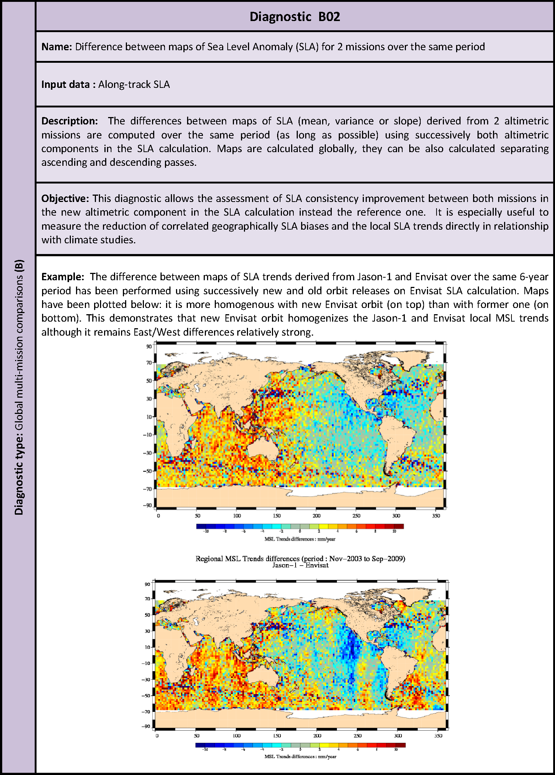
3) Description of PVP: focus on uncertainties
Number | Diagnostics name
A01 | Temporal evolution of differences between both altimetric components
A02 | Map of differences between both altimetric components over all the period
A03 | Periodogram derived from temporal evolution of altimetric component differences
A04 | Temporal evolution of SSH crossovers
A05 | Differences between temporal evolution of SSH crossovers
A06 | Map of SSH crossovers
A07 | Differences between maps of SSH crossovers
A08 | Temporal evolution of SLA
A09 | Differences of SLA temporal evolution
A10 | Map of SLA over all the period
A11 | Differences between maps of SLA
A12 | Periodogram derived from temporal SLA evolution
A13 | SLA differences versus coastal distances between 0 and 300 km
B01 | Temporal evolution of SLA for 2 missions over the same period
B02 | Differences between maps of SLA for 2 missions over the same period
C01 | Temporal evolution of SSH differences between tide gauges and altimetry data over all the altimetry period
C02 | Differences of temporal evolution of SSH differences between tide gauges and altimetry data over all the altimetry period
C03 | Periodogram derived from temporal evolution of SSH differences between tide gauges and altimetry data over all the altimetry period
C04 | Difference of histograms between tide gauges and altimeter SSH differences
C05 | Temporal evolution of SSH differences between T/S profiles and altimetry data over all the altimetry period: global, north/south, east/west
C06 | Differences of temporal evolution of SSH differences between T/S profiles and altimetry data over all the altimetry period
C07 | Periodogram derived from temporal evolution SSH differences between T/S profiles and altimetry data over all the altimetry period
The basic principle of validation diagnostic is to compare the new algorithms with the reference ones.
The reference algorithms or are the state of the art at the beginning of the project.

Slide 19
3) Description of PVP: focus on uncertainties
All these validation diagnoses lead to the uncertainties in the sea-level estimation at different temporal and spatial scales, and for each application in agreement with the URD:
Application |  | Global Mean Sea Level (requirements) | Global Mean Sea Level Errors (current status)
Stability |  | 0,3 mm/yr | 0.6 mm/yr in a confidence interval of 90% (Ablain et al, 2009)
Precision | over 1 month | 1 mm | < 4 mm
 | over 1 year | 0,5 mm | < 2 mm
 | over interannual period | 0,5 mm | < 2 mm
Accuracy |  | - | -
As specified in PSD, we will provide this information in the ECV products for global and regional mean sea level.

Slide 20
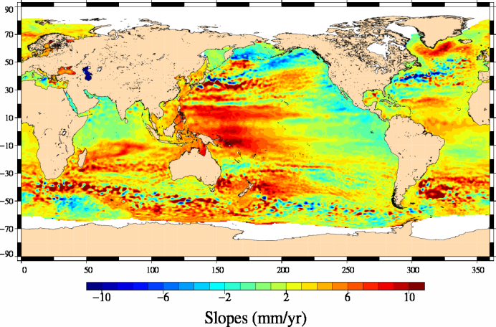
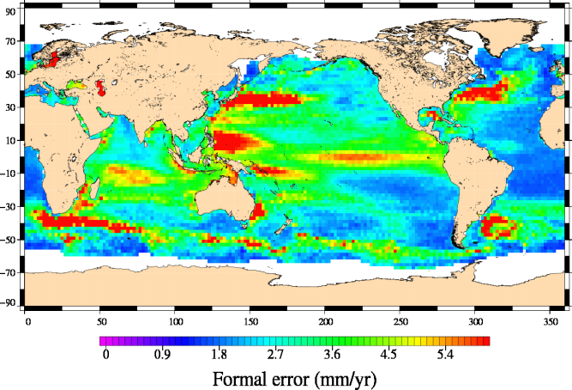
3) Description of PVP: focus on uncertainties
Example:
The local MSL trends calculated over the 1993 - 2009 period are plotted on the left map and the associated formal error on the right map
This information will be provided in the sea-level-ECV

Slide 21
4) DARD: Description of ECMWF data used
For the sea-level-CCI project, we need to use the ERA INTERIM Meteo fields to improve the wet and dry troposphere, and inverse barometer corrections:
model Levels: 3D-Specific humidity, 3D-Temperature, Logarithm of surface pressure
Surface: 2m temperature, 2m dew point, Mean Sea Level Pressure, 10m winds (U
Static files: Model topography grid, Geopotential, Land sea mask
We need also additional fields to improve the Sea-State bias model: Sea surface temperature, Sea-ice cover, wind stress for u and v, Mean wave direction, Mean wave period, Significant wave height
Period: 01/07/1991 to 31/12/2010
For wet and dry troposphere, and inverse barometer corrections: data were delivered until 31/12/2009 as part as the Reaper Project (reprocessing of ERS missions, ESA), therefore only last year is required
For additional fields: all the period is required.
We need in urgence of ECMWF data

Slide 22
5) Integrated perspective for consistency between the ECVs
Round Robin / Validation:
validation diagnoses have been clearly formalized: validation diagnoses are available for all the CCI participants (see PVP)
iteration with others ECVs is necessary to improve/homogenize our diagnoses
Uncertainty Characterization:
The approach to determine sea-level uncertainties is based on validation diagnoses
Uncertainties will be provided in ECV products
Data standards and formats:
All products will be generated in NetCDF-CF
Synergy with other projects has also to be developed (MyOcean, METAFOR, …)
Web sites and data access guidelines:
sea-level-CCI web site is on-line: http://www.esa-sealevel-cci.org/
a dedicated ftp site has been created to share all the documents, the altimetry database and the RRDP : ftp://ftp.esa-sealevel-cci.org/

Slide 23
5) Integrated perspective for consistency between the ECVs
Interactions with other ECVs:
sea-level ECV dependency on other ECVs is weak
Interaction with SST project could be developed in terms of validation diagnoses (PVP), and product specification (PSD) because the problematic is similar
More interactions could be developed with sea-ice ECV but this project is not started
Though not planned in the first phase of the CCI project, interaction with others ECVs as water vapor and sea state will be very useful for sea-level ECV

