Slide 1
Climate Modelling User Group – Current and Future work
Amy Doherty
25 July 2025
Notes:
V quick intro

Slide 2














What is CMUG?
The Climate Modelling User Group: a project in ESA’s Climate Change Initiative
Notes:
Partners – climate modelling expertise from across Europe

Slide 3


CMUG Aims
1. Support integration within the CCI programme
2. Foster exploitation of satellite-derived ECVs
3. Assess quality and impact of CCI ECVs
Notes:
Longer talk through each

Slide 4
CMUG Activities
Science studies to assess quality and impact of CCI data
Engage with climate science community
Integration across the CCI programme
CCI ECV dataset user requirements
Advance ECV uncertainty characterisation
Build links with the climate modelling community
Promote CCI data use in climate models
Support model evaluation with CCI data
Provide feedback to CCI teams
Improve access to ECV datasets through tools and databases
Publish scientific papers
Gap analysis
Notes:
Who we interact with:
CCI ECV Projects
EO bodies
Tools
Climate modelling – NMHS, CMIP, CORDEX
Climate monitoring
These fall under : studies, comms, tools

Slide 5

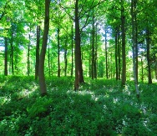

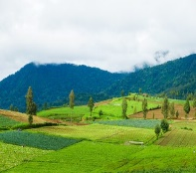


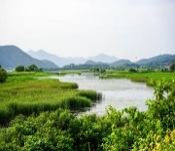


CMUG – Scientific Studies
WP5.1 Machine Learning for Process Understanding
LPS Sessions: A.01.04, A.01.06, A.05.04, A.05.06, A.07.01
WP5.2 Vegetation Phenology
WP5.6 Snow Dynamics
WP5.3 Land Cover
WP5.7 Ice Sheets
WP5.4 Ocean Biogeochemistry
WP5.8 Machine Learning for Wetland Methane Emissions
WP5.5 Clouds and Aerosols
WP5.9 Vegetation and Hydrometeorology
Notes:
Flick past

Slide 6
CMUG – Studies
Machine learning to advance climate model evaluation and process understanding – Lisa Bock, DLR (A.05.04)
Impacts and evaluation of vegetation phenology changes on observed and modelled land-atmosphere processes – Daniele Peano, CMCC
Impact of integrating CCI LC data in the ISBA land surface model – Jean-Christophe Calvet, Météo France (A.07.01)
Seasonal predictability of ocean biogeochemistry and potential benefits of ESA CCI data assimilation – David Ford, Met Office
Cloud and aerosol analysis study, Jeronimo Escribano, BSC / Kirsti Salonen, ECMWF
Snow dynamics impacts on temperate/high latitude climate – Amelie Cuynet, IPSL
Atmospheric drivers and feedback processes affecting the Greenland and Antarctic ice-sheets in observations and regional models – Ulrika Willen, SMHI
Using machine learning to evaluate and understand our capability to model tropical wetland methane emissions – Rob Parker, U. Leicester/NCEO (D.01.04)
Assessment and evaluation of the role of vegetation on hydrometeorological processes in CMIP models – Daniele Peano, CMCC
Notes:
Real summary of each – Kirsti Friday morning

Slide 7
CMUG – Other activities
CCI contributions to ESMValTool
– Axel Lauer, DLR (A.05.04)
Climate community requirements collection and analysis
Foresight Report – Richard Jones, Met Office (A.05.02)
CMUG support to the future evolution of obs4MIPs
– Alison Waterfall, CEDA / Claire Bulgin, U. Reading
Communications and outreach – Hannah Findley, Met Office
  Newsletter
  Climate Science Working Group
  Website: Climate Modelling User Group (CMUG)

Slide 8


CMUG – Future Evolution of Obs4MIPs
Obs4MIPs (Observations for Model Intercomparisons Project) datasets:
Formatted according to the Coupled Model Intercomparison Project (CMIP) model output requirements
Available on the Earth System Grid Federation (ESGF)
Documented in a standard format
Obs4MIPs underpins model evaluation in CMIP and beyond, contributing to assessment and improvement of Earth System Models (ESMs).
CCI ECV projects contribute selected ECV data sets of interest to the CMIP community, with CMUG assistance https://www.wcrp-esmo.org/projects-and-panels/obs4mips
CMUG has produced a report providing recommendations on the future evolution of obs4MIPs. This included:
Results from interviews with 37 users of obs4MIPs
A gap analysis of the current obs4MIPs datasets, identifying missing variables and out of data versions
An in-depth examination of the importance and relevance of recent developments in the understanding of observational error sources to the provision of obs4MIPs data
https://climate.esa.int/media/documents/CMUG_FutureEvolutionofObs4MIPs_D5.7f_v1.2_ieS8qqu.pdf
Notes:
CCI data into Obs4MIPs – CMUG has supported this process in past, also recommendations for future dev of obs4MIPs

Slide 9



CMUG – ESMValTool development
The Earth System Model Evaluation Tool
open-source
community-developed
diagnostics and performance metrics
evaluation and analysis of Earth System Models (ESMs)
Tailored analysis of ESM components
well-documented
source code
scientific background
CMUG supports ESMValTool by adding diagnostics and performance metrics using ESA CCI datasets, enabling tailored evaluation of models
https://esmvaltool.org/
Recent advances by CMUG include a prototype approach for utlising observational uncertainty and enhancing the range of earth system processes that can be evaluated in models.
Notes:
CMUG adds diagnostics and metrics for CCI datasets into ESMValTool to make them easier for modellers to use. Also trying to improve and facilitate use of uncertainties supplied by CCI projects through ESMValTool – treatment of uncertainties needs work

Slide 10
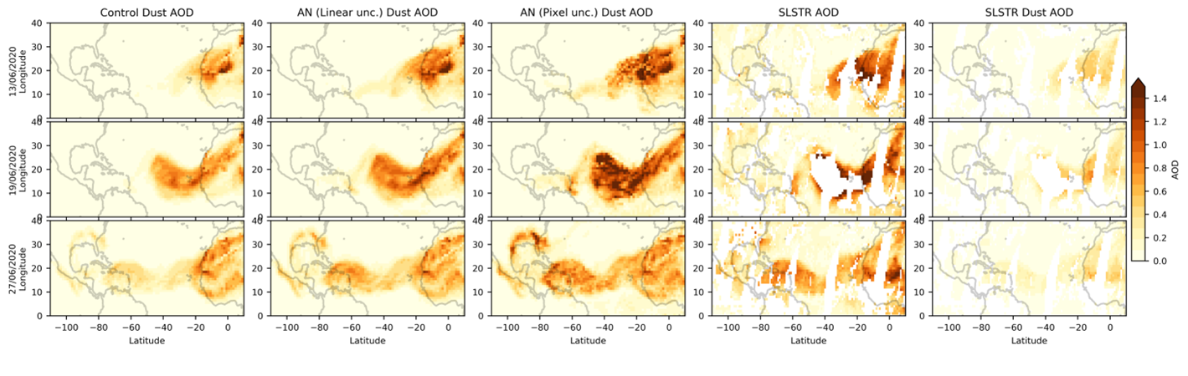

CMUG – Cloud and Aerosol Analysis Study
Jeronimo Escribano (BSC)
During the Godzilla dust event in June 2020 the BSC MONARCH model underestimated the Atlantic dust plume heading towards the Caribbean. The event was analysed again in this study, assimilating the CCI SLSTR aerosol optical depth (AOD) from SU algorithm v1.14 product. The first experiment used a linear model of uncertainties and the second used the uncertainties provided with the CCI product.
Improved agreement between model and independent observations when CCI AOD is assimilated
Pixel wise uncertainties supplied by CCI perform better than linear model uncertainties – larger increments and finer spatial structure
Forecast and analysis skill may be improved if uncertainties over the ocean are inflated by 2-4 times
No Assimilation
Pixelwise AOD uncertainties
SLSTR Dust observations
AOD assimilated with linear uncertainties
SLSTR AOD observations
Notes:
Showed ECV data can improve DA: Godzilla dust event case study. BSC model did not represent this well, Jeronimo showed assimilating CCI AOD dataset improved representation, he also investigated use of different uncertainty models with the AODs and showed this is really important for data assimilation.

Slide 11
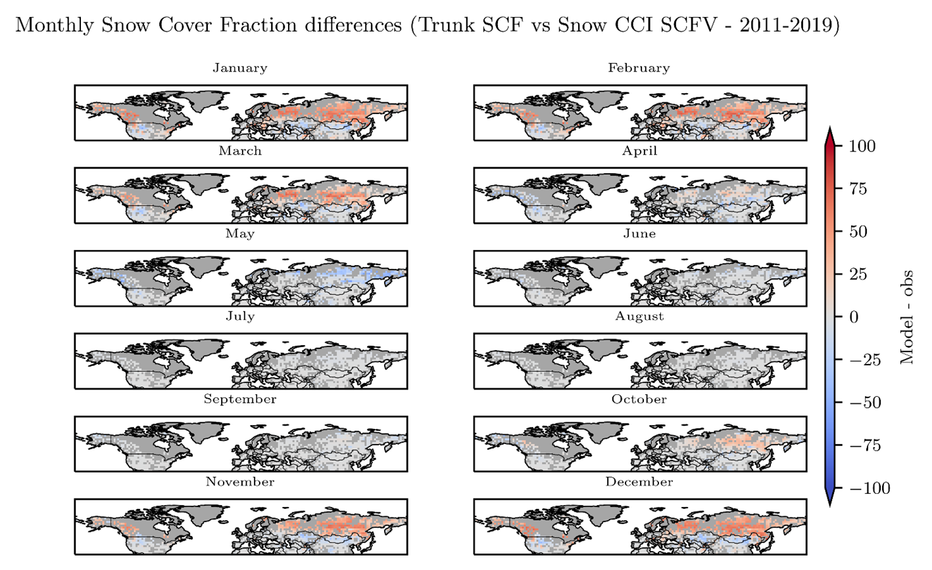
CMUG: Snow Dynamics Impacts on Temperate/High Latitude Climate Amelie Cuynet, Catherine Ottle, Philippe Peylin, IPSL
Analysis of the observation products: impact of the vegetation on snow behaviour
snow behaviour is strongly influenced by plant functional type (PFT)
snow coverage varies with vegetation type
Snow Cover Fraction (SCF) and albedo model parameters should be adapted for each PFT.
Comparison of CCI Snow products with ORCHIDEE simulation outputs
ORCHIDEE v4 without optimised snow compared with obs (CCI Snow and MODIS albedo products)
Above 30°N the model SCF is
overestimated in areas with year-round snow and
underestimated in May due to early onset of snow melt in the simulation.
Snow cover fraction (SCF) monthly differences [%] between Model [ORCHIDEE v4] and Observations [Snow CCI - 2011-2019]. The regions in grey correspond to pixels where data were unavailable
Notes:
Improving models through inspection of obs: identified relationship between SCF and PFT which can be adapted into model tuning also identified areas where model overestimates scf and has the snow melt process happening too early

Slide 12
CMUG – What should the future look like?
More CCI projects, less need for CMUG?
  OR
More CCI projects, more need for CMUG?
Way forward:
Build on CMUG experience and CMUG partners deep familiarity with CCI
CMUG Science studies continue
  Strategically chosen to fill gaps in other CCI activities
  Reach out to modelling centres with relevant expertise
Include CCI CRG reps in CMUG consortium
Include external partner organisations (CMIP, CORDEX) in design phase
“Inception Phase”: 6 months to a year interacting with existing and potential new partners, identifying the current gaps in CCI activities and designing a work plan.
Cross-ECV projects (6)
Interfacing Obs/Modelling projects (5)
Biodiversity studies
Climate change and Cities
Climate change and Health
Supporting the Paris Agreement (3)
CMIP forcings (2)
Tipping Elements projects (6)
More CCI projects, less need for CMUG?
CMUG strengths
Broad view
Connections between projects
Connections with external activities
Bringing together
Identifying gaps.
Notes:
CCI has expanded area of operation – still a series of discrete projects
Not just modelling – big picture view – identify connections. Connections between projects and outside CCI.
Still do studies? Yes. More strategic about it. Rather than letting each partner choose. BE more proactive in the design phase.
Include CRG reps in the consortium
Start out with a plan to evolve the next project with inception phase – 6 months to a year interacting with existing and potential new partners.
Is anyone else actually doing those? Or is there a gap?
Is this something that needs a function that tries to take a broad view? Bringing things together and identifying gaps.
Build on the CMUG experience so far and the partners knowledge of CCI activities

