Slide 1
Harnessing Earth Observation data across the satellite era to assess the state of the ocean
10/06/2025 - United Nations Ocean Conference, Nice, France - ESA CCI KE x PML

Slide 2
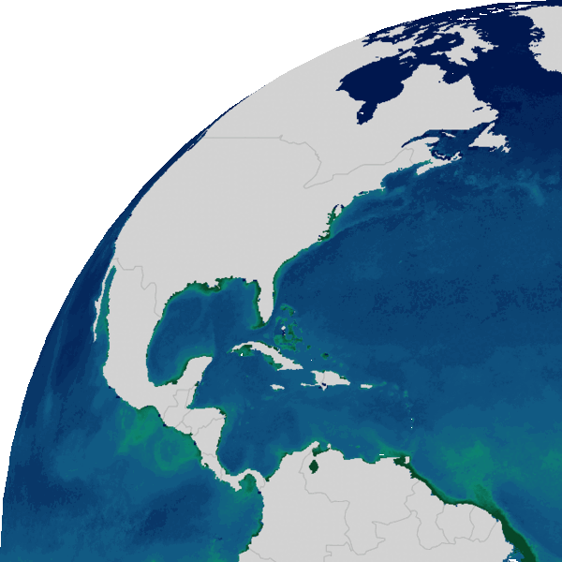
The importance of the ocean in the climate system
The ocean covers ~71% of the Earth’s surface and forms the largest ecosystem on Earth
It plays a key role in the Earth’s carbon cycle as it is biggest carbon store on the planet and an important sink of anthropogenic CO₂ emissions (~25%)
Increase in atmospheric CO₂ is leading to ocean warming, decreasing sea ice,
changing stratification and circulation, and increasing sea level
Long-term absorption of anthropogenic CO₂ is causing ocean acidification,
and fundamentally changing the drivers of the ocean carbon cycle
Phytoplankton are responsible for cycling a large amount of carbon
through the marine ecosystem, and for transporting carbon to
the deep ocean via the biological carbon pump
High-quality and long-term observations are needed for
climate assessment, adaptation & mitigation.
Notes:
Primary production by phytoplankton is known to contribute some 50 Pg C per year, comparable to net primary production by terrestrial organisms. To place this value in the context of climate change, this is about 5 times the magnitude of global anthropogenic emissions of carbon in the form of carbon dioxide into the atmosphere, which stands now at 10 Pg C per year, about double the value of what it was half a century ago.

Slide 3
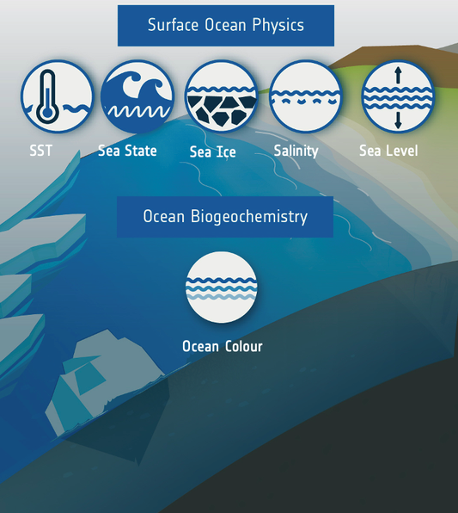
ESA Climate Change Initiative – Ocean Essential Climate Variables
8 Ocean ECV projects in ESA’s CCI:
6 ocean ECVs: Sea Surface Temperature, Sea Ice, Sea Surface Salinity, Ocean Colour, Sea Surface Level
+ Sea level budget closure: estimates of the overall level: sum of the contributions of various processes (thermal expansion, melting glaciers and ice sheets...)
+ 1 new ocean ECV: Phytoplankton carbon biomass and pigment diversity
Phytoplankton

Slide 4
CCI Ocean ECV data records
1970
1980
1990
2000
2010
2020
2030

Slide 5
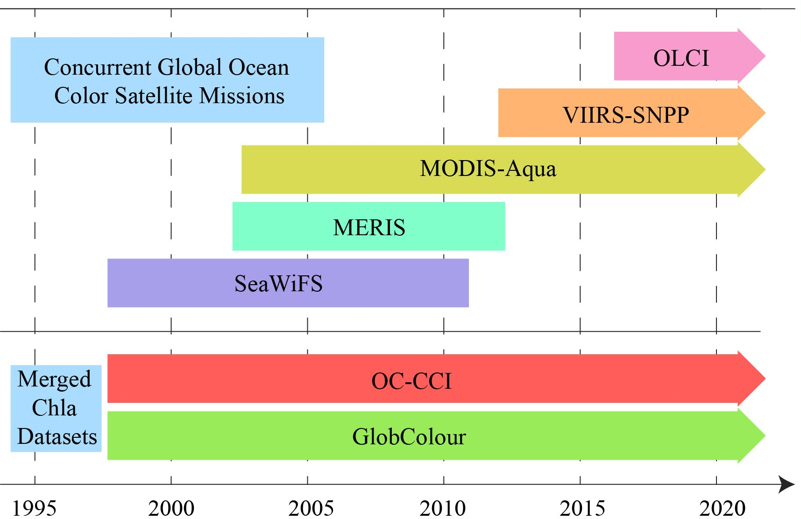
What makes ESA-CCI ECVs unique?
Satellite observations allow for high spatial and temporal coverage of GCOS ECVs
Consistency between products and approaches is sought
Specifically developed for climate applications (i.e., long time series, stability)
Observations of multiple satellite sensors are merged
Most products are provided with pixel-by-pixel uncertainty
High-level scientific and policy impact
Yu et al. 2023
Notes:
The scientific benefits of this R&D programme are expressed through +2,000 peer-reviewed publications (as of January 2024); data product and processing system uptake by operational climate services and modellers; and contribution to new insights cited in the IPCC assessment reports

Slide 6

Physical state of the ocean
iStoc

Slide 7
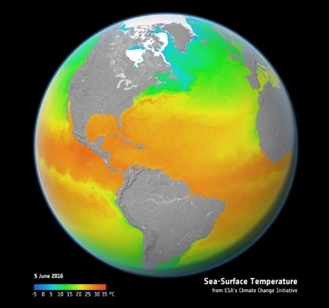
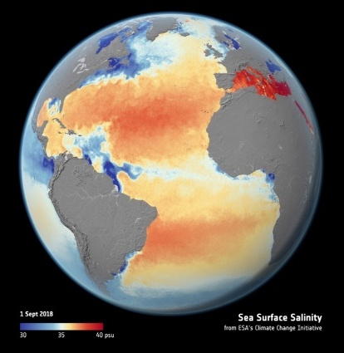
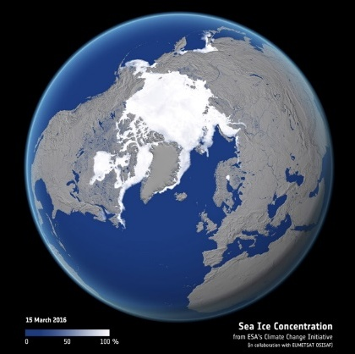
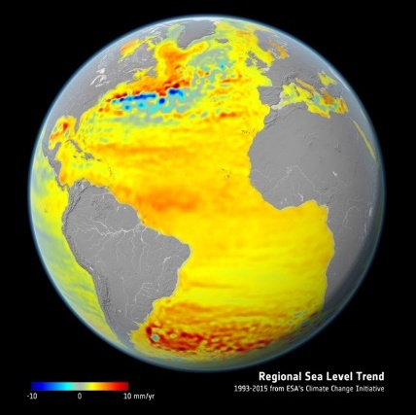
Observing ocean physics from space
Sea Surface Temperature data record for 1980-2021 based on 9 infrared and microwave sensors
Sea Surface Salinity data record for 2010-2023 based on 3 L-band radiometer sensors; difficult to observe from space
Sea Ice concentration data record since 1970s and thickness since 1990s based on 14 passive microwave sensors
Sea Level data record from 1992-2022 based on 8 altimetry sensors; Sentinel-6 offers high-resolution in coastal regions

Slide 8
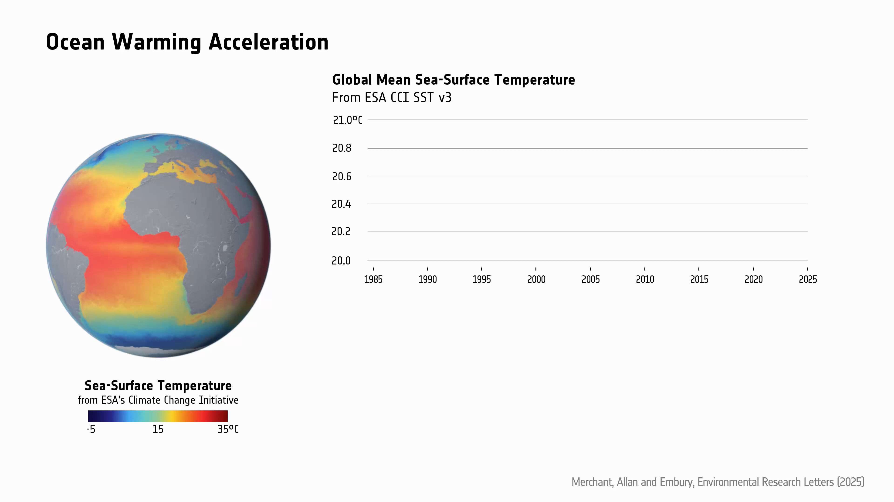
Sea Surface Temperature (SST)
CCI data shows 4-fold acceleration in SST rise
SST increased from 0.06K (1985-1989) to 0.27K (2019-2023)
Warming trend is linked to increasing Earth Energy Imbalance
Short-term factors (e.g., El Niño, volcanoes, solar shifts) do not change the long-term trend
Warming may outpace past 40-year linear trends within 20 years (so observations are critical)
Notes:
Quantifying the acceleration of multidecadal global sea surface warming driven by Earth's energy imbalance
ABSTRACT
DOI 10.1088/1748-9326/adaa8a
Global mean sea surface temperature (GMSST) is a fundamental diagnostic of ongoing climate change, yet there is incomplete understanding of multi-decadal changes in warming rate and year-to-year variability.
Exploiting satellite observations since 1985 and a statistical model incorporating drivers of variability and change, we identify an increasing rate of rise in GMSST. This accelerating ocean surface warming is physically linked to an upward trend in Earth's energy imbalance (EEI). We quantify that GMSST has increased by 0.54 ± 0.07 K for each GJ m^{–2} of accumulated energy, equivalent to 0.17 ± 0.02 K decade^{‒1} (W m^{‒2})^{‒1}. Using the statistical model to isolate the trend from interannual variability, the underlying rate of change of GMSST rises in proportion with Earth's energy accumulation from 0.06 K decade^{–1} during 1985–89 to 0.27 K decade^{–1} for 2019–23. While variability associated with the El Niño Southern Oscillation triggered the exceptionally high GMSSTs of 2023 and early 2024, 44% (90% confidence interval: 35%–52%) of the +0.22 K difference in GMSST between the peak of the 2023/24 event and that of the 2015/16 event is unexplained unless the acceleration of the GMSST trend is accounted for. Applying indicative future scenarios of EEI based on recent trends, GMSST increases are likely to be faster than would be expected from linear extrapolation of the past four decades. Our results provide observational evidence that the GMSST increase inferred over the past 40 years will likely be exceeded within the next 20 years.
Policy makers and wider society should be aware that the rate of global warming over recent decades is a poor guide to the faster change that is likely over the decades to come, underscoring the urgency of deep reductions in fossil-fuel burning.
“Given the acceleration in ocean warming, extrapolations of past observations alone may underestimate the rate of future temperature increases. Ongoing monitoring and continuous data improvements are needed to ensure that climate models accurately reflect evolving climate dynamics”, explains Professor Merchant.
GMSST derived from ESA Climate Change Initiative SST record derived uses data from satellite including ERS-1 -2 Envisat, Copernicus Sentinel-3.

Slide 9
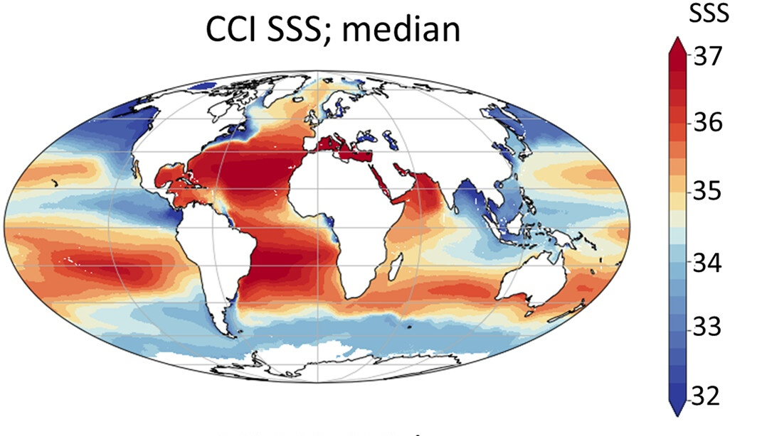
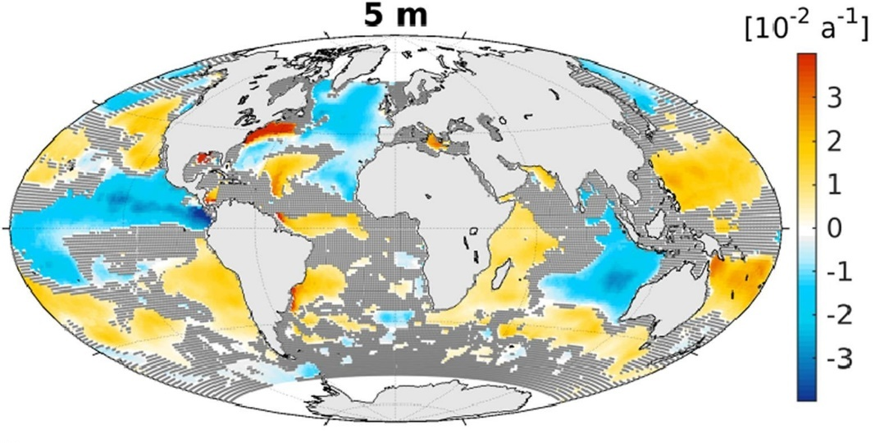
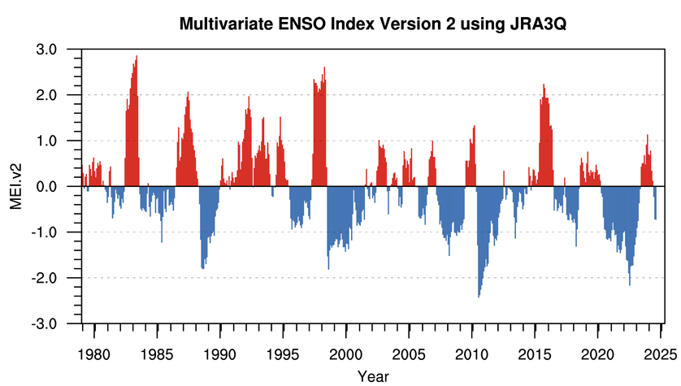
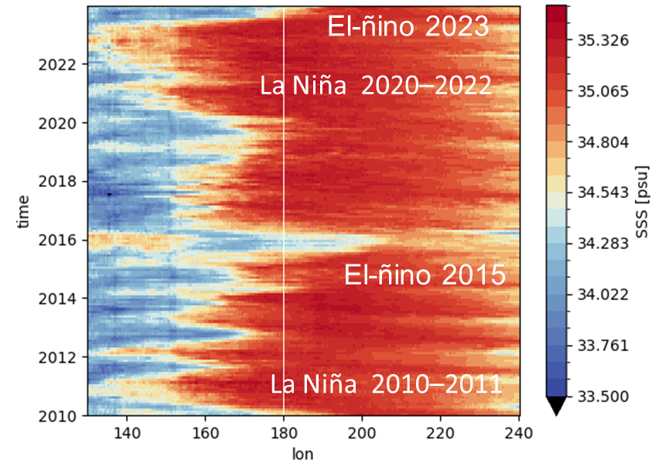
Sea Surface Salinity
Since the 1950s, more saline areas of the ocean are becoming saltier, and freshwater areas are becoming fresher
CCI record monitored two strongest and longest La Niña events since 1980
Incorporating sea surface salinity in addition to temperature improves ability of models to forecast El Niño events
SSS in the equatorial Pacific Ocean (5N-5S)
longest
strongest
Boutin et al. 2021; Stammer et al. 2021
Notes:
ESA’s Climate Change Initiative provides satellite observations to monitor El Niño and La Niña in a changing global climate.
The effects of periodic climate disturbances reverberate around the world, influencing global temperature and exacerbating regional floods and drought severity.
Climate models have historically used ESA CCI sea surface temperature to simulate the development of El Niño.
Incorporating ESA CCI sea surface salinity data, however, further improves the prediction of the timing, duration, and intensity of El Niño events.

Slide 10
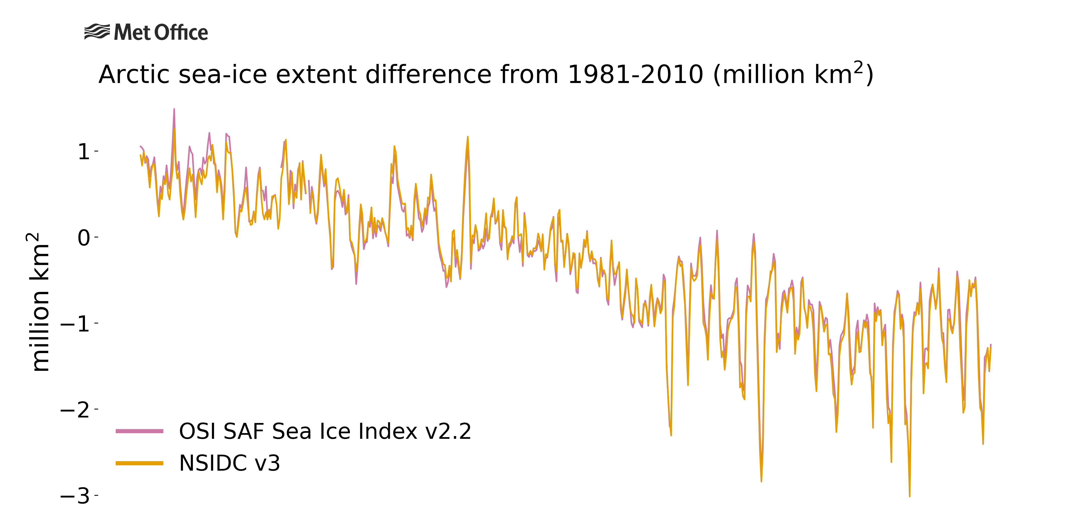
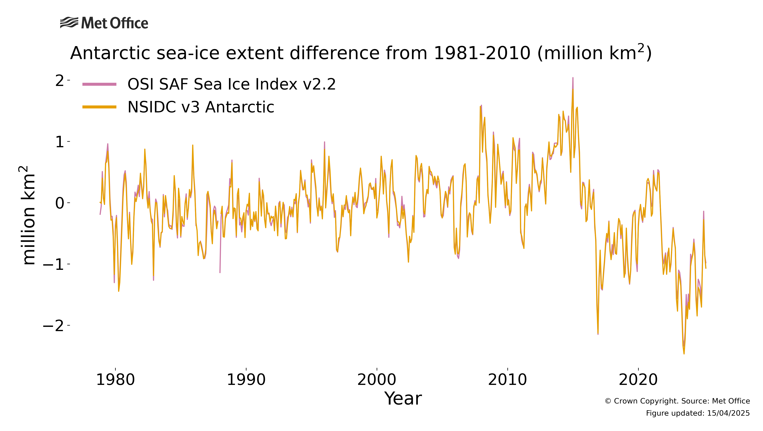
Sea Ice
Arctic sea ice extent and volume is decaying, with strongest reduction in later summer
This leads to a younger and more mobile sea ice cover in the Arctic Ocean
IPCC documents that risk of ice-free summers in the Arctic are substantially reduced at 1.5 °C warming compared with 2.0 °C warming
Sea ice extent in the Southern Hemisphere increased steadily until 2015, but shows much lower coverage since 2016
Met Office

Slide 11
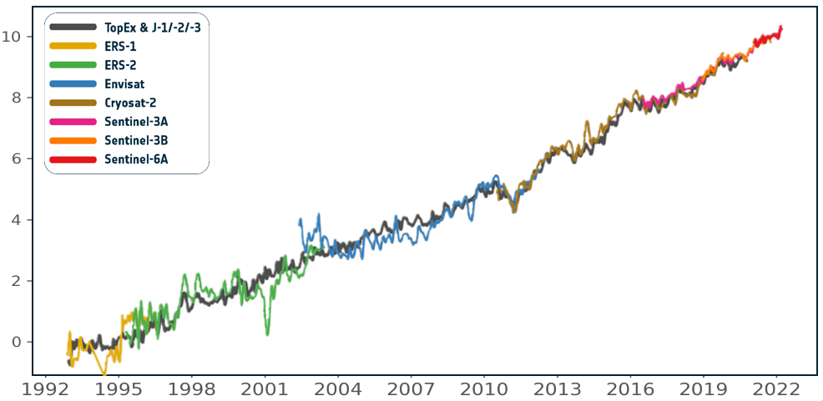
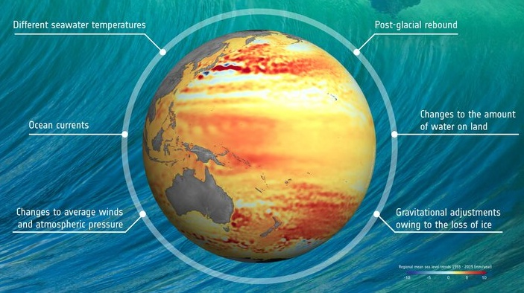
Sea Level
Since early 1990s, global mean sea level has risen by 8 cm, due to:
Ice melt (45%)
Thermal expansion (43%)
Other causes (12%)
Sea level rise is accelerating in satellite altimetry era by ~0.12 mm per year
Sea-level rise is not the same everywhere, and sometimes sea level is falling, but coastal regions experience 4x faster sea level rise than global mean
Notes:
Ice: the ice sheets that cover Greenland and Antarctica hold about 99% of Earth’s freshwater, with the potential to raise sea level dramatically. 21% due to melting of mountain glaciers, 16% due to Greenland Icesheet and 8% due to Antarctic icesheet.
Thermal expansion: As the ocean warms in response to climate change, seawater expands and, as a result, sea level rises.
Sea level rise is one of the most threatening consequences of current global warming for the populations living in low lying coastal zones.
Vertical land motions also contribute to relative sea level change at the coast.
Reseachers inc. the ESA CCI SLR team and using the ESA CCI SLR data record quantified global-mean relative sea-level rise to be 2.6 mm yr⁻¹ (at the time of the publication 2021) over the past two decades.
BUT
Coastal inhabitants, which are preferentially located in subsiding locations (due to many cities being locate in deltas for example), experience an average relative sea-level rise up to four times faster at 7.8 to 9.9 mm yr⁻¹
The impacts and adaptation needs are much higher than reported global sea-level rise measurements suggest.
Human-induced subsidence in and surrounding coastal cities can be rapidly reduced with appropriate policy for groundwater utilization and drainage. Such policy would offer substantial and rapid benefits to reduce growth of coastal flood exposure due to relative sea-level rise.

Slide 12
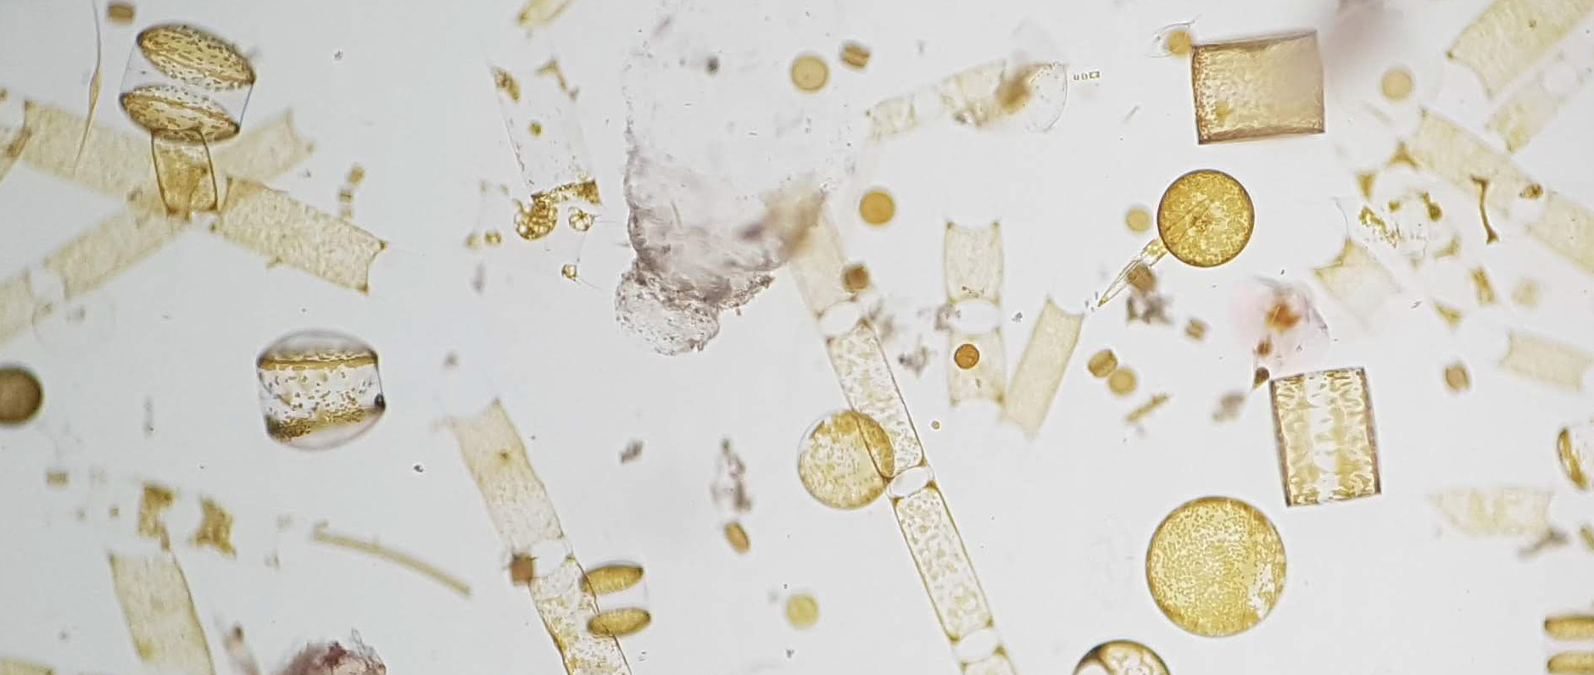
Biological state of the ocean
Marine Biological Association

Slide 13
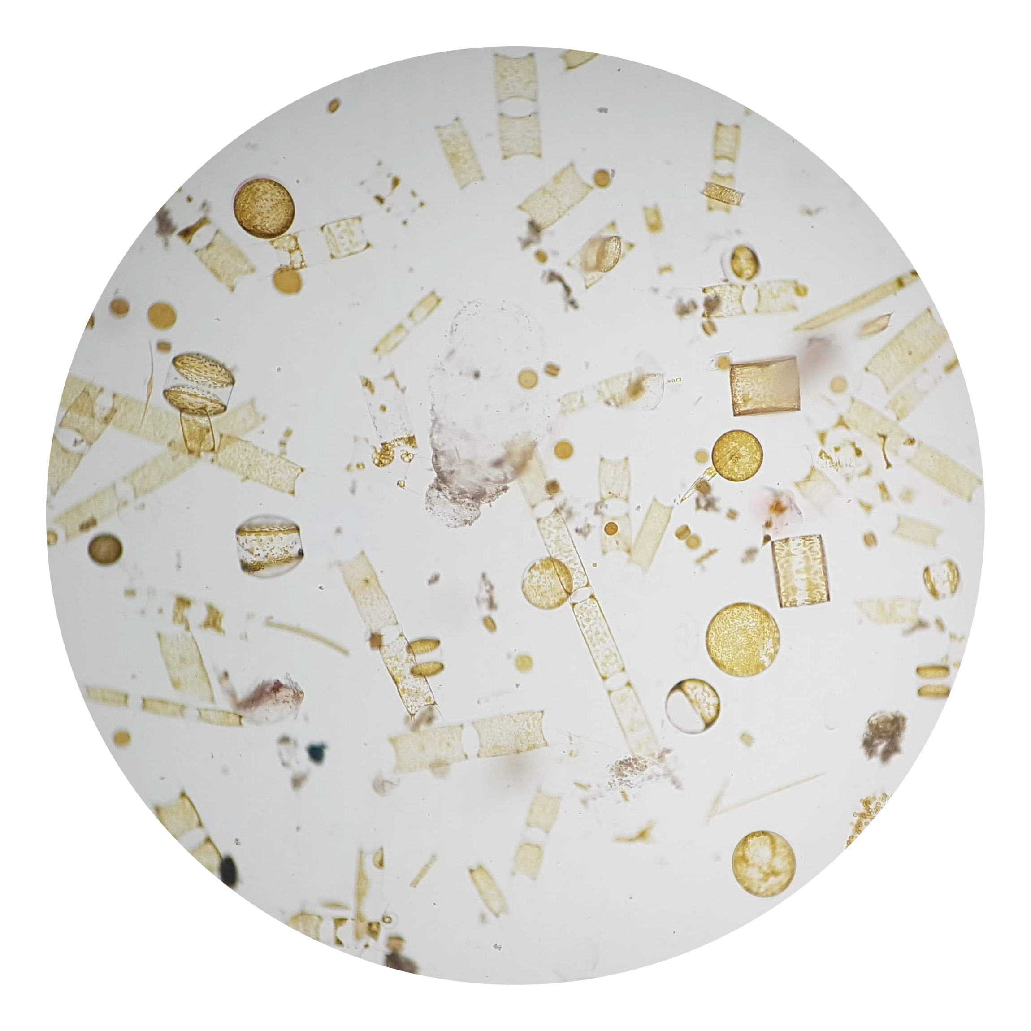
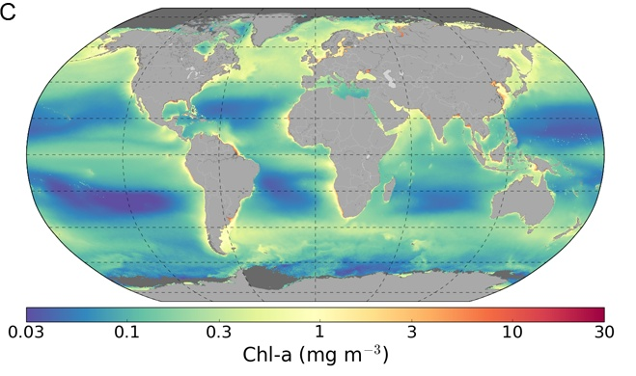
Observing ocean biology from space
Ocean Colour
Phytoplankton biomass and diversity
Four major groups affect ocean colour:
Phytoplankton
Coloured dissolved organic matter
Detrital material
Suspended sediments
For satellite observations, atmospheric correction is critical
Phytoplankton are marine micro-organisms that photosynthesise like plants on land. Collectively they impact the colour of the ocean which can be observed by satellites.
In the 1970s, ocean colour satellites provided the first global maps of phytoplankton biomass, using chlorophyll-a pigments as an indicator
CEOS 2018; Kulk et al. 2020; Sathyendranath et al. 2023; MBA
Notes:
The optical properties of phytoplankton are such that the colour of water changes from blue to green with increasing concentrations of phytoplankton. CDOM and detrital material tend to impart colours to the water that range from a deep yellow to orange (often described as the colour of black tea), and suspended sediments yield muddy brown, blackish or turquoise coloured waters, depending on the type of sediment present.

Slide 14
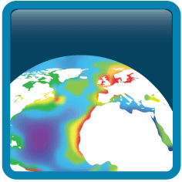

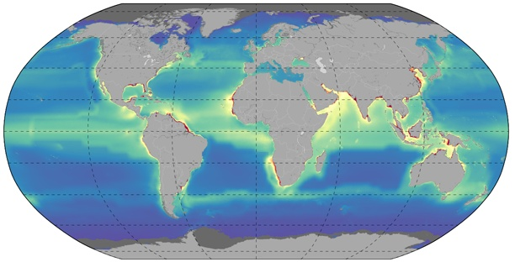
Ocean Colour Climate Change Initiative
Merged Ocean Colour products
Inter-sensor bias corrected
Error-characterised
Climate-quality controlled
28-year time series
OC-CCI for climate applications
Phytoplankton biomass
Ocean carbon cycle
Tipping points
OC-CCI system
Atmospheric Correction using best algorithms from round-robin comparison
SeaWiFS
MODIS
MERIS
Merging & bias correction
VIIRS
Quality Control
& Scientific Analysis
OLCI
Ocean Products
using best algorithms from round-robin comparison
Global in situ database
Unified multi-sensor products
Uncertainty characterisation
User Community: Modellers, Oceanographic Scientists, Earth Observation Scientists
Jackson, Sathyendranath et al.

Slide 15
Global carbon cycle
Global Carbon Budget 2024, Friedlingstein et al.

Slide 16
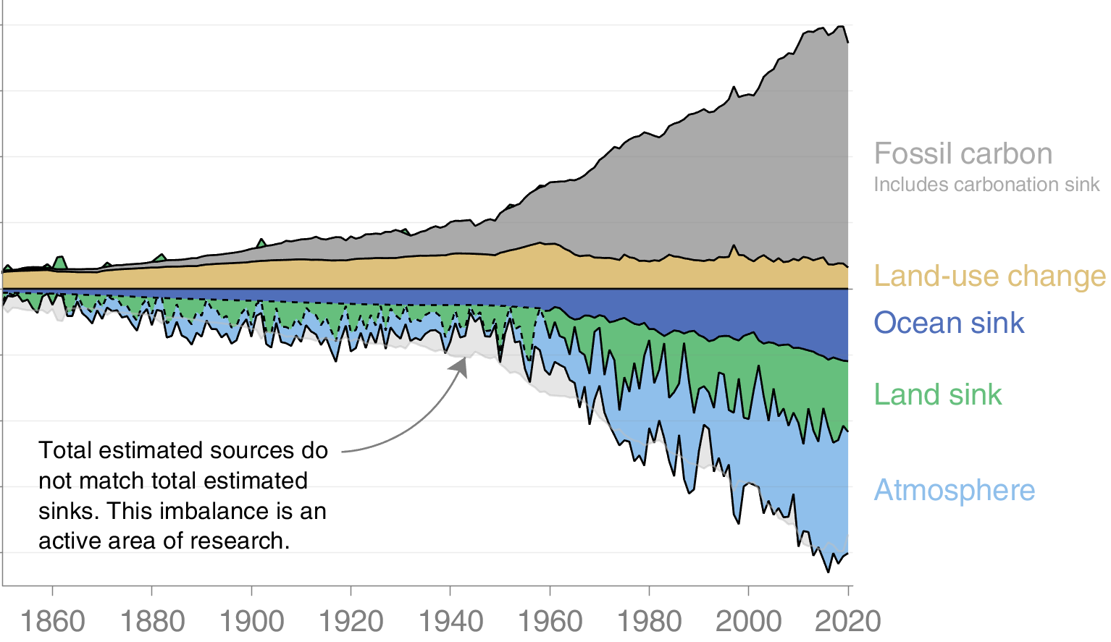
Global carbon budget
Partitioning of carbon between atmosphere, land and ocean
Carbon sources
Fossil carbon
→ good estimates
Land-use change
→ poor estimates
Carbon sinks
Ocean
→ good observations and models
Land
→ modelled
Atmosphere
→ measured
Global Carbon Budget 2021, Friedlingstein et al.; OCFS workshop, Shutler et al. 2022

Slide 17
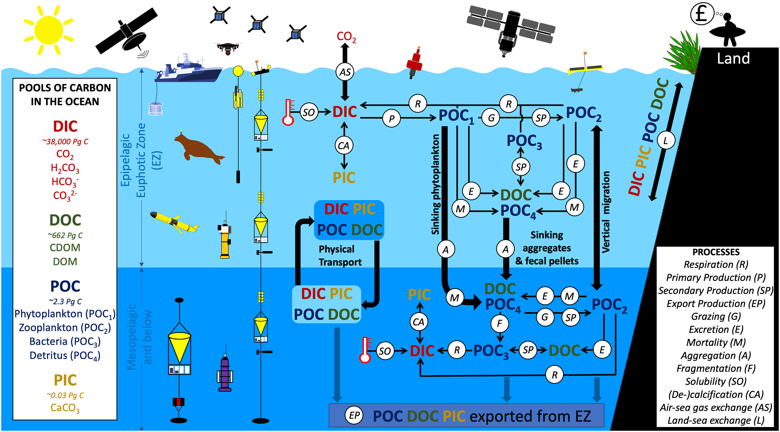
Ocean carbon cycle
Brewin et al. 2021

Slide 18
How are CCI ECVs used to observe the ocean carbon cycle?
Input data
Satellite-based models
Output data
Ocean Colour
Air-sea CO₂ flux
Sea Surface Temperature
Surface Carbonate System
CCI ECVs
Sea Surface Salinity
Dissolved Inorganic Carbon
Sea Ice
Dissolved Organic Carbon
Photosynthetically Active Radiation
Particulate Inorganic Carbon
Particulate Organic Carbon
In situ data
Phytoplankton Carbon
Primary production
Export production

Slide 19
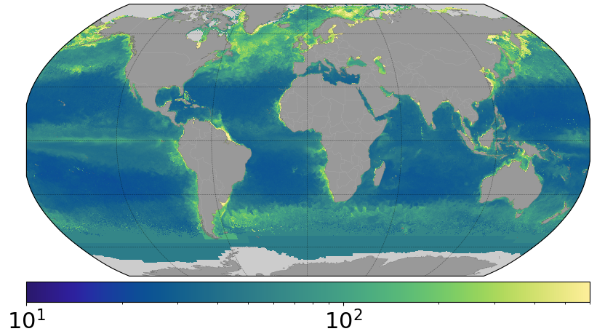
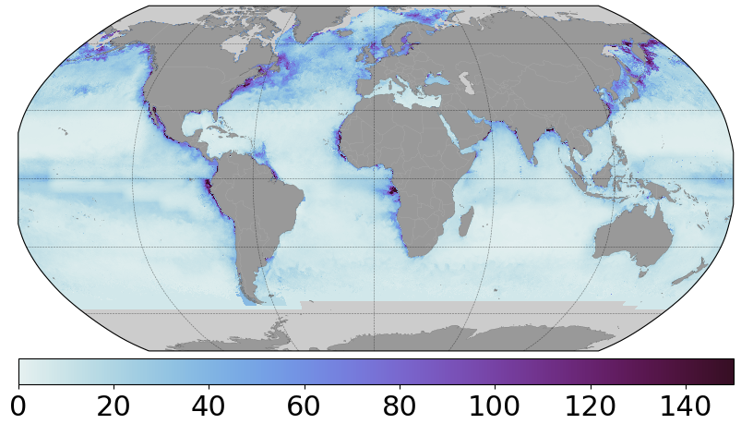
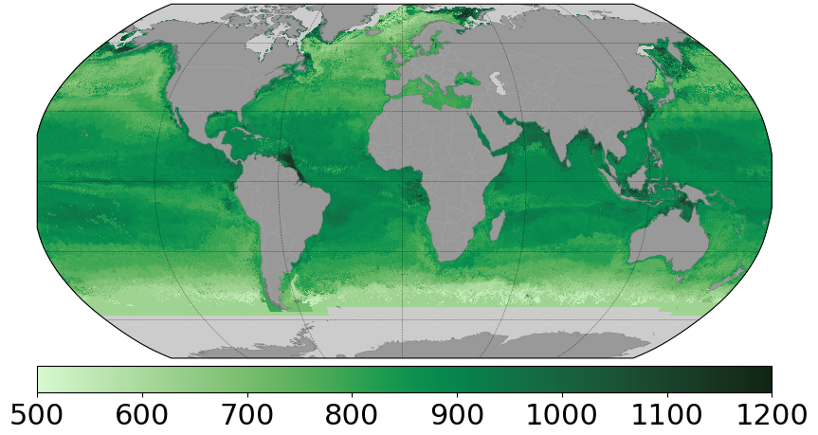
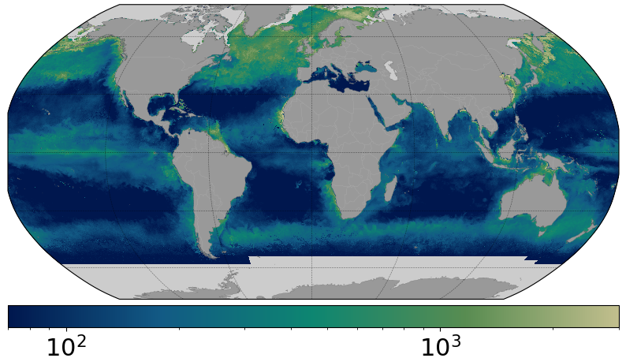
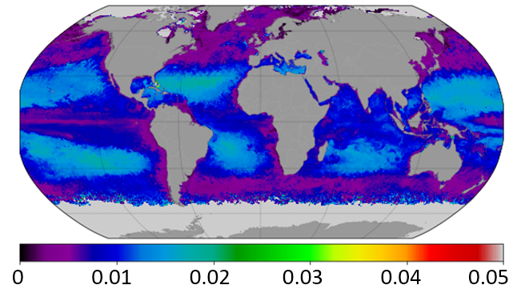
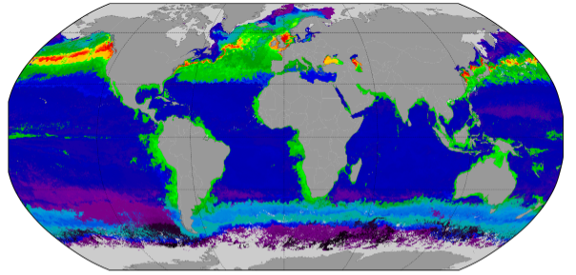
Ocean carbon pools and fluxes from space
Using satellite-based models together with machine learning techniques, ocean-colour observations are used to estimate carbon pools and fluxes in the ocean at the global scale
Particulate Organic Carbon (mg C m⁻³)
Phytoplankton Carbon (mg C m⁻³)
Dissolved Organic Carbon (mg C m⁻³)
Phytoplankton Primary Production (mg C m⁻² d⁻¹)
0 20 40 60 80 100 120 140
Particulate Inorganic Carbon (mol C m⁻³)
Export Production (mg C m⁻² y⁻¹)
Sathyendranath, Kulk, Kong, Laine, Jönsson et al.

Slide 20

Can we determine an ocean carbon budget from satellites?
Based on the Ocean-Colour CCI, we can produce high-quality and consistent products that can provide a satellite-based carbon budget in the surface (mixed) layer of the ocean
Dissolved
Organic
Carbon
Particulate
Organic
Carbon
Particulate
Inorganic
Carbon
Phytoplankton
Primary
Production
Phytoplankton
Carbon
Export
Production
labile
phyto-plankton
micro
nano
pico
mixed layer
remainder
euphotic zone
refractive
zooplankton, bacteria & detritus
euphotic zone
euphotic zone
14.8 Gt C
(labile fraction)
1.17 Gt C
0.22 Gt C
0.03-0.07 Gt C
50.7 Gt C y⁻¹
8 Gt C y⁻¹
Sathyendranath, Kulk, Kong, Laine, Jönsson et al.

Slide 21
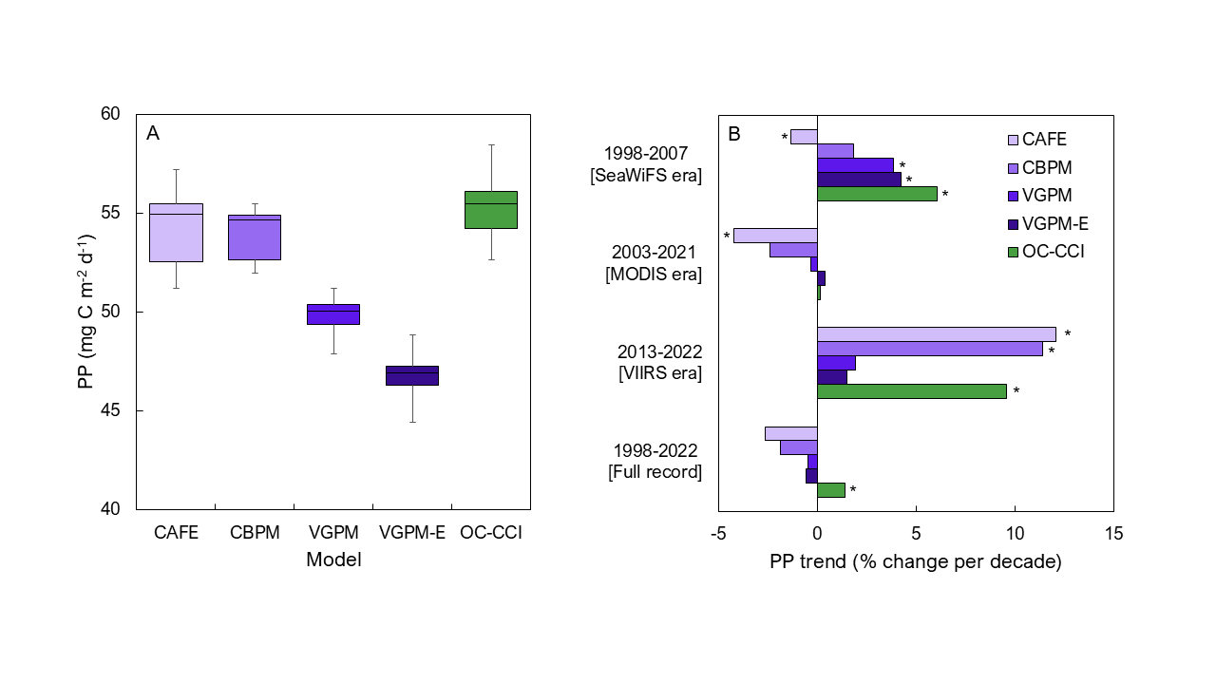
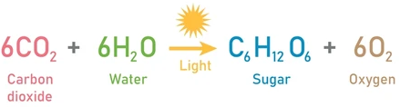
Is the ocean carbon cycle changing?
Not any easy question to answer, and depends on carbon pools or fluxes studied and data used
Primary production studied over 2 decades, as an example
Primary production is the synthesis of organic compounds
from carbon dioxide through photosynthesis
It forms the basis of the marine ecosystem, and is of
importance for many marine resources
Ocean-colour and in situ data are used to estimate
primary production in satellite-based models
Kulk, Sathyendranath et al.

Slide 22
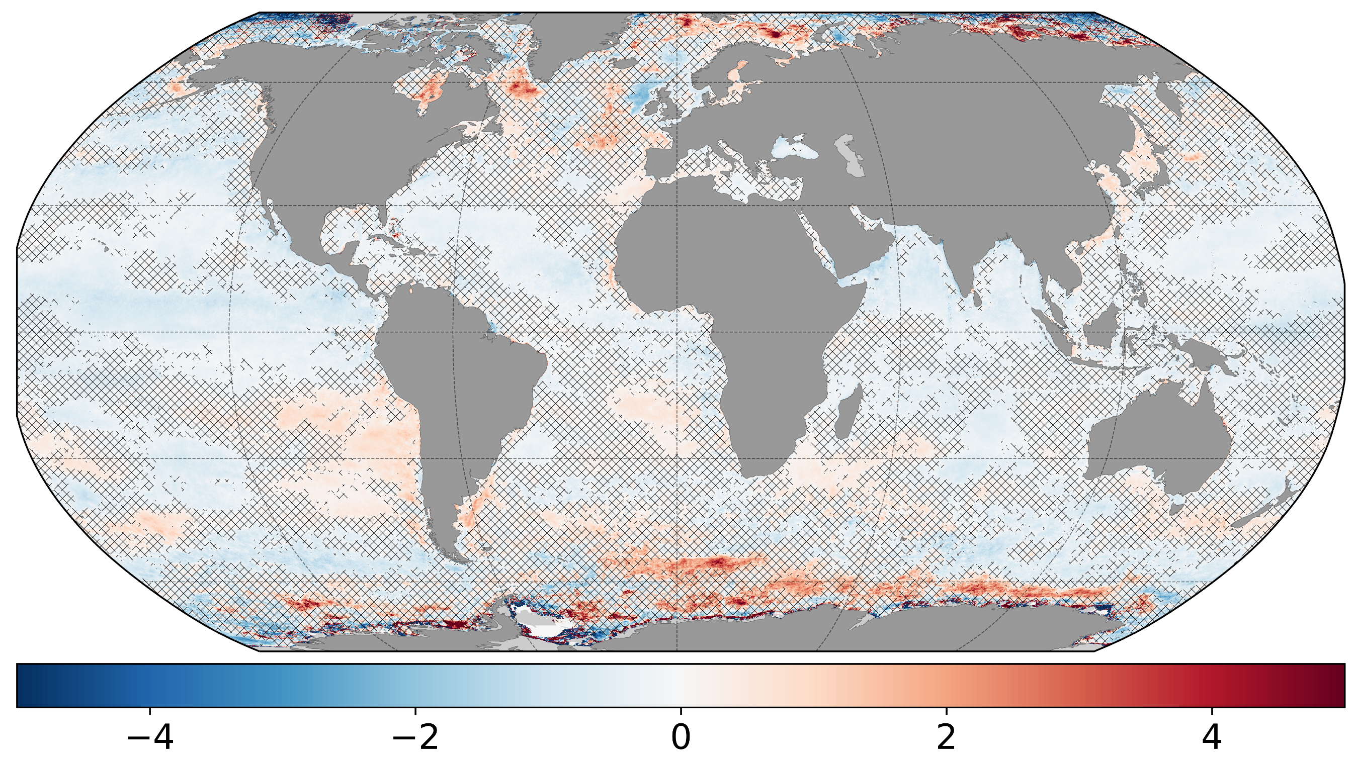
Long-term trends in primary production
Whilst no clear trend is observed globally, primary production is decreasing in open oceans and increasing in polar waters. These regional shifts in productivity will require adaptation if propagated through the food web to fisheries.
Phytoplankton Primary Production (% change y⁻¹)
Kulk et al. 2020; Kulk, Sathyendranath et al.

Slide 23
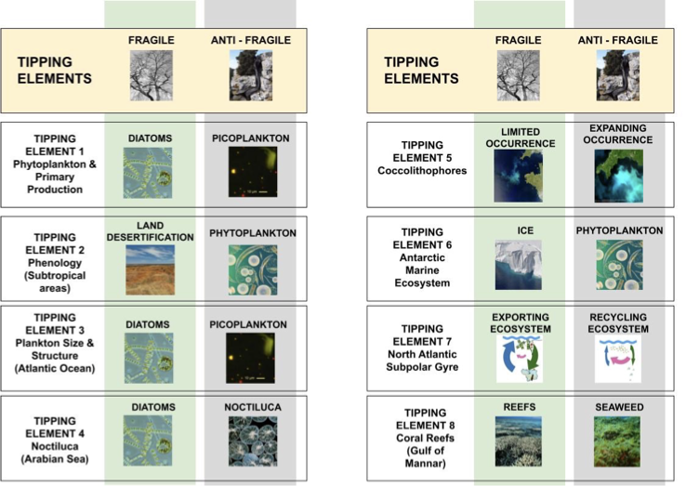
Marine ecosystem tipping points
Eight tipping elements are being investigated.
Typically, a negative change in an element of ecosystem is accompanied by a positive change in another element.

Slide 24
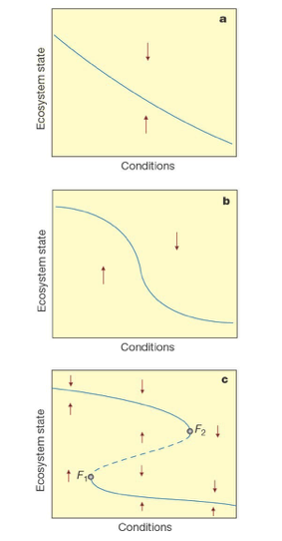
Tipping points In Marine Ecosystems (TIME)
A concern is that climate-related changes in some of the elements of the marine ecosystem may not be linear, slow, and steady.
Instead, non-linearities in the system could introduce acceleration of change; abrupt shifts; or changes in recovery time when perturbed (loss of resilience).
In the ESA project TIME, eight selected elements of the marine ecosystems will be examined using CCI and related data, as well as theoretical models for abrupt changes and tipping points.
Conditions
Ecosystem state Ecosystem state Ecosystem state
Conditions
Conditions
Scheffer et al. (2000, 2001)

Slide 25
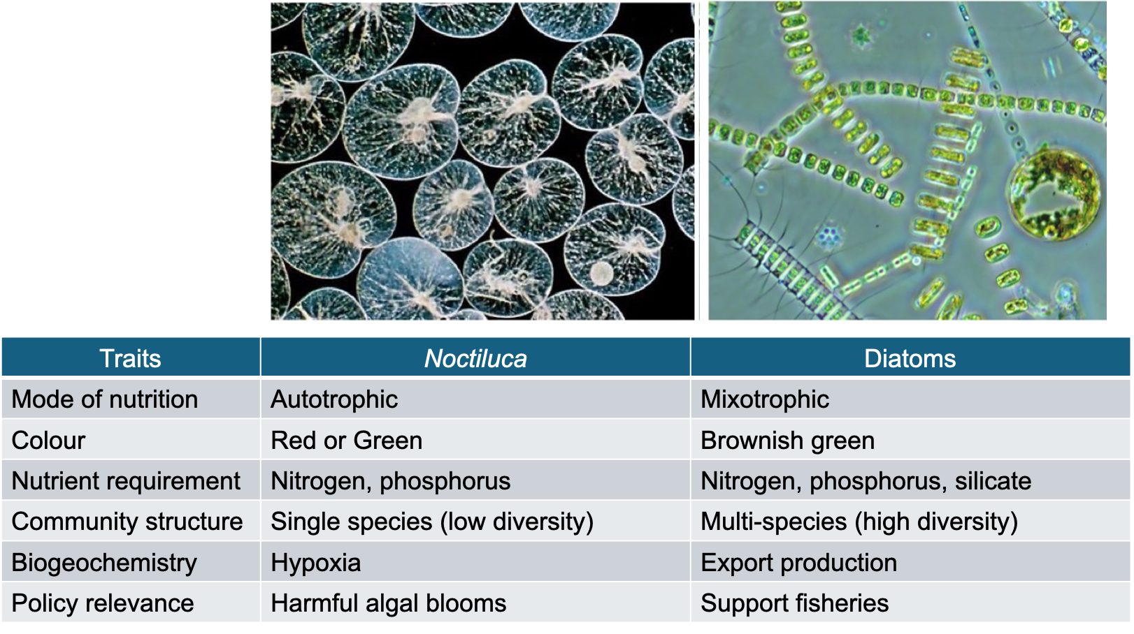
TIME: Noctiluca in the Arabian Sea
Reports suggest ecosystem is shifting from diatom-dominated to Noctiluca-dominated

Slide 26
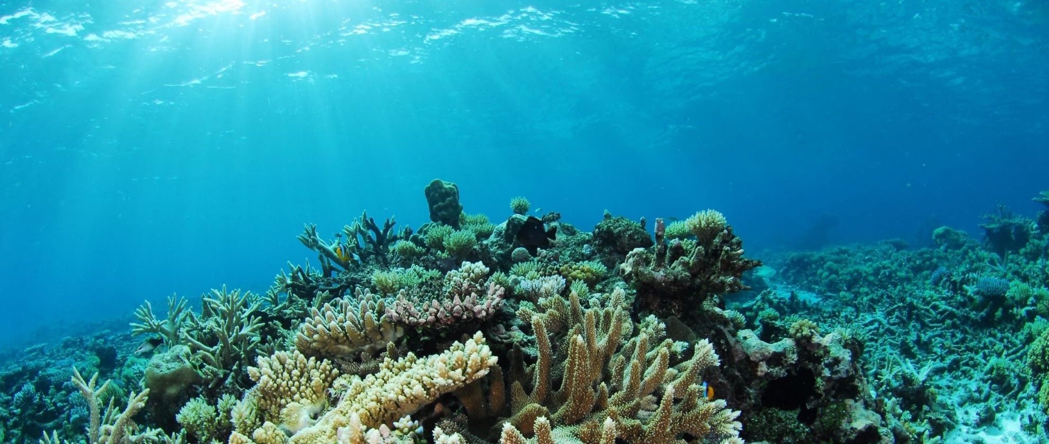
TIME: Coral reefs in the Indian Ocean
Charles Kreb

Slide 27
Dr. Gemma Kulk
gku@pml.ac.uk
Prof. Shubha Sathyendranath
ssat@pml.ac.uk
We acknowledge ESA CCI Project, and thank all the ocean ECV teams whose material we have used here to make this presentation.

