Slide 1

Analysis of urban surface temperature from satellite data with modeled 3D surface temperature
Maria Gkolemi, Zina Mitraka, Nektarios Chrysoulakis, Andreas Christen, Sue Grimmond, Jörn Birkmann
Remote Sensing Lab | IACM | http://rslab.gr
LST_cci workshop, Leicester, UK
6/12/2024

Slide 2
Outline/Introduction
Surface temperature measurement and modelling in cities is not a trivial task
It is however very important for studying the urban climate
Overall Goal: Use modeling to assess the complete temperature from satellite thermal observations
Goal of this study: Compare modelled 3D surface temperature against satellite LST
  Assuming near-nadir acquisition, we consider only the horizontal surfaces

Slide 3
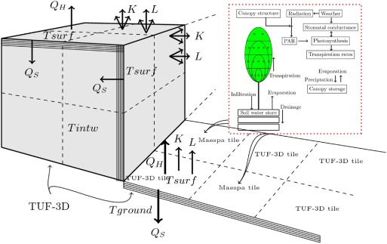
The model: VTUF-3D
Based on TUF-3D (Temperatures of Urban Facets in 3D) by Scott Krayenhoff
Includes a vegetation component using MAESPA (model of forest canopy radiation absorption, photosynthesis and water balance)
Can calculated energy balances and surface temperature in 3D
Depiction of the processes simulated in the model (Nice et. Al, 2018)

Slide 4
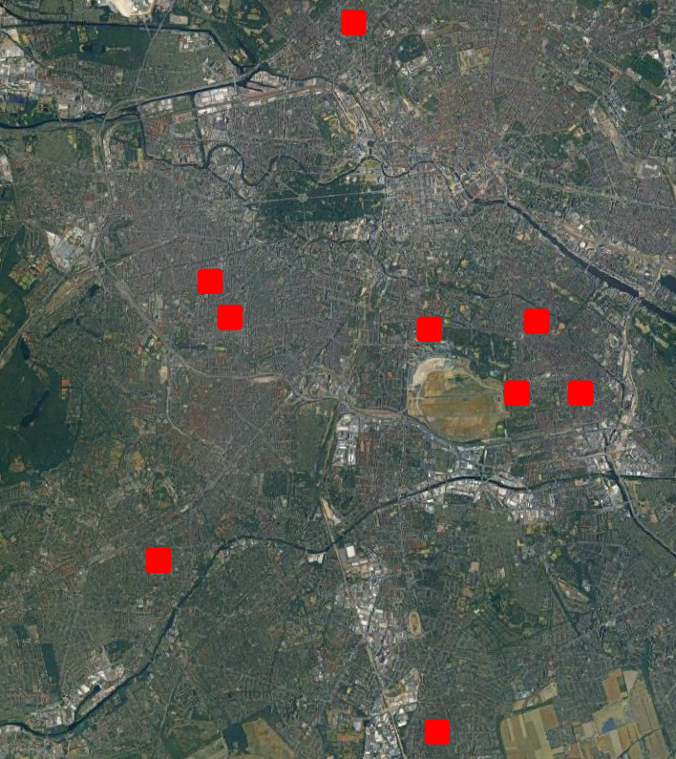
Study area
Several areas in Berlin were selected for simulation
Each area covers ~450x450 m²
  5x5 ASTER pixels
ASTER Images
  2022/06/30 22:43
  2022/07/16 22:42
  2022/08/10 22:35
  2022/08/11 12:06
The areas selected for simulation

Slide 5
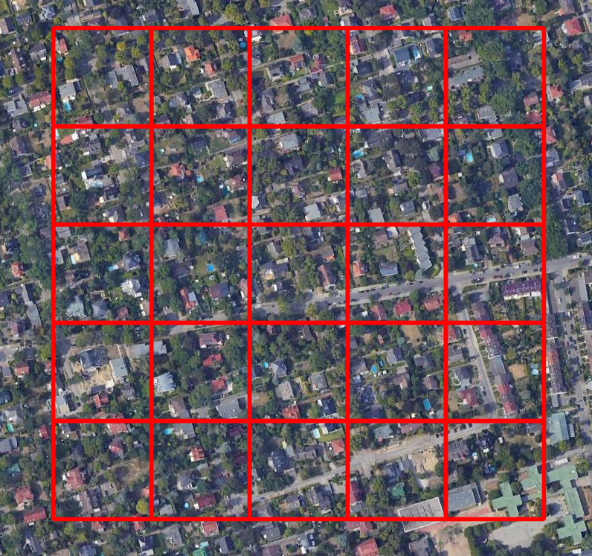
Study area
Several areas in Berlin were selected for simulation
Each area covers ~450x450 m²
  5x5 ASTER pixels
ASTER Images
  2022/06/30 22:43
  2022/07/16 22:42
  2022/08/10 22:35
  2022/08/11 122:06
Close up of one area

Slide 6
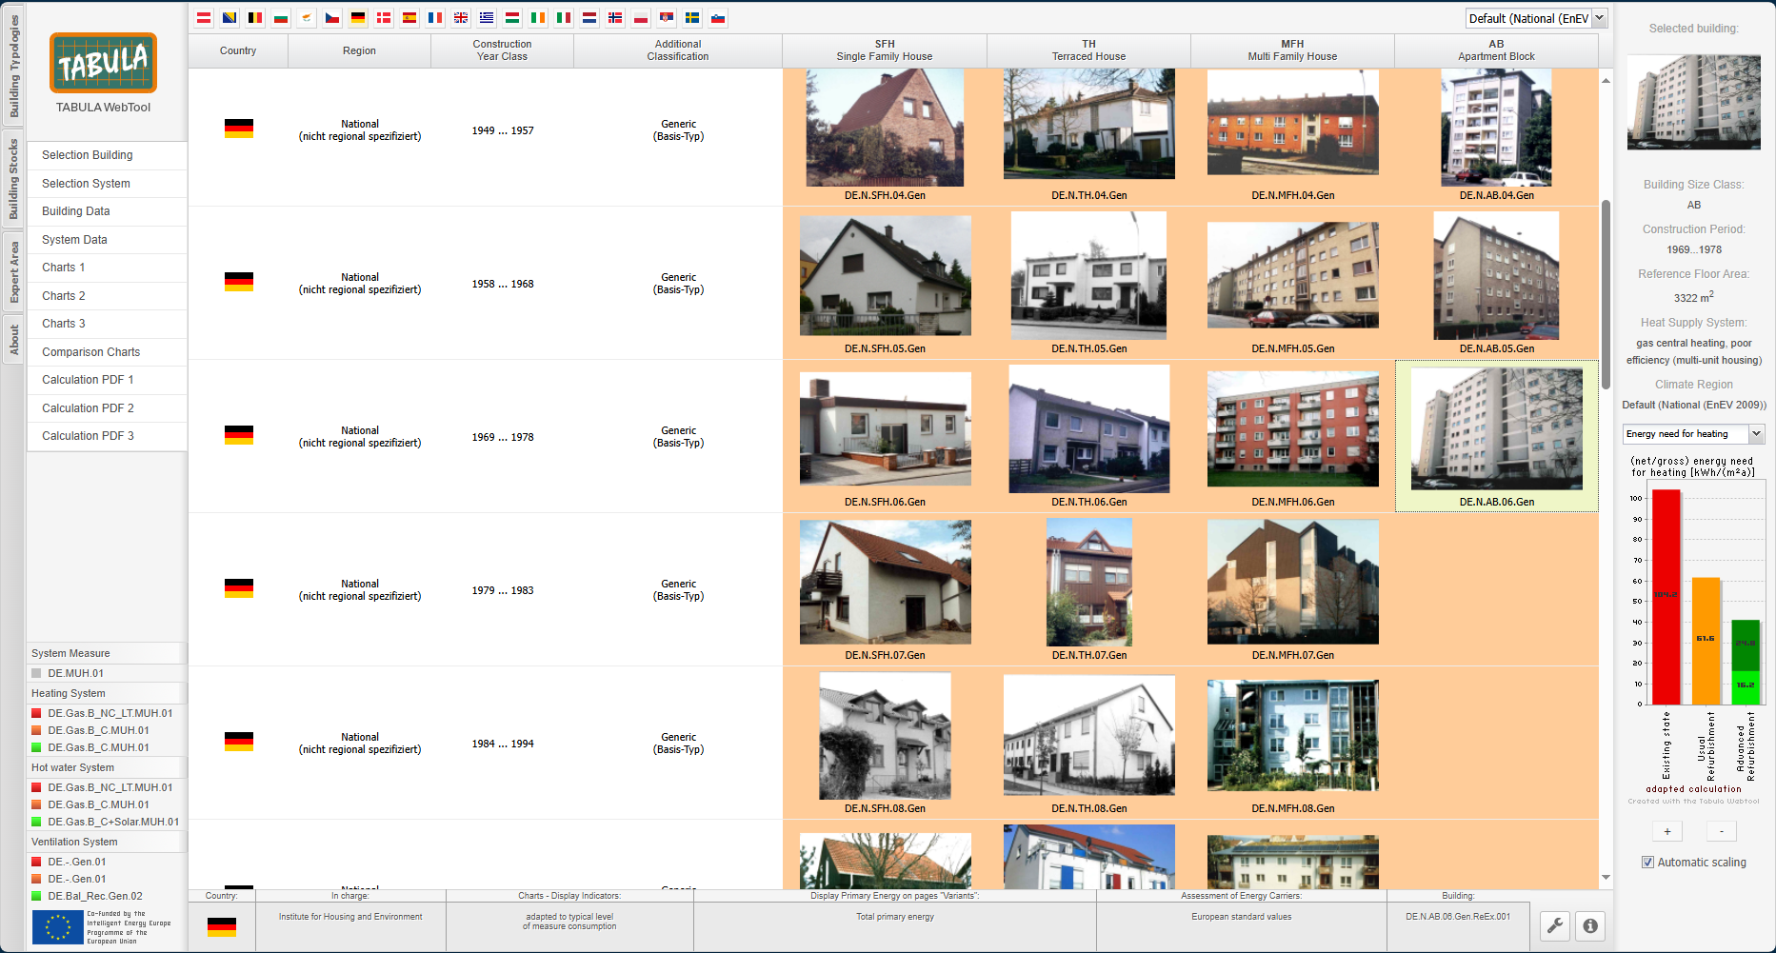
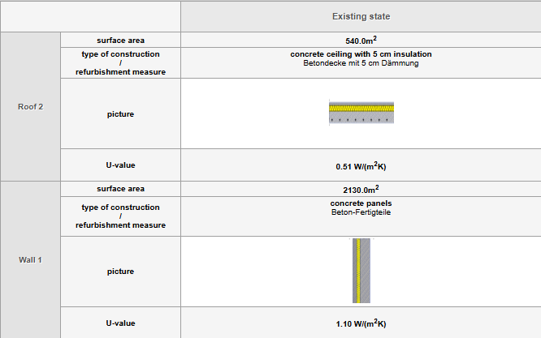
Model Parametrization
The buildings in the study areas were matched to a building category in the TABULA database
Wall and roof structure were taken from TABULA and material properties were taken from the CIBSE guide
  Thermal Conductivity
  Heat Capacity
The TABULA webtool

Slide 7
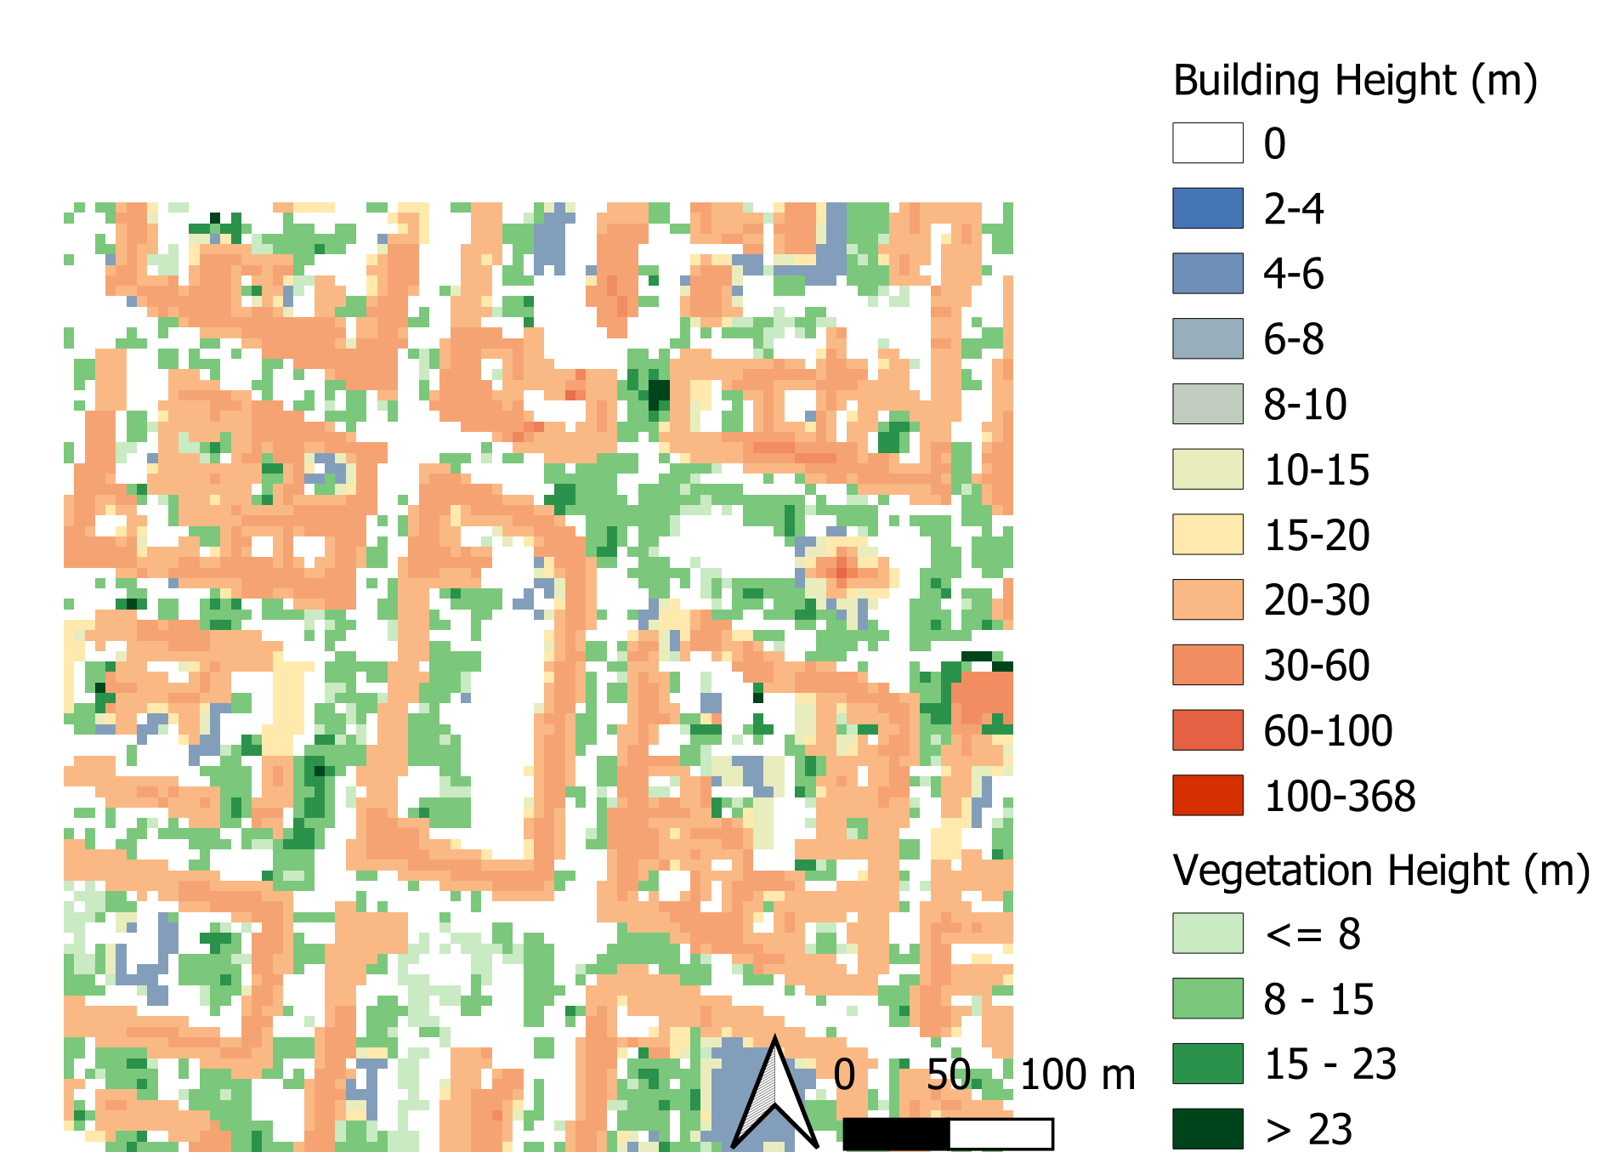
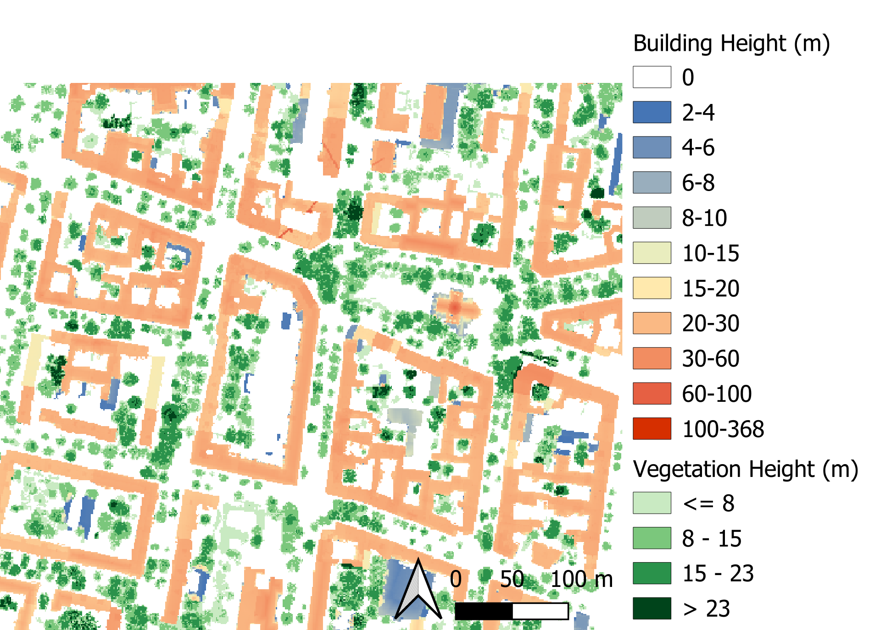
Model Parametrization
Used building and tree nDSM to parametrize the modeling domain
Original nDSM resolution was 1 m, upsampled to 5 m in all directions
Example Building & Vegetation nDSM

Slide 8
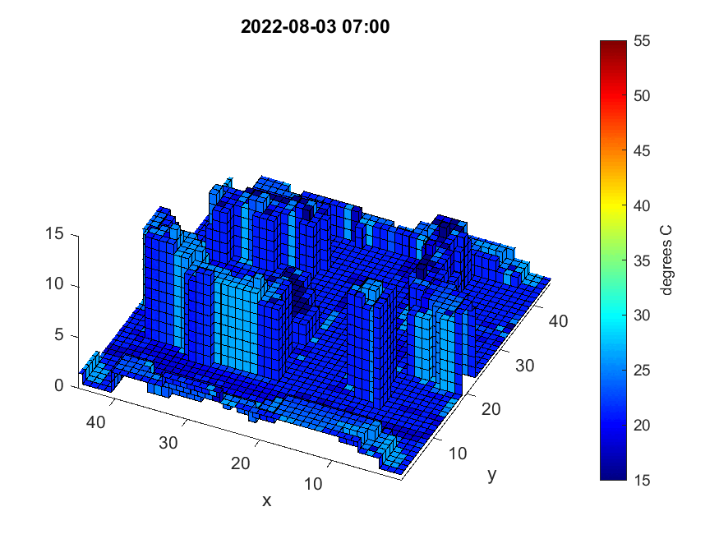
Model Output
Hourly 3D surface temperature for all facets in domain

Slide 9
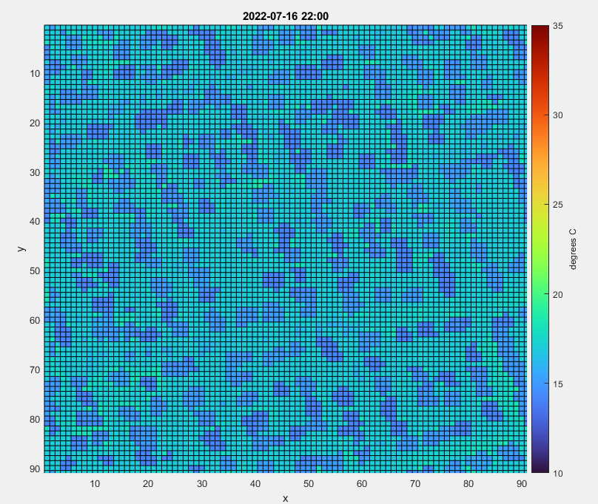
Results and Comparison
Compare model horizontal facets with ASTER LST
Only inner 3x3 pixel area was used for comparison with ASTER
9 pixels per area per acquisition
Matching VTUF-3D output with LST pixel

Slide 10
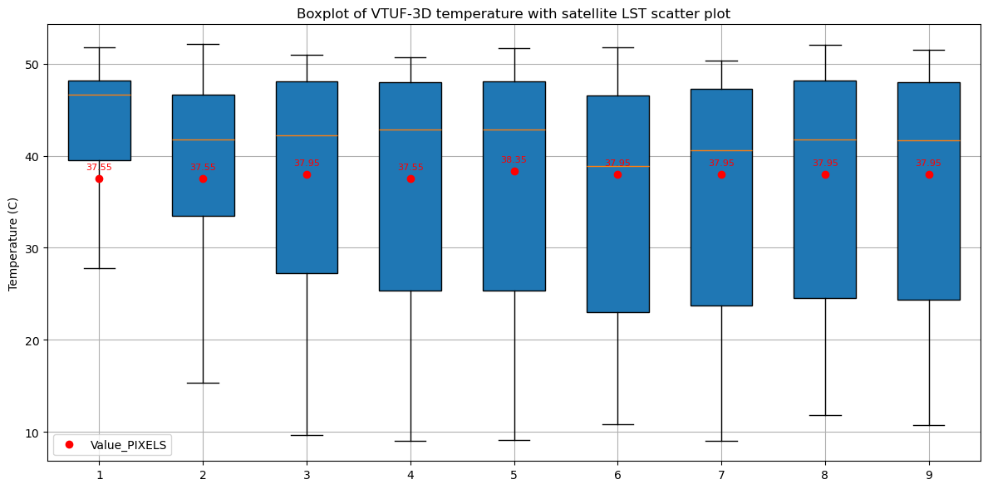
Results and Comparison
Compare model horizontal facets with ASTER LST
Only inner 3x3 pixel area was used for comparison with ASTER
9 pixels per area per acquisition
MAE = 3.35 C
Boxplot for one area for a daytime acquisition

Slide 11
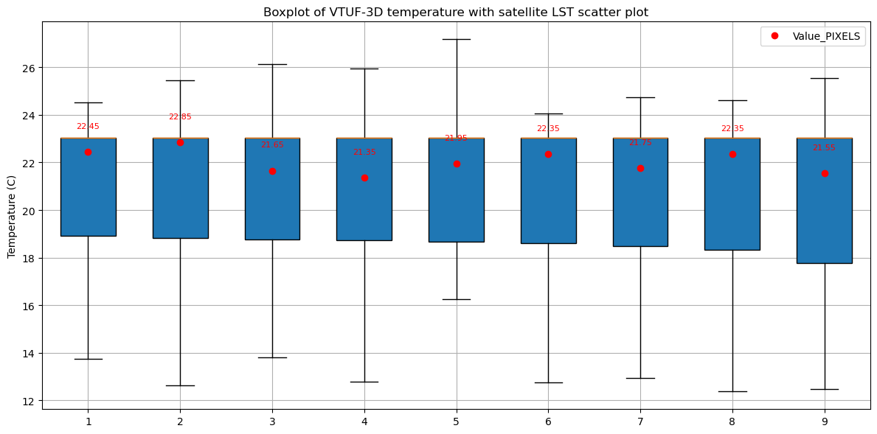
Results and Comparison
Compare model horizontal facets with ASTER LST
Only inner 3x3 pixel area was used for comparison with ASTER
9 pixels per area per acquisition
MAE = 3.7 C
Boxplot for one area for a nighttime acquisition

Slide 12
Results and Comparison
MAE (C) | 2022/06/30 | 2022/07/16 | 2022/08/10 | 2022/08/11
1 | 4.06 | 1.22 | 4.08 | 5.99
2 | 5.29 | 2.04 | 3.25 | 2.81
3 | 2.94 | 0.58 | 1.43 | 2.54
4 | 5.33 | 2.55 | 6.90 | 8.75
5 | 4.54 | 2.87 | 7.22 | 3.34
6 | 5.37 | 3.21 | 6.57 | 8.42
7 | 3.89 | 1.20 | 3.71 | 7.09
8 | 4.76 | 2.12 | 1.42 | 5.47
9 | 4.76 | 2.07 | 5.36 | 4.38
Total | 4.55 | 1.98 | 5.02 | 5.42

Slide 13
Conclusions and further research
Model is in agreement with satellite LST
Model limitations:
  Building types and material properties
  Model spatial & vertical resolution and temporal resolution
  Satellite data products registration
  Forcing data
Model has already been validated against in-situ thermal infrared observations (Gkolemi et al., 2024, URBIS24)
Model will be used for assessment of complete temperatures in urban setting

Slide 14
Thank you!

Slide 15



Contact info
Maria Gkolemi
gkolemi@iacm.forth.gr
tel. +30 2810 39171828
FORTH/IACM
http://rslab.gr

