Slide 1

Using LST to better understand land- atmosphere interactions and improve predictions
Christopher M. Taylor
Bethan Harris, Cornelia Klein, Jawairia Ahmad, Sonja Folwell

Slide 2
Long-time users of LST data…
LST allows us to use observations to characterise:
Surface energy balance changes with soil moisture (e.g. Gallego-Elvira et al, GRL 2016, 2019)
Atmospheric boundary layer responses to soil moisture (e.g. Taylor et al, GRL 2007)
Impact of soil moisture on deep convection (e.g. Taylor et al, Nat Geo 2011)
Five examples of current work using LST

Slide 3
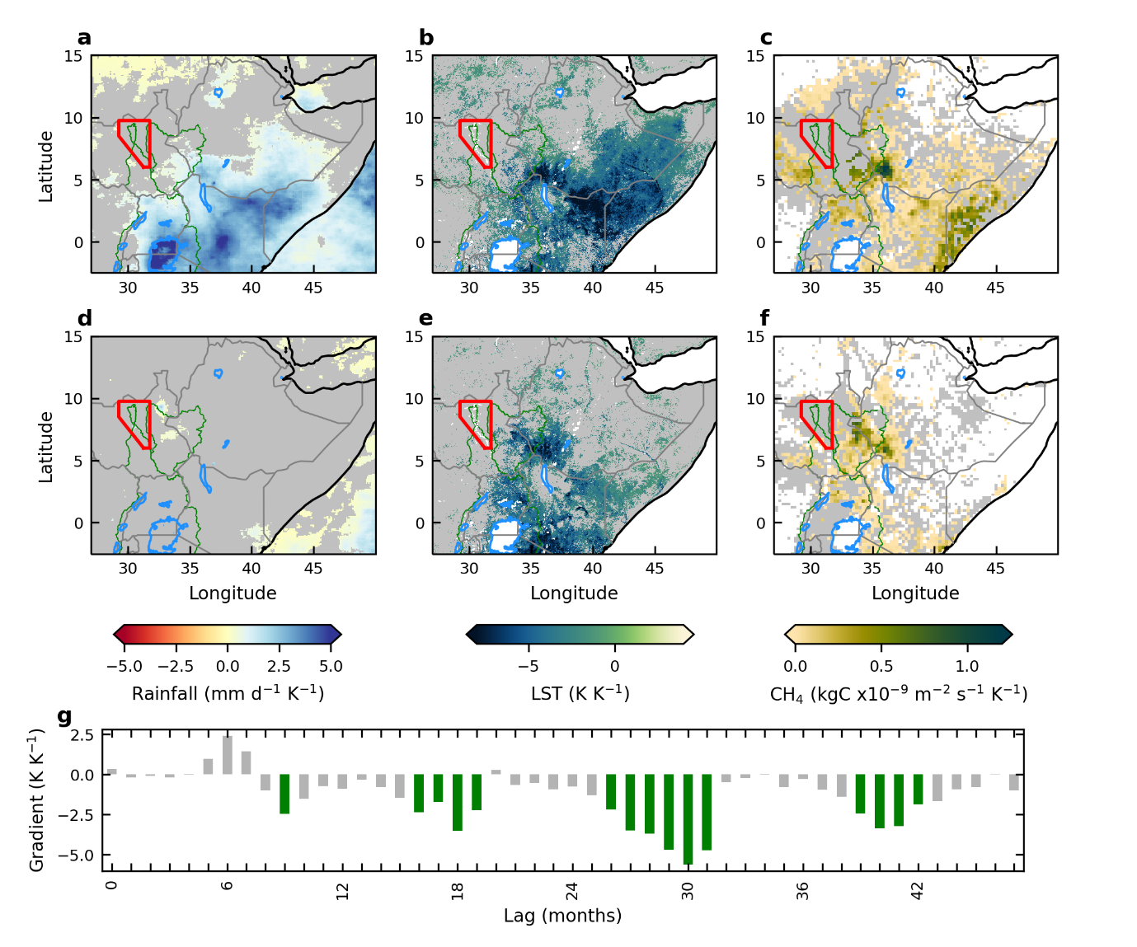
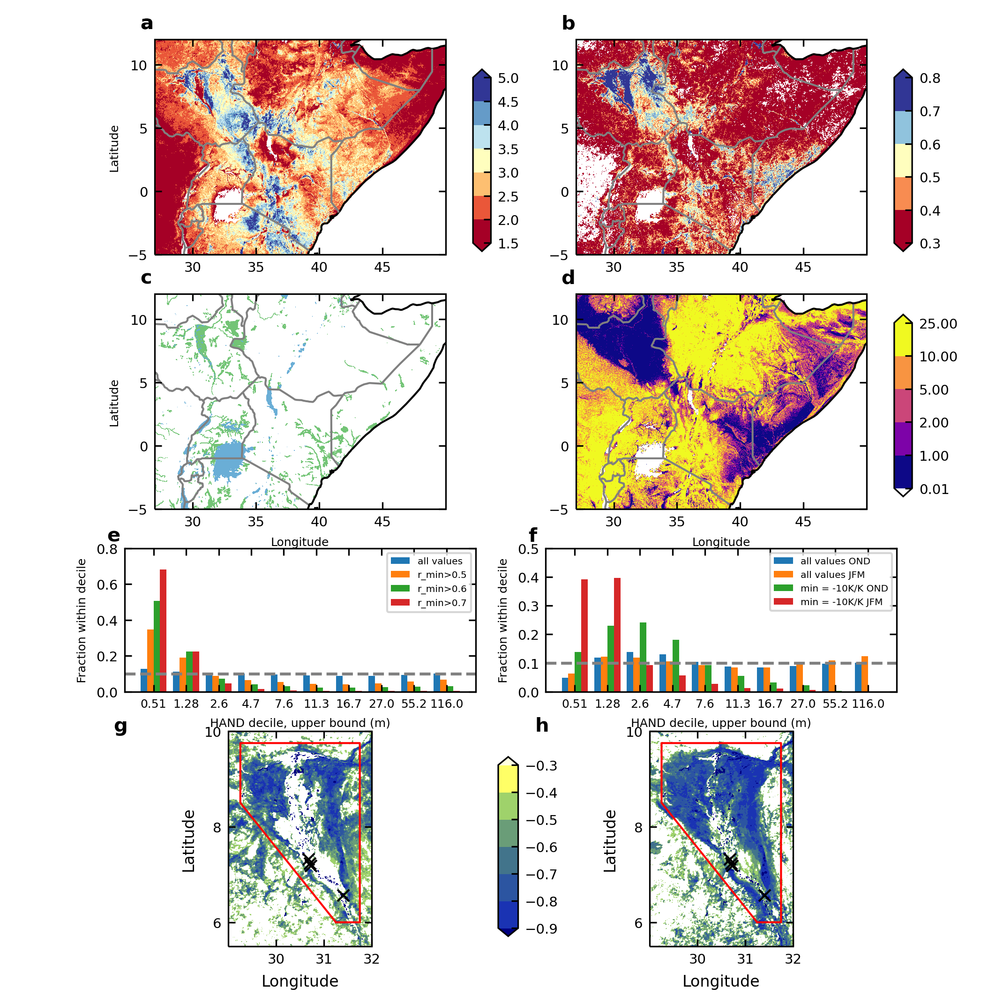
1. LST mapping of E African wetland responses to climate variability
Lag 1 autocorrelation in monthly LST
Response of wetland methane emissions to Indian Ocean Dipole (Folwell et al, in review)
OND
JFM
Global land water database
Sudd LST lags
MODIS Aqua data 2002-2024

Slide 4
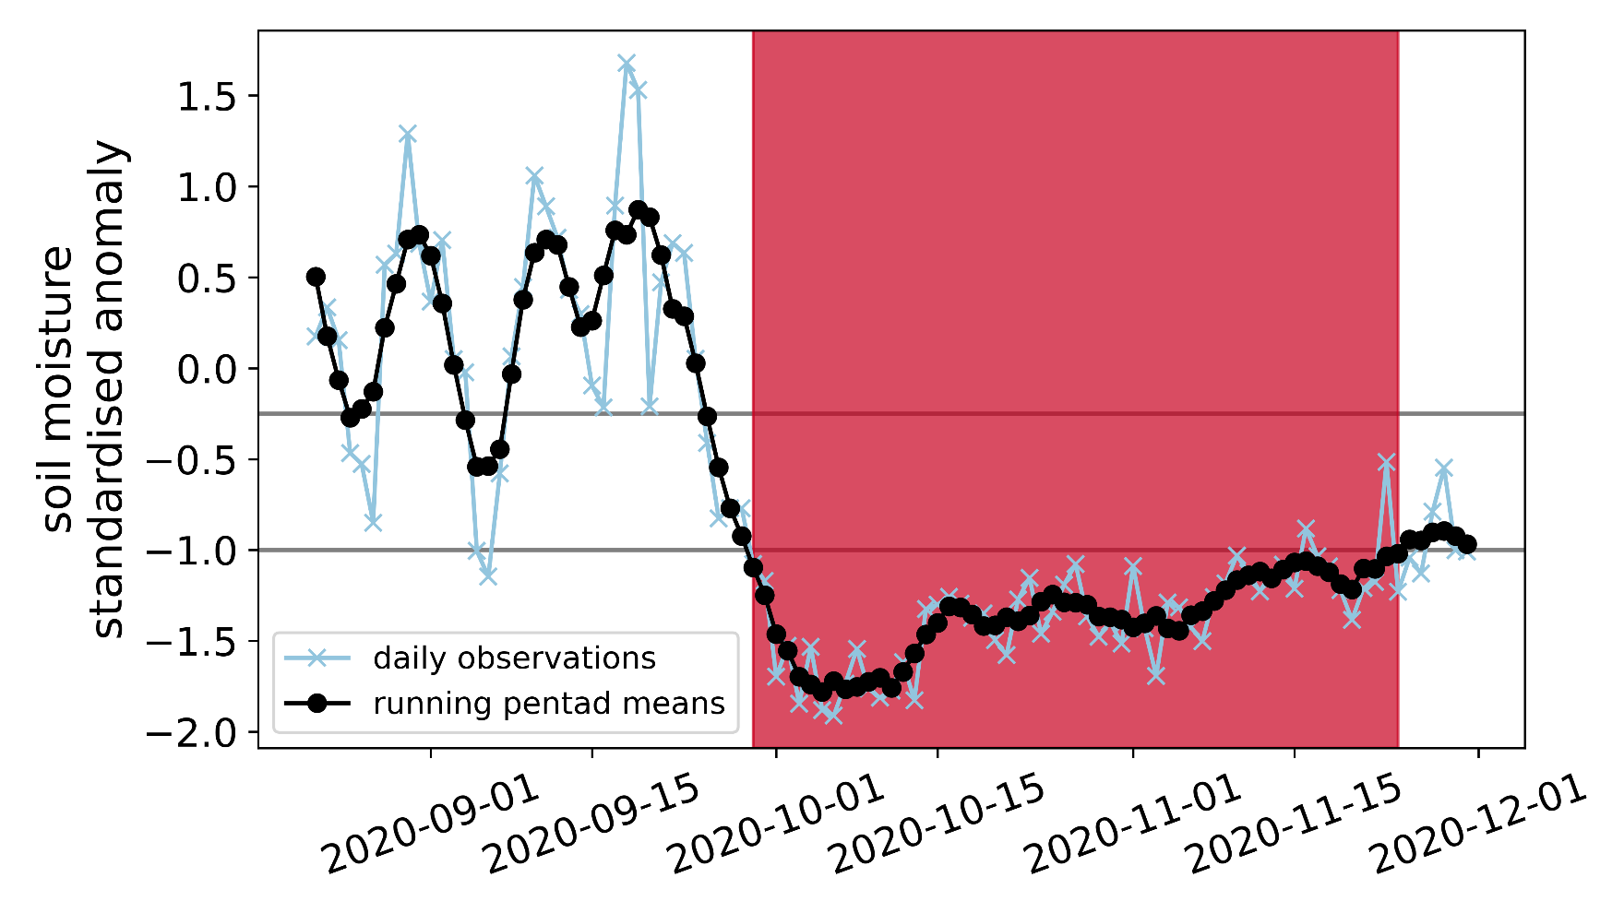

2. Identifying flash drought events
Droughts developing on subseasonal-to-seasonal (S2S) timescale = 2 weeks to 2 months
Use ESA CCI Soil Moisture combined active/passive microwave product (v08.1)
Identify rapid transitions from normal/wet conditions to dry
flash drought
event
flash drought onset
Harris et al, in prep
Notes:
Advantages: great temporal resolution for S2S timescale; good global coverage of obs. Note it’s surface SM only

Slide 5
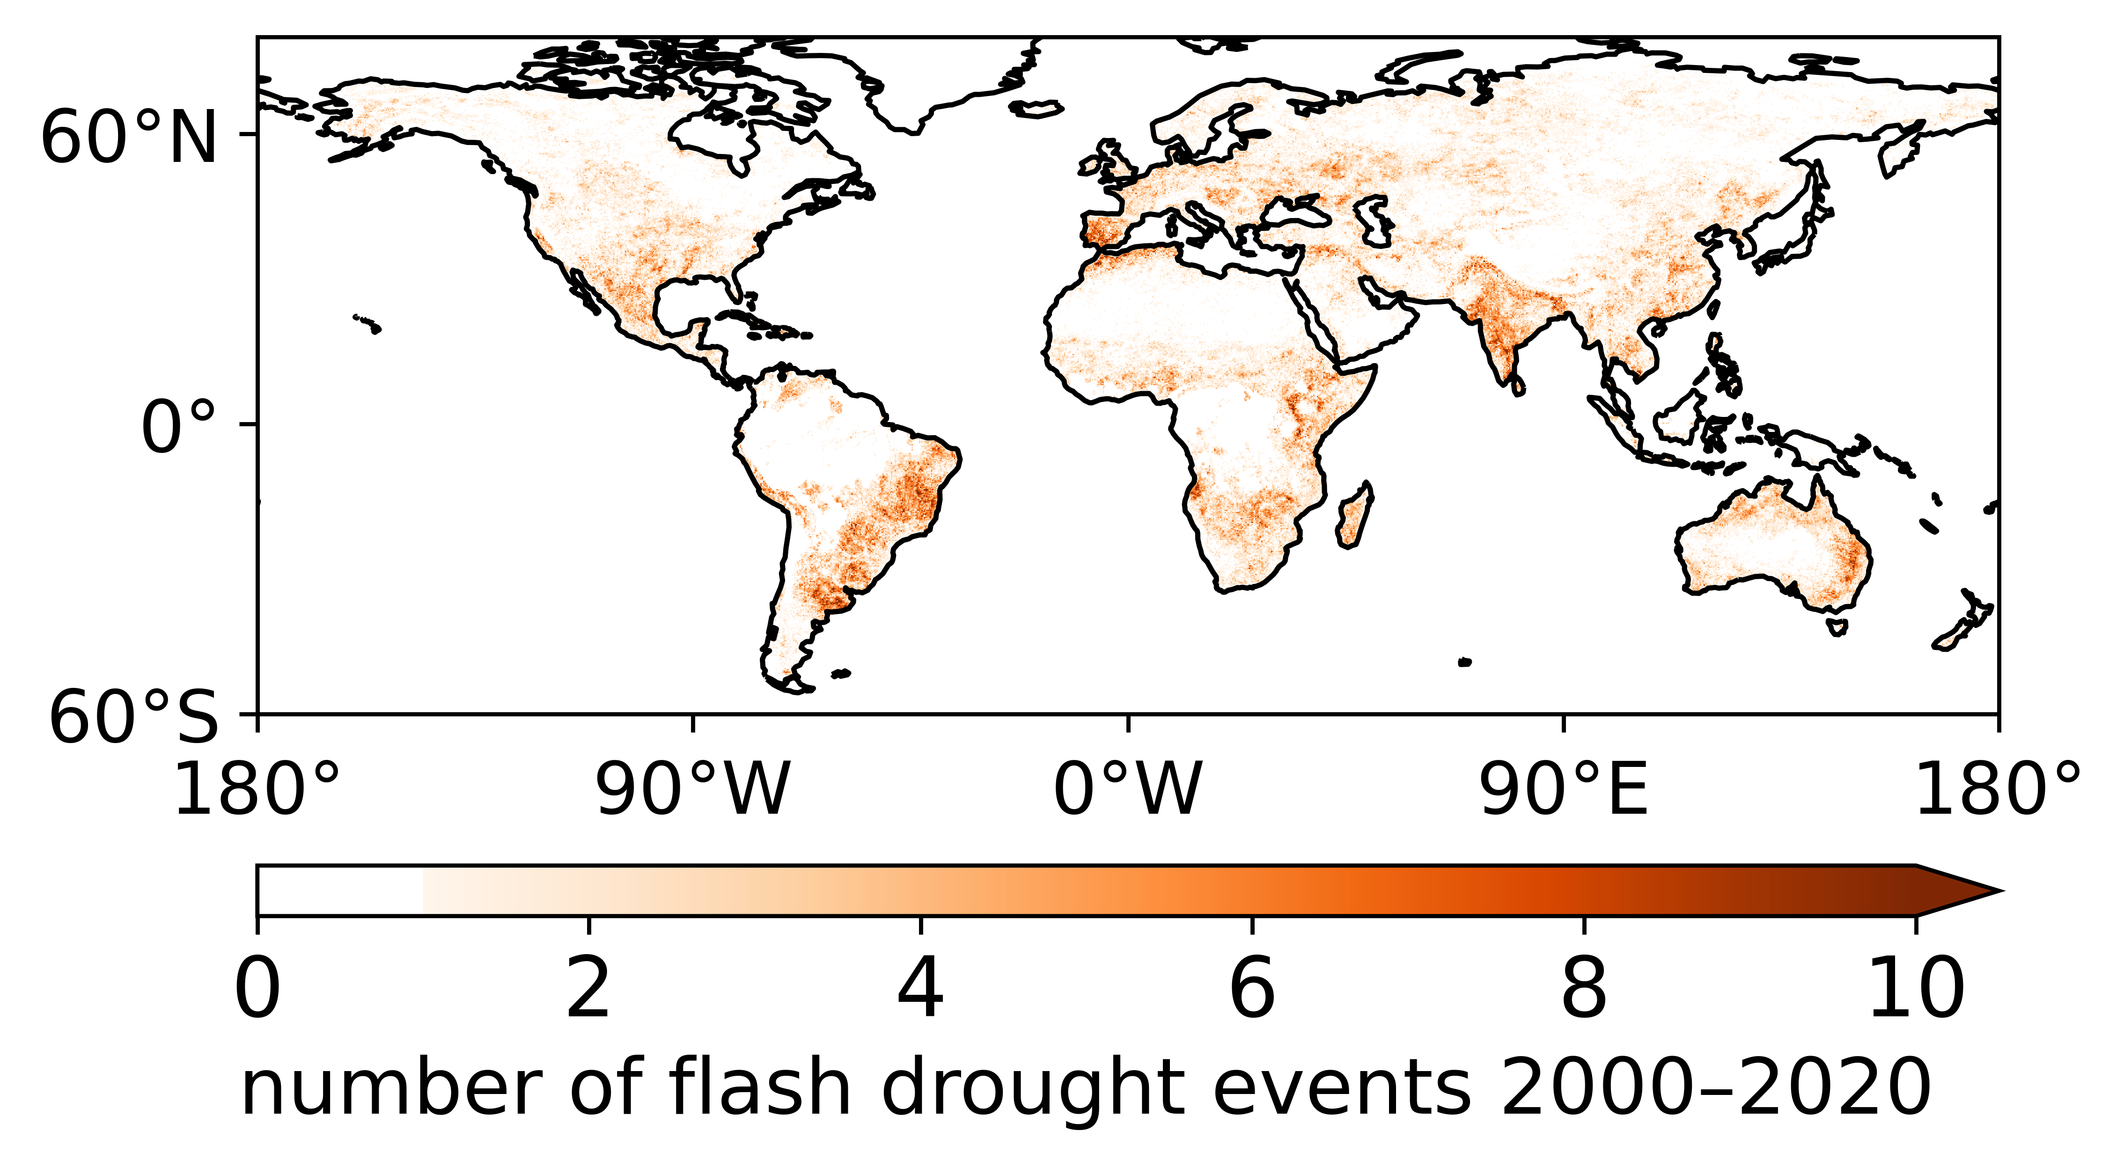
2. Identifying flash drought events
Droughts developing on subseasonal-to-seasonal (S2S) timescale = 2 weeks to 2 months
Use ESA CCI Soil Moisture combined active/passive microwave product (v08.1)
Identify rapid transitions from normal/wet conditions to dry
flash drought
event
flash drought onset
total = 236359
Harris et al, in prep
Notes:
Advantages: great temporal resolution for S2S timescale; good global coverage of obs. Note it’s surface SM only

Slide 6
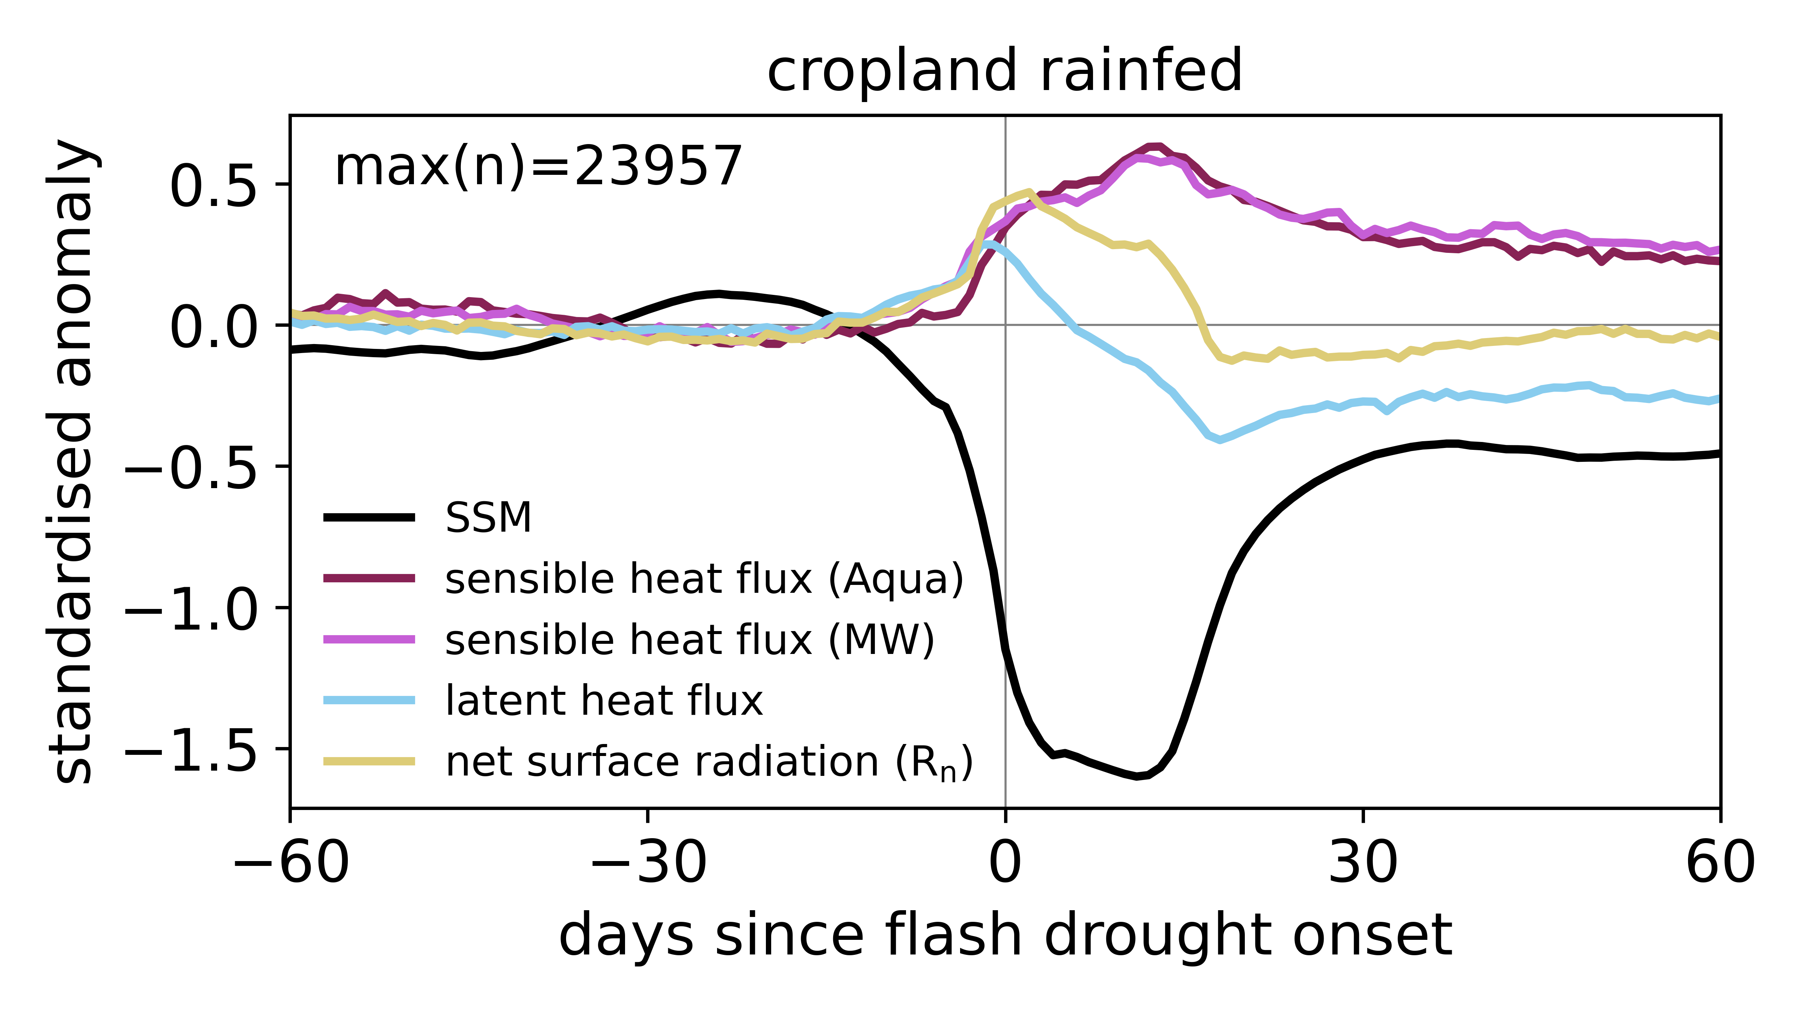
Surface energy budget
Composite around event onset dates
Use LST-T2m as a proxy for sensible heat flux
(Folwell et al., 2016; Gallego-Elvira et al., 2016)
Test ESA CCI MODIS Aqua and
microwave (SSMI) LST products,
with ERA5 T2m
Compare with:
  Net radiation at surface (CERES)
  Latent heat flux from GLEAM evaporation
Harris et al, in prep
Notes:
Example plot is from rainfed cropland CCI land cover class, for growing season only

Slide 7
Surface energy budget
R_{n} ≈ SHF + LHF (+ ground heat flux)
Get a consistent picture of surface energy budget across products
Initial increase in latent heat flux prior to onset
  Accelerates loss of soil moisture until water limitation reached
  Similar results between LST products
Harris et al, in prep
Notes:
Note you can’t add up the standardised anomalies

Slide 8
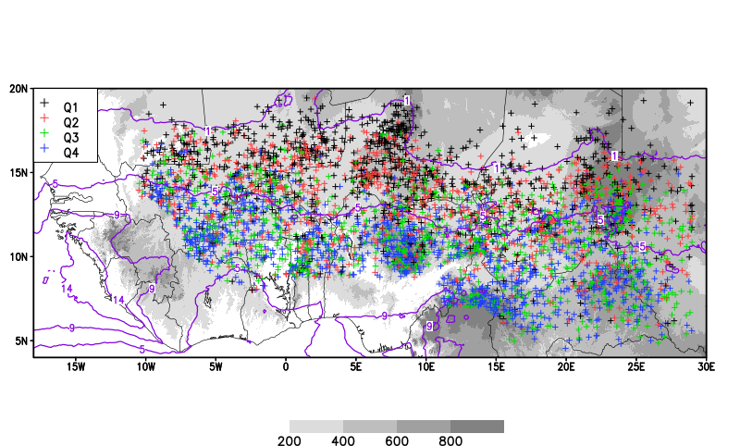
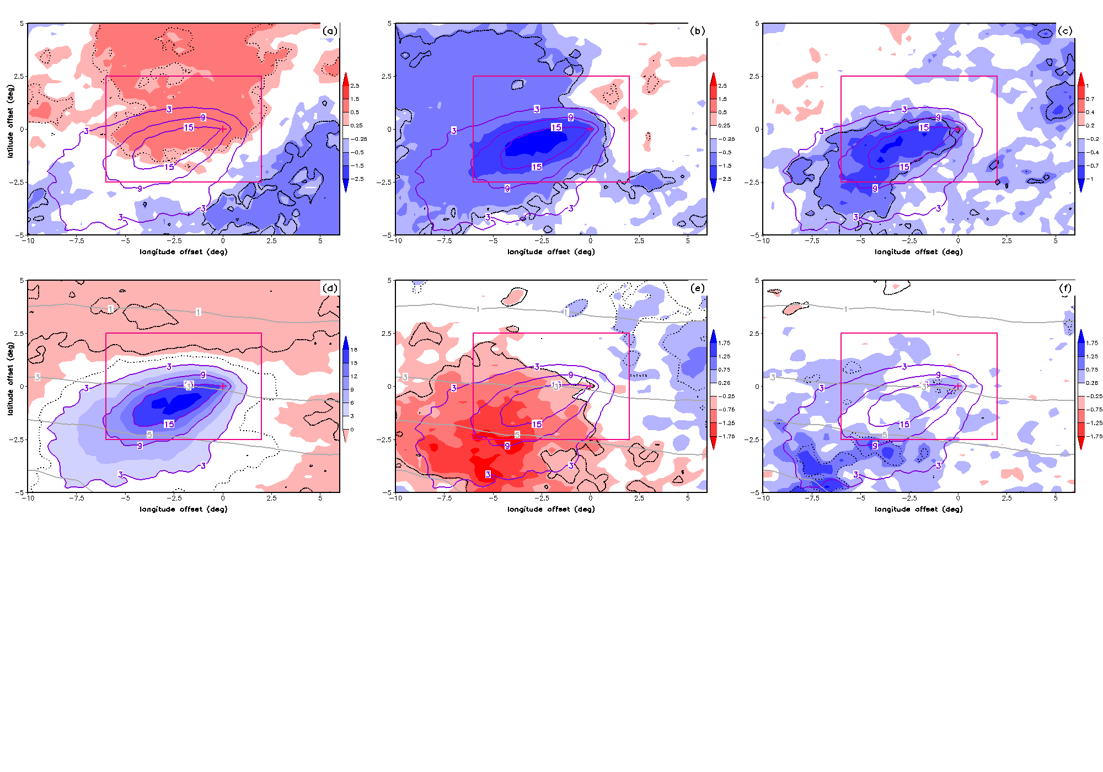
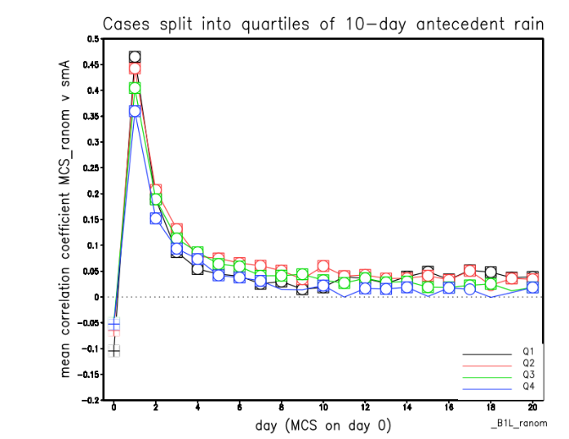
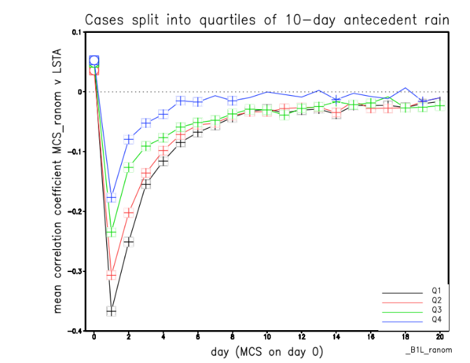
3. Persistence of land memory in Sahel
Storm rainfall [shading; mm]
Soil Moisture
Daytime LST anomaly 1-2 days after event [shading; K]
Locations of 5576 afternoon MCS initiations (2004-2020)
Colours: 10-day antecedent rain quartile.
SEVIRI LST (LandSAF) 0700-1700LT daytime mean anomalies
LST
Analysis provides understanding of predictability of rainfall at different lags
Taylor et al, GRL 2024
Spatial composite means
(purple contours: post-event ASCAT SM)
Lagged spatial correlations with storm rainfall

Slide 9
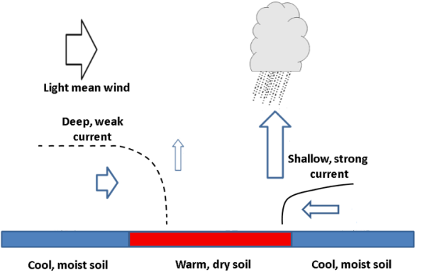
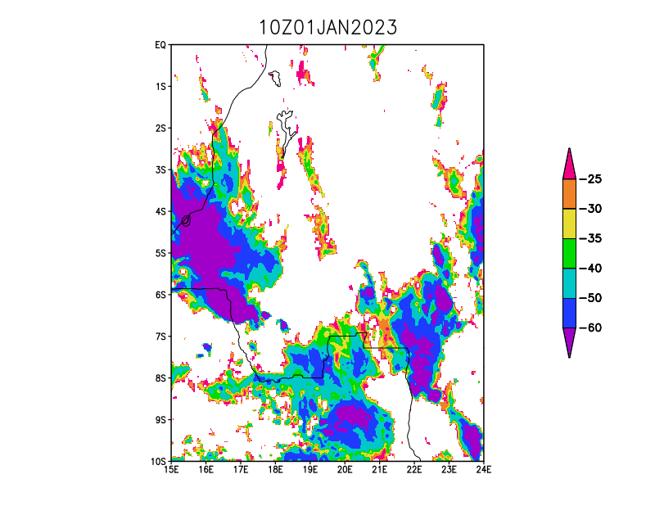
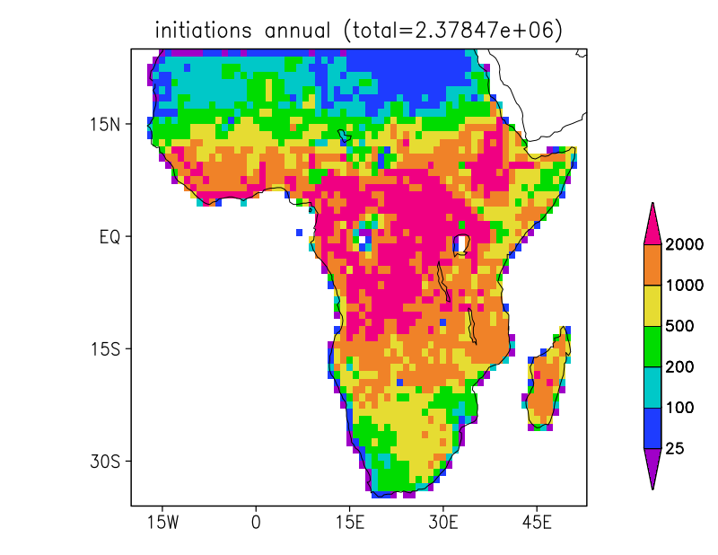
4. Soil moisture and convective initiation across Sub-Saharan Africa
Taylor et al, Nat Geo, 2011
Predicting where deep convection will initiate is a fundamental problem with big impacts across Africa
Soil moisture gradients can favour convective initiation through contrasts in sensible heat flux and mesoscale circulations
New analysis across Sub-Saharan analysis
15 minute, ~3km cloud-top temperature data from MSG for 2004-2023
LandSAF LST
HSAF ASCAT SM
Example day over DRC

Slide 10
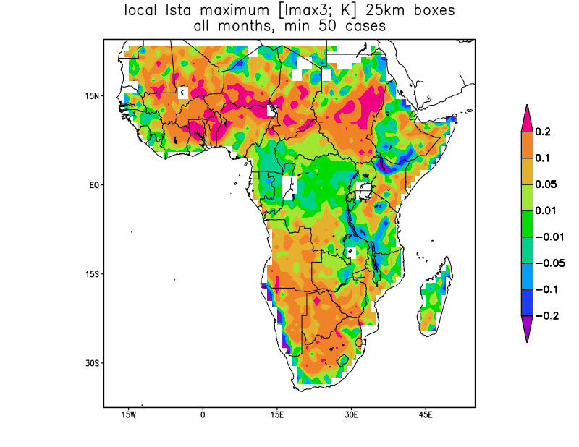
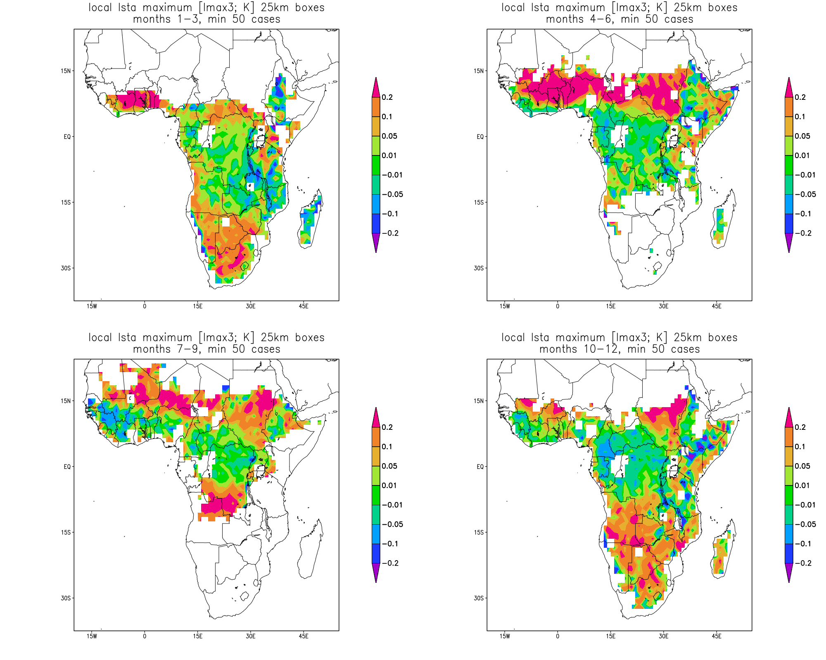
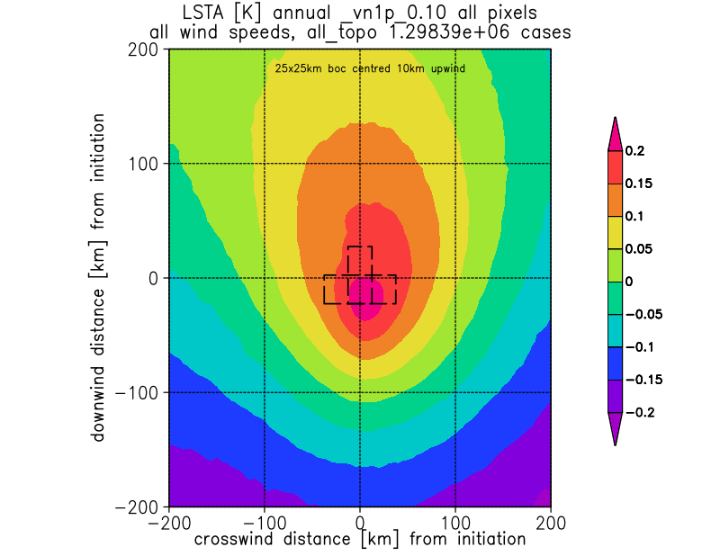
Hot spot effect in pre-storm LST across Africa
Stronger effect
JFM
AMJ
Shading is mean local LST contrast [C] in every 1 degree box
JAS
OND
Enhanced pre-storm LST gradients across lowland Africa outside of tropical forest.
Strong seasonality - SM signal strongest in drier months

Slide 11
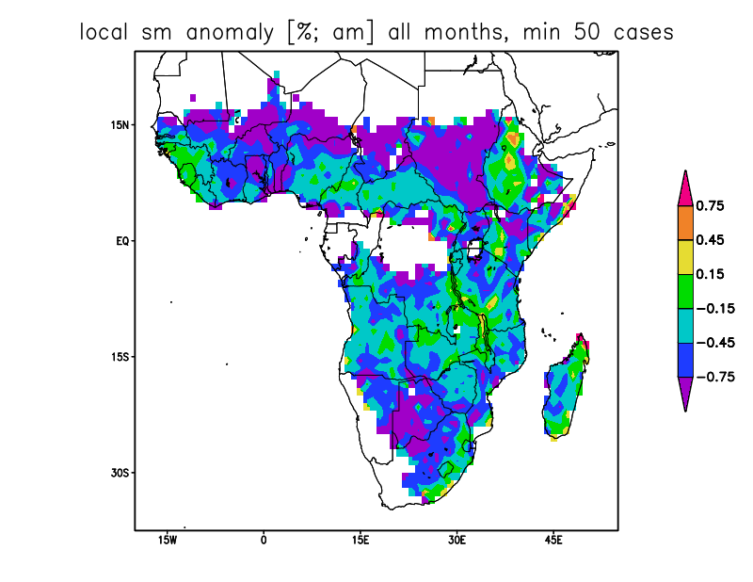
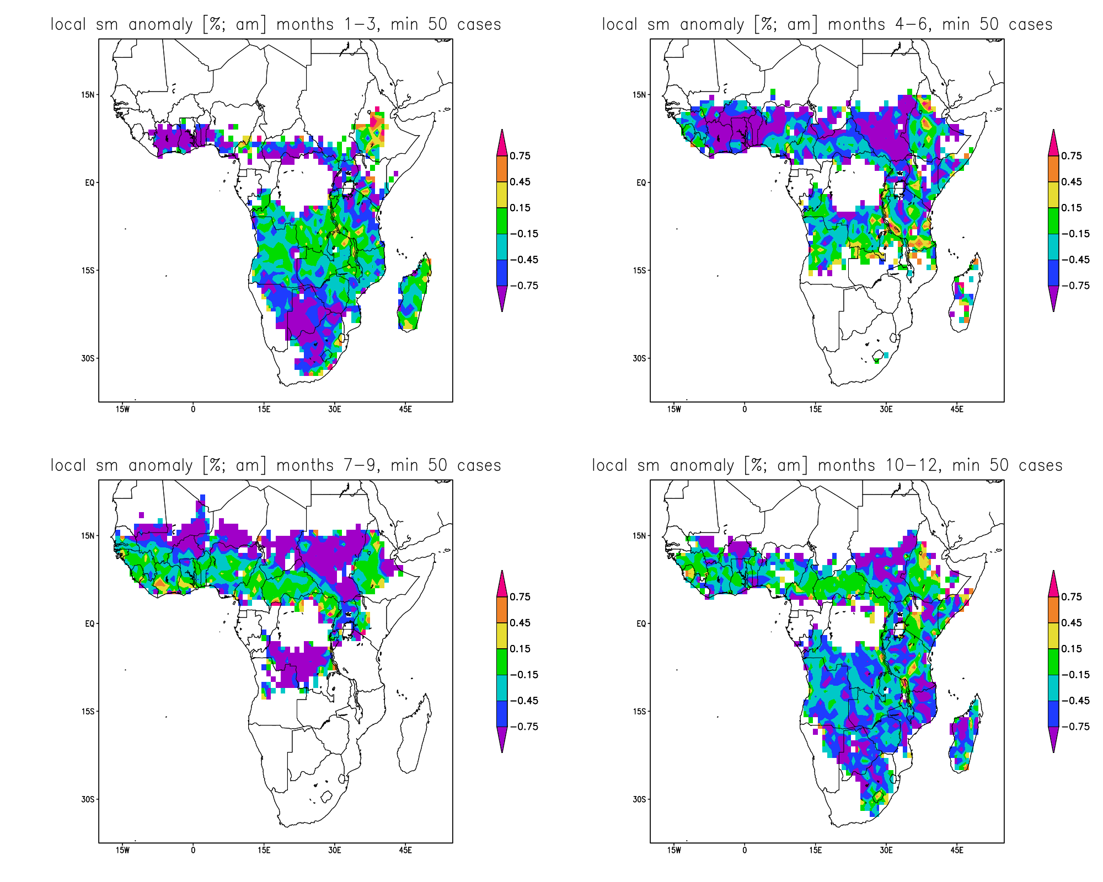
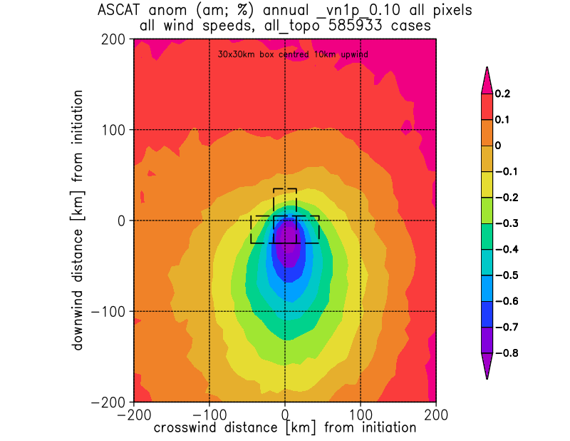
Dry spot effect in pre-storm SM across Africa
JFM
AMJ
Stronger effect
Shading is mean local SM contrast [%] in every 1 degree box
JAS
OND
Enhanced pre-storm SM gradients across lowland Africa outside of tropical forest.
Strong seasonality - SM signal strongest in drier months

Slide 12

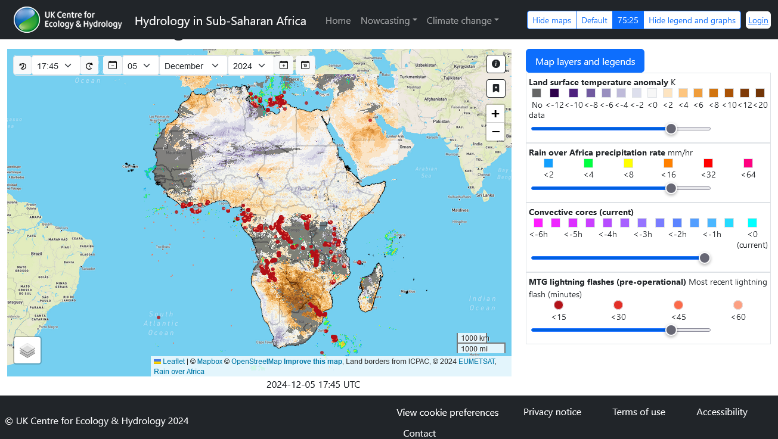
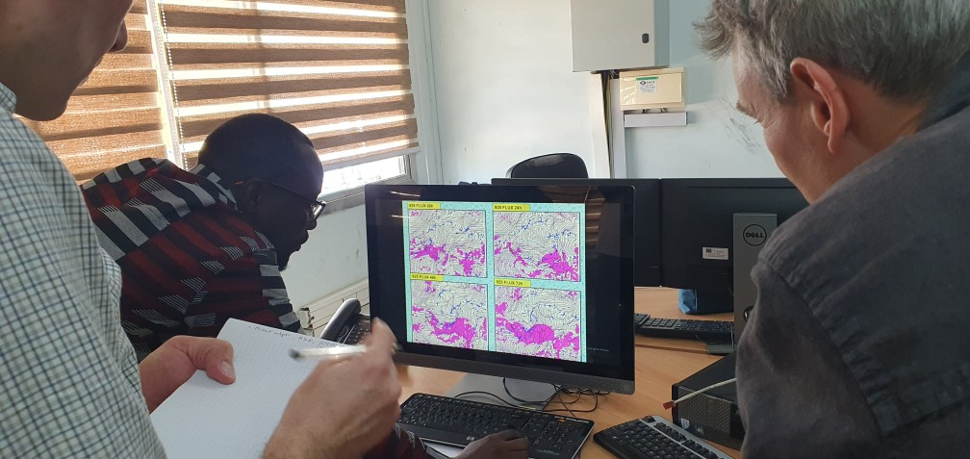
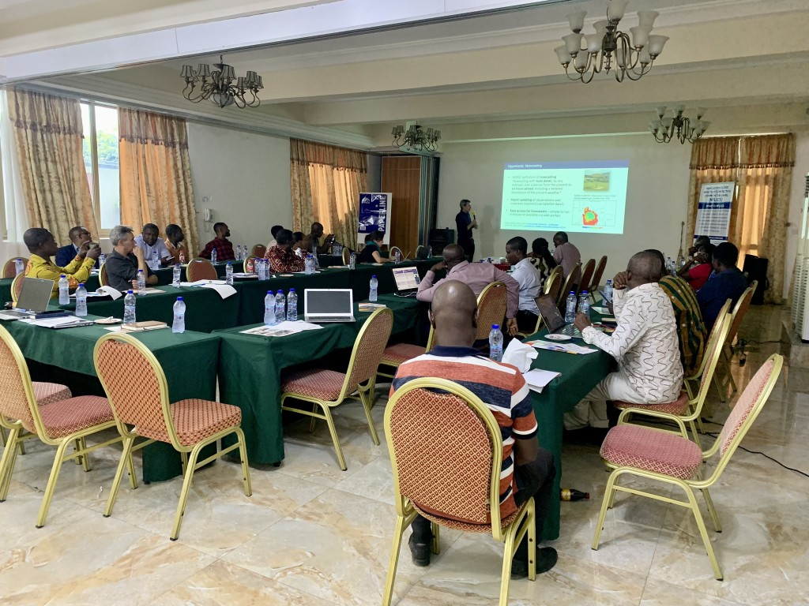








5. Web portal for nowcasting (to 6 hours) convective storms
Working with National Met services in Senegal, Ghana, Zambia, Mozambique and South Africa
https://africa-hydrology.ceh.ac.uk/nowcasting/

Slide 13
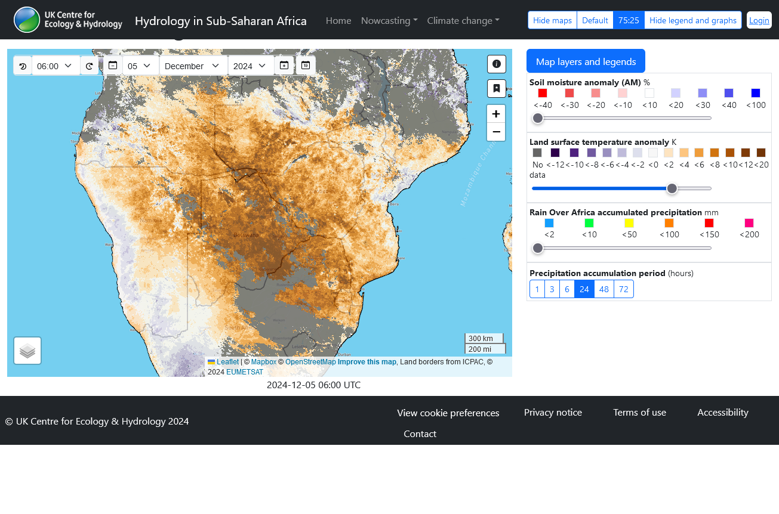
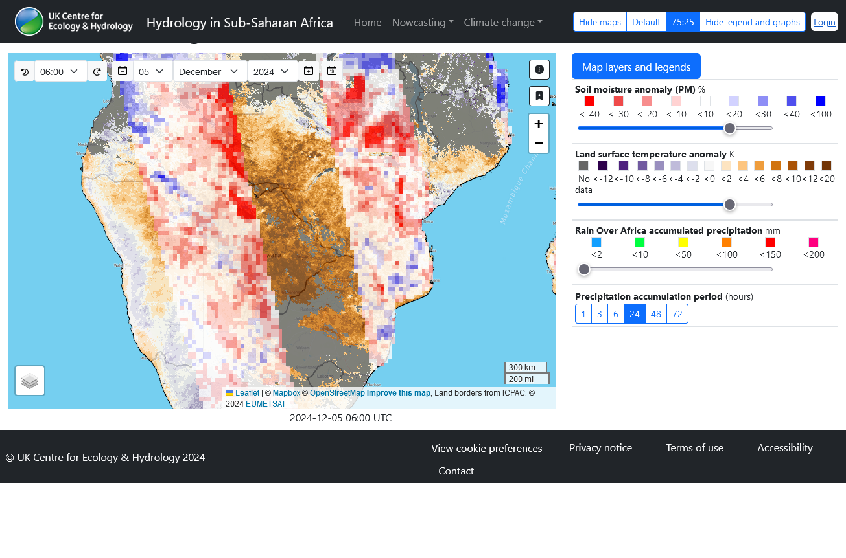
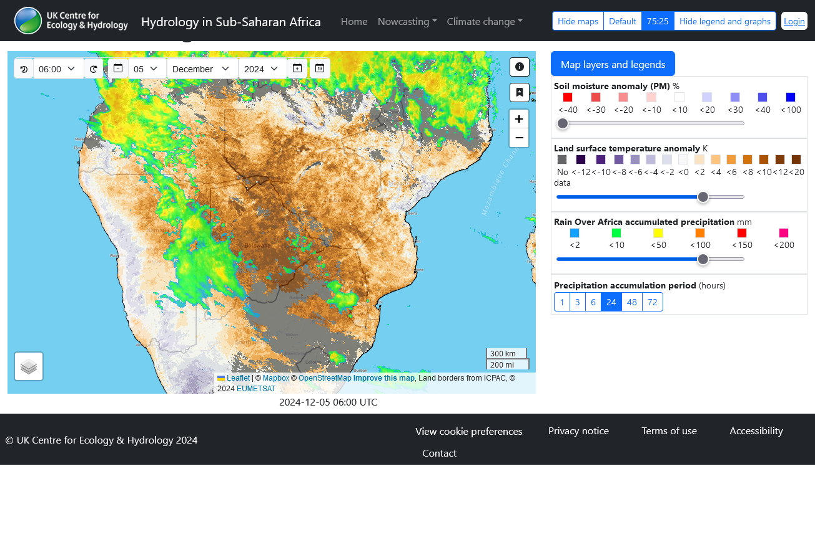

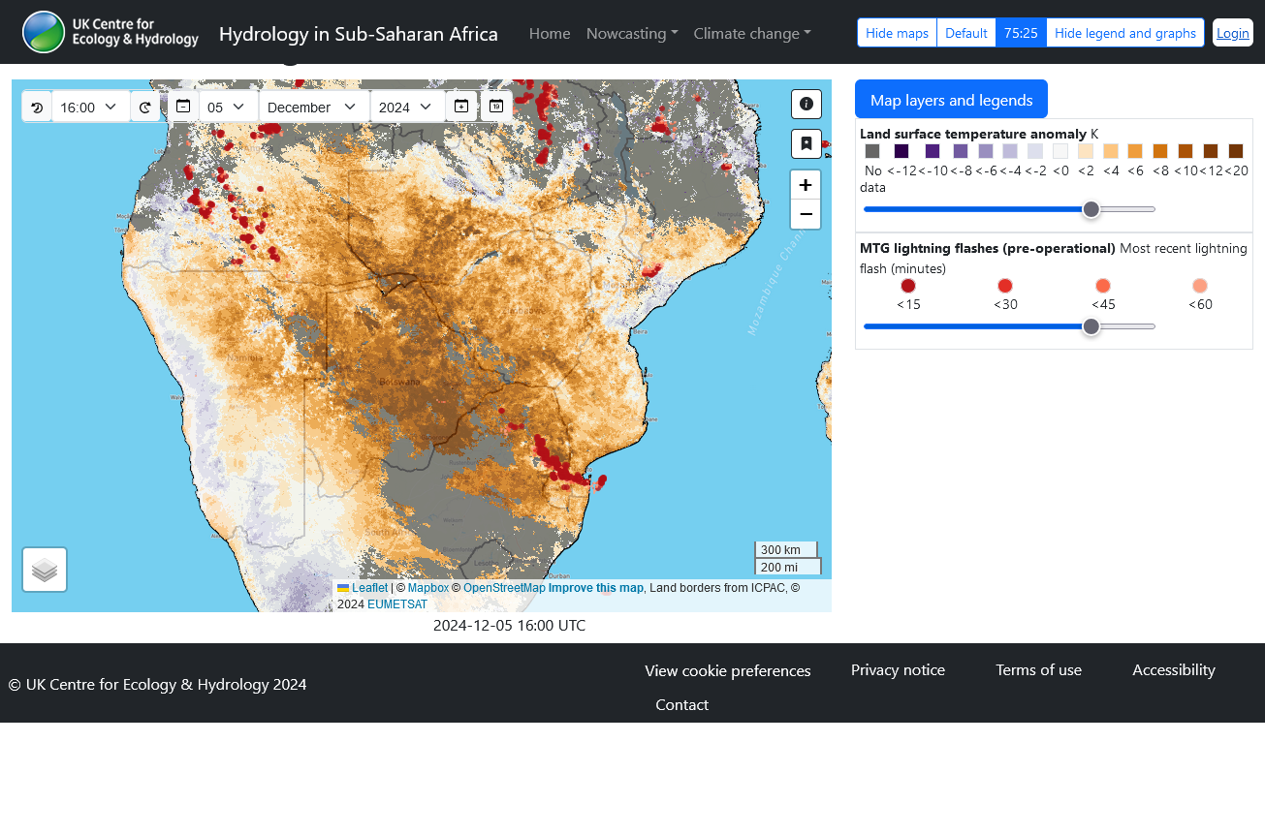
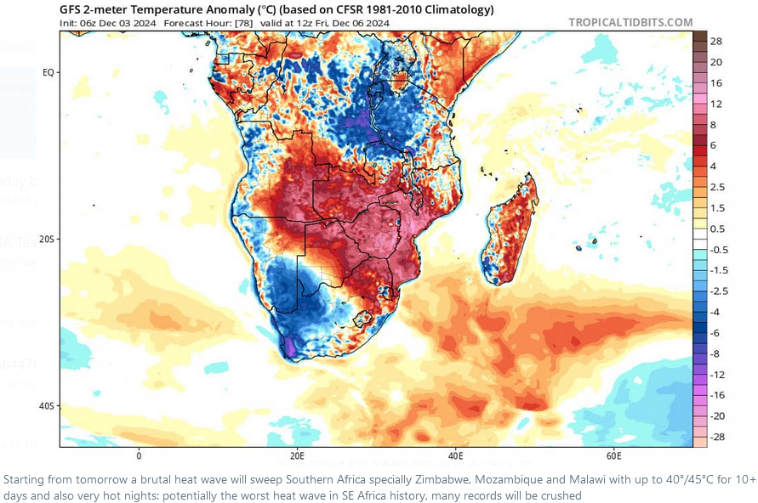
LST anomalies yesterday over Southern Africa
LandSAF LST
Widely-shared social media in the region on Wednesday discussing imminent “brutal heatwave”
https://africa-hydrology.ceh.ac.uk/nowcasting/

Slide 15
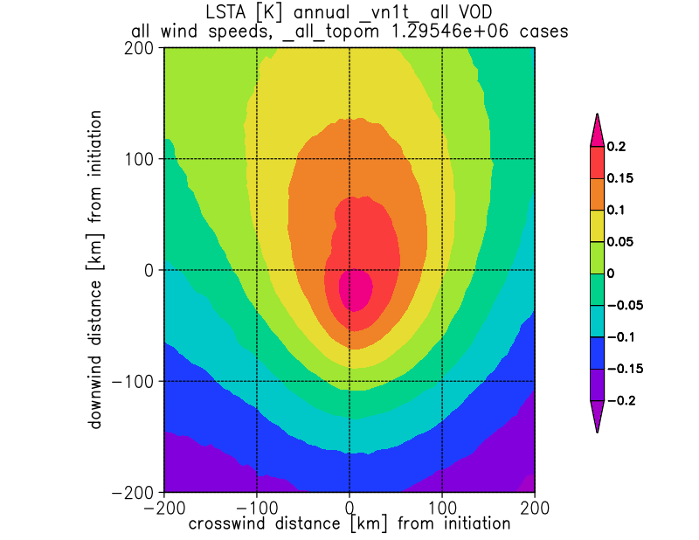
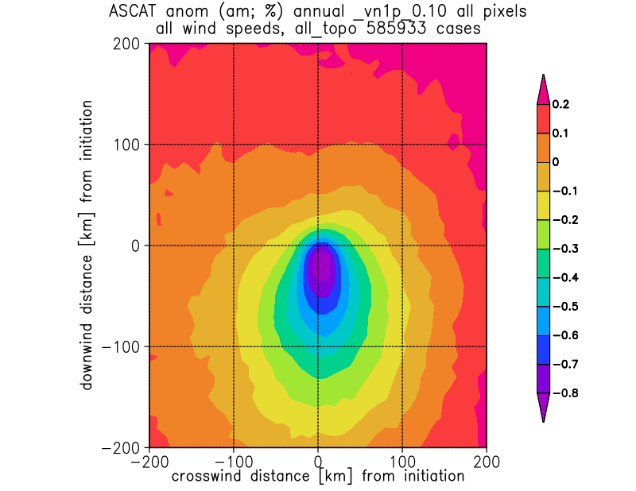
Composite pre-initiation land surface conditions
Composite pre-storm land surface observations
(aligned with background 500m wind from ERA5)
Wind direction
LST anomalies [K]
Surface SM anomalies [%]
0930LT
Initiations across Africa favoured over local hot/dry spot

