Slide 1
Use of LST data for producing data for the FAO-WaPOR portal: past, present and future
Dec 6th 2024
Henk Pelgrum, Joost Brombacher, Karlis Zalite, Steven Wonink

Slide 2

FAO - WaPOR
WaPOR
  Near real time global database using satellite data that allows the monitoring of agricultural water productivity at different scales
  Capacity building in the use of WaPOR data for different applications
  Generate solutions to local challenges linked to water productivity and land productivity as well as water management
  Training is done by IHE Delft
  Capacity building is done by IWMI
  Data provision (v3.0) is ensured by eLEAF
  Data provisions for previous versions was done by eLEAF and VITO

Slide 3
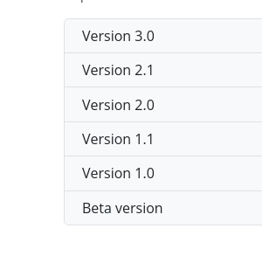
FAO-WaPOR requirements
Data used for producing database data should be open source
Software used for producing database is also open source
  PyWAPOR (https://bitbucket.org/cioapps/pywapor/src/master/)
General idea is that users should be able to calculate their own data without additional costs for data
Currently we are on v3 of the dataset

Slide 4
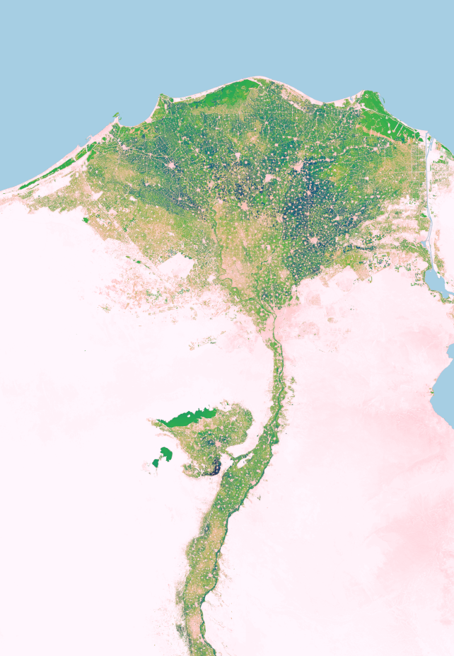
FAO-WaPOR database content
Evapotranspiration (separated into E, T)
Interception
Land Cover Classification (not in v3)
Net Primary Productivity
Phenology (not in v3)
Precipitation
Quality layers
Relative soil moisture content for the rootzone
Total biomass production
Water productivity

Slide 5
FAO-WaPOR Coverage
Database version | Description | V1 | V2 | v3
L1 L2 L3 | Continental level Basin level Irrigation scheme | 250 m 100 m 30 m | 250 m 100 m 30 m | 300 m 100 m 20 m
Database version | Description | V1 | V2 | v3
L1 L2 L3 | Continental level Basin level Irrigation scheme | Africa Middle East Major watersheds Africa 10+ areas | Africa Middle East Major watersheds Africa 20+ areas | Global Africa Middle East Pakistan Colombia 30+ areas

Slide 6
Models
Models used for the main components:
Evapotranspiration & Interception --> ETLook
  NDVI
  Surface Albedo
  Soil Moisture
  Meteorological data
Net Primary Production --> C-fix
  NDVI
  Meteorological data
Soil moisture --> Pixel-based trapezoid approach
  Land Surface Temperature
  NDVI
  Meteorological data

Slide 7
Data providers
Input Variable | v1 | V2 | v3
NDVI | MODIS Landsat | MODIS Landsat Sentinel-2 | MODIS VIIRS Landsat Sentinel-2
Surface Albedo | MODIS Landsat | MODIS Landsat Sentinel-2 | VIIRS Landsat Sentinel-2
LST | MODIS Landsat | MODIS Landsat | VIIRS Landsat
Meteorological data | MERRA GEOS-5 | MERRA GEOS-5 | (ag)ERA5 GEOS-5

Slide 8
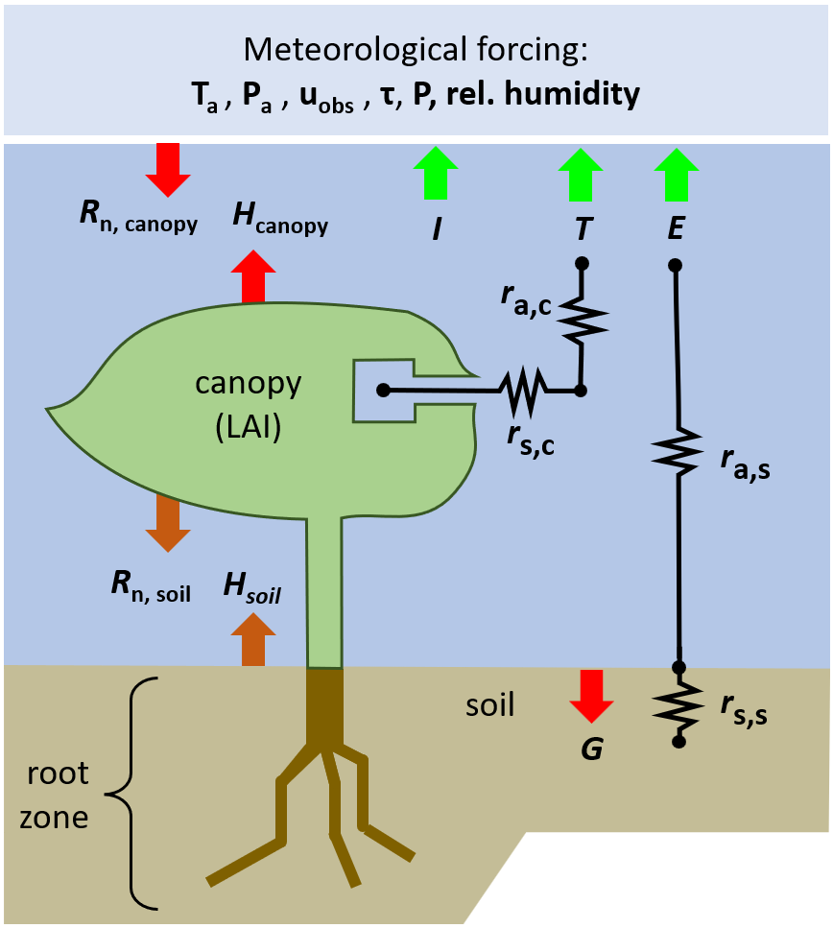

ETLook
Separate Penman-Monteith for soil and canopy
Computes daily Interception, Evaporation and Transpiration
Reduction of Potential ET through a soil moisture stress factor

Slide 9

C-Fix model
Radiation based
fPAR is a function of NDVI
Uses similar soil moisture stress as ETLook for reducing NPP

Slide 10
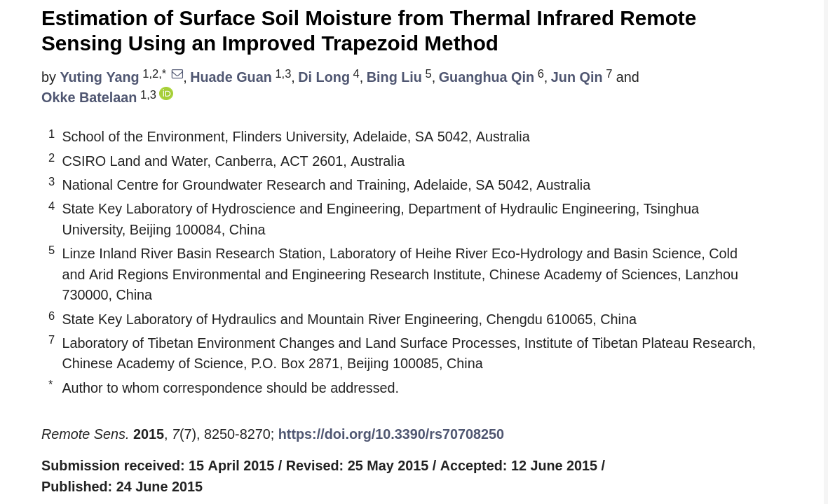
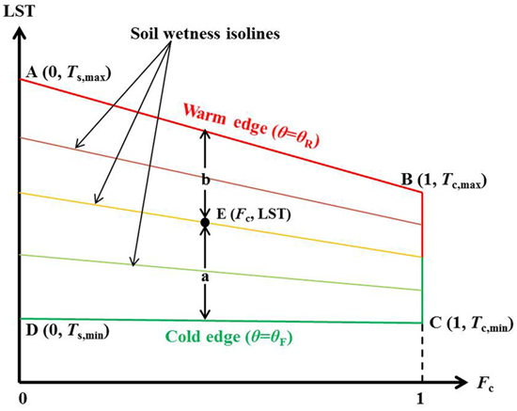
Soil moisture model
Trapezoid approach
Pixel based instead of image-based

Slide 11
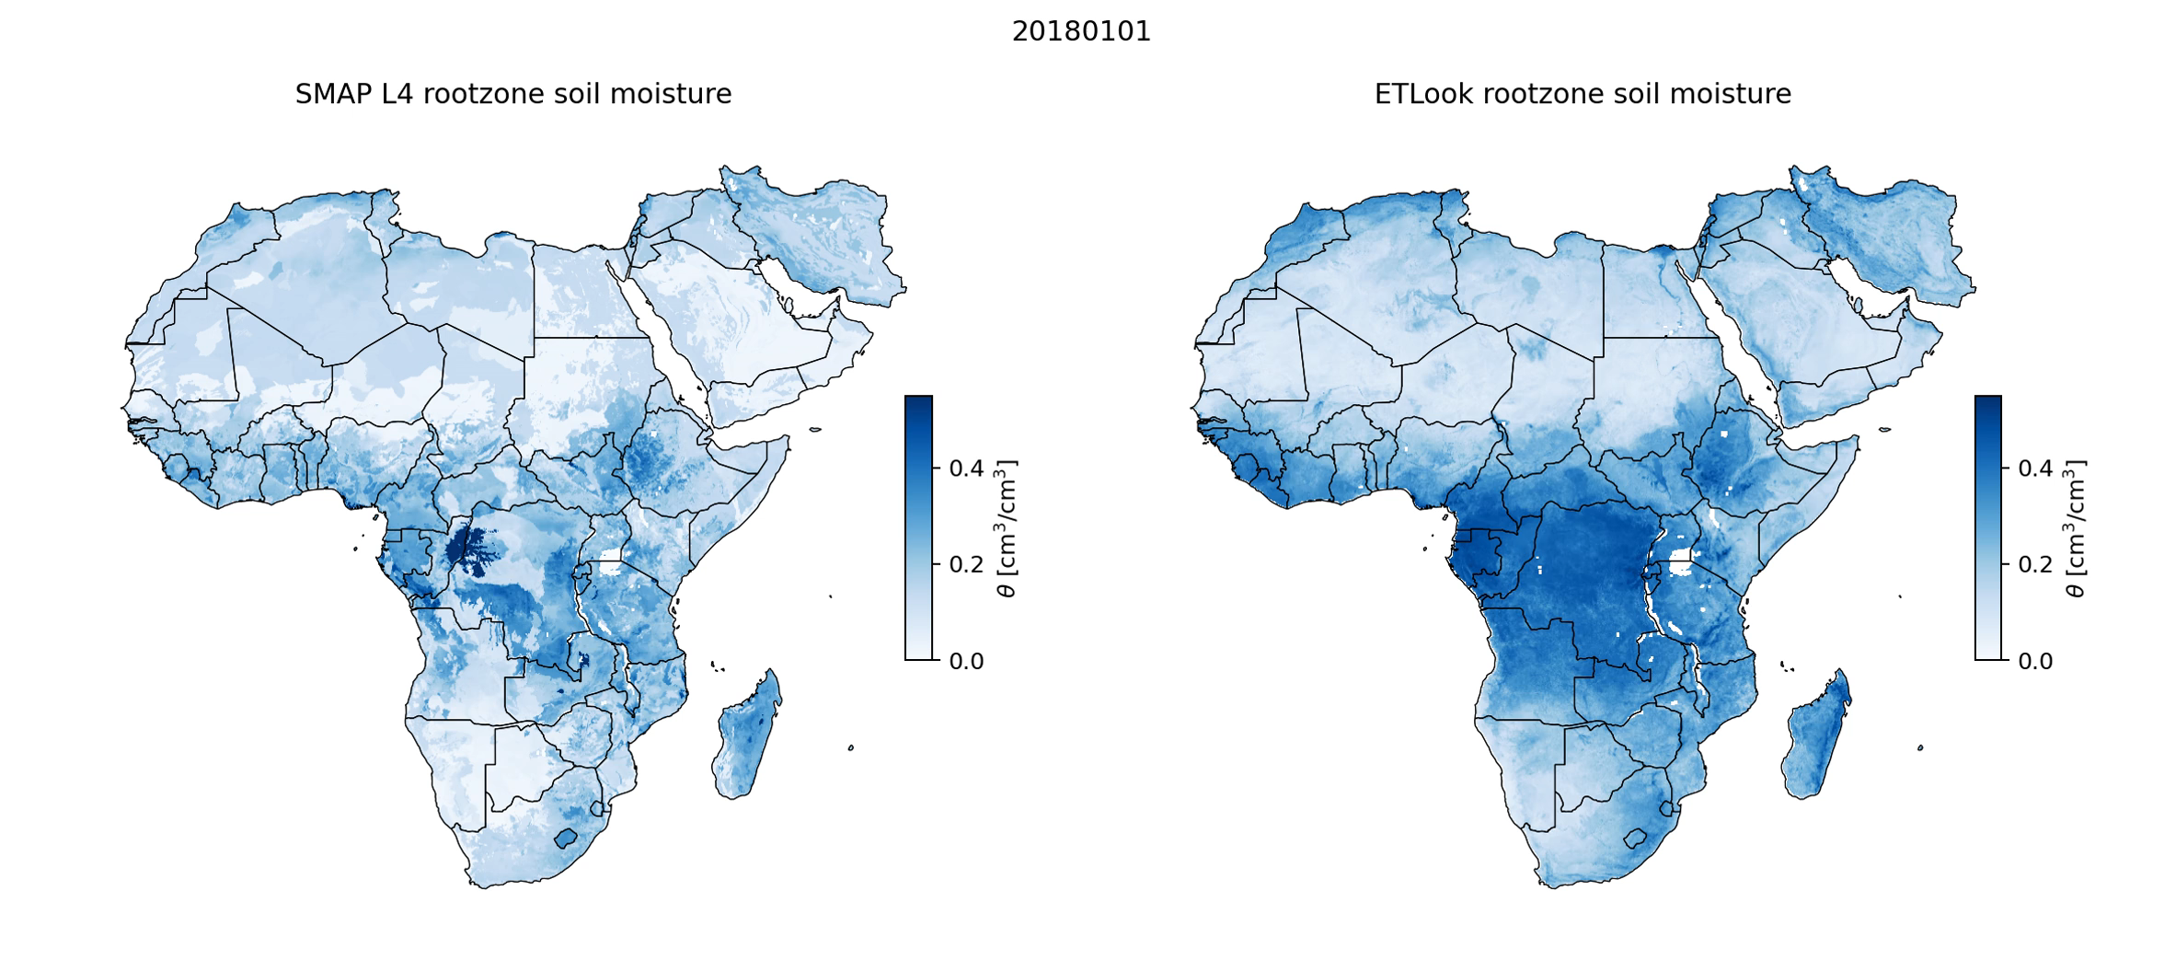
Soil Moisture: WaPOR vs SMAP
A rudimentary comparison

Slide 12
Changes in versions related to inputs
MODIS Tile data (v0-v2) -> VIIRS Swath data (v3)
  MODIS/VIIRS Tiles are troublesome when going global!
  Sinusoidal projection
  Instead of using LST as a product, LST is derived from the brightness temperature
For the 100m products (Africa/Middle East/Pakistan/Colombia)
  Resampling -> Thermal sharpening
  Resampling lead to errors on dry/wet boundaries

Slide 13
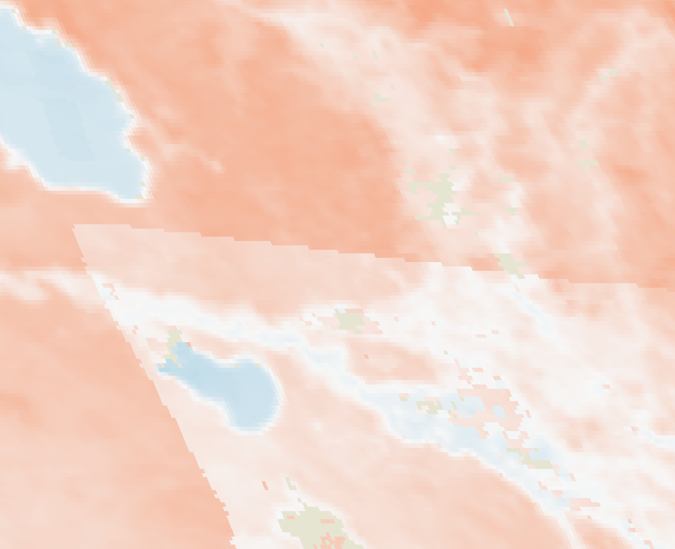
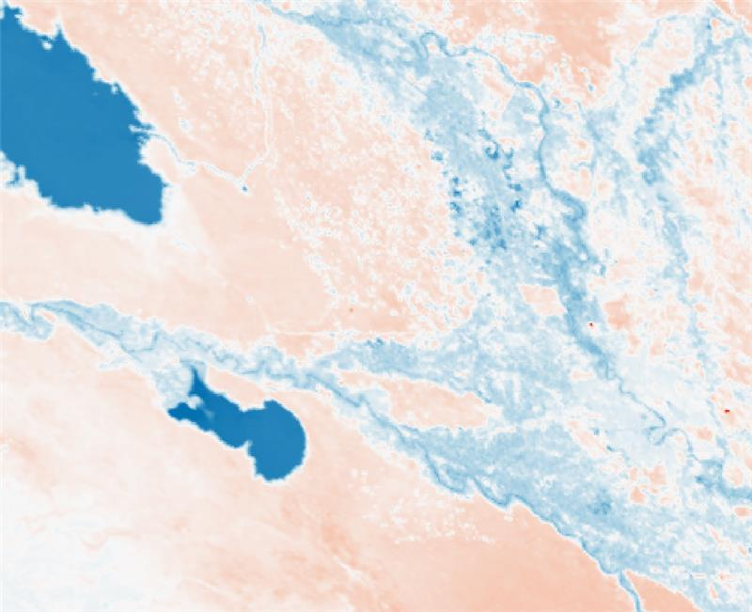
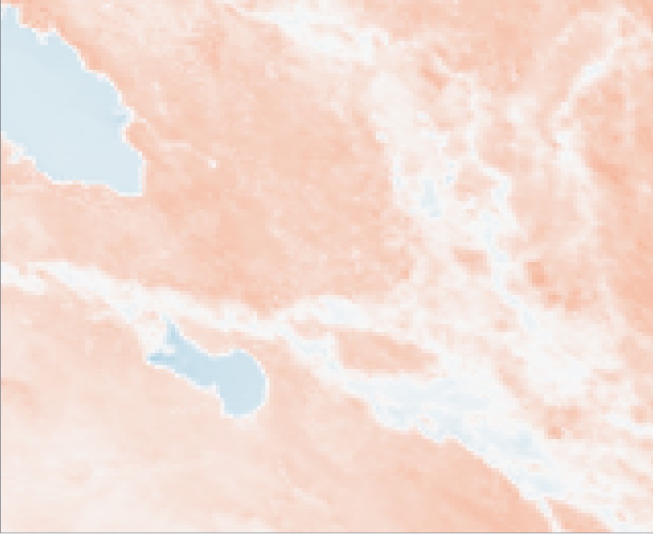
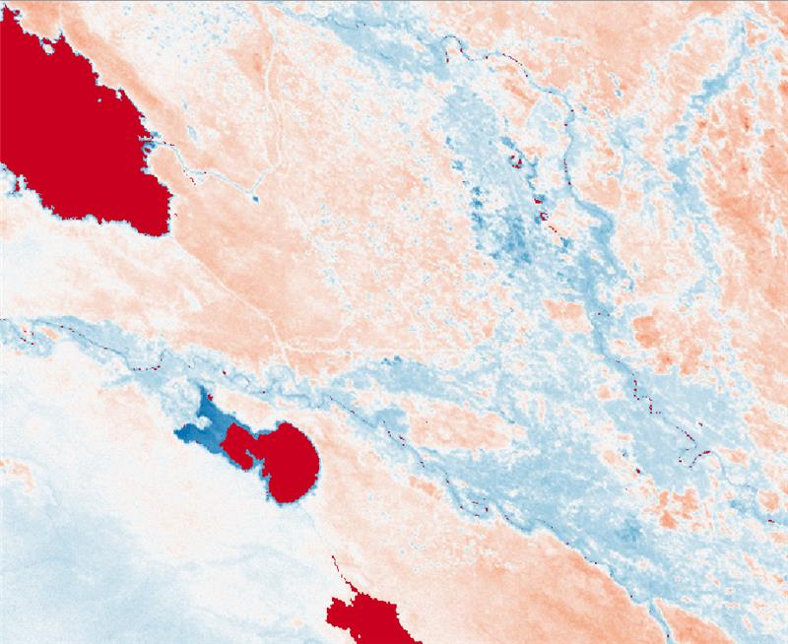
Coarse resolution LST products
MODIS
VIIRS
 | Spatial resolution (m) | Archive since
MODIS | 1000 | 2000
S-3 | 1000 | 2016
VIIRS | 375 | 2011
GCOM-C | 250 | 2018
Sentinel-3
GCOM
(not very suitable for operational application)
Euphrates Tigris

Slide 14
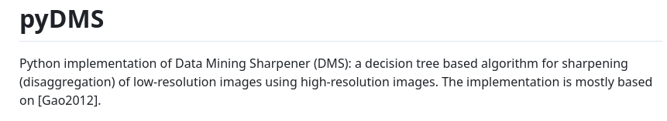
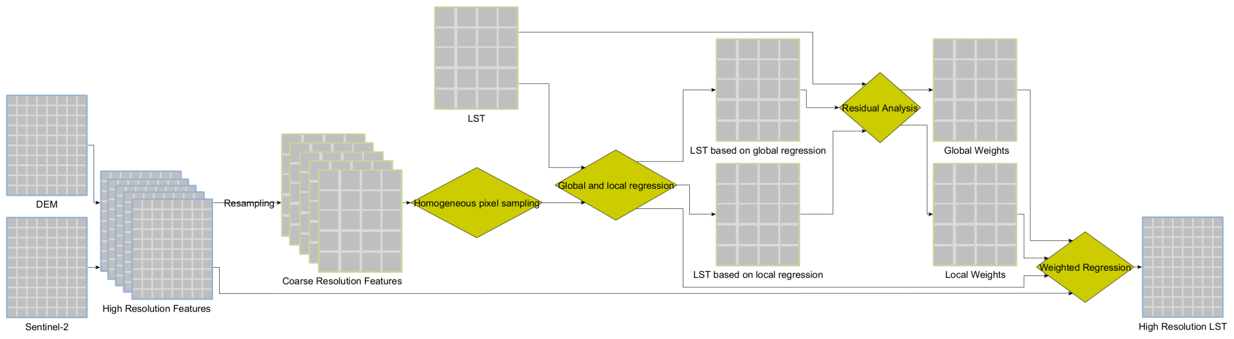

Thermal Sharpening
https://github.com/radosuav/pyDMS
PyDMS
Feature selection and data preparation
PyDMS application

Slide 15
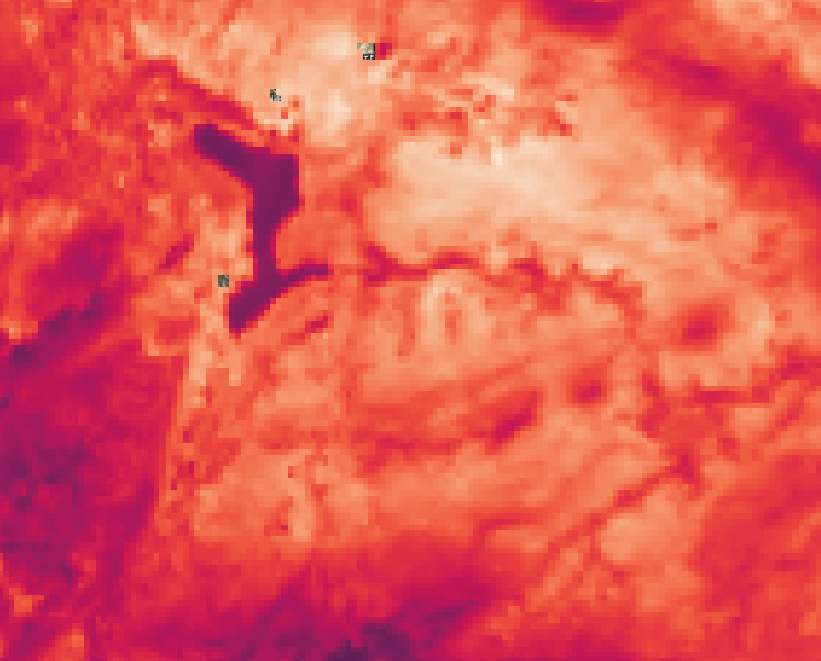
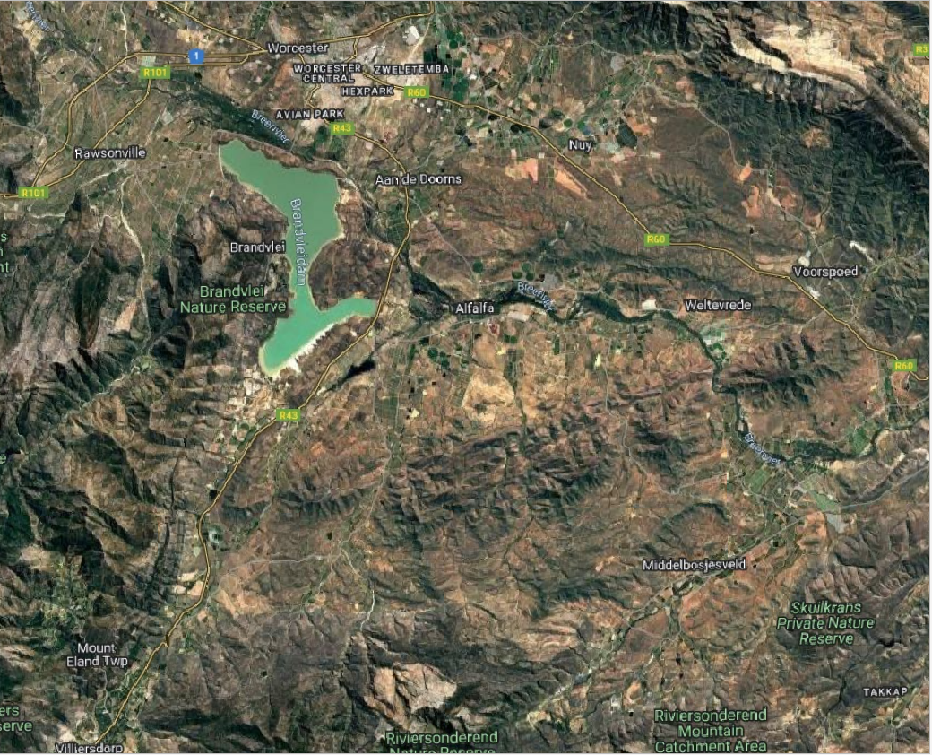
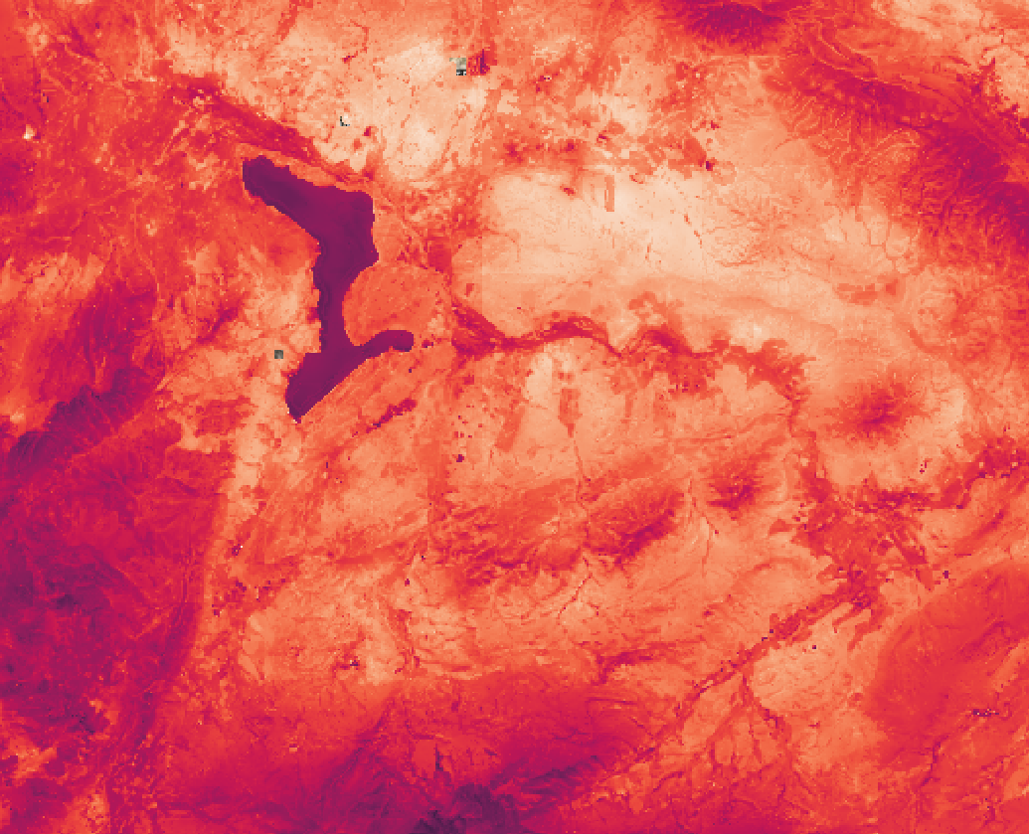

Thermal sharpening example
VIIRS Brightness Temperature
November 16th, 2024
South-Africa
SEntinel-2 Tile ID: 34HCH

Slide 16
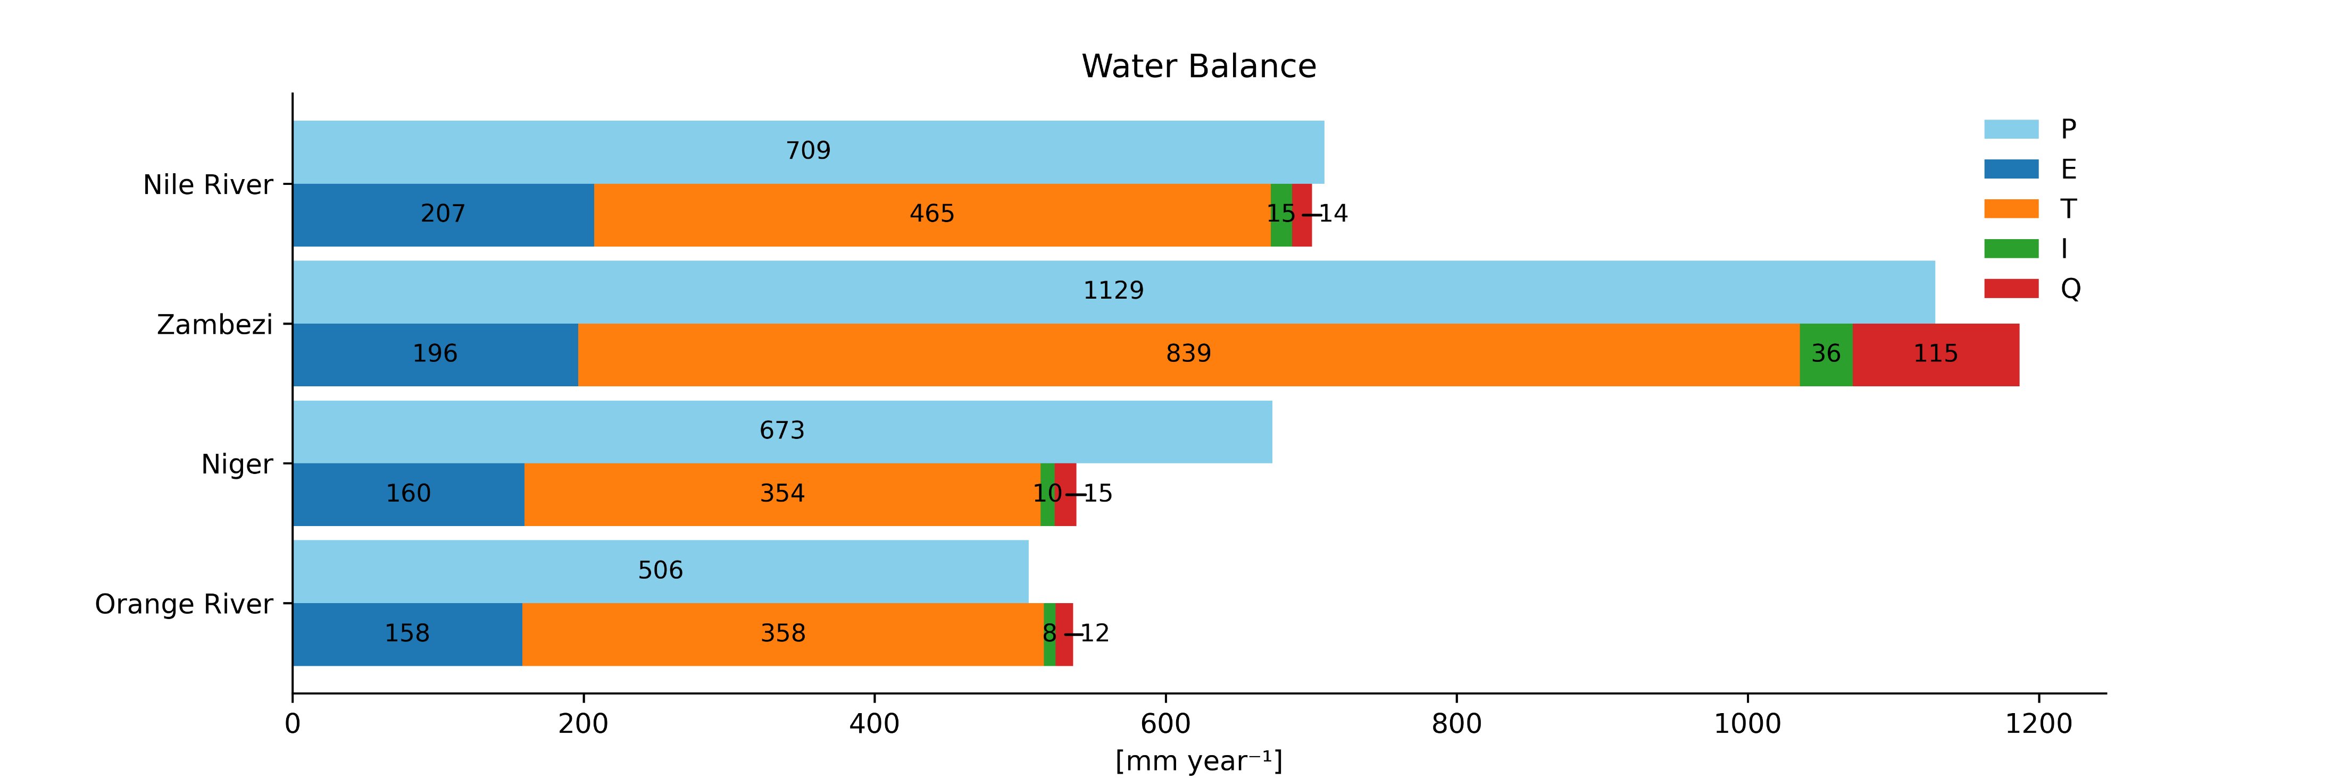
Water Balance Closure
Water Balance Equation:
Precipitation (P) = Evaporation (E) + Transpiration (T) + Interception (I) + Discharge (Q)
Assessment for four African catchments
On average -1.8% difference between P and sum of E, T, I and Q
Meaning: ETLook is capable of accurately estimating the ETI at catchment level, the model has no systematic bias that results in an unclosed water balance. The individual accuracy of E, T, and I is still unknown.

Slide 17
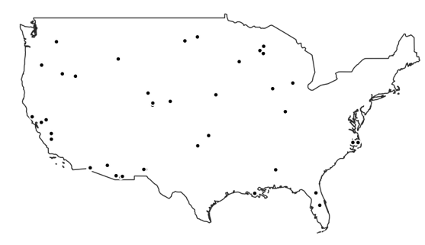
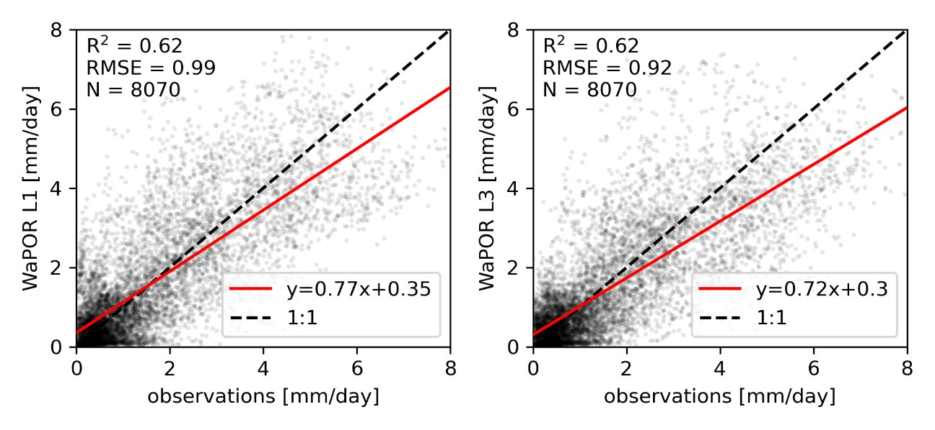
Validation
Validation with EC-data in the USA​
Daily data​
Good consistency between L1 and L3 in general

Slide 18
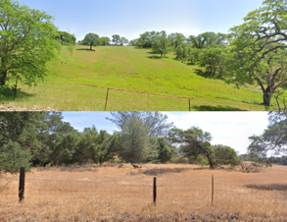
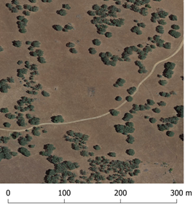
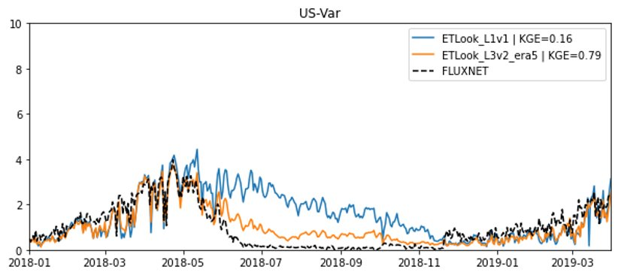
Validation – L1 vs L3
Spring​
Summer

Slide 19
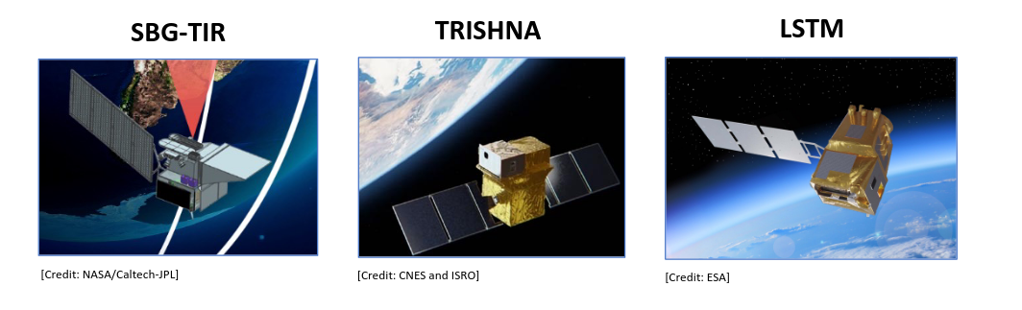
Future outlook
New high resolution sensors on the horizon (open data)
Observations instead of artificial sharpened data for L2 and L3
Sensor | Resolution | Revisit time | Launch date
SGB-TIR TRISHNA LSTM | 60 m 60 m 50 m | 3 days 3 days 4 days | 2029 2026 2028 - 2030

Slide 20
LST is integral part of the WaPOR data pipeline
In the past resampled LST caused issues
Currently thermal sharpening is used to provide high resolution LST
Future versions will incorporate next generation high resolution LST open-source data
Contact:
henk.pelgrum@eleaf.com
Wapor Database:
https://data.apps.fao.org/wapor/

