Slide 1
Intercomparison of SEVIRI Land Surface Temperature with ERA5 reanalysis over Africa
By Riccardo Monfardini
Supervisors: Claire Bulgin, Sara Dance, Patricia de Rosnay, David Fairbairn
Notes:
Morning all, I am Riccardo Monfardini
PHD student at University of Reading, and my superviors are Bulgin, Dance, De Rosnay and Fairbairn.
And today I will present some of the results of our analysis comparing SEVIRI retrieved LST with ECMWF reanalysis

Slide 2
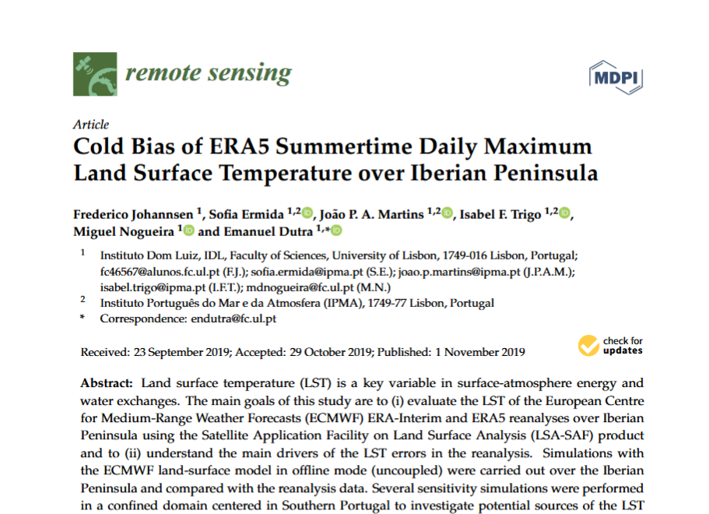
Aim and sources
Aim:
To use high frequency LST retrievals from geostationary satellites to assess diurnal discrepancies with ERA5 skin temperature
Motivation:
Extending work done by Johannsen et al, and
preparatory work for future data assimilation of LST in Numerical Weather Models

Slide 3
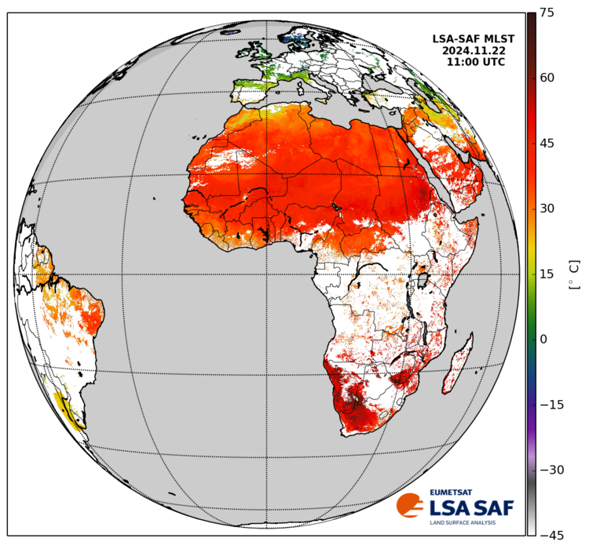
Data Sources
LST retrieval
ERA5
SEVIRI MSG data from
Land Surface Analysis of the Satellite Application Facility
Resolution: 0.05°
Frequency: 15 min
Land Surface Temperature (LST):
The radiative skin temperature over land of the first ~50μm.
The infrared retrieval needs cloud free skies
Reanalysis data from ECMWF, that “blends” model and observations to get a “map without gaps” of the past
Resolution: 0.25°
Frequency: 1 hour
Skin temperature (skt):
the uppermost surface layer (over ground, snow, vegetation canopy) with no thickness
Notes:
Mention that you use hourly data

Slide 4
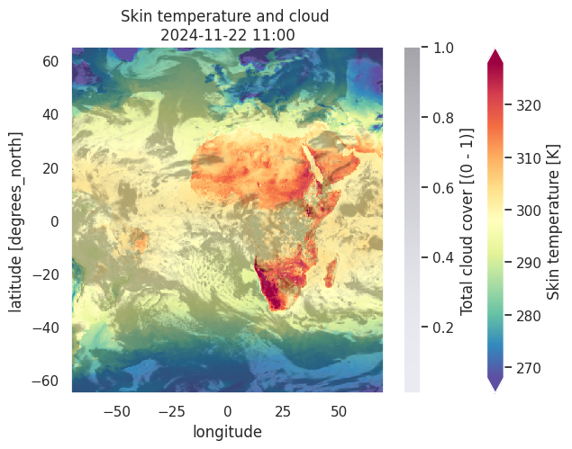
Data Sources
LST retrieval
ERA5
SEVIRI MSG data from
Land Surface Analysis of the Satellite Application Facility
Resolution: 0.05°
Frequency: 15 min
Land Surface Temperature (LST):
The radiative skin temperature over land of the first ~50μm.
The infrared retrieval needs cloud free skies
Reanalysis data from ECMWF, that “blends” model and observations to get a “map without gaps” of the past
Resolution: 0.25°
Frequency: 1 hour
Skin temperature (skt):
The temperature of the uppermost surface layer (over ground, snow, vegetation canopy) with no thickness
Notes:
Describe the figure, clouds as well as skt

Slide 5
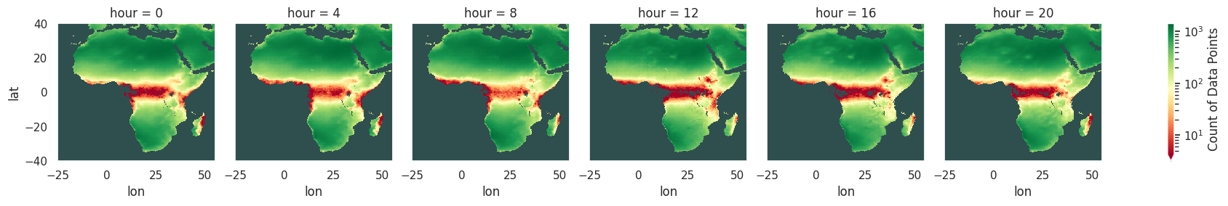
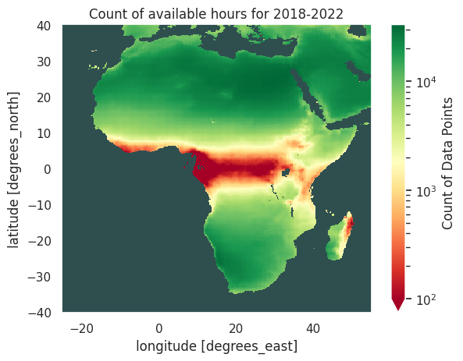
Data availability
LST data coarsen to ERA5 0.25°, taking the mean of underlying pixels
Cloud filters:
ERA5 total cloud cover < 0.01
valid fraction of LST pixels in coarser resolution > 0.99
Notes:
Take your time to explain the figure
5 years data = 43,824 hours + 4.3 x10^4

Slide 6
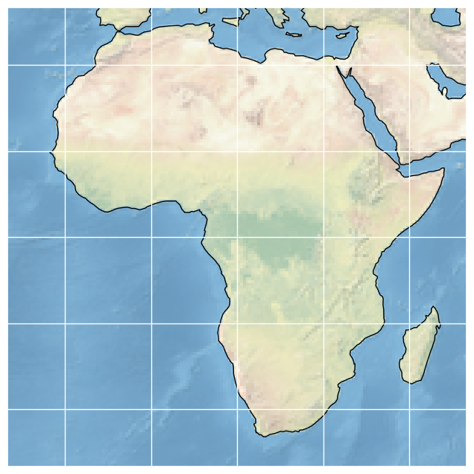
ERA5 skt vs SEVIRI retrieved LST
5 year period: 2018-2022
Grouped by hour, corrected for local solar time
African domain
40N
25W
55E
40S

Slide 7
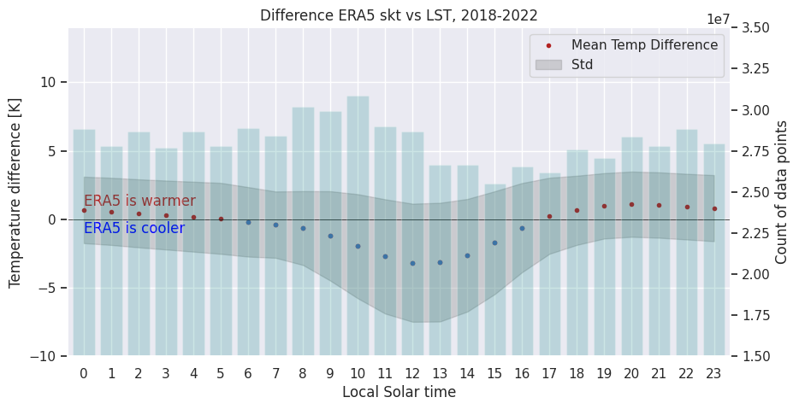
ERA5 skt vs SEVIRI retrieved LST
 | ERA5
Daytime 06-17 | -1.5 ±1.0 K largest -3.2 K
Nighttime 18-05 | 0.7 ±0.7 K largest +1.1K
Full day 0-24 | -0.4 ±0.6 K largest -3.17 K
Old std | ERA5
Daytime 06-17 | -1.5 ±1.2 K largest -3.2 K
Nighttime 18-05 | 0.7 ±0.3 K largest +1.1K
Full day 0-24 | -0.4 ±1.4 K largest -3.17 K
Notes:
Take you time to explain the figure
Figure axis, bottom left and right
Mean diff and STD
Behaviour through the average day

Slide 8
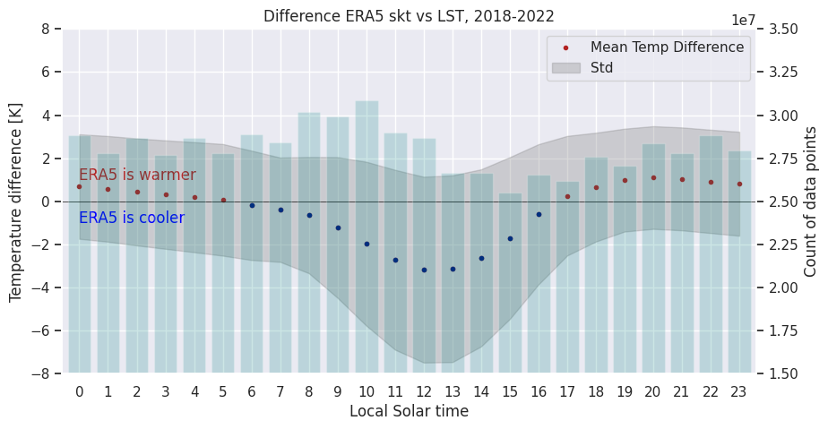
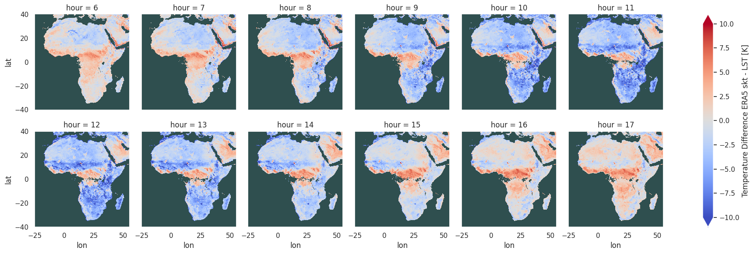
Daytime
Daytime (06-17):
-1.5 ±1.0 K
largest -3.17

Slide 9
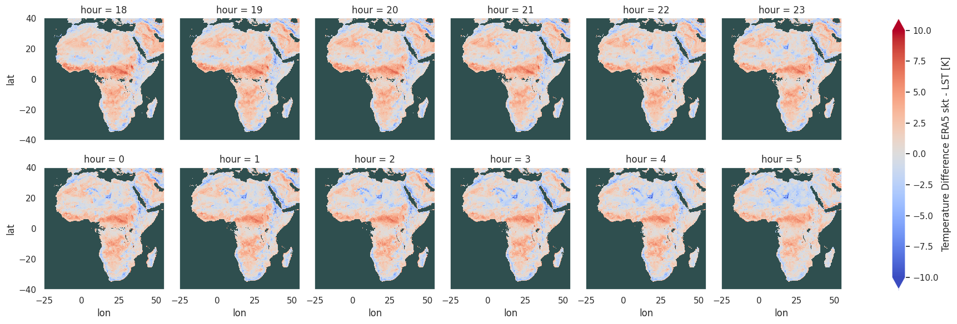
Nighttime
Nighttime (18-05):
0.7 ±0.7 K
largest 1.10 K

Slide 10
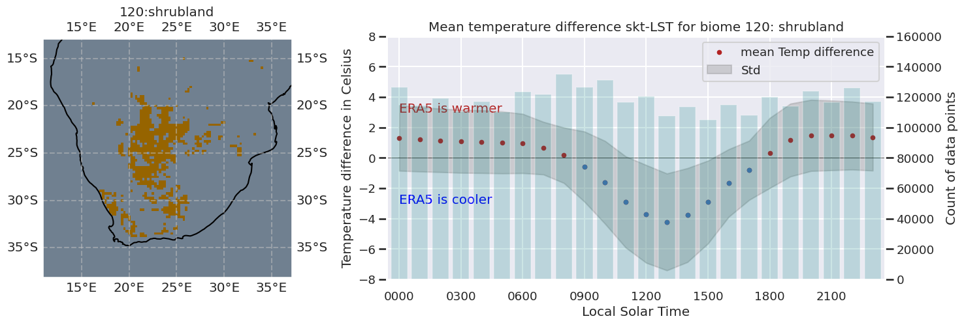
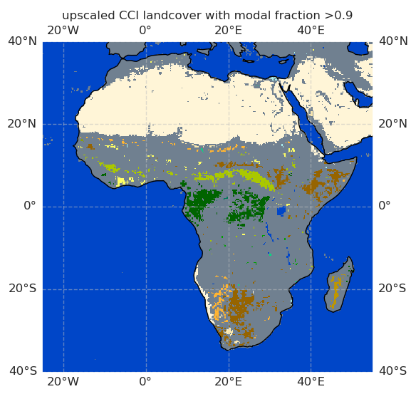
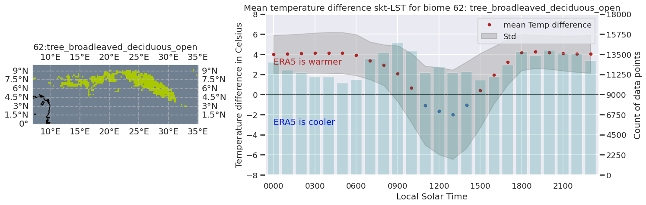
Biome specific examples with CCI Land Cover data
Year: 2020
Using CCI Land Cover data to isolate specific biome. Only considering highly homogeneous areas.
Year: 2020

Slide 11
ERA5 Land
ERA5 Land is enhanced reanalysis of the land component of ERA5.
Resolution: 0.1°
Frequency: 1 hour
Model: more modern IFS cycle 45r2 + HTESSEL
(ERA5 uses cycle 41r2)
Data assimilation: None,
but ERA5 atmospheric forcing + altitude correction

Slide 12
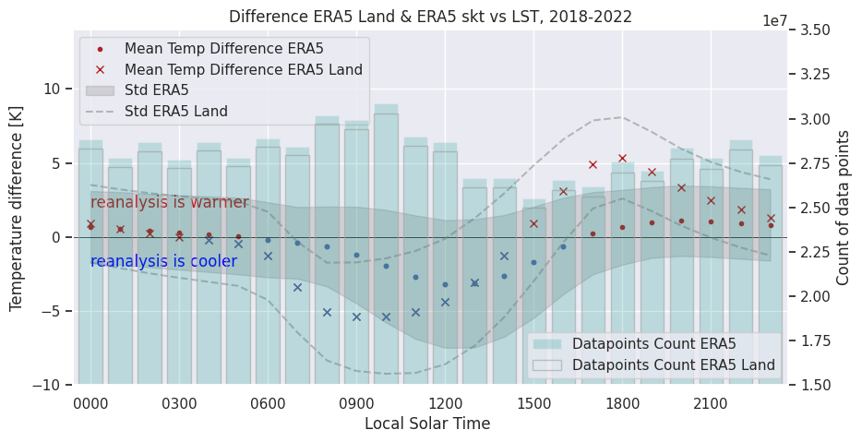
ERA5 Land skt vs SEVIRI retrieved LST
Old std | ERA5 LAND | ERA5
Daytime 06-17 | -2.1 ±3.3 K largest -5.4 | -1.5 ±1.2 K largest -3.2 K
Nighttime 18-05 | 1.7 ±1.8 K largest 5.3 | 0.7 ±0.3 K largest +1.1 K
Full day 0-24 | -0.2 ±3.3 K largest -5.4 | -0.4 ±1.4 K largest -3.7 K
Updated std | ERA5 LAND | ERA5
Daytime 06-17 | -2.1 ±1.1 K largest -5.4 | -1.5 ±1.0 K largest -3.2 K
Nighttime 18-05 | 1.7 ±0.8 K largest 5.3 | 0.7 ±0.7 K largest +1.1 K
Full day 0-24 | -0.2 ±0.7 K largest -5.4 | -0.4 ±0.6 K largest -3.17 K

Slide 13
Concluding remarks
A comparison between SEVIRI LST and ERA5 skt 2018-2022
ERA5 skt diurnal range is too limited in clear skies
  Small warm bias during nighttime
  Large cold bias during daytime hours
This bias is strongly influenced by location/biome
ERA5 Land higher resolution still has bias, shifted by lack of data assimilation

Slide 14
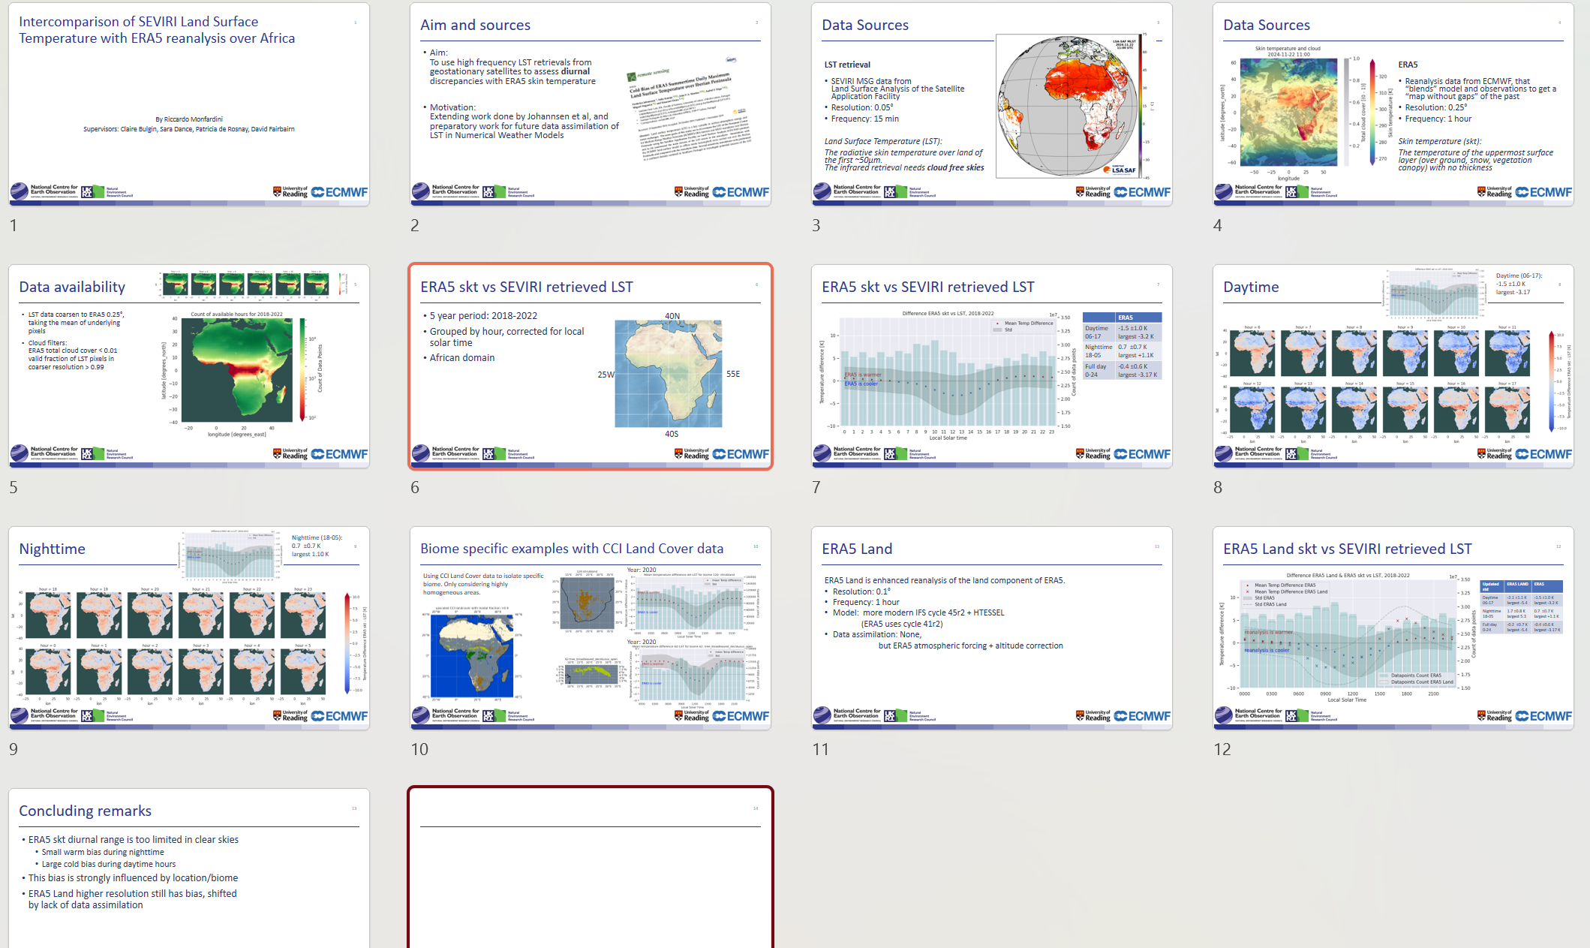
Thank you & questions welcome

