Slide 1
Long-term Trends of Land Surface Temperature over Europe derived from a daytime normalized AVHRR Time Series
Philipp Reiners

Slide 2
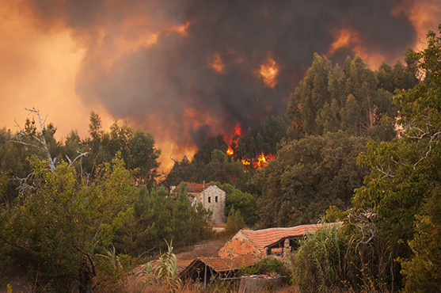
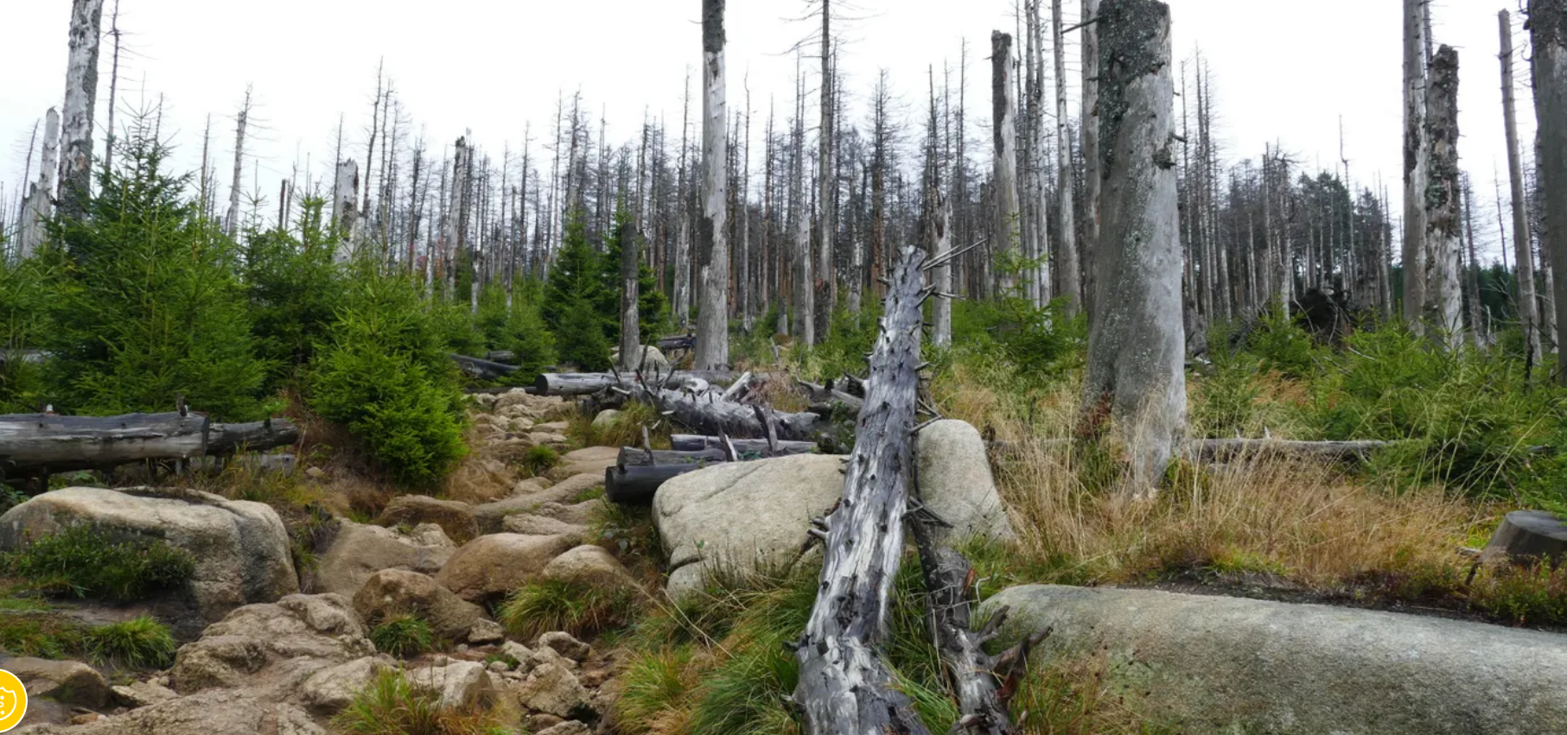
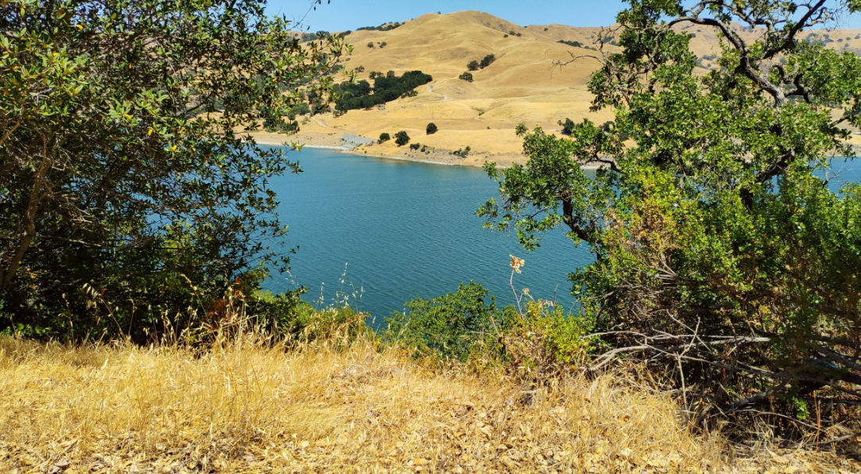
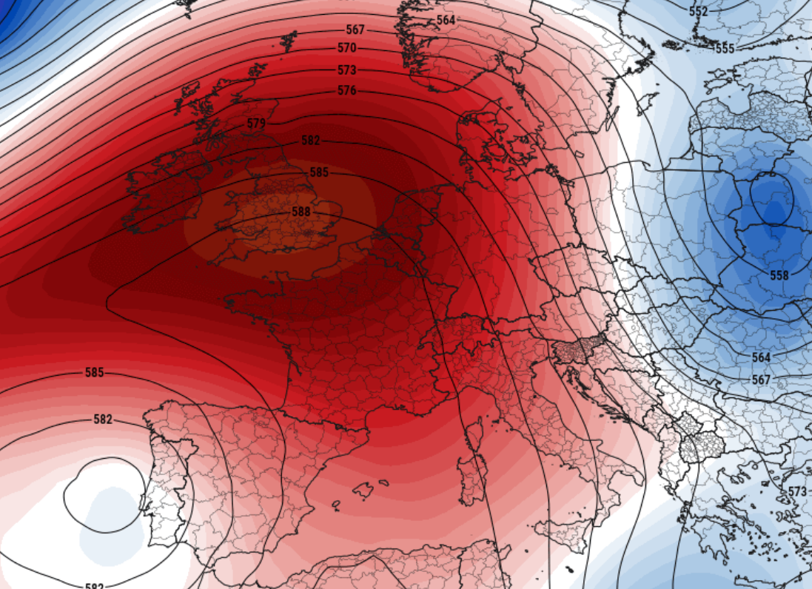
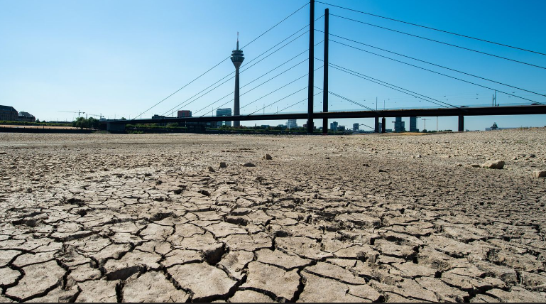
Climate Change is a serious Threat to Europe...

Slide 3
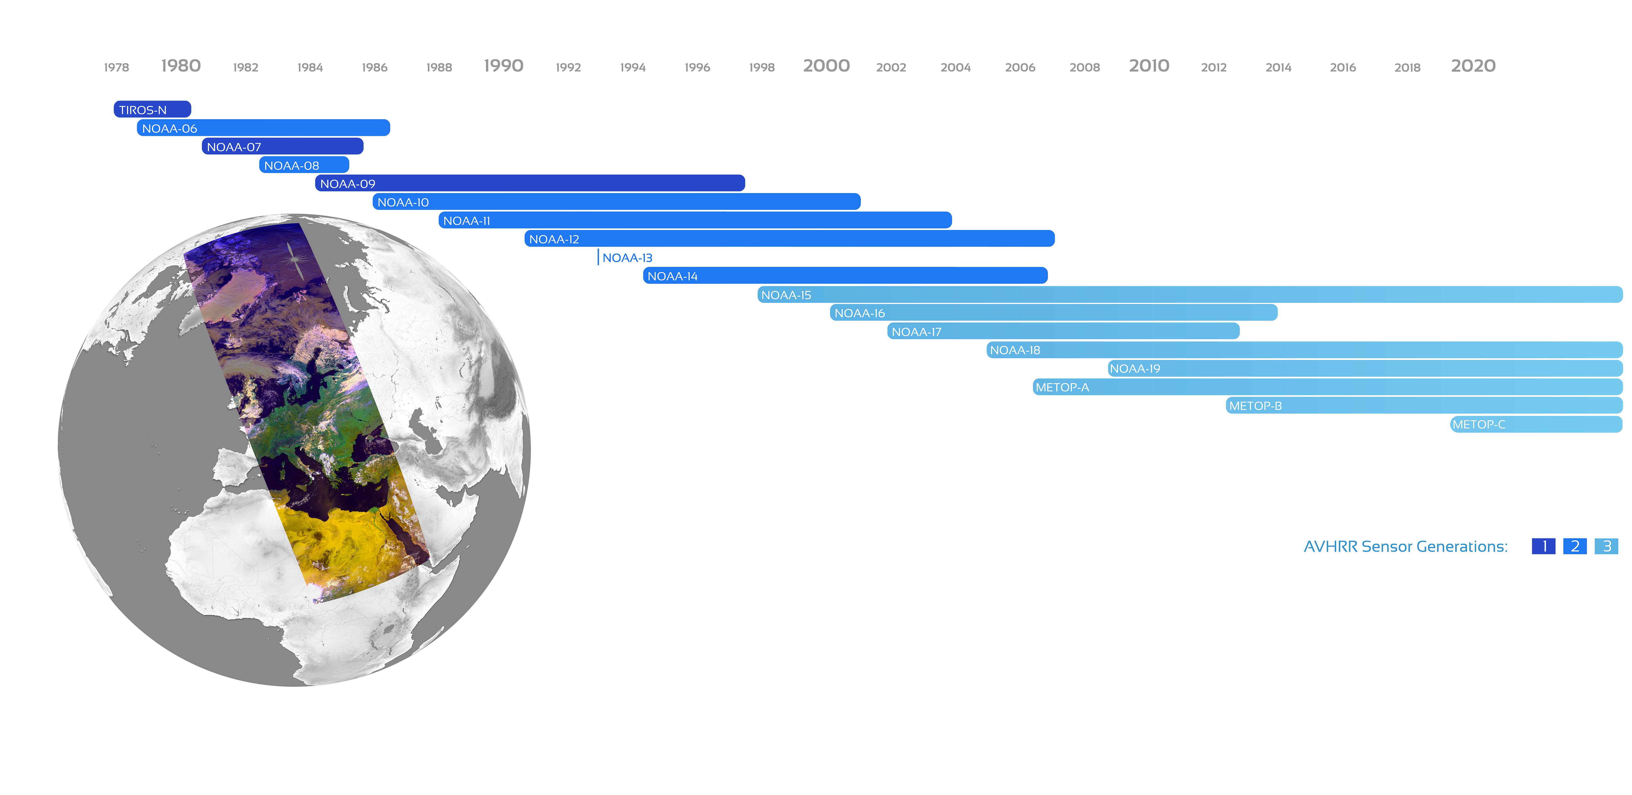
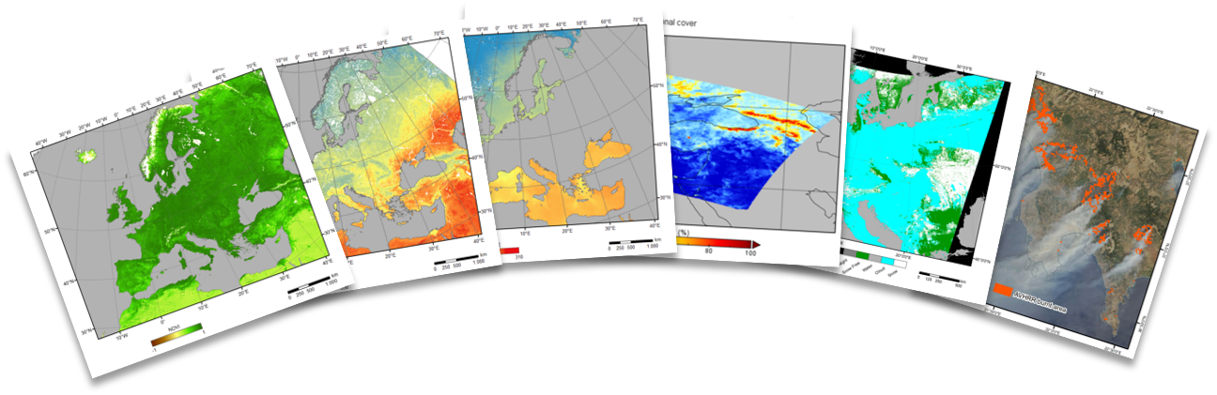

The TIMELINE Project – Geophysical Products over Europe from ~40 Years of AVHRR Data
Sensors: AVHRR-1 (4 Channels), AVHRR-2 (5 Channels) & AVHRR-3 (6 Channels) onboard NOAA 7 - 19 [integrated] and MetOp-A, -B, & -C [being integrated]
Resolution: 1 km (LAC + HRTP data)
Coverage: Europe and North Africa

Slide 4
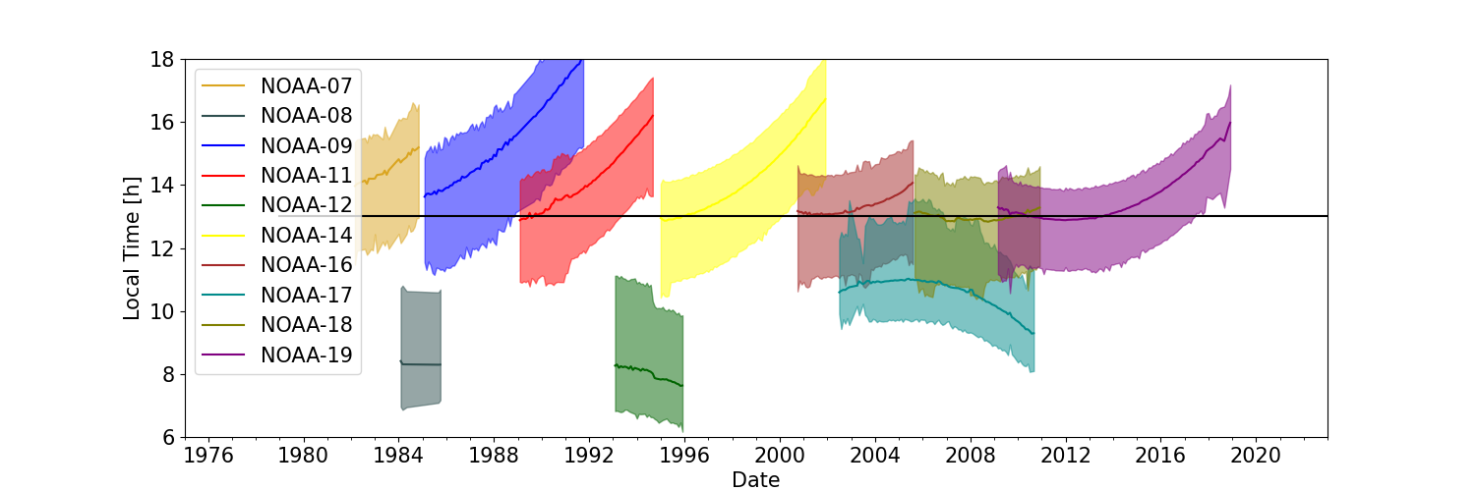
Challenge for LST Time Series: AVHRR Orbit Drift
AVHRR observation times over Europe
Notes:
Normalize the overpasses to daily maximum (13h) and minimum (3h) LST

Slide 5
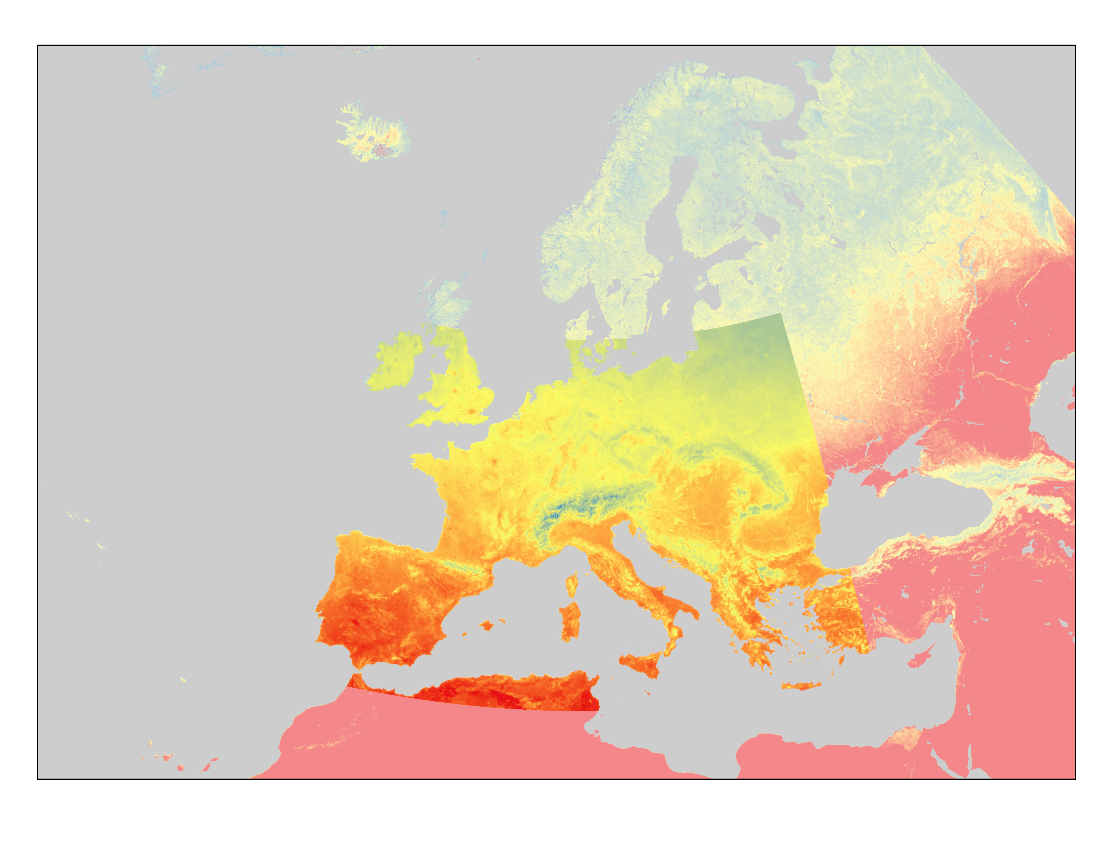

Fusion of SEVIRI continuous LST with AVHRR LST
$$∆LST1={LST}_{SEVIRI} \left(13h, doy\right)−LSTSEVIRI \left(t1, doy\right)$$
$$∆LST2={LST}_{SEVIRI}\left(13h, doy\right)−{LST}_{SEVIRI}\left(t2, doy\right)$$
$$∆LST=∆LST1+\left(t−t1\right) ∗ \frac{∆LST2−∆LST1}{t2−t1}$$
$$LSTAVHRR\left(13h\right)=LSTAVHRR\left(t\right)+0.75∗∆LST$$
$LSTAVHRR\left(t\right)$ : AVHRR LST at observation time
$LSTAVHRR\left(13h\right)$ : AVHRR LST at 13h
$LSTSEVIRI \left(t1,t2\right)$ : Modelled SEVIRI LST at nearest times to t
$LSTSEVIRI \left(13h\right)$ : SEVIRI LST at 13h
doy = day of the year
Available Area for diurnal LST cycles from SEVIRI
LST model parameters derived from SEVIRI LST by Sismanidis et al (2021)
1 km resolution Dataset containing the annual LST cycle parameters (ACPs) on a pixel level for every 30 min interval of the day
Can be used to calculate gap free LST in 30 min resolution
Notes:
LST correction term was derived from the difference between the modelled LST at noon (or night) and at the respective observation time of the AVHRR pixel

Slide 6
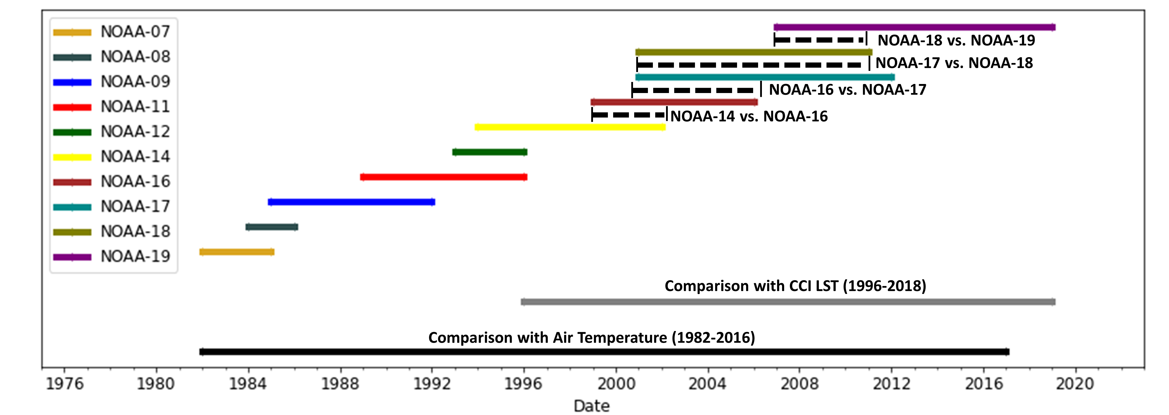
Validation of the Daytime Normalized AVHRR LST
Cross Validation with „Same Day Observations“ from different platforms
Time Series Comparison with Daily CCI LST (1996-2018)
Time Series Comparison with EUSTACE Air Temperature Data
(1982-2018)

Slide 7
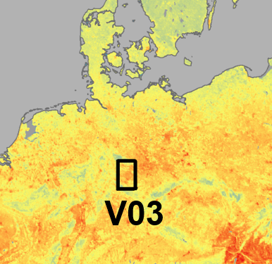
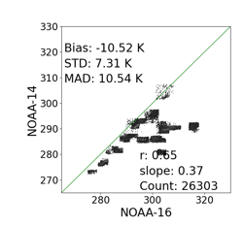
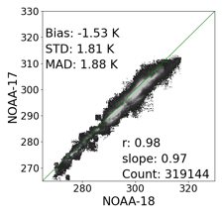
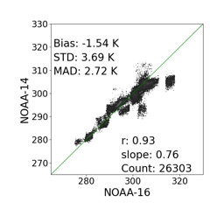
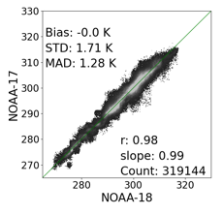
Results for the Cross Validation for Germany (V03)
Before Correction
After Correction

Slide 8
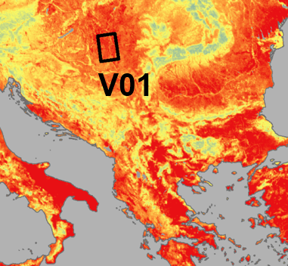
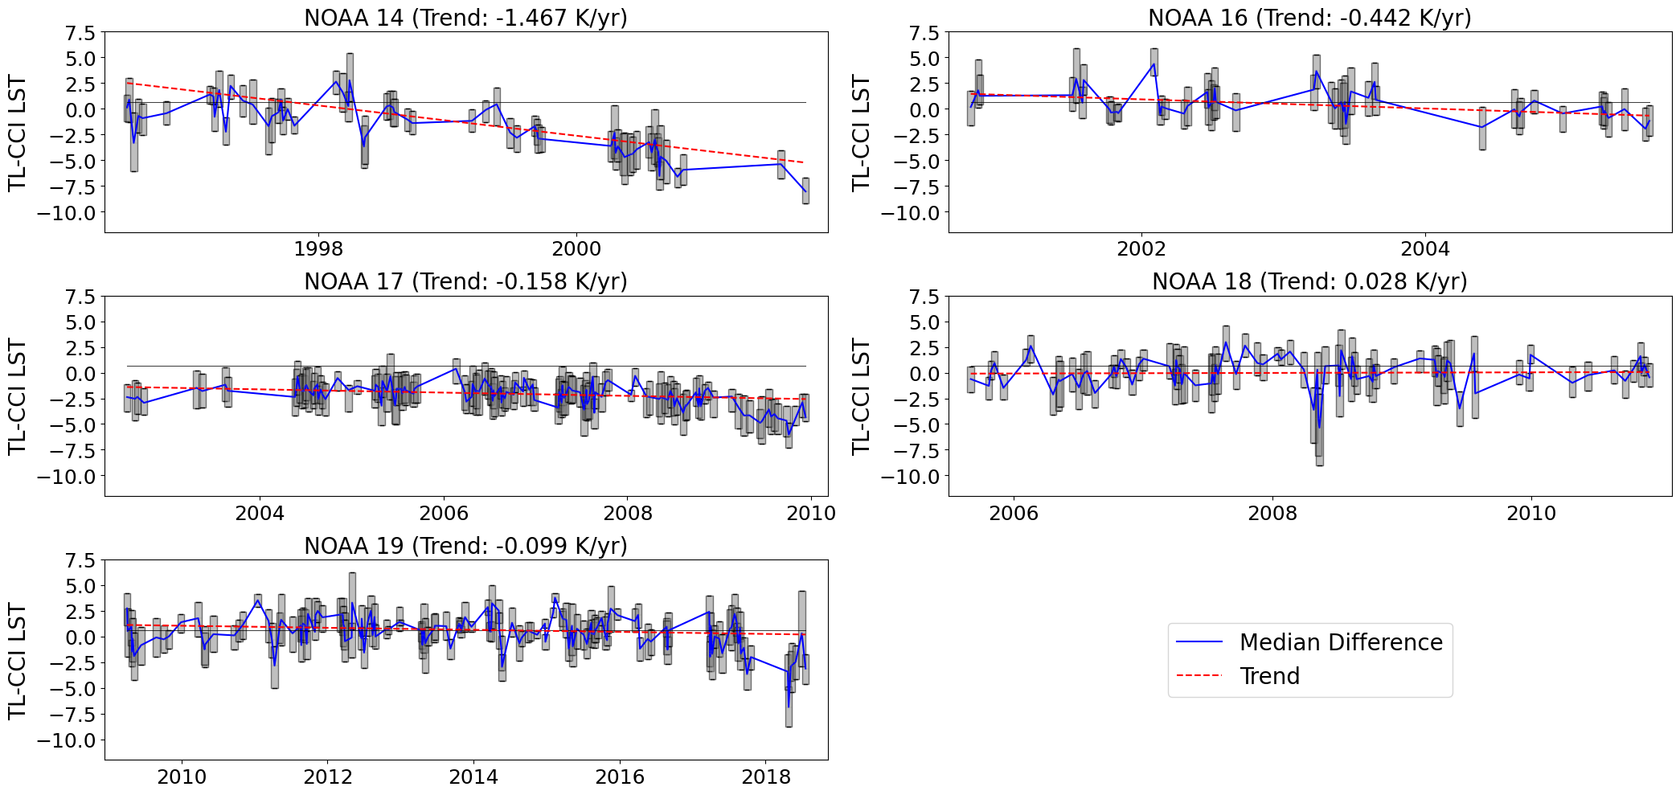
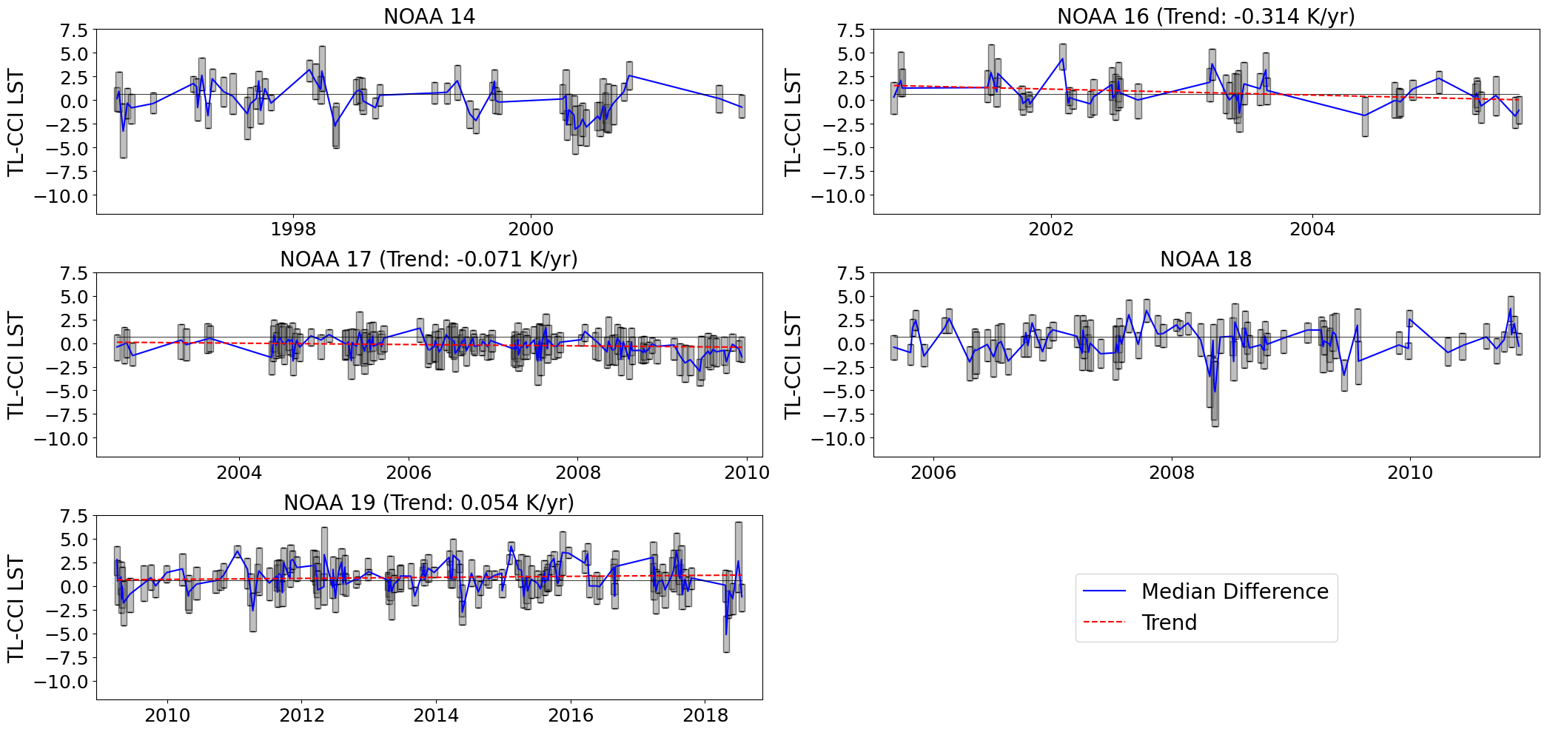
Results for the Cross Validation for the Hungarian Plane (V01)
Before Correction
After Correction
Before Correction
Platform | Bias | MAD | Trend
NOAA-14 | -2.62 | 3.61 | -1.467
NOAA-16 | -0.25 | 2.29 | -0.414
NOAA-17 | -2.9 | 3.21 | -0.156
NOAA-18 | -0.68 | 2.18 | 0.03
NOAA-19 | -0.32 | 2.07 | -0.095
Platform | Bias | MAD | Trend
NOAA-14 | -0.79 | 2.42 | 0.009
NOAA-16 | -0.01 | 2.25 | -0.296
NOAA-17 | -0.96 | 2.03 | -0.073
NOAA-18 | -0.48 | 2.23 | 0.03
NOAA-19 | 0.16 | 2.01 | 0.086

Slide 9
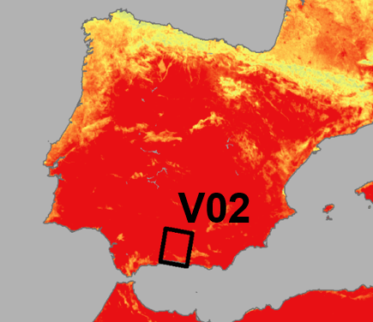
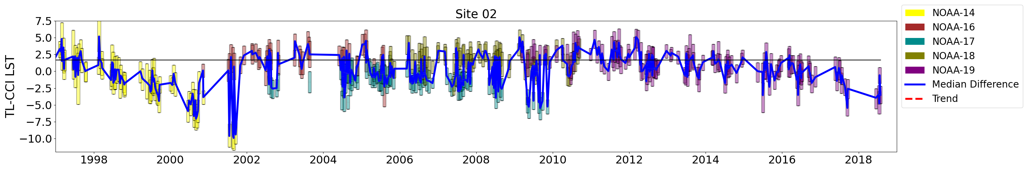
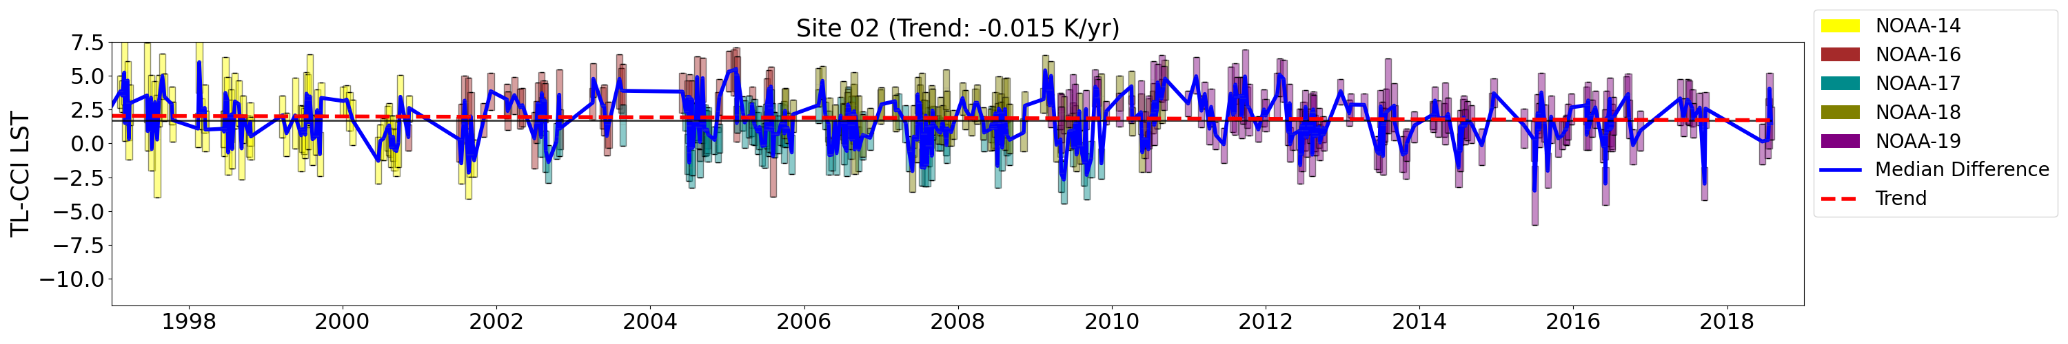
Results for the Comparison with CCI LST for Southern Spain (V02)
Before Correction
Bias | MAD | Trend
-1.39 | 2.94 | n.s.
Before Correction
After Correction
Bias | MAD | Trend
-0.11 | 2.5 | -0.016

Slide 10
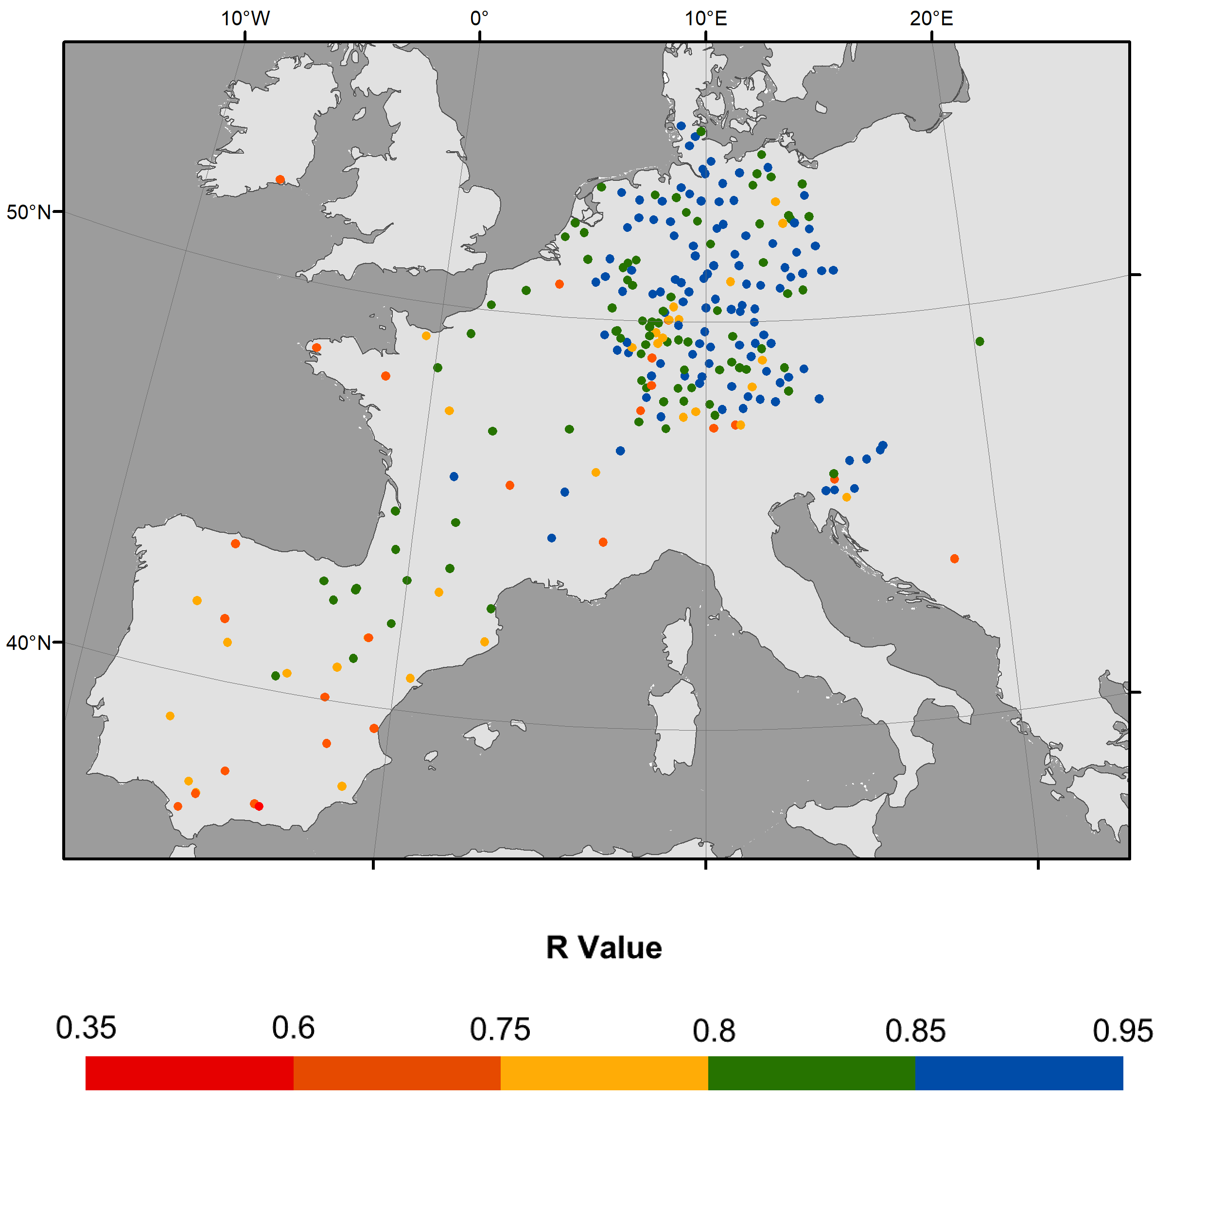
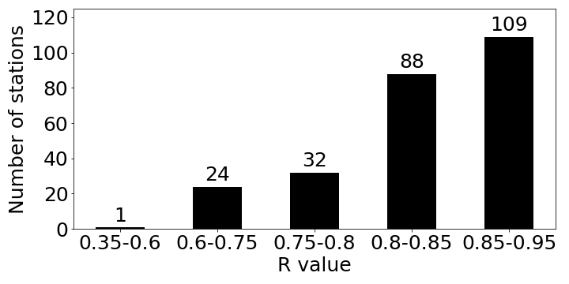
Correlation between LST and Air Temperature Anomalies (1982-2018)

Slide 11
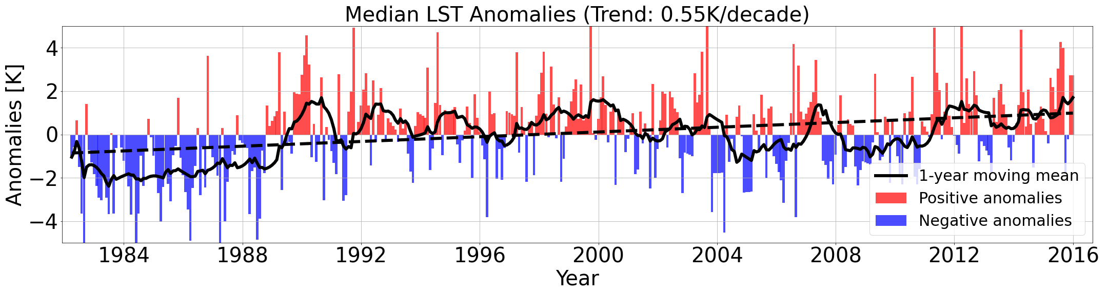
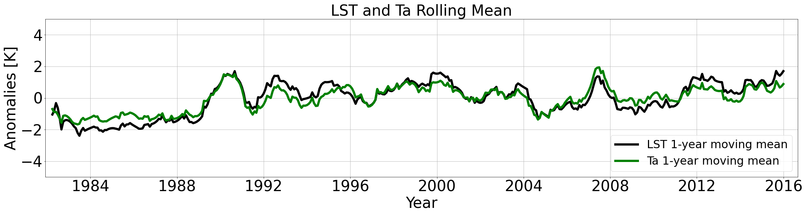
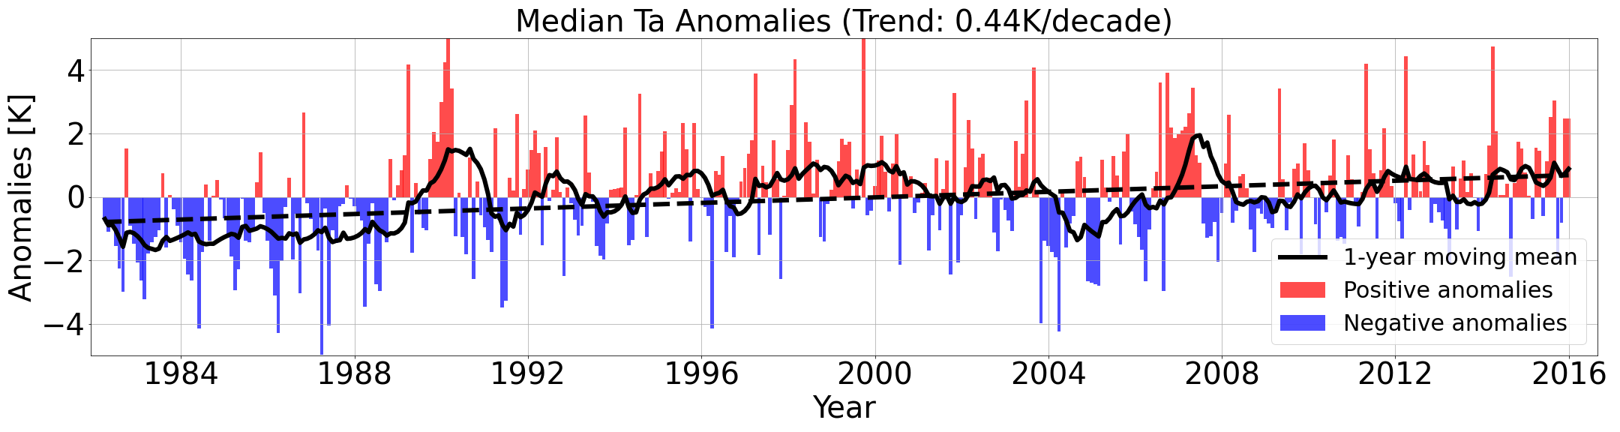
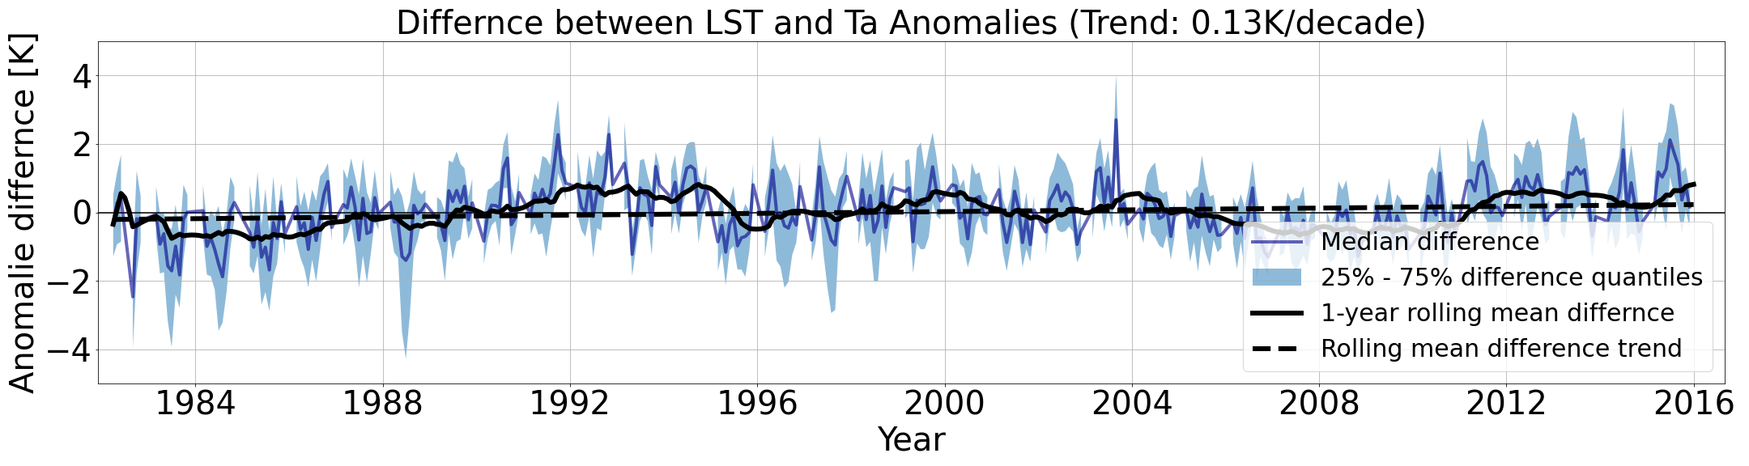
Time Series Comparison between LST and Air Temperature

Slide 12
Calculation of monthly maximum Trends (1986-2018) from TIMELINE and ERA 5 LST
Daily maximum ERA 5 LST
Calculation of monthly maximum LST
Monthly maximum TIMELINE LST
Gap Filling with Random Forest Regression
Calculation of monthly Anomalies
(Reference Period 1986-2018)
Calculation of monthly Anomalies
(Reference Period 1986-2018)
Calculation of monthly maximum LST Trends
Calculation of monthly maximum LST Trends

Slide 13
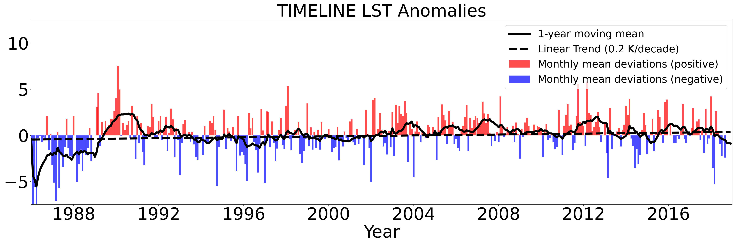
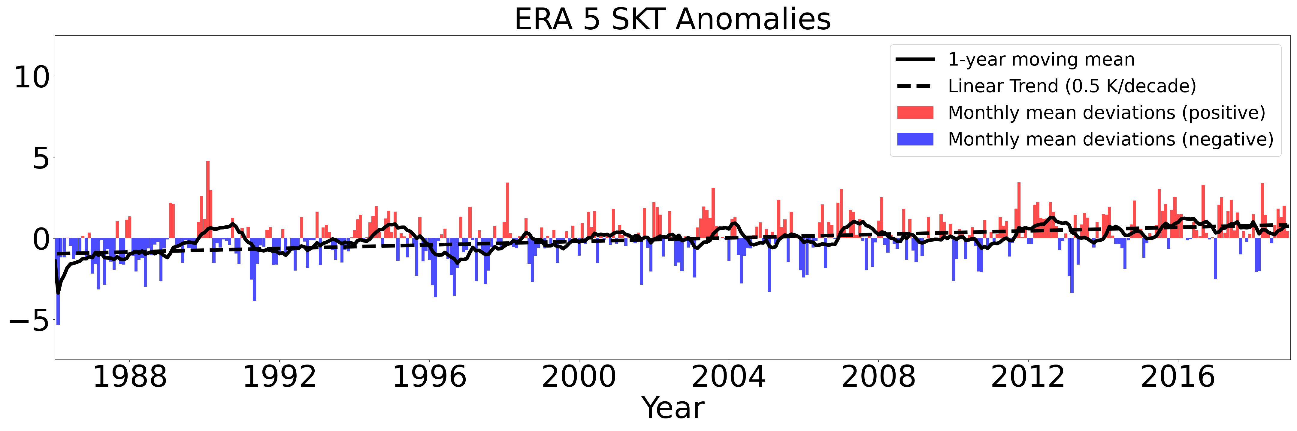
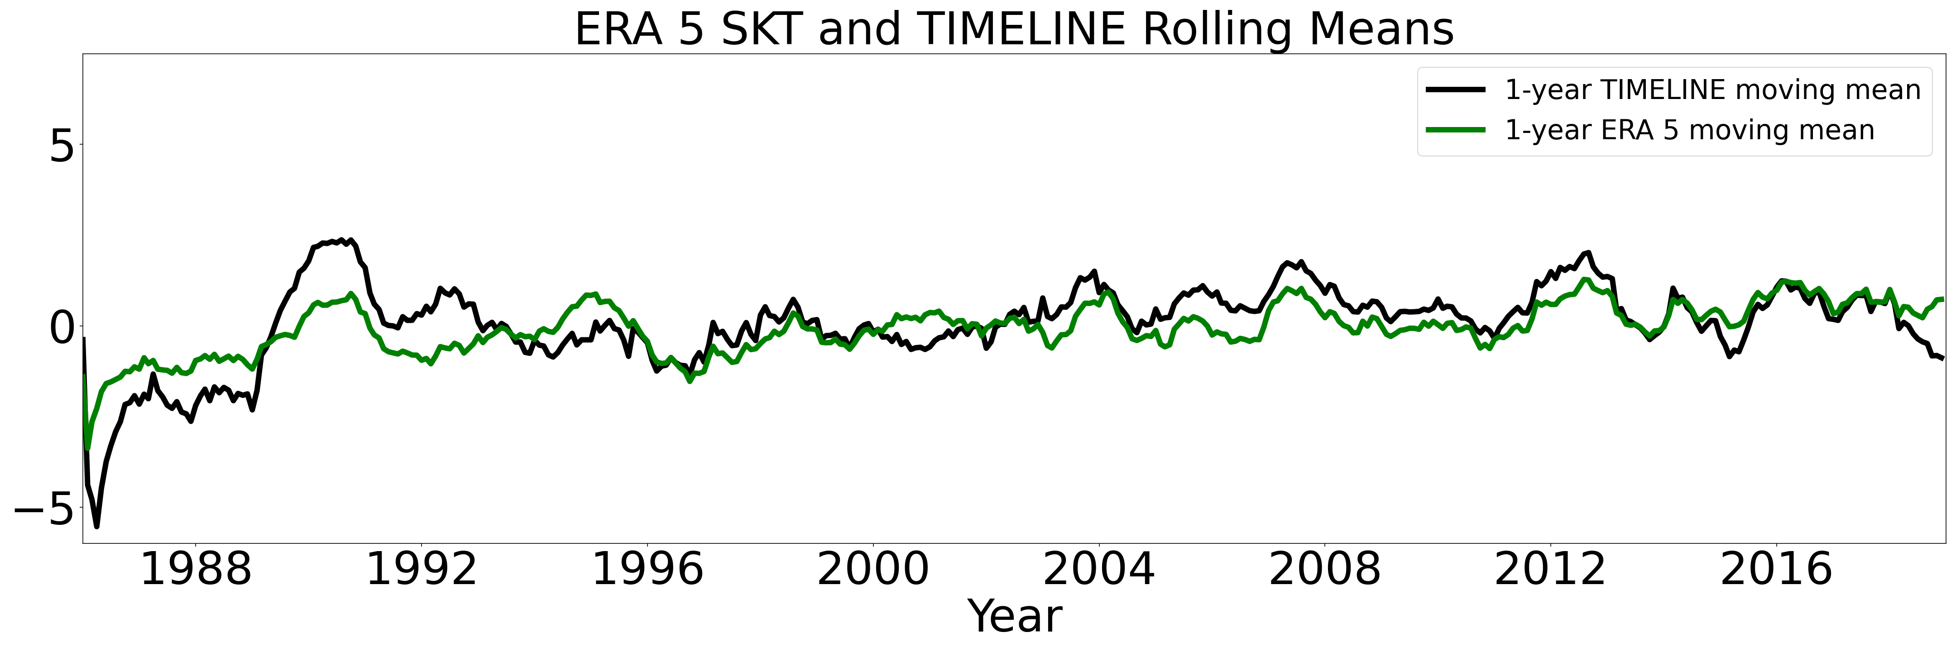
Monthly maximum LST Trends (1986-2018)
Notes:
Normalize the overpasses to daily maximum (13h) and minimum (3h) LST

Slide 14
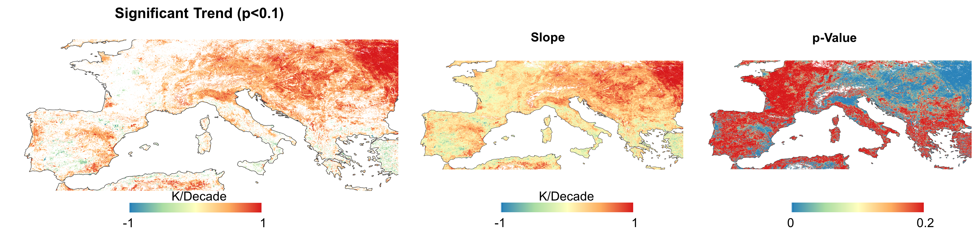
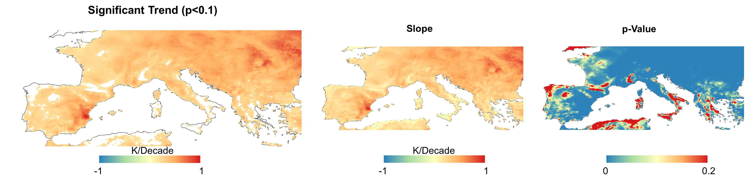
Monthly maximum LST Trends (1986-2018)
TIMELINE monthly maximum LST Trends
ERA 5 monthly maximum LST Trends
Notes:
Normalize the overpasses to daily maximum (13h) and minimum (3h) LST

Slide 15
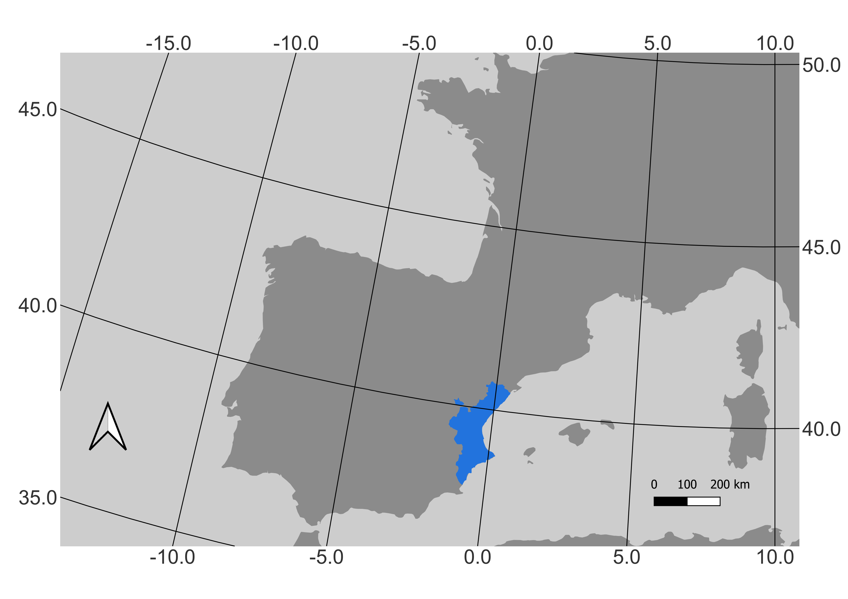
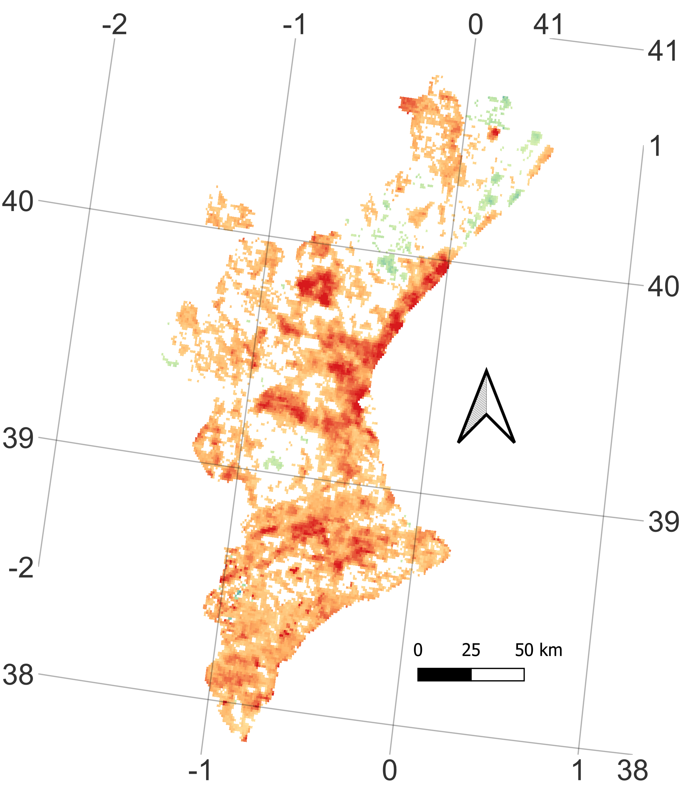
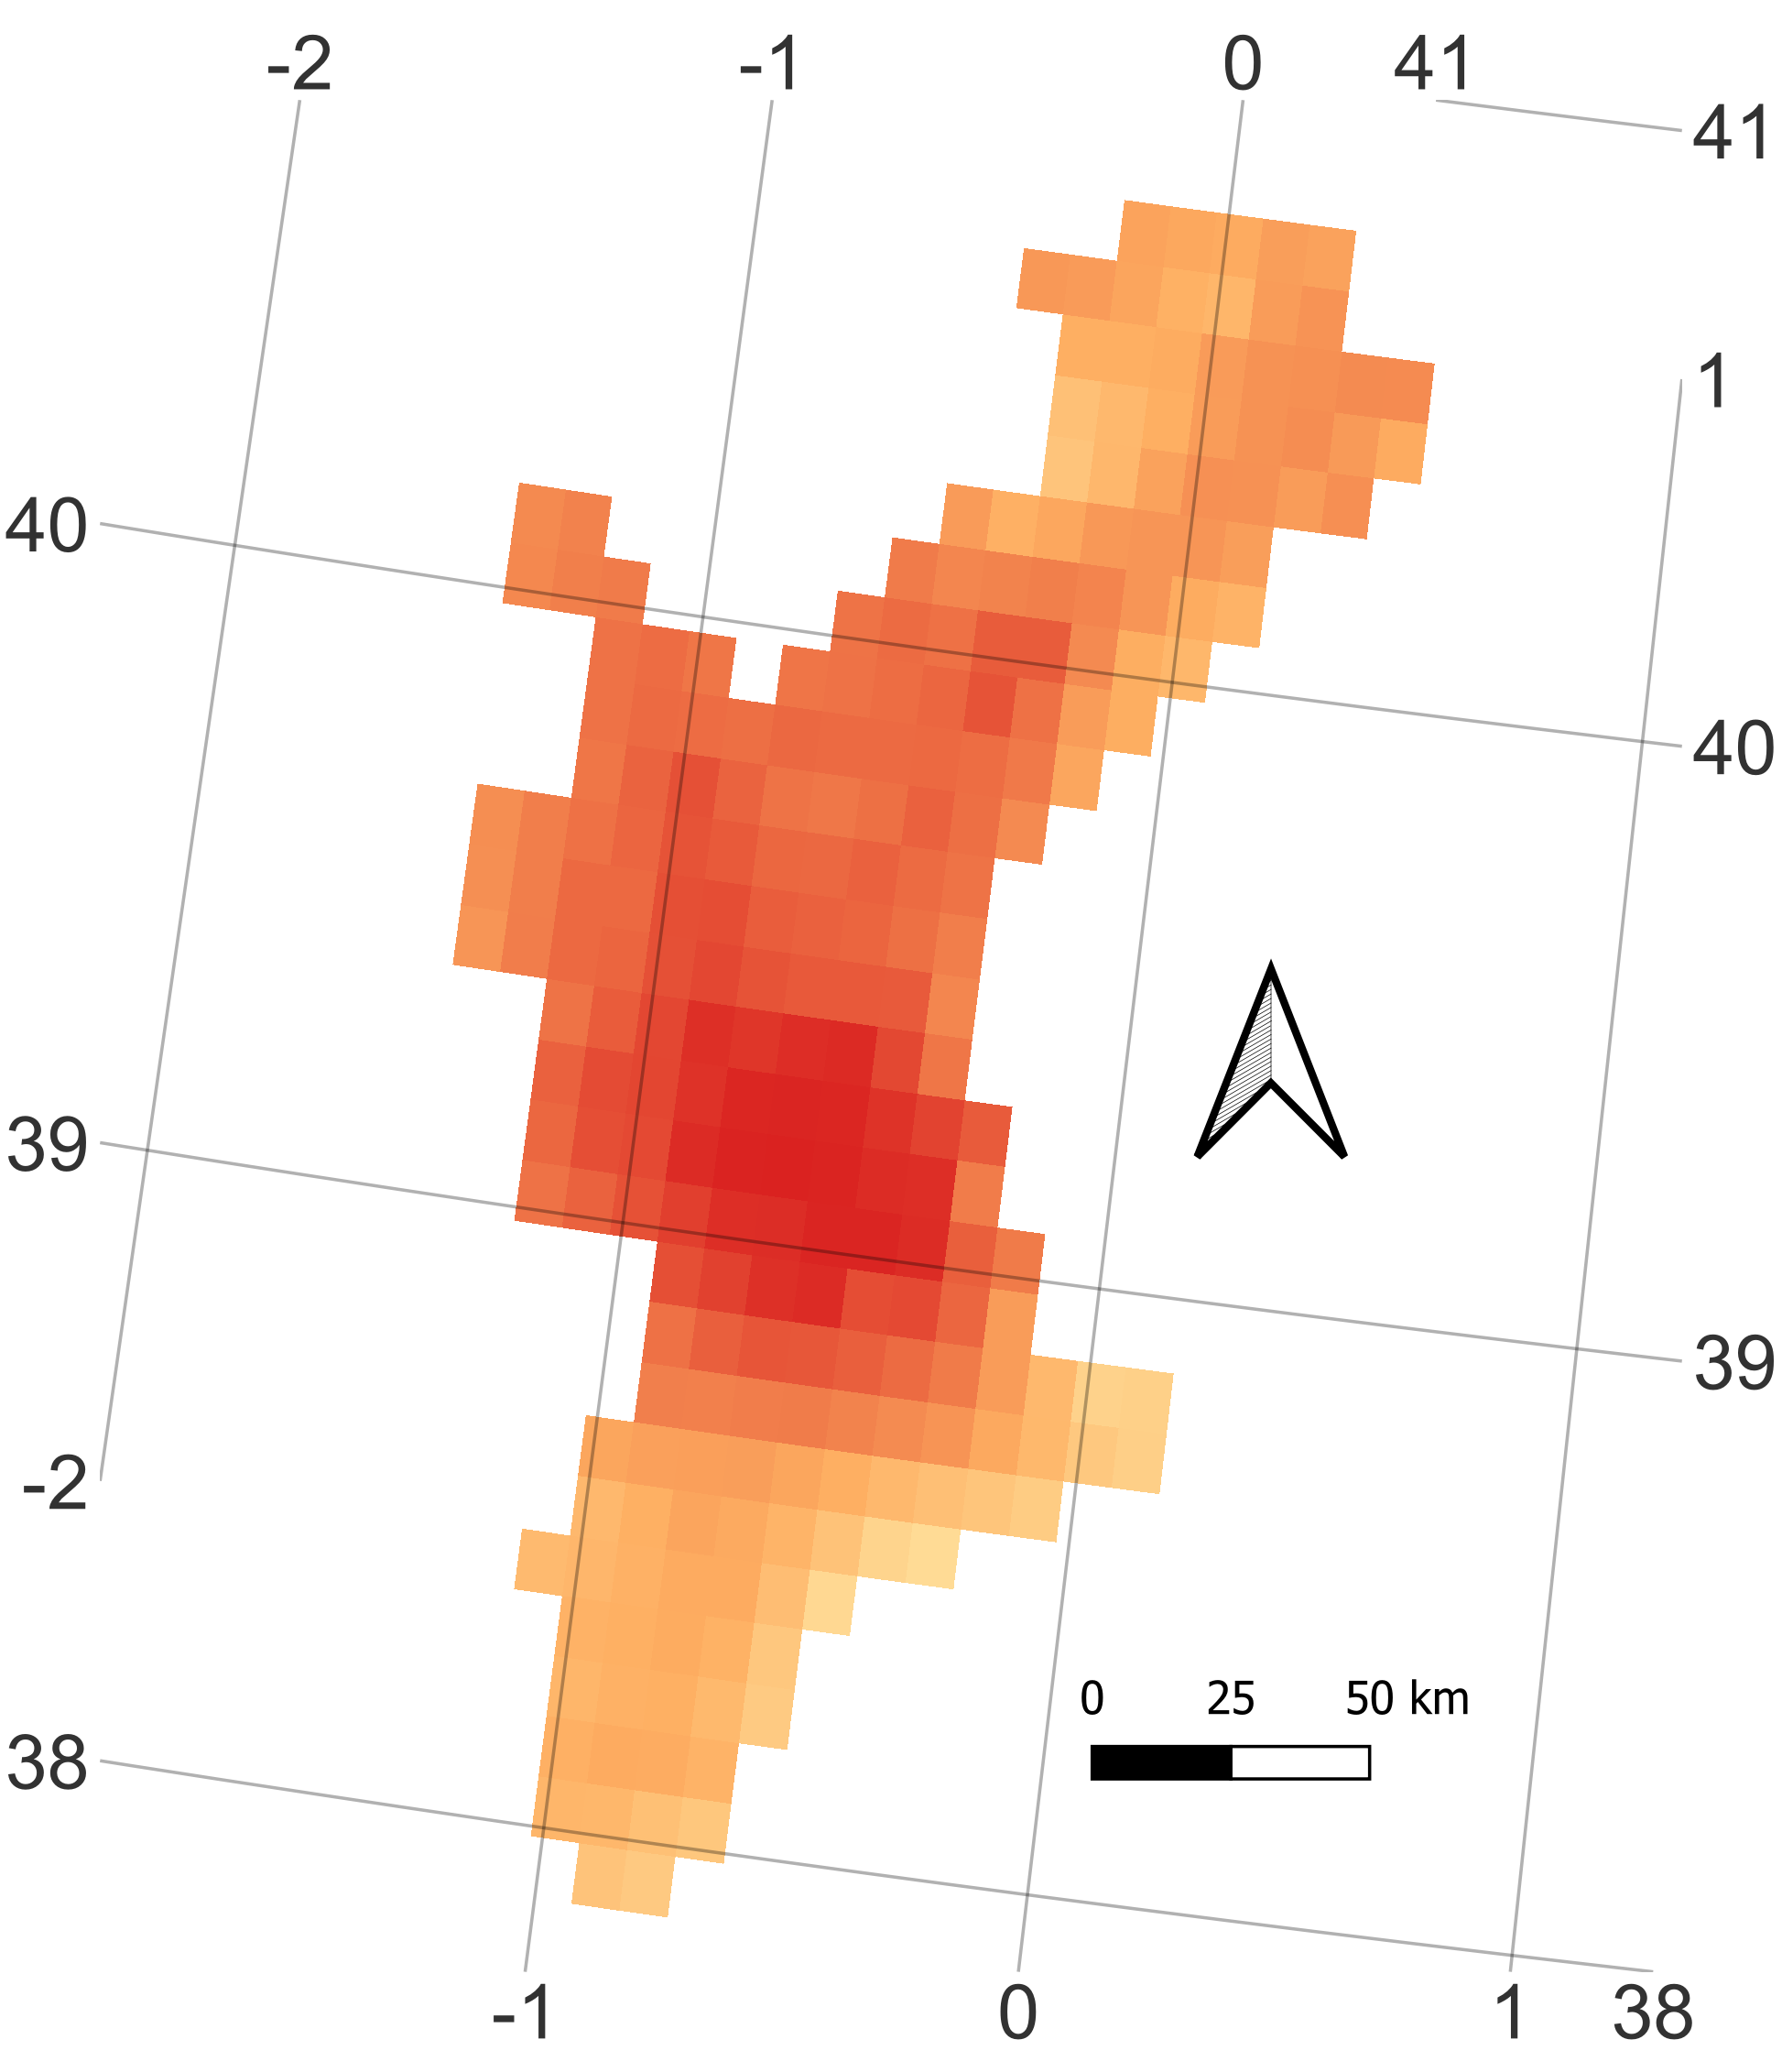
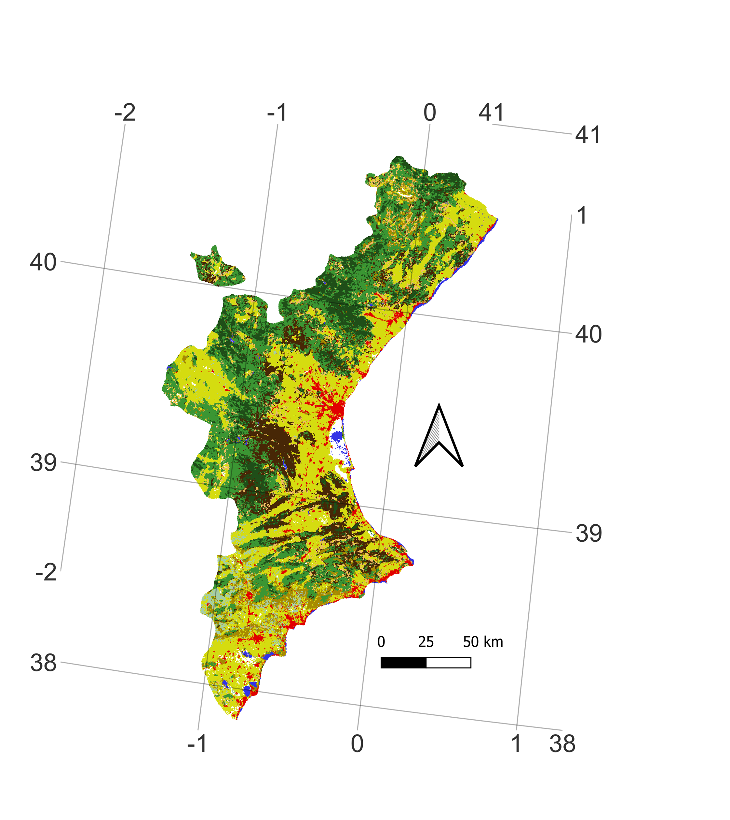
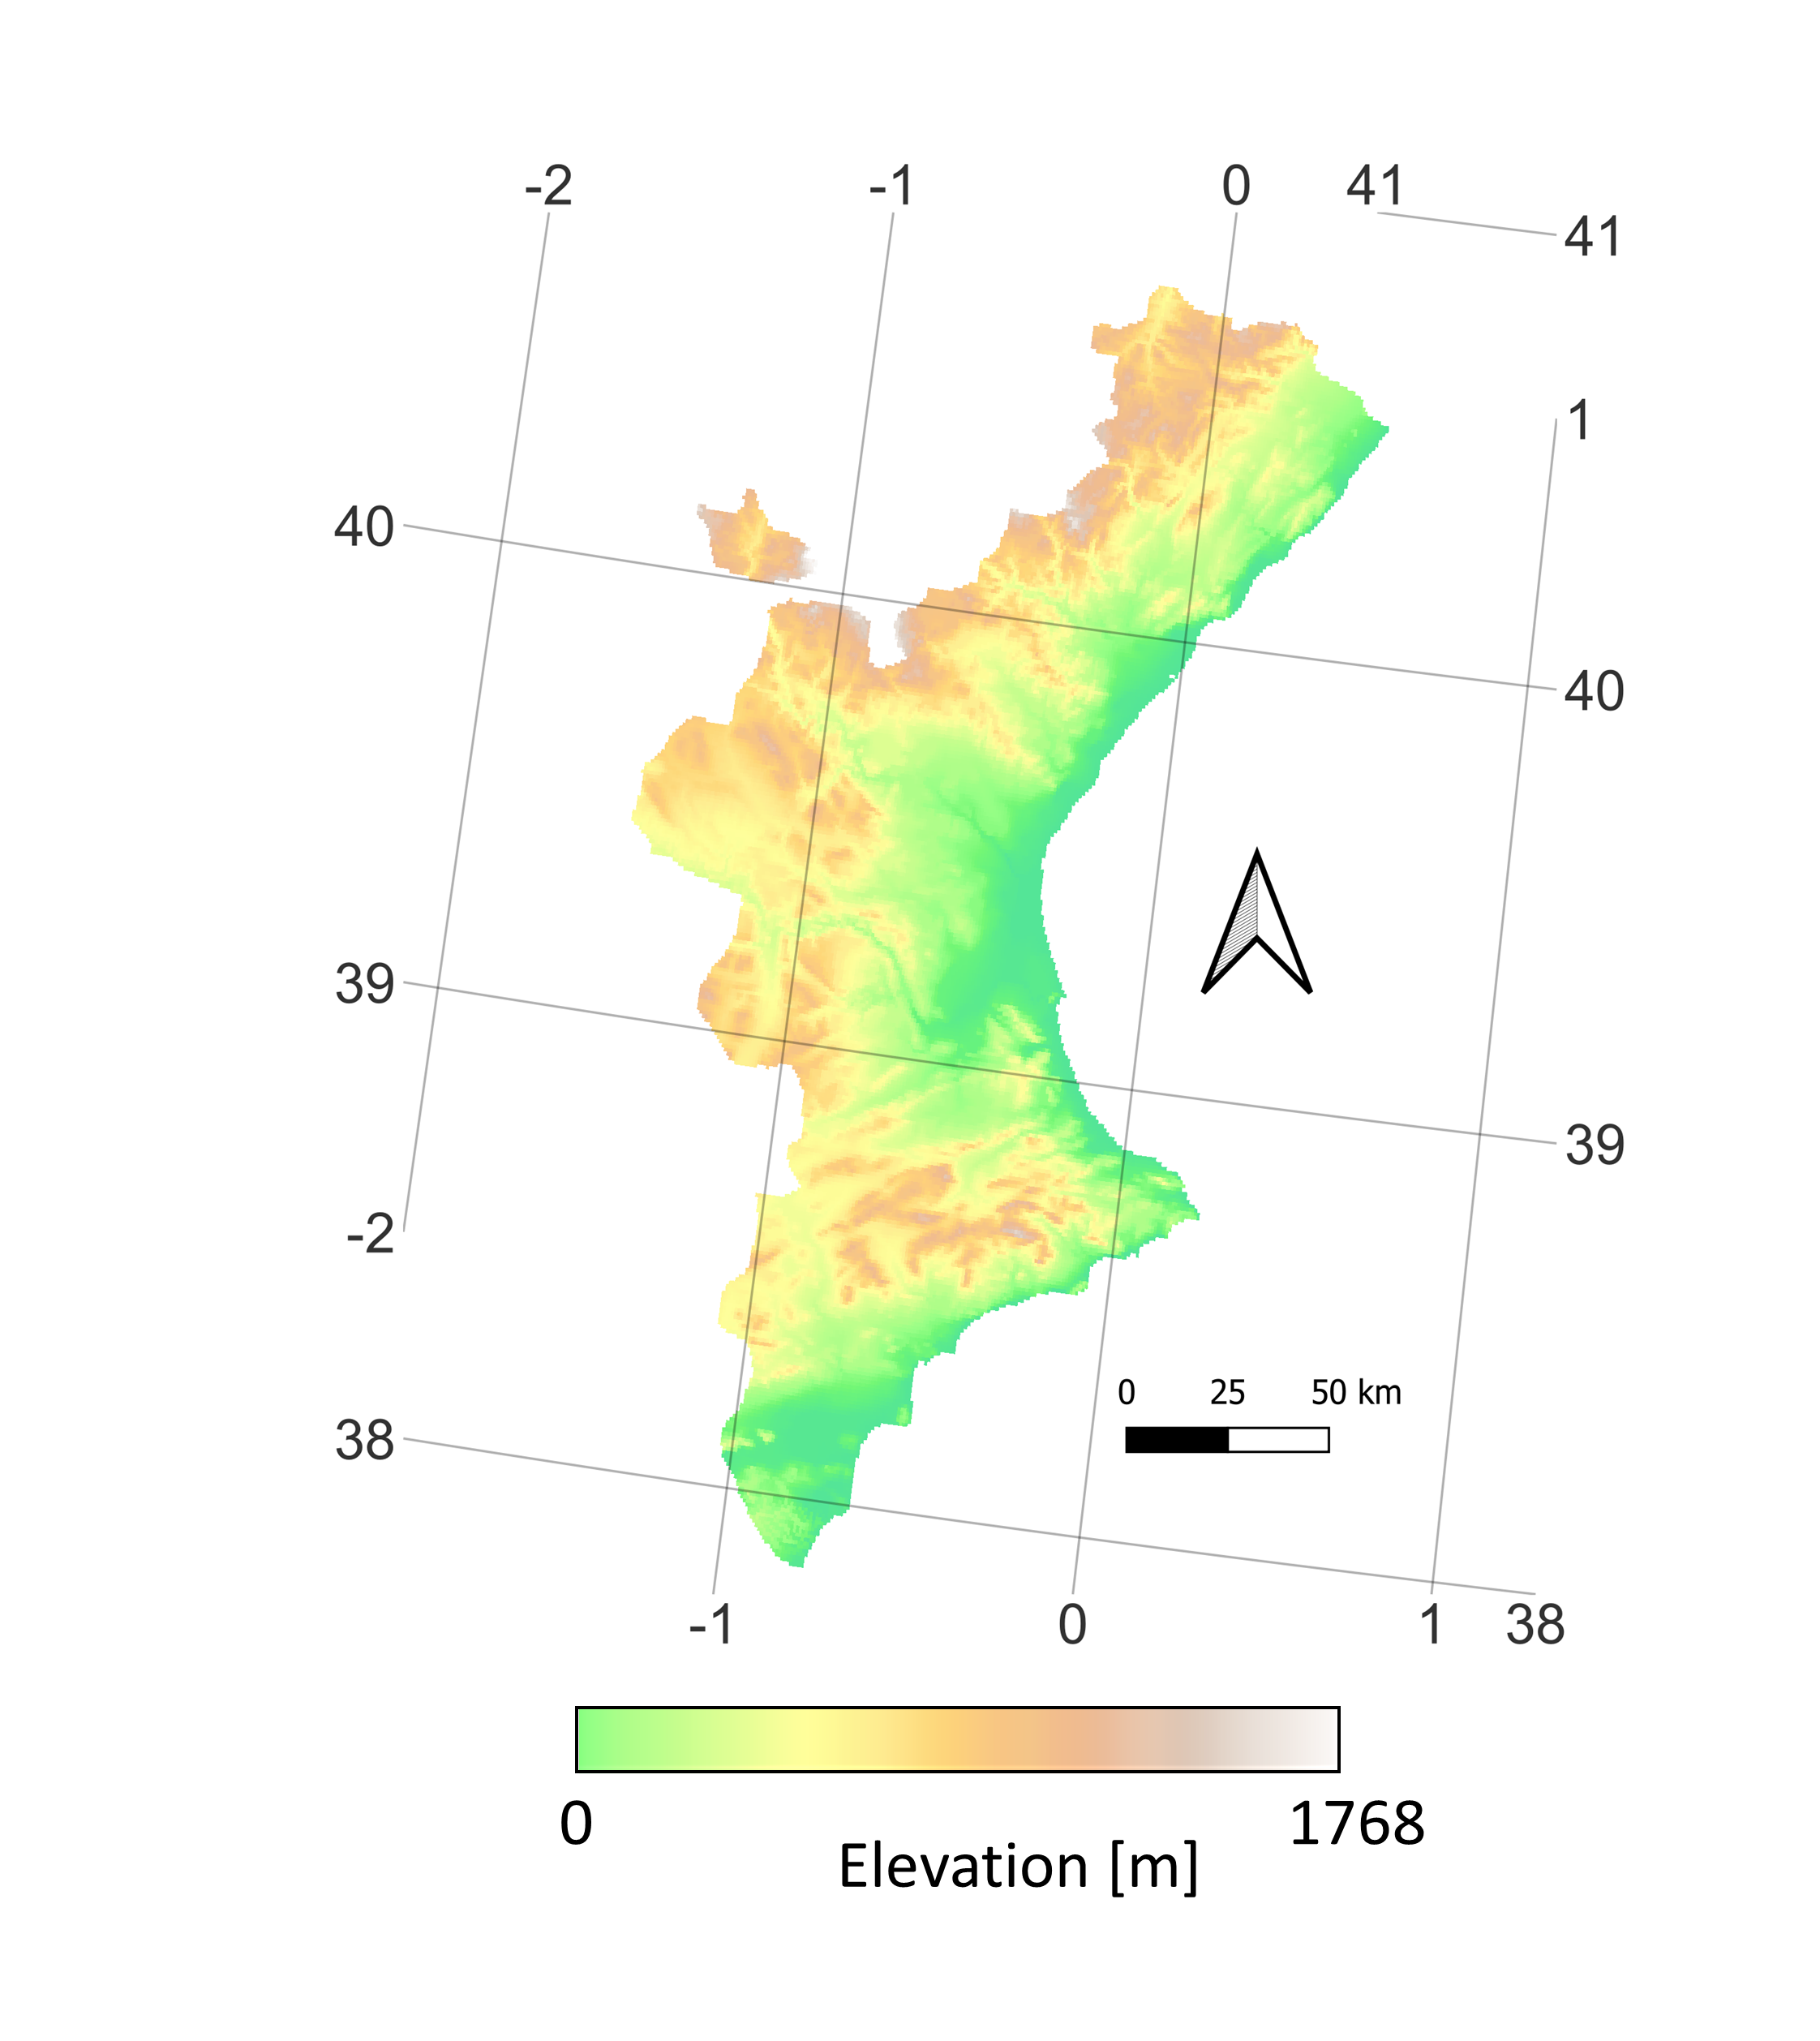
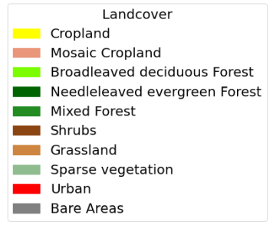
Example Study Area: Valencia Community
TIMELINE monthly maximum LST Trends
ERA 5 monthly maximum LST Trends
K/Decade
K/Decade
-1
1
-1
1
Notes:
Normalize the overpasses to daily maximum (13h) and minimum (3h) LST

Slide 16
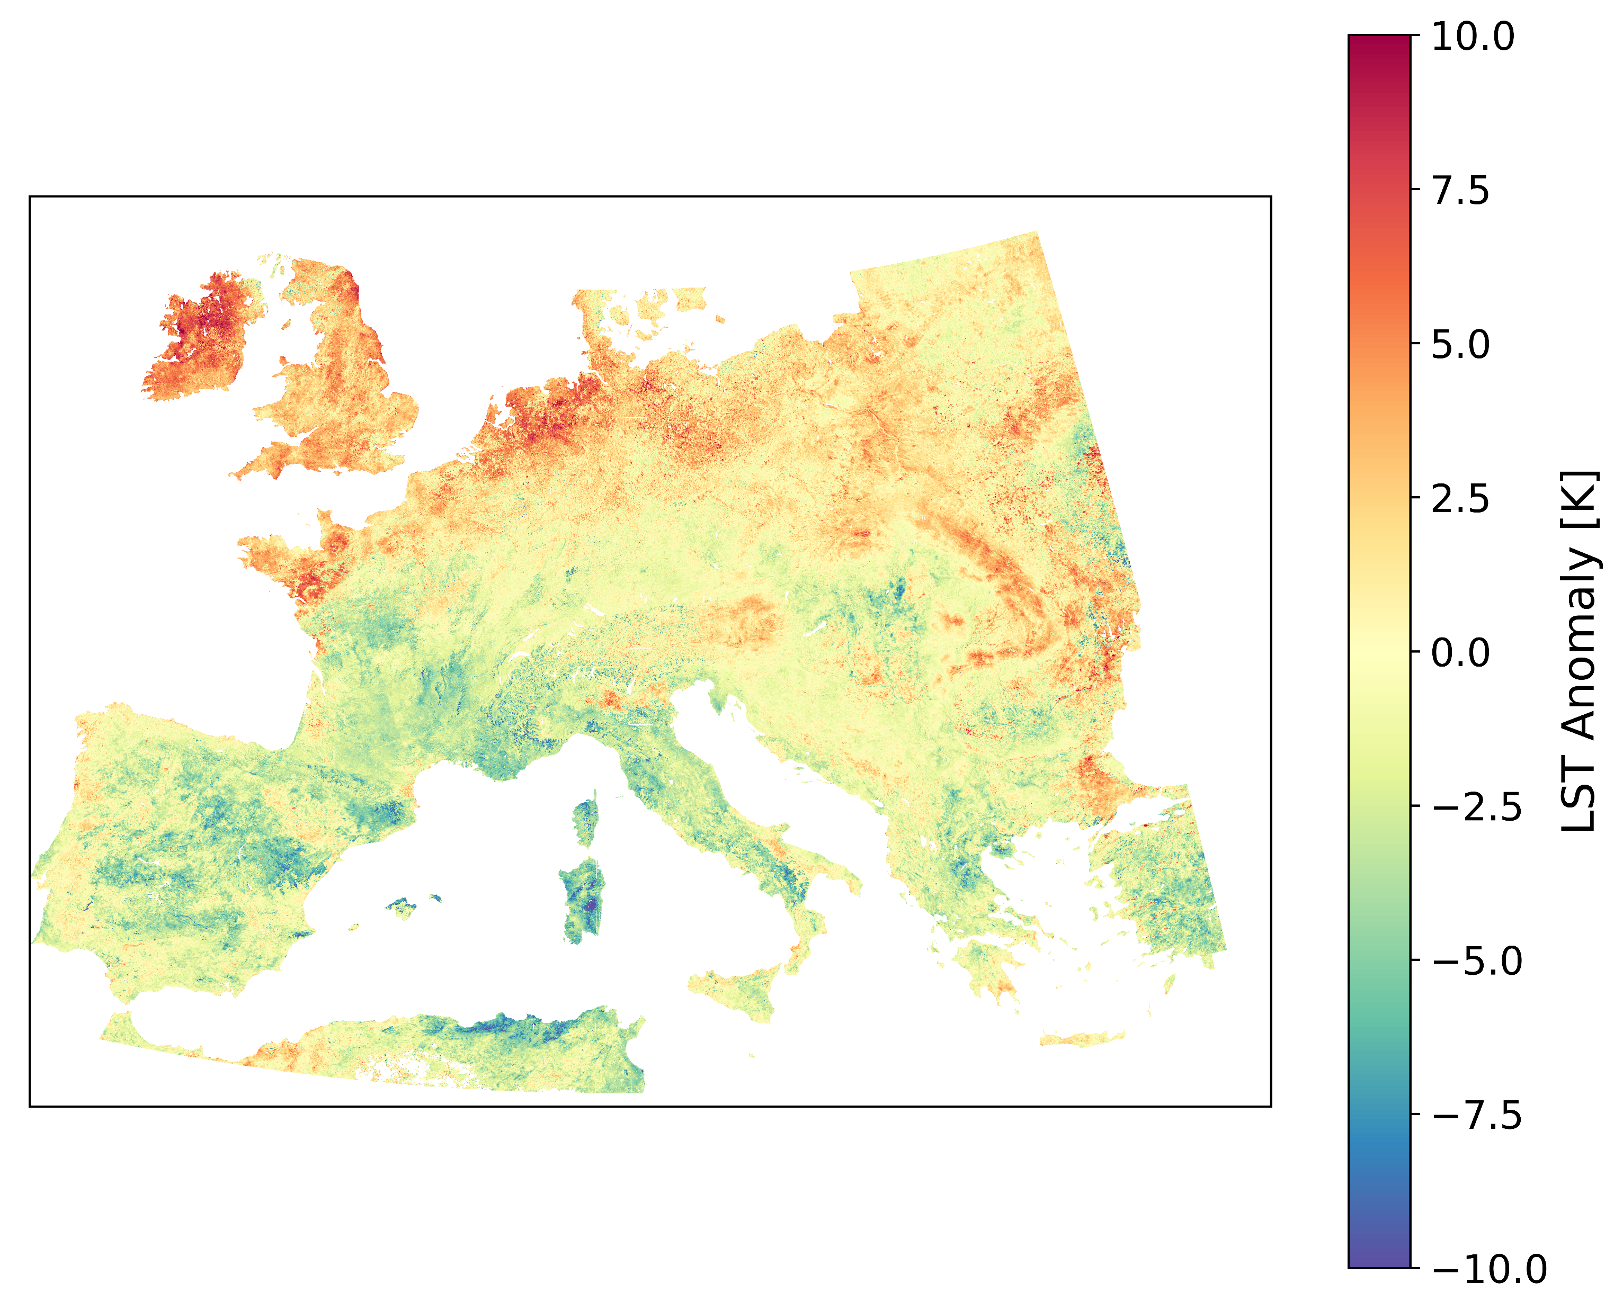
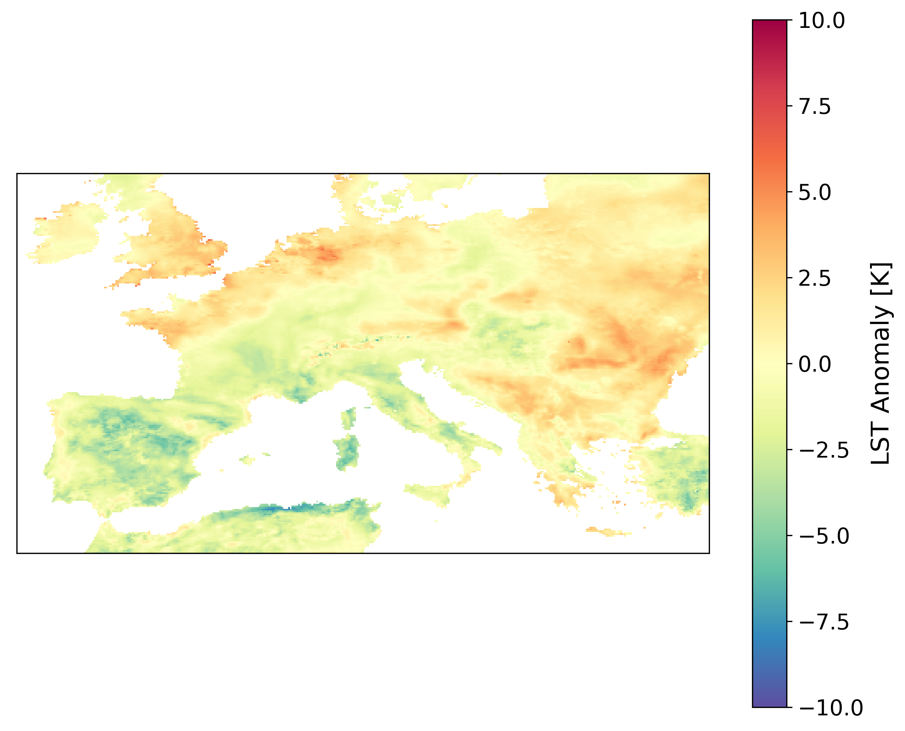
Monthly maximum LST Anomalies in June 2010
TIMELINE monthly maximum LST Anomalies
ERA 5 monthly maximum LST Anomalies
Notes:
Normalize the overpasses to daily maximum (13h) and minimum (3h) LST

Slide 17
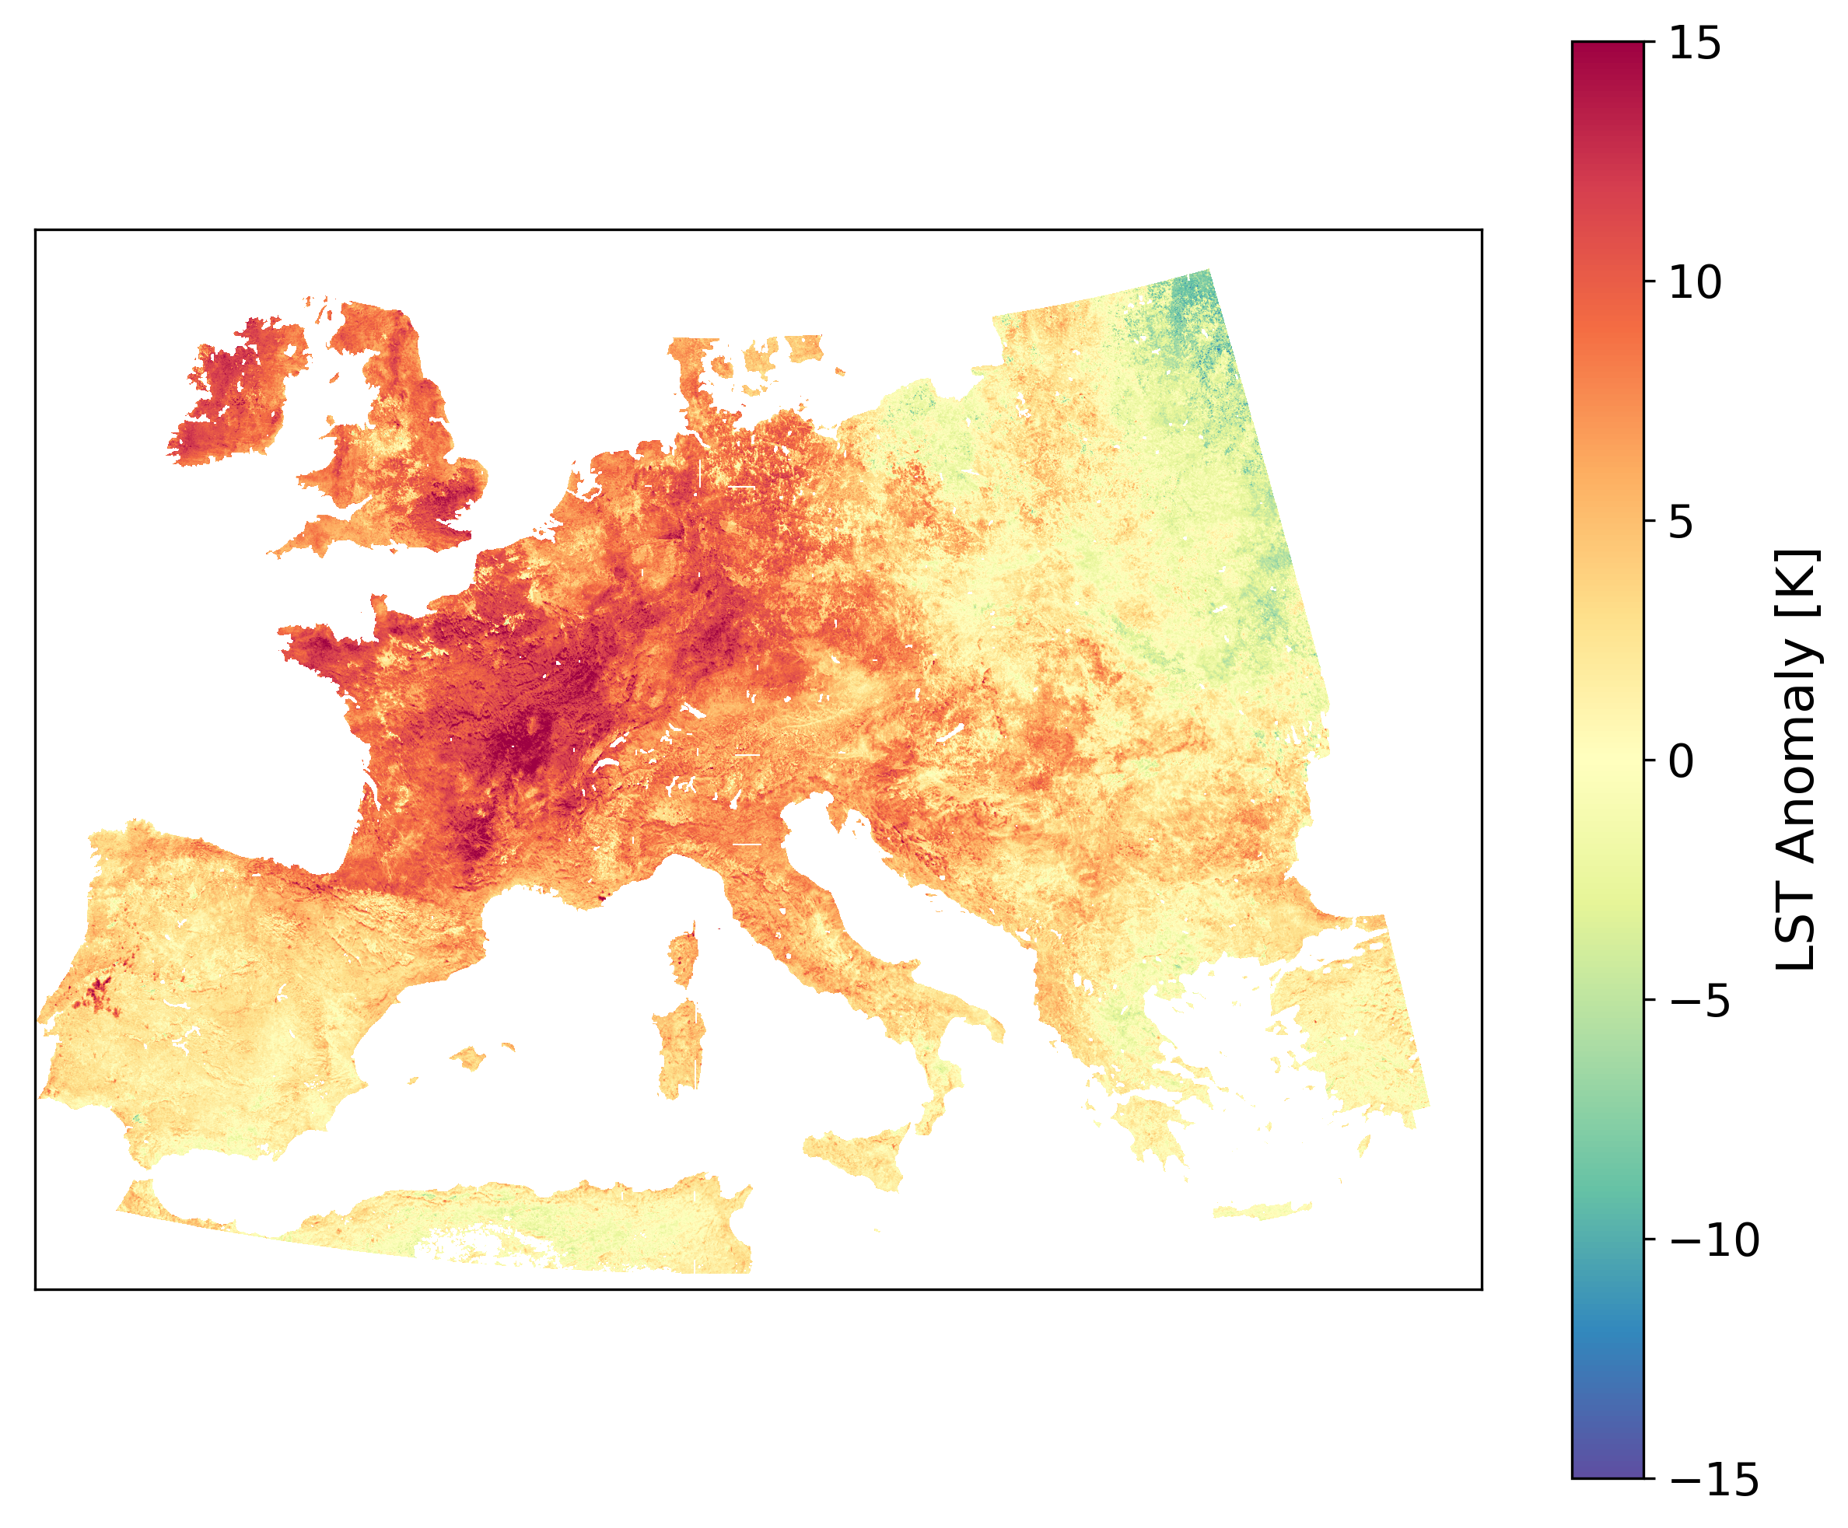
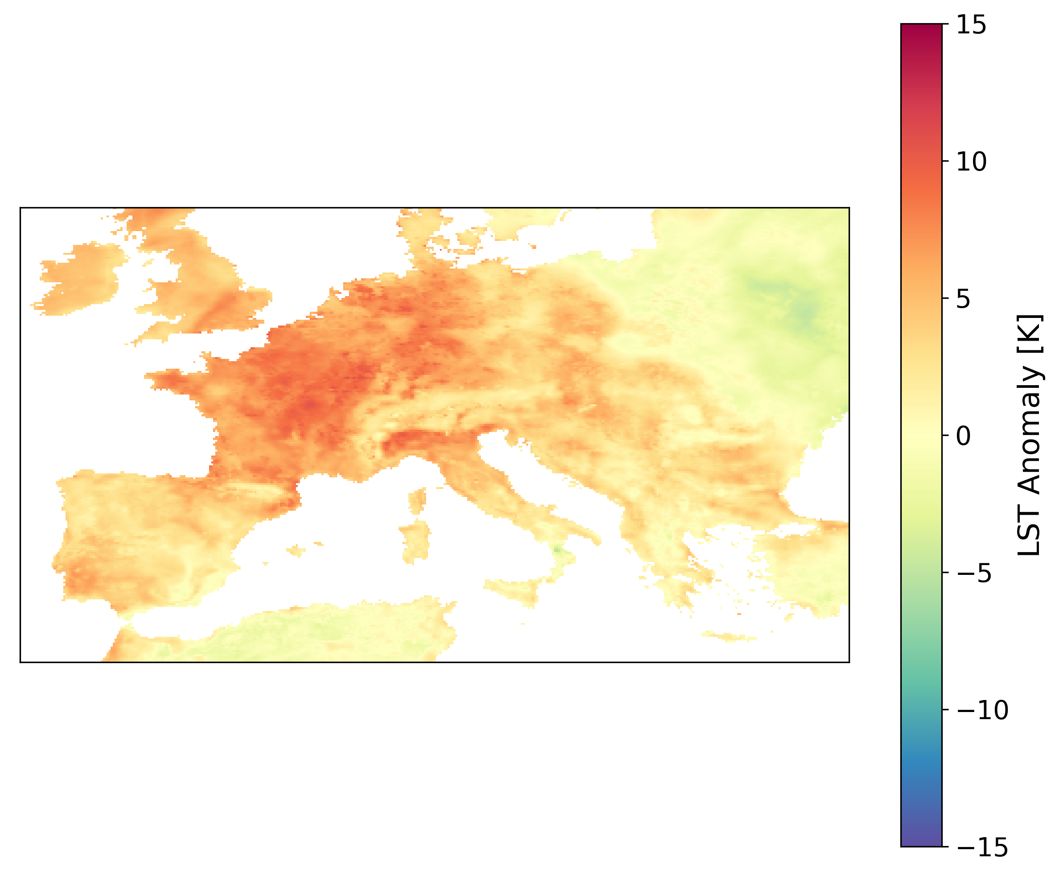
Monthly maximum LST Anomalies in August 2003
TIMELINE monthly maximum LST Anomalies
ERA 5 monthly maximum LST Anomalies
Notes:
Normalize the overpasses to daily maximum (13h) and minimum (3h) LST

Slide 18
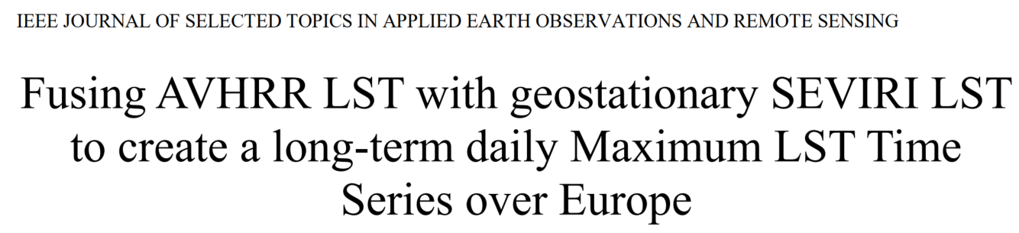




Summary and Outlook
The TIMELINE LST Product enables the analysis of:
Global warming
Heat waves
Landcover dynamics
Fire risks
Harmonized the spectral response curves of the different NOAA satellites
Implemented the correction for emissivity, sensor view angle and water vapor content
Implemented and validated an orbit drift correction by using LST Annual Cycle Parameters (ACPs) from geostationary data
Created a long-term daily maximum LST time series (1982-2018) as well as 10-daily and monthly products
Extent the LST time series by incorporating MetOp data
Further compare the AVHRR LST time series and the LST trends to other available long-term LST sources
(Reiners et. al., just accepted)
philipp.reiners@dlr.de
Challenge | Solution
Derivation of accurate LST from AVHRR Data | Algorithms published by Frey et al. (2017) Generation of the Level 2 and 3 Product Validation with MODIS and in situ LST published by Reiners et al. (2021)
Daytime Normalization and Orbit Drift Correction | Statistical Approach Physical Approach
Validation of early parts of Time Series | Comparison with near Surface Air Temperature Comparison with Landsat LST

Slide 19
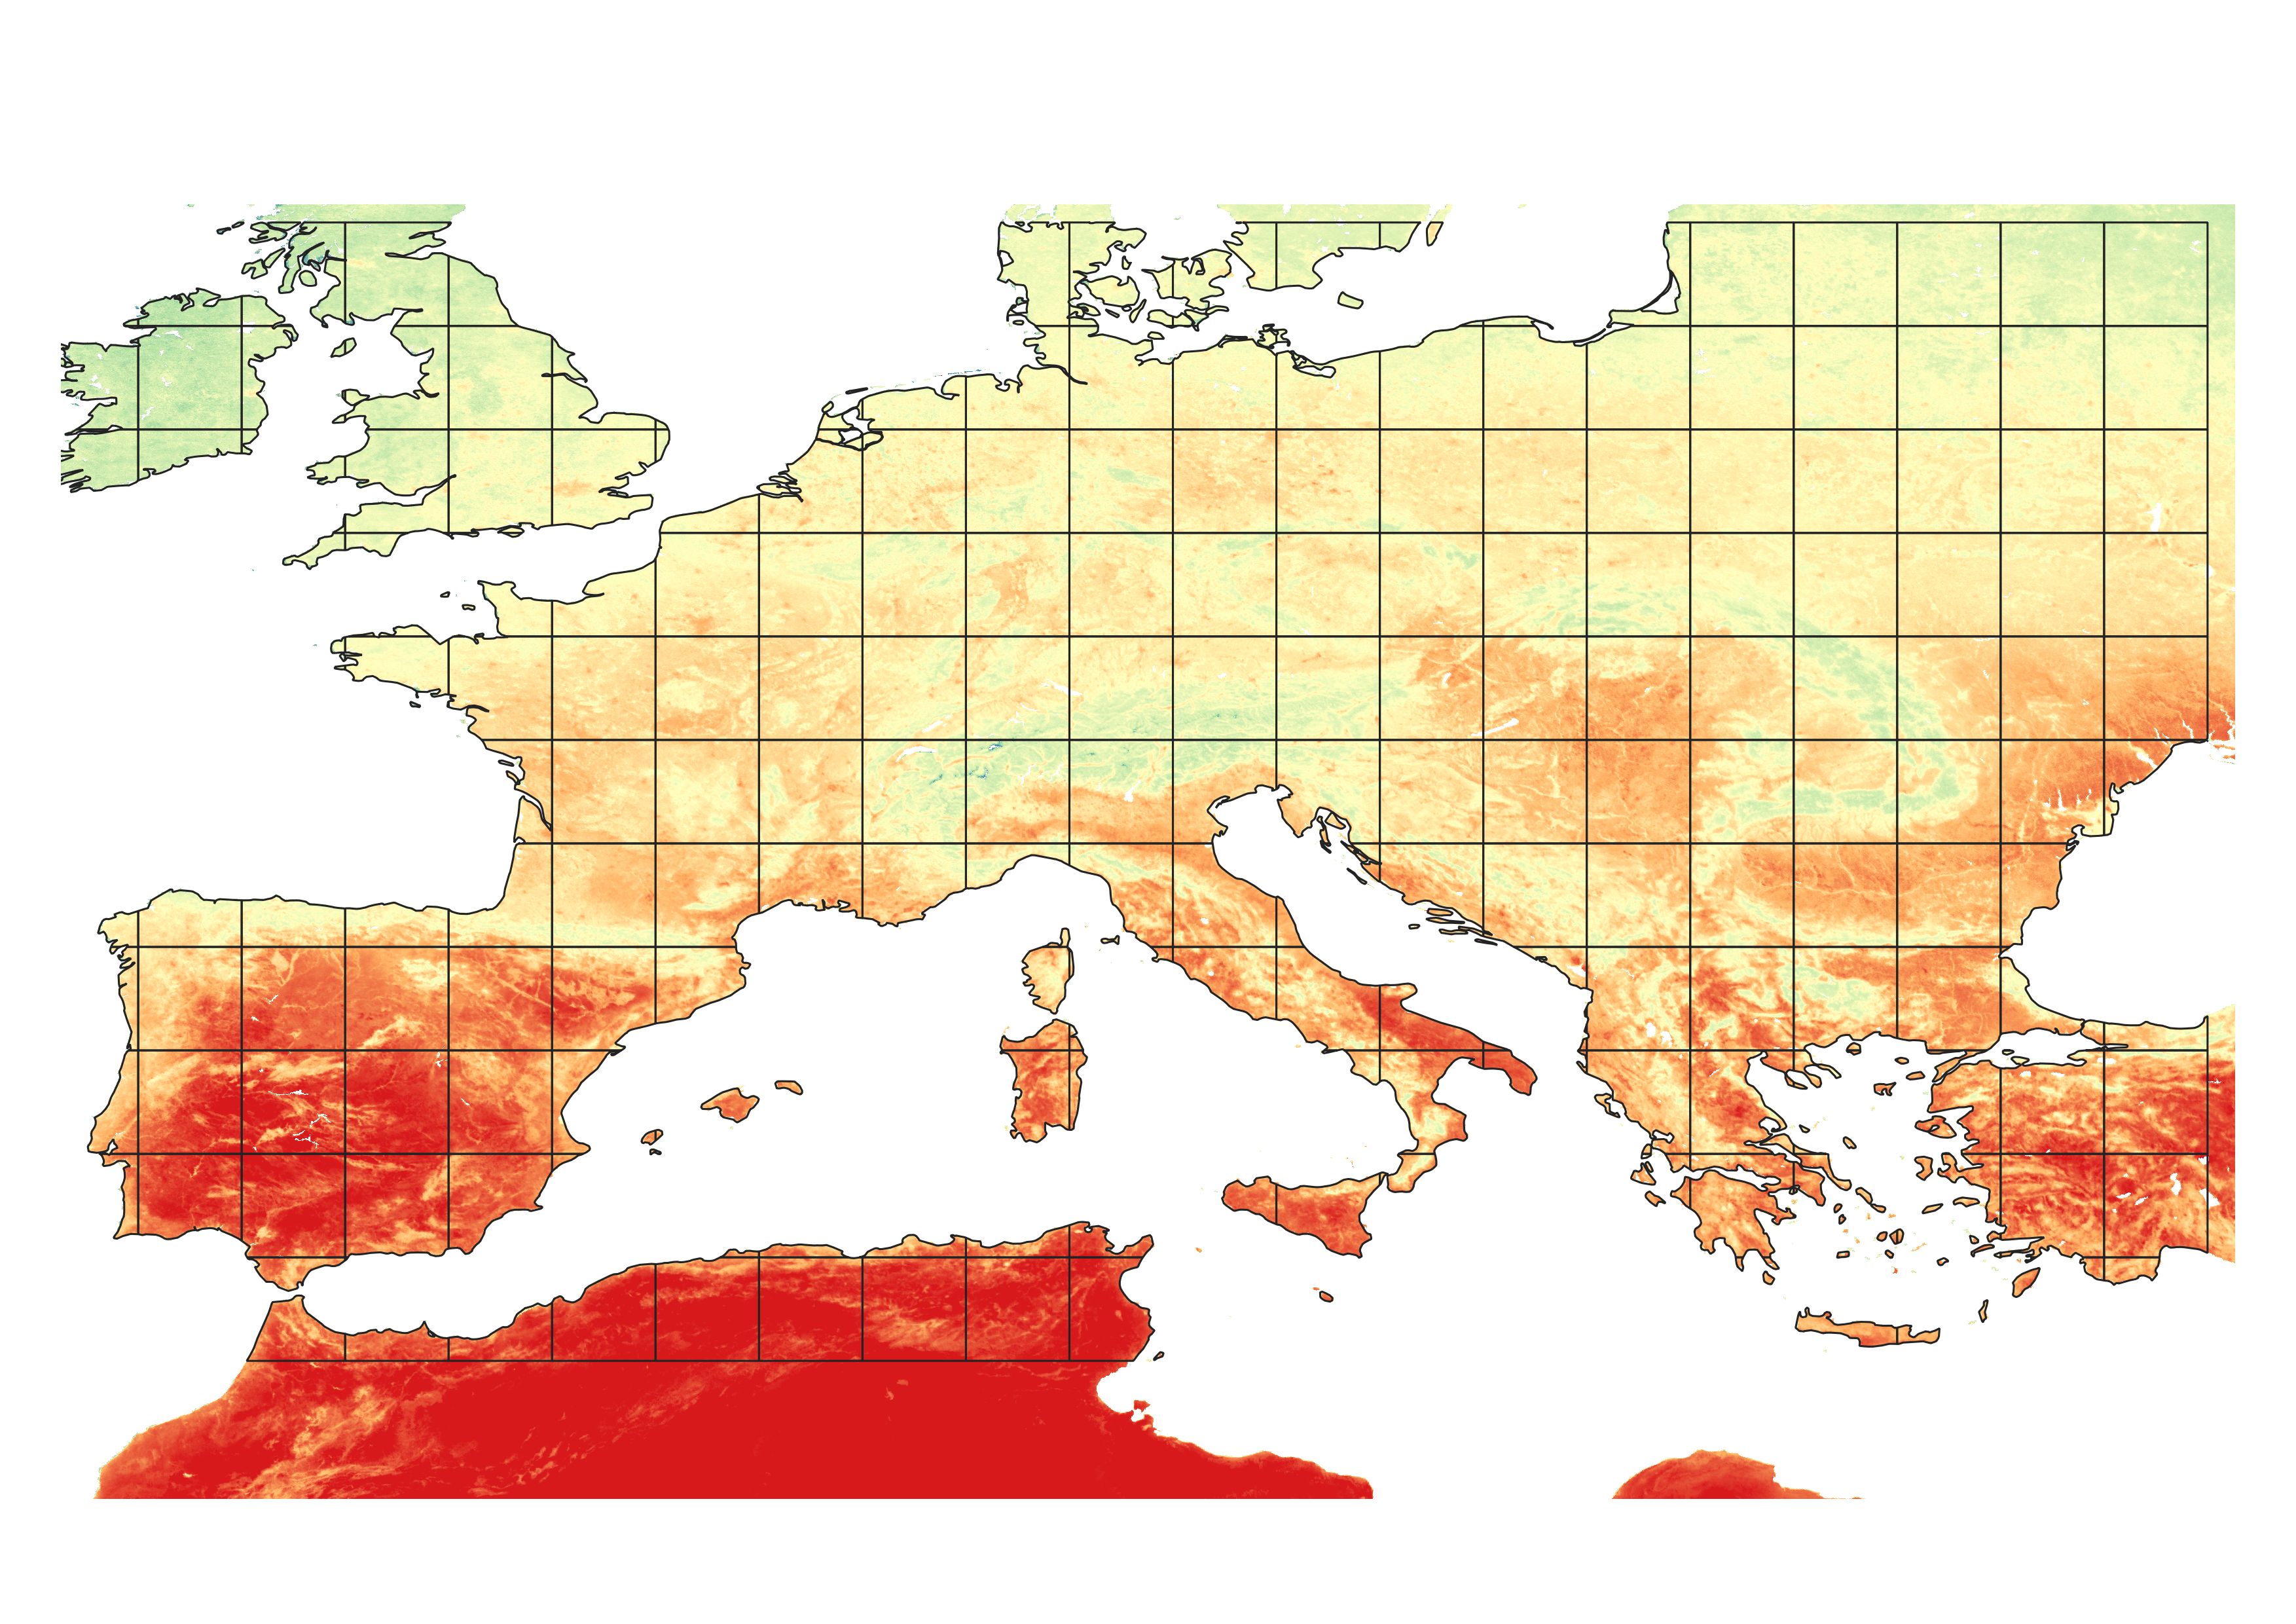
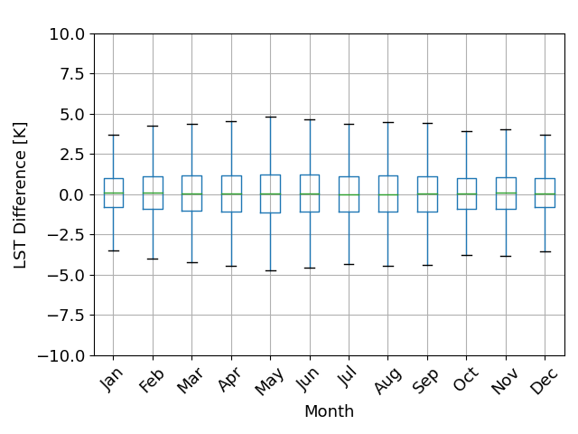
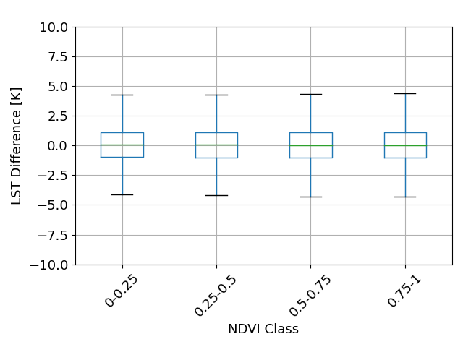
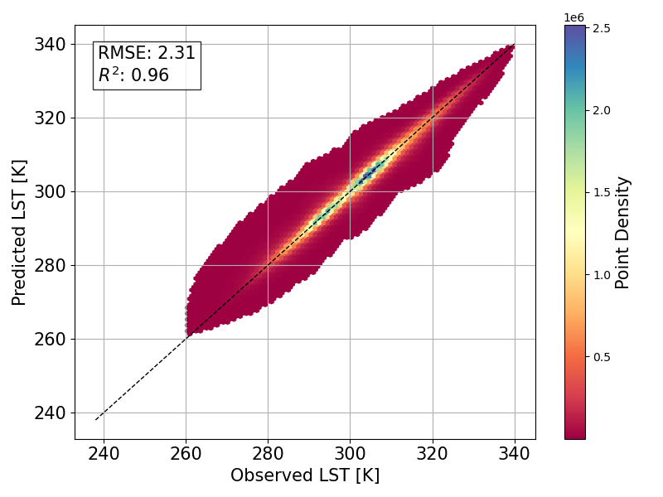
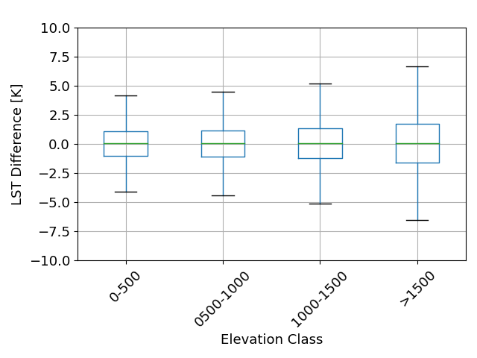
Gap Filling with Random Forest Regression
Difference between observed and predicted LST
Missing LST values were predicted for each month within a 2 x 2° tile.
Predictors were:
Longterm mean maximum LST
NDVI
Elevation

Slide 20
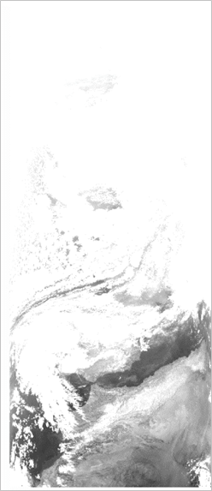






TIMELINE LST Product Generation Overview
L1B L2 L2c L3
L2-Processor [1,2]
L2c-Processor
L3-Processor
Vegetation Cover Method
Mono window algorithm
Pixel-based filtering of the monthly time series (1.5*stdev)
Compositing
Projection to LAEA Tiles
Daily: Best observation of the day (lowest sat zenith angle)
10-Daily: LST stastistics (Max,Mean,Median,Min)
Monthly: LST stastistics (Max,Mean,Median,Min)
Split window algorithm
LST in orbit projection at observation time
Validated against MODIS LST and in situ LST [2]
AVHRR Brightness Temperatures
[1] Frey, C.M.; Kuenzer, C.; Dech, S. Assessment of Mono- and Split-Window Approaches for Time Series Processing of LST from AVHRR—A TIMELINE Round Robin. Remote Sens. 2017, 9, 72. https://doi.org/10.3390/rs9010072
[2] Reiners, P.; Asam, S.; Frey, C.; Holzwarth, S.; Bachmann, M.; Sobrino, J.; Göttsche, F.-M.; Bendix, J.; Kuenzer, C. Validation of AVHRR Land Surface Temperature with MODIS and In Situ LST—A TIMELINE Thematic Processor. Remote Sens. 2021, 13, 3473. https://doi.org/10.3390/rs13173473
Notes:
Short summary of the TIMELINE workflow for calculating LST product
Split Window and Mono Window for emissivity correction and atmospheric correction
Harmonization of AVHRR Sensors during the atmospheric correction
Level 2 product was validated against MODIS and in situ LST

Slide 21


Level 2 LST Validierung
TIMELINE LST against in situ LST at 10 stations in North America
Temporal and spatial Matches between TIMELINE and MODIS LST
Notes:
Short summary of the TIMELINE workflow for calculating LST product
Split Window and Mono Window for emissivity correction and atmospheric correction
Harmonization of AVHRR Sensors during the atmospheric correction
Level 2 product was validated against MODIS and in situ LST

