Slide 1
Identification, characterisation and correction of directional effects in high-resolution LST
06/12/2024
Louis Snyders (PhD student)

Slide 2
Problem statement
Directional effects in thermal remote sensing
→ Implications for future high-resolution TIR missions: LSTM (30°), Trishna (34°), SBG (34°)?
© Mary Langsdale, King’s College London, National Centre for Earth Observation
T_{avg} = 41.2 °C
T_{avg} = 34.9 °C
© King’s College London, National Centre for Earth Observation

Slide 3

Multi-angular high resolution TIR data
In preparation for LSTM, Trishna, SBG …
Quasi-simultaneous satellite acquisitions
Airborne data
Sentinel-3
ECOSTRESS

Slide 4
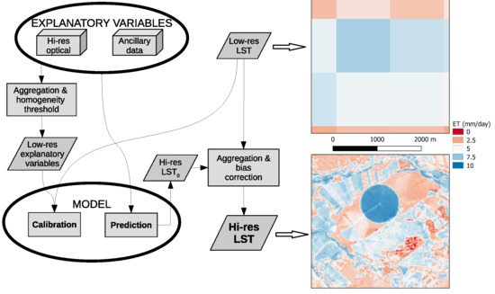
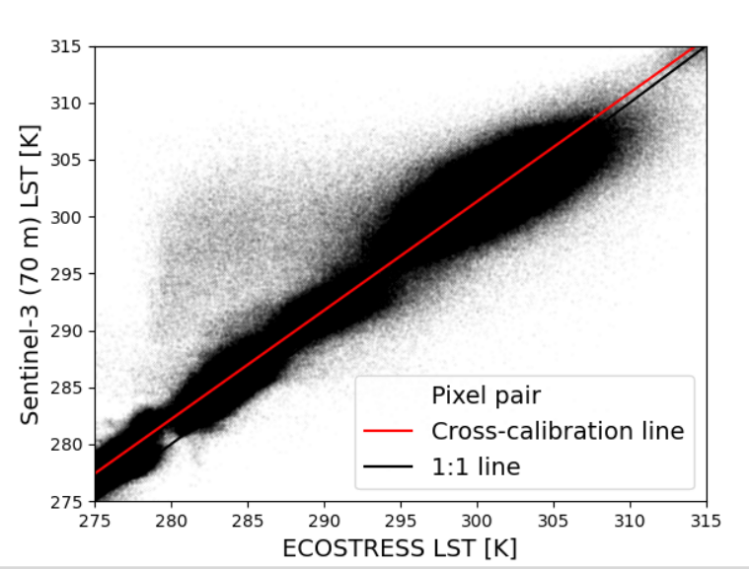
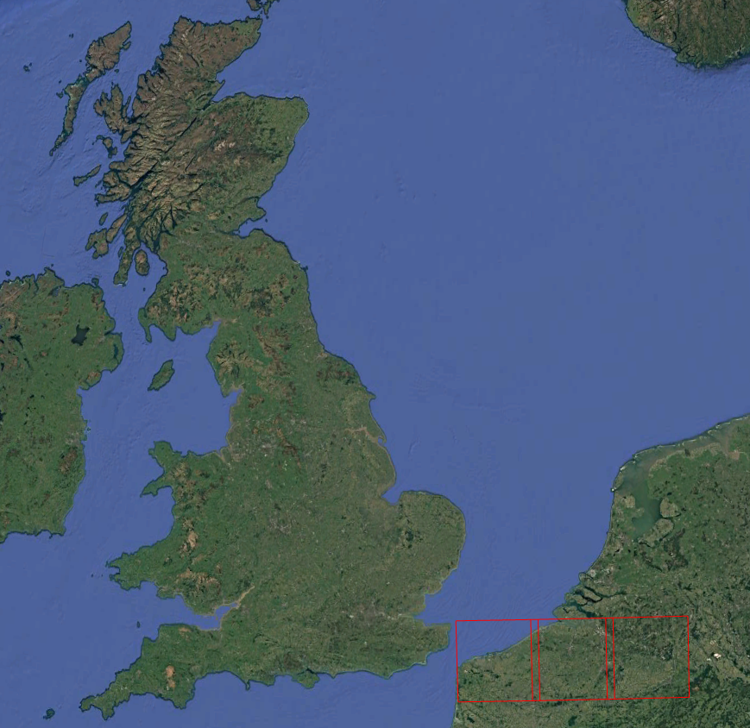
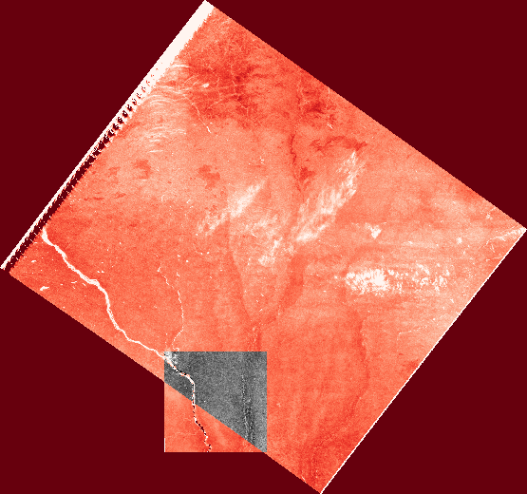
Quasi-simultaneous satellite acquisitions
Define period & region
Collect S3 & ECOSTRESS
Resample S3
Cross-calibrate
Analyze
Flanders
Sen-ET data mining sharpener
Reduce radiometric uncertainty
Directional effects
Directional models
90 Pairs
2019 - 2023
$$Δt<10 min$$
Δt<10 min
S3 at ECOSTRESS resolution
|∆VZA| < 10°
An experimental approach
Sen-ET *
* uses Sentinel-3, Sentinel-2, DEM

Slide 5
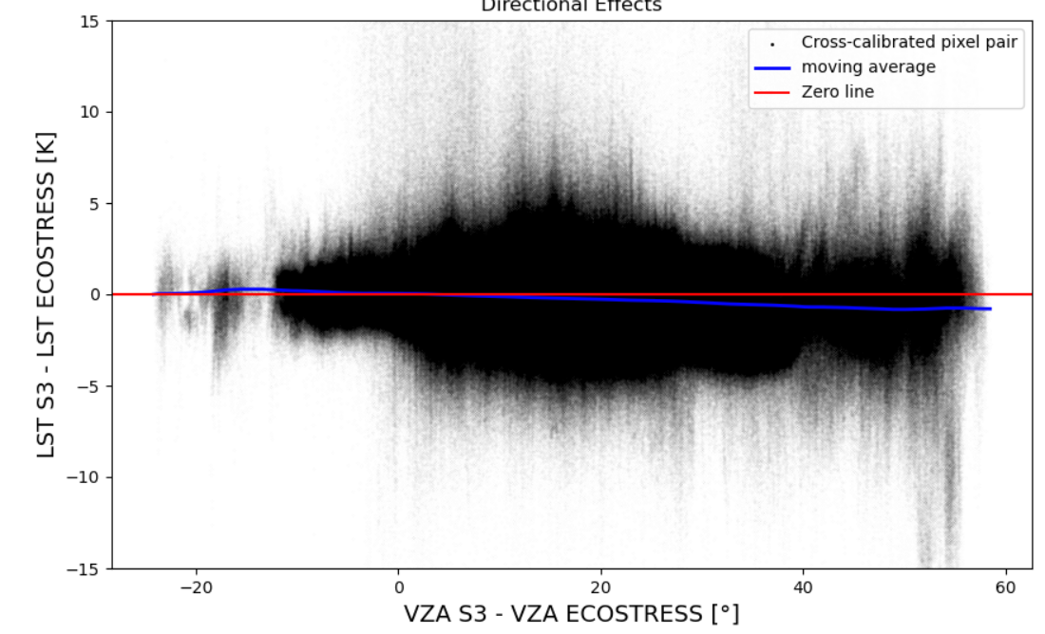
Directional effects present
Year | Acquisition pairs
2019 | 10
2020 | 22
2021 | 24
2022 | 18
2023 | 16
All | 90
Figure: Scatter plot of LST differences and view zenith angle (VZA) differences between S3 and ECOSTRESS after cross-calibration for pixel pairs of all quasi-simultaneous acquisitions over Flanders for 2019-2023.

Slide 6
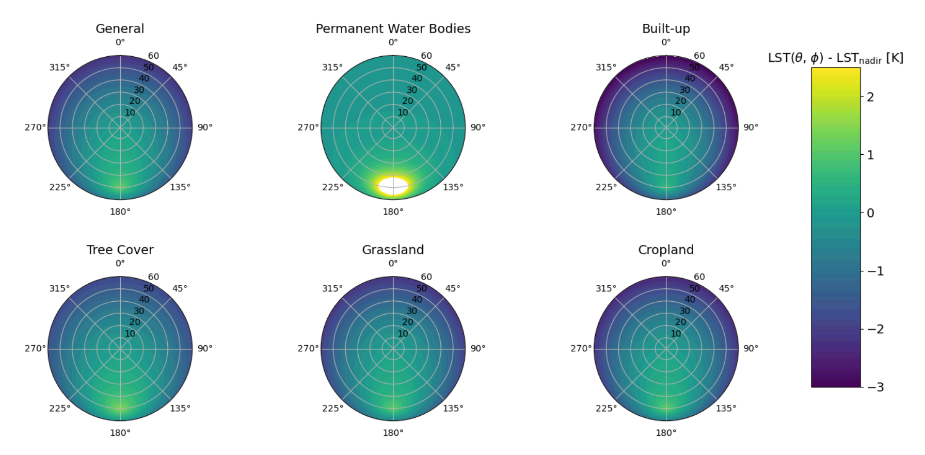

Directional parametric model for Flanders (2019-2023)
Vinnikov-RL model
$$LST\left(θ_{v}, θ_{s}, Δφ\right)=LST_{nadir}+A⋅K_{gap} \left(θ_{v}\right)+B⋅K_{hotspot}\left(θ_{v}, θ_{s},Δφ,width\right)$$
Figure: Polar plot displaying modelled directional effects of LST for varying view angles based on the Vinnikov-RL model. The nadir direction serves as reference point. In this figure the Sun is located at a zenith angle of 50° and an azimuth angle of 180°.

Slide 7
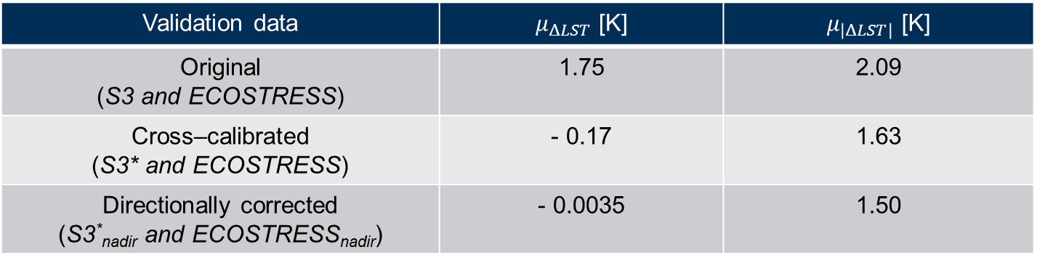
General directional correction
Validation
Training dataset:
2019-2022
Validation dataset:
2023
Cross-calibration: $LST_{S3}→LST_{S3}^{∗}$
Cross-calibration: 𝐿𝑆𝑇_𝑆3→𝐿𝑆𝑇_𝑆3^∗
Directional correction: $LST_{S3}^{∗}→LST_{S3,nadir}^{∗}$ and$LST_{ECOSTRESS}→LST_{ECOSTRESS,nadir }$
Directional correction: 𝐿𝑆𝑇_𝑆3^∗→𝐿𝑆𝑇_(𝑆3,𝑛𝑎𝑑𝑖𝑟)^∗ and 𝐿𝑆𝑇_𝐸𝐶𝑂𝑆𝑇𝑅𝐸𝑆𝑆→𝐿𝑆𝑇_(𝐸𝐶𝑂𝑆𝑇𝑅𝐸𝑆𝑆,𝑛𝑎𝑑𝑖𝑟 )
Gain, offset
Vinnikov (gap), RL (hotspot)
Table: Validation performance metrics. $μ_{ΔLST}$ and $μ_{|ΔLST|}$ represent the mean LST difference and the mean absolute LST difference between S3 and ECOSTRESS for all pixel pairs in the 2023 validation data, respectively.
Validation data | $μ_{ΔLST}$ [K] | $μ_{\left|ΔLST\right|}$ [K]
Original (S3 and ECOSTRESS) | 1.75 | 2.09
Cross–calibrated (S3* and ECOSTRESS) | - 0.17 | 1.63
Directionally corrected (S3*_{nadir} and ECOSTRESS_{nadir}) | - 0.0035 | 1.50

Slide 8
Case-specific models for Flanders (2019-2023)
Land cover
Figure: Polar plots displaying modelled directional effects (Vinnikov-RL) of LST for varying view angles based on the Vinnikov-RL model. The nadir direction serves as reference point. In this figure the Sun is located at a zenith angle of 50° and an azimuth angle of 180°.

Slide 9
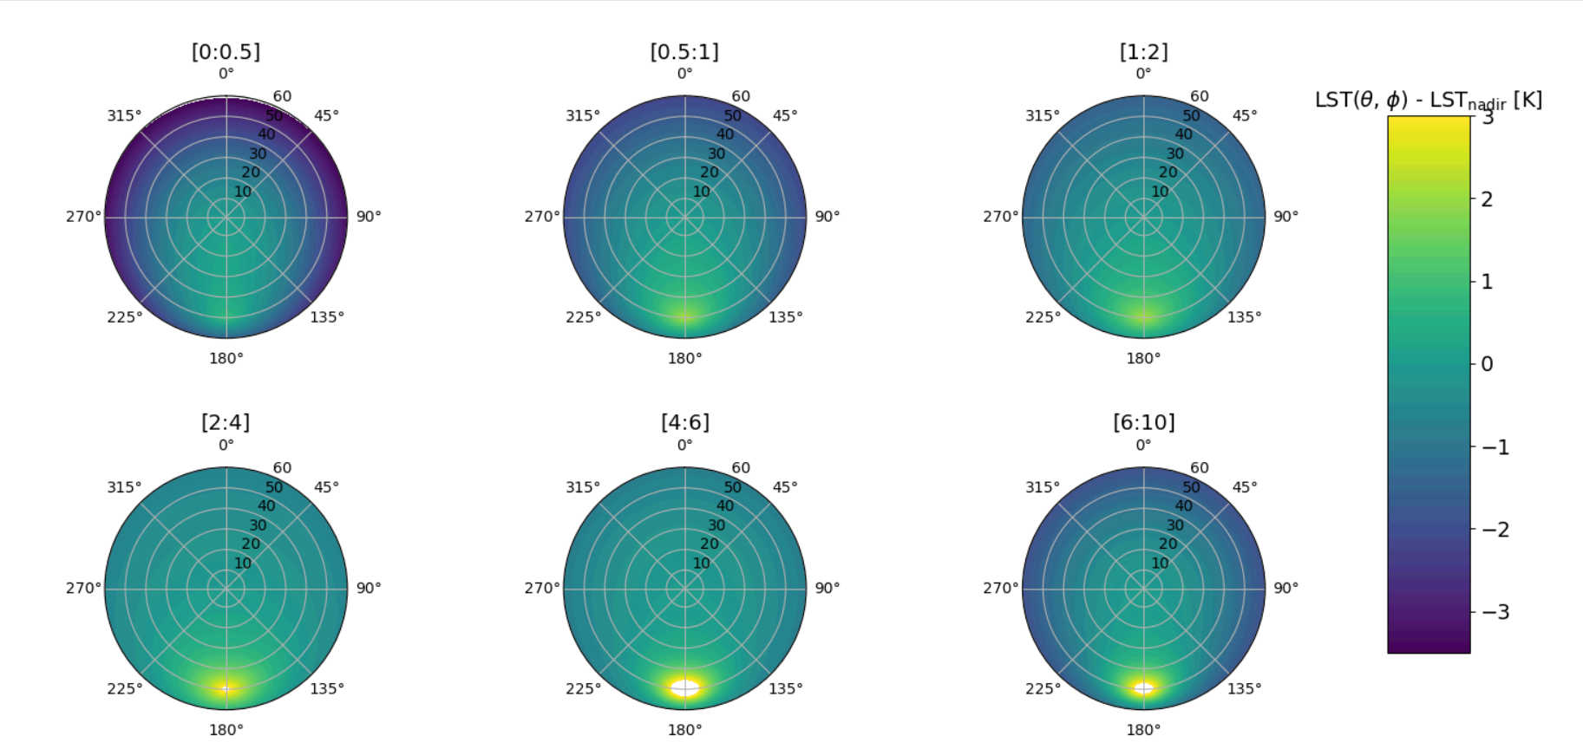
Case-specific models for Flanders (2019-2023)
Leaf area index (LAI) specific
Figure: Polar plots displaying modelled directional effects (Vinnikov-RL) of LST for varying view angles based on the Vinnikov-RL model. The nadir direction serves as reference point. In this figure the Sun is located at a zenith angle of 50° and an azimuth angle of 180°.

Slide 10
Conclusion & future prospects
Directional effects
Up to several °C
Parametric models
Land cover dependent
LAI dependent
General directional correction
Improves accuracy: 1.63 K → 1.50K
Caution!
Hotspot estimation = extrapolation
Large uncertainty in sharpened data (large spread)
Next?
Modelling of directional effects in airborne TIR data
Potentially further improvement for case specific correction
Case specific corrections

