Slide 1

Max Gulde | max.gulde@constellr.com
HiVE, a land surface temperature
monitoring mission for better resource accountability
Christophe Lerot, Andreas Brunn, Alexandre Delahaye, Ellis Freedman, Imaduddin Humayun, Christian Köppl, Daniel Spengler, Tianran Zhang
LST_cci workshop | 05-06.12.2024

Slide 2



Outline
constellr in a nutshell
The HiVE constellation
The constellr product portfolio and LSTfusion

Slide 3


About constellr
Launch of new HiVE satellite constellation
2025
Mission :
Measure temperatures from space to support food security and provide insights for better resource accountability
Launch of LST product family
80+ employees
Offices in Germany, Belgium, France
Internationalisation to US and Brazil
Copernicus Contributing Mission and strong support from ESA
CO2
Z
today
Founded after five years of R&D
New sensor tech on international space station (ISS)
Acquisition of ScanWorld
Start of R&D work
From 2020

Slide 4
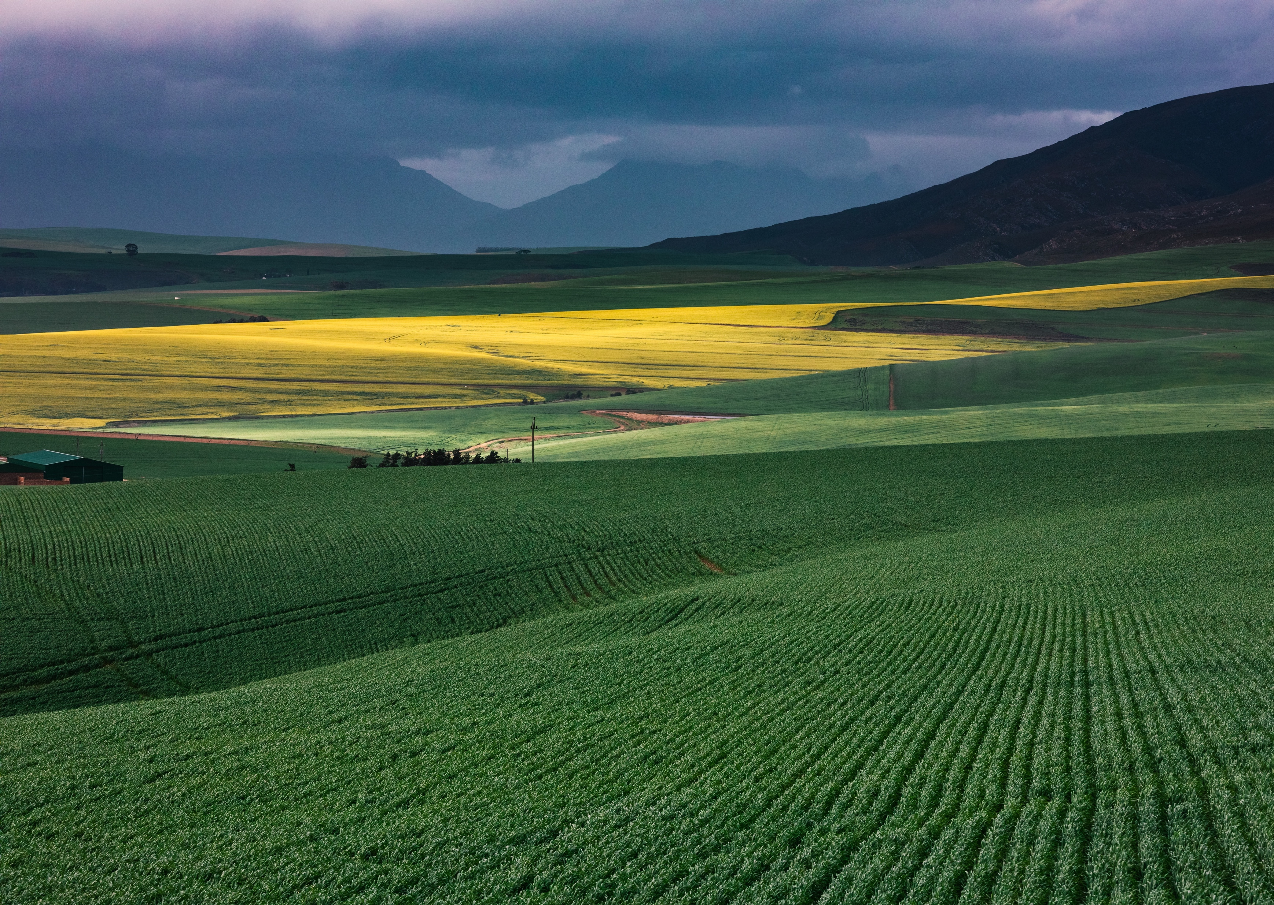


Why we do it:
Agriculture is key to addressing the combined carbon and water challenges
CO2
CO₂ binding
potential of terrestrial
vegetation:
13.7 Gt globally
Global water consumption in agriculture:
1,200 cubic kilometers p.a. = 70%
of the total available freshwater on earth
Global food
production by 2050:
60% increase
required
We need
to optimise agriculture
to feed the world
and to help
attenuate climate change
The result: additional challenges in terms of water and carbon
That is why constellr’s primary focus is on agriculture.

Slide 5
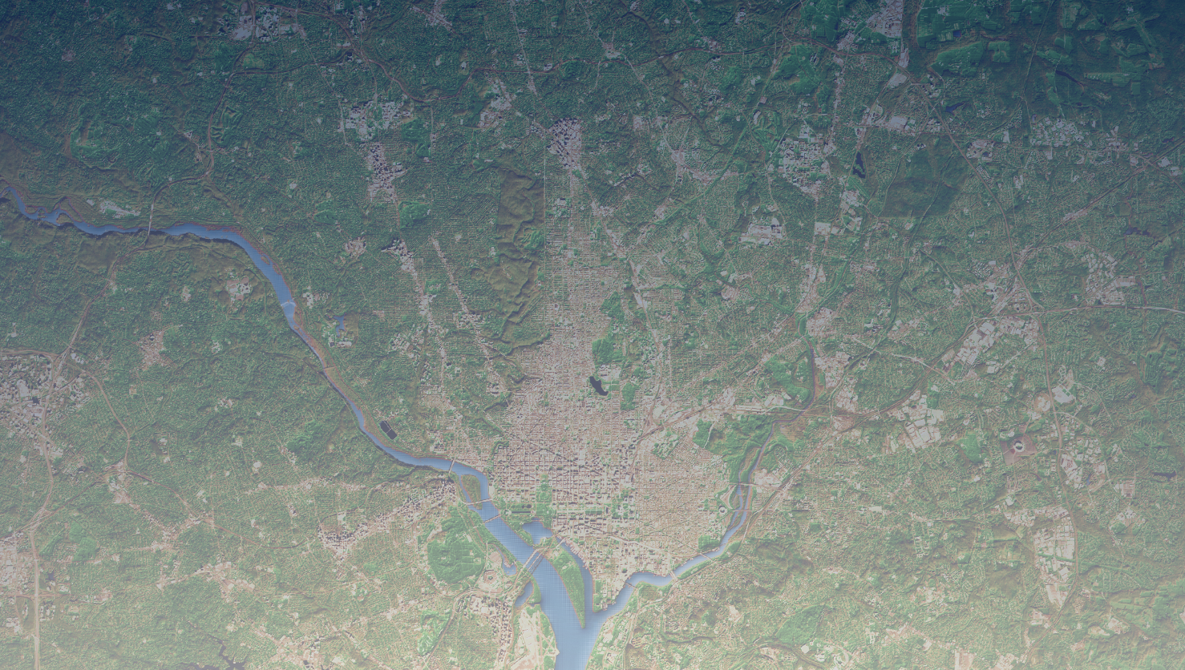
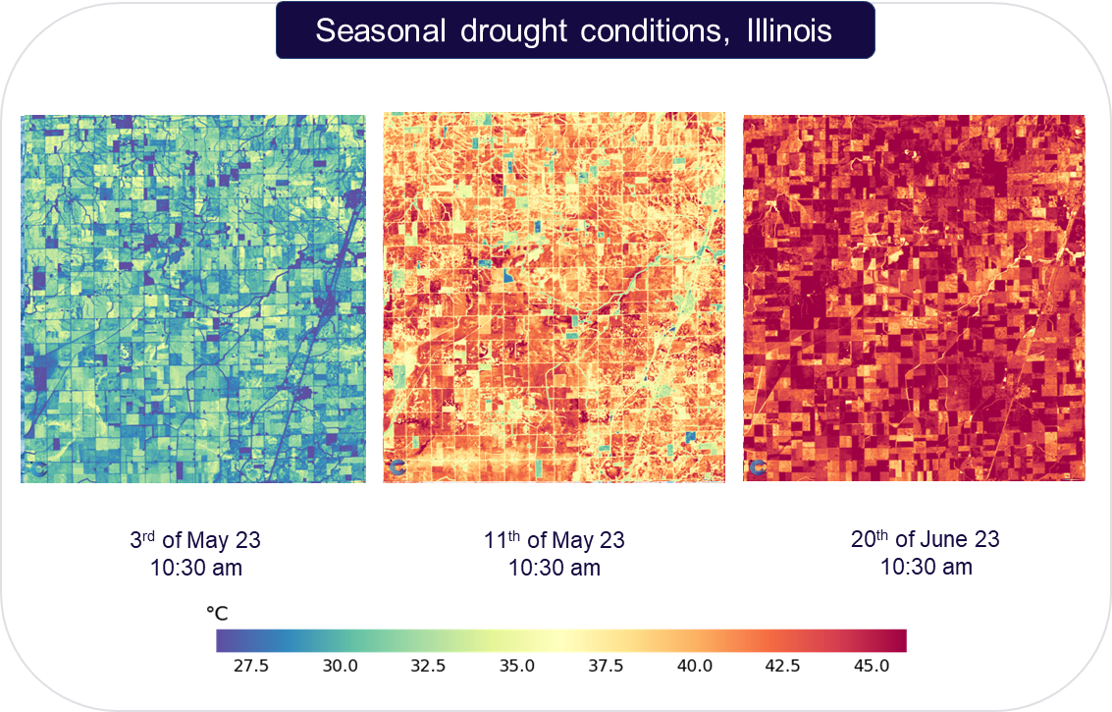
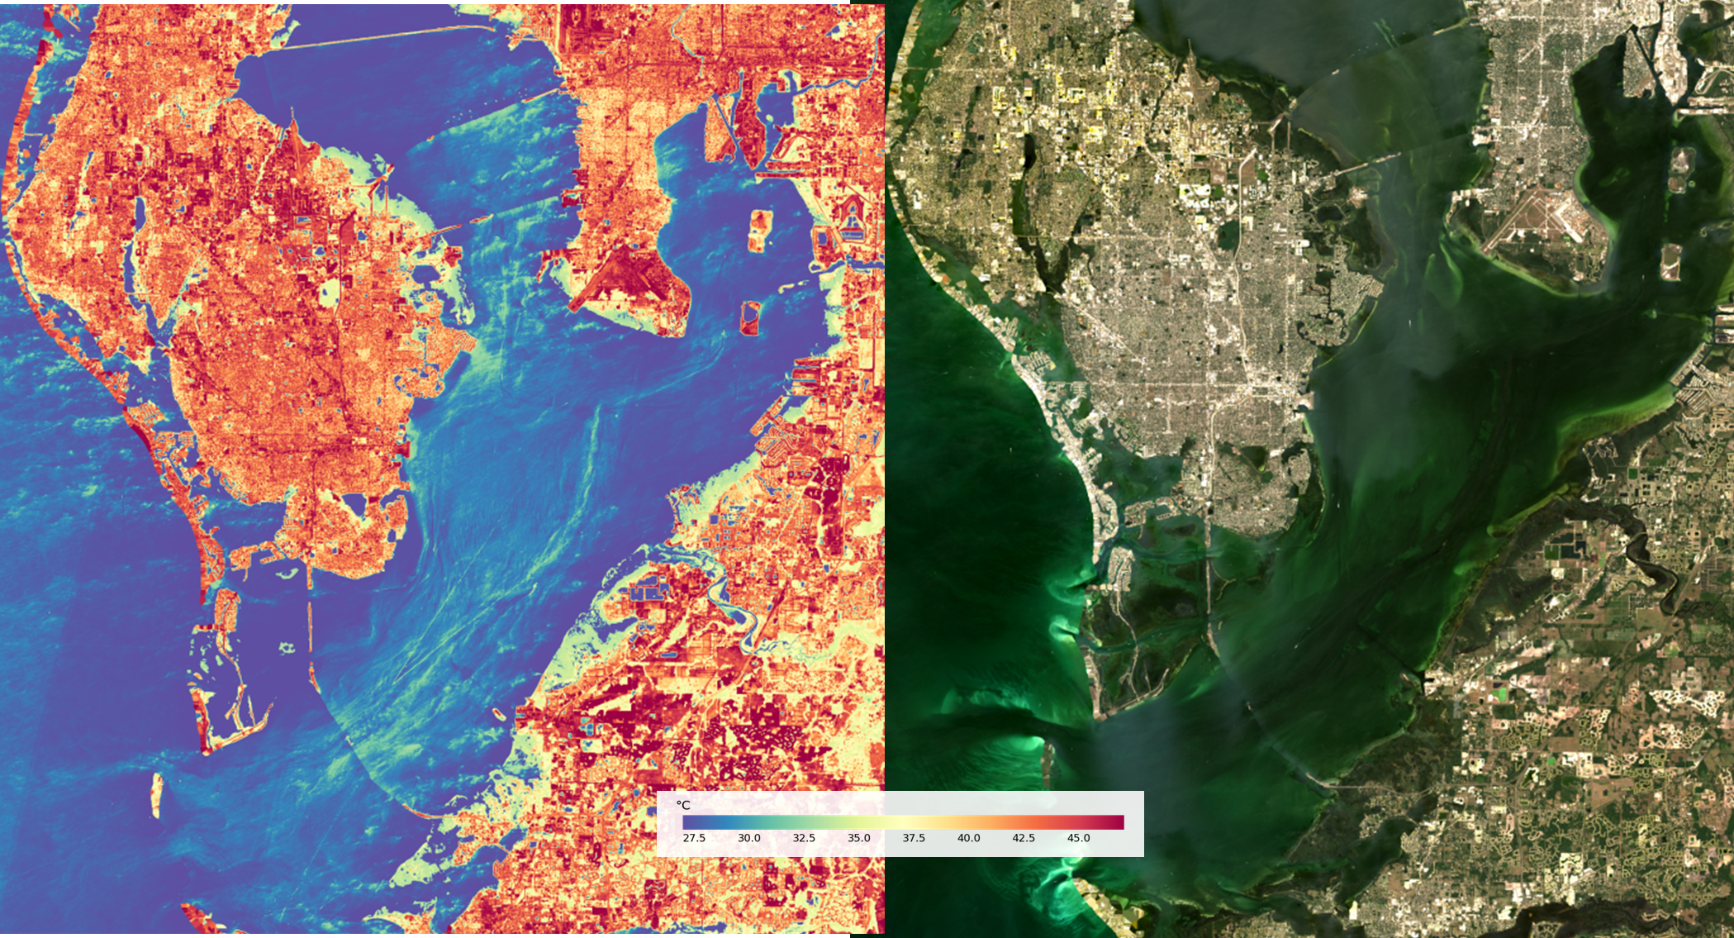
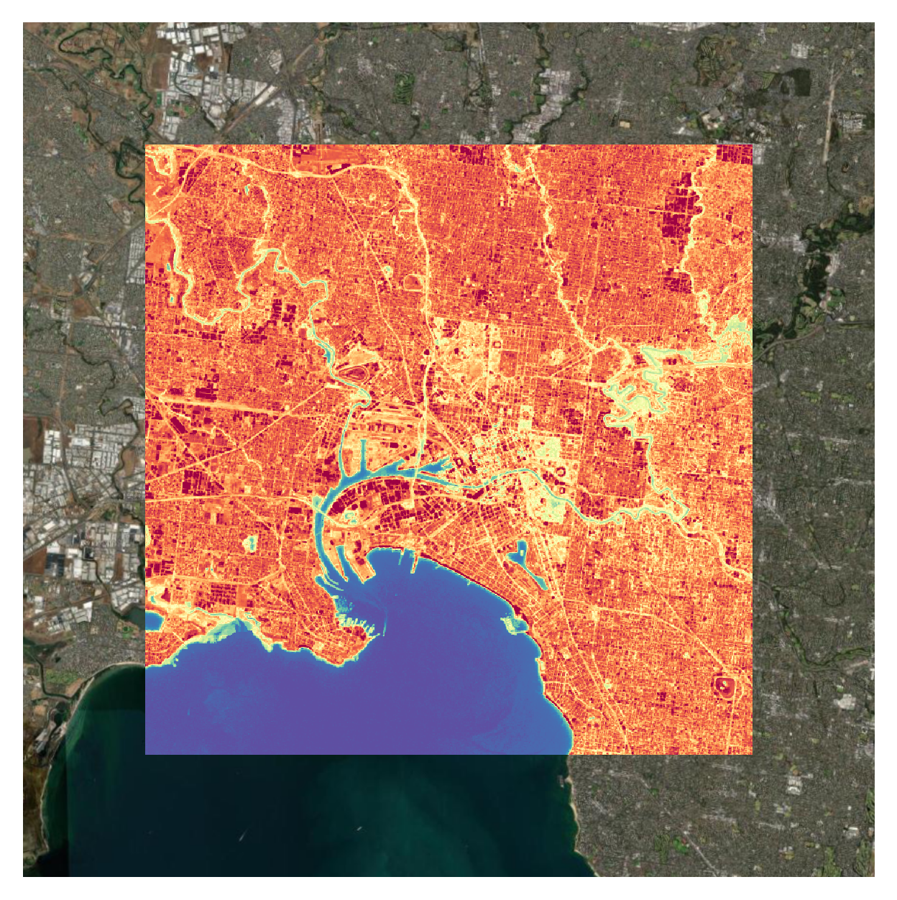
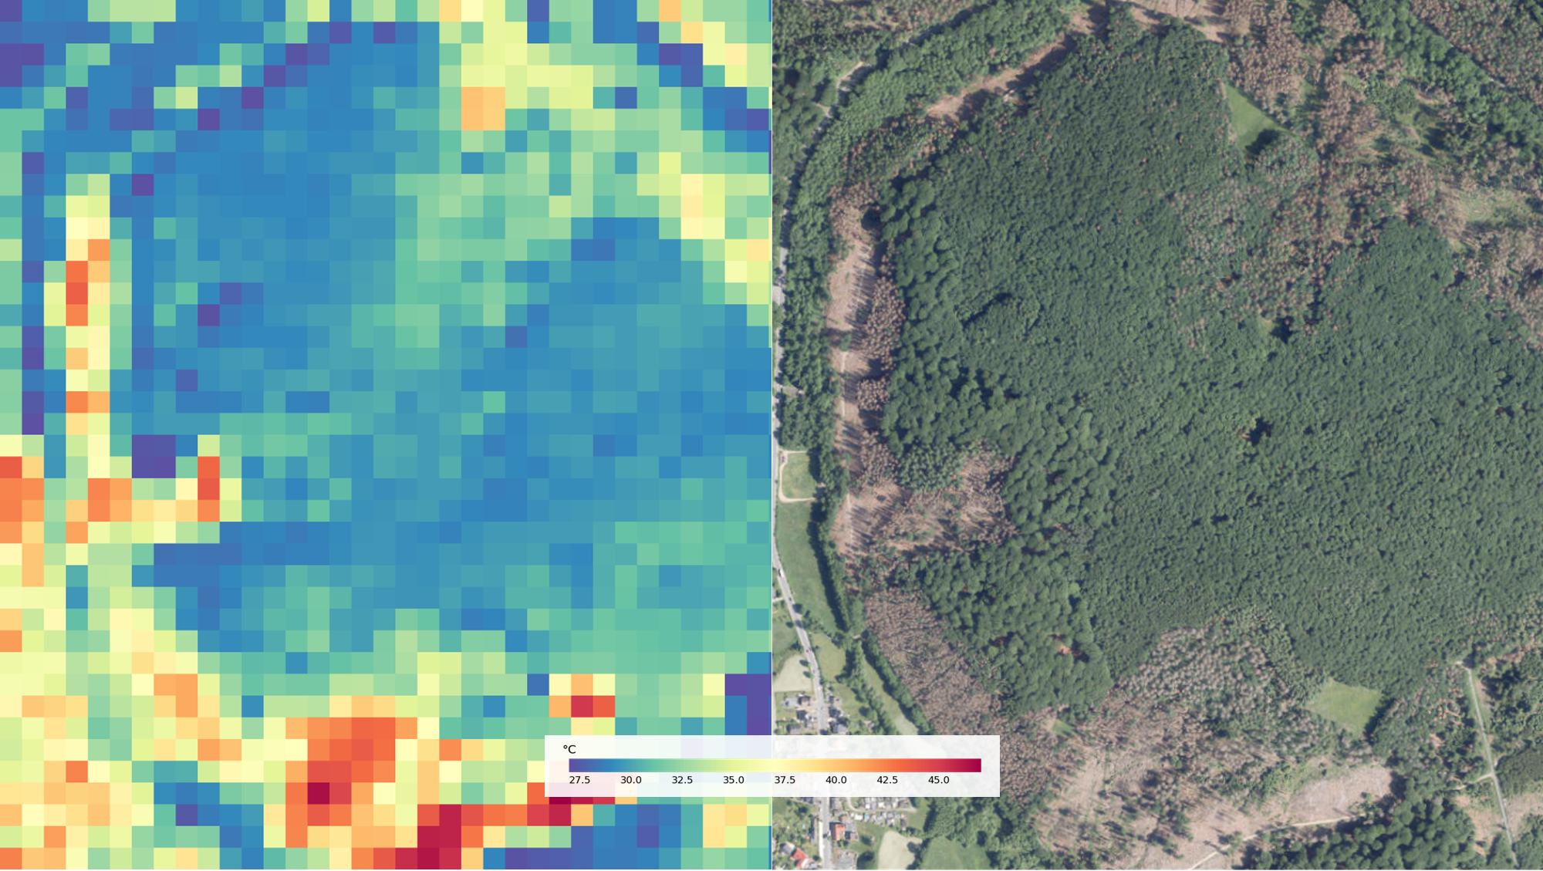
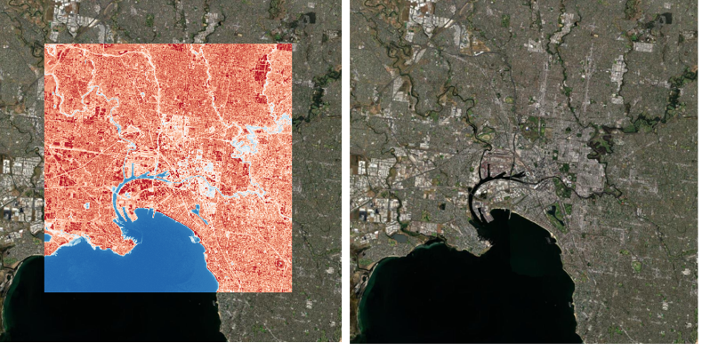
Sectors we address
Crop stress detection
Water and coast monitoring
Infrastructure monitoring
Forestry
Notes:
Heat stress is detected before damage is visible on the plants
Optimal time for pollination is determined
Allows to prioritize field intervention to mitigate earlier where it matters most

Slide 6

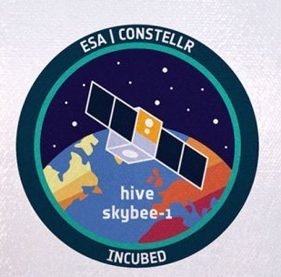






The HiVE mission roadmap
The HiVE mission roadmap
In-Orbit Demonstrator LisR
Payload on board ISS
HiVE Satellite #1 and #2
First free-flying satellites
HiVE Satellite #3, #4, #5
Minimum viable constellation for daily revisit
HiVE Constellation
Operations at scale with up to 30 Satellites launched
Feb 2022
01/2025
06/2025
2026/27
by 2030

Slide 7

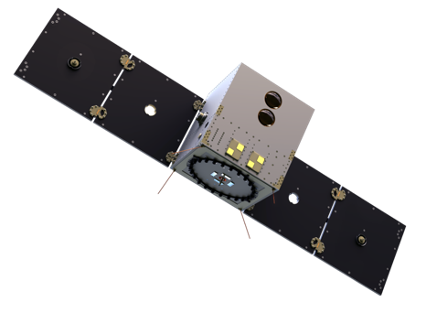






High-Precision Versatile Ecosphere Monitoring Mission (HiVE)
HiVE consists of a constellation of Thermal Infrared and VNIR Satellites
Bands
Status
Launch:early 2025, data from mid 2025
Orbit
SSO, 510 km, LTDN 10:30 AM / 1:30PM
Technology
Cryo-cooled, four-band LWIR
10 band MS VNIR
Instrument | # of bands | Wavelength range (μm) | Synergy to other missions
VNIR | 10 | Multispectral 0.44 – 0.94 | Sentinel-2
TIR | 4 | 8.6 (c) – 0.3 FWHM 9.2 (c) – 0.3 FWHM 10.6 (c) – 0.5 FWHM 11.75 (c) – 0.5 FWHM | LSTM+TRISHNA LSTM (+TRISHNA slightly shifted) TRISHNA (+LSTM slightly shifted) (LSTM+TRISHNA slightly shifted)
Revisit time
From 4 days (1 sat) to daily (5 sat)
Swath
18.5 km LWIR / 20km VNIR
GSD (nadir)
30 m LWIR / 10 m VNIR
Field of regard
600 km (by pointing off-nadir)
NEDT
30 mK
L2 LST uncertainty
< 2.0 K
Total Mass
~ 120 kg
Platform rendering © NanoAvionics (2023)
Notes:
Mission architecture for operational service optimized for high resolution imagery, high radiometric accuracy, high revisit frequencies, low latencies, global scalability to help farmers saving water and costs
Space Segment 1st gen payload developed with OHB, DPU by Fraunhofer EMI, platform by Kongsberg Nanoavionics
Virtual calibration methodology enables payload miniaturisation, satellite mass ~110kg with payload accounting for ~30%
Commercial & COTS cost-efficient via the use of commercial-off-the-shelves components and 3rd party services

Slide 8
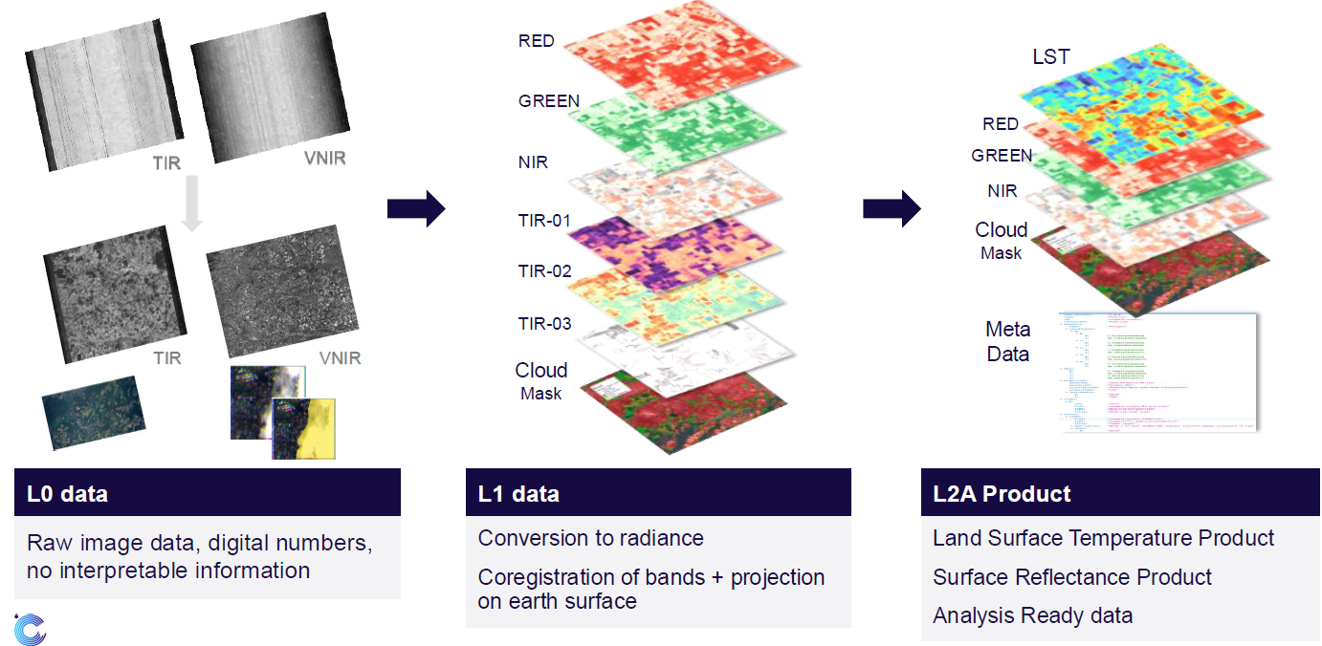
The HiVE processing pipeline

Slide 9
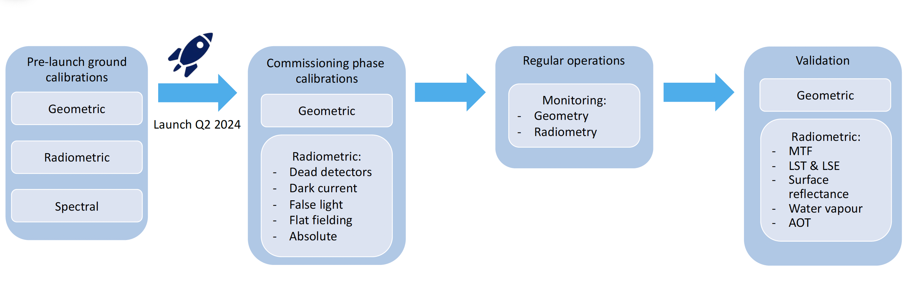
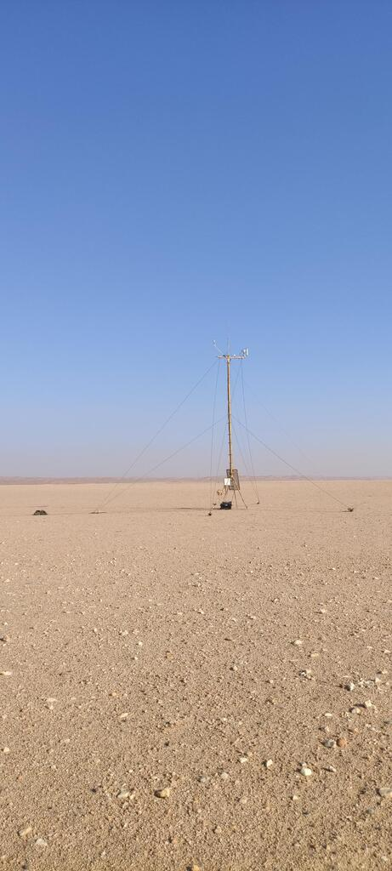
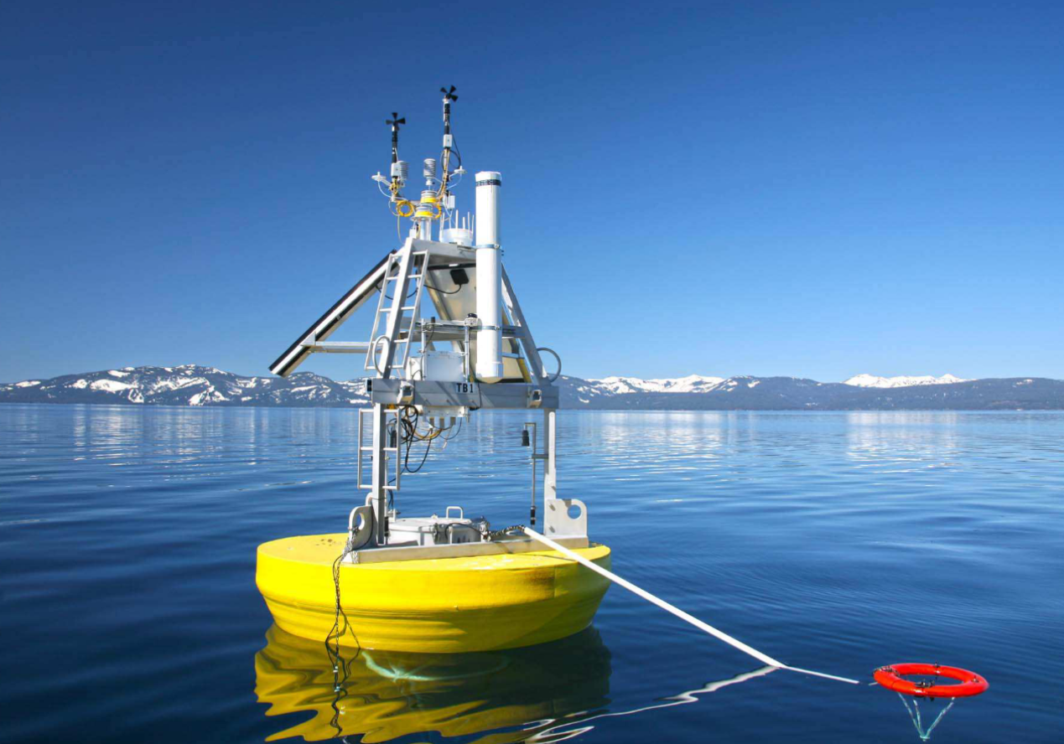
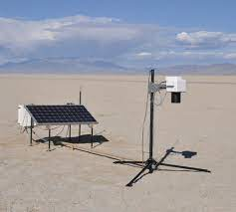
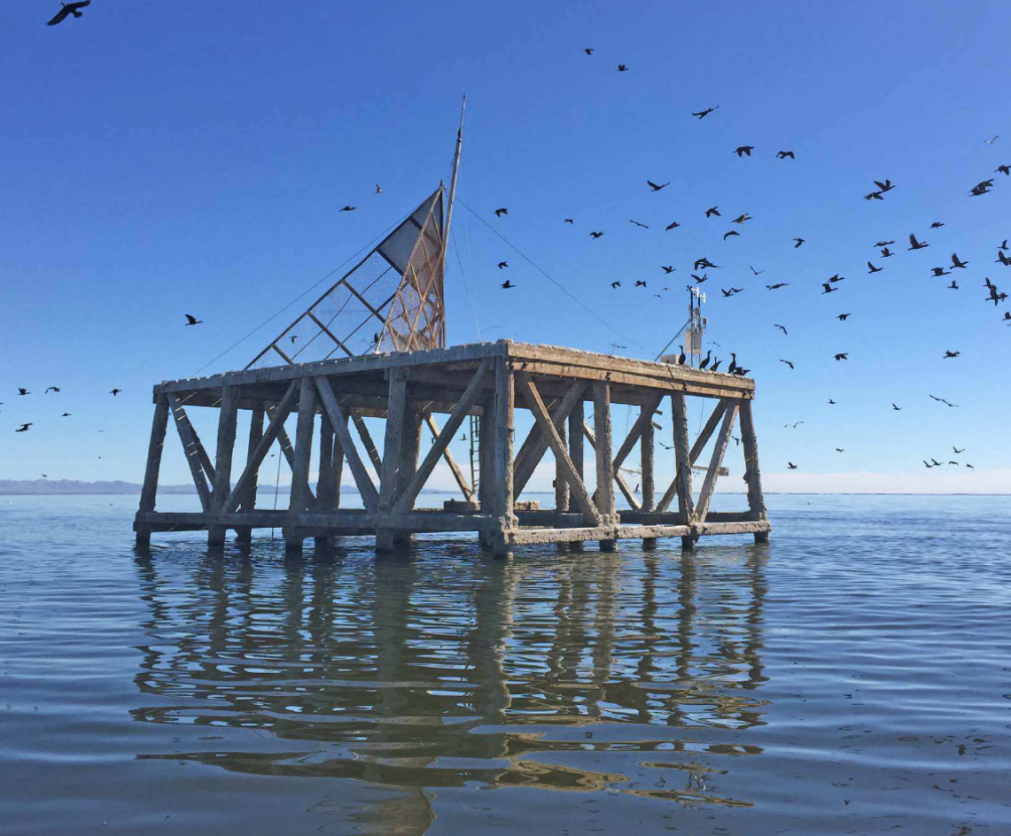

How to measure with precision? Cal/Val strategy
Launch Q1/2025
Q1/Q2-2024
Q1/2025 – Q2/2025
Q2/2025+
HiVE performance evaluated by
Q2/2025+
Notes:
VNIR
RadCalNet (robotic sites) Railroad Valley (USA), La Crau (France), Gobabeb (Namibia), …
PICS (Libya4, Salton Sea, …)
TIR
La Crau, Lake Tahoe, Salton Sea,
Potentially own cal site – synergy to other missions

Slide 10
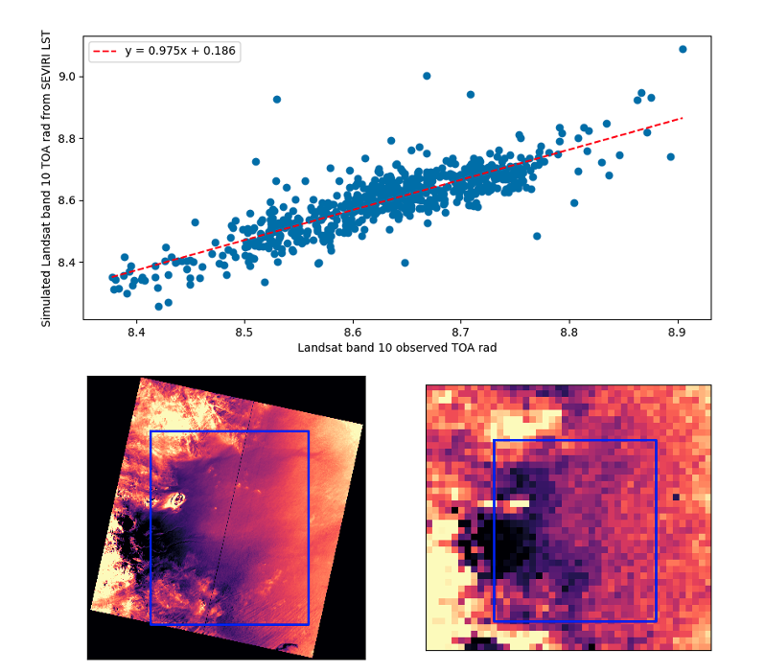
TIR Radiometric Calibration
Objective
Radiometrically calibrate a thermal sensor without the use of an onboard blackbody source
Cross-calibration Procedure
Simultaneously, collect imagery of uniform area with HiVE and Geostationary high revisit sensors (e.g. SEVIRI) + sun synchronous sensors (Landsat , S3)
Use low resolution ground temperature as ground truth for HiVE
Use on-board VNIR data (aerosol and water vapor bands) with external atmospheric profile
Vicarious Calibration
Future TIRCALNET sites
Building own calibration site based on drone measurements in collaboration with Fraunhofer IPM

Slide 11

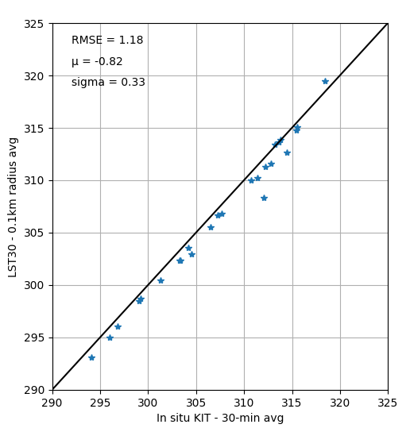
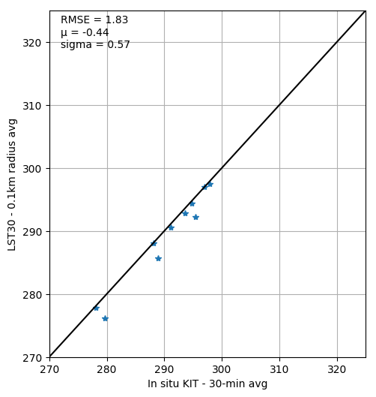
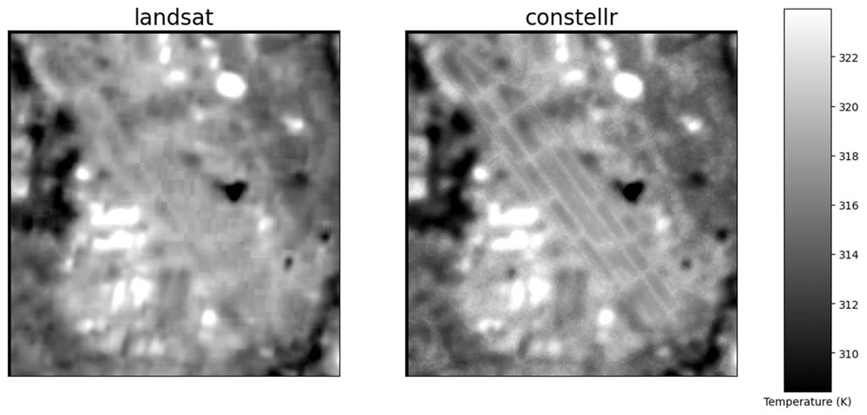
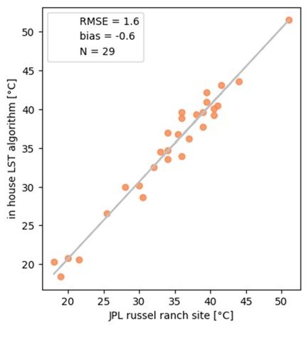
constellr LST algorithm performance
Gobabeb (2023)
Constance Lake (2023)
Applied to Landsat L1 data
Russel Ranch
Better detail visibility and less artifacts compared to Landsat algorithm (due to emissivity calc. procedure)

Slide 12
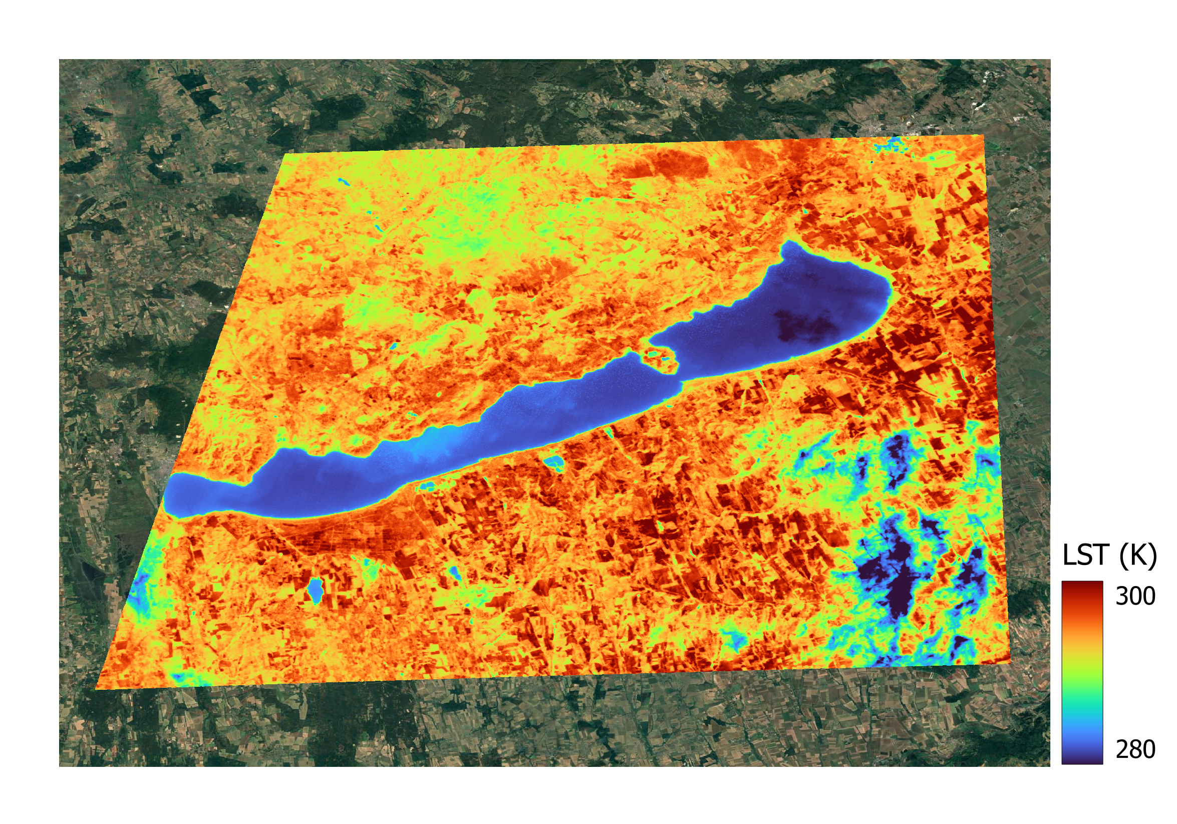
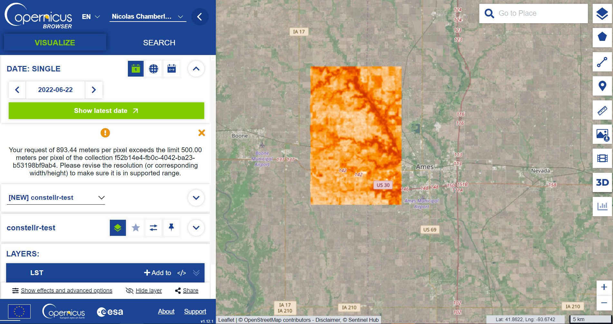
Other sectors
constellr as a Copernicus Contributing Mission
Balaton lake – 17/03/2019
Pilot activity:
10 years of harmonized data over Balaton Lake have been processed and delivered for a case study on algae blooming detection and turbidity monitoring.
HiVE data will follow in 2025.
Data will be included in the Copernicus Climate Data Store

Slide 13
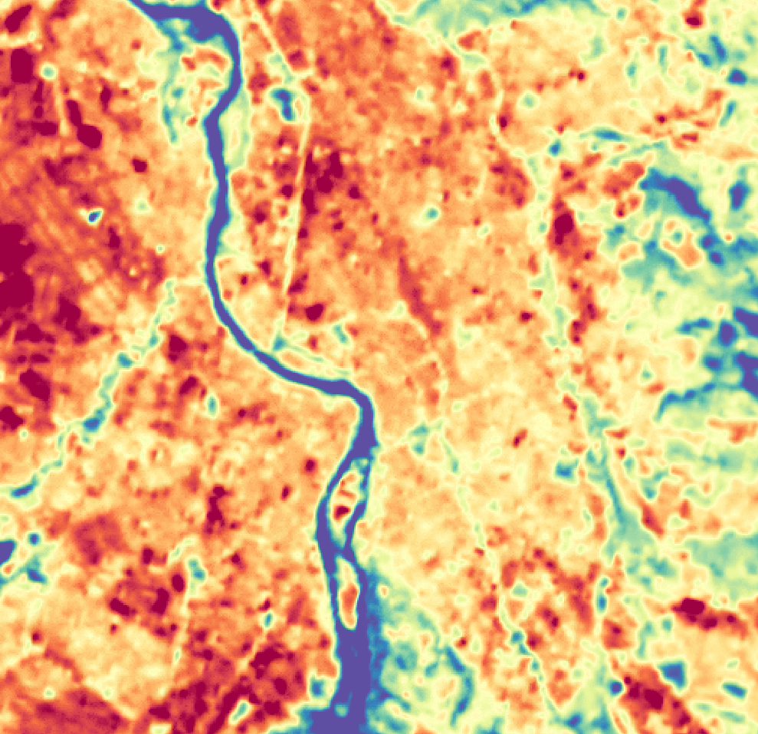
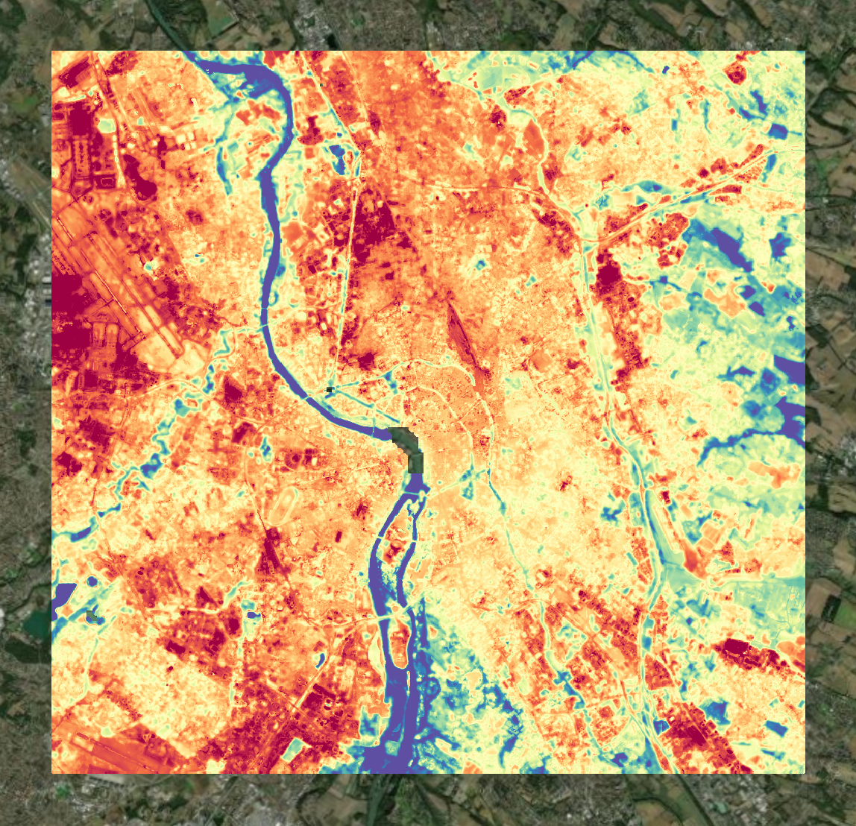
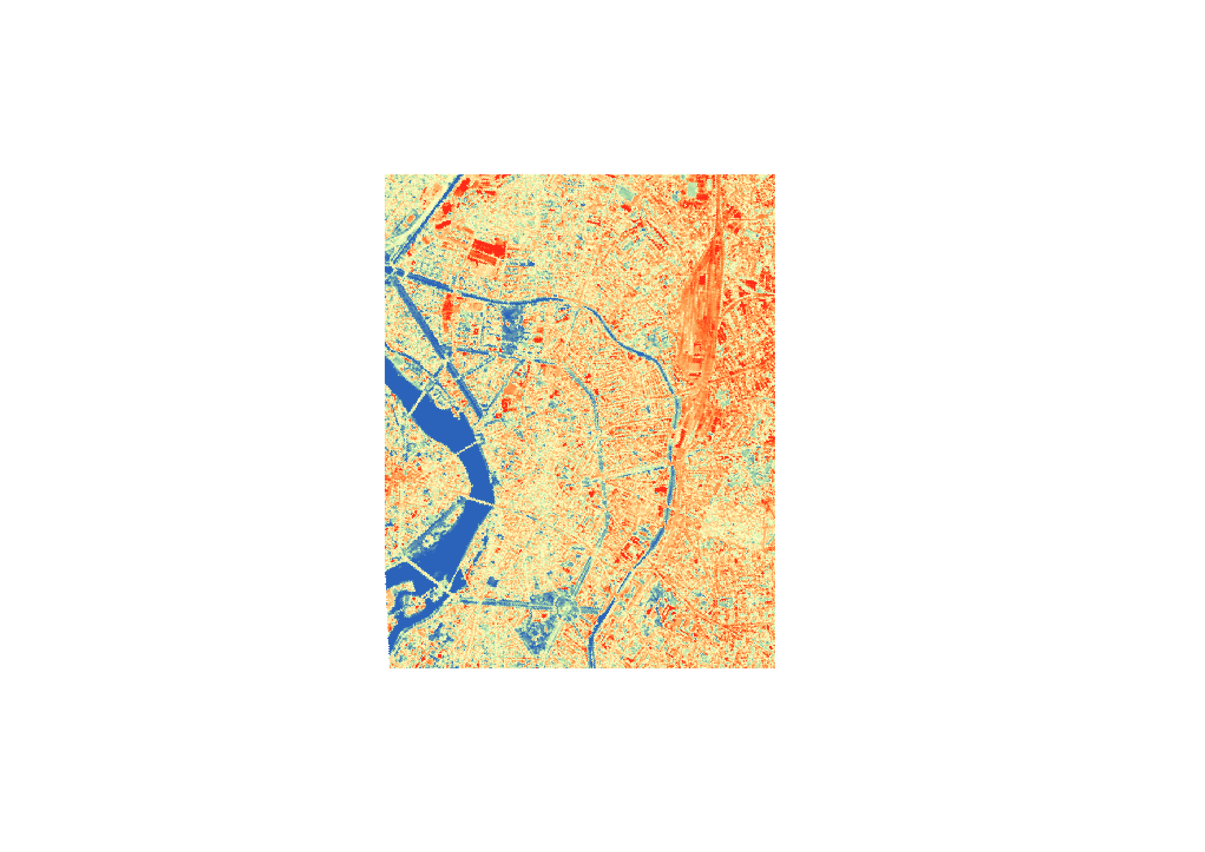

Product portfolio for 2025 offers possibilities for customers to explore temperature data in ways never seen before
End of Q1 2025
Q2 2025
Q2 2025
LSTfusion
LSTprecision
LSTzoom
30m spatial resolution
Fused data sources
Large area coverage
Reliable data frequency (8days)
30m native resolution
Proprietary data
High temperature sensitivity
Up to 4 day revisit
10m spatial resolution
Proprietary data – sharpened
Visually best resolved
Up to 4 day revisit
for reliable large scale monitoring
for high-value asset monitoring
for zooming-in on anomalies
Large coverage & continuity
High accuracy
Best resolution

Slide 14
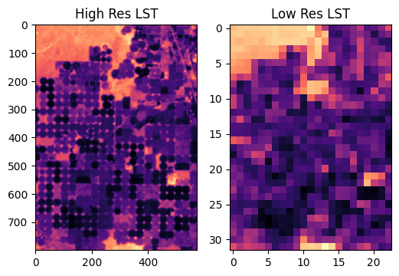
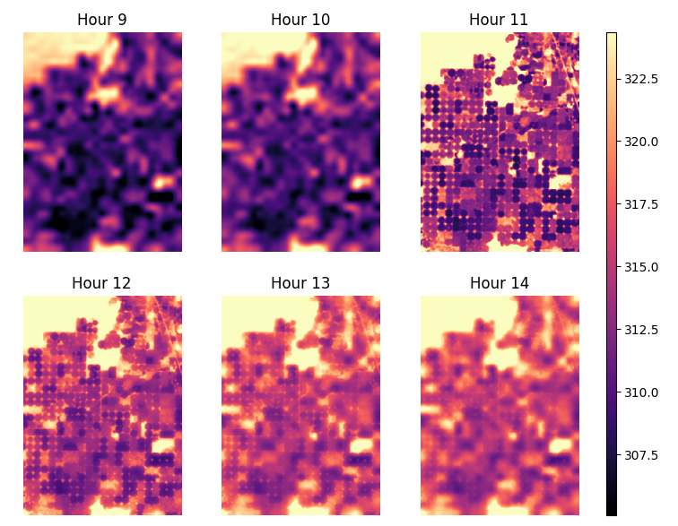
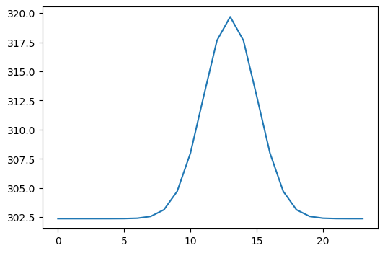
The LSTfusion product
The problem
Many gaps in LST observation maps caused by limited spatial coverage and revisit times of current thermal instruments.
Inconsistencies between satellite products.
Development of LSTfusion
Sat. observations
Relies on a data assimilation approach combining EO data and an optimized diurnal cycle model.
Diurnal cycle model

Slide 15
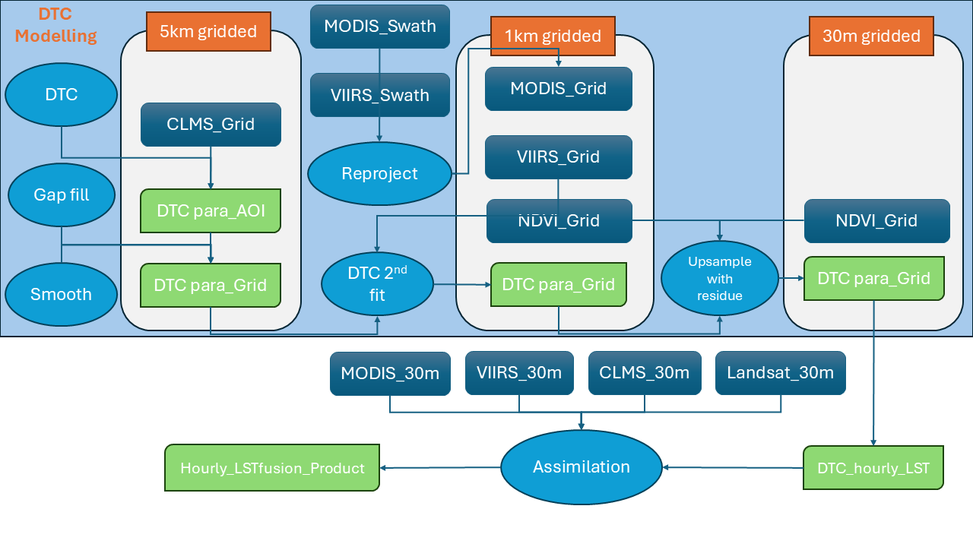
The LSTfusion product
Sensor/satellite | resolution | Revisit time | Spatial coverage | Time span | Swath (km)
Hive | 30 | 16 D |  |  | 18
Landsat8/9 | 100 | 16 D | global | 2013- | 185
Ecostress | 70 | - |  | 2018- | 384
ASTER/Terra | 90 | 16 D | Global | 2000- | 60
MODIS/Aqua,Terra | 1000+ | 0.5 D | Global | 2000- | 2330
VIIRS/snpp,noaa | 1000+ | 0.5 D | global | 2012- | 3000
SLSTR/S3 | 1000+ | 0.5 D | global | 2016- | 1420
SEVIRI/MSG | 3000+ | 15 min | Africa/EU | 2009-
ABI/GOES-R | 2000+ | 1 h | America | 2010-
AHI/Himawari-8,9 | 2000+ | 1 h | Japan/Australia | 2015-
Meteosat-9 |  |  | Africa/India
LSTM * 2 | 37/50 | 4 D | global | 2028 | 700
TRISHNA | 57/90 | 3 D | global | 2025 | 1000
SBG | 60/93 | ? | global | ? | 935
Fusion of high-res imagery, inc. HiVE and public missions, with coarse geostationary data to produce hourly 30m LST data for any AoI.
Expected release in mid 2025.

Slide 16
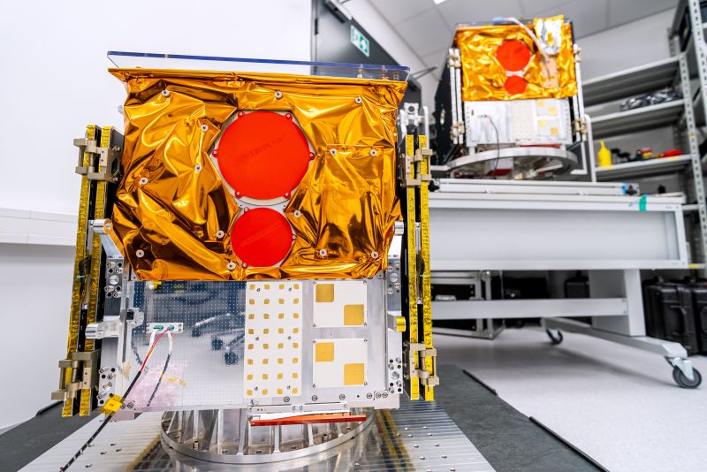
Thank you!
Any question?

Slide 17
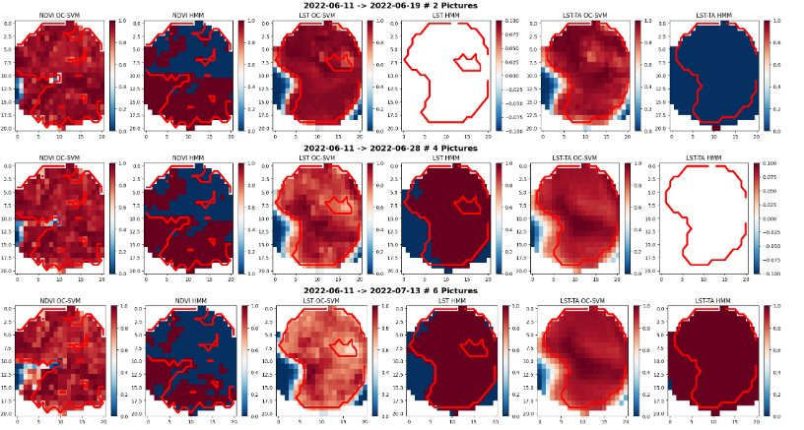
Early detection of vegetative stress using our thermal imagery
Anomaly detection
NDVI
LST
LST detects earlier signs of stress
Notes:
Heat stress is detected before damage is visible on the plants
Optimal time for pollination is determined
Allows to prioritize field intervention to mitigate earlier where it matters most

Slide 18
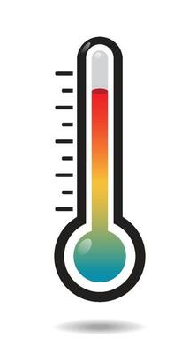
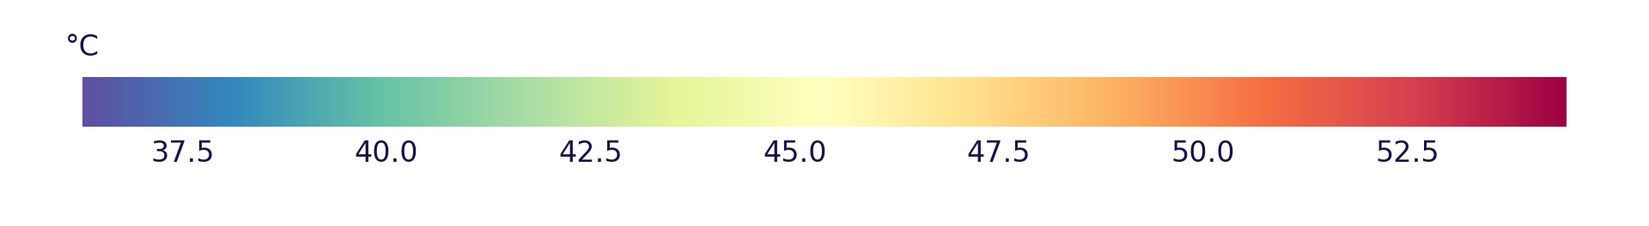
LST Fusion
Constellr LST
LST Zoom
The world‘s most precise temperature intelligence
LST Precision

