Slide 1

Analyzing Seasonal Patterns and Temperature Extremes in Urban Areas Using MODIS Data
IRINA ONTEL, ALEXANDRU DUMITRESCU, DANA MICU, SORIN CHEVAL
NATIONAL METEOROLOGICAL ADMINISTRATION, ROMANIA

Slide 2
Aims & approach of the study
Examine the seasonal LST variations across urban, peri-urban and rural areas.
Investigate the seasonal LST trends across different cities of Romania over 2002-2021.
Examine shifts in the seasonality and LST extremes in urban areas over 2002-2021.

Slide 3
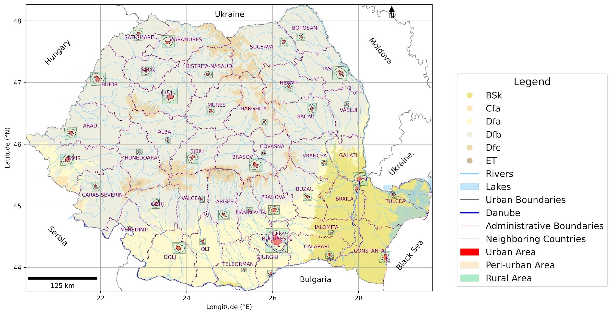
Study area
41 cities in Romania, each with a population exceeding 41,000 inhabitants.
Three zones have been established for each city:
Urban (represented by the built-up area within the administrative boundaries),
Peri-urban (defined by a buffer generated using half the maximum distance from the centroid),
Rural (represented by a rectangular polygon created based on the buffer, extending 10% beyond its limits).
Geographical distribution of the urban areas analyzed in this study across Romania

Slide 4
Data and methodology
Data collection: Terra MODIS (2001 to 2021) and Aqua MODIS (2002 to 2021) for both day and night, from LST_cci version 4.00.
LST Preprocessing:
Spatial Subletting: Extracting LST data within the 41 cities from Romania;
Quality Control: Applying quality flags provided with the LST product to exclude unreliable or missing data;
Temporal Aggregation: Generating seasonal LST mean for day time and night time.
LST Trend Analysis:
Ordinary least squares (OLS) model;
Get Durbin-Watson statistic to check for autocorrelation and apply Newey-West correction if autocorrelation detected (Waring et al., 2023).
Seasonality and extremes:
Seasonality was identified when LST reached or exceeded 30°C for at least three consecutive days, using Aqua daytime data. Metrics of seasonality: Start of Season (SOS), End of Season (EOS), Length of Season (LOS), and Position of Peak.
Extremes were identified using the following criteria:
(i) daytime LST (Aqua), exceeding 40°C for at least three consecutive days, and
(ii) nighttime LST (Aqua), exceeding 20°C for at least three consecutive days.
Clustering algorithm
Clustering was performed using the Euclidean distance metric and Ward's method.

Slide 5
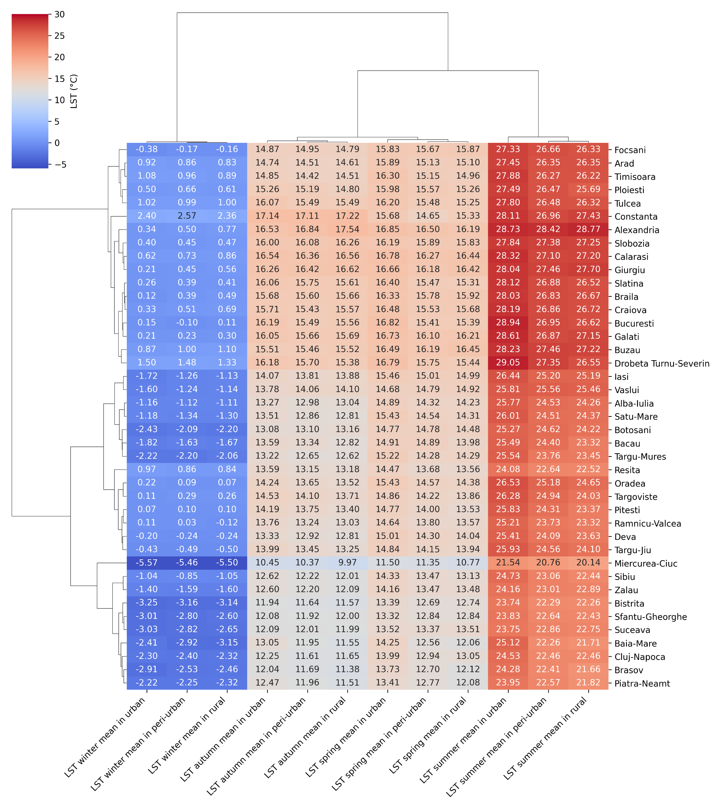
Terra and Aqua (night and day)
Results
The average seasonal LST for the 2001–2021 period, derived from Terra and Aqua satellite data
The highest LST across all seasons were recorded in the plain and hill cities located in the southern, southeastern, and western parts of the country.
In summer, the LST differences between urban and peri-urban areas are approximately 1°C, while the differences between peri-urban and rural areas are smaller, around 0.5°C.
In winter, these differences are negligible.

Slide 6
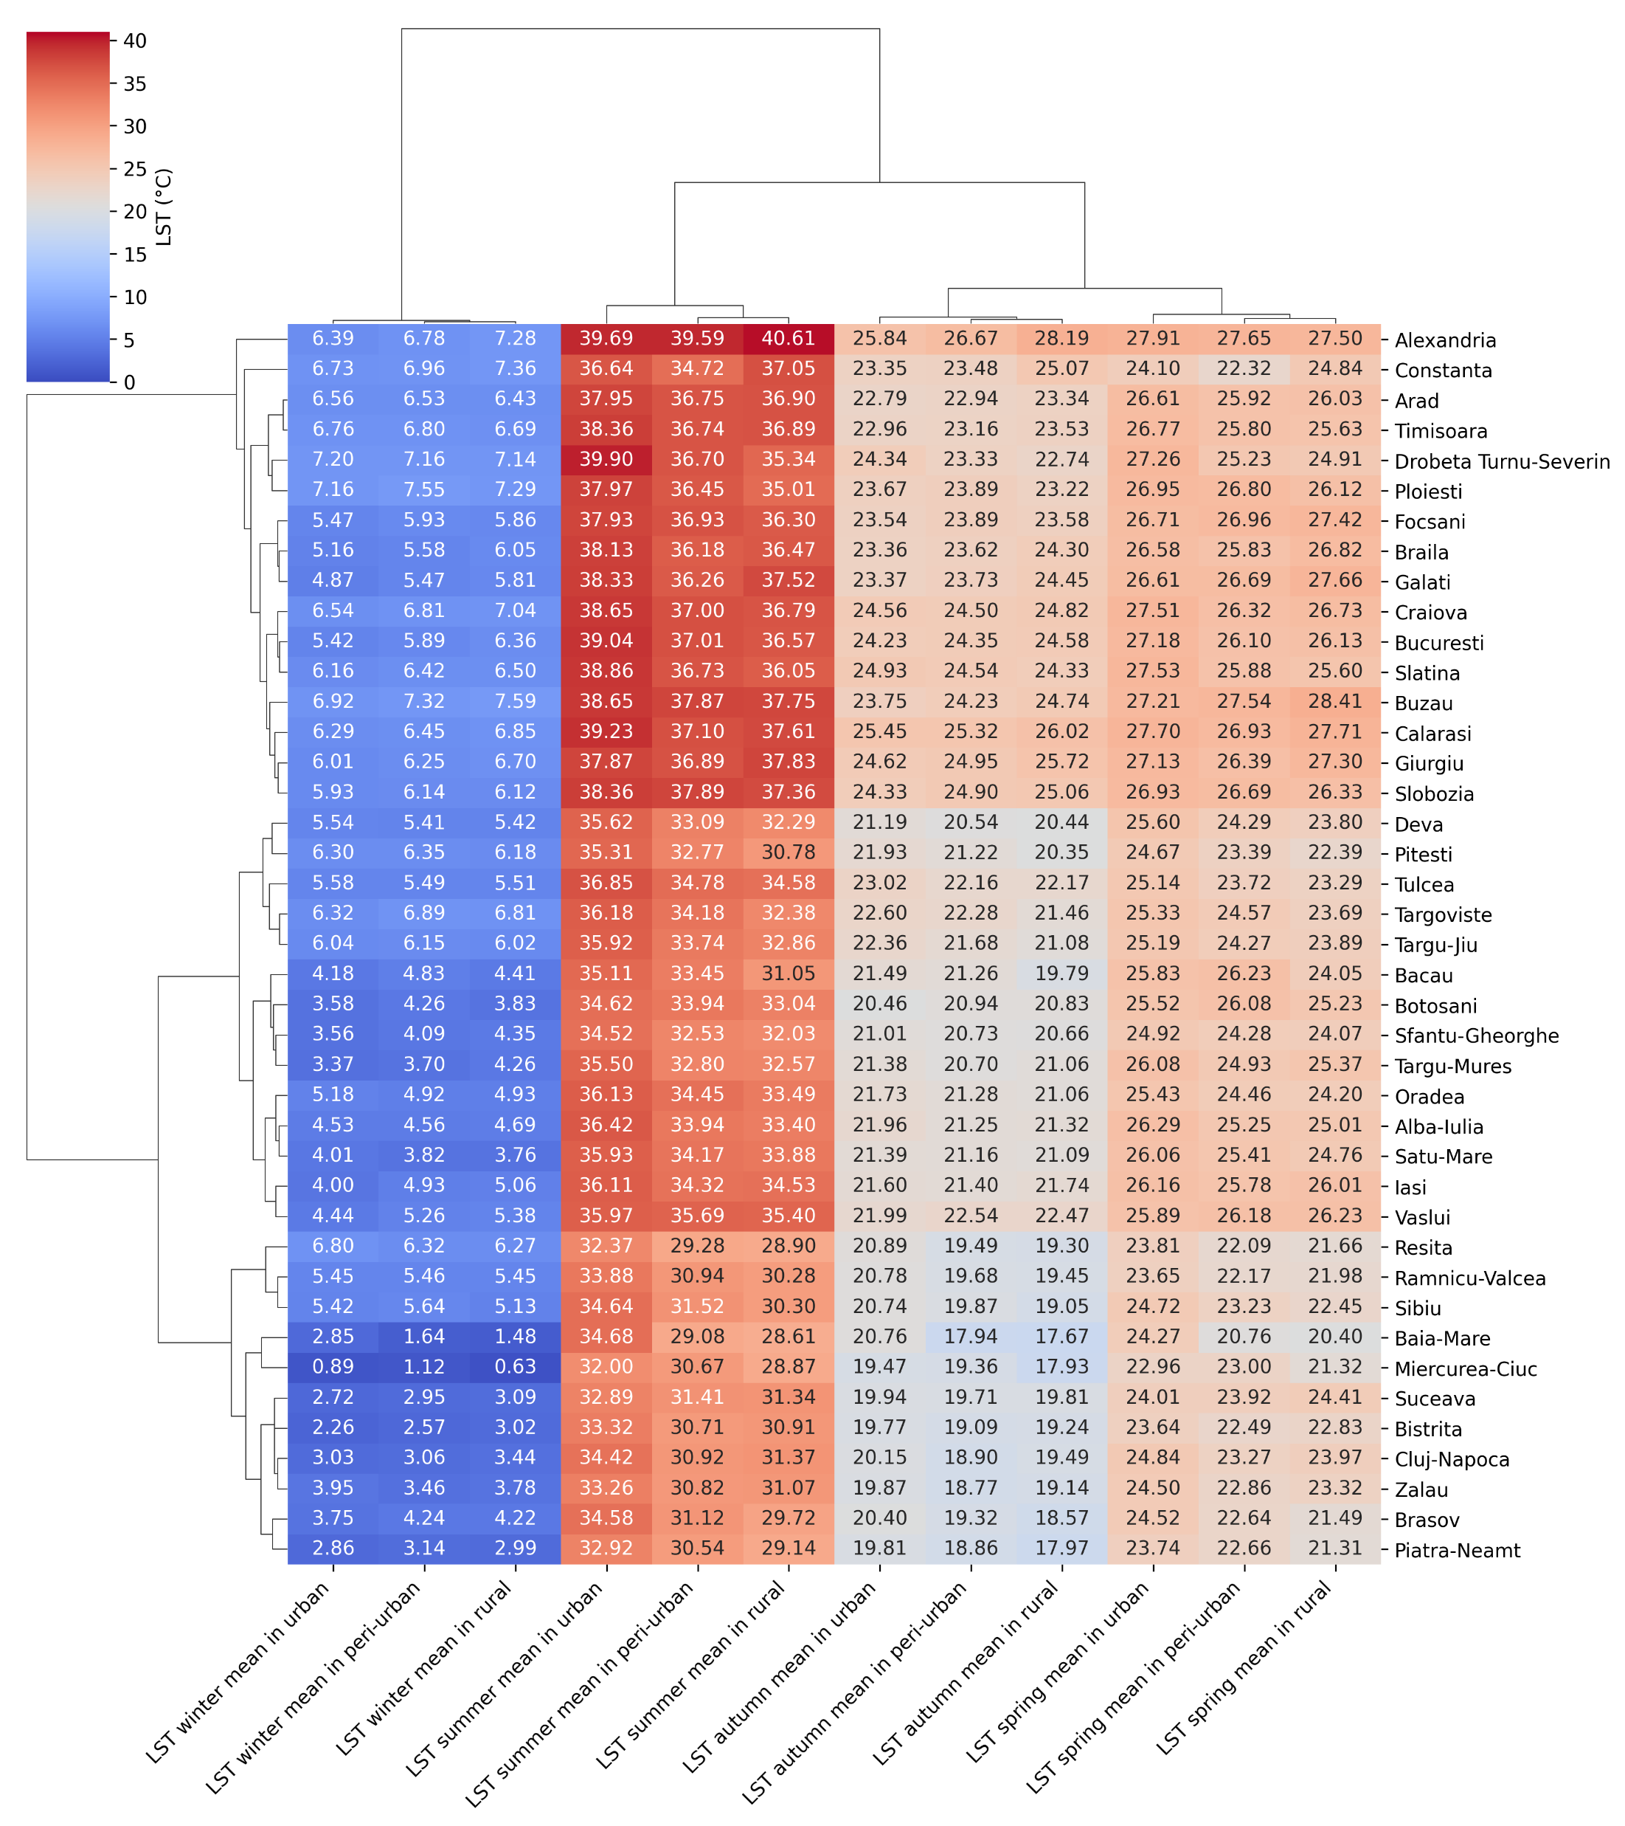
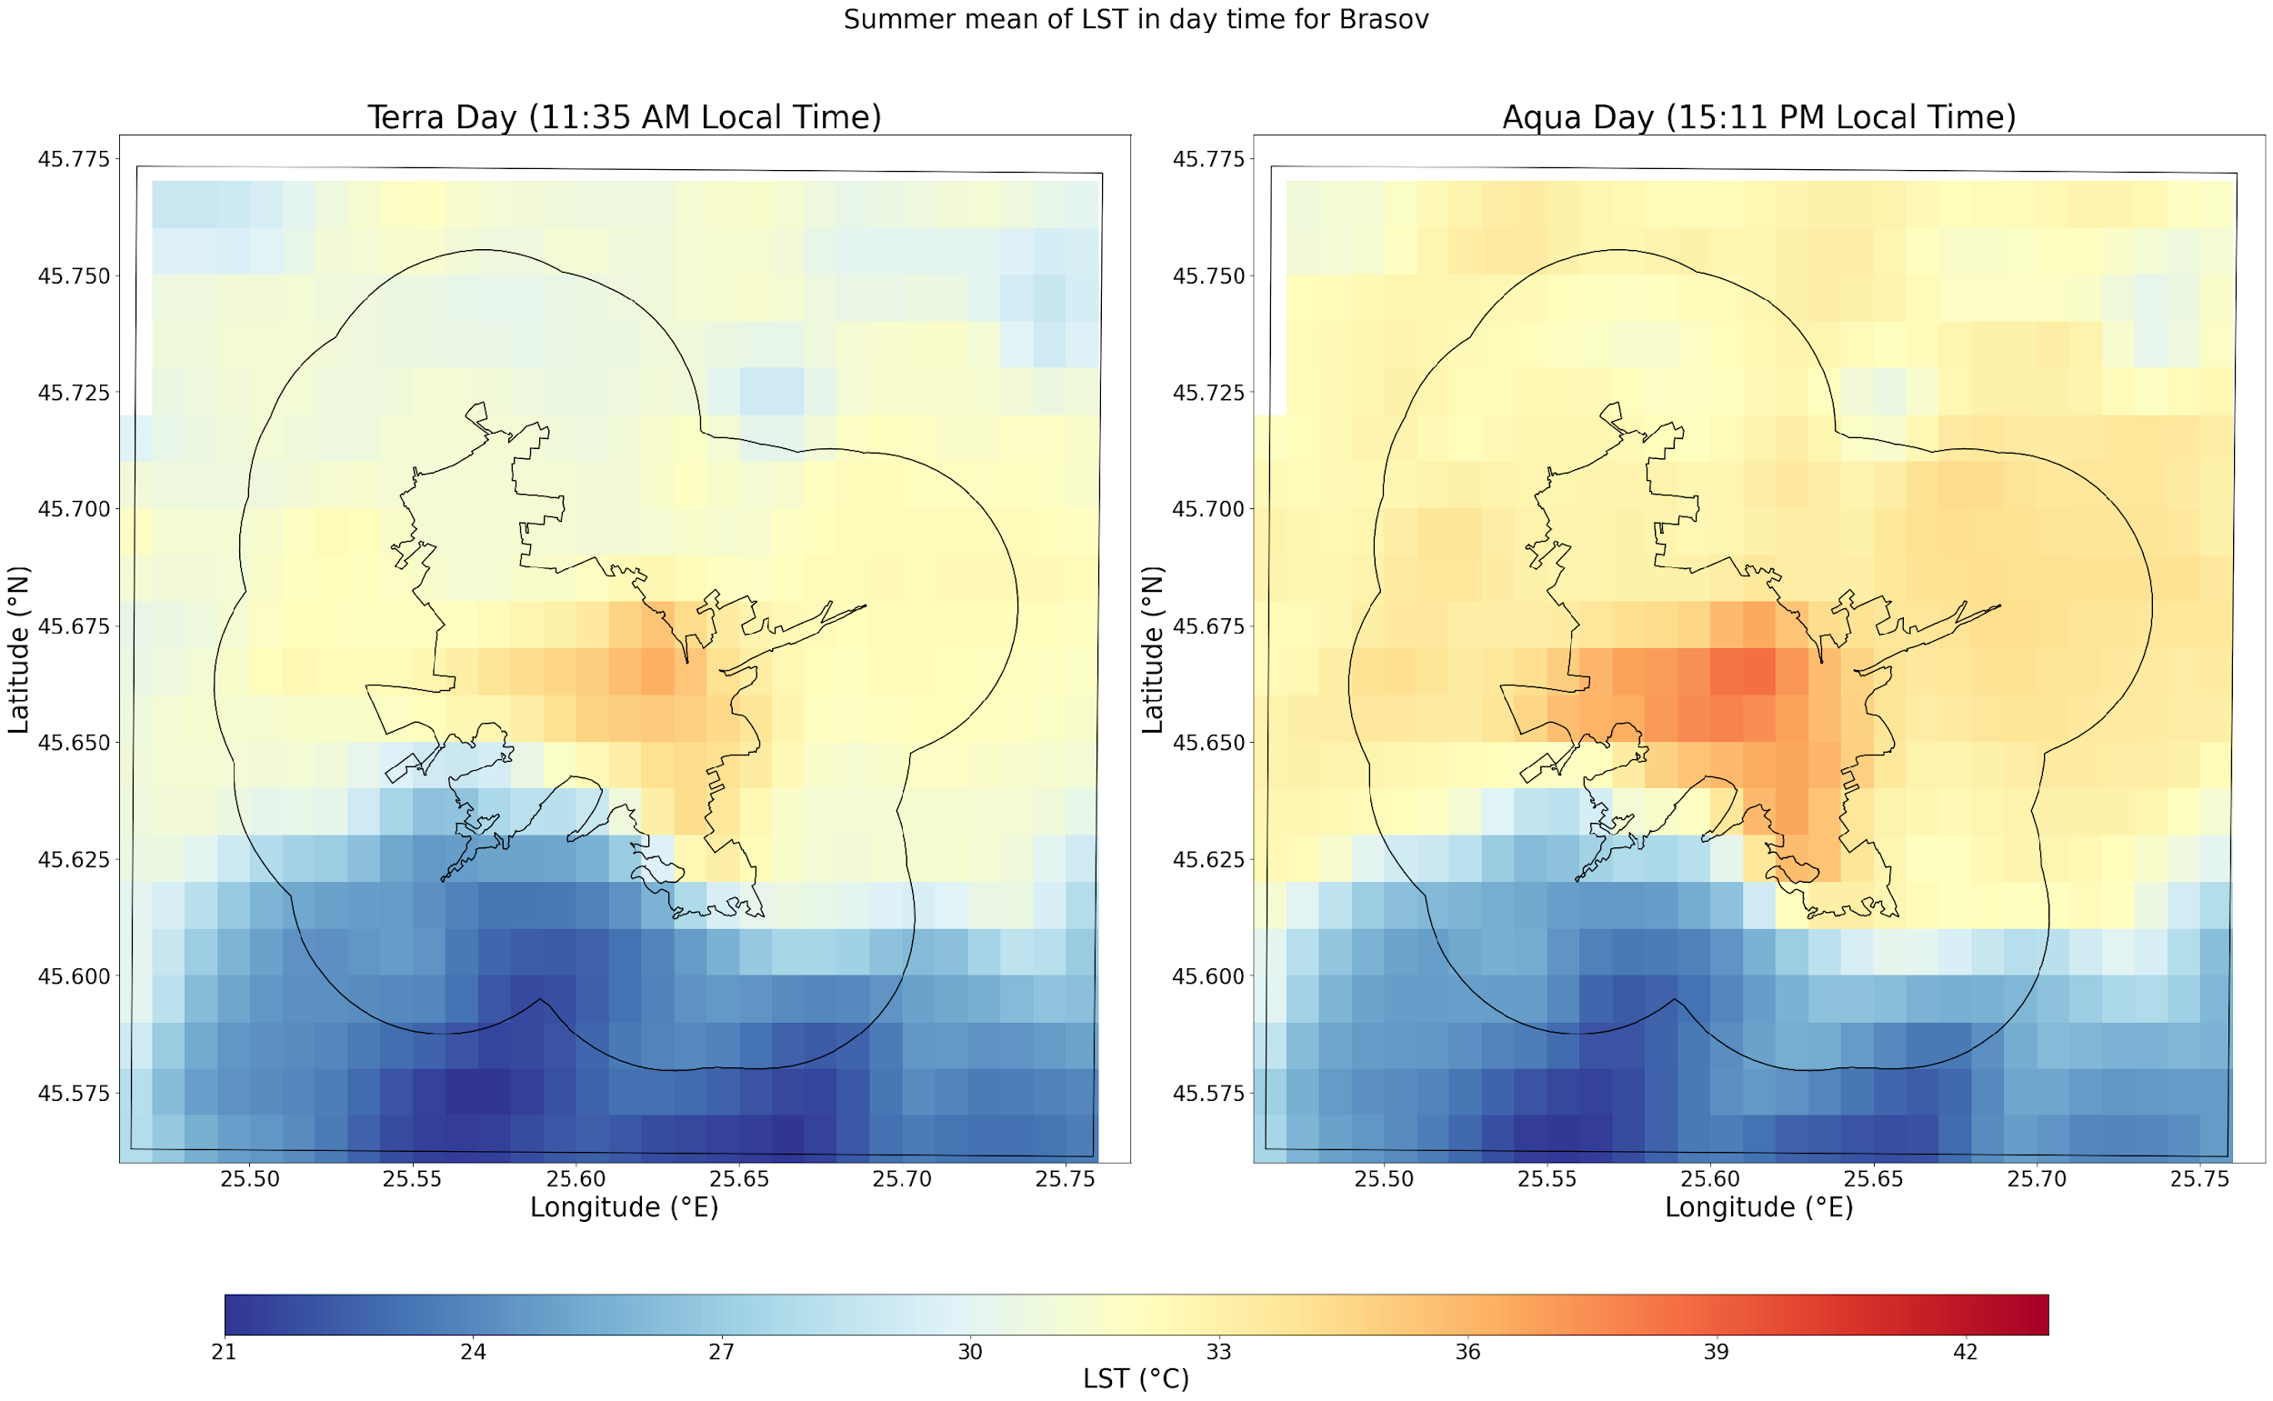
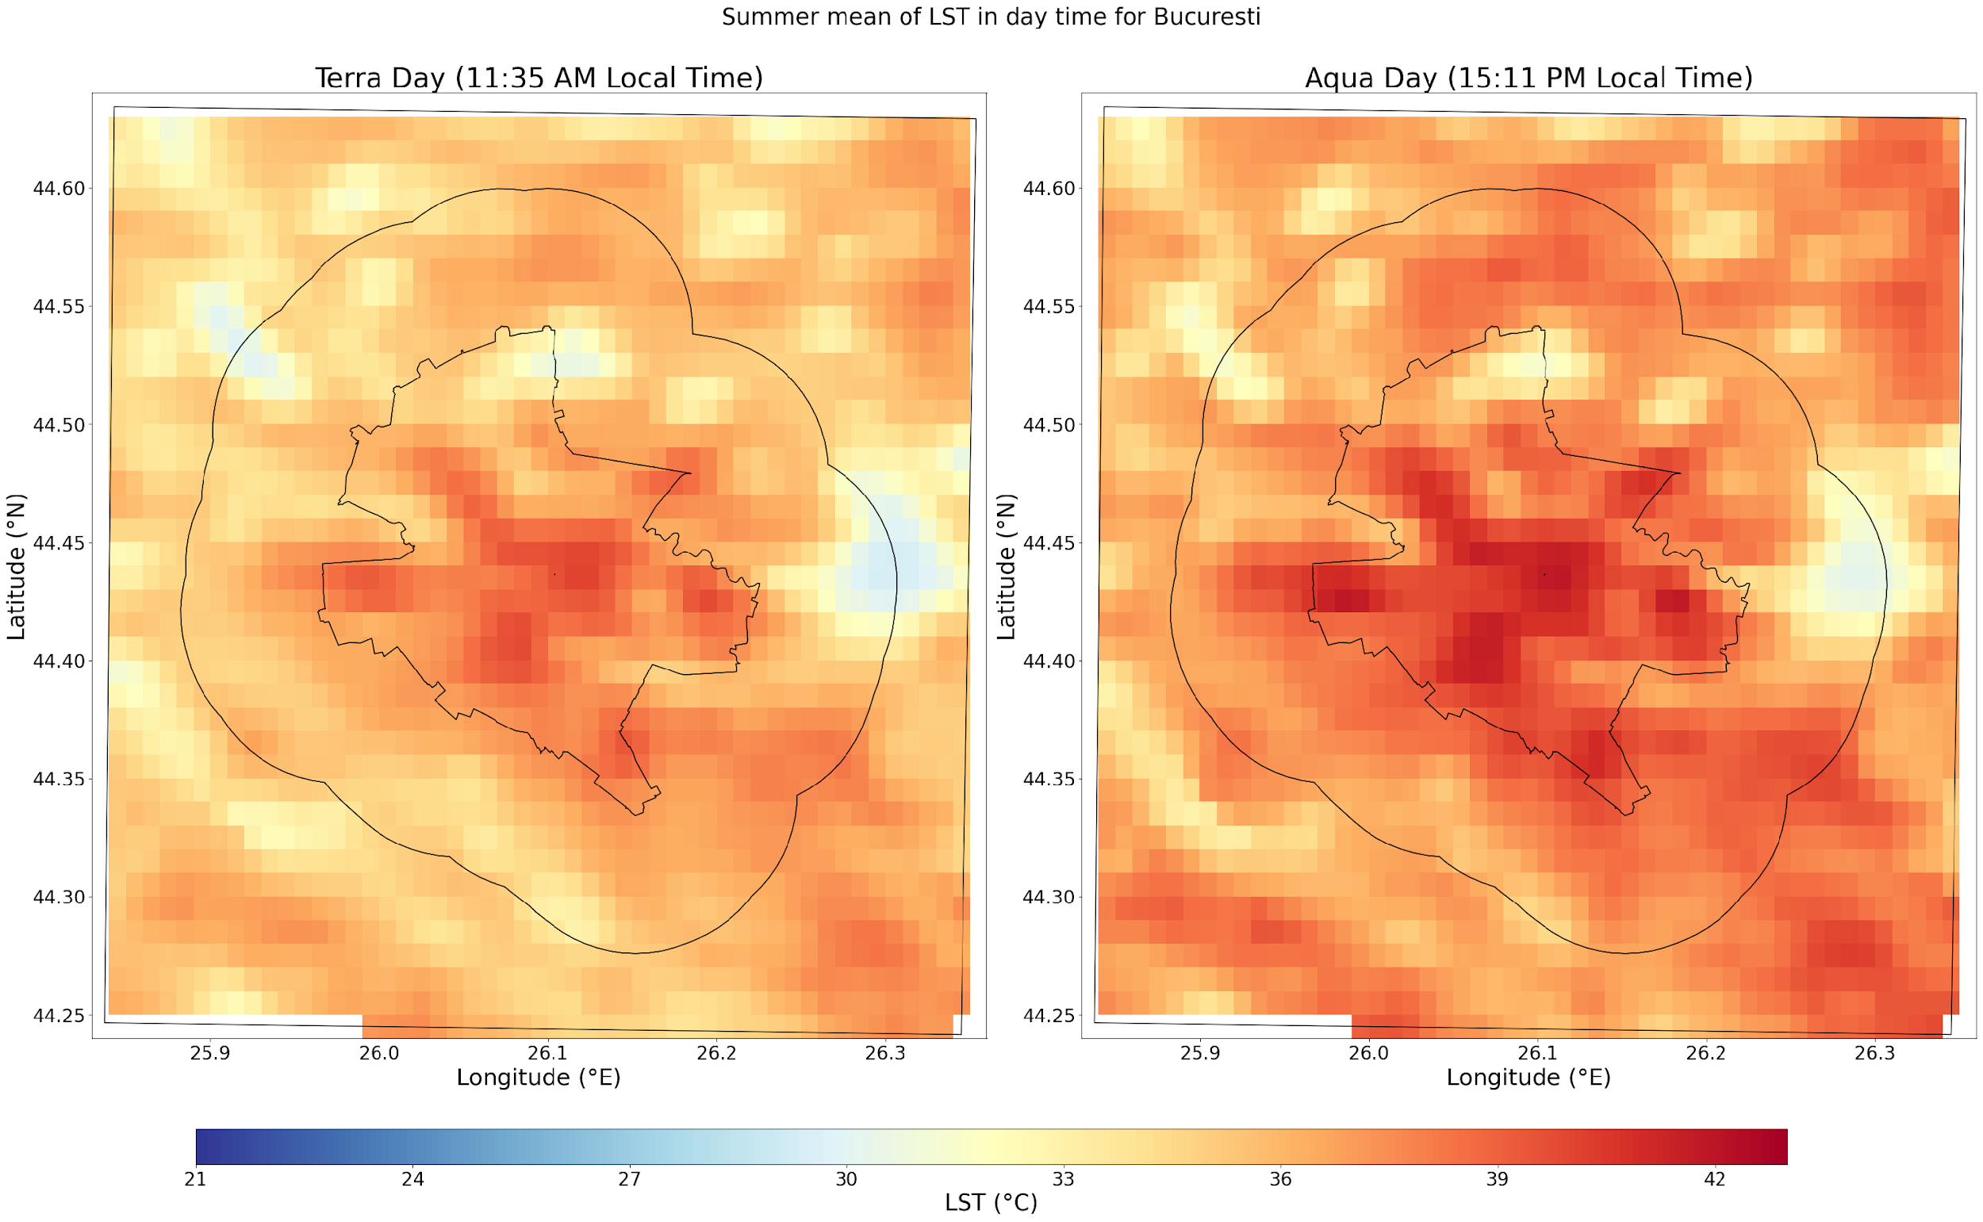
Aqua - day
Results
Seasonal average LST at 12:00 UTC (2002-2021)
The differences during the day (12:00 UTC) between urban and peri-urban are reduced in all seasons for all cities located at lower altitudes, especially in the plain regions.
Differences of 1-2°C have been observed for cities located at higher altitudes in the hilly or mountainous areas.
summer
Aqua
Terra
Brașov (located in a mountain depression, mountain heights at south)
Bucharest (located at in a flat plain area)

Slide 7
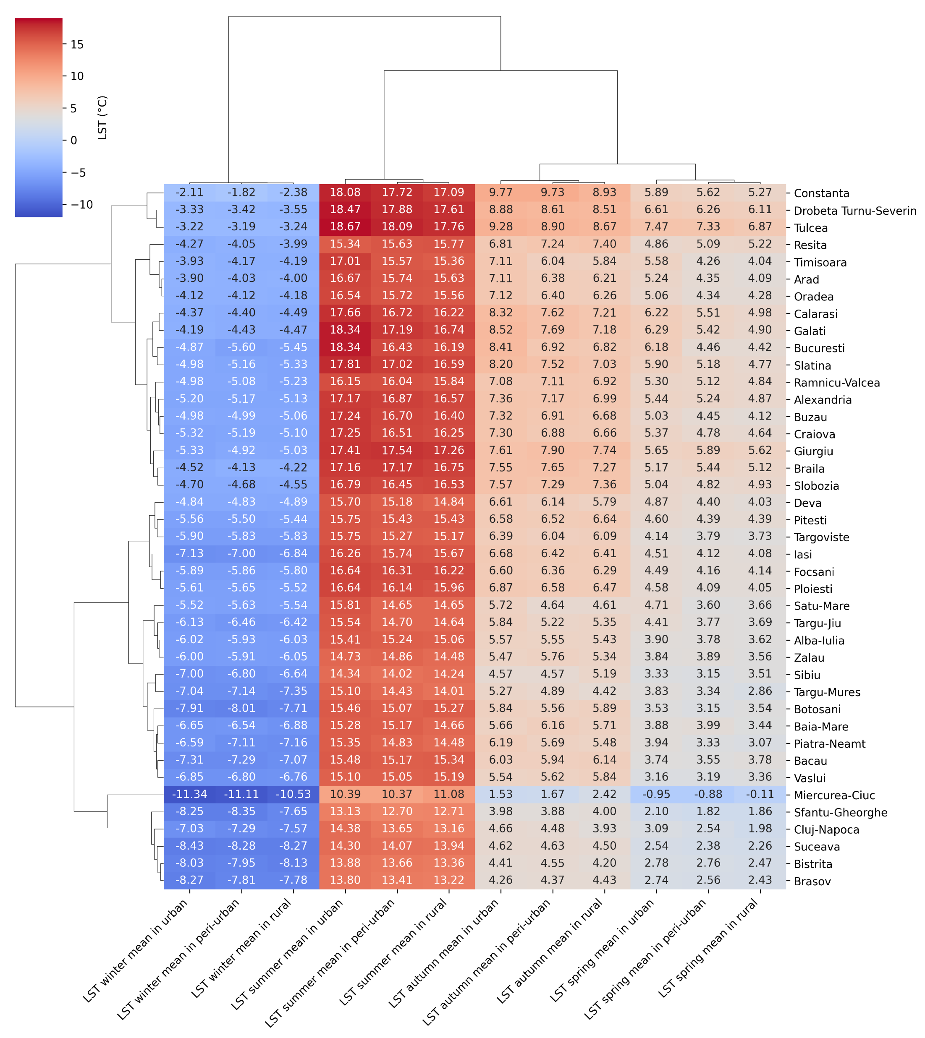
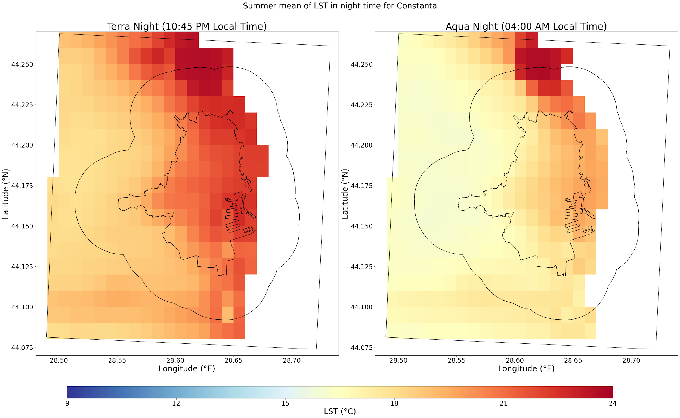
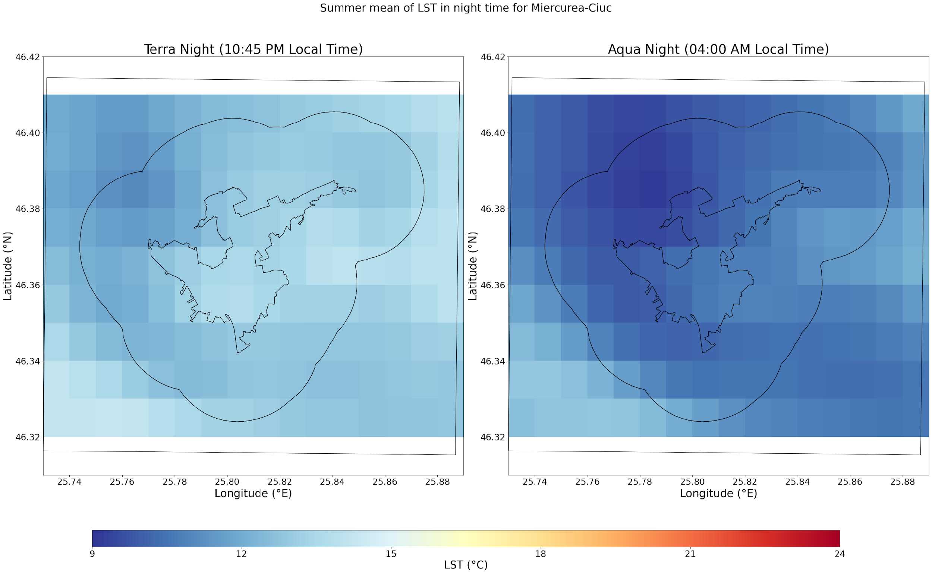
Aqua - night
Results
Seasonal average LST at 1:00 UTC (2002-2021)
The nighttime differences (1:00 UTC) between urban and peri-urban are 1-2°C for most cities, for winter and summer and less significant for spring and autumn.
The highest nighttime LST are recorded in the southern and southeastern areas of the country near major water bodies, and the lowest in the northern ones, especially in the hilly and mountainous areas.
summer
Terra
Aqua
Constanța (located near Black Sea)
Miercurea-Ciuc (located in the mountainous areas)

Slide 8
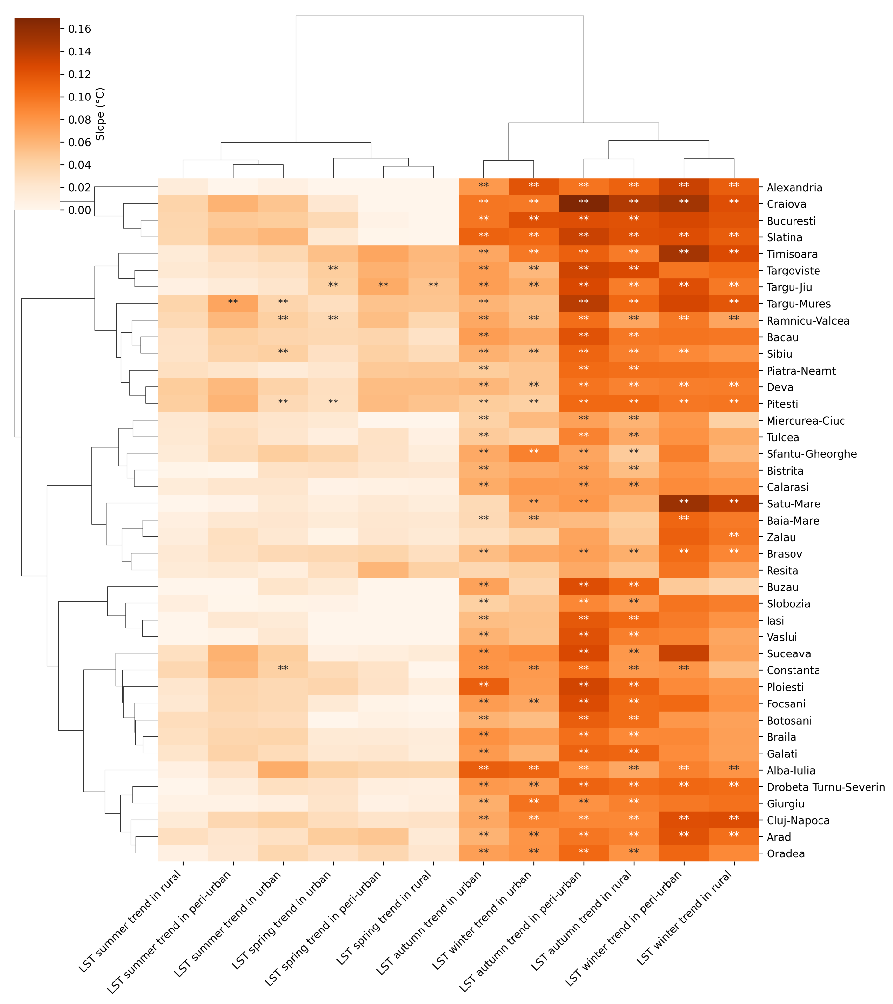
Aqua - day
Results
Pvalue < 0.05
Seasonal LST trend at 12:00 UTC (2002-2021)
Significant daytime LST trends (up to 0.17°C/year in autumn and up to up to 0.15°C/year in winter) were identified in autumn and winter in most cities.
In summer and spring, the trends were significant (0.05°C/year) in urban areas only for a few cities such as: Târgoviște, Târgu-Jiu, Târgu-Mureș, Râmnicu-Vâlcea, and insignificant in peri-urban and rural areas.

Slide 9
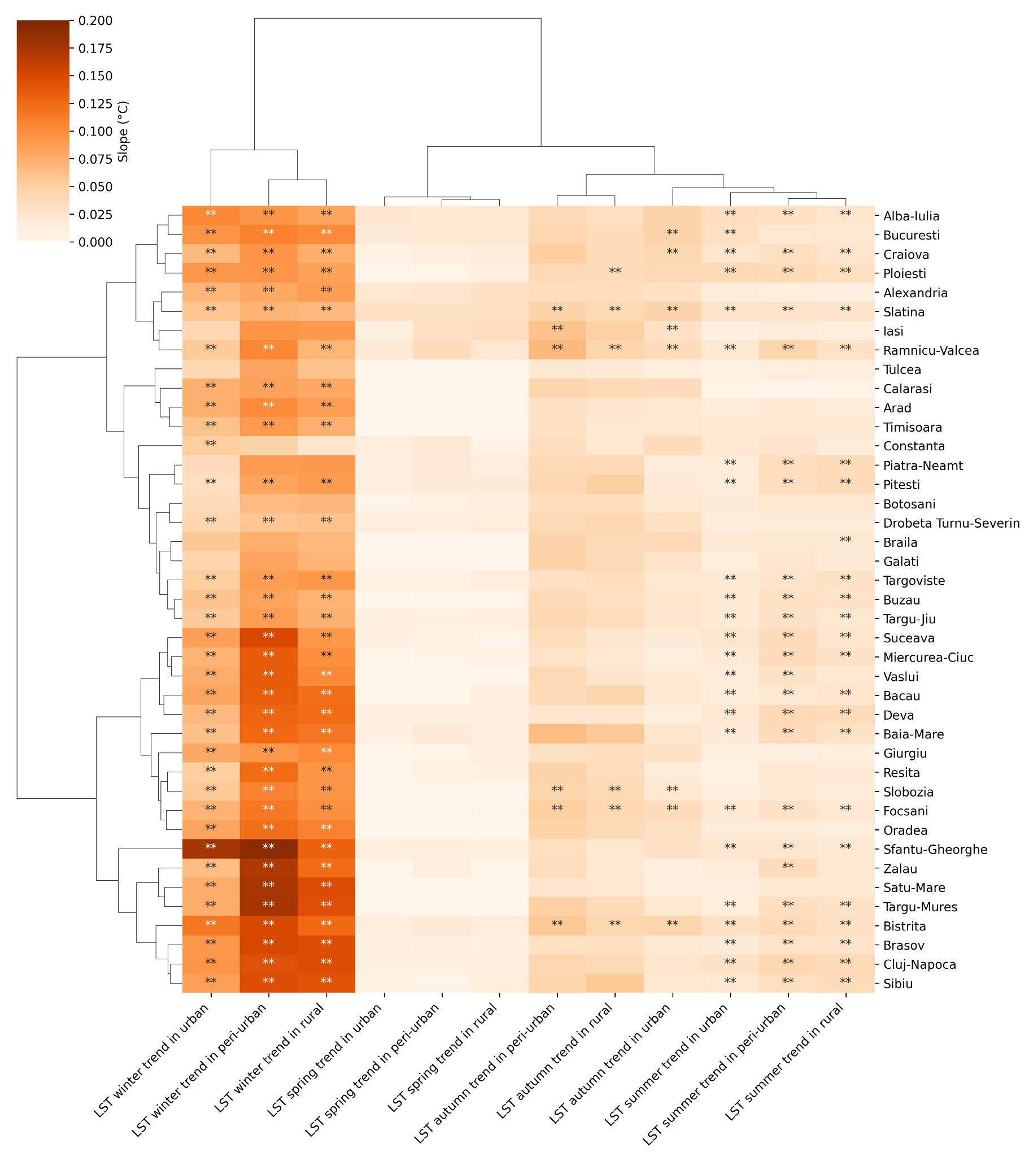
Aqua - night
Results
Pvalue < 0.05
Seasonal LST trend at 1:00 UTC (2002-2021)
At night, statistically significant increasing trends of up to 0.2°C/year were recorded in winter in the valley and mountain cities and lower in the rest of the cities.
In summer, the trends are also statistically significant but with a lower increasing slope of approximately 0.05°C, compared to winter.
In spring, at night, no significant trends were recorded for any city.

Slide 10
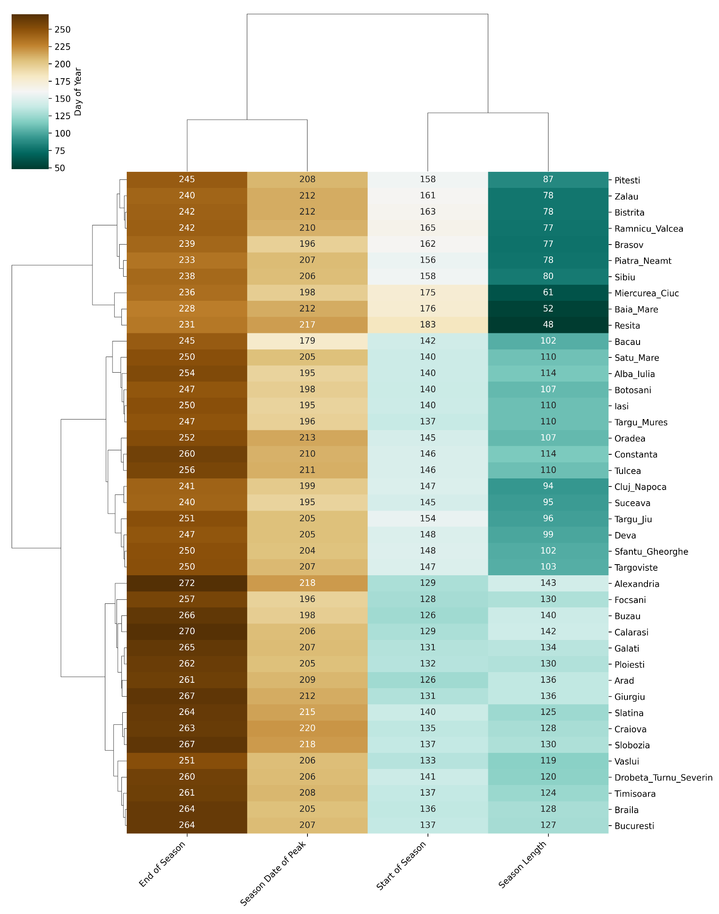
Results
Aqua - day
Identifying seasonality characteristics in urban areas
Seasonality was identified based on the condition that a temperature of 30°C or higher must be recorded for three consecutive days, using Aqua daytime data.
Start of Season, begins earlier for cities in the south and west (in cites such as Arad, Calarasi, Alexandria, Giurgiu the SOS registered at the beginning of May), compared to those in the north (Resita, Baia-Mare, Miercurea-Ciuc at the end of June);
End of Season, occurs later in the south and west (end of September) and mid of August for those in the north;
Length of Season, is longer for southern cities and shorter for those in the north or at higher altitudes (40 m to 660 m); the LOS ranges between 50 and 140 days, with a mean amplitude of 100 days.
Position of Peak, no significant differences were observed among the analyzed cities.

Slide 11
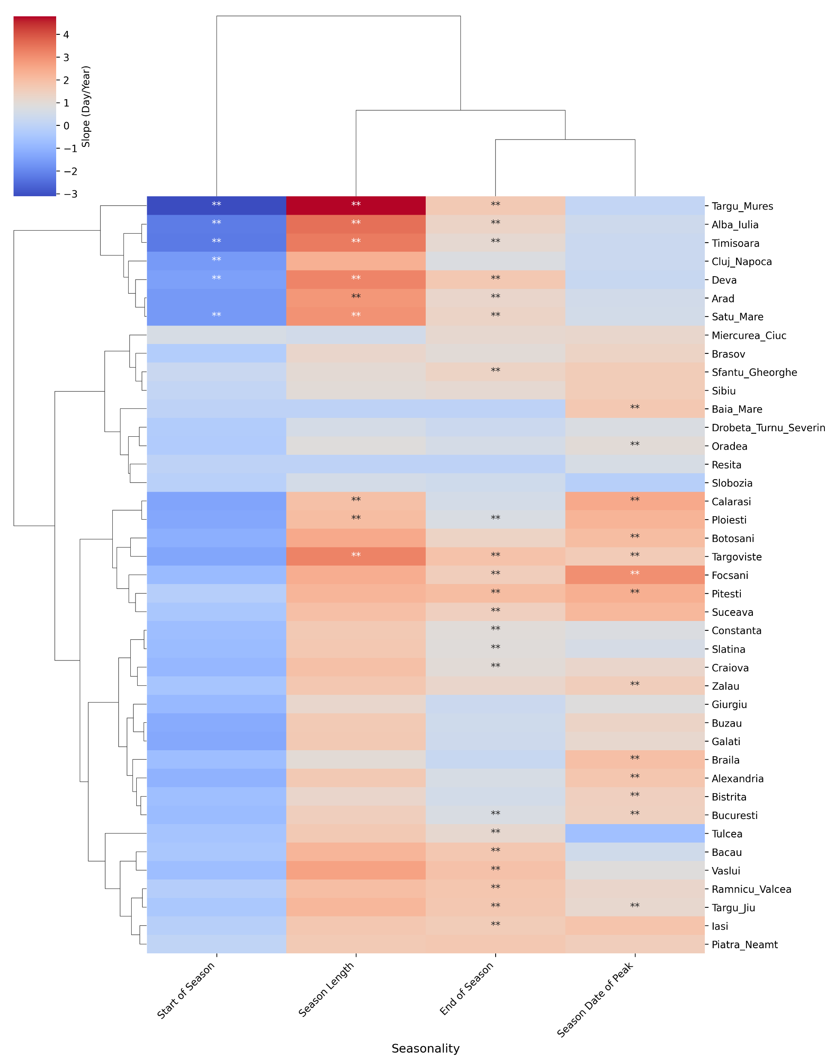
Results
Aqua - day
Pvalue < 0.05
Examine the observed shifts in LST seasonality in urban areas
Start of Season begins earlier in several cities located in the central and western part of the country;
End of Season tends to be later for cities in the western part of the country, as well as for other cities in the southern and eastern region;
Length of Season is longer for cities located in the western part of the country;
Position of Peak tend to occur later in most cities in the southern and eastern parts of the country.

Slide 12
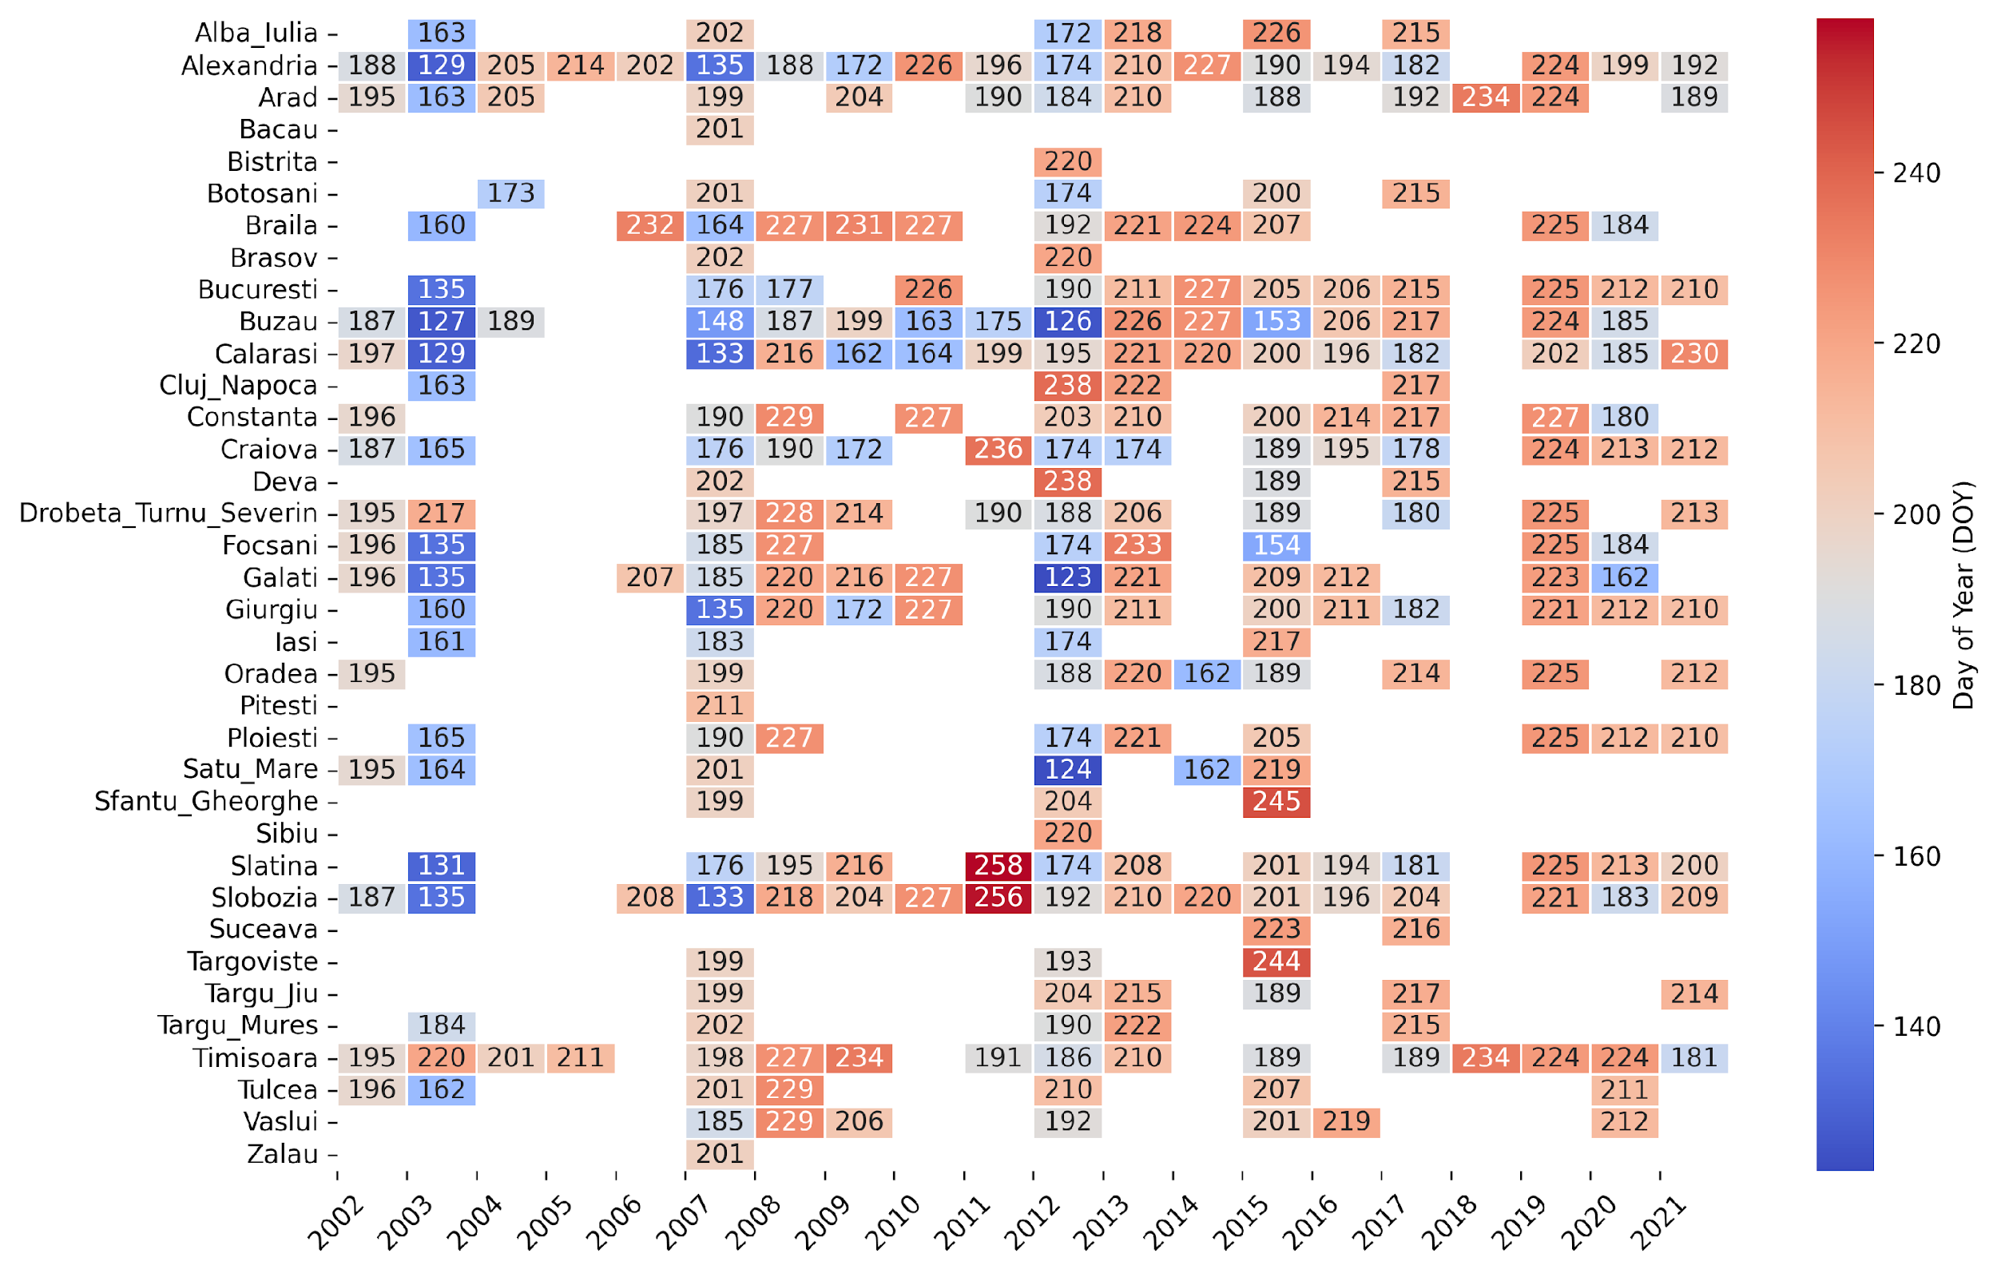
Results
The start date when at least three consecutive days with LST above 40°C are recorded
Identifying extremes in urban areas (LST above 40°C during the day at 12:00 UTC)
36 of cities experienced at least three consecutive days with LST values above 40°C.
LST values exceeding 40°C were recorded in most cities during exceptionally hot years, marked by intense heatwaves such as those in 2003, 2007, 2012, and 2015.
In the first half (2002-2012) of the analyzed period these events occurred in June and July, in the second half (2013-2021), they tend to occur later in the year.

Slide 13
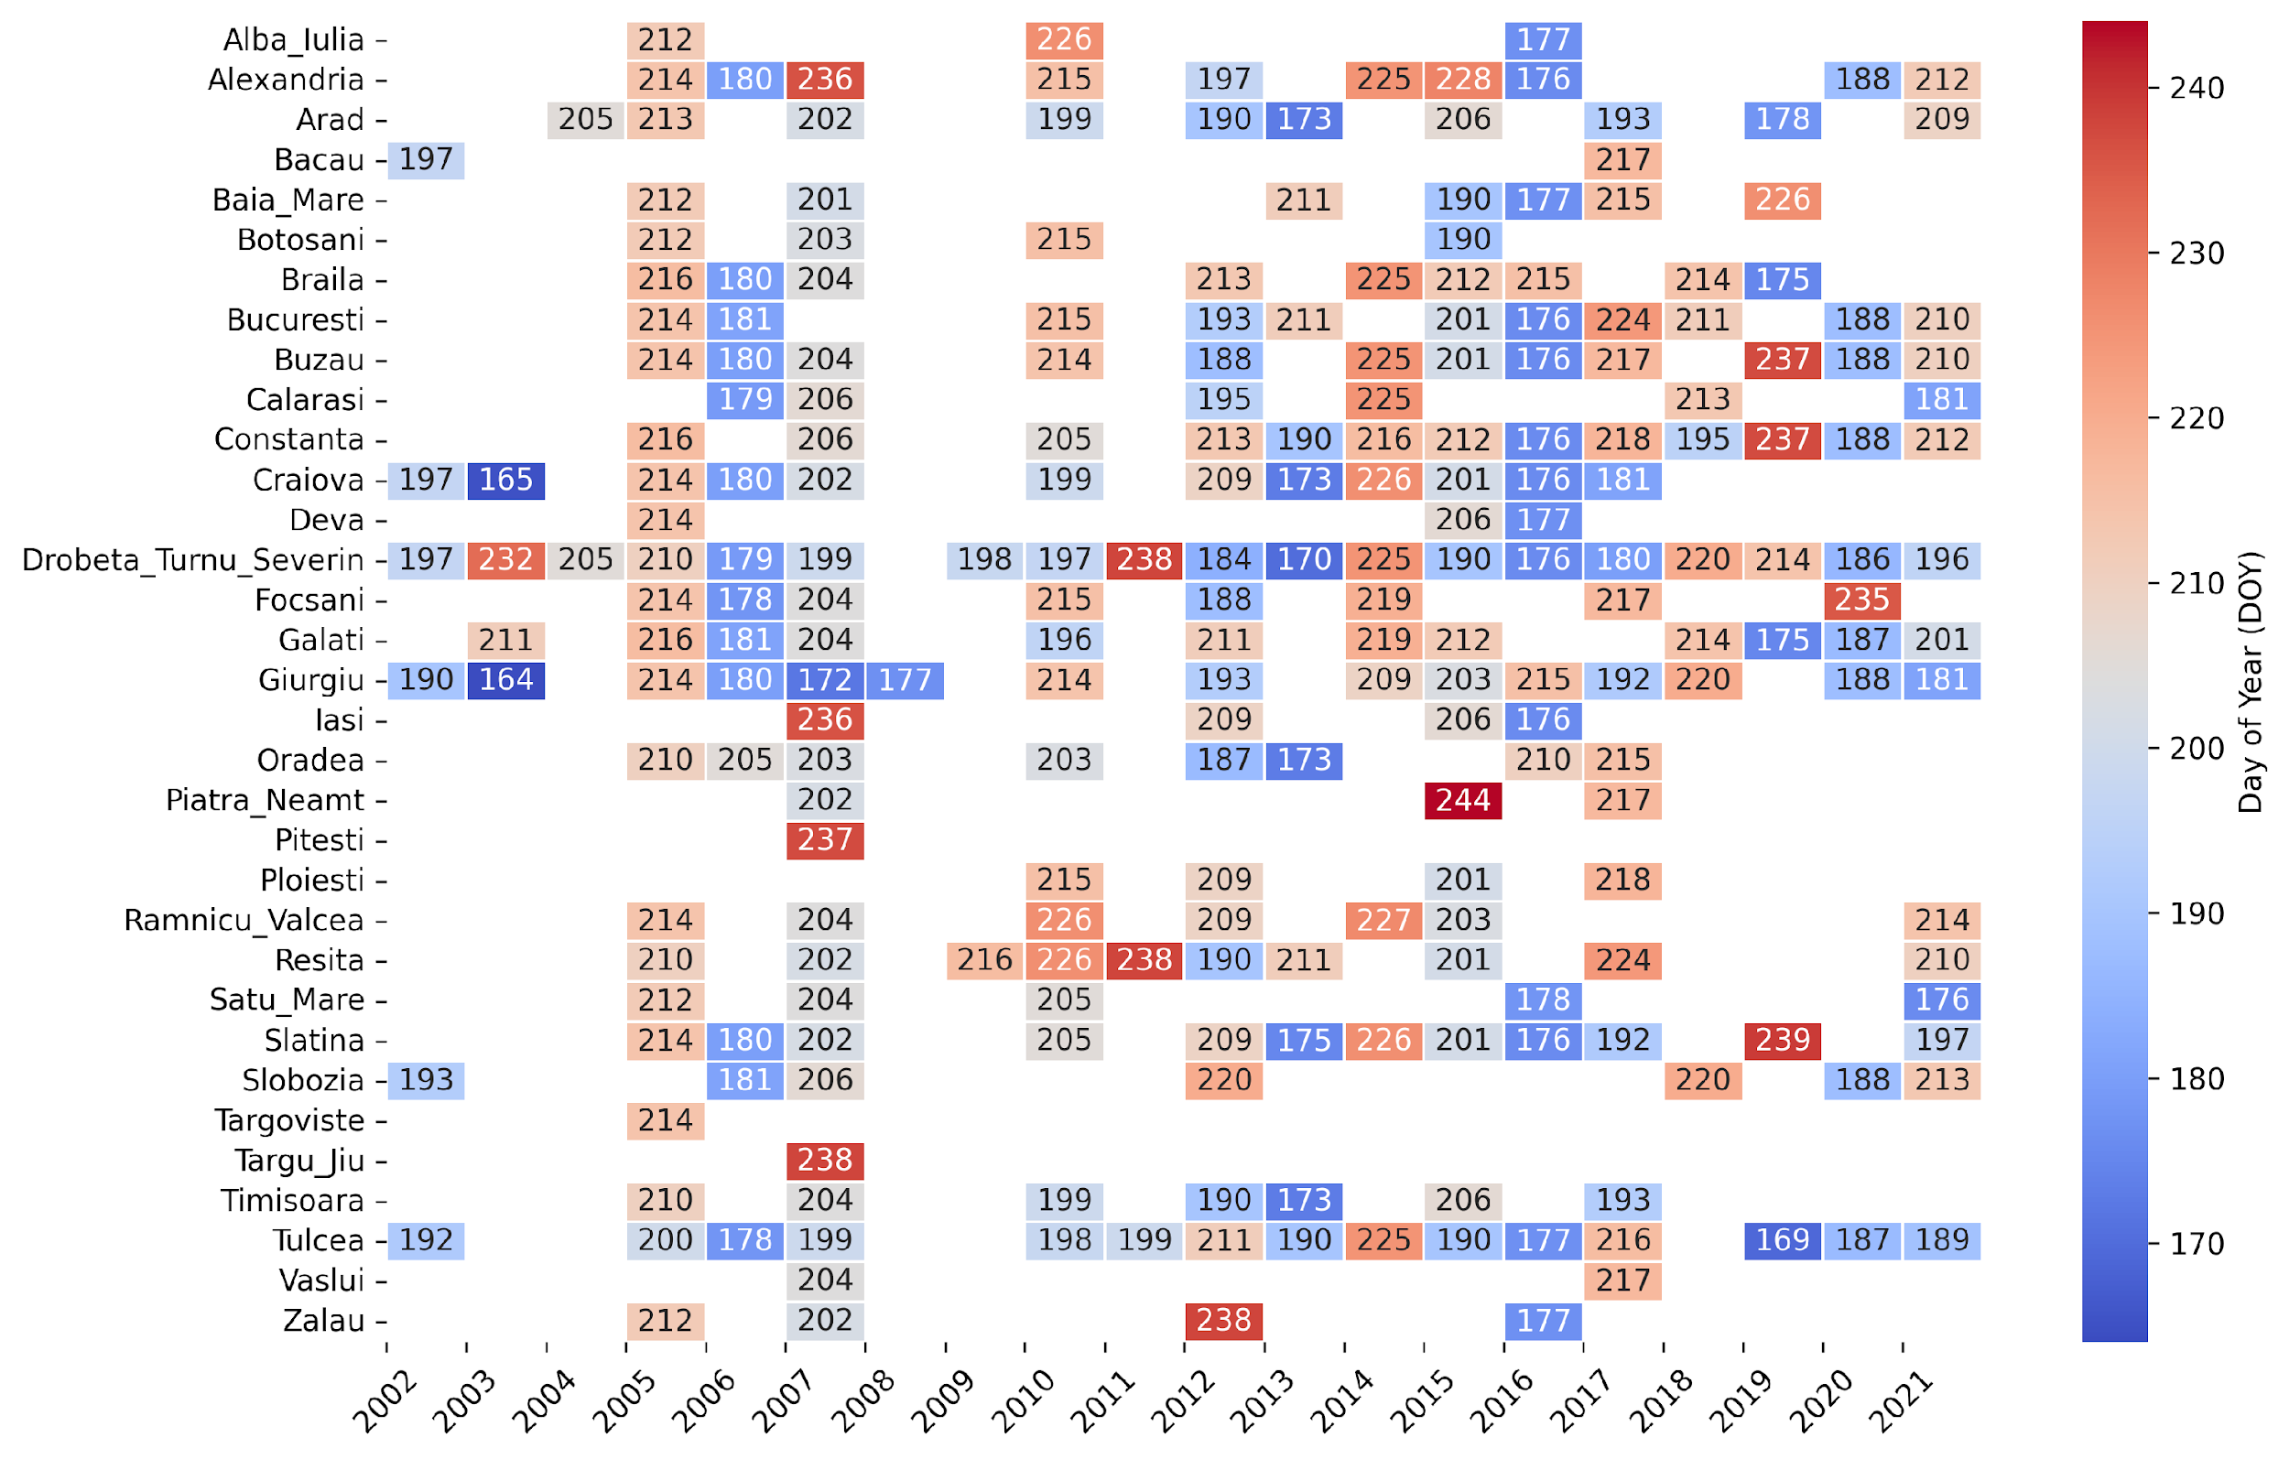
Results
The start date when at least three consecutive night with LST above 20°C are recorded
Identifying extremes in urban areas (LST above 20°C during the night at 1:00 UTC)
33 of cities recorded at least one event where LST exceeded 20°C for three consecutive nights;
LST values exceeding 20°C were recorded during years marked by heatwaves, such as 2007 and 2012, as well as in years like 2005, 2016, and 2017, for over half of cities.

Slide 14
Conclusion
The difference between urban and peri-urban areas is greater in summer and insignificant in winter.
During the day, the differences are insignificant for most cities, but increase at night.
The trends of daily LST maxima are of significant increase in winter and autumn regardless of the area, and those of minima are significant in winter and summer.
In terms of seasonality, cities in the central and western part of the country have a longer season, due to an earlier start and a later end. In other cities, only the end of the season occurs later, while the start does not show a significant trend.
The LOS ranges between 50 and 140 days, with a mean amplitude of 100 days.
Satellite data have proven to be useful tools in analyzing the spatial variation in surface temperature and identifying differences between urban, peri-urban and rural areas.

Slide 15
Thank you for your attention!

