Slide 1
Urban Nighttime Warming Trends derived from LST_cci MODIS Data
Panagiotis Sismanidis and Benjamin Bechtel
Ruhr University Bochum
In collaboration with:
Marzie Naserikia, Negin Nazarian, Melissa Hart, Iphigenia Keramitsoglou, and Darren Ghent

Slide 2
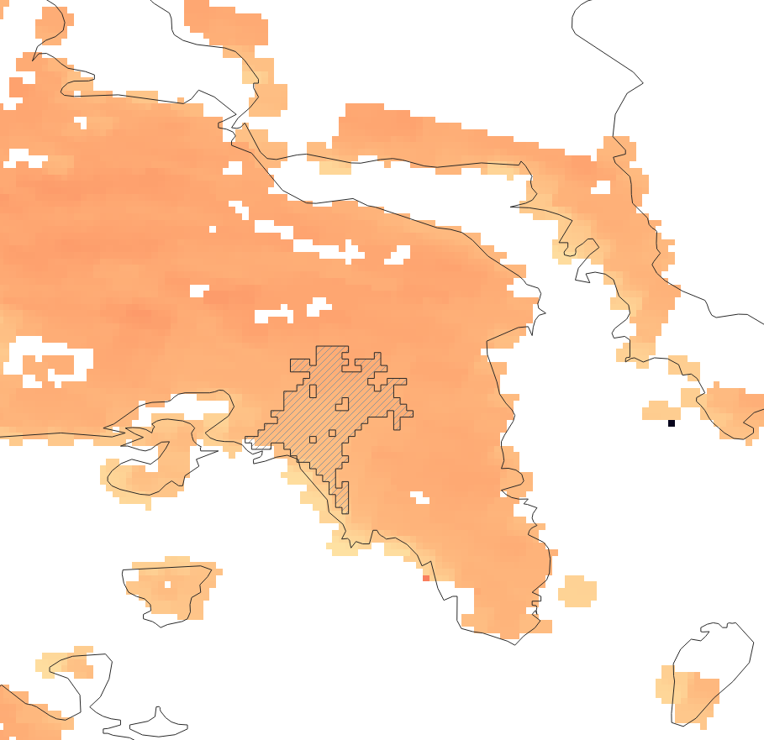
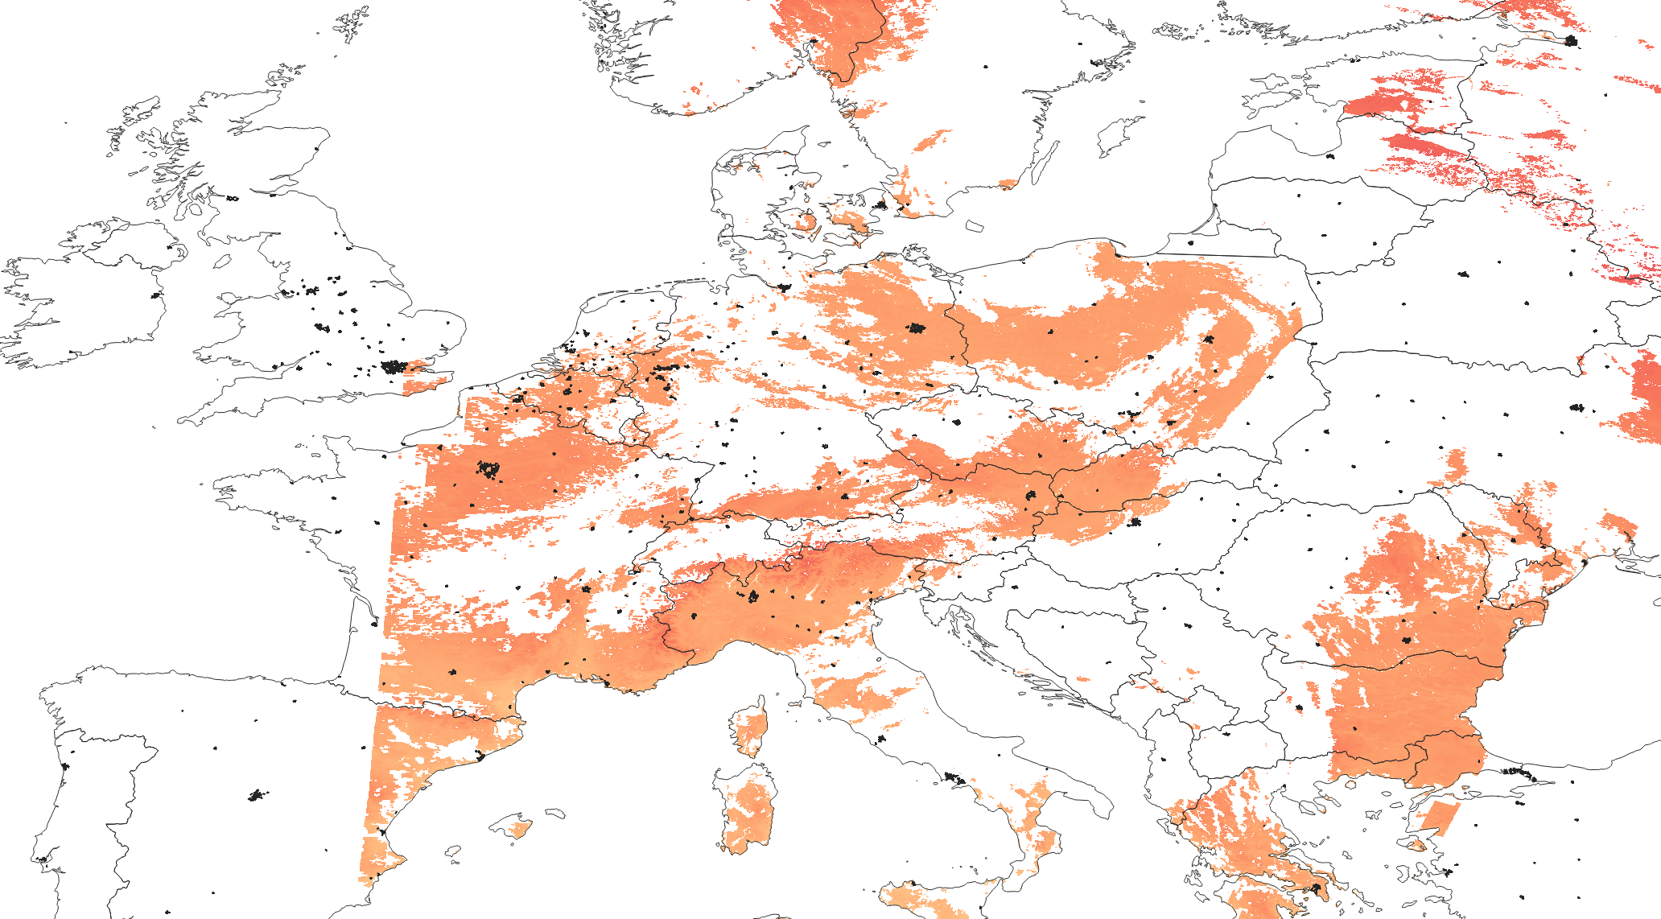
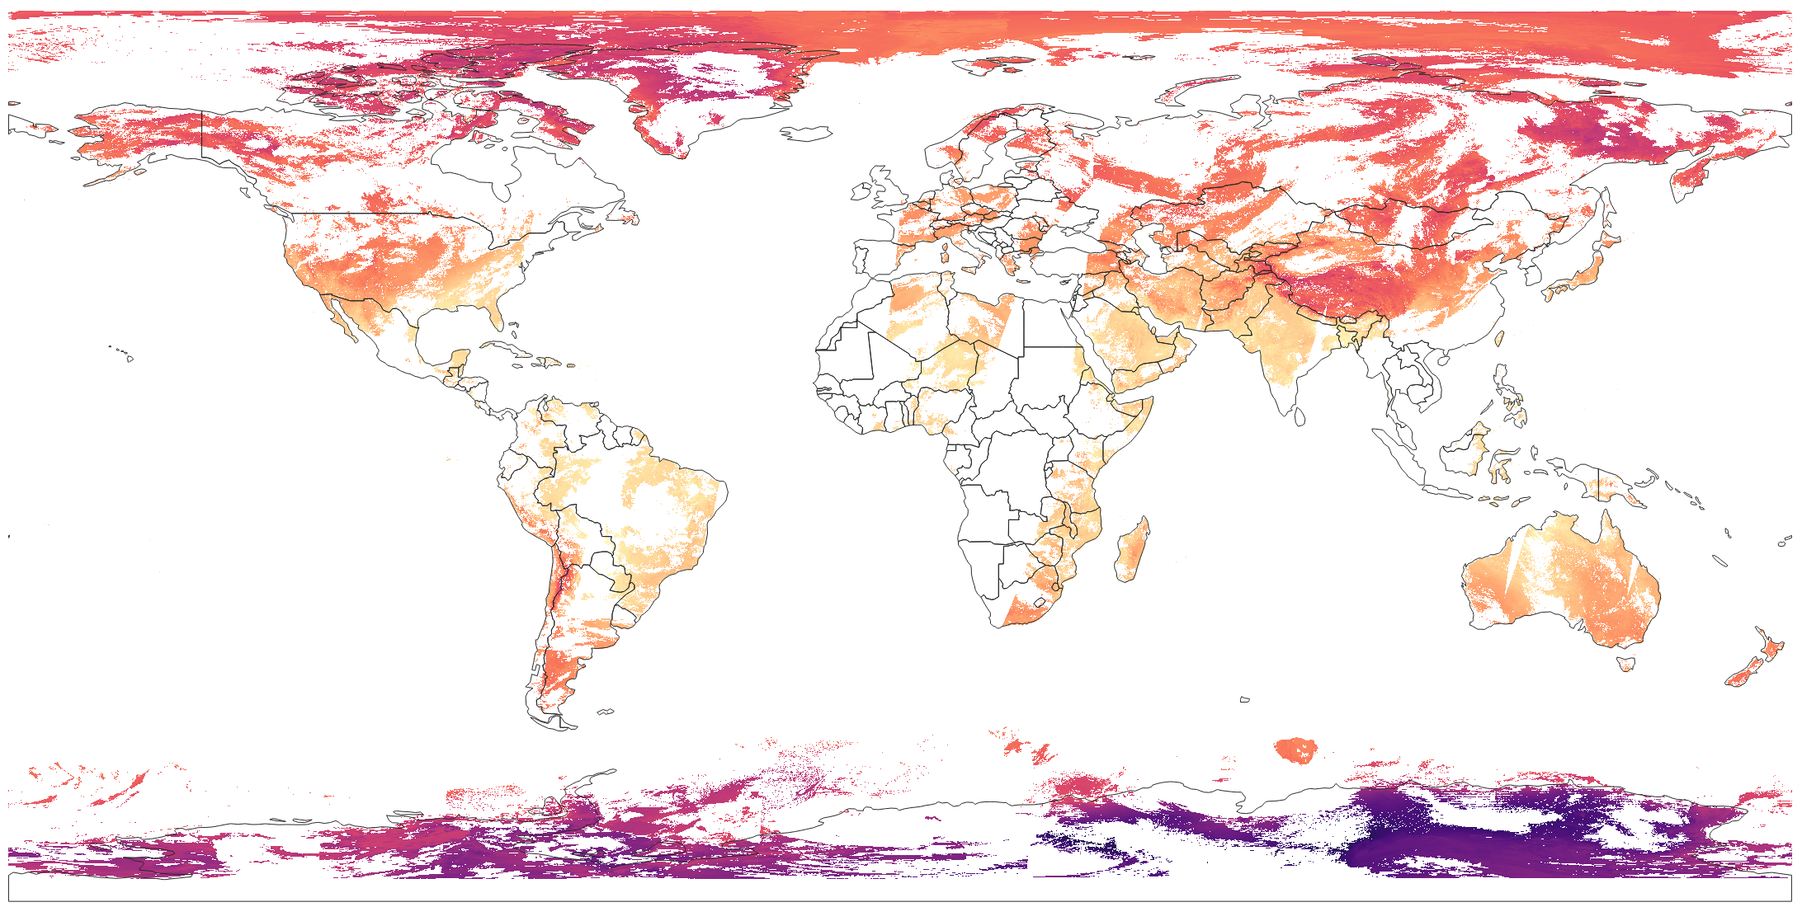
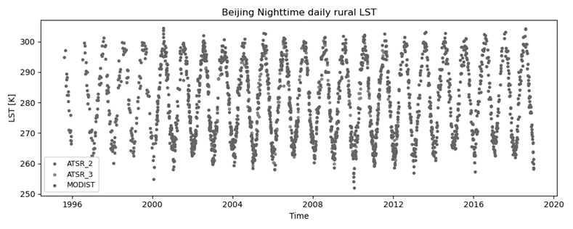

Data Extraction
Athens, GR
Aggregate the satellite data per city
LST Data overlaid with Urban Boundaries
Process the data
Estimate the uncertainty of each mean.
Calculate the CC-% for each mean.
Store each time series into a DB
LST_cci Dataset: 0.01 deg MODISAN v4.00
One file for each day (2002-2021) – 01:30 am

Slide 3
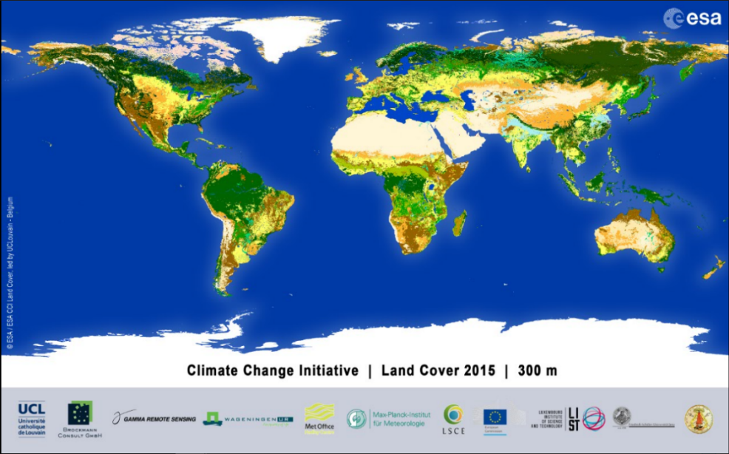
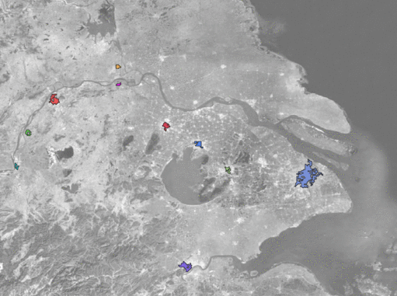
Tracking how the Cities Change over Time
Shanghai
300 m, annual data from 2002 to 2021
>1500 cities detected.

Slide 4
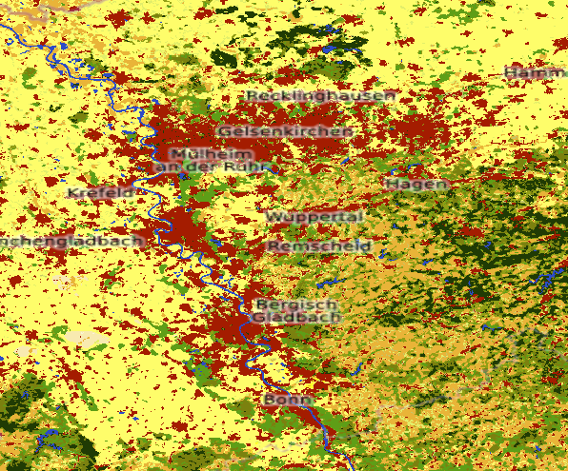




City Delineation
We use a custom implementation of the City Clustering Algorithm.
300 m Land Cover
1 km Urban Fraction
Filtered Urban Mask
Labelled Urban Clusters
Urban Fraction >95%
Water fraction 0%
Distance from coastline > ~2 km
9 or more connected pixels
Notes:
- An implementation of the City Clustering Algorithm
- We define as a city, any cluster of 9 or more 1 km pixels that have an urban fraction of at least 95%, a water fraction equal to 0%, and are more than ~2 km away from the coastline.

Slide 5
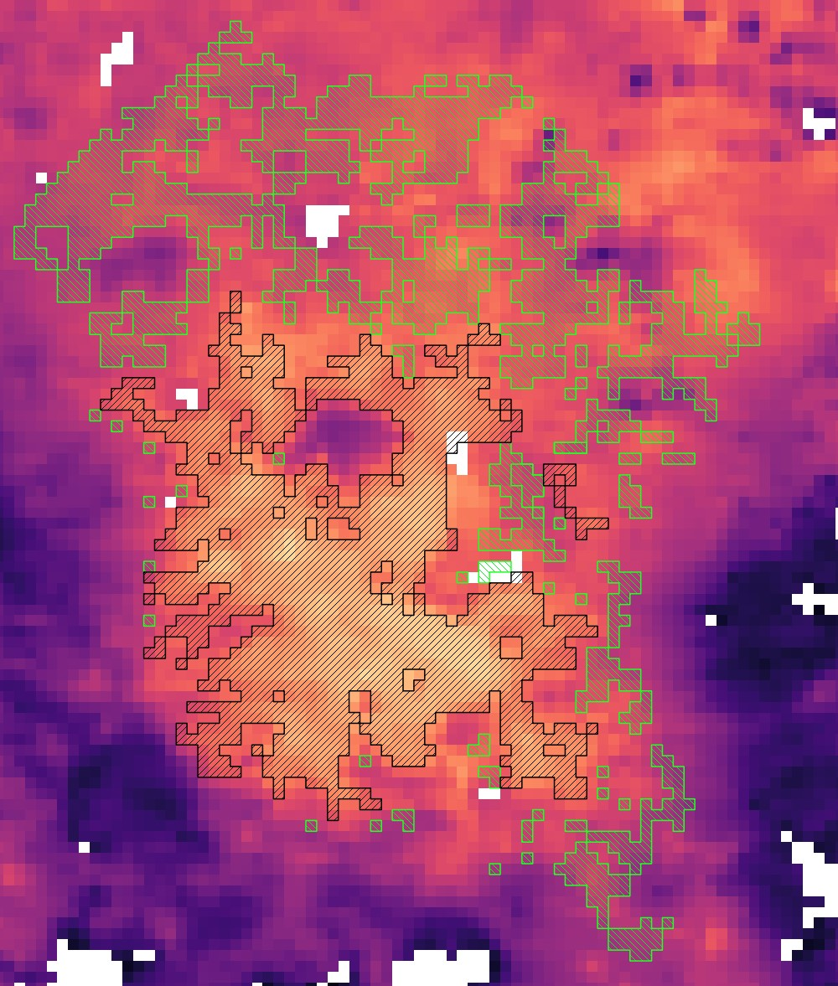
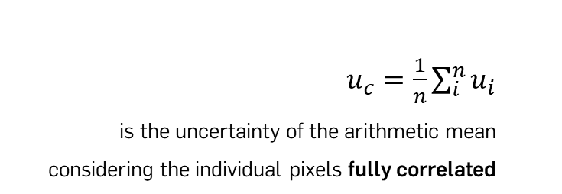
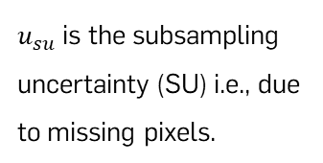

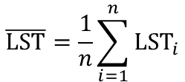
LST Mean and Total Uncertainty
For each day, we calculate the urban and rural LST arithmetic mean only when the sensing time is ±45 min from the nominal overpass time:
LST [K]
$$\overline{\text{LST}}=\frac{1}{n}\sum_{i=1}^{n}{{\text{LST}}_{i}}$$
We also calculate the total uncertainty of the LST mean as:
$$u_{total}=\sqrt{u_{c}^{2}+u_{su}^{2}}$$
$u_{c}=\frac{1}{n}\sum_{i}^{n}{u_{i}}$
is the uncertainty of the arithmetic mean considering the individual pixels fully correlated
$u_{su}$is the subsampling uncertainty (SU) i.e., due to missing pixels.
Notes:
For MXD11A1 I consider the most pessimistic value, i.e. if according to the QA layer the LST error is between 3-4 K I will set the $u_{i}$ to 4 K.

Slide 6

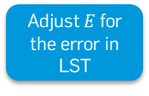





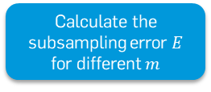



LST Sampling Uncertainty
One distribution per
CC-% group
StD group
size group
We cannot estimate $u_{su}$ from the data, so we model it using the approach proposed in Bulgin et al. 2016.
For each city and day
Split cities into groups
Keep only the days where CC = 0%
Calculate the subsampling error $E$ for different $m$
Adjust $E$ for the error in LST
…
,
,
$$E_{adj}$$
$$E_{adj}$$
$$\begin{matrix}\left[\left.0, 25 {\text{km}}^{2}\right)\right. \\ \left[\left.25, 50 {\text{km}}^{2}\right)\right. \\ ⋮\end{matrix}$$
$$E=\frac{1}{m}\sum_{j=1}^{m}{{\text{LST}}_{j}}−\frac{1}{n}\sum_{i=1}^{n}{{\text{LST}}_{i}}$$
Calculate SU from the $E_{adj}$ distributions
$$\begin{matrix}\begin{matrix}m=0.9n \\ m=0.8n\end{matrix} \\ ⋮ \\ m=0.1n\end{matrix}$$
where,
$$SU\text{=}\sqrt{\operatorname{var}\left(E_{adj}\right)}$$

Slide 7
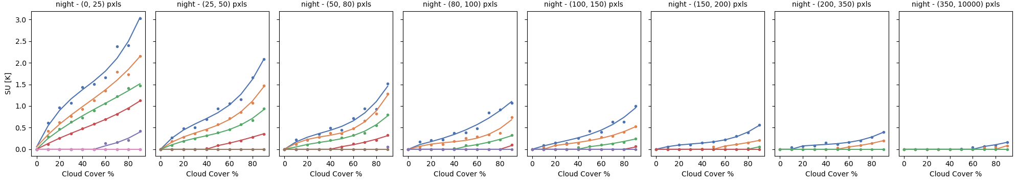

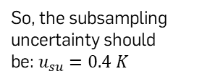

LST Sampling Uncertainty
Example:
City Size = 115 sq. km
Cloud Cover = 50%
StD = 4.5 K
So, the subsampling uncertainty should be:$u_{su}=0.4 K$
$$u_{total}=\sqrt{u_{c}^{2}+u_{su}^{2}}$$

Slide 8
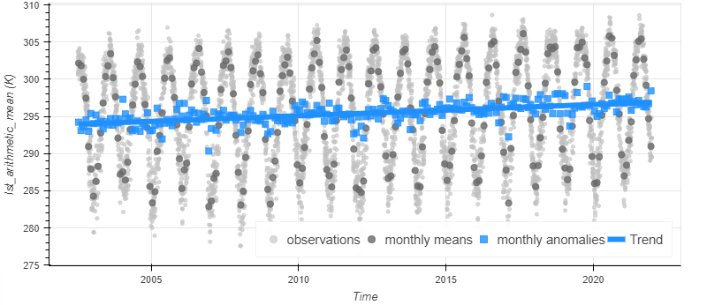

Trend Estimation
Calculate the weighted monthly means
De-season
Calculate the monthly anomalies
Calculate the Theil-Sen slope
For every city, we estimate the LST trend.
Notes:
Sutton et al. (2022): 10.3389/fmars.2022.1045667

Slide 9
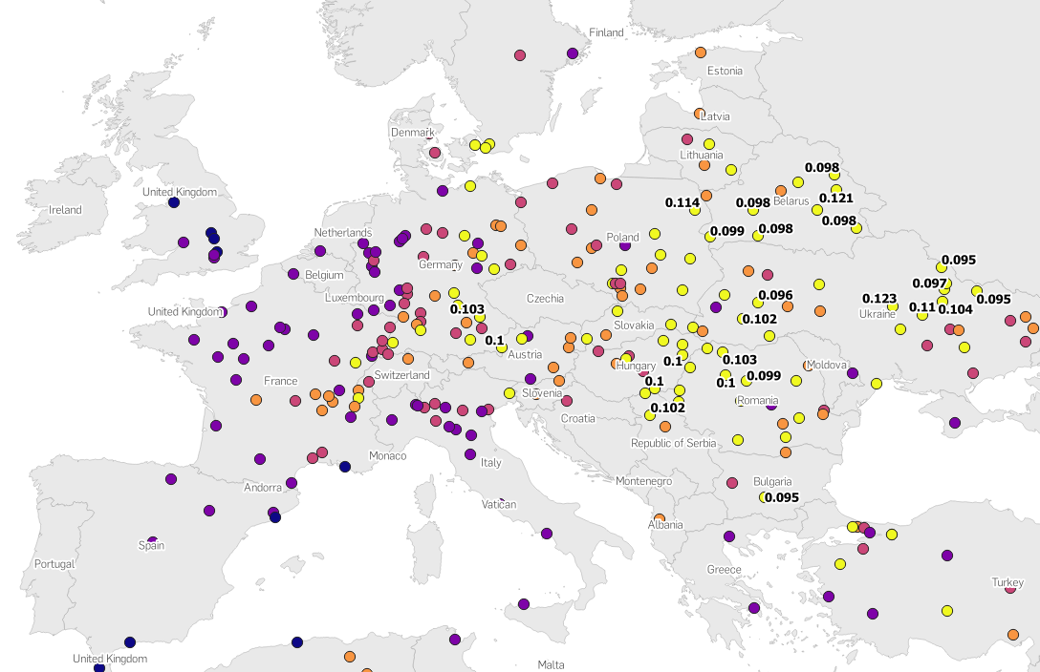
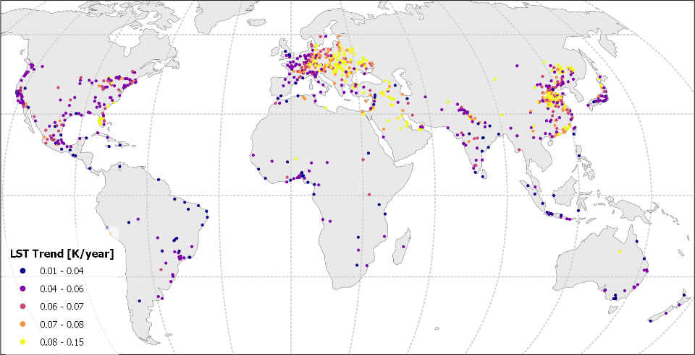
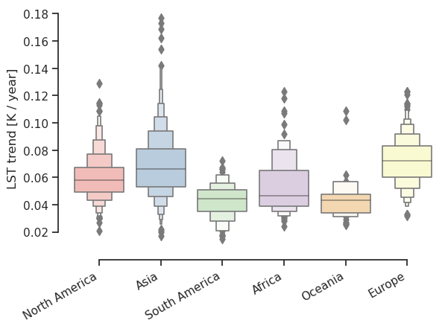
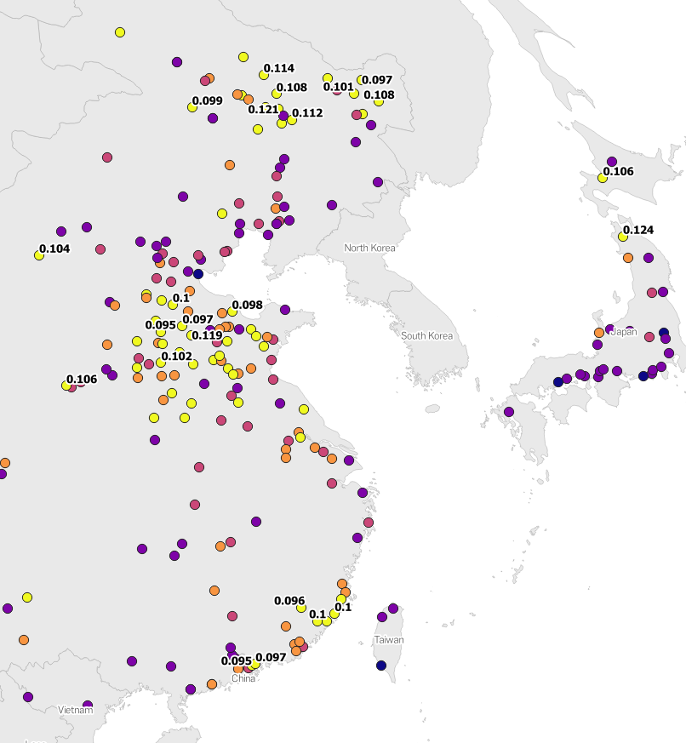
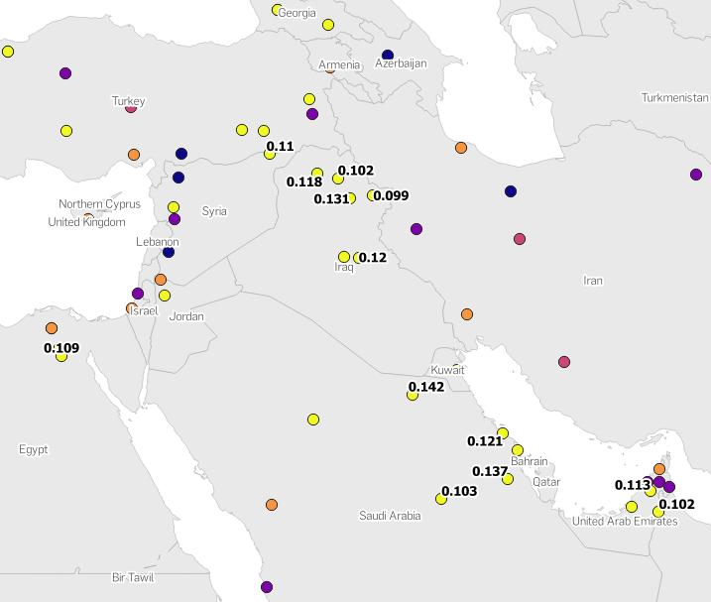
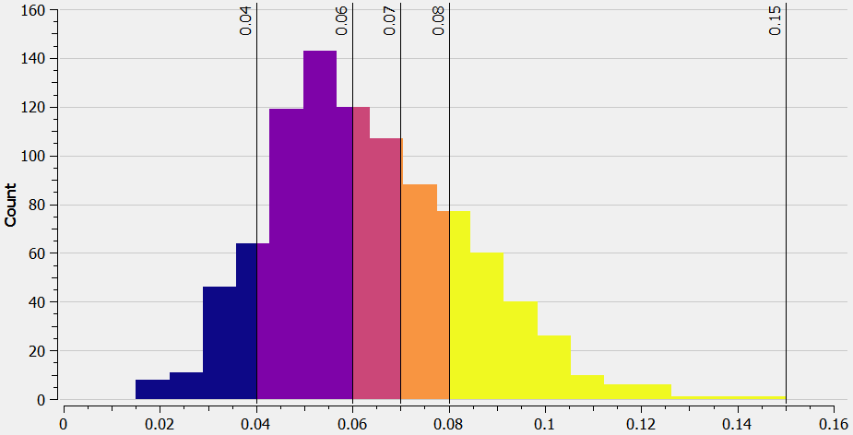
Results
Europe
5.7% (14/246) cities exhibit a ≥ 0.1 K /year trend.
China
Middle East
Mean ± SD = 0.06 ± 0.02 K/year
Min. = 0.02 K / year
Max. = 0.15 K / year
N = 935
20.3% (13/64) cities exhibit a ≥ 0.1 K /year trend.
4.9% (46/935) cities exhibit a ≥ 0.1 K /year trend.
7.3% (14/192) cities exhibit a ≥ 0.1 K /year trend.

Slide 10
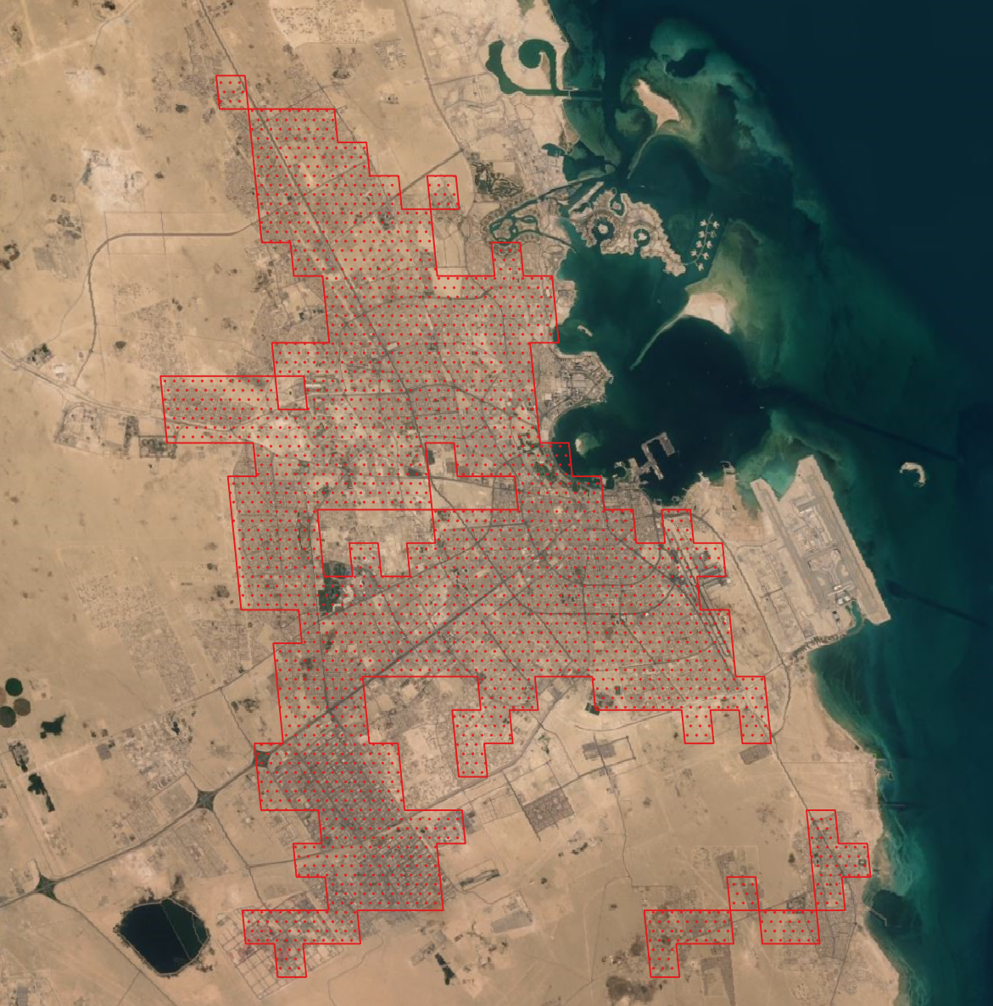

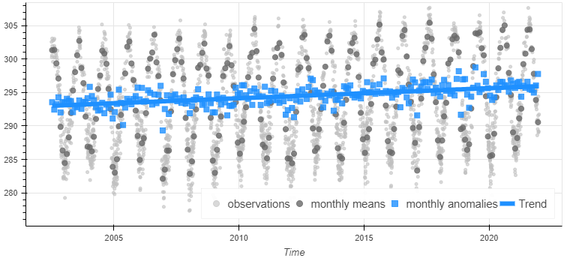
Fastest Warming City
Doha, Qatar
0.154 K/year [CI95: 0.128 - 0.180 K/year]
LST [K]
Photography by: Elmar Bajora (https://onebigphoto.com/downtown-doha-from-airplane/)

Slide 11
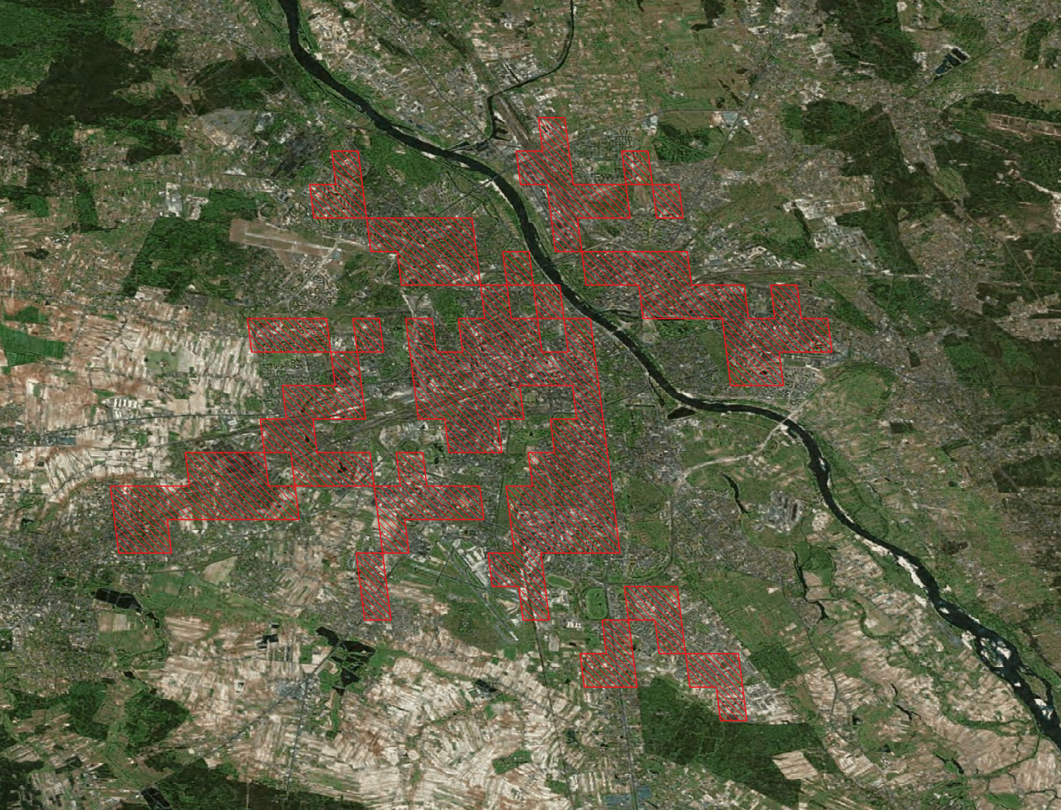

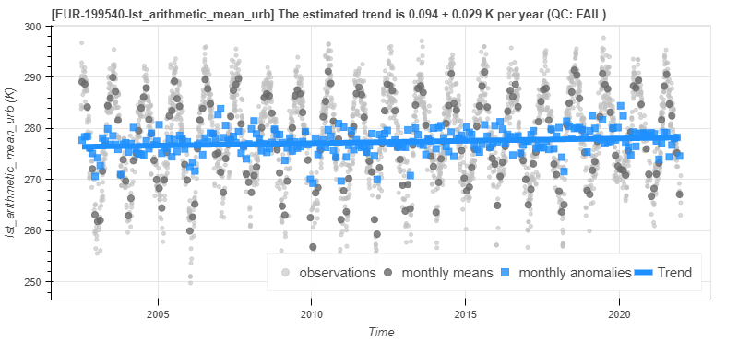
Fastest Warming European Capital
Warsaw, Poland
0.093 K/year [CI95: 0.044 - 0.143K/year]
LST [K]
Image: https://en.wikipedia.org/wiki/Warsaw

Slide 12
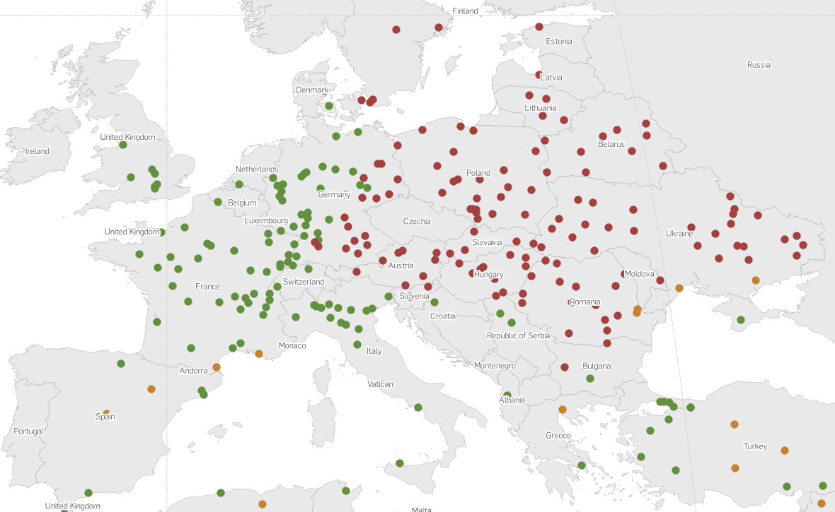
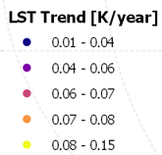
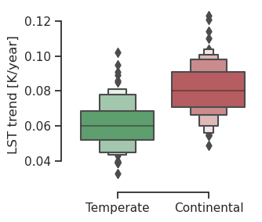

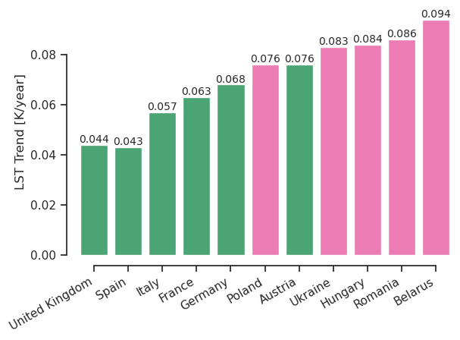
Eastern vs. Western Europe
LST Trends
Climate Class
Mean LST trend per country
Western Europe Eastern Europe

Slide 13

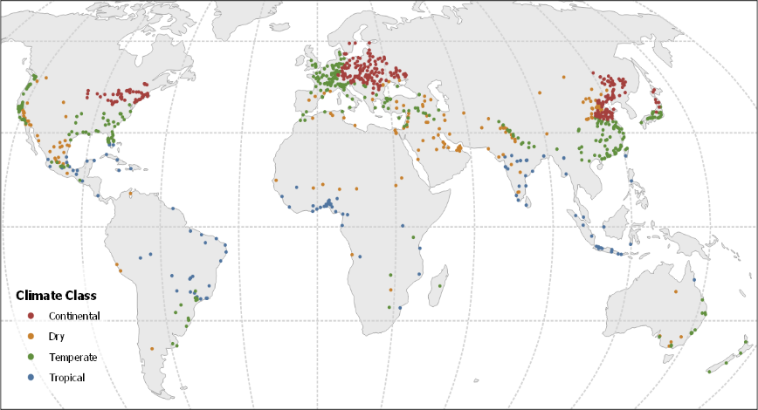
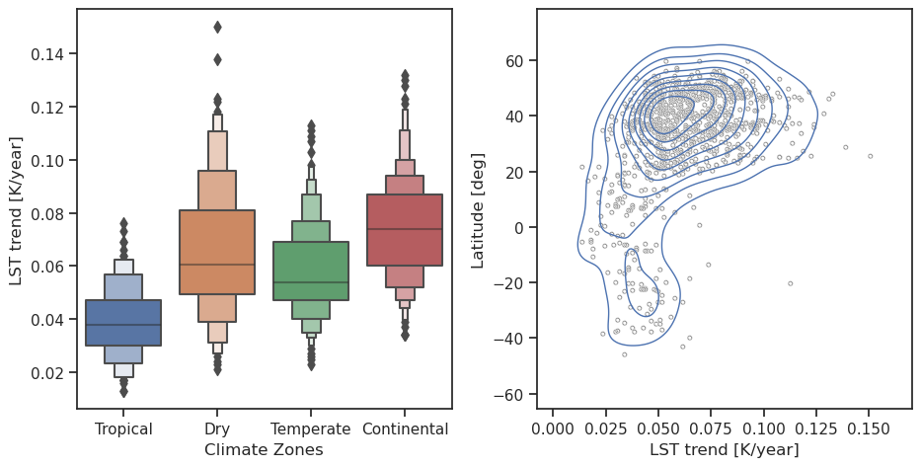
LST Trends vs. Climate
LST Trends
Climate Class
 | Tropical | Dry | Temperate | Continental
Mean ± SD [K/year] | 0.042 ± 0.015 | 0.066 ± 0.024 | 0.060 ± 0.017 | 0.074 ± 0.018
[Min., Max.] [K/year] | [0.015, 0.089] | [0.027, 0.154] | [0.025, 0.118] | [0.040, 0.124]
N | 111 | 162 | 369 | 293

Slide 14
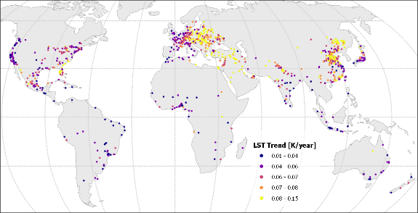
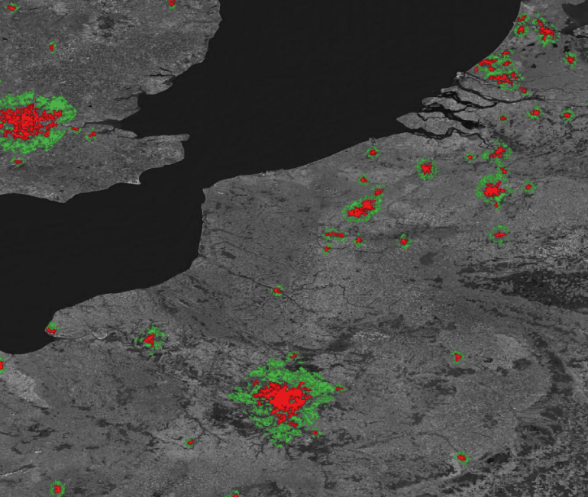
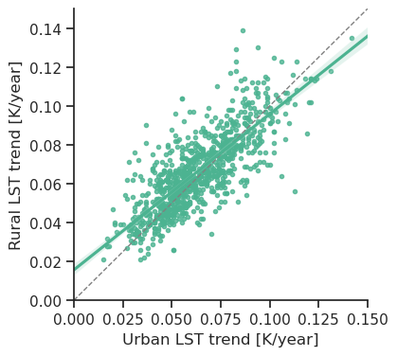
Urban vs. Rural
LST Trend of Rural Buffers
Urban vs. Rural Trends
Correlation: 0.78 (p-value < 0.001 )
y = x
Paris

Slide 15
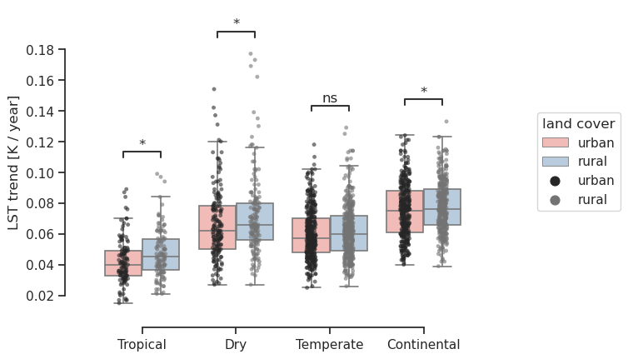
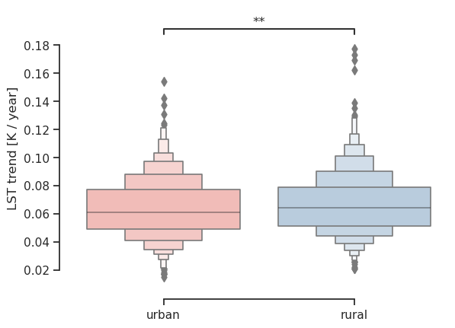
Urban vs. Rural
Urban Areas (red) and Rural Buffers (green)
 | Tropical | Dry | Temperate | Continental
Mean ± SD | 0.042 ± 0.015 | 0.066 ± 0.024 | 0.060 ± 0.017 | 0.074 ± 0.018
[Min., Max.] | [0.015, 0.089] | [0.027, 0.154] | [0.025, 0.118] | [0.040, 0.124]
 | Urban | Rural
Mean ± SD [K/year] | 0.063 ± 0.021 | 0.066 ± 0.021
[Min., Max.] [K/year] | [0.015, 0.154] | [0.021, 0.177]
N | 935 | 935
Paris
Mean ± SD | 0.047 ± 0.016 | 0.071 ± 0.026 | 0.062 ± 0.018 | 0.077 ± 0.017
[Min., Max.] | [0.021, 0.099] | [0.027, 0.177] | [0.026, 0.129] | [0.039, 0.123]
N | 111 | 162 | 369 | 293

Slide 16
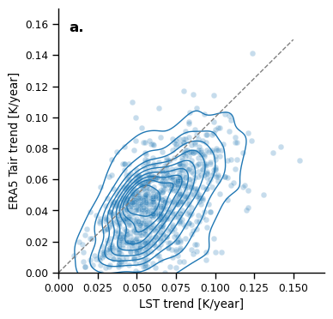
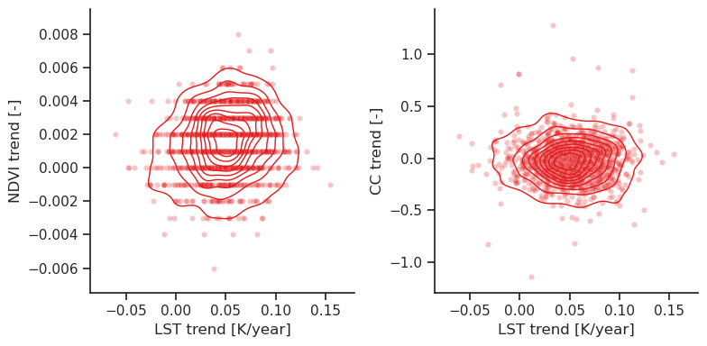
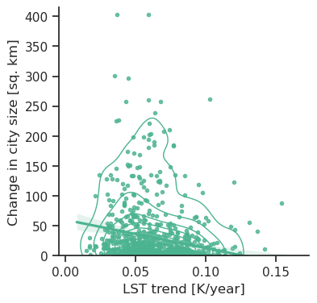
LST vs. Tair, NDVI and CC Trends
ERA5 Air Temperature
NDVI
Cloud Cover % (annual)
Change in City size
Corr.: 0.44 (p-value < 0.001 )
Corr.: 0.07 (p-value < 0.05 )
Corr.: 0.02 (p-value < 1.00)
Corr.: -0.14 (p-value < 0.001)
y = x

Slide 17

Conclusions
Globally, the nighttime LST of urban areas increases by 0.06 ± 0.02 K/year.
5% of these cities exhibit trends higher than 0.1 K / year.
Cities in continental climates, Eastern Europe, China and Middle East warm faster that the rest.

