Slide 1
Extreme Temperature Indices Based on Satellite Land Surface Temperature Data
Josh Blannin, Lizzie Good
Met Office

Slide 2
Overview
Motivation
Satellite Data
Data Processing
Current Indices
Data Availability
Conclusion

Slide 3
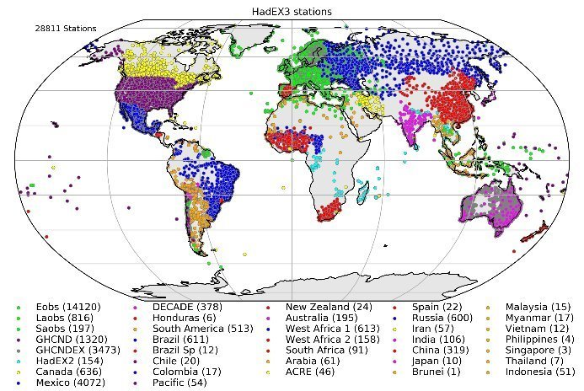
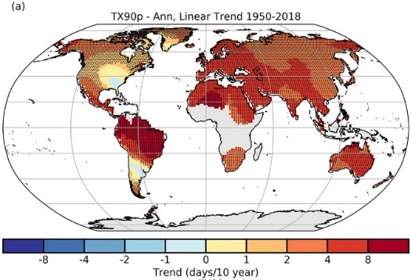

Motivation
HadEX3¹ is an in situ-based moderate extremes indices dataset for precipitation and 2m air temperature (T2m)
HadEX3 uses the Climpact indices - a standardised set of climate indices originally recommended by the Expert Team on Sector-Specific Climate Indices (ET-SCI).
Runs from 1901 at a spatial resolution of 1.875ᵒ x 1.25ᵒ longitude-latitude.
Used to examine how the frequency of moderate extremes are changing over time as well as evaluate models.​
There are some limitations:
Limited resolution
Unmonitored regions
Can we provide a satellite-based extremes indices product to compliment HadEX3 using Land Surface Temperature (LST)?
Stations used to produce the HadEX3 data set using the 1981-2010 baseline period¹
1. Dunn, R. J. H., Alexander, L. V., Donat, M. G., Zhang, X., Bador, M., Herold, N., et al. (2020). Development of an updated global land in situ-based data set of temperature and precipitation extremes: HadEX3. Journal of Geophysical Research: Atmospheres, 125, e2019JD032263. https://doi.org/10.1029/2019JD032263
Linear trends in annual series of TX90p over 1950–2018 (days/decade)¹
Time series of HadEX3 (compared with HadEX, HadEX2 and GHCNDEX)¹

Slide 4
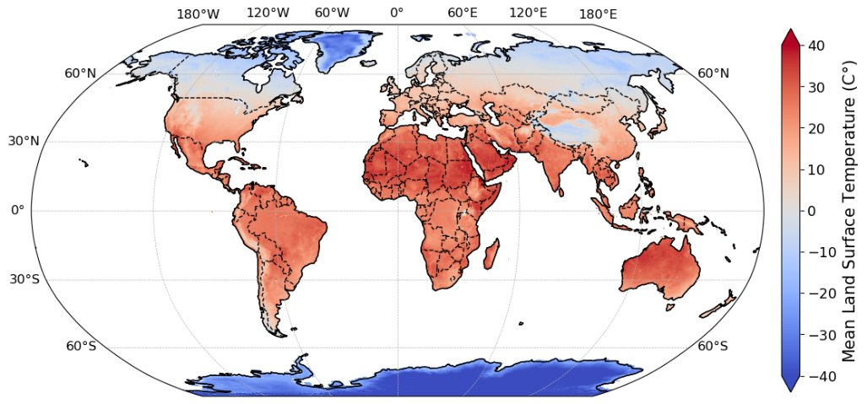
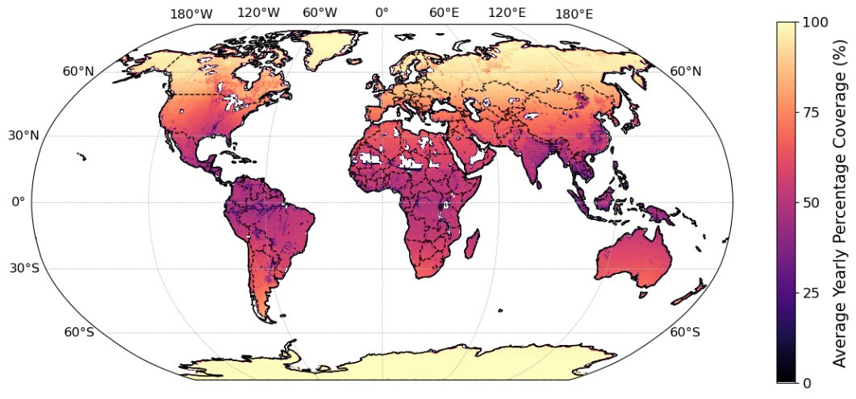
Satellite Data
This work uses the ESA LST_cci Microwave data product between 1996-2020 due to lesser cloud impact improving data availability
Lower coverage nearer the equator due to swath width – this is a main challenge
Satellite microwave ‘all-sky’ land surface temperature (LST) image; mean LST from 2020
Global mean yearly percentage coverage of LST_cci MW data (1996-2020)

Slide 5
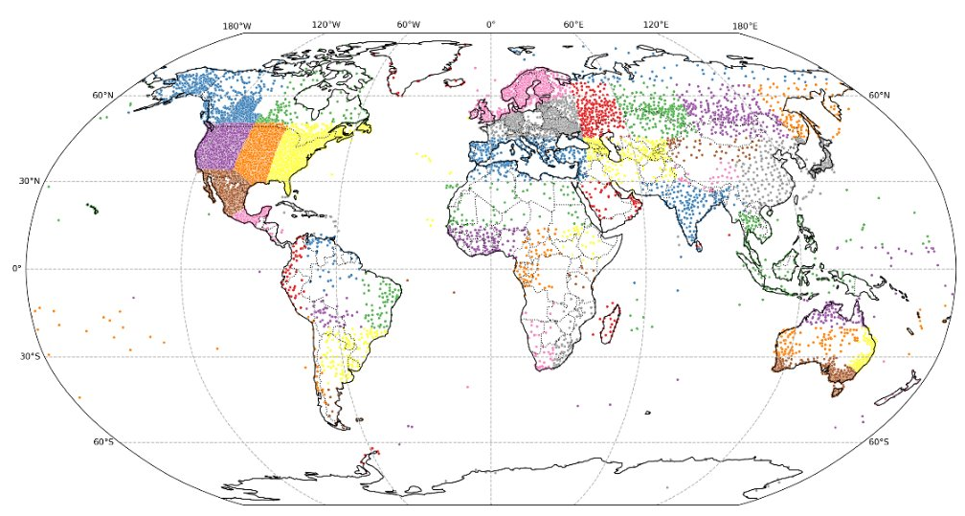
Data Processing
Obtain station 2m air temperature daily summary data from NCEI Global Historical Climatology Network daily (GHCNd) and LST data from ESA LST_cci
Pre-process GHCNd station data:
Check for and drop measurements with suspect quality flags
Drop data where daily maximum is less than daily minimum
Get station meta-data (latitude, longitude, elevation)
Identify the AR6 region containing the station
Pre-process LST data:
Co-locate all stations in gridded LST data
Use the max/min of the 6am/6pm overpass time data as a proxy for daily min/max 2m air temperature
Calculate indices
Compare air temperature and LST indices for various AR6 regions
Remaining GHCNd stations after pre-processing (step 2) and coloured by AR6 region

Slide 6
Current Indices
Considered three categories of indices:
Value-based: indices reporting a statistical measure
Threshold-based: indices reporting number of days triggering a temperature threshold
Percentile-based: indices reporting the fraction of days above/below a given percentile
Value-based Index​ | Description​
TXx​ | Monthly maximum value of daily maximum temperature​
TXn​ | Monthly minimum value of daily maximum temperature​
TNx​ | Monthly maximum value of daily minimum temperature​
TNn​ | Monthly minimum value of daily minimum temperature​
TXm​ | Monthly mean of the daily maximum temperature​
TNm​ | Monthly mean of the daily minimum temperature​
DTR​ | Month mean of the the daily temperature range​
Threshold-based Index​ | Description​
SD​ | Annual number of days where the daily maximum temperature is above 25 °C​
ID​ | Annual number of days where the daily maximum temperature is less than 0 °C​
TR​ | Annual number of days where the daily minimum temperature is above 20 °C​
FD​ | Annual number of days where the daily minimum temperature is less than 0 °C​
TNlt2​ | Annual number of days where the daily minimum temperature is less than 2 °C​
TNltm2​ | Annual number of days where the daily minimum temperature is less than -2 °C​
Tltm20​ | Annual number of days where the daily minimum temperature is less than -20 °C​
TXge30​ | Annual number of days where the daily maximum temperature is greater than or equal to 30 °C​
TXge35​ | Annual number of days where the daily maximum temperature is greater than or equal to 35 °C​
Percentile-based Index​ | Description​
TX90p​ | Monthly percentage of days with daily maximum temperature greater than 90th percentile​
TX10p​ | Monthly percentage of days with daily maximum temperature less than 10th percentile​
TN90p​ | Monthly percentage of days with daily minimum temperature greater than 90th percentile​
TN10p​ | Monthly percentage of days with daily minimum temperature less than 10th percentile​
TXgt50p​ | Monthly percentage of days with daily maximum temperature greater than 50th percentile​

Slide 7
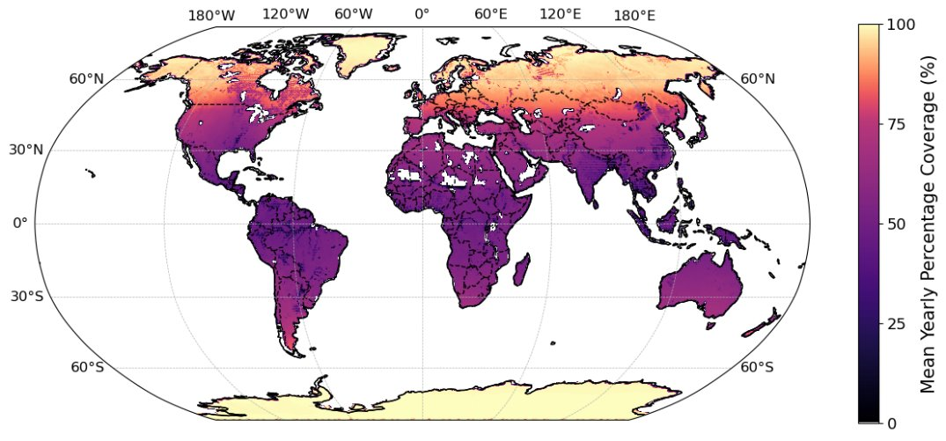
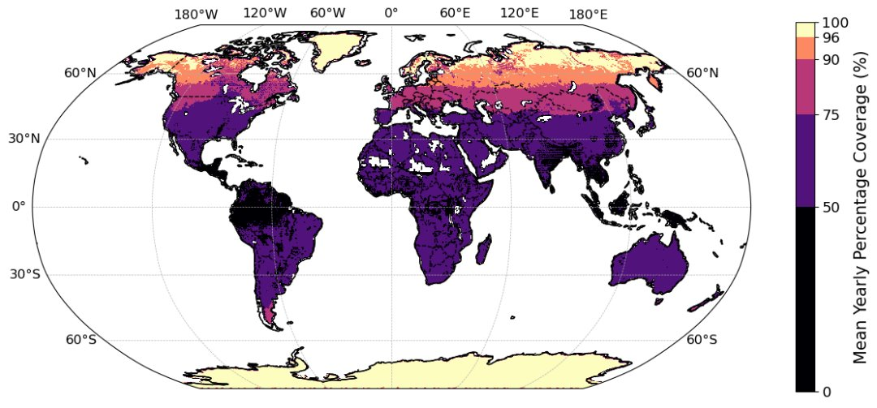
Data Availability
Climpact indices requirements:
Maximum of 3 missing days in any month
Maximum of 15 missing days in any year.
Further, if a month is missing then the corresponding year is also removed.
At least 10% of the base period must have valid values for percentile-based indices to be calculated
For some indices this can be difficult achieve with LST
If maximum of 15 days missing in a year, this means ~96% data coverage is required
Updated indices requirements:
Maximum of 3 missing days in any month
Maximum of 36 missing days in any year.
Further, if a month is missing then the corresponding year is also removed.
At least 10% of the base period must have valid values for percentile-based indices to be calculated
A maximum of 36 days missing in a year, means ~90% data coverage is required
Global average yearly percentage coverage of LST_cci MW data (1996-2020)

Slide 8
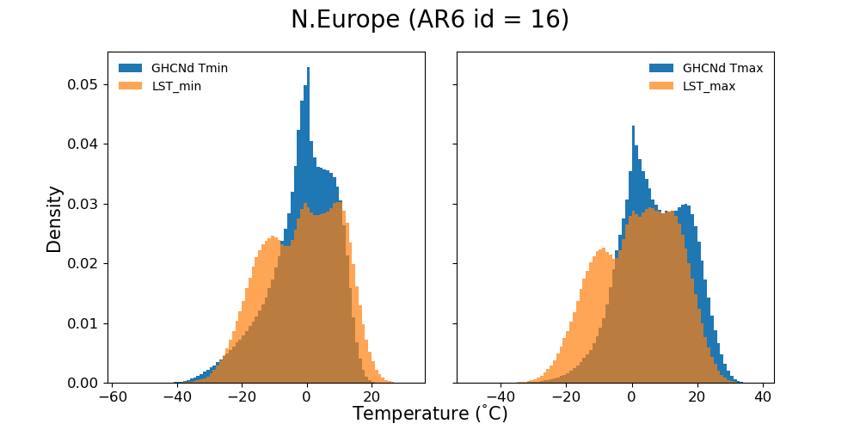
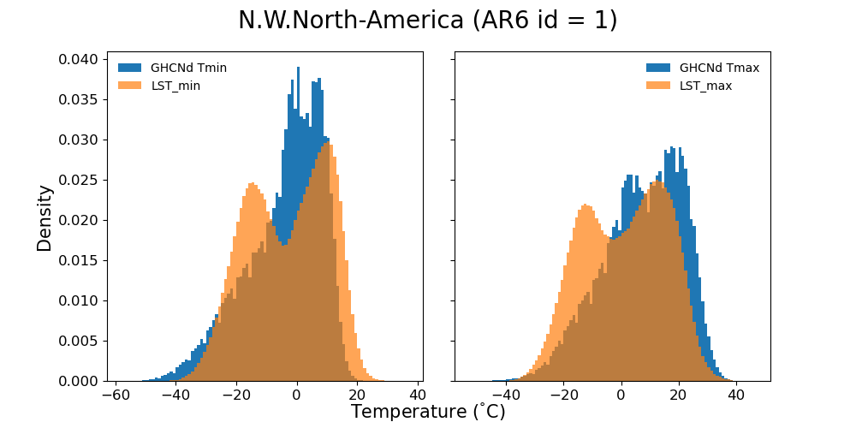
Results
Able to calculate indices for 45 AR6 regions
Can check the temperature distributions:
T2m daily minimum vs LST_cci overpass minimum
T2m daily maximum vs LST_cci overpass maxiumum
Shown are regions Northern Europe (AR6 id = 16) and North-Western North America (AR6 id = 1)
Distributions tend to show bi-modal distributions – likely due to seasonal variation in temperatures
LST tends to appear slightly cooler – first peaks of LST distributions often shifted colder than T2m
There are considerable regions of overlap in the distributions

Slide 9
Results
Climpact Index (unit) | T2m index mean value | LST index mean value | Difference (LST-T2m) | % Difference with respect to T2m (%) | % Difference with respect to 365 days (%)
SU (ndays) | 12.6 | 3.7 | -8.9 | 70.6 | 2.4
ID (ndays) | 64 | 153 | 89 | 139.1 | 24.4
TR (ndays) | 0.5 | 4.4 | 3.9 | 780 | 1.1
FD (ndays) | 136.5 | 188 | 51.5 | 37.7 | 14.1
TNlt2 (ndays) | 172.3 | 204.8 | 32.5 | 18.9 | 8.9
TNltm2 (ndays) | 104 | 169.9 | 65.9 | 63.4 | 18.1
TNltm20 (ndays) | 12.1 | 28.3 | 16.2 | 133.9 | 4.4
TXge30 (ndays) | 1.2 | 0.2 | -1 | 83.3 | 0.3
TXge35 (ndays) | 0 | 0 | 0 | N/A | 0.0
TXx (°C) | 16.1 | 7.9 | -8.2 | 50.9 | -
TXn (°C) | 2.3 | -11.5 | -13.8 | 600.0 | -
TNx (°C) | 8.5 | 4.5 | -4 | 47.1 | -
TNn (°C) | -6.3 | -14.9 | -8.6 | 136.5 | -
TXm (°C) | 9.3 | -1.9 | -11.2 | 120.4 | -
TNm (°C) | 1.8 | -5.2 | -7 | 388.9 | -
DTR (°C) | 7.3 | 3.6 | -3.7 | 50.7 | -
Shown are the threshold- and value-based indices results for Northern Europe (AR6 id = 16)
Some indices show reasonable agreement:
A selection of threshold-based indices (SU, TR, TNlt2, TNltm20, TXge30) have differences between T2m and LST of less than 10% of a year
A couple of LST value-based indices (TNx, DTR) are within 5°C of their T2m counterpart
Some indices do not occur with enough frequency to give a good assessment e.g. TXge35
Appears Tmin/LST_6am may give more comparable indices – more likely to be similar in diurnal cycle¹
Threshold-based Indices
Annual
Value-based Indices
Monthly
1. Good, E.J., 2016. An in situ‐based analysis of the relationship between land surface “skin” and screen‐level air temperatures. Journal of Geophysical Research: Atmospheres, 121(15), pp.8801-8819.
Threshold- and value-based indices for N. Europe (AR6 region 16)

Slide 10
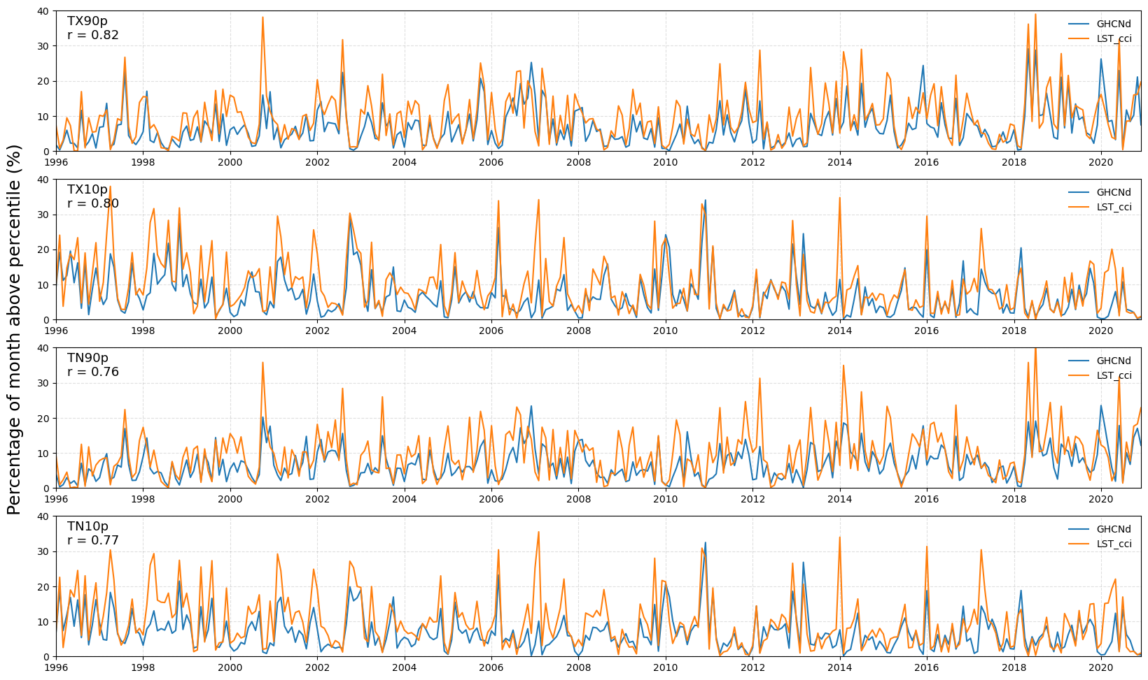
Results
Shown are the percentile-based indices results for Northern Europe (AR6 id = 16)
Implemented bootstrap method of Zhang et al. (2005) for within base period indices calculations
Overall good agreement
Correlations of r ≥ 0.76
For events particularly looking at:
TX90p = “warm days”
TN10p = “cool nights”
Find the co-identifying of extreme events
Some cases where LST indices shows extremes but not for T2m (“false positives”)

Slide 11
Conclusions & Next Steps
Conclusions
The aim is to produce an LST indices dataset to compliment HadEX3
Used satellite LST data from ESA LST_cci, and station 2m air-temperature from NCEI GHCNd
Distributions of LST and T2m temperatures are similar, but with LST being slightly cooler (in AR6 regions 1 & 16)
Several promising threshold- and value-based indices in AR6 region 16 – these to be investigated further across the other AR6 regions
Percentile-based indices for AR6 region 16 show good correlation and identification of moderate extreme events – also to be investigated in other AR6 regions
Next Steps
Investigate threshold-/value-/percentile-based indices in other AR6 regions
Investigate the effects of data availability on indices
Consider LST specific indices in the future
Adjust current threshold-based indices to be more appropriate to LST
New LST specific indices

