Slide 1
Uncertainty information in LST CCI products
Claire Bulgin
University of Reading, National Centre for Earth Observation

Slide 2
Background
Every measurement we make (both in-situ or remotely sensed) deviates from the ‘true’ surface temperature due imperfections in the instrumentation and measurement process. Therefore, in order to use the data correctly, you must consider the uncertainty in the measurement.
Error and uncertainty are two different concepts…
Error: How different is the measured value from the true value?
Uncertainty: To what degree is the measured value in doubt?
Measurement error is often unknown (and if we did know what it was we would correct for it). We therefore provide an uncertainty, a measure of the dispersion of the error distribution.

Slide 3
How do we provide uncertainty information?
1) Infrared
For infrared products we build up an uncertainty budget by identifying all possible sources of error (or ‘error effects’) in the instrumentation and measurement process.
Where possible, we calculate the uncertainty attributable to each of these error effects, either by direct propagation through the measurement equation, or by using a simple model.
We sum (in quadrature) these uncertainty estimates from the different components to give a total uncertainty, which is provided to data users.

Slide 4
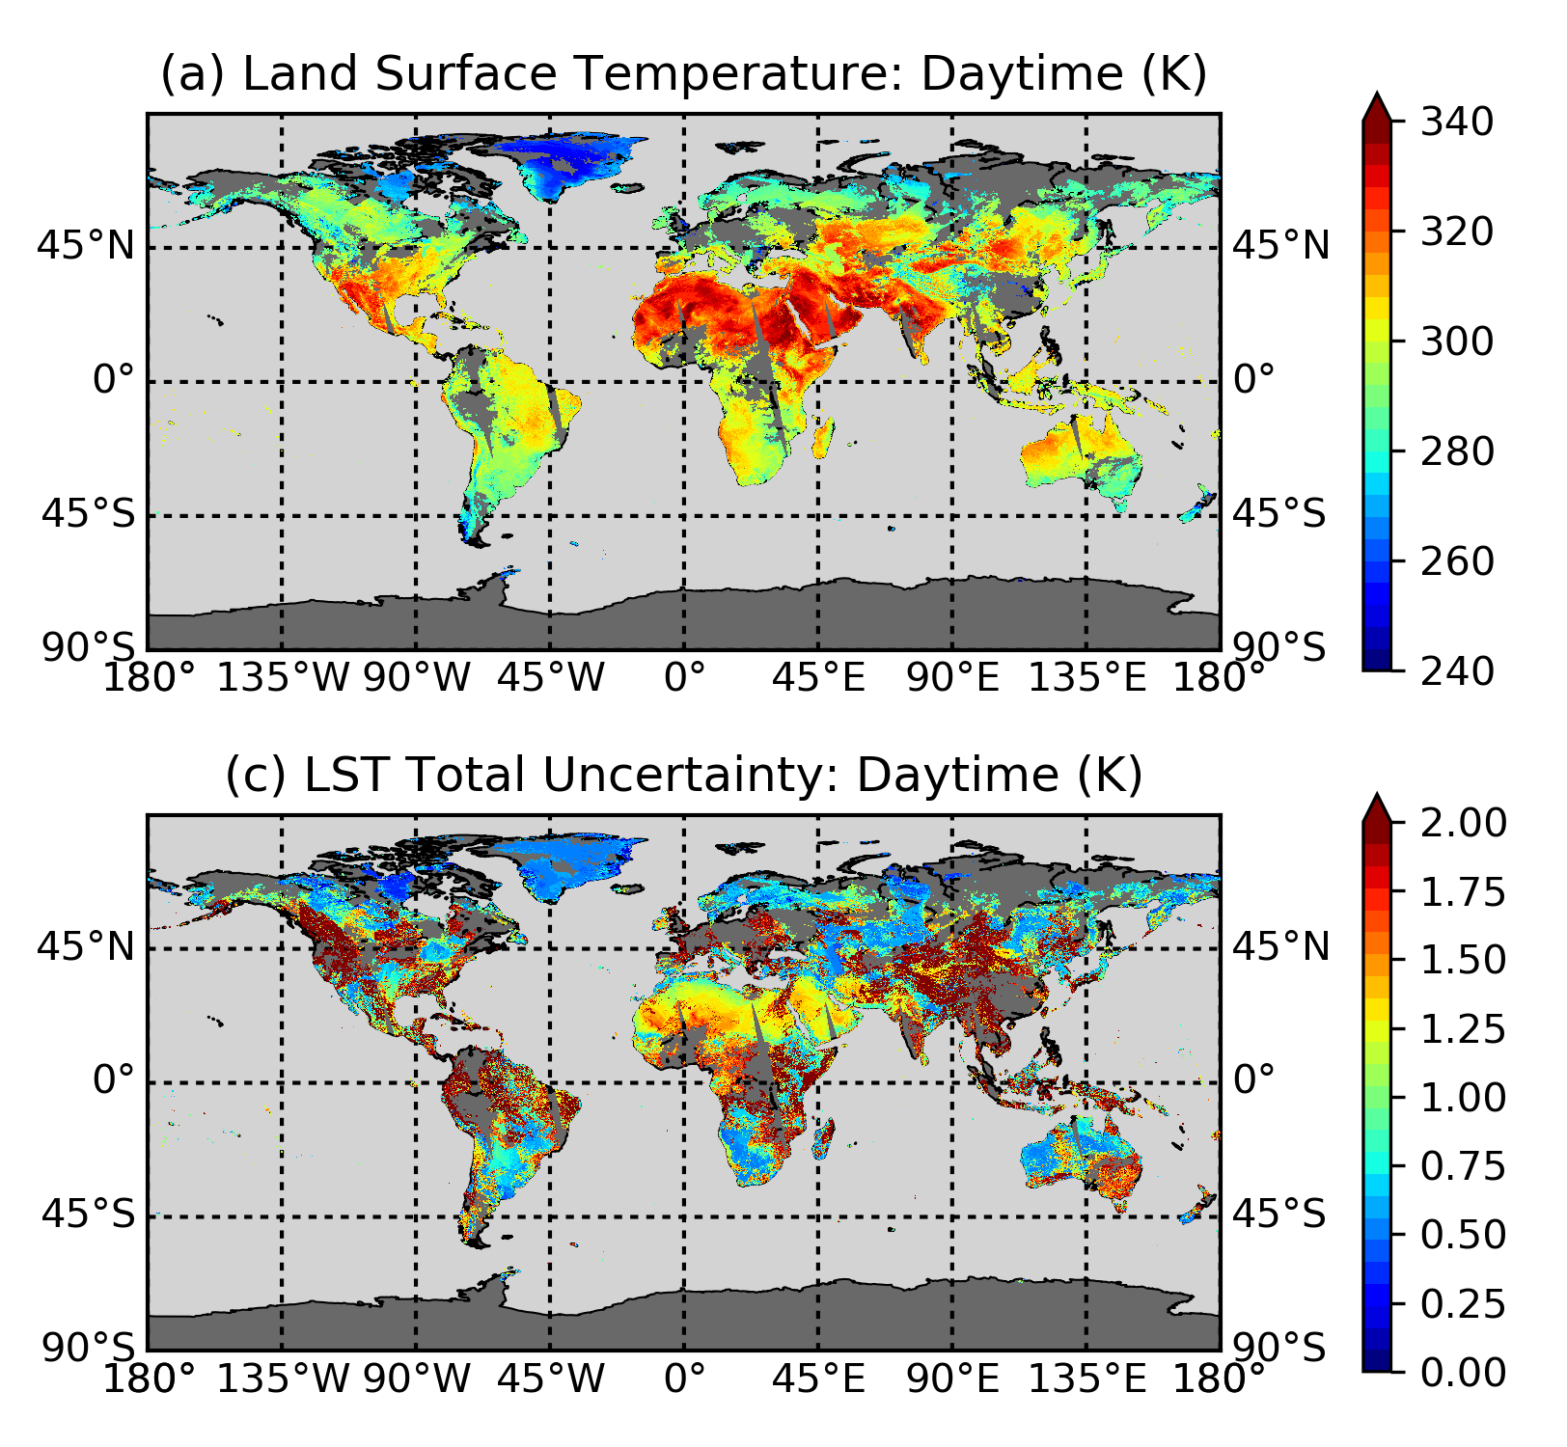
Infrared product uncertainties
LST
Total uncertainty
MODIS, 10:30am overpass

Slide 5
Providing a breakdown of uncertainty components
We also take each of the uncertainty estimates (from each error effect) and group them according to their correlation length scale:
Independent (these uncertainties are uncorrelated between one observation and the next)
Systematic (these uncertainties are correlated with neighbouring observations over a specified correlation length scale in time and/or space)
Common (these uncertainties are fully correlated over all observations)
We add the uncertainties (in quadrature) in each group to provide the individual components to our total uncertainty budget. Note: under the ‘systematic’ group, there can be more than one component if there are uncertainties that vary with different correlation length scales e.g. atmosphere and surface.

Slide 6
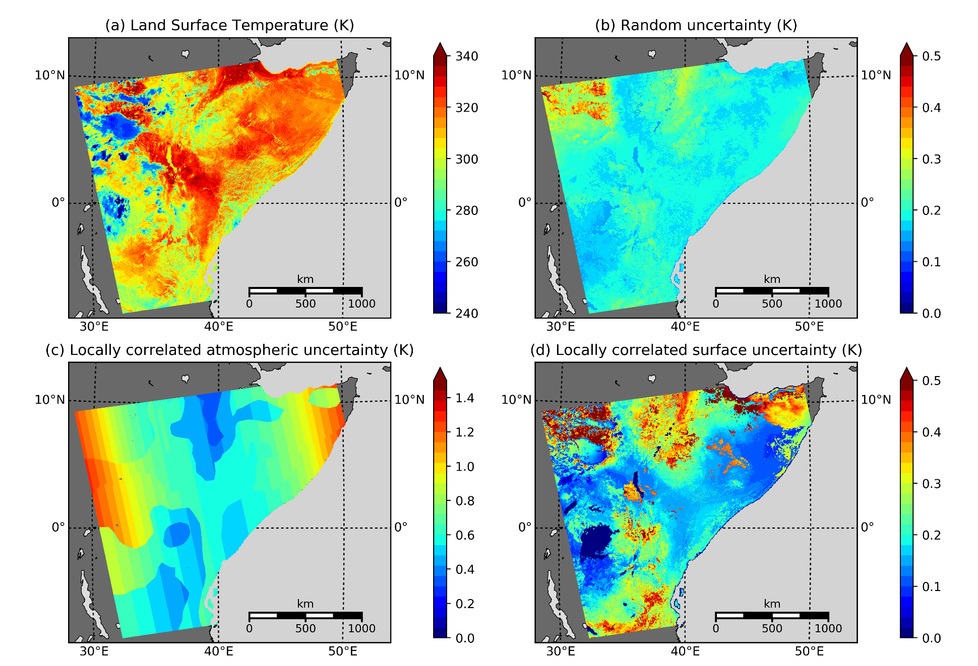
Breakdown of uncertainty components
Why do we provide this breakdown?
The main reason is so that users can use our data to create new products e.g.
Coarsening data for comparison with model output.
Calculating area averages over cities or regions of interest.
With the breakdown of uncertainty components, the uncertainties can also be correctly propagated.

Slide 7
How do we provide uncertainty information?
2) Microwave
Similarly to the infrared retrieval, we can construct a table of error effects relevant to the the microwave measurement equation (and have done this in the E3UB).
The microwave retrieval uses a neural network trained using a calibration database, so the measurement equation takes a different form. At present, only a subset of these error effects can be well constrained either through direct propagation or by applying a simple model and we cannot fully capture the total uncertainty in the microwave data using this method.
Instead, we use the regression model to estimate the total uncertainty (instrument and retrieval errors combined) by sampling the neighbouring input-output space.

Slide 8
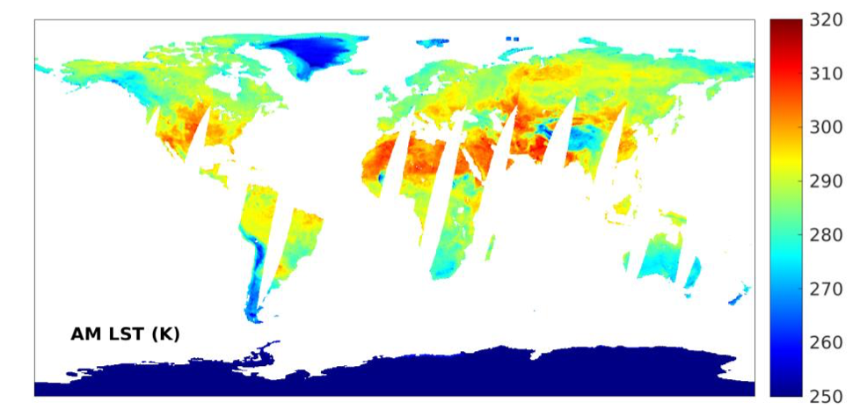
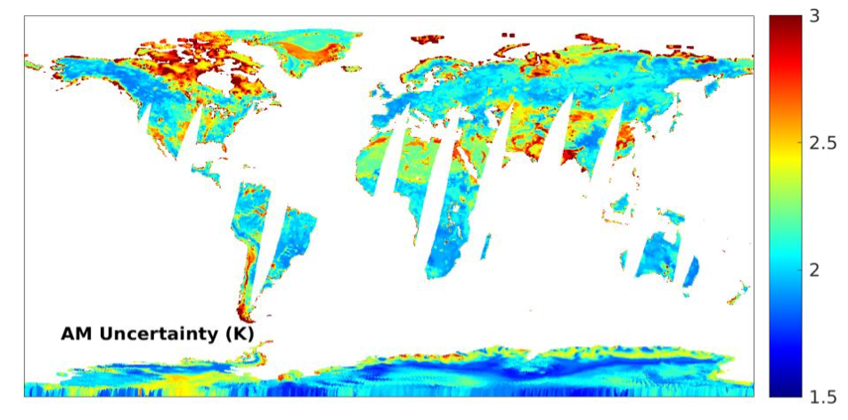
Microwave product uncertainties
LST
Total uncertainty
SSMI, 6.30am overpass
Notes:
Larger uncertainties: where the microwave inversion problem is most difficult e.g. regions where emissivity changes rapidly: snow, humid surfaces from rainfall or inundation or vegetation transition regions. Coasts can be problematic if there is a large amount of water in the field of view (not reflected in the land-based climatology). Arid areas are hard because the penetration depth of the microwave is greater here and you can have sub-surface emission.

Slide 9

Where can I find information on uncertainties?
Product User Guide
Here you can find a description of our dataset written for our data users including:
Description of the uncertainty fields in the products.
Basic description of the uncertainty components and how they combine to provide the total.
An FAQ on the difference between error and uncertainty.

Slide 10
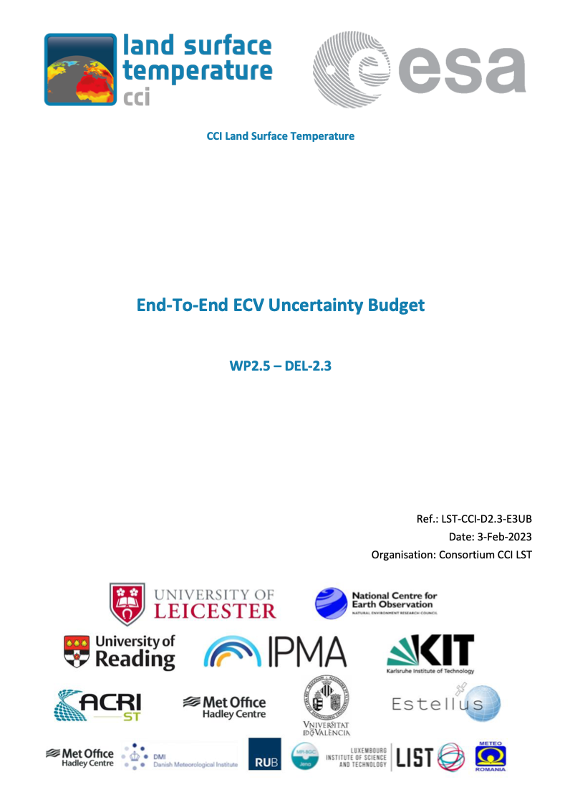
Where can I find information on uncertainties?
End-to-end ECV Uncertainty Budget
Here you will find a complete (and detailed!) description of the uncertainties if you are interested.
The final three pages are particularly useful for all users as they give examples of how practically to use the uncertainty information for a few different applications.

Slide 11
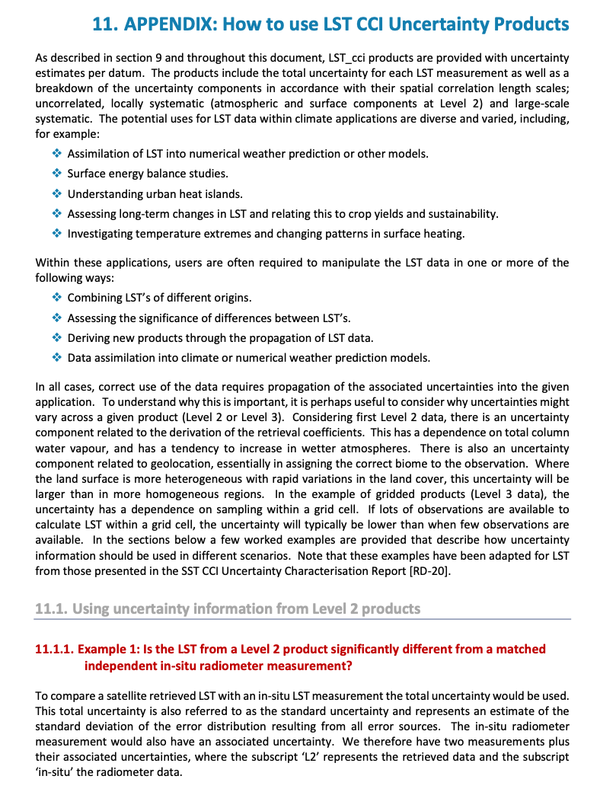
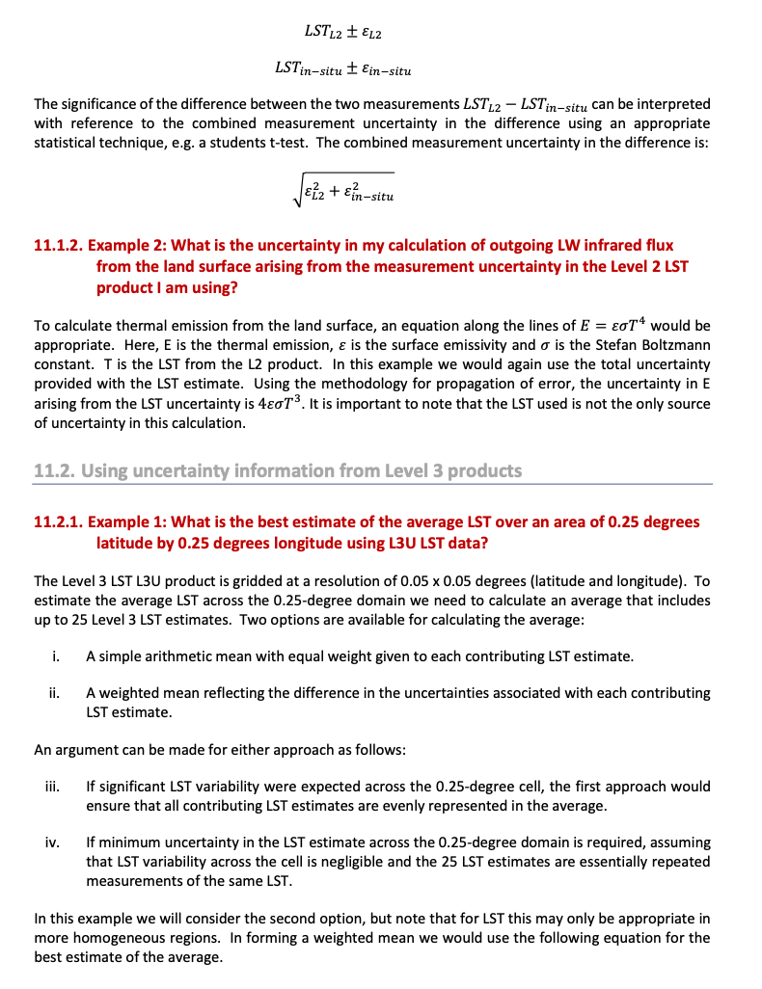
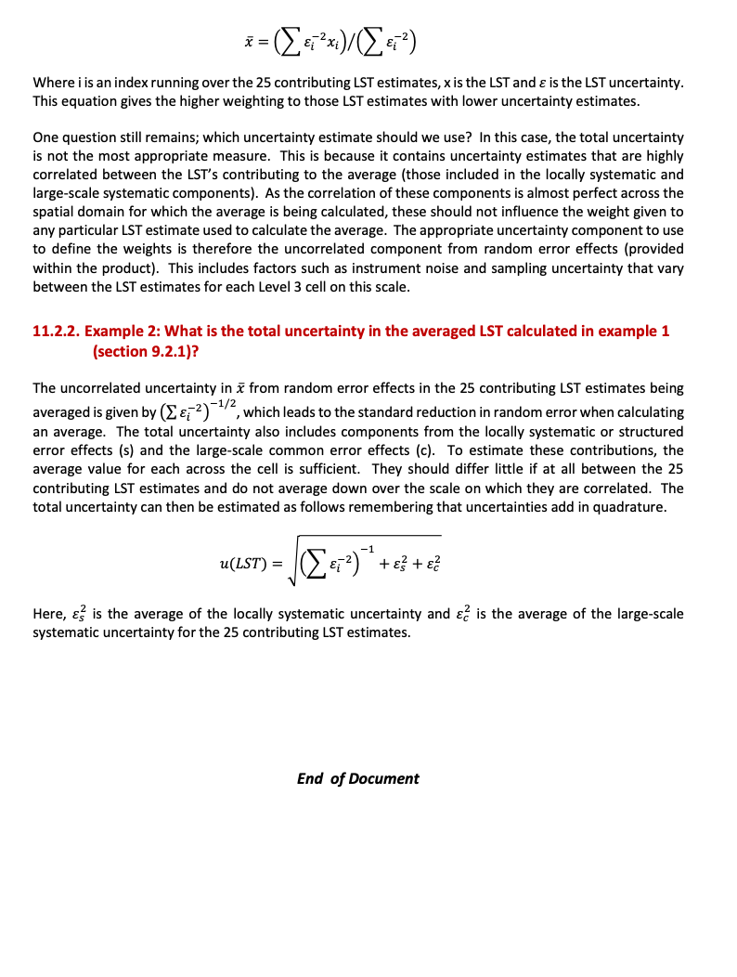
E3UB: Appendix 11

