Slide 1

Progress Towards a Merged All-Sky LST Dataset
By Abigail Marie Waring (PhD Candidate)
University of Leicester School of Physics & Astronomy
and the National Centre for Earth Observation
Dr David Moffat (PML/NEODAAS/NCEO), Dr Darren Ghent (UoL/NCEO), Prof John Remedios (UoL/NCEO)

Slide 2
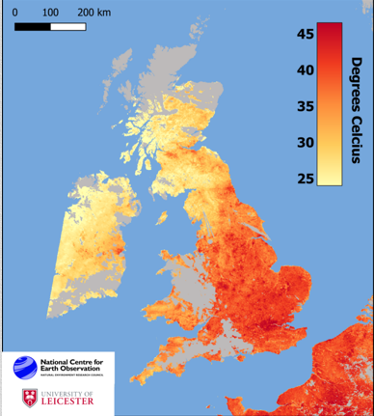
The Clear-Sky Bias Problem
The problem:
Infrared signal is blocked by clouds
Huge data gaps means our weather & climate trends are only indicative of a clear sky
Why is this important?:
Lack of data == higher uncertainty of the Earth's total energy budget
What now?:
We build an all-sky LST dataset that merges other LST data
BBC article on the 2022 UK heatwave. SLSTR infrared compiled by the University of Leicester/NCEO's surface temperature group
Notes:
The main issue is that infrared signal is blocked by clouds so we get data gaps like in the image on the right
Although we have high resolution robust climate data records, we have gaps in the earths total energy budget
We have built an all-sky dataset which merges other LST data

Slide 3
All-Sky Merged Model
Microwave data
Thermal data
AMSR-E
MODIS
All-sky
Low resolution
Clear-sky bias
High resolution
Advanced Microwave Scanning Radiometer | Moderate resolution Imaging Spectroradiometer
Microwave | Thermal Infrared
1-2 days revisit
12.5 km spatial resolution | 1 km spatial resolution
Notes:
The merged model is based on merging TIR & MW LST measurements from NASA’s AQUA satellite
IR has high spatial res and lower uncs but has gaps due to clouds.
MW is mostly all-sky but a much lower resolution
They are on the same platform == same temporal resolution
The MW will essentially gap-fill the TIR
The issue with this is that although same temporal res, different spatial res and this is why we have chosen a ML method to combat this

Slide 4
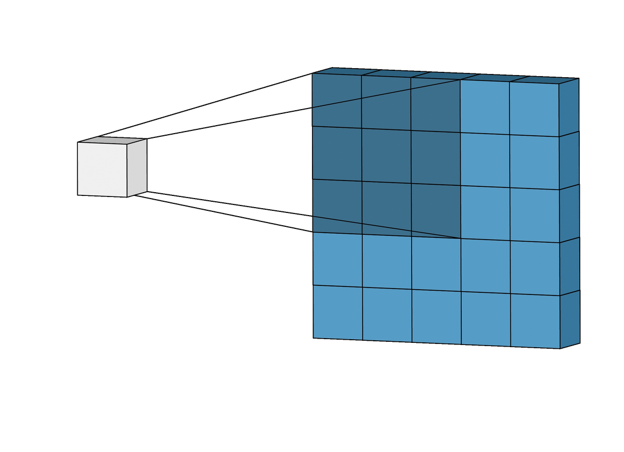
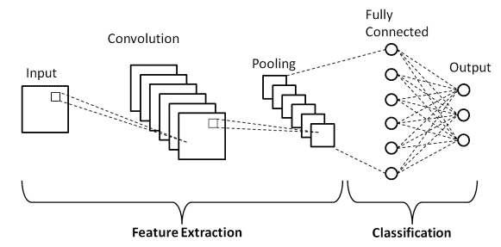
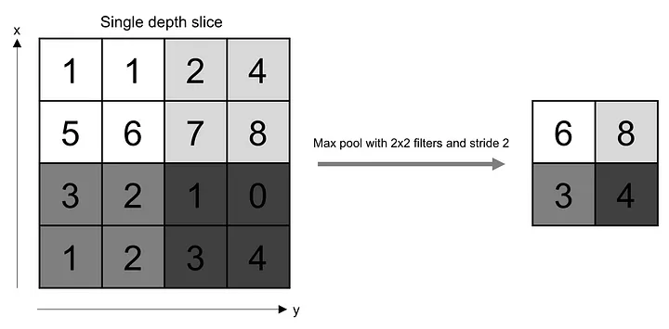
What is a Convolutional Neural Network?
Convolutional layer
Core building block of the CNN
Performs feature extraction from input data using kernels
Kernels are small matrices designed to detect specific patterns or features as feature maps
Pooling layer
Used to reduce spatial dimensions of the feature maps
Pooling averages and helps to reduce computational complexity
Fully connected layer
Each neuron is connected to every neuron in the previous and subsequent layers
Used to learn complex relationships and patterns in the data
3. Fully Connected layer
Convolutional layer
2. Pooling layer
UNet autoencoder-decoder CNN
Notes:
A CNN typically has three layers that work in tandem to enable a CNN to learn features from input data
Convolutional layer = Core building block of the CNN that performs feature extraction from input data using learnable filters (kernels). Kernels are small matrices designed to detect specific patterns or features as feature maps
Pooling layer = Used to reduce spatial dimensions of the feature maps generated
Fully connected layer = Each neuron in network is connected to every neuron in the previous and subsequent layers. Use to learn complex relationships and patterns in the data and connects to output layer to produce final predictions.

Slide 5

Method & Results so far...

Slide 6
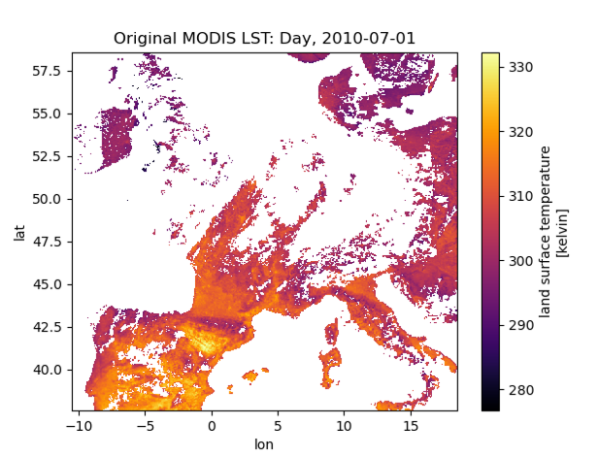
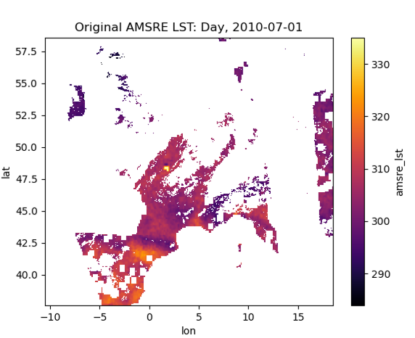
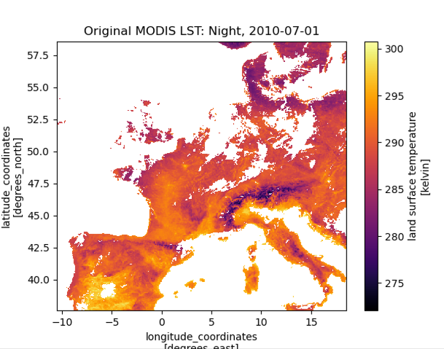
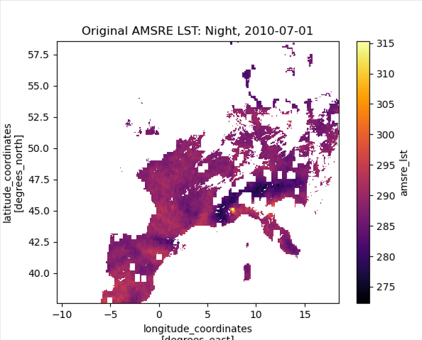
Step 1: MODIS & AMSR Matchup Outputs
DAY
Microwave has been filtered for large convective clouds
NIGHT
Bi-linear 5 km regrid of cloud cleared AMSR pixels,
matched with clear-sky 5 km MODIS
Notes:
Step 1 is to matchup AMSR-E pixels to the MODIS 5 km grid using bi-linear interpolation.
Blocks in the microwave are from convective cloud clearing so the model doesn’t learn cold biases

Slide 7
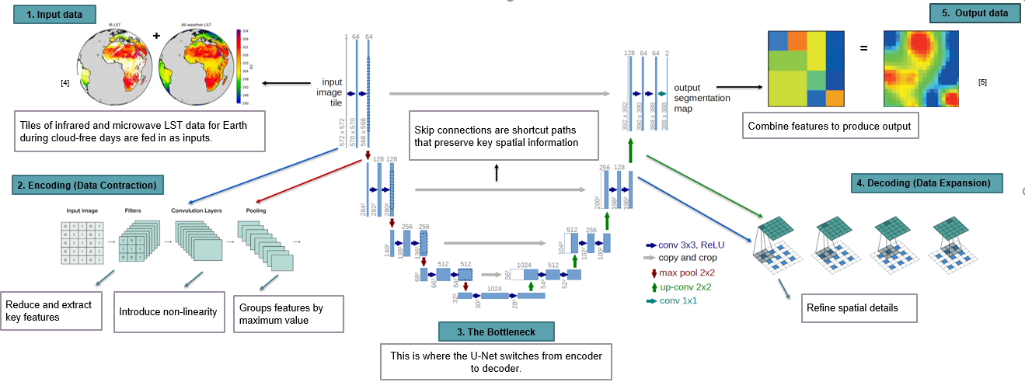
Step 2: Build and Run UNet CNN
How does a UNet work?:
It learns two types of data (TIR & MW), breaks down by extracting key features, then builds them up using the information to improve resolution
Notes:
Unet is called so due to its shape as you can see.
Step 1 input matched up MODIS and AMSRE data
Step 2 is the encoding of data, where features are extracted, learned and grouped
Step 3 is changing from encoder to decoder
Step 4 decoding the data, by expanding the feature maps and upsampling the features
We add an extra layer to be able to continue to refine the resolution
Step 5 output map predictions with increased spatial dimensions
Skip connections preserve rest of the data for the model to learn and self validate later
Notes:
The horizontal blue arrows = the features extracted at each level are refined through multiple convolutions before being either downsampled or upsampled.
Numbers above the convs i.e. 1, 64, 128 are the depth of the feature maps and increases the deeper into the downsample
The bottom numbers are represent spatial dimensions (h x w) of the feature map of that layer. These decrease in downsampling due to max pooling, and increase in upsampling.

Slide 8
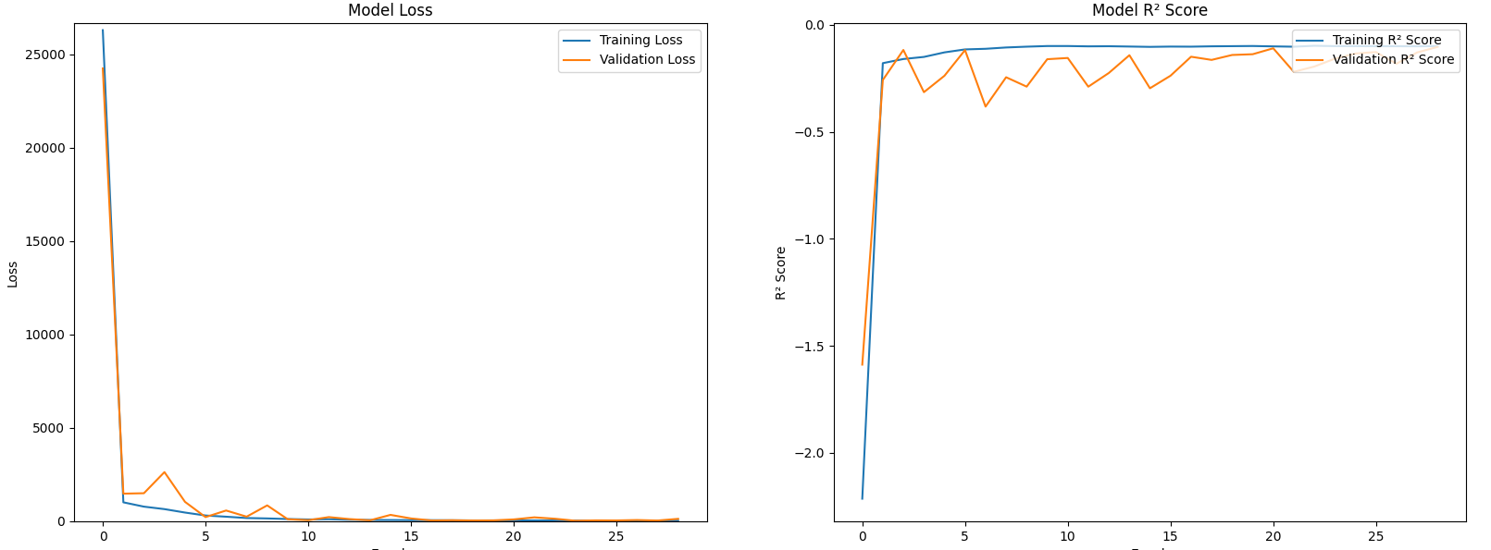
Model Accuracy and Errors
Model loss explains how the model trains and learns over time
R2 shows how well the model explains the variance in the data
Blue line – Training dataset
Orange line – Validation dataset
Sharp decrease to 0 = very rapid learning of both training and validation loss
This is more desirable for efficient learning
Rapidly improving R² scores that stabilize close to 1.0
Indicates strong predictive performance and good generalisation without overfitting
Notes:
U-Net Error Loss Plot: Tracks the training and validation loss over epochs, showing how well the U-Net model is minimizing the error during training. A decreasing trend in loss generally indicates that the model is learning effectively.
R² Plot: Displays the R² (coefficient of determination) score over epochs, indicating the proportion of variance in the target variable that is predictable from the input features. A higher R² value signifies better model performance and fit.
Learning Rate Plot: Illustrates changes in the learning rate over time, often showing how it varies according to a scheduled policy or adaptive method. Proper management of the learning rate helps optimize convergence and model performance.

Slide 9
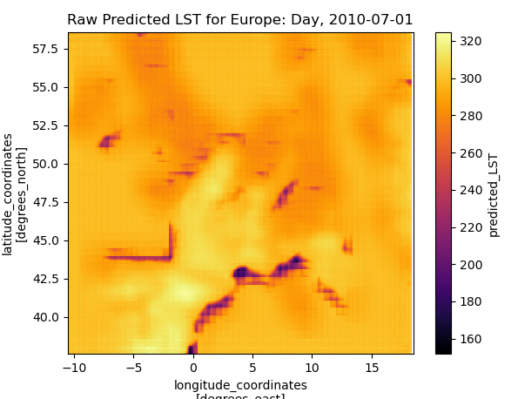
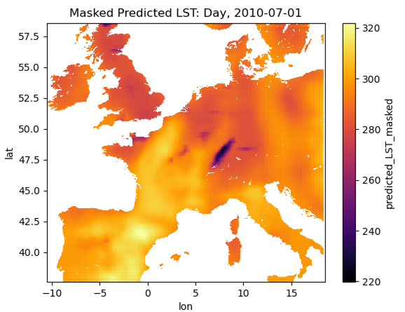
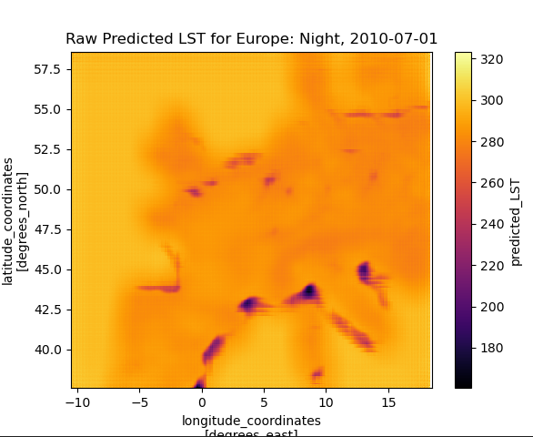
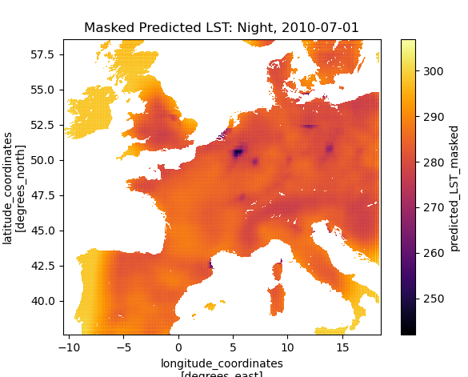
Step 3 : Attributes & Land Mask
Predict all pixels within a region
Unmasked
Masked
DAY
NIGHT

Slide 10
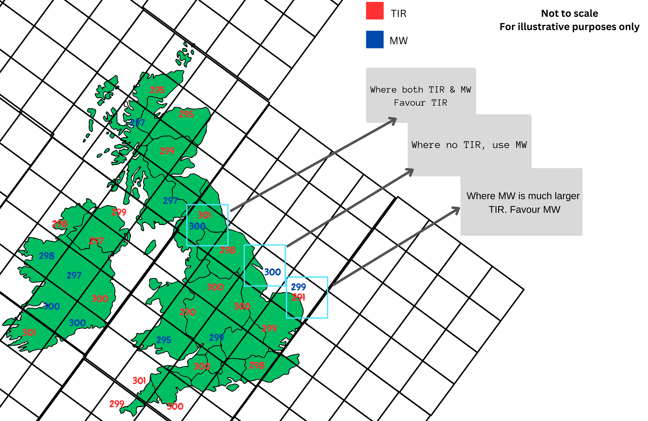
Step 4: Merged Dataset Product
Selection of LST data:
Where pixel == TIR & MW, favour TIR over MW
(lower uncertainties)
Where pixel == cloud, fill with MW
Where TIR < MW, favour MW
(TIR likely seeing cloud top height not the surface, MW can penetrate the misclassified cloud)
End goal:
A merged all-sky LST for the globe at 5 km resolution
Notes:
The final product will be at a 5 km resolution for both TIR & MW LST data
We will treat as best knowledge but are aware of unaccounted uncertainties for what we have not yet quantified
The point is there is still a benefit as we are improving observations even if its not 100% perfect
TIR and MW are complimentary == utilise the best features in order to improve observations
Notes:
We use gap-filling instead of overall averaging in order to keep traceability of the uncertainties
Both TIR & MW use the same uncertainty model & will take them as face value
We will treat as best knowledge but are aware of unaccounted uncertainties for what we have not yet quantified

Slide 11
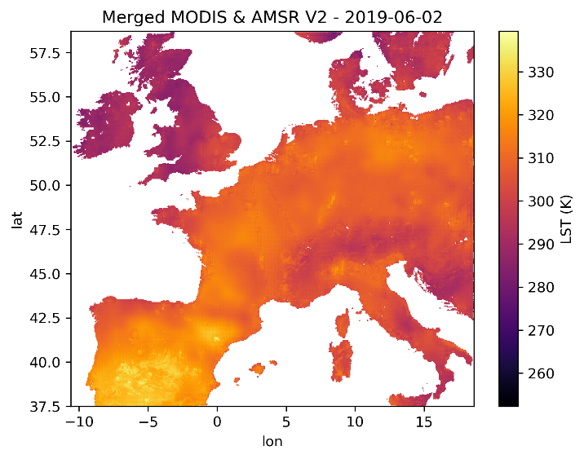
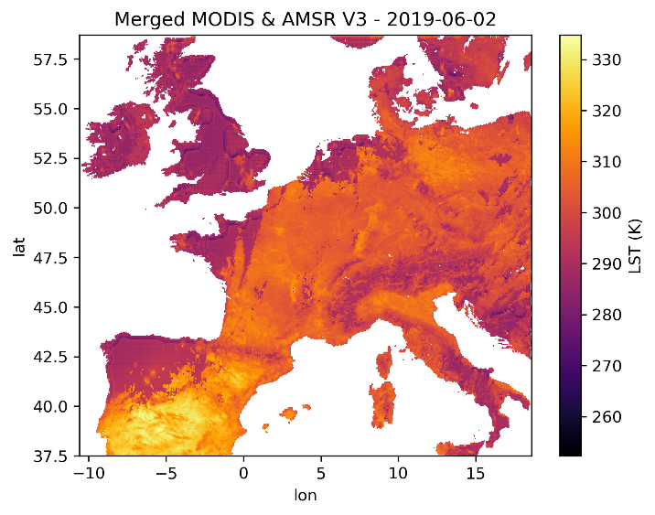
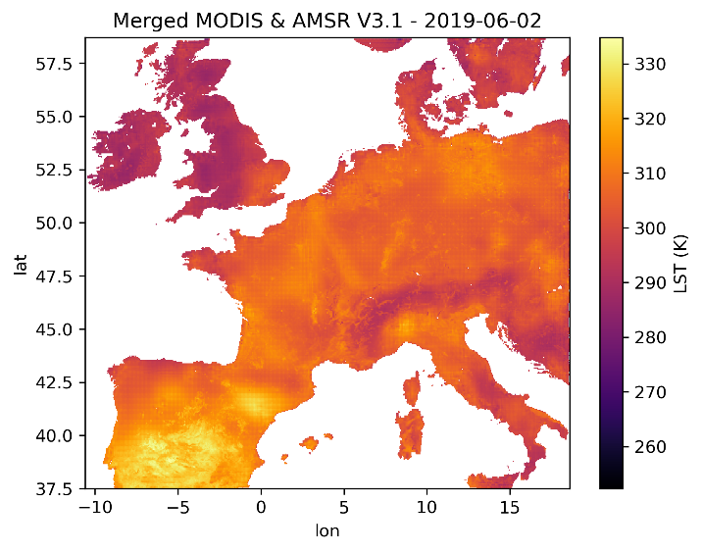
Testing: Model Optimisation
Full Merge Prototype
V0.2
V0.3
V0.3.1
Added up sampling layers to improve the resolution
Added learning rate of 0.01
Reduced learning rate to 0.001

Slide 12
First Test Model
West Europe training 2003-2018
Make predictions 2019-2021
Train day and night tiles together in one model

Slide 13
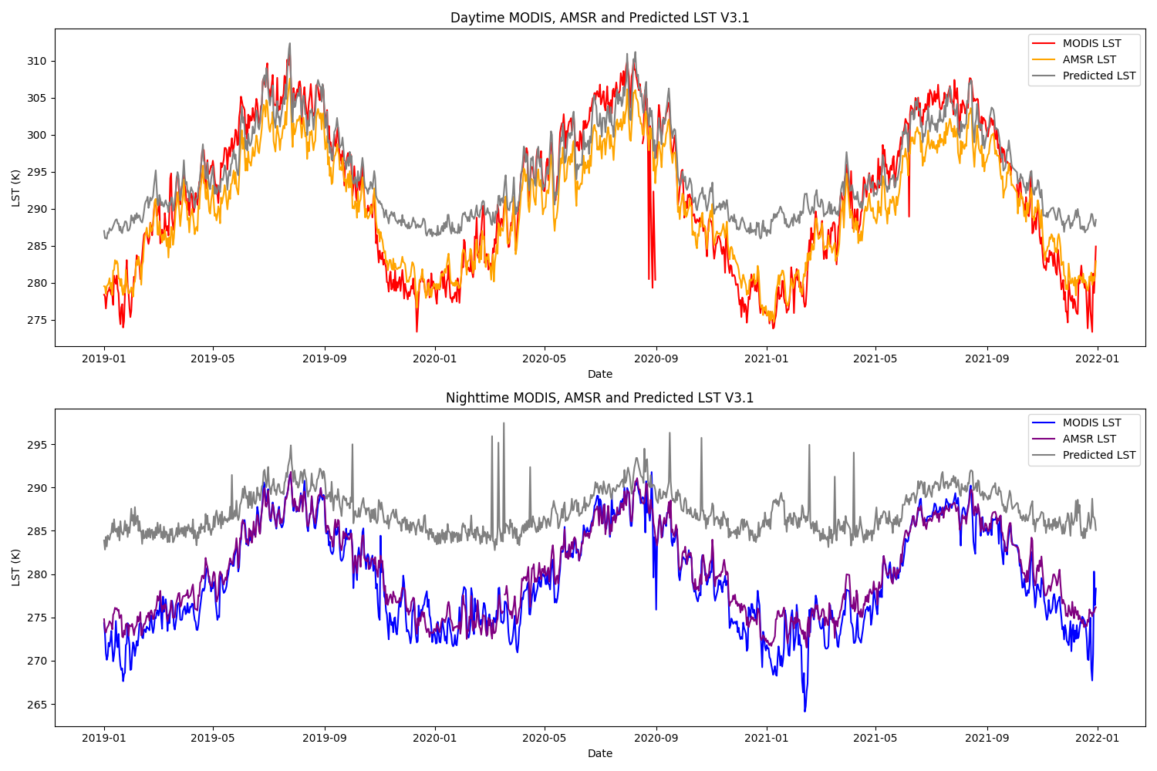
Test 1: West Europe Prediction v3.1
Model is trained on clear sky data which is clearly lacking during winter and at night time
Has a warm bias that doesn’t go below 280 K

Slide 14
Test 1: West Europe Prediction v3.1
It is predicting daytime microwave LST during the summer very well
The end goal would be that the predicted microwave is closer to the thermal data which represents the point spread function of temperature distribution.
This is achieved as the UNet model effectively applies a correction based on finer details captured from the thermal data.

Slide 15
Second Test Models
West Europe training 2003-2018
Make predictions 2019-2021
Same UNet version
Train summer day/night and winter day/night as 4 separate models to capture the signatures

Slide 16
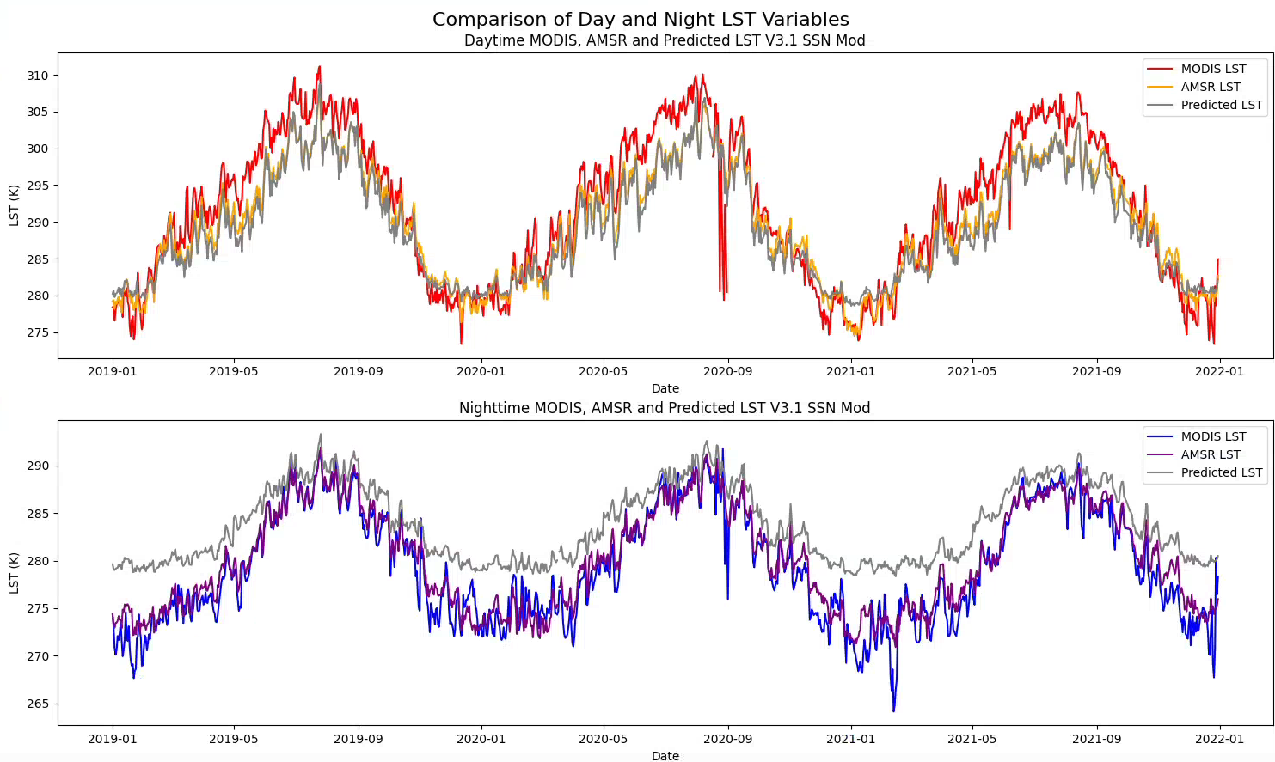
Test 2: West Europe Prediction v3.1
Removed the warm bias in the summer
Reduced the warm bias significantly in the night/winter

Slide 17
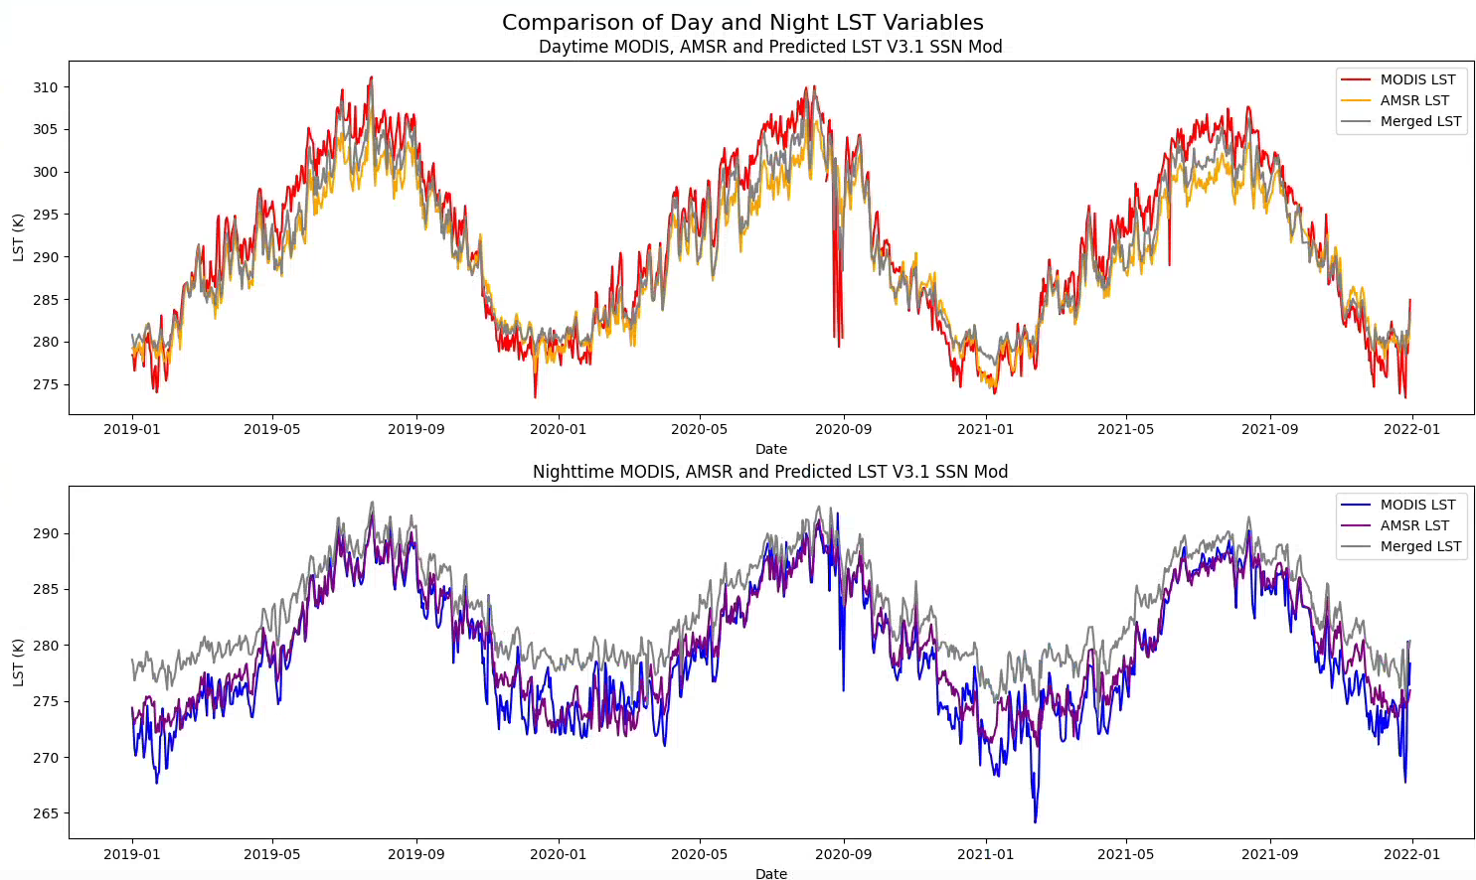
Test 2: West Europe Merge v3.1
When predicted LST pixels are merged with original infrared MODIS pixels, the results improve further

Slide 18
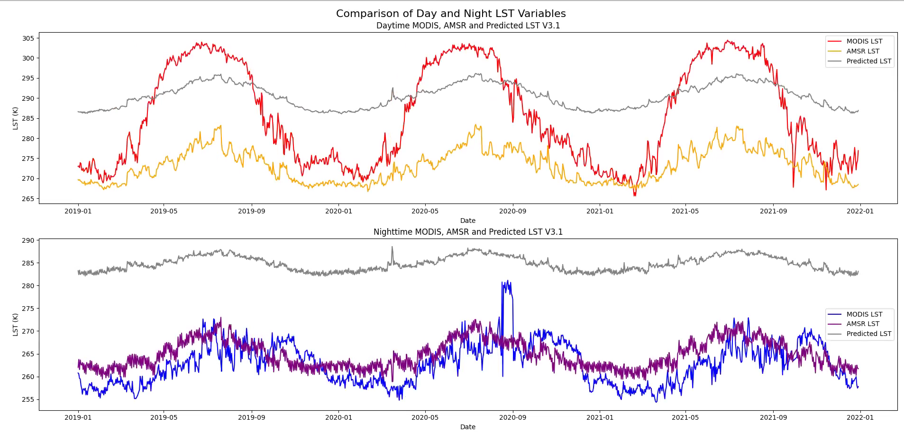
Test 2: Global Merge v3.1
Global predictions for day and night have a significant warm bias
Next steps to implement biome pixel classification training through seasons

Slide 19






Next Steps
Optimise the model so it can run global data trained by biome
Consider post-processing bias correction for nighttime/winter (regions like high lats)
Complete a full merge test-run of the entire CDR (2003-2021)
Run global validation and analysis
Prepare results for publication
Run an application case study and intercomparison to demonstrate improvements

Slide 20
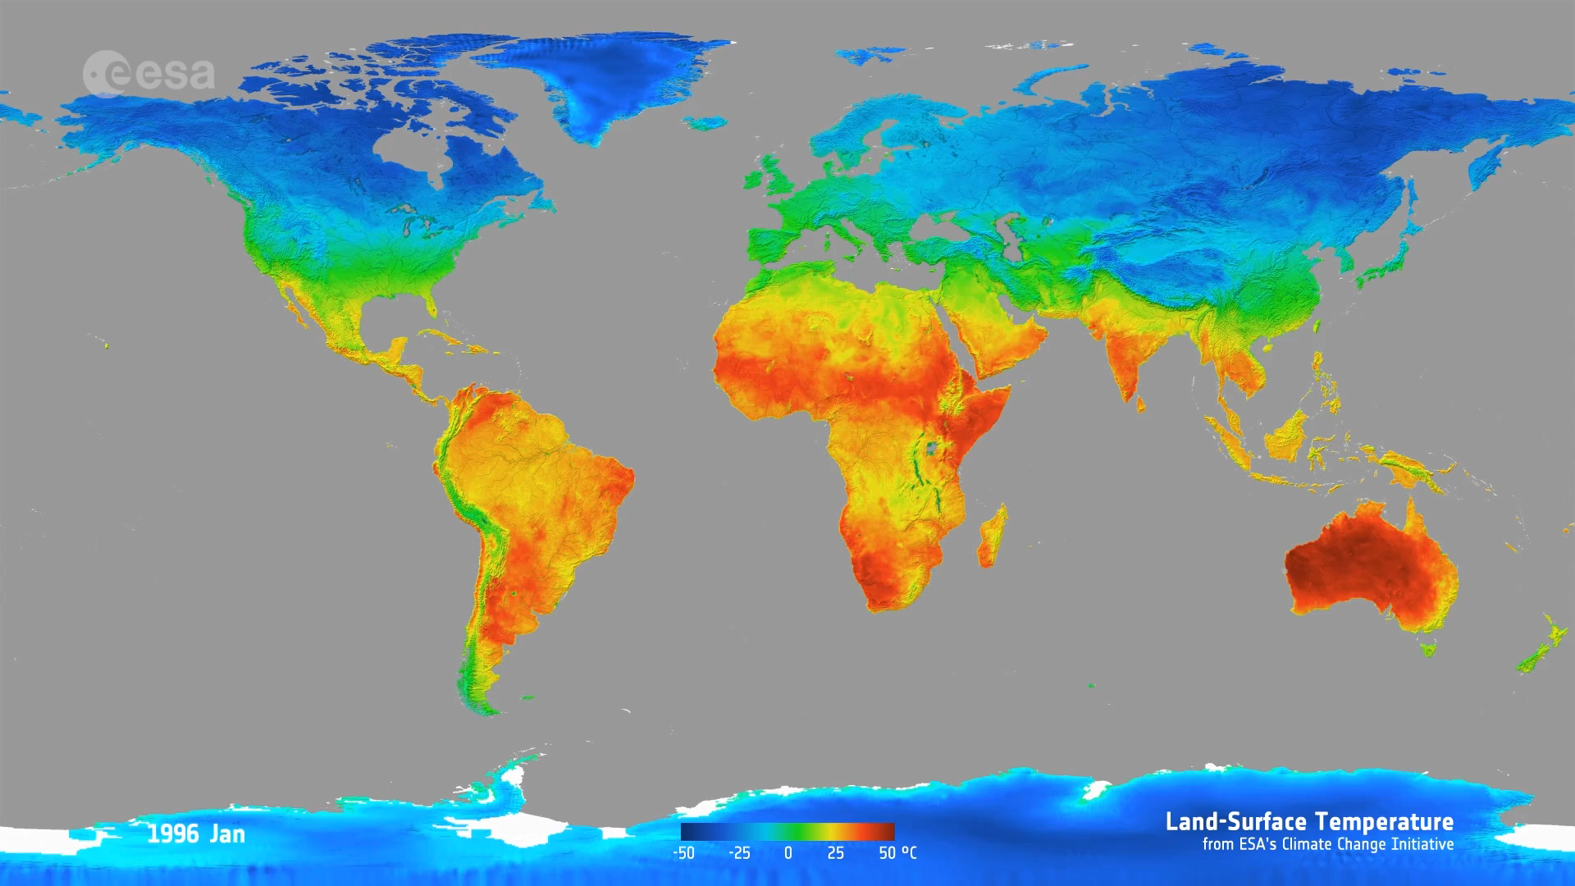
Summary
LST is a significant ECV that determines Earth's energy balance
To solve the clear sky bias problem & improve LST observations we are building an all-sky merged LST product using machine learning techniques
Implementing a UNET CNN to learn from TIR and MW data, and map MW to refine its resolution to 5 km
Next steps are to optimise the model and then run for the whole globe
The model explores a range of training inputs to best describe the spatio-temporal distribution of LST
The all-sky LST product will cover the globe at a resolution of 5 km
The final product will advance climate & weather applications where observations are scarce, e.g. in the polar regions

Slide 21



Thank you!
Notes:
- Climate applications of LST

