Slide 1
User Requirements for LST

Slide 2



Please download and install the Slido app on all computers you use
1. Your main application
ⓘ Start presenting to display the poll results on this slide.

Slide 3

Please download and install the Slido app on all computers you use
2a. Have you used any LST_cci datasets? Indicate all that apply.
ⓘ Start presenting to display the poll results on this slide.

Slide 4
Please download and install the Slido app on all computers you use
2b. Which ESA Land Surface Temperature Climate Change Initiative (LST_cci) products have you used? Indicate all that apply.
ⓘ Start presenting to display the poll results on this slide.

Slide 5
Please download and install the Slido app on all computers you use
2c. Which temporal resolution of LST_cci products do you use? Indicate all that apply.
ⓘ Start presenting to display the poll results on this slide.

Slide 6

LST_cci VIIRS LST product
Visible Infra-red Imaging Radiometry Suite
Platforms
Suomi NPP asc 13:25
NOAA-20 asc 13:25
NOAA-21 asc 13:25
VIIRS 750m L1 products have stripes of missing data, which get thicker as you move towards the edge of swath, due to the ‘bow-tie’ deletion process
These propagate through to the 0.01˚ L3C product
Different treatment of overlapping pixels produces different amounts of striping:
By nearest to nominal time (current method), by lowest uncertainty, by lowest zenith angle
NASA method is to average all overlapping pixels, which reduces the striping but loses the traceability of the acquisition time and averages pixels that could be over 1 hour apart.
Propagating to 0.05˚ L3C product effectively removes this problem
L3C 0.01˚

Slide 7
Please download and install the Slido app on all computers you use
2d. We are producing a VIIRS LST product in LST_cci. Would you consider using VIIRS as a follow-on to Aqua MODIS?
ⓘ Start presenting to display the poll results on this slide.

Slide 8
Please download and install the Slido app on all computers you use
2e. When collating different VIIRS orbits to daily grids which treatment of overlapping pixels would you prefer?
ⓘ Start presenting to display the poll results on this slide.

Slide 9
Please download and install the Slido app on all computers you use
3a. We would like to know which auxiliary variables that could be provided within LST_cci data files might be useful for your work. Please pick up to three variables that you find the most useful.
ⓘ Start presenting to display the poll results on this slide.

Slide 10

Please download and install the Slido app on all computers you use
3b. Are there other auxiliary variables that you would find useful?
ⓘ Start presenting to display the poll results on this slide.

Slide 11
Gap-filled LST product
IR products have no LST under cloud – only clear-sky LST
Approximately 50% of Earth’s surface is obscured by cloud at any time
Most users would prefer more data!
There are may ways of gap-filling, for example:
Interpolation
Using MW LST as described by Abi Waring earlier
Machine Learning techniques, e.g. auto-encoder
Reanalysis using a model
Model filled, e.g. Land surface energy balance (EB) model using other land variables
Filling of LST fields is difficult due to the high temporal variability of LST
Most methods fill the gaps (under cloud) with a clear-sky estimate of LST

Slide 12
Please download and install the Slido app on all computers you use
4a. LST_cci products typically have gaps due to non-overlapping swaths/orbits, cloud contamination and other issues. How useful would it be for your work to have a gap-filled product but with higher uncertainty?
ⓘ Start presenting to display the poll results on this slide.

Slide 13

Please download and install the Slido app on all computers you use
4b. How would you use this product?
ⓘ Start presenting to display the poll results on this slide.

Slide 14
Please download and install the Slido app on all computers you use
5. Which timeliness best matches your need for data delivery for your application?
ⓘ Start presenting to display the poll results on this slide.

Slide 15
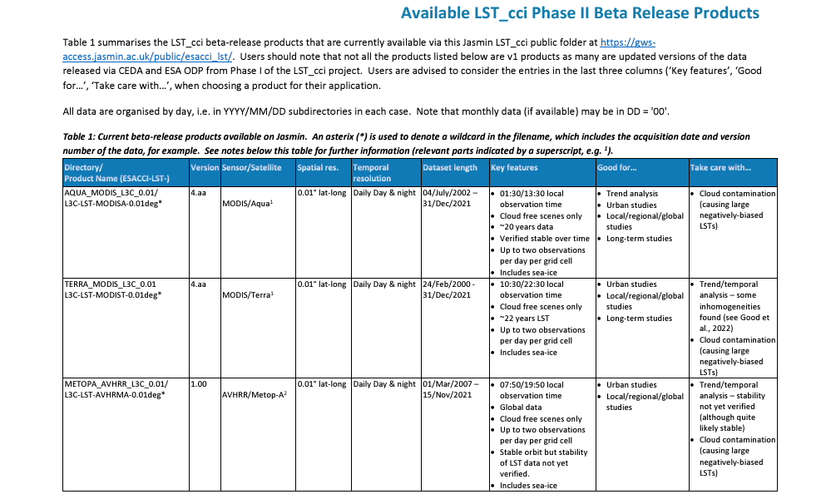
Product User Guide (PUG)

Slide 16
Please download and install the Slido app on all computers you use
6a. Would you find it useful to have a table summarising key dataset features with recommendations for how the dataset should/shouldn't be used to help you choose the best product for different applications?
ⓘ Start presenting to display the poll results on this slide.

Slide 17
Please download and install the Slido app on all computers you use
6b. Do you have other suggestions for how we can help users choose the best LST_cci dataset for their application?
ⓘ Start presenting to display the poll results on this slide.

Slide 18
Please download and install the Slido app on all computers you use
6c. What other information would be useful to add to the Product User Guide?
ⓘ Start presenting to display the poll results on this slide.

