Slide 1
Microwave LST_cci Product
Carlos Jimenez, Catherine Prigent, Iris de Gelis
Estellus, Paris Observatory

Slide 2
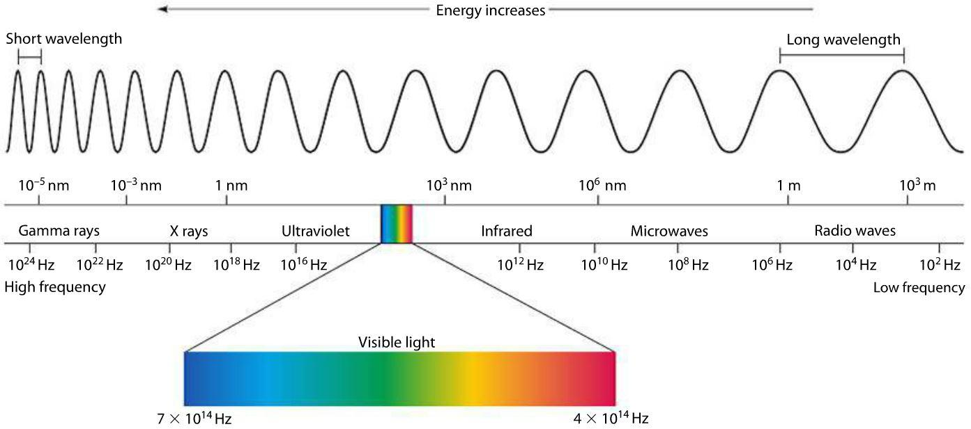
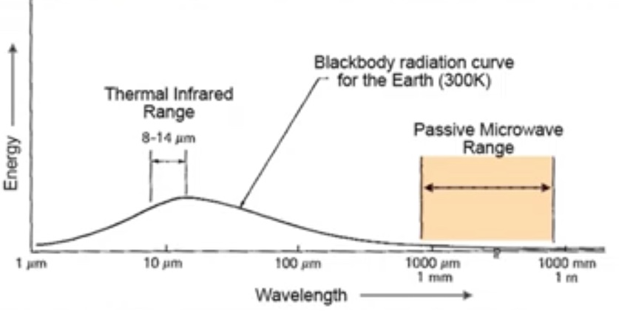
Microwave remote sensing
Microwave (MW) emission from the Earth’s surface at much longer wavelengths than in the infrared (IR) can also be used to estimate the land surface temperature (LST). However, the energy emitted (E) is weaker and is less sensitive to changes on the emitting temperature (T).
E ~ T⁴ E ~ T

Slide 3
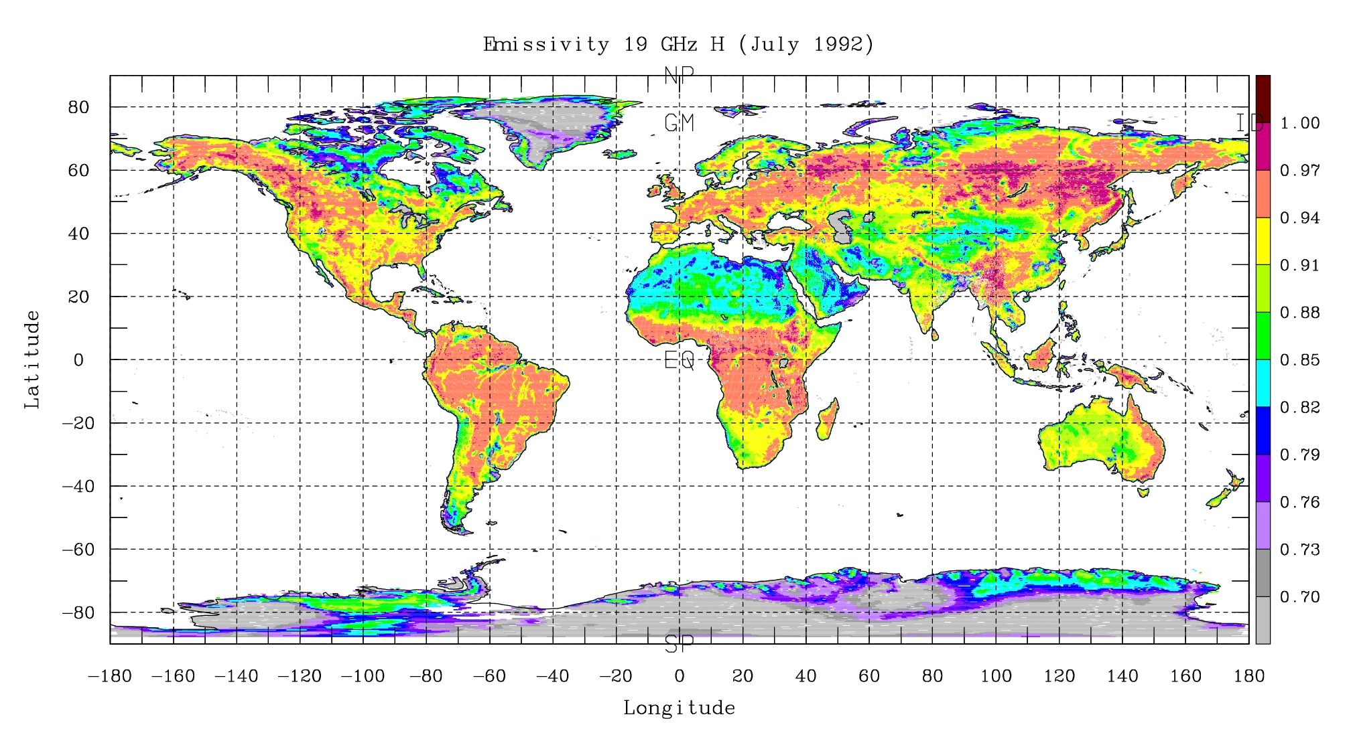
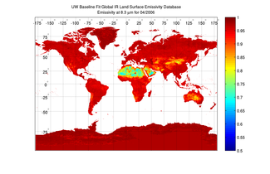
Microwave observations emissivity
The radiant temperature (T_{R}) has also a larger dependence on the emissivity (e), which has a larger variability than in the IR, changing with the surface conditions (e.g., the state of the vegetation, the soil moisture content).
T_{R} = e_{MW} T
T_{R} = e_{IR}^{1/4} T
e_{IR[8.3um]}
e_{MW[19GHz-hpol]}

Slide 4
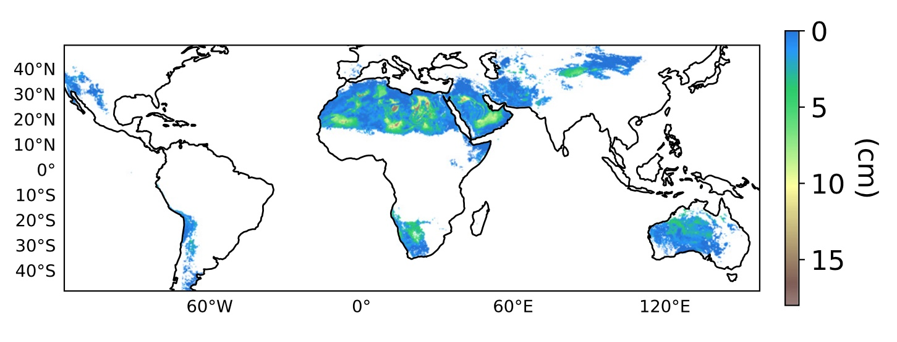
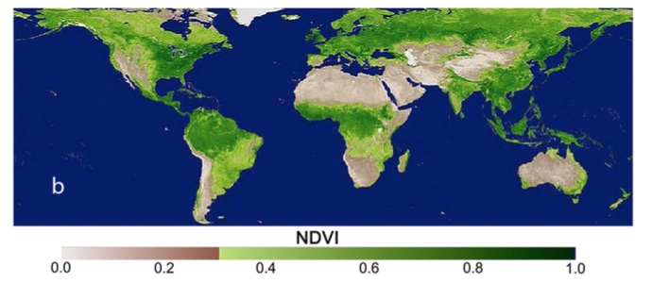
Microwave observations emitting temperature
Longer wavelengths have larger penetration depth; in very arid places MWs observe a emitting temperature integrated over a few cms below the surface, differing from the skin temperature measured in the IR.
emitting depth at 18 GHz
Favrichon et al., 2021, ﻿https://doi.org/10.3390/ rs13071325

Slide 5
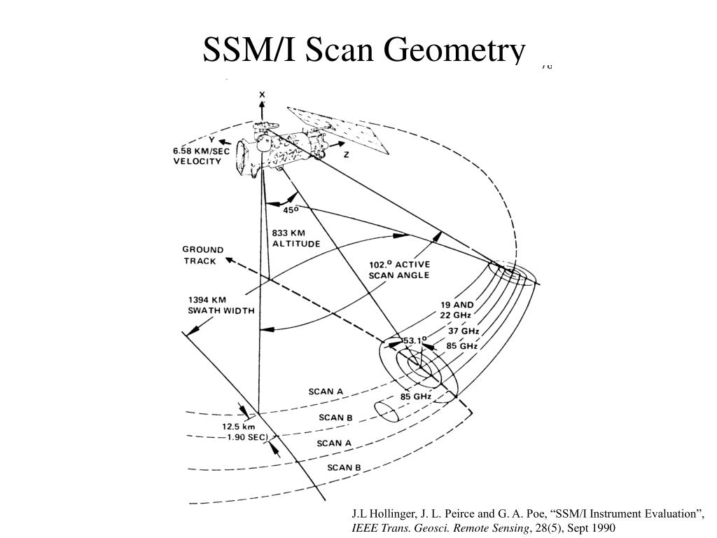
Microwave observations spatial resolution
Weaker emission and longer wavelengths require large antennas, resulting in relatively large measurement footprints on the ground, in the order of tens of kms.
~25 km

Slide 6
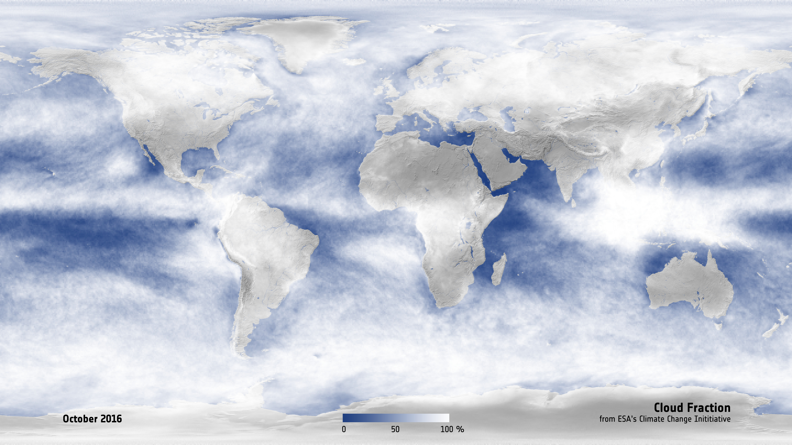
Microwave observations clouds
At the observing MW window channels the land surface emission traverses most of the clouds, therefore LST can be estimated for most weather conditions and does not suffer from the “clear-sky bias” of the IR measurements.

Slide 7
MW LST product sensors
v2.33 MW LST
^{ongoing}
SSM/I | SSMIS | AMSR-E | AMSR2
Frequency & Resolution
19.35 GHz (69x43 km) | 19.35 GHz (73x47 km) | 18.7 GHz (27x16 km) | 18.7 GHz (14x22 km)
23.235 GHz (50x40 km) | 23.235 GHz (73x47 km) | 23.8 GHz (32x18 km) | 23.8 GHz (15x26 km)
37.0 GHz (37x28 km) | 37.0 GHz (41x31 km) | 36.5 GHz (14x8 km) | 36.5 GHz (7x12 km)
85.5 GHz (15x13 km) | 91.5 GHz (14x13 km) | 89.0 GHz (6x4 km) | 89.0 GHz (3x5 km)
Nominal Incident Angle
53º | 53º | 55º | 55º
Swath width
1400 km | 1700 km | 1450 km | 1450 km
Nominal Equator Crossing Local Time
6 am/pm | 6 am/pm | 1.30 am/pm | 1.30 am/pm
Satellite Platform
DMSP F13 | DMSP F17 | Aqua | GCOM-W1
Period
1996-2008 | 2008-2022 | 2003-2011 | 2013-2022
Radiances sourced from a CM-SAF MW Fundamental Climate Data Record (FCDR) of inter-calibrated brightness temperatures
doi: 10.5676/EUM_SAF_CM/FCDR_MWI/V003

Slide 8
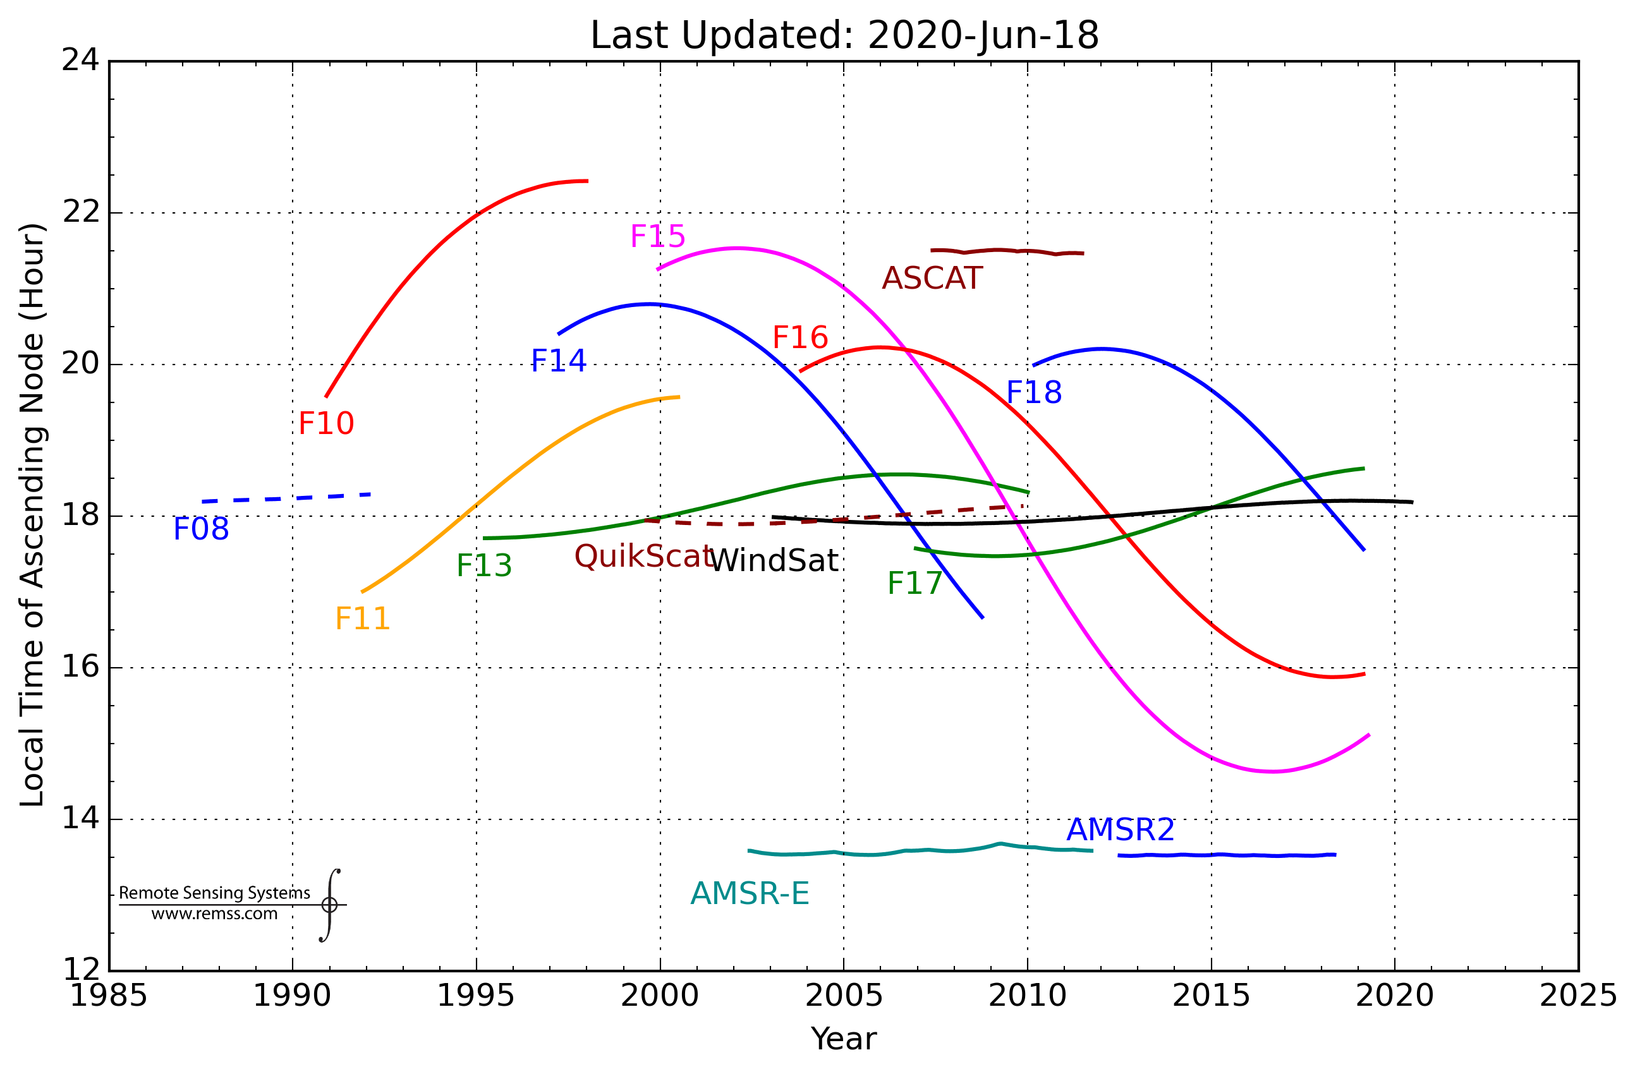
MW LST product sensors
The FX satellites do not have system to stabilize their orbits, so orbit injection and orbital drift affect the observing local time. F13 and F17 are selected to minimize the change in observing local time, and an optional LST correction to homogenize the record to a 6AM/PM overpass is also provided.
F13
F17
1996-2020

Slide 9
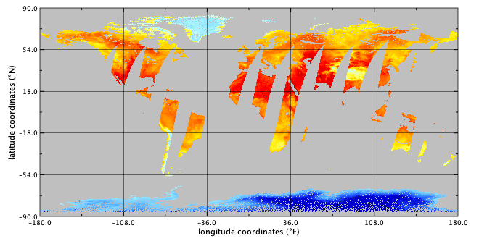
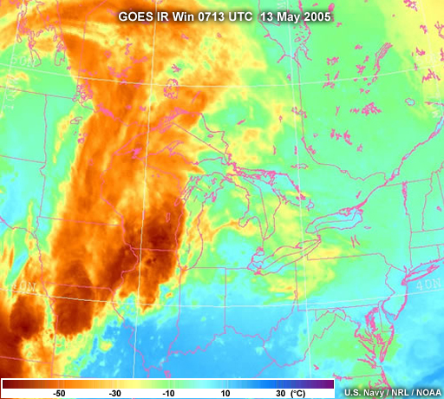
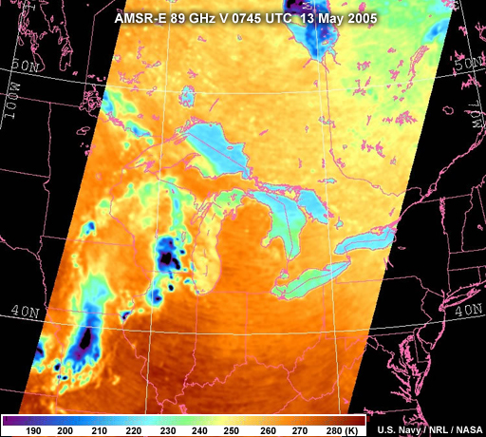

MW LST product temporal-spatial resolution
- FX polar satellites, so twice per day (~6 AM/ PM), with a sensor swath of ~ 1400 – 1700 km.
- LST under most cloudy conditions, but deep convective clouds identified and LST flagged out (surface radiation scattered away by ice cloud particles at 37 and 85 GHz).
2006/06/06
SSM/I ~6AM

Slide 10
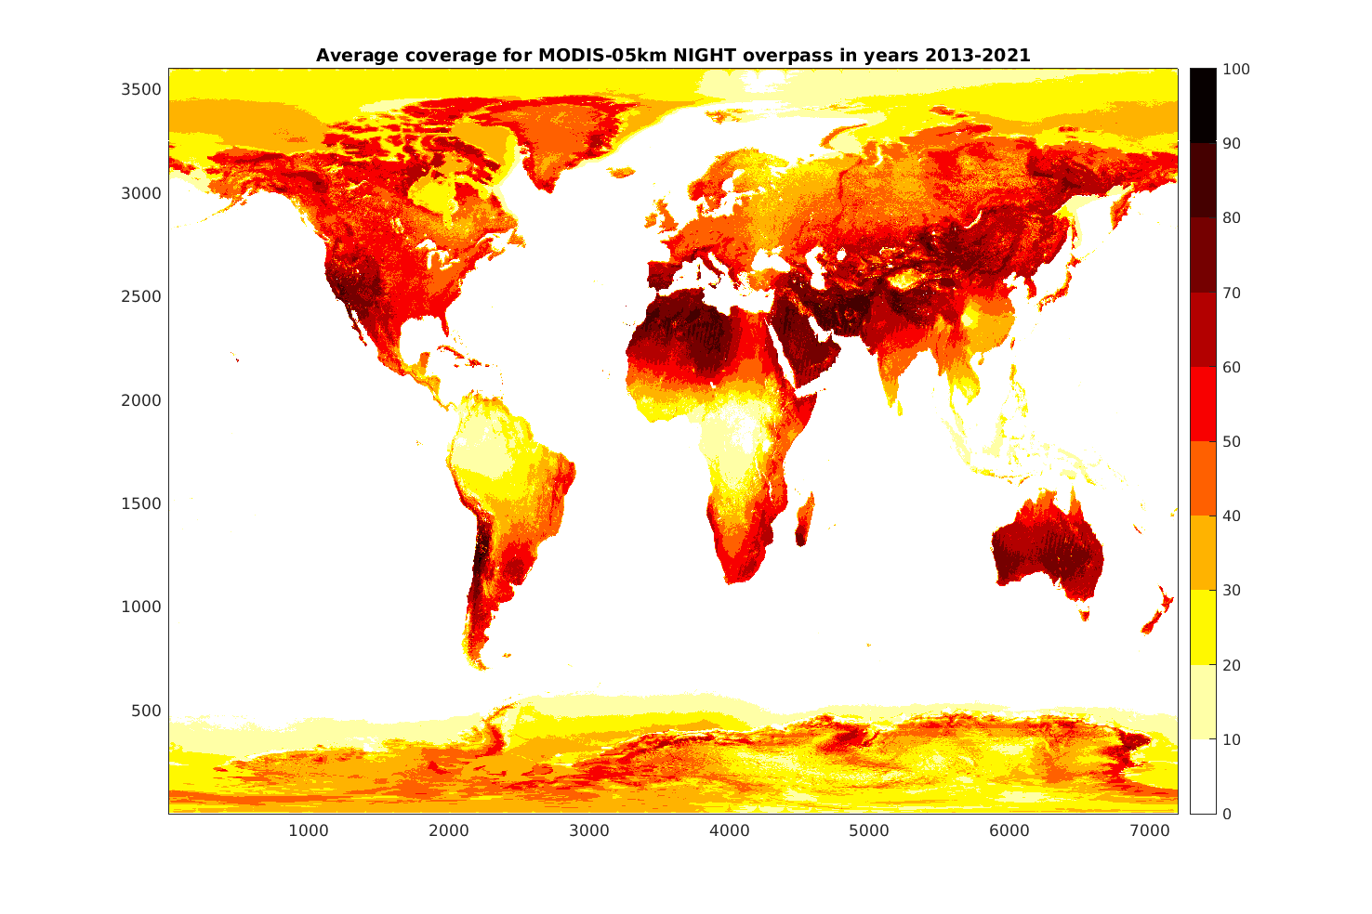
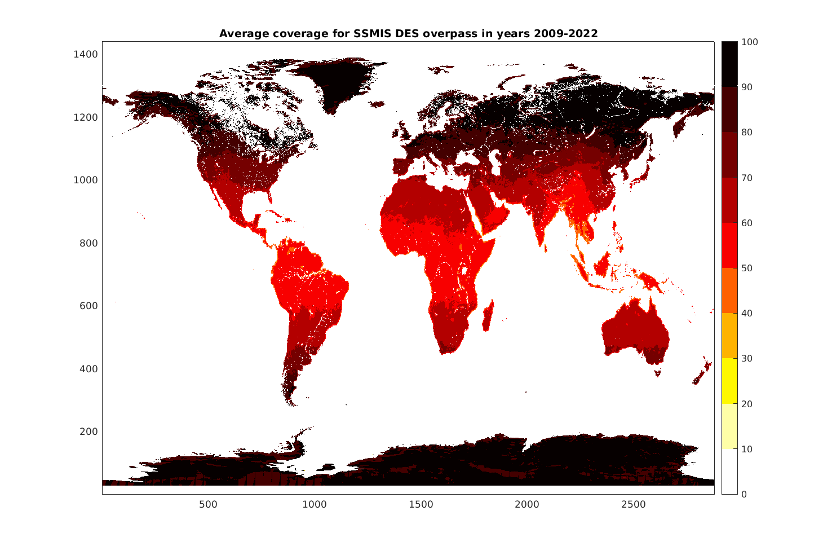
MW LST product time coverage
- Swath width resulting in coverage of ~50% at the equator (due to the ~2 days revisiting time), increasing toward the poles (overlapping swaths).
MODIS 1.30AM coverage
SSMIS 6AM coverage

Slide 11
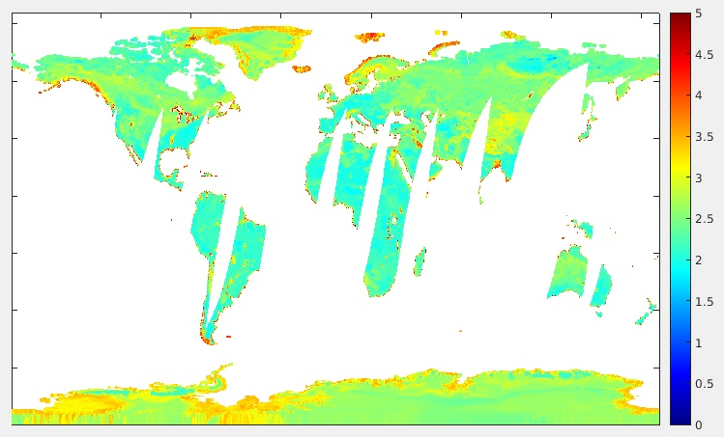
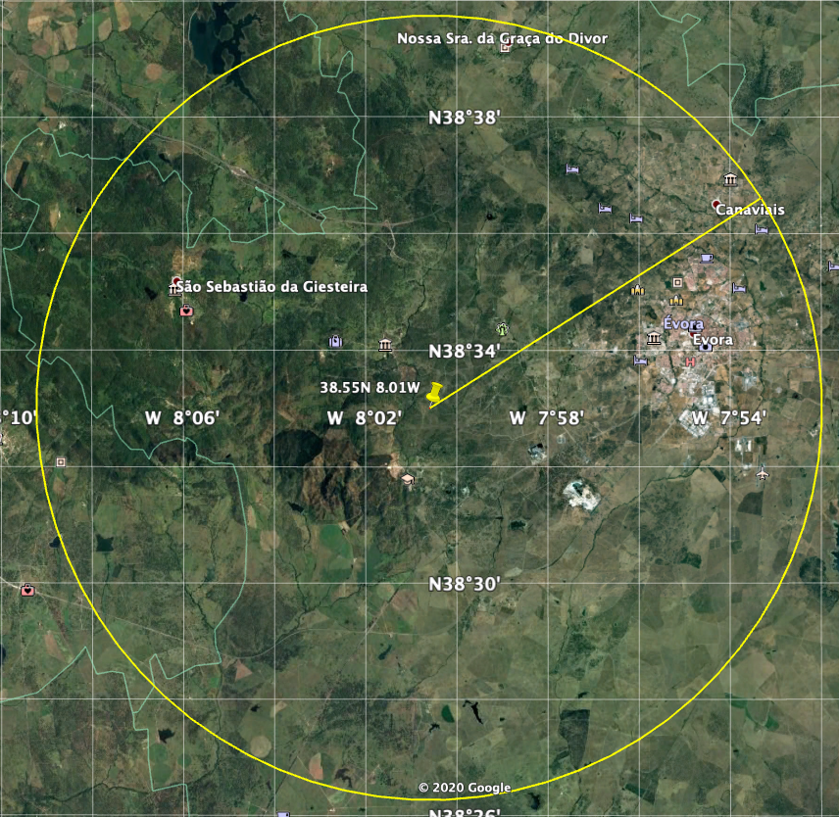
MW LST product uncertainty
Larger than for the IR LST due to the more varying emissivity, with estimated uncertainty in the order of 2-4K.
Comparison with station data can show larger differences, partly due to the terrain inhomogeneity at the ~25km resolution.
Uncertainty 2010/01/01 6AM (K)
12 km
simulated SSM/I footprint
Evora LST station

Slide 12
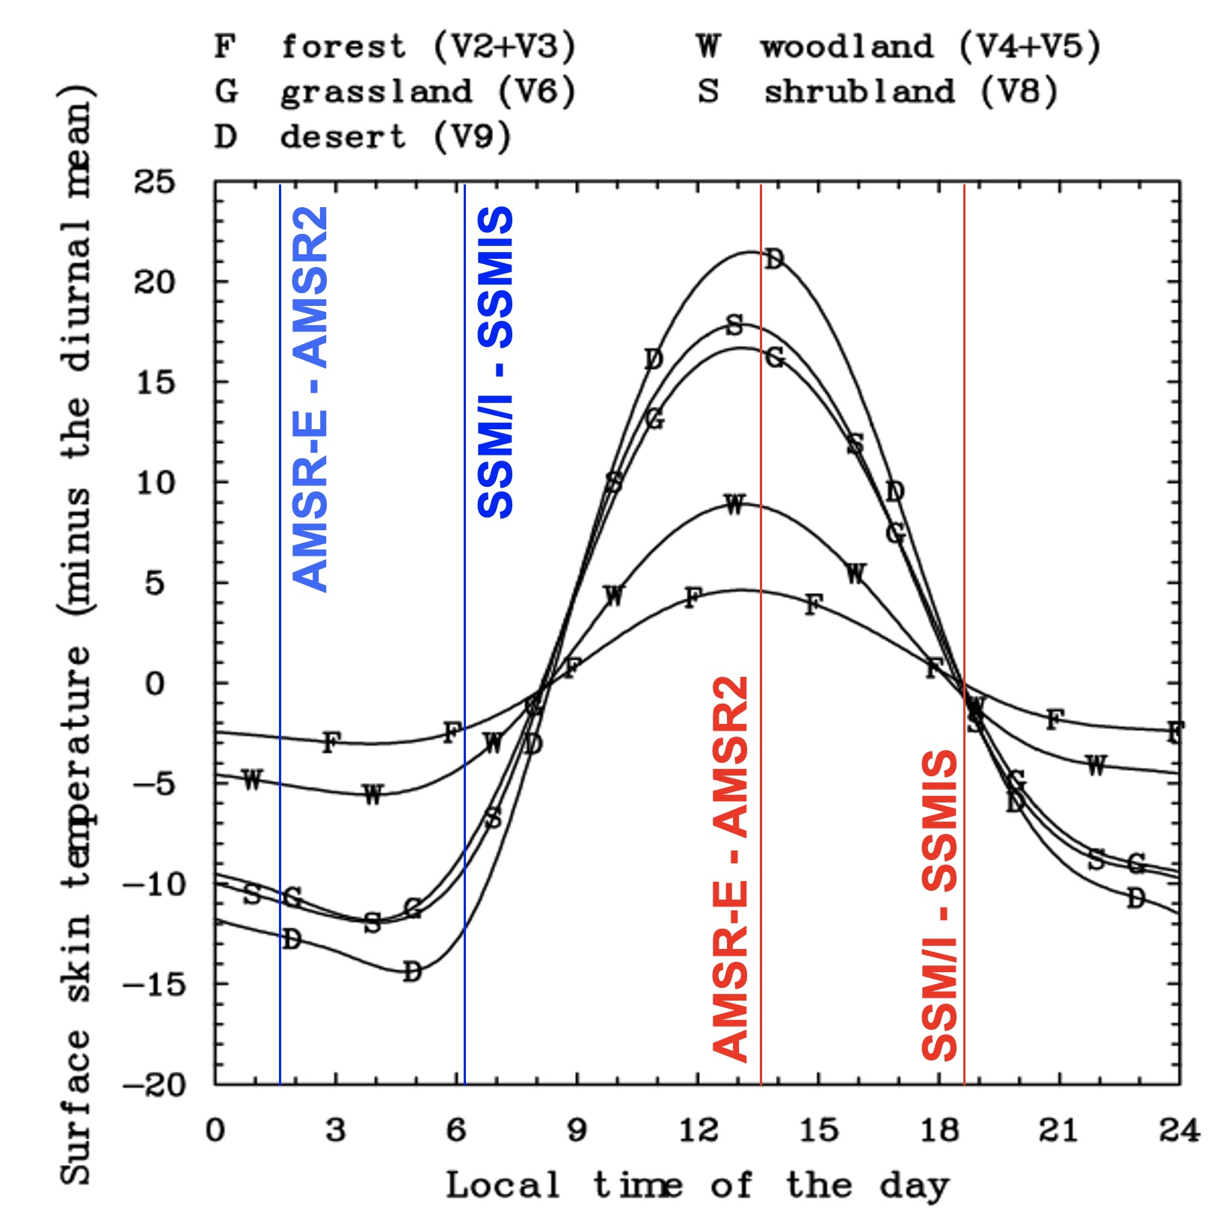
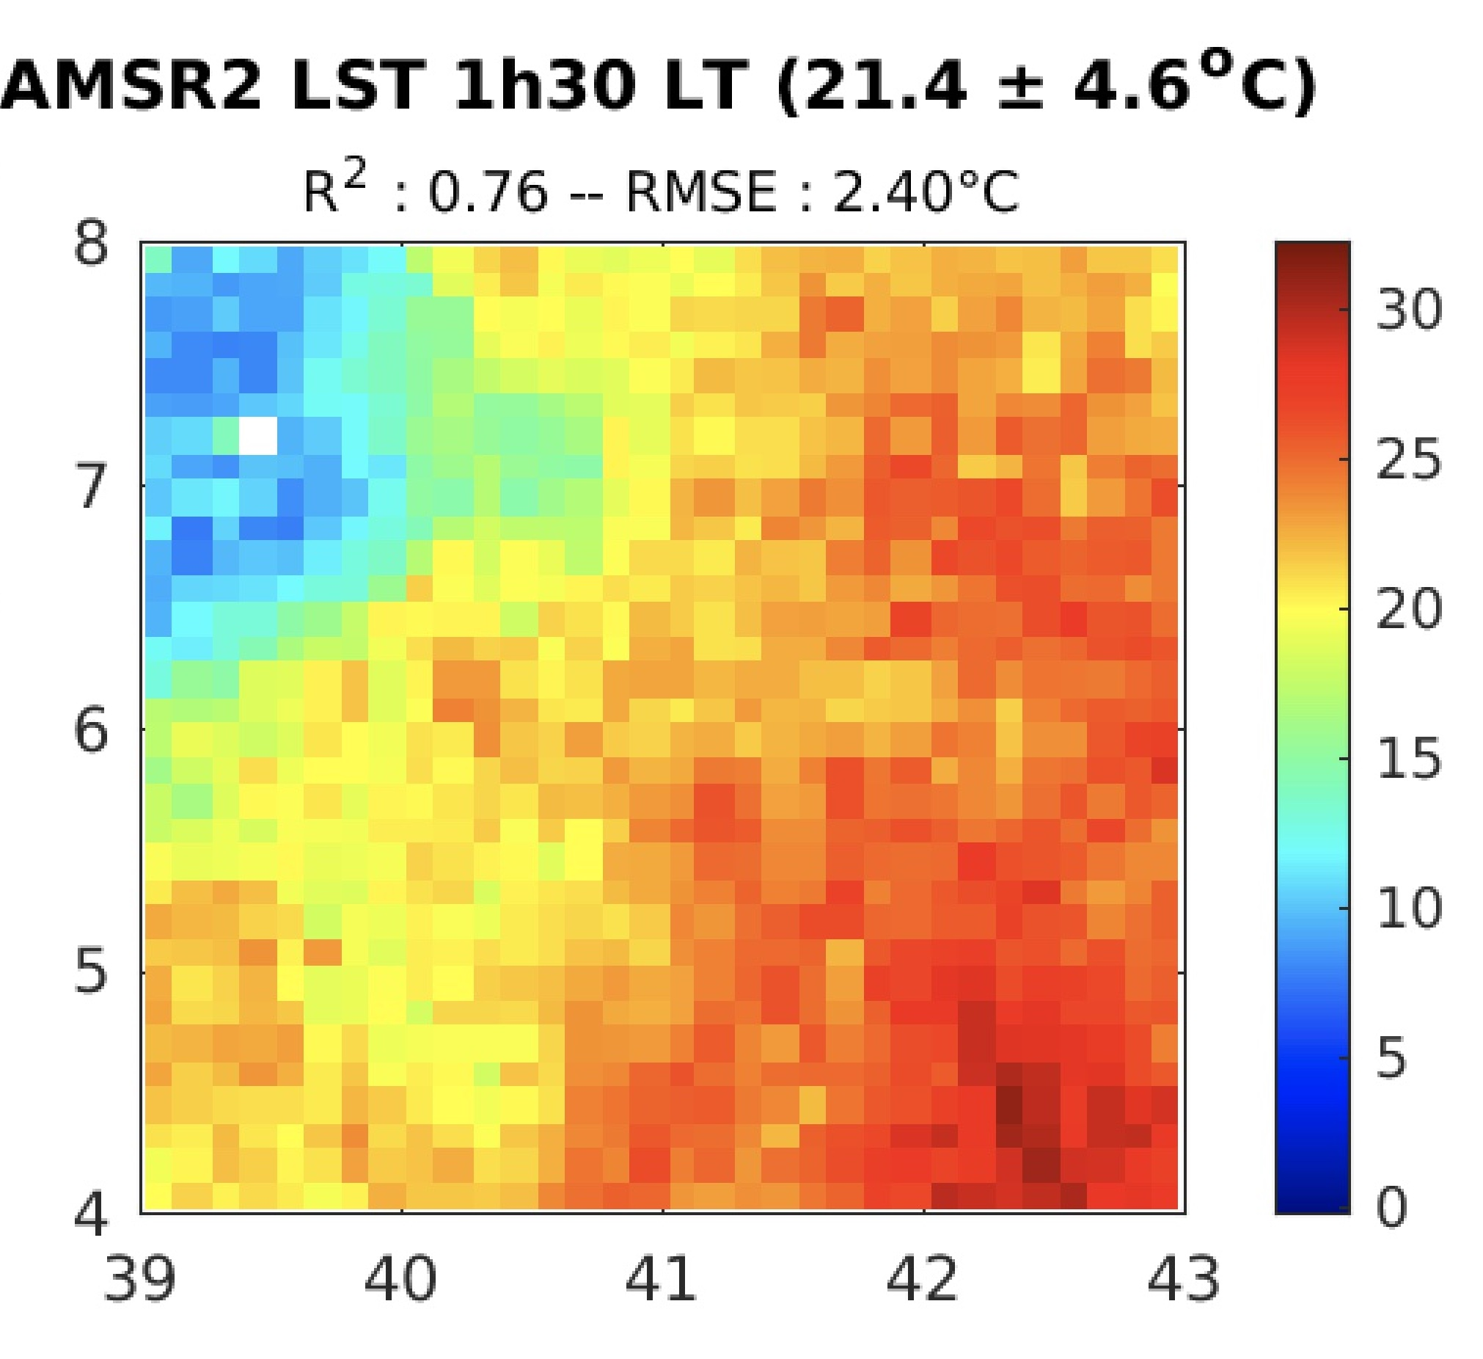
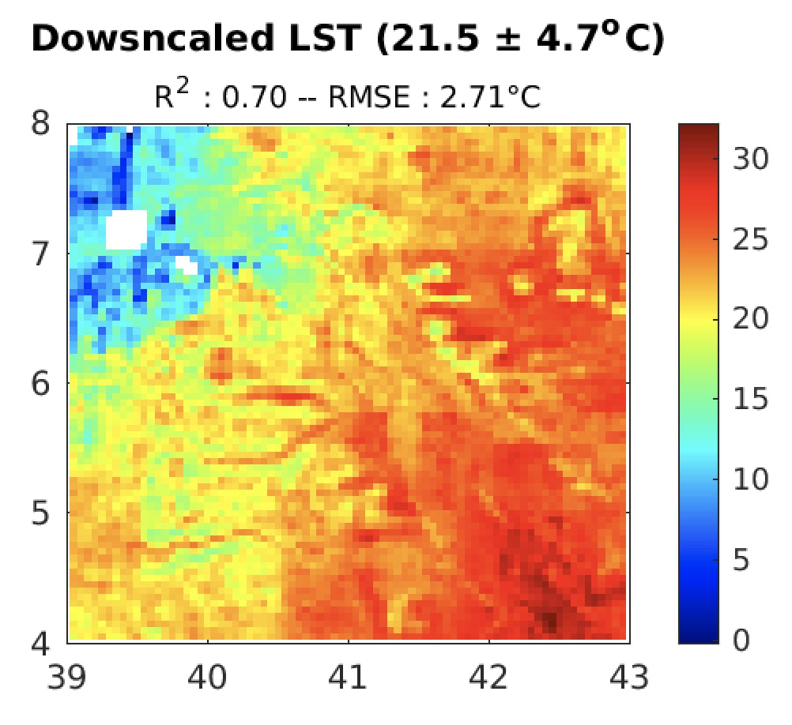
MW LST product Ongoing work
Extending the data record to sample the LST diurnal cycle 4 times per day by processing the AMSR-E and AMSR2 radiances.
Working on a downscaling method to offer a MW LST product at 5km resolution.
example in Southern Ethiopia

Slide 13
MW LST product Summary
A 1996-2202 microwave LST data record of “all-weather” LST based on SSM/I and SSMIS observations is currently available, with:
two estimates per day (6AM/6PM),
spatial resolution of ~25 km,
estimated uncertainties in the ~2-4 K range,
daily coverage from 50 to 100% (lower in the tropics).
https://dx.doi.org/10.5285/a7e811fe11d34df5abac6f18c920bbeb
Currently working on:
extending the time period to cover the more recent years,
including AMSR-E and AMSR2 to sample the diurnal cycle 4 times per day
a downscaling methodology to improve the spatial resolution.

