Slide 1
High-resolution Infrared LST_cci Products
Charlotte Paton / Mike Perry
University of Leicester

Slide 2
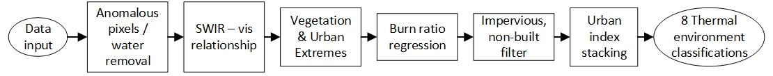
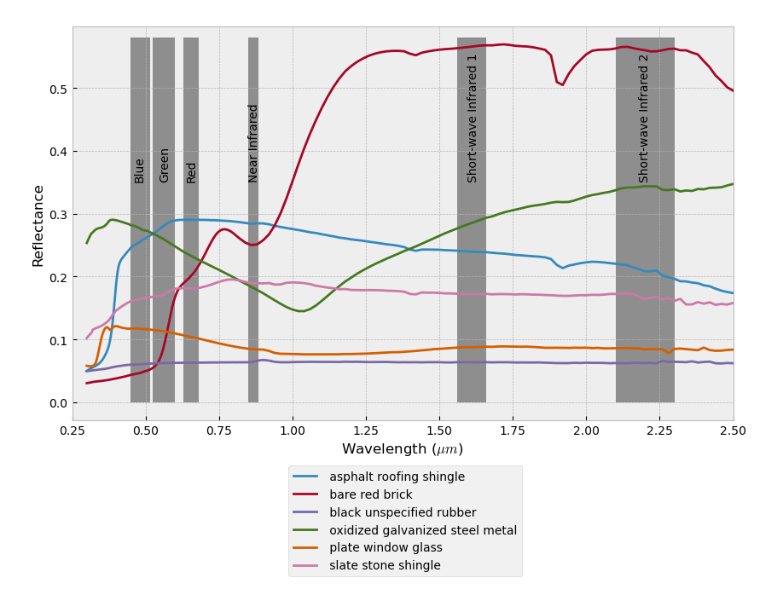
High resolution thermal classification
100m classification scheme based on thermal properties of observed land as opposed to standard land use based classifications
Created by applying a series of statistically derived limits to visible and shortwave infrared indices

Slide 3
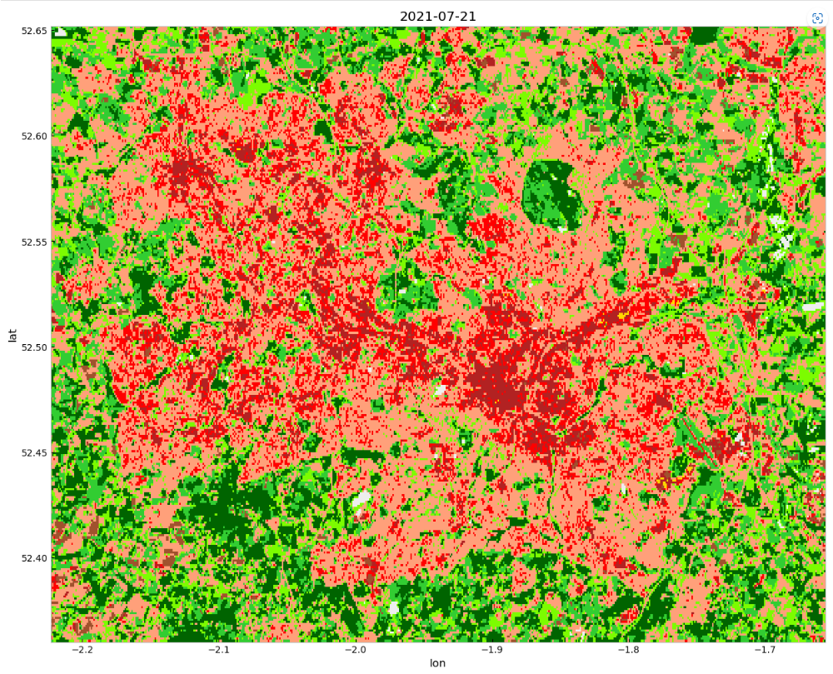
High resolution thermal classification
100m classification scheme based on thermal properties of observed land as opposed to standard land use based classifications
The 8 output classifications therefore become:
Dense urban,
Mid density urban,
Low density urban,
Dense vegetation,
Mid density vegetation,
Low density vegetation,
Coastal,
Bare soil

Slide 4
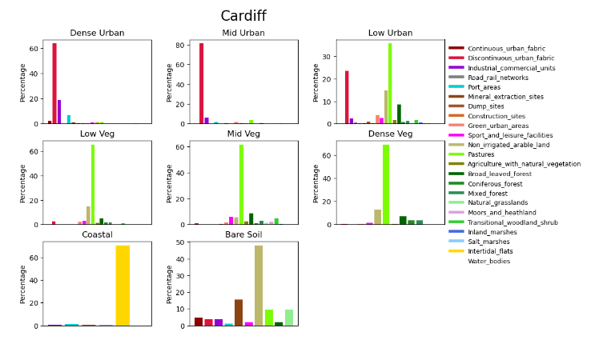
High resolution thermal classification
The classification shows good agreement with other LULC based schemes and where differences occur it is shown to better represent the thermal properties of the surface

Slide 5
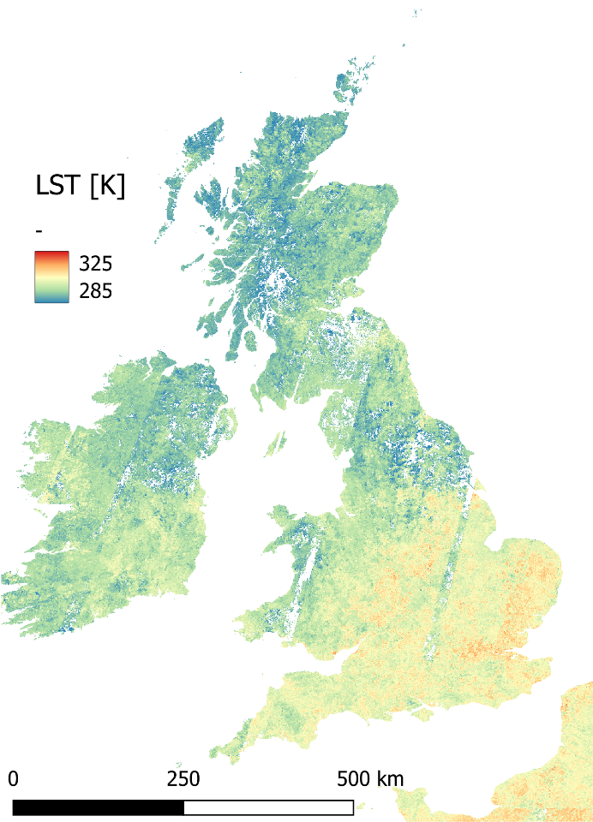
Native High Resolution Landsat Product
Newley created 100m Landsat 8 product is based on updated emissivity priors from developed thermal classification scheme:
Availability:
All UK 2019-2022
Small region requests being taken
Future plans to extend to whole of Europe

Slide 6
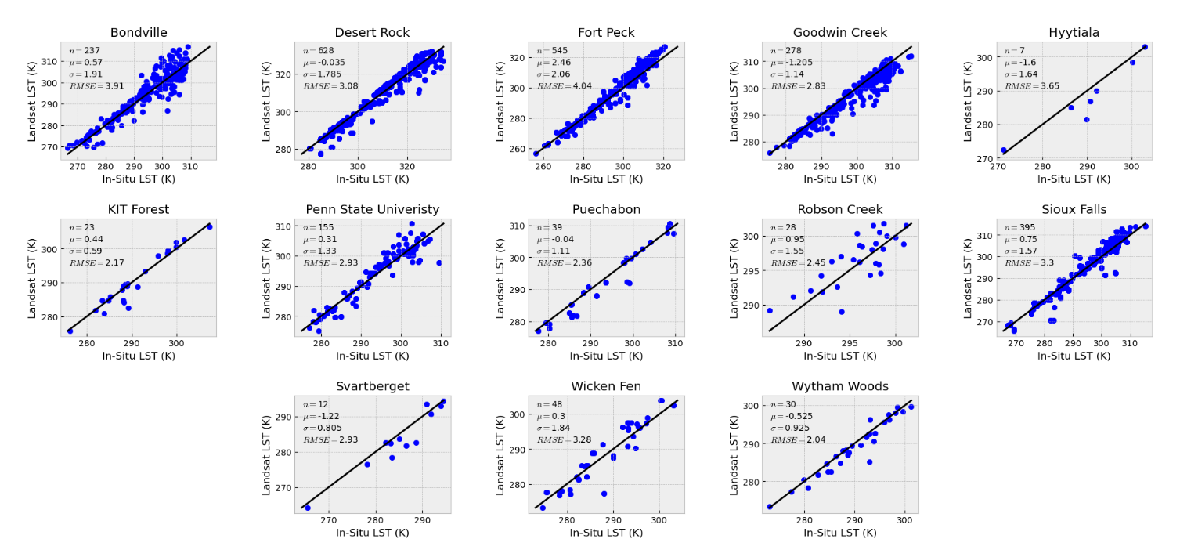
Native High Resolution Landsat Product
Validation
When compared to 13 in-situ sites differences in the two LST measurements fall close to the 1:1 line, showing good agreement

Slide 7
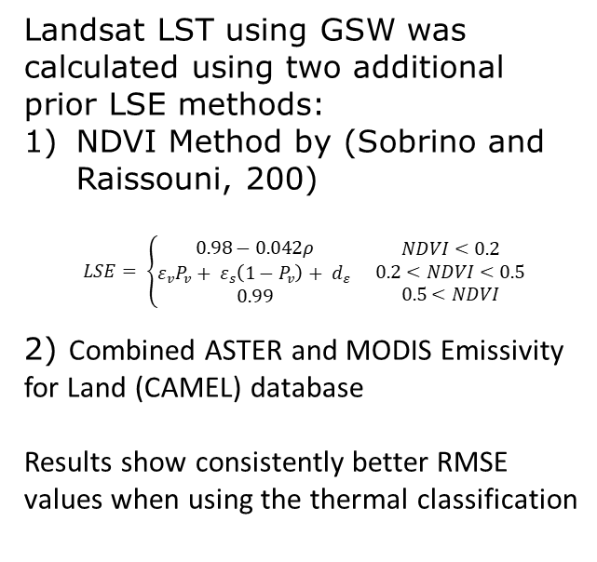
Native High Resolution Landsat Product
Site | Thermal Classification RMSE | NDVI Method RMSE | CAMEL RMSE
Bondville, Illinois | 3.91 | 4.83 | 4.13
Fort Peck, Montana | 4.04 | 3.74 | 3.41
Goodwin Creek, Mississippi | 2.83 | 4.15 | 3.88
Hyytiala, Finland | 3.65 | 4.08 | 4.39
KIT Forest, Germany | 2.17 | 2.37 | 2.61
Penn State University, Pennsylvania | 2.93 | 3.18 | 3.24
Puechabon, France | 2.36 | 2.7 | 2.66
Robson Creek, Australia | 2.45 | 4.32 | 4.3
Sioux Falls, South Dakota | 3.3 | 4.21 | 3.51
Svartberget, Sweden | 2.93 | 4.23 | 4.4
Wicken Fen, UK | 3.28 | 1.87 | 3.28
Wytham Woods, UK | 2.04 | 3.55 | 2.35
Landsat LST using GSW was calculated using two additional prior LSE methods:
NDVI Method by (Sobrino and Raissouni, 200)
$$LSE= \left\{\begin{matrix}0.98−0.042ρ \\ ε_{v}P_{v}+ ε_{s}\left(1−P_{v}\right)+ d_{ε} \\ 0.99\end{matrix}\right. \begin{matrix}NDVI<0.2 \\ 0.2<NDVI<0.5 \\ 0.5<NDVI\end{matrix}$$
2) Combined ASTER and MODIS Emissivity for Land (CAMEL) database
Results show consistently better RMSE values when using the thermal classification

Slide 8
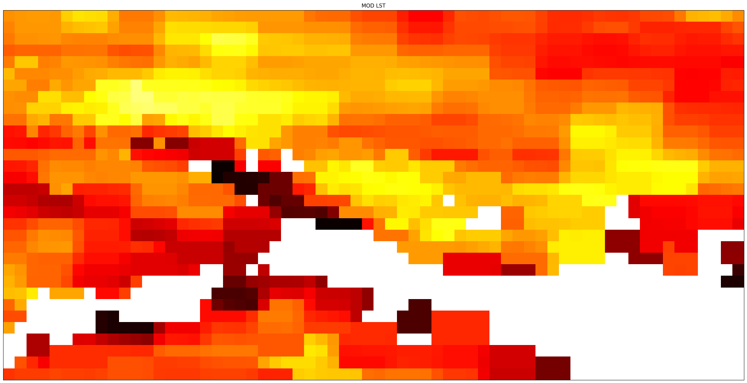
Downscaling
Portsmouth case study:
7 summer cloud free scenes
Coincident data for:
  MODIS Terra
  ASTER
  LANDSAT 8
Provides great ability to inter compare and check the spatial outputs

Slide 9
Downscaling
Southampton
Agriculture
Dense Forest
Portsmouth

Slide 10
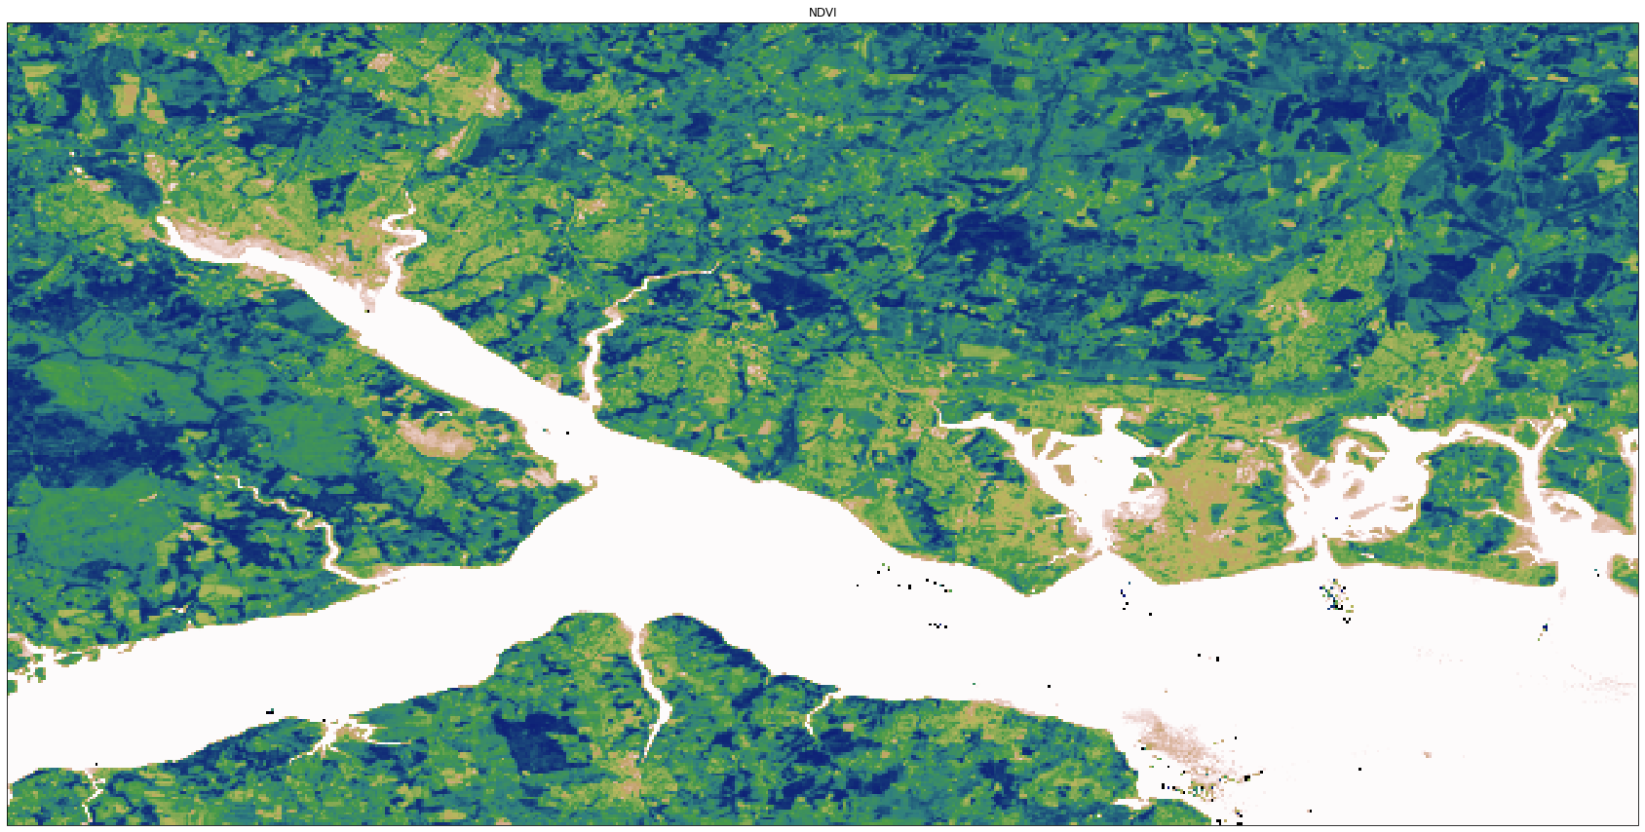
Downscaling

Slide 11
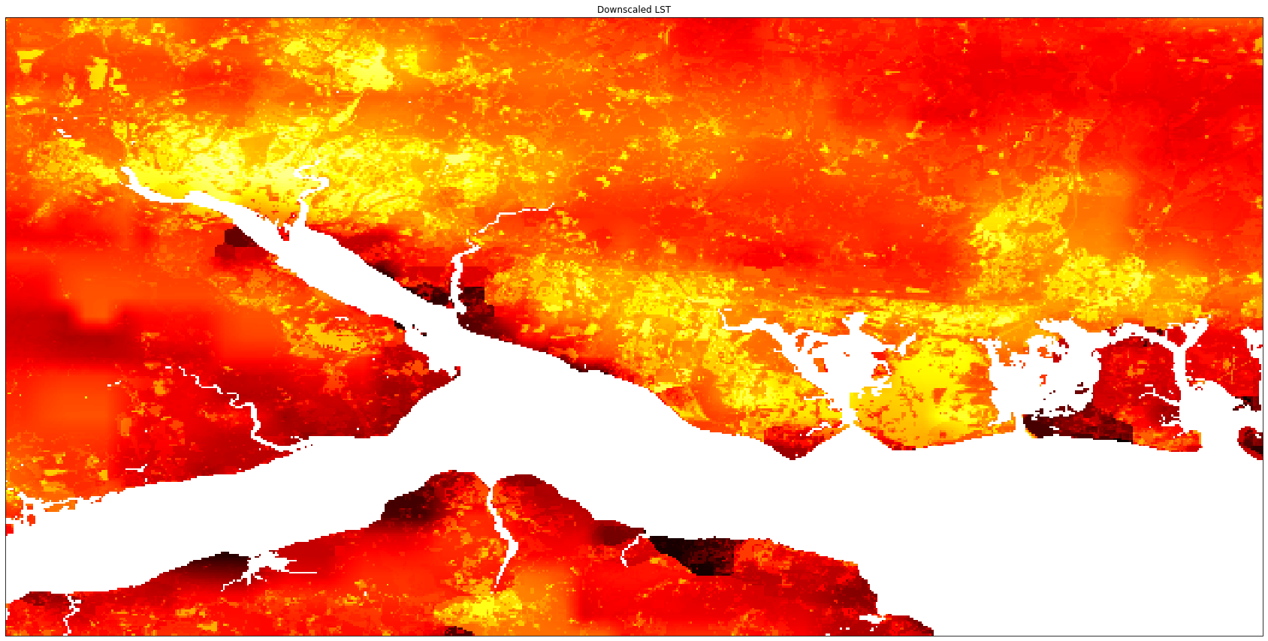
Downscaling

Slide 12
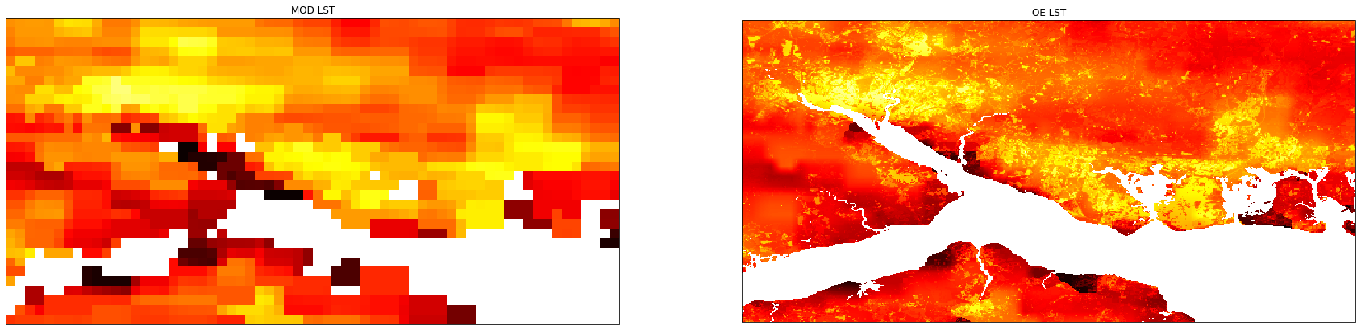
Downscaling
Portsmouth

Slide 13
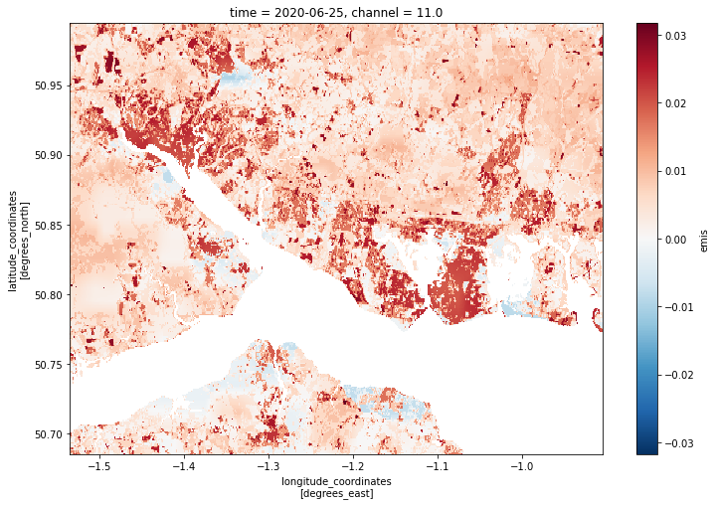
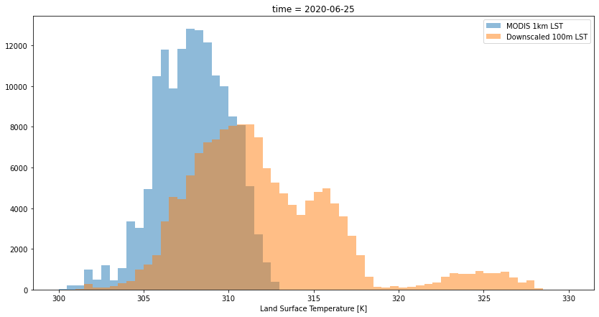
Downscaling
Portsmouth

Slide 14
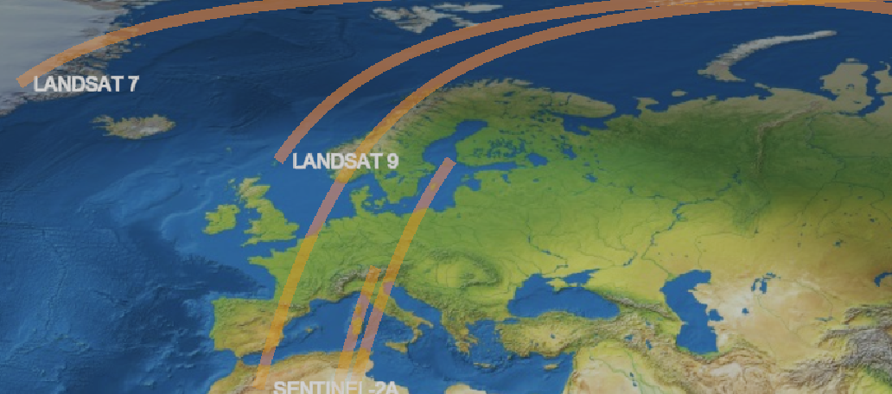
Today at 11am

