Slide 1
LST from IR instruments on
Polar Orbiting Satellites
Karen Veal, Darren Ghent, and Mike Perry
University of Leicester, NCEO
Notes:
Good Morning
I’m Karen Veal from the Surface Temperature Group at University of Leicester. I shall be talking about the LST CCI products from infra-red sensors on polar orbiting satellites. This is work done by Darren Ghent, Mike Perry and myself.

Slide 2
Outline
Approach
Phase 1 products
  Single sensor products
  Infra-red (IR) Climate Data Record from polar satellite sensors (IRCDR)
  Merged GEO and LEO IR product (IRMGP)
Phase 2 developments
Notes:
Note, if I refer to LEO or low earth orbiters in this talk I mean the same as polar orbiters.
In outline, I’ll start by talking about elements of the approach to developing LST products from the infra-red sensors on polar orbiters in LST CCI.
Note, if I will refer to polar orbiters in this talk as LEOs or Low Earth Orbiters.
Then I’ll illustrate some of the characteristics of the data products, run through the single sensor products, say a bit more about the multisensory products: the LEO Infra-red CDR and the multi-sensor merged GEO LEO product. I’ll end with outlining developments in Phase 2 and new products.

Slide 3
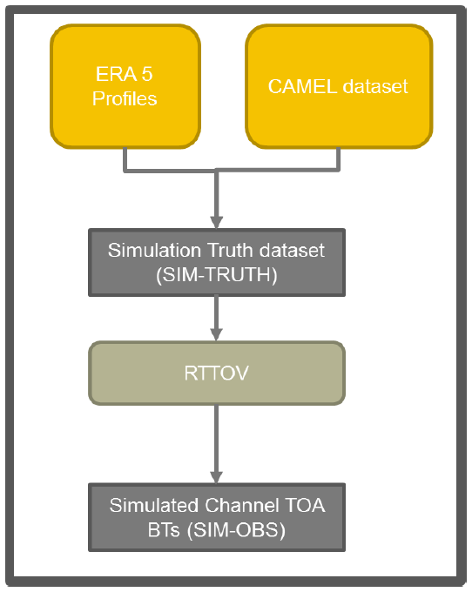
Consistent approach
CCI Calibration and Validation Database
  Perry, M. et al, Multisensor Thermal Infrared and Microwave Land Surface Temperature Algorithm Intercomparison.
  https://doi.org/10.3390/rs12244164
    Atmospheric profiles (ECMWF ERA-5)
    Surface emissivities (Combined ASTER and MODIS Emissivity for Land, CAMEL)
    Simulated TOA BTs (RTTOV)
  Database used in round robin exercise to select best algorithm for each product
  Database used in calculation of retrieval coefficients, error coefficients, and expected BTs for cloud masking
Common probabilistic cloud masking algorithm
Common auxiliary data (ERA-5, NDVI, FV, LCC)
ESA Land Cover Classification with further sub-division of bare soil class
Notes:
We’ve aimed to take a consistent approach across all the IR products, in fact all the LST CCI products.
We developed a CCI Calibration and Validation Database of atmospheric profiles and surface emissivities. The atmospheric profiles are selected from ERA-5 data in such a way as to represent the full range of physically real atmospheres. We use the CAMEL emissivities, again selecting to cover the likely range of emissivities of the Earth’s surface. These data together form a simulation Truth dataset. A radiative transfer model (RTTOV) is used to simulate the channel top-of-the-atmosphere brightness temperatures.
This database of profiles, surface emissivities, and TOA brightness temperatures was used in a round-robin exercise to select the best algorithm for each product. The database is also used for the calculation of the retrieval coefficients, error coefficients, and the expected brightness temperatures used in the cloud clearing algorithm.
We use a common cloud clearing algorithm across all the LEO infra-red products. The input auxiliary data is common to all products. We use the ESA Land cover classification as an input but with a modification – we have further subdivided the bare soil class with more soil types which increases the retrieval accuracy over some soil types.

Slide 4
Phase 1 Single Sensor Products
Level 1 (swath, BTs) → Level 2P (LST, swath) → Level 3U (gridded, uncollated) → Level 3C (gridded, collated)
All (single and multi sensor) LST_cci polar obiter, IR products:
  Regular equal-angle spatial grid.
  Day and Night in separate files.
  Temporal resolutions: daily, monthly.
LST_cci polar orbiter, single IR sensor, products:
  Level 3C
LST products developed in Phase 1:
  Terra MODIS, Aqua MODIS, ATSR-2, AATSR, Sentinel 3A SLSTR, Sentinel 3B SLSTR, Metop-A AVHRR
Notes:
If we move on to the processing of the data. We start with the brightness temperatures on the orbit swath, retrieve the LST on the swath and then the swaths are regridded onto a regular latitude-longitude grid. These swaths are then collated into day and night daily grids, keeping the swath pixel closest to the nominal overpass time. The monthly data are simply an average of the daily files. So all LEO IR single sensor products are level 3C.
The products delivered in Phase 1 and those currently available through the ESA Open Data Portal and the CEDA archive. These are LST from the MODIS instruments on Terra and Aqua, the Along-Track Scanning Radiometer 2, the Advanced Along-Track Scanning Radiometer, the Sea and Land Surface Temperature Radiometers on Sentinels 3A and 3B and the Advanced Very High Resolution Radiometer on Metop-A.

Slide 5
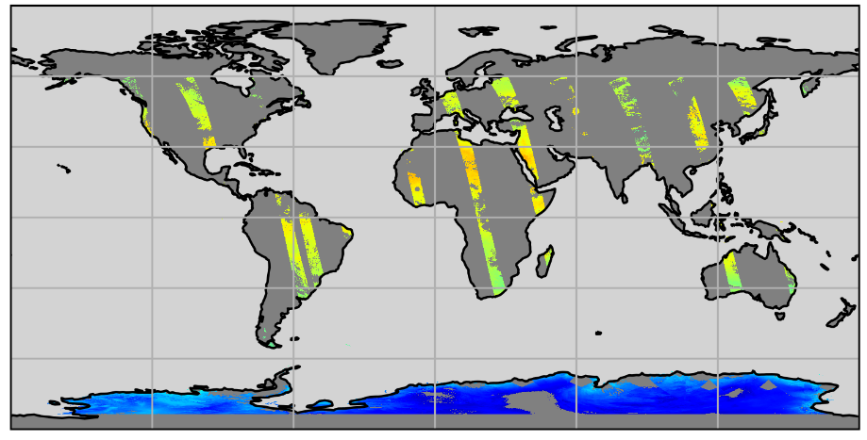
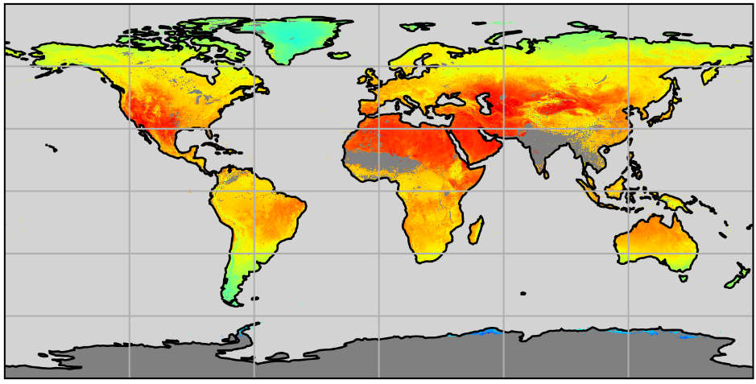
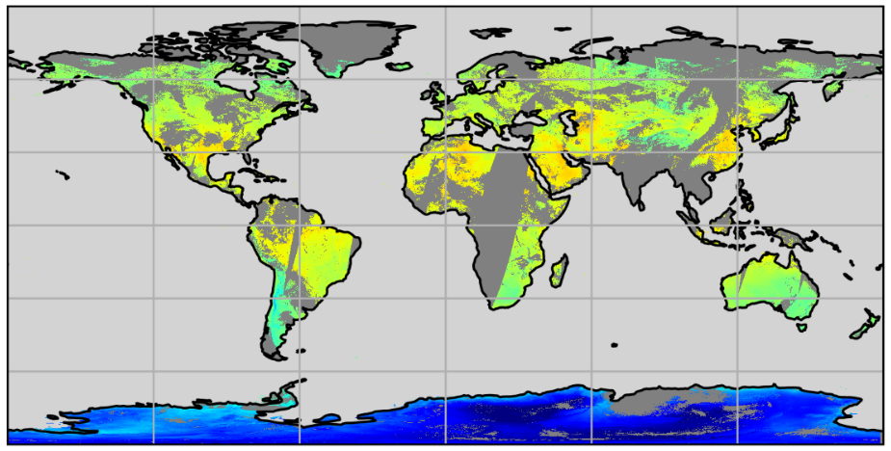
Coverage
Sun-synchronous, polar orbiters
  pass over or close to poles
  cross the equator at the same local solar time each day and night
Day/night defined by solar elevation
  poles – day data in summer, night data in winter
Coverage of IR data reduced by clouds
AATSR
Daily, night
Aqua MODIS
Aqua MODIS
Monthly, day
Notes:
This slide will give you some idea of the kind of coverage you can get with the LEO IR products. On the right you have examples of a daily resolution nighttime grid from AATSR on Envisat at the top and Aqua MODIS at the bottom. AATSR was a narrow swath sensor and so global coverage is achieved in 5 days where as MODIS gets global coverage nearly twice daily (so once daily for daytime, and once daily for nighttime).
We currently split our products by day and night on solar elevation so this means that coverage at the poles is seasonal.
Coverage of IR data is of course affected by clouds and you can see that even in the monthly plot on the left that there are some regions where there are no data for the whole month – this is July so the monsoon season in India, and the wet season over the Sahel.
Daily AATSR Night 2010/06/28
Daily MODISA Night 2018/07/20
Monthly MODISA Day 2018/07/01

Slide 6
Uncertainties
Total uncertainty and a breakdown of the uncertainty budget into components base on error correlation:
uncertainty from uncorrelated errors
  lst_unc_ran
uncertainty from locally correlated errors on atmospheric scales
  lst_unc_loc_atm
uncertainty from locally correlated errors on surface scales
  lst_unc_loc_sfc
uncertainty from large-scale systematic errors
  lst_unc_sys
Notes:
So if we move on to what you get in the products. As well as the LST we supply a total uncertainty at the pixel level and also a breakdown of the uncertainty budget by error correlation scale. So one component for uncertainty arising from uncorrelated errors: such as instrument noise, sampling uncertainty. uncertainty arising from errors correlated on atmospheric scale for instance errors in total column water vapour estimates. the third component is uncertainty from errors correlated on surface scales such as geolocation errors. Finally there is a term for large scale systematic errors such as radiative transfer model errors.

Slide 7
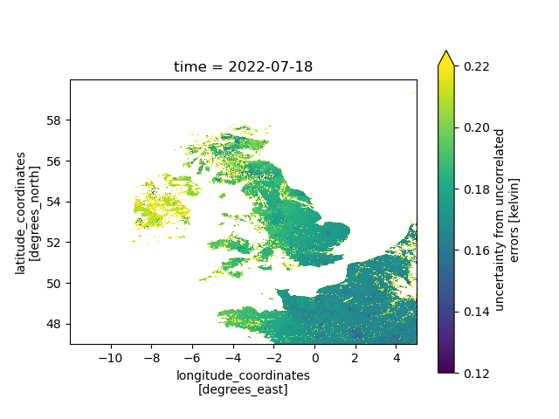
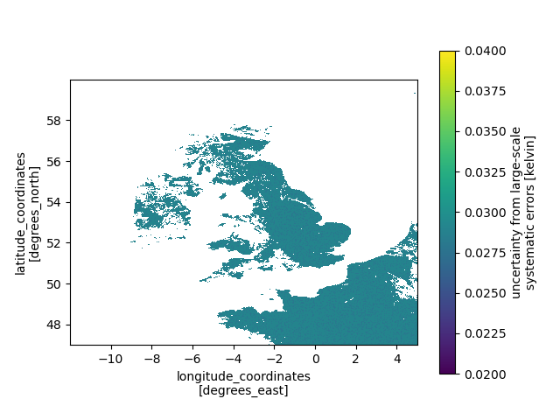
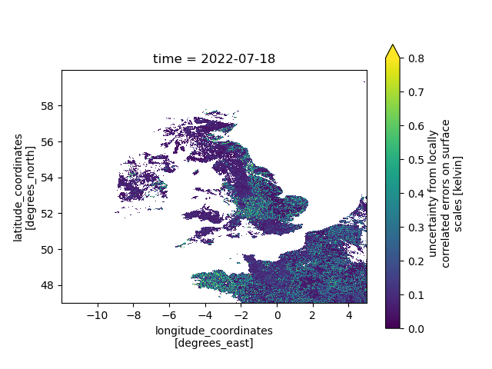
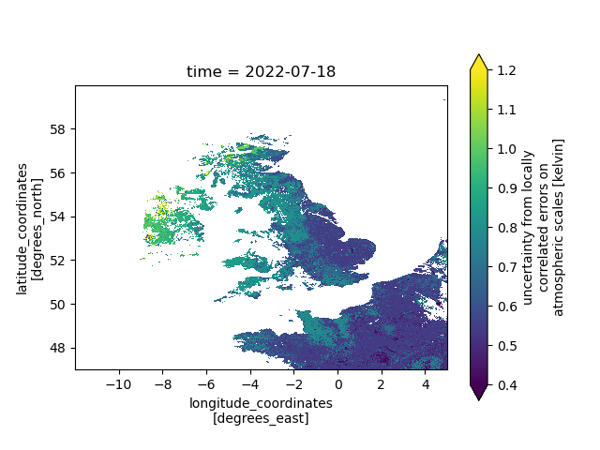
Uncertainties
Uncorrelated
Large-scale
Correlated on surface scales
Correlated on atmospheric scales
Notes:
These plots give you some idea of the relative scale of the uncertainty components. The component arising from uncorrelated errors is usually < 0.2 K. The locally correlated errors are somewhat larger, the systematic error is much smaller.

Slide 8
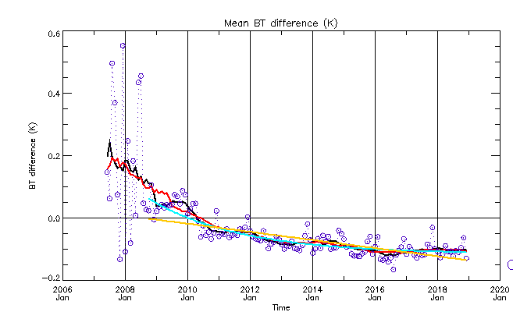
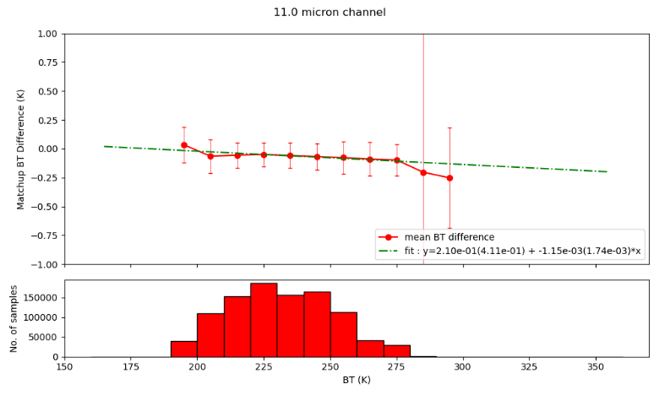
Intercalibration of sensors
When combining data from different sensors we must account for instrument calibration differences.
Intercalibration is performed in brightness temperature (BT) space using the GSICS methodology.
IASI (Infrared Atmospheric Sounding Interferometer) spectra convolved with sensor channel spectral response function.
Resulting BTs matched with actual sensor BTs in time and space.
Phase 1
  IASI operational L1C product used and time dependent calibration applied.
Phase 2
  IASI FCDR used and temperature dependent calibration applied.
Terra MODIS 11 μm minus IASI
Notes:
These next slides concern the development of the multisensor products.
When combining data from different sensors we must account for instrument calibration differences. Different sensors even if observing the same object through the same atmosphere would show small differences in observed temperatures due to calibration differences.
We do the intercalibration in brightness temperature space using a method based on the Global Space-based Inter-Calibration System method using IASI as a reference.
First, we calculate MODIS equivalent brightness temperatures by convolving the MODIS spectral response function with the IASI spectra. Then we match these in space and time with the actual MODIS brightness temperatures. In Phase 1 we used the operational IASI L1C data and estimated a time dependent calibration by doing a linear fit to the monthly average BT differences. [This is shown in the top plot for Terra MODIS 11 micron channel, the yellow line is the fit used for the calibration]. However, the operational IASI data uses different processors at different times so contains instabilities. Also, as the IASI data are not available before 2007 we had to extrapolate back in time. In Phase 2 we have used the IASI FCDR which accounts for the processor changes and we have instead used a temperature dependent calibration [this shown in the bottom plot which shows small temperature dependency ].
We have applied the calibration to the MODIS instruments. We don’t apply a calibration to the SLSTRs as the offset against IASI is very small, an order of magnitude smaller than its uncertainty.

Slide 9
Multisensor IRCDR V2.00 (1995 - 2020)
Multisensor IRCDR comprises data from a series of instruments with a common heritage and the Moderate Resolution Imaging Spectroradiometer on EOS Terra.
Instrument | Morning overpass time | Time Coverage
Along-Track Scanning Radiometer 2 (ATSR-2) | 10:30 | 08/1995 – 07/2002
Advanced Along-Track Scanning Radiometer (AATSR) | 10:00 | 08/2002 – 03/2012
Sea and Land Surface Temperature Radiometer (SLSTR) on Sentinel 3A | 10:00 | 08/2016 – 12/2020
Terra MODIS | 10:30 | 04/2012 – 07/2016
Notes:
The first multi-sensor product I want to talk about is the Multi-sensor Infra red climate data record or IRCDR. This is comprised of data from a series of instruments with a common heritage: the ATSR-2, AATSR, and SLSTR on Sentinel 3A. There was a time gap between AATSR and SLSTR. We use Terra MODIS to fill this gap as the overpass time is close to the other instruments. You can see from the table that there is a half-hour difference between the overpass times of AATSR SLSTR and Terra MODIS so we must apply a correction for this time difference otherwise we would likely end up with non-climatic step changes in the record.

Slide 10

Multisensor IRCDR time correction
MODIS mission time coverage overlaps ATSR-2, AATSR, and SLSTR on S3A so we use MODIS as the reference
Time correction is done in LST space.
Correction calculated using matchups between the L3U (0.01 degree gridded) data.
Time correction is banded by day-night, land cover class, and latitude.
AATSR minus Terra MODIS
Latitude 40-50$°$N
Day
Night
Notes:
We use MODIS as the reference and correct to 10:30. The correction is calculated in LST space so using matchups between the two instruments. and calculating a straight line fit to the LST difference as a function of observation time difference. The correction was banded by day-night, land-cover class, and latitude band. The plots show an example of the matchup difference v. time difference for daytime and nighttime. Note, these matchups were calculated before the intercalibration was applied to the MODIS data which is why the LST difference is non-zero at zero time difference. For the morning overpasses, the earlier instrument observes colder temperatures, whilst at night the reverse is true and the LST differences are much smaller which is as expected.
The IRCDR runs from 1995 – 2020. For consistency, we have kept the reduced swath width of the ATSRs for the whole time series.

Slide 11
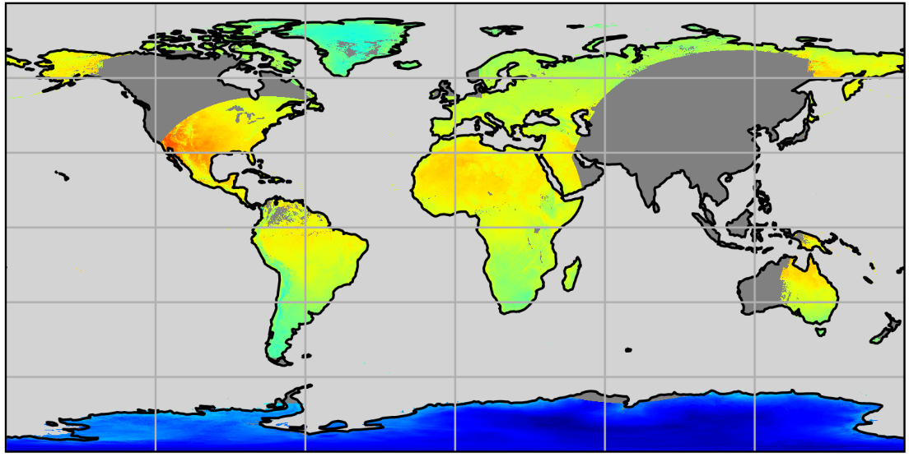
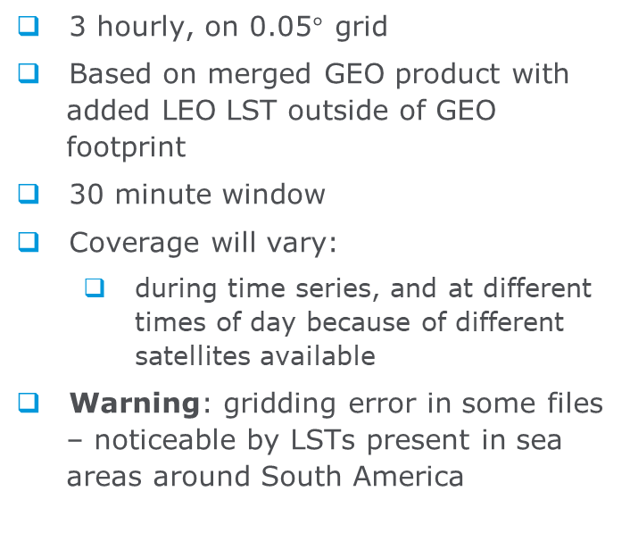
Multisensor IRMGP
3 hourly, on 0.05$°$grid
Based on merged GEO product with added LEO LST outside of GEO footprint
30 minute window
Coverage will vary:
  during time series, and at different times of day because of different satellites available
Warning: gridding error in some files – noticeable by LSTs present in sea areas around South America
Monthly LST at 00:00 UTC on 2018/07/01
Notes:
ESACCI-LST-L3S-IRMGP_-0.05deg_1MONTHLY-20180701000000-lst-global-rectangle-200-350-lightgrey-grey
the second multi-sensor product is the merged GEO LEO product. This is based on a merged GEO product produced by Sofia and colleagues at IPMA.
the product is 3 hourly on a 0.05 degree grid.
Data from ATSR-2,AATSR,SLSTR and MODIS are included outside of the footprint of the GEOS if the observations lie within a 30 minute window around the time of the product. this time window was chosen to be in line with the typical scan periods of the GEO sensors.
For this product a common algorithm is preferred so the LEOS are processed with a Generalized Split Window Algorithm as are the GEOs unless they don’t have the required channels and a single channel retrieval is used.
The coverage of this product will vary throughout the time series depending on which sensors are available.
The product may be suitable for diurnal studies.
We have noticed a gridding error in some of the products which shows LSTs in the ocean around South America. These products shouldn’t be used. We will rectify this problem in the next version.

Slide 12
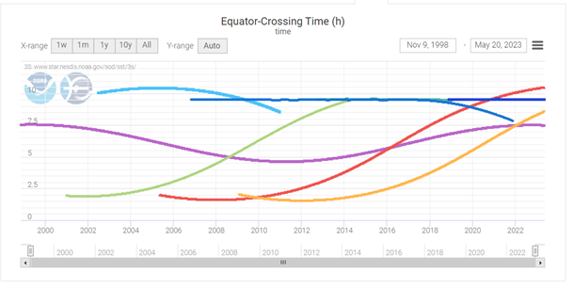
Phase 2 (available next year)
New sensors
  AVHRR/3 on Metop-B and Metop-C
  VIIRS on SuomiNPP
  AVHRR/3 on NOAAs with a correction for orbital drift
Extension of current products in time:
  SLSTRs 2023, Metop-A 2023
  MODISs 2021
Retrieving ST over sea-ice
https://www.star.nesdis.noaa.gov/socd/sst/3s/
Notes:
So to bring you up to date: these are some of the developments underway in phase 2
We’re developing LST products from new sensors : the AVHRRs on Metop B and C, VIIRS on SuomiNPP. We’re also developing a correction for the orbital drift in the NOAA satellites which will contribute to LST products from the AVHRR instruments on these satellites.
The time coverage of the current products will be extended to 2023 where possible. For the MODISs this will be until 2021 because of the orbital drift of Aqua and Terra. All the products will include Surface temperatures over sea-ice.

Slide 13
Data Access
Data Access
  ESA Open Data Portal
    https://climate.esa.int/en/data/#/dashboard
  CEDA Catalogue
    https://catalogue.ceda.ac.uk/ (search for “lst cci”)
Key Documents
  https://climate.esa.int/en/projects/land-surface-temperature/
  Product User Guide
  End-to-End ECV Uncertainty Budget
  Product Validation and Intercomparison Report
  among others
Notes:
to end the products can be accessed through the ESA Open Data Portal or CEDA if you have access
key documents can be found on the project website:
Thank you

Slide 14
Variables
time:long_name = "reference time of file"
dtime:long_name = "time difference from reference time“
lat:long_name = "latitude_coordinates“
lon:long_name = "longitude_coordinates“
satze:long_name = "satellite zenith angle"
sataz:long_name = "satellite azimuth angle" ;
solze:long_name = "solar zenith angle"
solaz:long_name = "solar azimuth angle" ;
qual_flag:long_name = "Quality Flags" ;
lst:long_name = "land surface temperature"
lst_uncertainty:long_name = "land surface temperature total uncertainty" ;
lst_unc_ran:long_name = "uncertainty from uncorrelated errors" ;
lst_unc_loc_atm:long_name = "uncertainty from locally correlated errors on atmospheric scales" ;
lst_unc_loc_sfc:long_name = "uncertainty from locally correlated errors on surface scales" ;
lst_unc_sys:long_name = "uncertainty from large-scale systematic errors" ;
lcc:long_name = "land cover class"
other auxiliary variables
Notes:
Just quickly, the other variables that you get in the files are the coordinates, the view angles, a quality flag, and some auxiliary variables such as land cover classification.

