Slide 1
LST in ESA's Climate Change Initiative
Simon Pinnock, ESA Climate Office, Harwell, UK
simon.pinnock@esa.int
05/12/2024

Slide 2
ESA Climate Change Initiative (CCI)
ESA Earth Watch programme element first funded at the 2008 Ministerial Council
(CCI = GMECV + CLIMATE SPACE)
Objective:
“To realize the full potential of the long-term global Earth Observation archives that ESA together with its Member States have established over the last thirty years, as a significant and timely contribution to the Essential Climate Variable (ECV) databases required by United Nations Framework Convention on Climate Change (UNFCCC).”
Development of multi-decadal multi-satellite global Climate Data Records according to the GCOS ECV requirements and their exploitation in climate science.
Transfer mature ECVs to an operational environment (C3S, Eumetsat SAF, …)

Slide 3
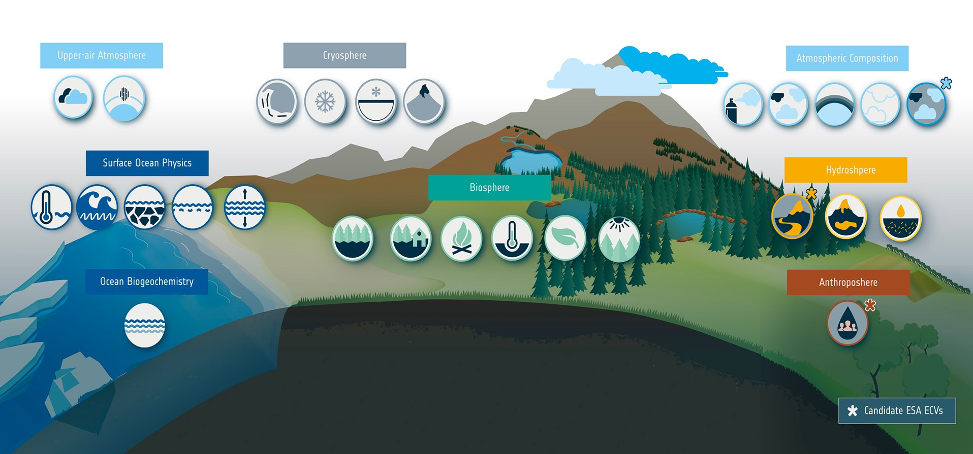
ESA Climate Change Initiative (CCI)
GCOS defined 55 Essential Climate Variables | 36 benefit from space observations | 27 generated by ESA Climate Change Initiative
Glaciers
Clouds
Water Vapour
Ice Sheets
Snow
Permafrost
Aerosol
GHGs
Ozone
Precursors
Other
GHGs
SST
Sea State
Sea Ice
Salinity
Sea Level
River
Discharge
Lakes
Soil
Moisture
Above-ground Biomass
Land
Cover
Fire
LST
LAI
FAPAR
Ocean Colour
+ Cross-cutting projects on:
Climate Science, Modelling, Mitigation, Adaptation
Knowledge Exchange (portal, toolbox, education)
Anthropogenic
Water Use

Slide 4
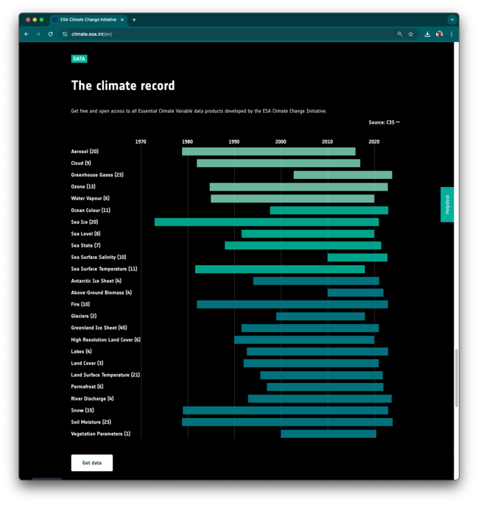
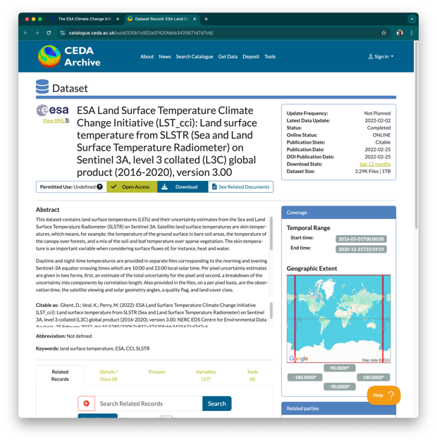
CCI Data Access
CCI ECV data sets available from climate.esa.int
Many have been transferred to operational production by the Copernicus Climate Change Service:
climate.copernicus.eu
CCI data on CEDA archive
CCI Web site

Slide 5
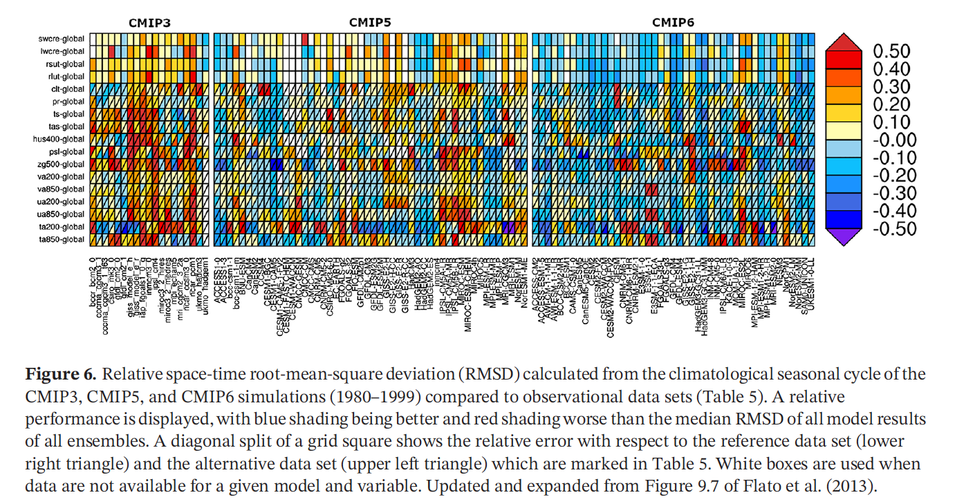
Applications: Climate Model Benchmarking
Data sets used in ESMValTool for IPCC AR6 CMIP evaluations
Dr. Axel Lauer, DLR:
Implementing CCI ECVs into ESMValTool esmvaltool.org
LST, biomass, snow, land cover, soil moisture, aerosol, cloud, water vapour, CH₄, salinity, ocean colour.
including diagnostics

Slide 6
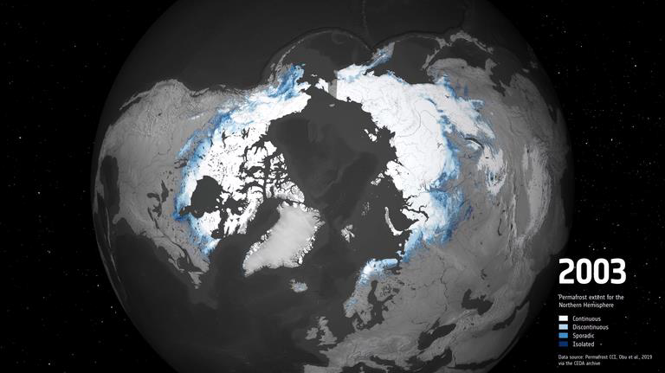
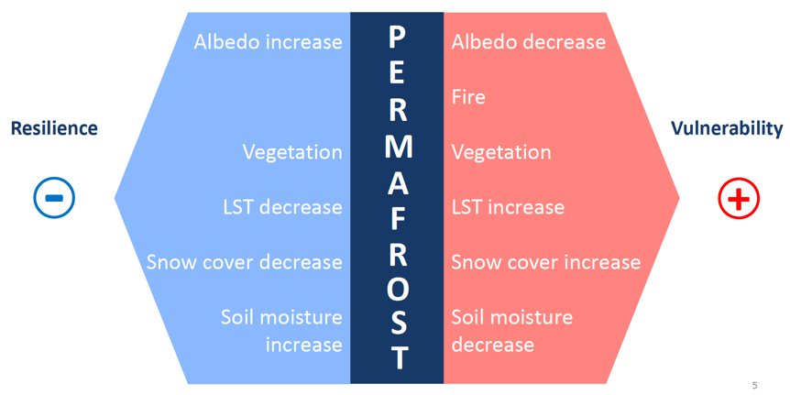
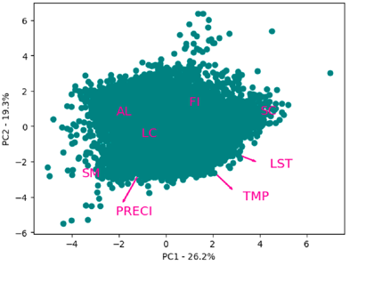
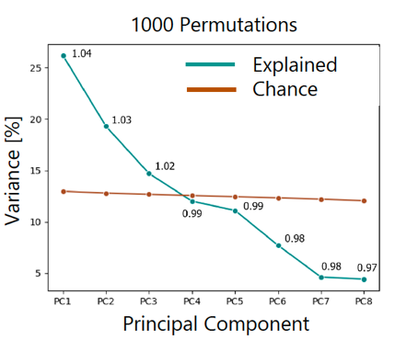
Applications: Permafrost Vulnerability
Dr. Alexandra Runge, Alfred Wegener Institute.
Investigation of the vulnerability of permafrost to multiple ECVs: snow, soil moisture, LST, land cover, fire, albedo.
ESA CCI Permafrost ECV (Obu et al. 2019)
Result:
LST = 26%
Soil Moisture = 26%
Fire = 23%
…

Slide 7
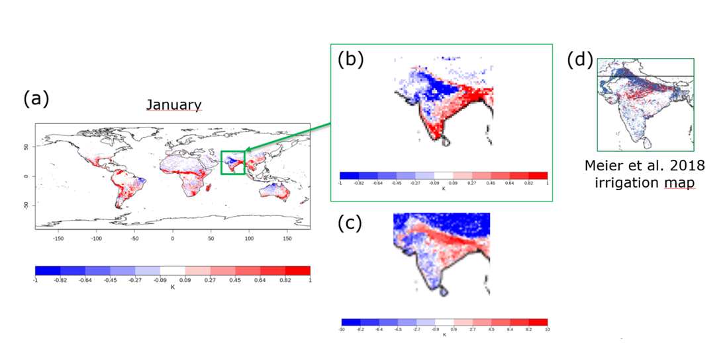
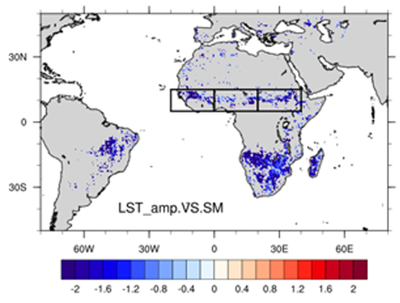
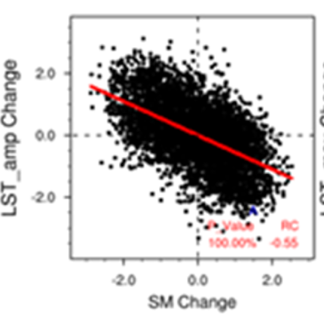
Application: Improving Land Surface Modelling
Dr. J.-C. Calvet, Météo-France
Assimilated CCI soil moisture into ISBA Land Surface Model
Comparison of model with CCI LST is used to test impact of assimilating CCI Soil Moisture
Found problem in model related to irrigated crops
Dr. F. Cheruy, IPSL: Soil Thermal Inertia
Characterised the effect of soil moisture on thermal inertia, and the impact on the diurnal temperature range.
Demonstrated model improvements between CMIP5 and CMIP6 using this approach.

Slide 8
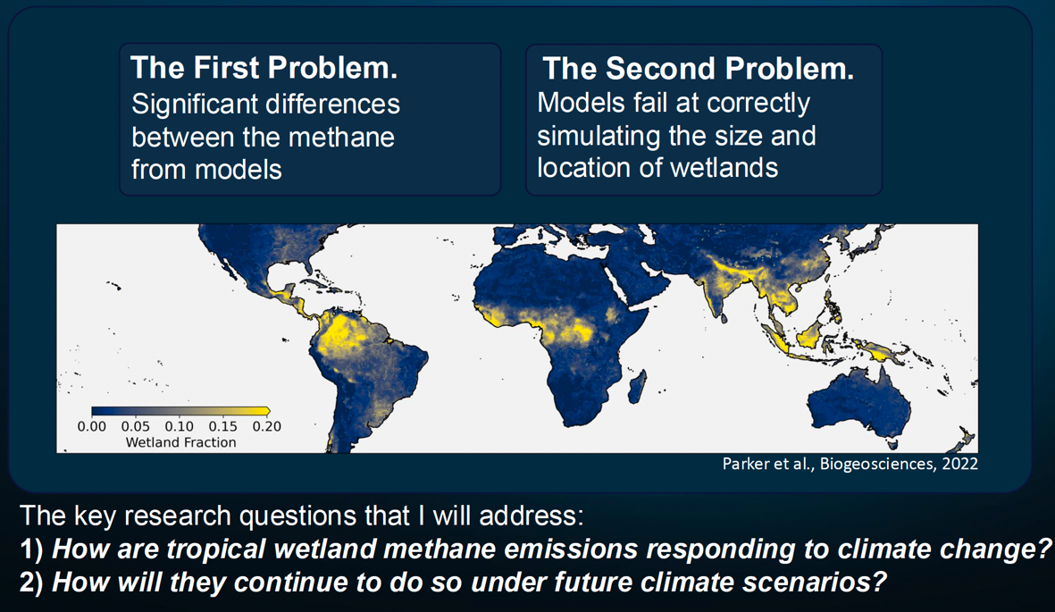
Application: Tropical Wetland Methane Emissions
Dr. Rob Parker, U. Leicester/NCEO
Develop a ML emulator for JULES land surface model.
Investigate which factors most influence CH₄ emissions.
Drive the emulator with CCI ECVs: LST, soil moisture, land cover, …
Compare to inversion of CCI CH₄ atmospheric concentrations.

Slide 9
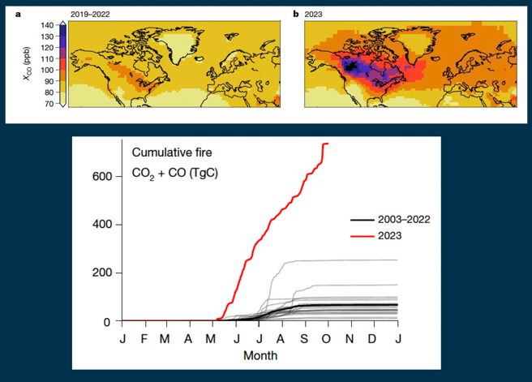
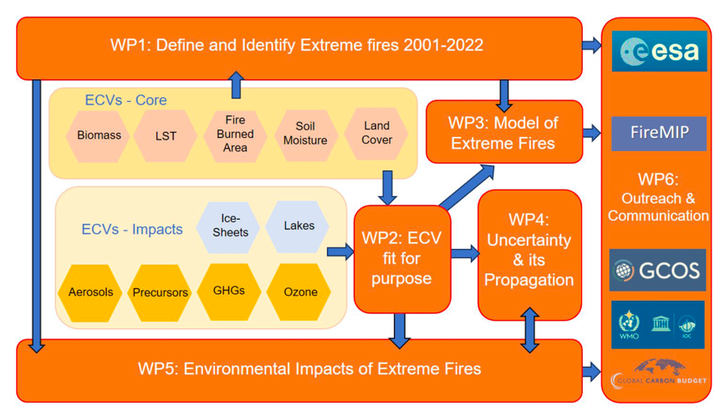
New project: Xfires - Extreme Fires
Prof. Stephen Sitch, U. Exeter
Extreme fires cause huge CO₂ emissions – e.g. 2023 Canadian fire emissions were larger than most countries’ annual emissions.
Provoke unusual impacts on environment and climate
Investigate causes and impacts:
Extreme impacts on carbon cycle
Erosion and land cover change
Air pollution and health impacts (ozone, aerosol)
Pollution from runoff of lakes and coastal sea
Stratospheric injection of aerosols (AU, 2020)
Black carbon deposits on Glaciers and Ice Sheets accelerating ice melt.
Can we model and predict them?
Will they become more likely under future climate?
Contribute to FireMIP
Canadian forest fire emissions 2023 Byrne et al. 2024
Notes:
See the colocation youtube video: https://www.youtube.com/watch?v=70qCbg1i8Dk&t=382s

Slide 10
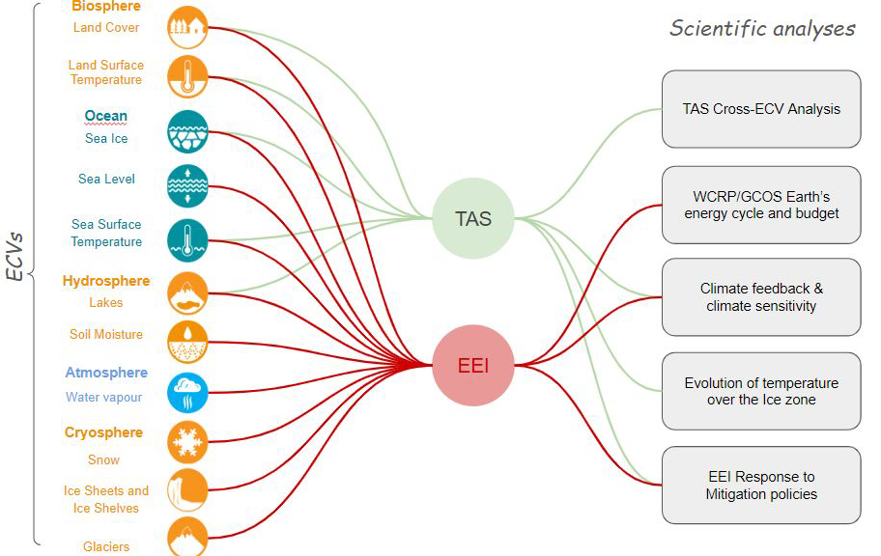
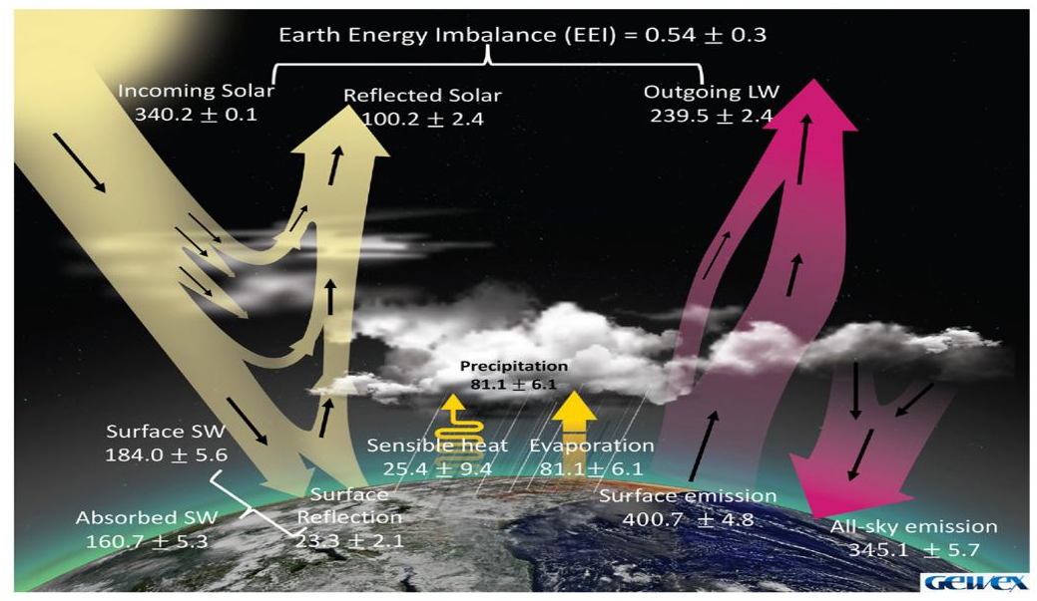
New project: MOTECUSOMA - Earth Energy Imbalance
Dr. Benoît Meyssignac, LEGOS
Earth’s energy imbalance is increasing
Climate models don’t reproduce this – cause unknown
EEI provides early warning of the impact of GHG mitigation
Use multiple CCI ECVs and other data to observationally quantify climate feedback parameters and climate sensitivity.
Quantify time-response of GHG mitigation
Particular focus on Arctic processes causing rapid changes.
Notes:
See the colocation youtube video: https://www.youtube.com/watch?v=70qCbg1i8Dk&t=382s
Approach is to derive surface temperature and EEI from different ECVs
By monitoring EEI, can detect impact of GHG mitigation 20-30yrs earlier than it can be seen in the surface temperature.

Slide 11

Conclusions
ESA’s Climate Change Initiative is producing a suite of climate data records for many ECVs, including Land Surface Temperature
LST is extremely valuable, particularly in combination with other ECVs, for model evaluation and assimilation, and for characterizing Earth system processes.
All our climate data records are made publicly available, either from climate.esa.int or directly from the projects.
ESA Climate Change Initiative
Glaciers
Clouds
Water Vapour
Ice Sheets
Snow
Permafrost
Aerosol
GHGs
Ozone
Precursors
Other
GHGs
SST
Sea State
Sea Ice
Salinity
Sea Level
River
Discharge
Lakes
Soil
Moisture
Above-ground Biomass
Land
Cover
Fire
LST
LAI
FAPAR
Ocean Colour
Anthropogenic
Water Use

