Slide 1

Overview of the LST_cci Project
Lizzie Good (Met Office), Darren Ghent (U. Leicester/NCEO)

Slide 2
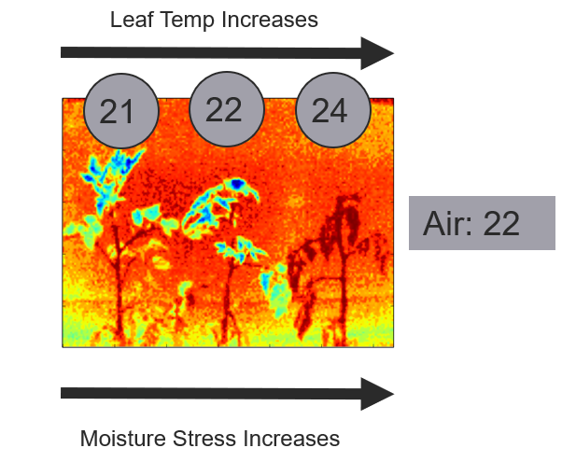
What is Land Surface Temperature
Land Surface Temperature (LST) is a measure of how hot or cold the surface of the Earth would feel to the touch
For ground-based, airborne, and spaceborne remote sensing instruments it is the aggregated radiometric surface temperature of the ensemble of components within the sensor field of view
LST is an independent temperature data set for quantifying climate change complementary to the near-surface air temperature Essential Climate Variable (ECV) based on in situ measurements and reanalyses
LST can be determined from thermal emission at wavelengths in either infrared (IR) or microwave (MW) atmospheric windows
Credit: Rob King, Met Office, UK

Slide 3
Importance of LST for Climate
LST increasingly recognised as an essential parameter for diagnosing Earth System behaviour and evaluating Earth System Models:
can provide a globally consistent record from satellite of radiative temperatures of the Earth’s surface
provides a crucial constraint on surface energy budgets, particularly in moisture-limited states - the LST record contains the imprint of climate events related to water stress and availability
provides a metric of surface state when combined with vegetation parameters and soil moisture, and is related to the driving of vegetation phenology.
an important source of information for monitoring surface temperature in regions with sparse measurement stations, such as parts of Africa and the Arctic
a long, stable record of LST is particularly useful for model evaluation in regions where few in situ measurements of surface air temperature exist and for attribution of observed changes in such regions to their possible causes

Slide 4
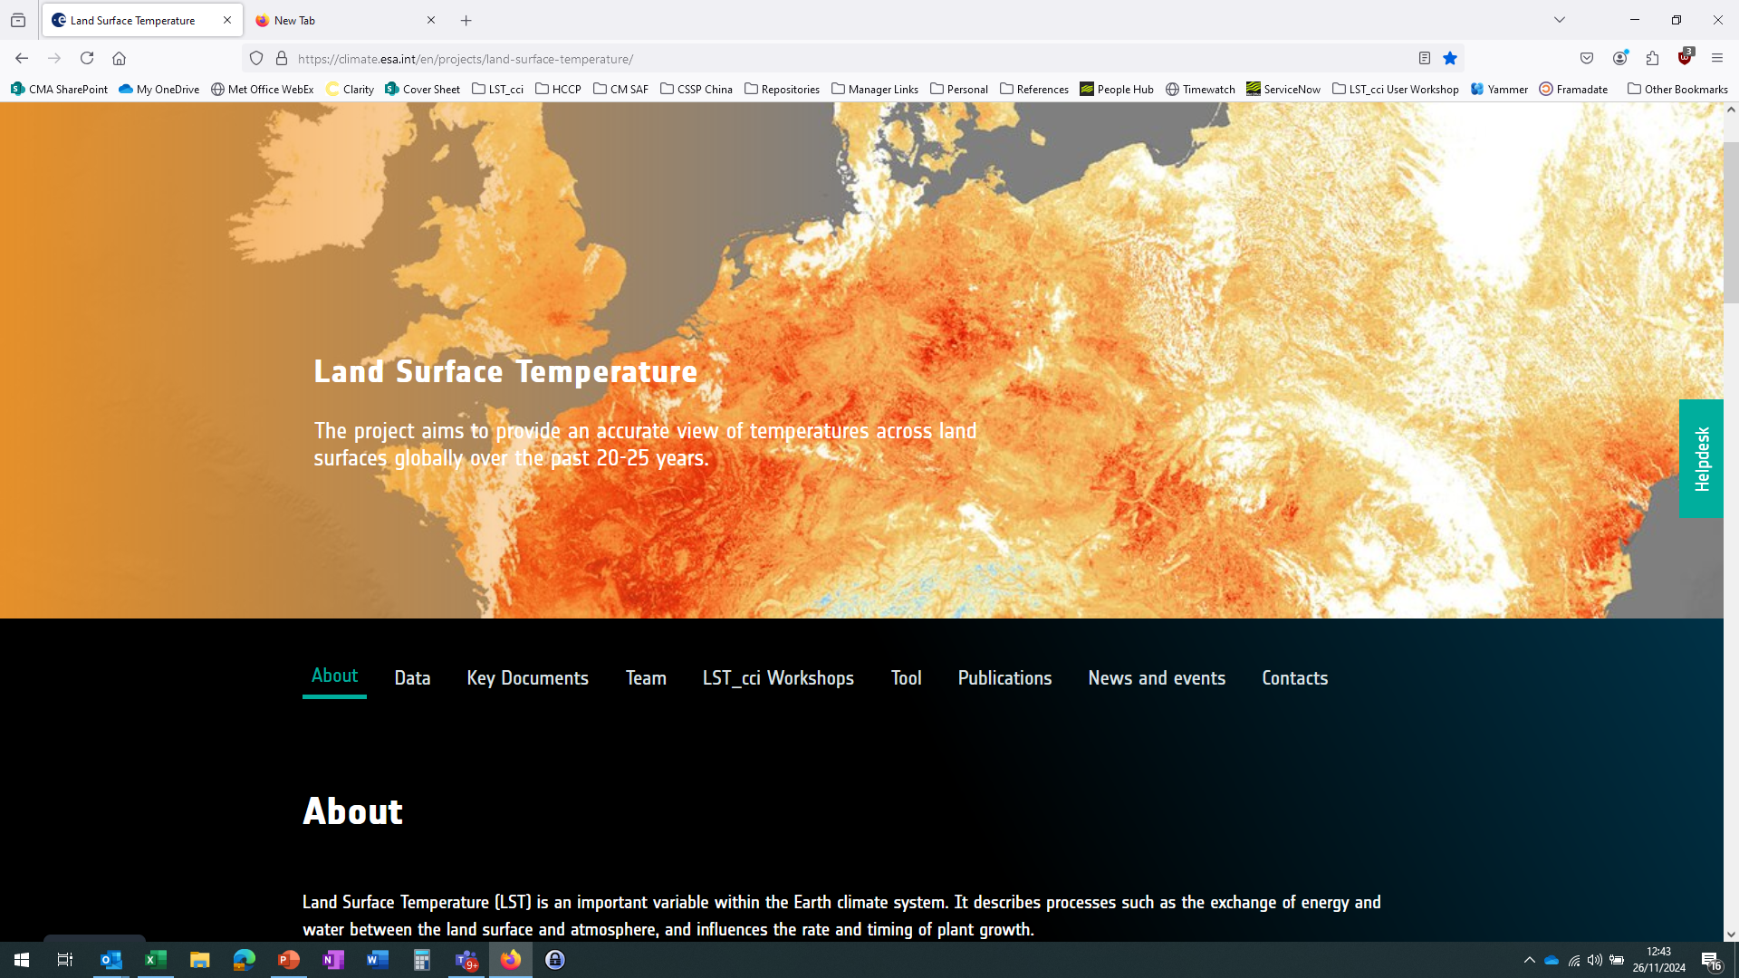
The LST_cci Project
Aims:
To provide global, accurate satellite-based land surface temperature (LST) data for the past 20-30 years.
Consortium:
University of Leicester (primary)
ACRI-ST
National Centre for Earth Observation (NCEO)
University of Reading
Met Office
ESTELLUS
Karlsruhe Institute of Technology (KIT)
Instituto Português do Mar e da Atmosfera (IPMA)
RUHR-UNIVERSITÄT BOCHUM (RUB)
Danish Meteorological Institute (DMI)
Luxembourg Institute of Science and Technology (LIST)
MeteoRomania
https://climate.esa.int/en/projects/land-surface-temperature/

Slide 5
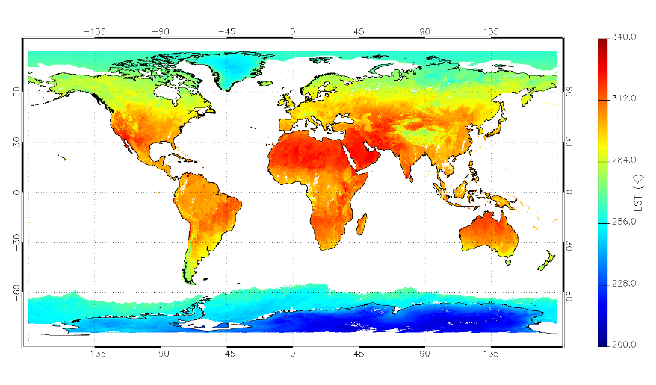

Data Products
Instrument | Satellite(s) | Period | Overpass Times | Products
ATSR-2 | ERS-2 | 1995-2003 | 10:30 / 22:30 | 1 km L2P 0.01° Daily + Monthly L3C
AATSR | Envisat | 2002-2012 | 10:00 / 22:00
MODIS | Terra | 2000-2018 | 10:30 / 22:30
 | Aqua | 2002-2018 | 01:30 / 13:30
SLSTR | Sentinel-3A | 2016-2020 | 10:00 / 22:00
 | Sentinel-3B | 2018-2020 | 10:00 / 22:00
SEVIRI | MSG-1-4 | 2004-2020 | Every hour | 0.05° Hourly L3U
Imager | GOES 12,13,16 | 2009-2020 | Every 3-hours (GOES 12-13) Every hour (GOES 16) | 0.05° 3-hourly / HourlyL3U
JAMI | MTSAT 1-2 | 2009-2015 | Every 3-hours | 0.05° 3-hourly L3U
SSM/I | DMSP F-13,17 | 1995-2018 | 06:00 / 18:00 | 0.25° Daily L3C
Merged IR CDR | GEO+LEO IR above | 2009-2020 | Every 3-hours (00:00, 03:00, …., 21:00) | 0.05° 3-hourly L3S
ATSR-S3 CDR | ATSR, MODIS, SLSTR | 1995-2020 | 10:30 / 22:30 | 0.05° Daily + Monthly L3S
Data available from CCI Open Data Portal
https://climate.esa.int/en/odp/#/project/land-surface-temperature
@SurfaceTempUoL

Slide 6
Proposed Products
Instrument | Satellite(s) | LST_cci Phase-1 |  | LST_cci Phase-2 |  | Products | Comments
 |  | Year 1 | Year 3 | Year 1 | Year 3
ATSR-2 | ERS-2 | 1995-2003 | 1995-2003 | 1995-2003 | 1995-2003 | 1 km L2P 0.01° Daily L3C
AATSR | Envisat | 2002-2012 | 2002-2012 | 2002-2012 | 2002-2012
AVHRR/3 | NOAA-15 to 19 |  | 2010-2020 | 2010-2020 | 1998-2020 |  | GAC (4km)
 | Metop-A to C |  | 2010 | 2007-2021 | 2007-2023 |  | FRAC (1km)
MODIS | Terra | 1999-2018 | 1999-2018 | 1999-2021 | 1999-2021
 | Aqua | 2002-2018 | 2002-2018 | 2002-2021 | 2002-2021
SLSTR | Sentinel-3A | 2016-2018 | 2016-2020 | 2016-2021 | 2016-2023
 | Sentinel-3B |  | 2018-2020 | 2018-2021 | 2018-2023
SEVIRI | MSG-1-4 | 2008-2010 | 2004-2020 | 2004-2021 | 2004-2023 | 0.05° Hourly L3U | MVIRI done by CM SAF
Imager | GOES 12-16 |  | 2004-2020 | 2004-2021 | 2004-2023
JAMI | MTSAT-2 |  | 2009-2015 | 2009-2015 | 2009-2015
SSM/I | DMSP F-13,17 | 1998-2018 | 1995-2020 | 1995-2021 | 1995-2023 | 0.25° Daily L3C
ATSR-S3 CDR | ATSR, MODIS, SLSTR | 1995-2012 | 1995-2020 | 1995-2021 | 1995-2023 | 0.05° Daily + Monthly L3S | ATSR-2 to SLSTR (+ sea ice)
Merged IR CDR | LEO+GEO IR above |  | 2009-2020 | 2009-2021 | 2009-2023 | 0.05° 3-hourly L3S | 3-hr Merged GEO+LEO
VIIRS | Suomi-NPP + JPSS-1 |  |  |  | 2012-2023 | 750m / 1 km L2P 0.01° Daily L3C
AHI | Himawari 8-9 |  |  |  | 2015-2023 | 0.05° Hourly L3U
AMSR-E | Aqua |  |  | 2002-2011 | 2002-2011 | ~0.1° Daily L3C
AMSR2 | GCOM-W |  |  |  | 2012-2023
Downscaled MW | SSMIS + AMSR2 + Merged IR CDR above |  |  |  | 2012-2023 | 0.05° 10-day L3S | Sub-daily composites
Prototype HR | Landsat |  |  | 2013-2021 | 2013-2023 | 100m select areas
Prototype Downscaled HR | Landsat + Sentinel-3A/B |  |  |  | 2002-2021 | 100m select areas | Downscaled from 1km
Prototype IR+MW | Multiple |  |  |  | 2010
Low Earth Orbiting (LEO) InfraRed (IR)
LEO MicroWave (MW)
Geostationary (GEO) IR
Merged GEO-LEO
High-resolution (HR) IR
Downscaled MW
Prototype blend IR+MW
Please do contact us if you need help to choose the best option for your work!

Slide 7
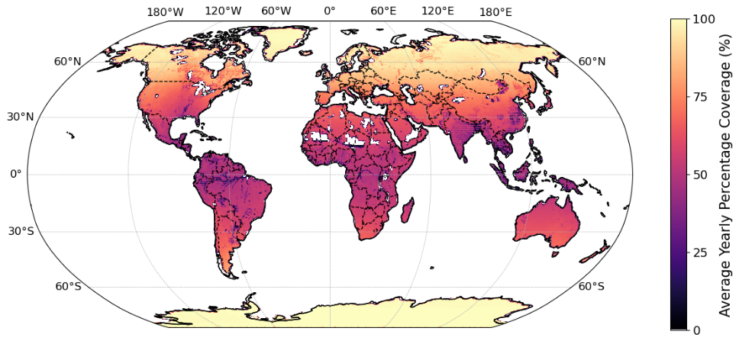
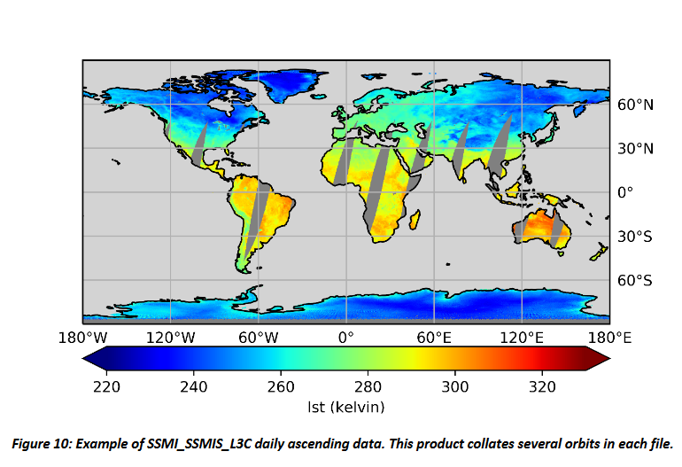
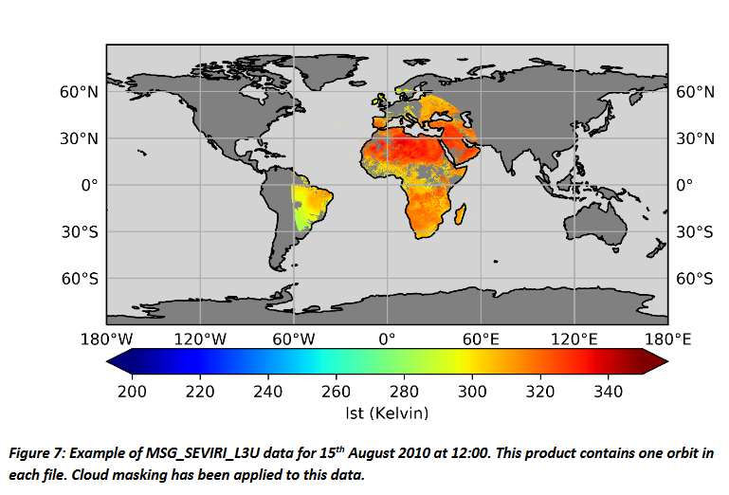
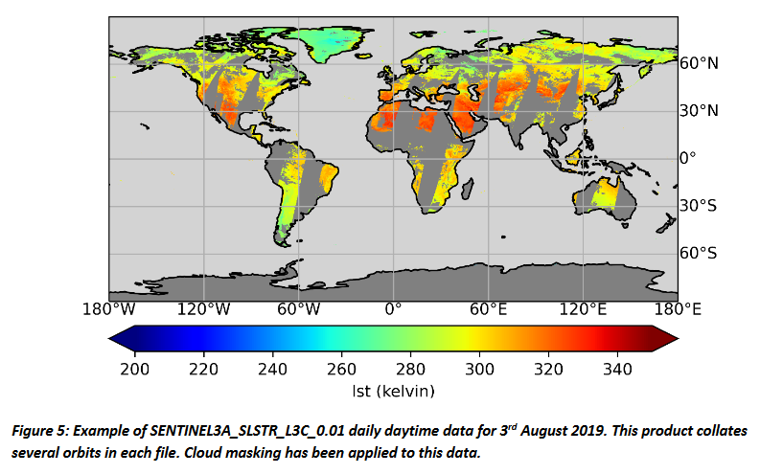
Some Key Points and Examples
Data are surface ‘skin’ temperatures
IR LST data are clear-sky only
MW LST is near all sky, but still gaps between swaths
All products have gaps
Wide choice of products – users need to select products that best meet their needs (we can help!)
MW coverage
SEVIRI (GEO IR)
SLSTR (LEO IR)
SSMI/SSMIS (LEO MW)

Slide 8
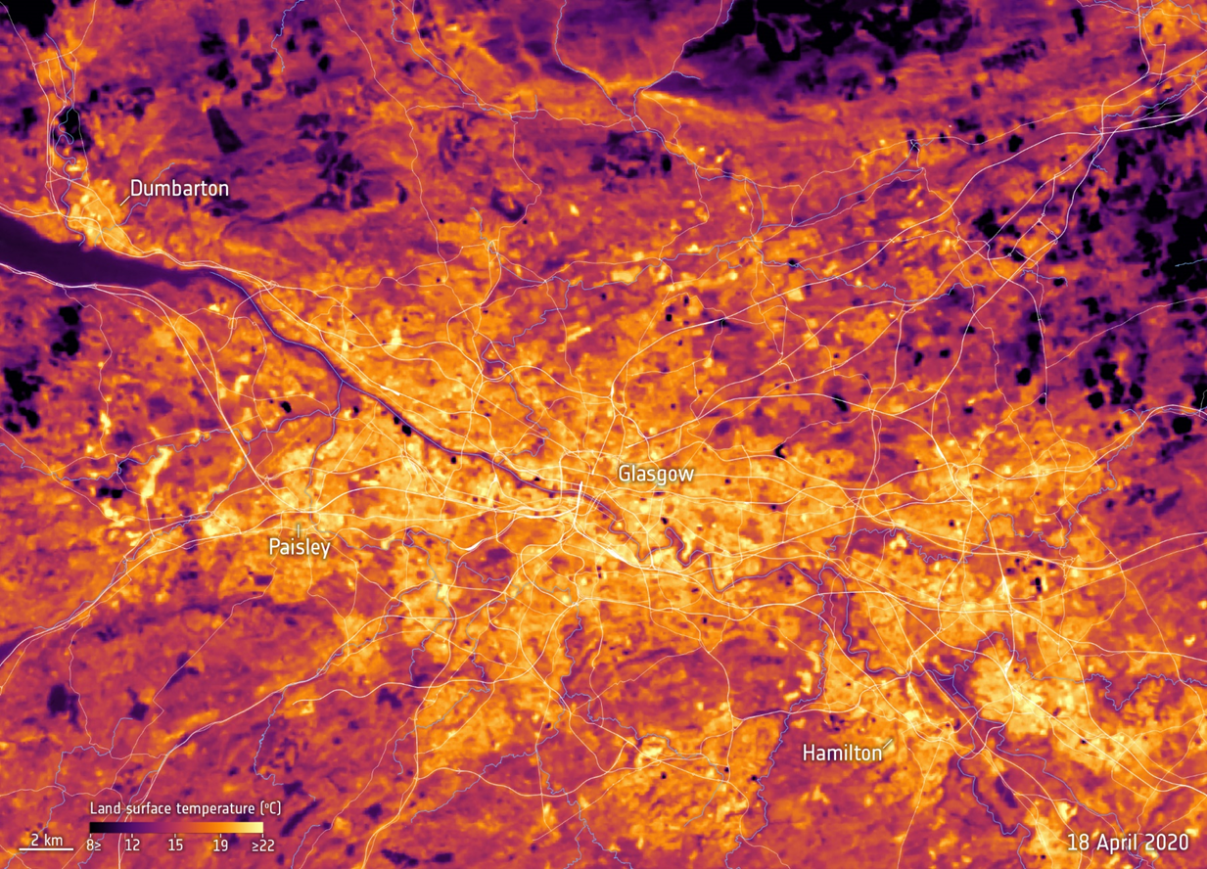
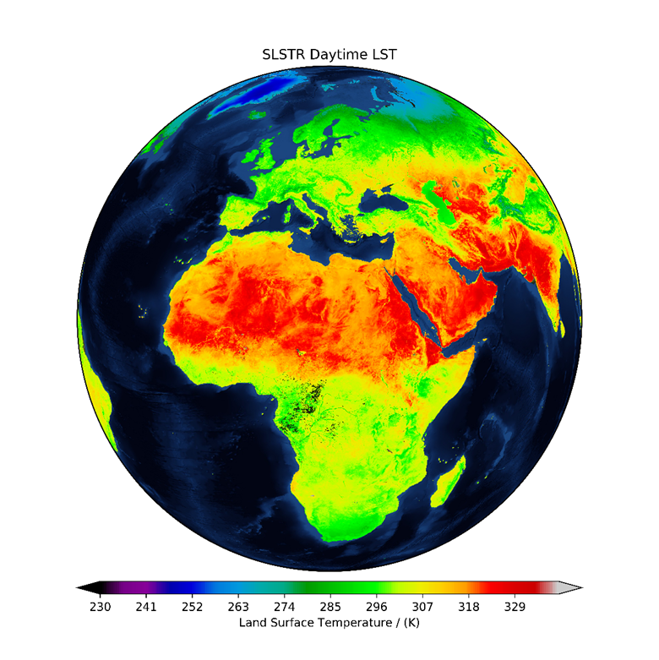
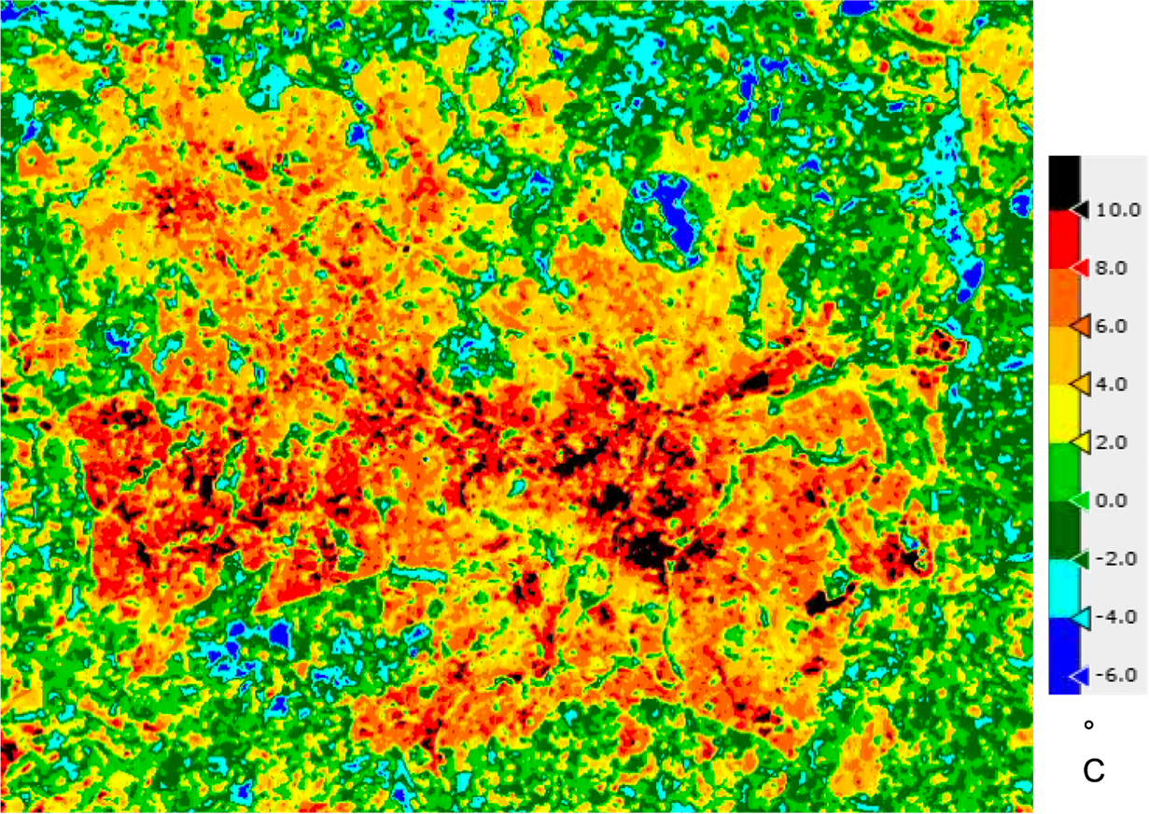
From Global to Local Climate Monitoring
Glasgow LST
Credit: ESA and NCEO Leicester
Birmingham UHI
Credit: NCEO Leicester

Slide 9
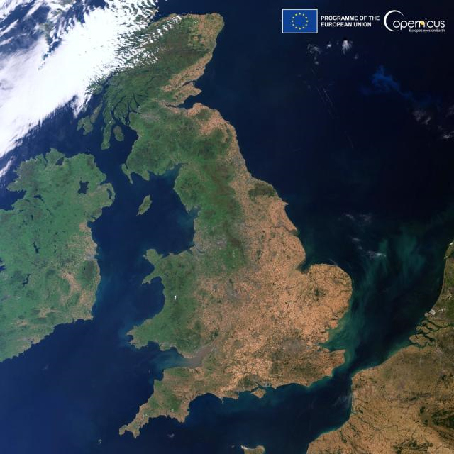
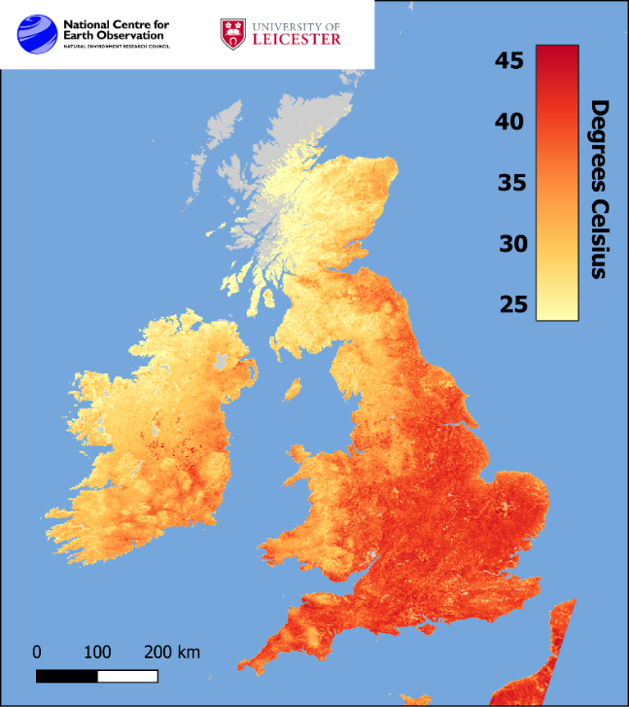
Impacts: UK Heatwaves
Satellite and in-situ land surface temperature observations can be used to evaluate diurnal variations and spatial heterogeneity of UK (e.g. urban versus rural)
NCEO-Leicester providing some newly improved data on urban temperatures using LST_cci methods.
Data on cities being tested with government and industry users
UK Drought 2022
UK LST during Heatwave 2022
https://www.bbc.co.uk/news/science-environment-62257163

Slide 10
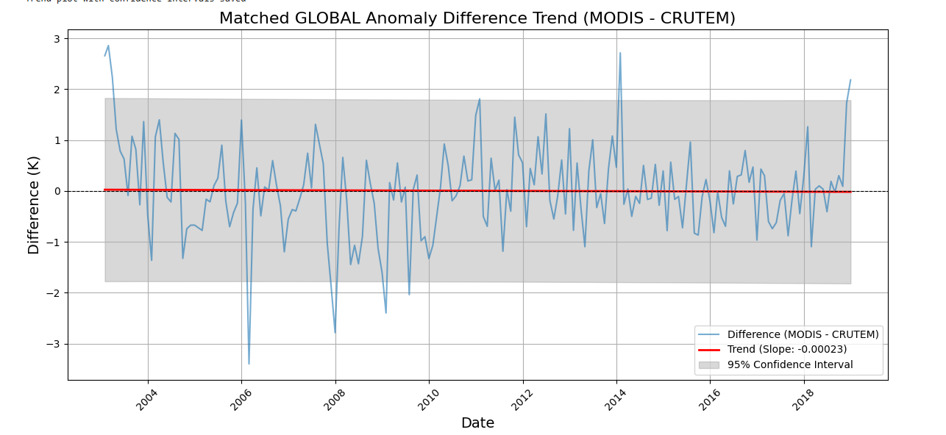
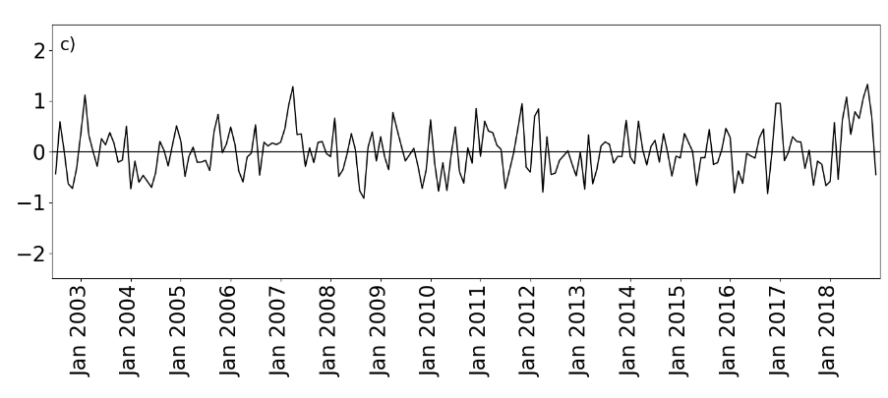
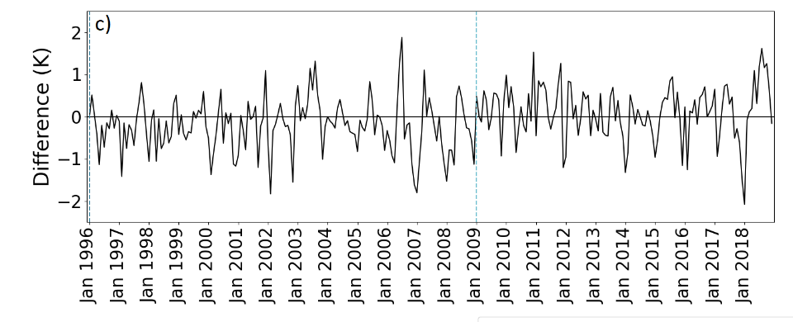
Ensuring and Verifying Stability is a Priority
LSTnight-Tmin for MODIS/Aqua:
No significant trend 0.03 K/decade (-0.11 – 0.17) = stable dataset
-0.00023 K/year (95% confidence interval for the slope ranges from 0.28236 to 0.00215)
LSTdesc-Tmin for multisensor MW:
Significant trend 0.21 K/decade (0.10 – 0.32) = unstable dataset but individual sensors stable!
LST_cci is carefully checking the stability of the data by comparing products with independent homogenised data sources
F-17
F-13
Top: Credit, Abi Waring, U. Leicester
Right: Good, E. J. et al. (2022). An analysis of the stability and trends in the LST_cci Land Surface Temperature datasets over Europe. Earth and Space Science, 9, e2022EA002317. https://doi.org/10.1029/2022EA002317
Figure source: Abi Waring, U. Leicester

Slide 11
Regridding Tool & Other Resources
Regridding Tool
Code in Python to regrid and subset LST_cci data, including propagation of uncertainties
Other Resources
To be provided in the training session on Friday morning
https://notebooks.gesis.org/ binder/jupyter/user/ mikejsperry-esa_cci_lst_demo -lr7kpdmh/lab (note this can take a while to load)
https://climate.esa.int/en/projects/land-surface-temperature/

Slide 12
Summary
LST_cci is providing satellite LST datasets based on InfraRed (IR) and MicroWave (MW), and low Earth orbiting (LEO) and geostationary satellites (GEO)
An expected accuracy and precision of all the LST ECV Products will be better than 1 K.
An assessment of the stability of LST_cci data to ensure they meet they threshold requirement < 0.3 K / decade.
Multi-decadal datasets useful for climate applications based on IR and MW data
Phase-1 datasets are available via the ESA Open Data Portal
Phase-2 datasets will be publicly available next year
Includes several new datasets including the long-term time series from AVHRRs from the 1980s to present
High-resolution data (<1 km)
Merged products combining different LST data sources to provide better spatial and temporal coverage.

Slide 13
Contact and Further Information
LST_cci webpages: https://climate.esa.int/en/projects/land-surface-temperature/
Key documents:
Strongly suggest reading the Product User Guide (PUG)
Climate Assessment Report (CAR) may also be useful – demonstrates real applications for LST_cci data.
Other LST_cci documents provide crucial underpinning and detailed information but are not designed for the typical user.
Please encourage your colleagues to register for our LST_cci mailing list to keep up with the latest news (we only send a few emails per year)
Information password protected and not shared with 3rd parties.
Please email project email info.lst-cci@acri-st.fr for further information, questions, etc.

