Slide 1


Welcome to the 2024 LST_cci Workshop
Lizzie Good (Met Office) & Karen Veal (U. Leicester/NCEO)

Slide 2
Agenda day 1: The LST_cci Project
05-Dec
UK time |  | Topic | Speaker |  | Duration
08:00 | 09:00 | Registration |  |  | 01:00
09:00 | 09:05 | Fire and safety briefing | SPL Staff |  | 00:05
09:05 | 09:05 | Introduction to CCI and LST_cci | Chair: Claire Bulgin (U. Reading)
09:05 | 09:15 | Arrival and welcome | Welcome from U. Leicester & Lizzie Good |  | 00:10
09:15 | 09:30 | Overview of the LST_cci Project | Lizzie Good (Met Office) |  | 00:15
09:30 | 09:45 | LST in ESA's climate programme | Simon Pinnock (ESA) |  | 00:15
09:45 | 10:15 | Poster Lightning Presentations | Poster Presenters |  | 00:30
10:15 | 10:45 | Break & Poster Viewing |  |  | 00:30
10:45 | 10:45 | LST_cci Products (1) | Chair: Abigail Waring (U. Leicester)
10:45 | 11:00 | Polar orbiting Infrared LST_cci Products | Karen Veal (U. Leicester) |  | 00:15
11:00 | 11:15 | Geostationary Infrared LST_cci Products | Sofia Ermida (IPMA) |  | 00:15
11:15 | 11:30 | High-resolution Infrared LST_cci Products | Charlotte Paton (U. Leicester) |  | 00:15
11:30 | 11:45 | UCS#2: Assessment of ESA LST_cci Sea-Ice Surface Temperatures (IST) in the Arctic | Ioanna Karagali (DMI) |  | 00:15
11:45 | 12:00 | Microwave LST_cci Products | Carlos Jiménez (Estellus) |  | 00:15
12:00 | 13:30 | Lunch Break and Poster Viewing (+ Group Photo) |  |  | 01:30
13:30 | 13:30 | LST_cci Products (2) | Chair: Carlos Jiménez (Estellus)
13:30 | 13:45 | Merged Infrared & Microwave product | Abigail Waring (U. Leicester) |  | 00:15
13:45 | 14:00 | Uncertainties in the LST_cci products | Claire Bulgin (U. Reading) |  | 00:15
14:00 | 14:15 | Validation of the LST_cci products | Lluis Pérez-Planells (KIT) |  | 00:15
14:15 | 15:15 | User Requirements Discussion Session & Slido Questions | Lizzie Good & Karen Veal |  | 01:00
15:15 | 15:45 | Break & Poster Viewing |  |  | 00:30
15:45 | 15:45 | User Case Studies | Chair: Lluis Pérez-Planells (KIT)
15:45 | 16:00 | UCS#1: Moderate extremes indices based on LST | Josh Blannin (Met Office) |  | 00:15
16:00 | 16:15 | UCS#3: Urban Nighttime Warming Trends derived from LST_cci MODIS Data | Panagiotis Sismanidis (RUB) |  | 00:15
16:15 | 16:30 | UCS#5: Analyzing Seasonal Patterns and Temperature Extremes in Urban Areas Using MODIS Data | Irina Ontel (MeteoRomania) |  | 00:15
16:30 |  | Finish

Slide 3
Agenda day 2: User Presentations
06-Dec
UK time |  | Topic | Speaker |  | Duration
08:00 | 09:00 | Registration |  |  | 01:00
09:00 | 09:05 | Fire and safety briefing | SPL Staff |  | 00:05
09:05 | 09:05 | LST Applications (1) | Chair: Lizzie Good (Met Office)
09:05 | 09:20 | constellr HiVE, a land surface temperature monitoring mission for better resource accountability | Christophe Lerot (constellr) |  | 00:15
09:20 | 09:35 | A new methodology to generate infrared Land Surface Emissivity including directional effects | Sofia Ermida (IPMA) |  | 00:15
09:35 | 09:50 | Identification, characterization and correction of directional effects in high-resolution LST | Louis Snyders (VITO) |  | 00:15
09:50 | 10:05 | Improving Satellite-based Land Surface Temperature Estimates in Dust-Contaminated Atmospheres: A Generalized Split-Window Algorithm Dependent on Dust Aerosol Optical Depth | Francesco Stante (IPMA) |  | 00:15
10:05 | 11:05 | LST_cci data training session | ESA Knowledge Exchange Team |  | 01:00
11:05 | 11:25 | Break |  |  | 00:20
11:25 | 11:25 | LST Applications (2) | Chair: Sofia Ermida (IPMA)
11:25 | 11:40 | Long-term Trends of LST from a new Daytime-normalized AVHRR Time Series over Central and Southern Europe | Philipp Reiners (DLR, DFD) |  | 00:15
11:40 | 11:55 | Intercomparison of SEVIRI Land Surface Temperature with ERA5 reanalysis over Africa | Riccardo Monfardini (U. Reading) |  | 00:15
11:55 | 12:10 | Use of LST data for producing data for the FAO-WaPOR portal: past, present and future | Henk Pelgrum (eLEAF) |  | 00:15
12:10 | 12:25 | Using LST to better understand land atmosphere interactions and improve predictions | Christopher Taylor (CEH) |  | 00:15
12:25 | 12:40 | A multi-layer perceptron approach on downscaling land surface temperature for the study of surface urban heat islands | Alexandra Hurduc (IDL) |  | 00:15
12:40 | 12:55 | Analysis of urban surface temperature from satellite data with modelled 3D surface temperature | Maria Gkolemi (FORTH) |  | 00:15
12:55 | 13:00 | Wrap up and close | Lizzie Good & Karen Veal

Slide 4
Posters: Available to view in all the breaks
1 | Towards subdaily Land Surface Temperature | Christian Mollière (OroraTech GmbH)
2 | Assessing the accuracy of LST_cci products and analyzing LST trends in the Iberian Peninsula | Raquel Niclos, presented by Sara Arribas (Departament of Earth Physics and Thermodynamics, University of Valencia)
3 | Hyperspectral Soil Property Mapping Using Thermal Infrared (LWIR) Imagery | Helge Daempfling (GFZ Potsdam)
4 | Emissivity correction of 3D thermal model based on image processing and deep learning | Shaojuan Xu (Research Institute for Regional and Urban Development, Dortmund, Germany)
5 | On the suitability of different satellite land surface temperature products to study surface urban heat islands | Alexandra Hurduc (Instituto Dom Luiz - IDL)
6 | Downscaling urban Land Surface Temperature variations across different land cover types using high-resolution satellite imagery | Liliia Hebryn Baidy (Scott Polar Research Institute, University of Cambridge)
7 | Performance validation of a commercial radiometer | Tom Snelling (STFC RAL Space)
8 | Towards subdaily Land Surface Temperature | Abigail Waring (University of Leicester)
9 | A low cost, small satellite constellation approach to rapidly monitor Land Surface Temperature for Urban and Agricultural applications over UK and Europe, with optimised cross calibration to ESA and Copernicus missions | Robert Elliott (Surrey Satellite Technology Ltd)
10 | Nationwide surface thermal analysis to detect priority areas for urban mitigation interventions | Giulia Guerri (Istituto per la BioEconomia (IBE) - Consiglio Nazionale delle Ricerche Institute of BioEconomy (IBE) - National Research Council)
11 | Development of a Climate Web Application on the EO Data Hub | Dan Ormsby (Sparkgeo)

Slide 5
Reminders
Registration is required on both workshop days for health and safety reasons
Registration is open from 08:00.
Please be seated by 09:00 ready for the fire & safety briefing each day.
Please vacate the building by 17:00.
Please use your own water bottle if possible – there will be opportunities to refill during the breaks.
Enjoy the workshop!

Slide 6
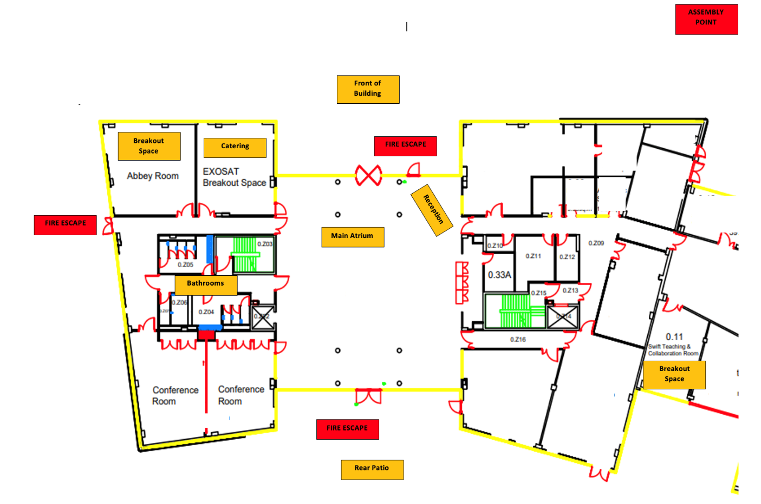
Space Park Leicester
Rooms
Conference room
EXOSAT(coffee breaks, lunch)
Atrium (posters)
Fire escapes
Assembly Point

