Slide 1
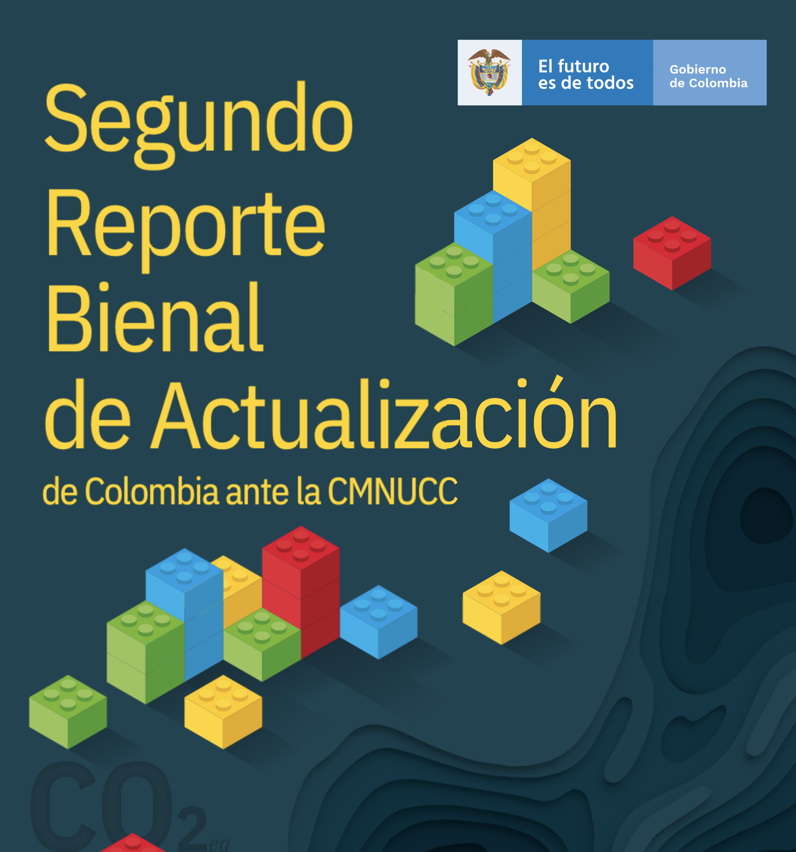
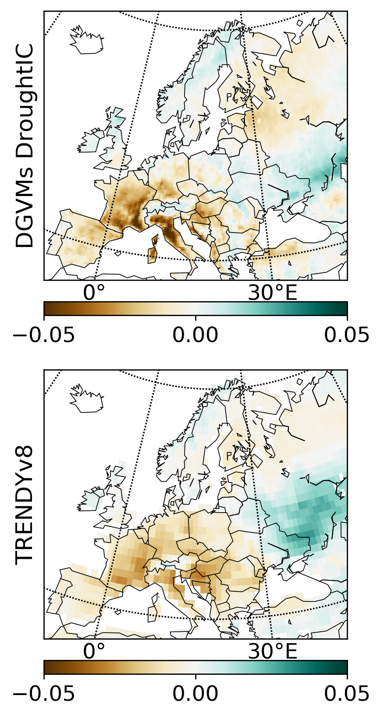

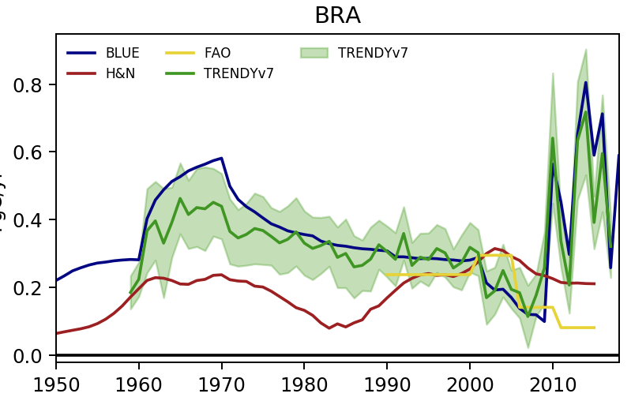



Exploitation of CCI products in the second Regional Carbon Cycle Assessment and Processes RECCAP­-2, 2nd phase ESA-CCI Collocation Meeting September 2020 Online
RECCAP-2 CCI 1st phase:
The first phase of ESA-CCI RECCAP-2, delivered preliminary analyses evaluating:
the feasibility of producing annual updates of regional carbon budgets from different approaches;
the potential of ESA-CCI variables in improving estimates of regional natural and anthropogenic CO2 fluxes from ensembles of models used for the annual global carbon budget publication led by the Global Carbon Project
land surface model benchmarking.
Fig. 1 Examples of outcomes from ESA-CCI RECCAP-2 Phase 1: Time-series of regional CO2 fluxes from global datasets used in the Global Carbon Budget 2018 [1] available in the global carbon atlas portal; results from benchmark of different global vegetation models with ESA-CCI datasets.
RECCAP-2 CCI 2nd phase objectives:
Evaluate the feasibility of producing at least every two years updated estimates of GHG balance (natural and anthropogenic) at country level constrained by EO data using ensembles of top-down atmospheric inversions and bottom-up land surface models.
Improve the consistency between estimates of total greenhouse budgets produced in (i) against official estimates of national anthropogenic emissions and land sinks reported by countries to the UNFCCC as national communications, annually for Annex 1 countries and bi-annually for non-Annex 1 countries.
To promote a dialogue with national inventory agencies to identify the largest sources of uncertainty in inventories and how the uncertainty provided by ESA-CCI datasets can support uncertainty estimation.
To scope the information that could be delivered by EO data products and priority requirements for data products that would help to improve/support national inventories.
Evaluation of consistency between country-level greenhouse gas budgets from satellite-based and in-situ inversions
Variability in anthropogenic and natural biosphere surface fluxes for EU countries
Compilation and harmonization of national GHG reporting from original sources
Apply corrections to CO2, CH4 and N2O inversions as described above;
Produce country-level estimates of anthropogenic emissions from the global inversions and their uncertainties, with a focus on satellite-based inversions , that will be compared with UNFCCC estimates for UK, Italy, Germany and France and with the latest version of Biennial Reports for Brazil and Colombia;
Evaluate reasons for discrepancies between estimates, if these are found: are these now accepted as being sensible or is there still debate on bias??
Higher resolution DGVM simulations using ESA-CCI LC land-cover and improved climate forcing for European countries.
Provide biospheric CH4 fluxes from the Global Methane Budget.
Evaluate long-term trends and variability in both anthropogenic and natural biospheric fluxes at country scale.
Compare the results with ESA-CCI datasets (biomass, permafrost) and with NA reporting, in order to evaluate the added value of the high-resolution and of EO-based DGVM simulations.
Fig. 2 Examples of reports to be compiled and harmonized.
Fig. 4 Comparison of net CO2 uptake during the heatwave in 2003 by medium-resolution model simulations and the models in the Global Carbon Budget [2]
Non-Annex 1 country level budgets and consistency with UNFCCC reporting
Extend the preliminary work from phase 1 of ESA-CCI RECCAP2 to use ESA-CCI ECVs in benchmarking simulated land carbon budgets and relevant variables simulated for non-Annex I countries;
Compare them with those provided by National Agencies to the UNFCCC inventories.
Investigate sources of uncertainty and
potential methods to reconcile different
estimates.
Engagement with National Agencies and UNFCCC
Organise a meeting with National Agencies in order to discuss the results of the previous WPs and the potential contribution of ESA-CCI datasets to improve NA budgets.
4 EU National Agencies; 2 Non-Annex I (Brazil + Colombia)
Workshop @ COP26
Fig. 3 Comparison of different land-use change emission estimates for Brazil.
Workshop with Annex-II NA at UNFCCC COP-26 (Glasgow, Nov. 2021) to promote the results of the analysis, possibly as part of an ESA-organised side-event.
[1] Le Quéré et al., 2018. ESSD
[2] Friedlingstein et al., 2019, ESSD

