Slide 1
Insights Into the Aerodynamic Versus Radiometric Surface Temperature Debate in Thermal-Based Evaporation Modeling
Kaniska Mallick(1,2), Dennis Baldocchi(2), Andrew Jarvis(3), Tian Hu(1) and co-authors
(1)REMOTE, Luxembourg Institute of Science and Technology, Belvaux, Luxembourg; (2)Biometeorology Lab, Dept. Env. Sci. Policy and Management, University of California, Berkeley, United States; (3) Lancaster University, United Kingdom

Slide 2
Content
For any ecosystem to evaporate……
What is aerodynamic temperature
What has been done previously?
What the present study addressed?
Data and study regions
Results and insights

Slide 3

For any ecosystem to evaporate…..
What we can observed / measure
LST
Radiation
Temperature
Humidity
Vegetation cover
What we can never observe / measure
Aerodynamic temperature (T₀)
Aerodynamic conductance (g_{a})
Canopy-soil-substrate conductance (g_{cs})
Solar radiation (R_{G})
Terrestrial radiation (R_{L})
Temperature (T_{a}), Humidity (rH)
Vegetation cover, Leaf area
Net available energy (‘Engine’)
Wet evaporation and Transpiration
Surface energy balance partitioning
Heat accumulation
Convection
Terrestrial ecosystem
T_{0,} D₀, g_{a}, g_{cs}
Sensible heat flux (H)
T_{0,} D₀, g_{a}, g_{cs}
Evaporation (E)
Reflected radiation (R_{r})
Water Stress (‘Fuel’)
Land surface temperature (LST or T_{r})
Surface heating

Slide 4
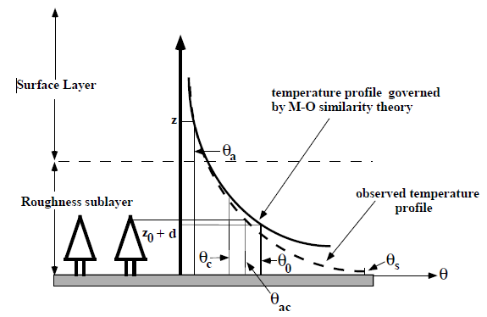

What is aerodynamic temperature (T₀)
$$T_{0}≠ T_{r}$$
Solar radiation (R_{G})
Terrestrial radiation (R_{L})
Temperature at the canopy-air space: i.e., T_{a} extrapolated downwards inside the canopy where momentum is almost absorbed
Temperature (T_{a}), Humidity (rH)
Vegetation cover, Leaf area
Net available energy (‘Engine’)
Wet evaporation and Transpiration
Surface energy balance partitioning
Heat accumulation
Convection
Terrestrial ecosystem
T_{0,} D₀, g_{a}, g_{cs}
Sensible heat flux (H)
T_{0,} D₀, g_{a}, g_{cs}
Evaporation (E)
Reflected radiation (R_{r})
Water Stress (‘Fuel’)
Land surface temperature (LST or T_{r})
Sun et al. (1999), BLM
Surface heating

Slide 5




What is aerodynamic temperature (T0)
$$T_{0}≠ T_{r}$$
Solar radiation (R_{G})
Terrestrial radiation (R_{L})
Temperature (T_{a}), Humidity (rH)
Vegetation cover, Leaf area
Net available energy (‘Engine’)
$$R_{N}−G=H+E$$
Wet evaporation and Transpiration
Surface energy balance partitioning
$$H= c_{H}\left(T_{0} − T_{a}\right)$$
Heat accumulation
Convection
Terrestrial ecosystem
T_{0,} D₀, g_{a}, g_{cs}
Sensible heat flux (H)
$$E= c_{E}\left(e_{0}^{∗} − e_{a}\right)$$
T_{0,} D₀, g_{a}, g_{cs}
Evaporation (E)
Reflected radiation (R_{r})
Water Stress (‘Fuel’)
$${c_{H}, c}_{E}=Heat and water vapor transfer coefficients$$
Land surface temperature (LST or T_{r})
Surface heating
$$T_{0}= \frac{\left(R_{G} − R_{r}\right)−4a_{sh}ε_{s}σ\left(T_{a}^{3}T_{r}−T_{a}^{4}\right) −G+ c_{H}T_{a}+c_{E}\left(sT_{a}−D_{a}\right)}{c_{H}+c_{E}s}$$

Slide 6
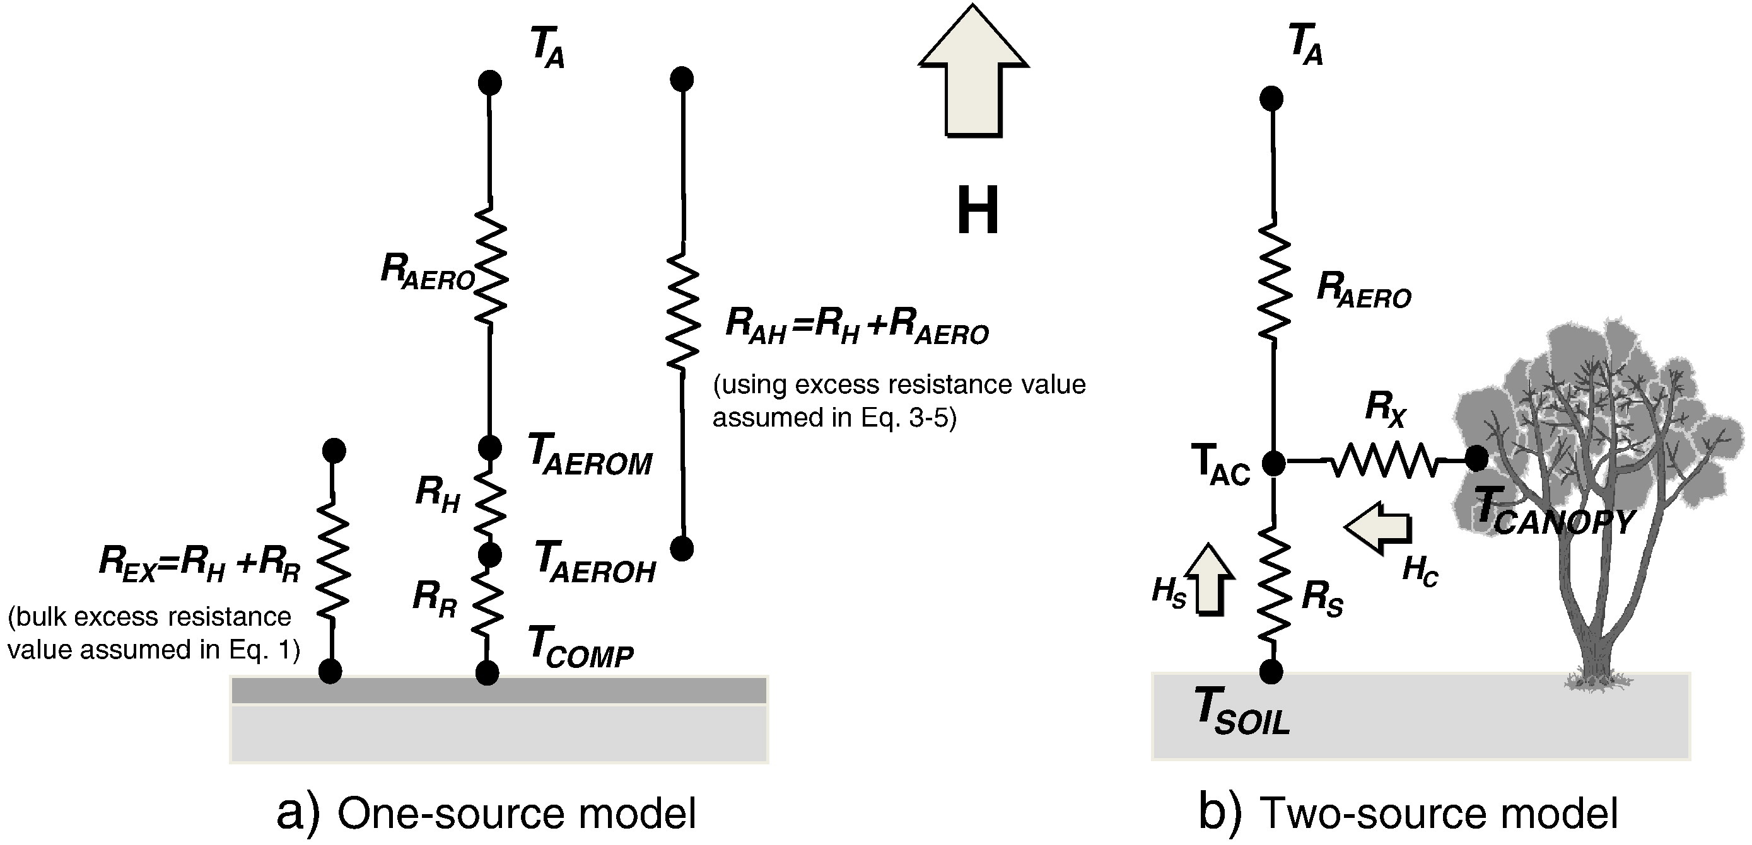

Accommodating T_{r} vs T₀ inequality?
$$T_{0}≠ T_{r}$$
Single-source formulation: Additional radiative and heat resistance; kB⁻¹
Two-source formulation: Soil and canopy aerodynamic resistance
Kustas et al. (2016), RSE

Slide 7
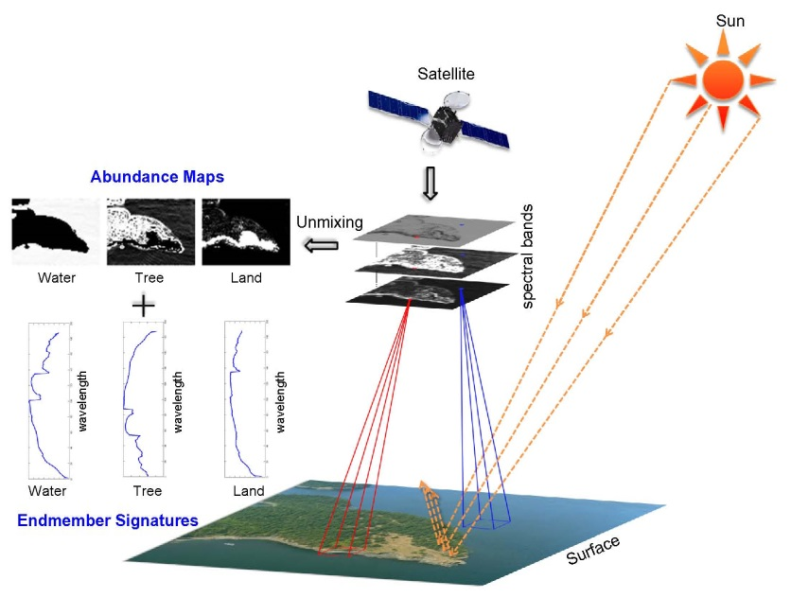
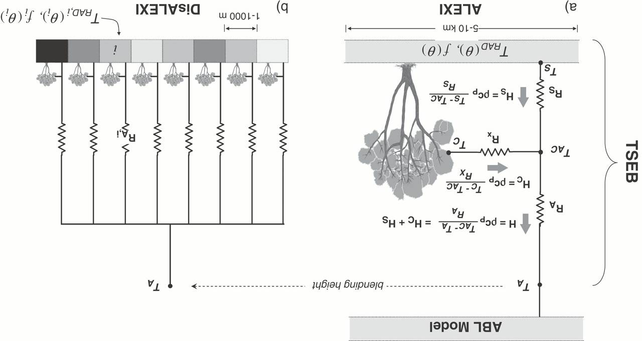

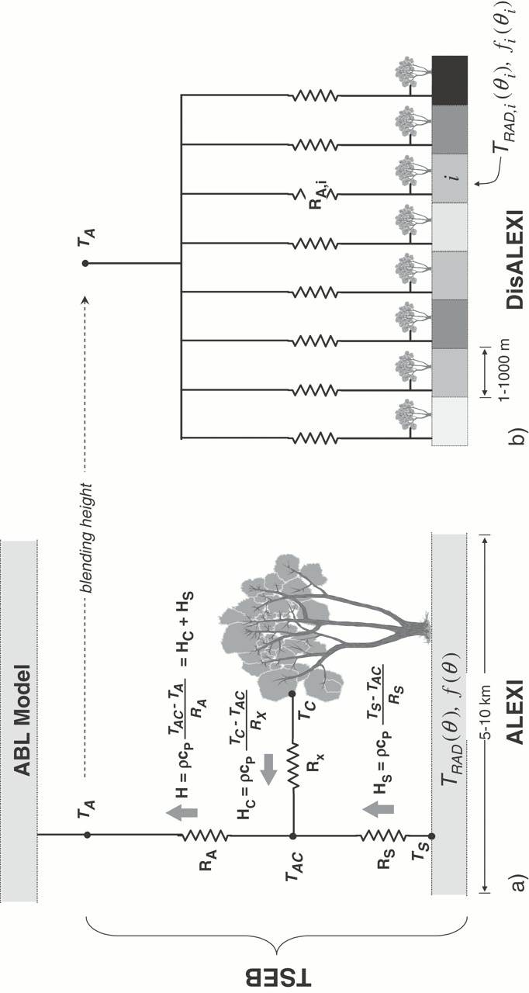


Present study
Upper boundary conditions
Solar radiation (R_{G})
Terrestrial radiation (R_{L})
R_{N}
(T_{r}, ε_{s}, R_{G}, R_{r})
T_{a}, rH
Reference height (z)
T_{r}
Temperature (T_{a}), Humidity (rH)
E, H
(T_{r}, rH, T_{a})
Vegetation cover, Leaf area
Net available energy (‘Engine’)
Wet evaporation and Transpiration
Surface energy balance partitioning
r_{a}
(=1/g_{a})
F_{E}
Heat accumulation
Convection
Terrestrial ecosystem
T_{0,} D₀, g_{a}, g_{cs}
Soil-vegetation-atmosphere system
Vegetation surface
Sensible heat flux (H)
T_{0,} D₀, g_{a}, g_{cs}
T₀, α, e₀, e₀*
Evaporation (E)
z_{0H}
r_{cs} (=1/g_{cs})
d₀
Water Stress (‘Fuel’)
Lower boundary conditions
Reflected radiation (R_{r})
G (R_{N}, T_{r}, I_{SM})
Land surface temperature (LST or T_{r})
Substrate
I_{SM}
Surface heating
1-D Surface energy balance representation

Slide 8
Present study
Aerodynamic theory of heat
Aerodynamic theory of water vapor
Water Stress
Biophysical conductance
Upper boundary conditions
R_{N}
(T_{r}, ε_{s}, R_{G}, R_{r})
T_{a}, rH
Reference height (z)
T_{r}
E, H
(T_{r}, rH, T_{a})
CCI+ LST; meteorology
Australia, aridity gradient
r_{a}
(=1/g_{a})
F_{E}
Soil-vegetation-atmosphere system
Vegetation surface
T₀, α, e₀, e₀*
z_{0H}
r_{cs} (=1/g_{cs})
d₀
Lower boundary conditions
G (R_{N}, T_{r}, I_{SM})
Substrate
I_{SM}
1-D Surface energy balance representation

Slide 9
Results
Insights
How does in-situ T0 compare with satellite T0
How does satellite T0 compare with satellite Tr
Aerodynamic and stomatal controls

Slide 10
T₀-STIC versus T₀-inverted
Inverted T₀: estimated by using EC tower friction velocity, wind speed, and associated surface energy balance components.
Significant correlation
Constant kB⁻¹: Effects of g_{a} and wind speed.

Slide 11
Varying kB⁻¹
kB-1
kB-1 = f{T_{r}, u}
Large difference in water-limited ecosystems
Both static and dynamic kB−1 revealed marginal difference in the statistical metrics in mesic ecosystems.

Slide 12
Results
Insights
How does in-situ T0 compare with satellite T0
How does satellite-T0 compare with satellite-Tr
Aerodynamic and stomatal controls

Slide 13
Satellite-T₀ versus Satellite-T_{r}
STIC T₀ and MODIS T_{r} differed by ±4–6°C in arid and semiarid ecosystems.
T₀ consistently exceeded T_{r} in the mesic ecosystems.
Almost independent of satellite view zenith angle (vza) variations.
vza(°)

Slide 14
T₀ vs. T_{r} and energy-water limits
SWC (m³/m³)
Significant correlation b/w T_{r}–T₀ and R_{G} for the entire range of SWC
SWC (m³/m³)
Energy limit: Global radiation (R_{G}) (W/m²)
Water limit: Soil water content (SWC) (m³/m³)
T₀ exceeded T_{r} with declining SWC at constant R_{G} when R_{G} exceeded >600 W/m2.

Slide 15
T₀ vs. T_{r} and vegetation cover limits
f_{v}
f_{v}
Significant correlation b/w T_{r}–T₀ and R_{G} for the entire range of fractional vegetation cover (f_{v}).
No distinct pattern between T_{r}–T₀ and R_{G} in mesic ecosystems

Slide 16
Results
Insights
How does in-situ T0 compare with satellite T0
How does satellite-T0 compare with satellite-Tr
Aerodynamic and stomatal controls

Slide 17
Aerodynamic and stomatal controls
g_{cs}/g_{a}
Sparse vegetation, high D_{a}, radiative heating, low SWC triggers a decline in g_{cs}, F_{E} and humidity at the source-sink height.
Water-limited ecosystems
g_{cs}/g_{a}
Elevated vapor pressure deficit at the source-sink height (D₀) (D₀ >> D_{a}); increase in H at the cost of a decline in F_{E} and the g_{cs}/g_{a} ratio due to high D₀–D_{a}

Slide 18
Aerodynamic and stomatal controls
Sparse vegetation: when Tsoil>>Tveg due to water stress, T_{r}>T₀ due to the larger impact of soil temperature on T_{r}
Strong vegetation-atmospheric coupling, rising soil water stress, and high D₀ leads to T₀>T_{r}
Mesic ecosystems: High SWC, consistently lower T_{r} than T₀ was due to high evaporative cooling from the transpiring vegetation

Slide 19
Aerodynamic and stomatal controls
Energy-limited ecosystems

Slide 20
How does the fluxes compare?

Slide 21
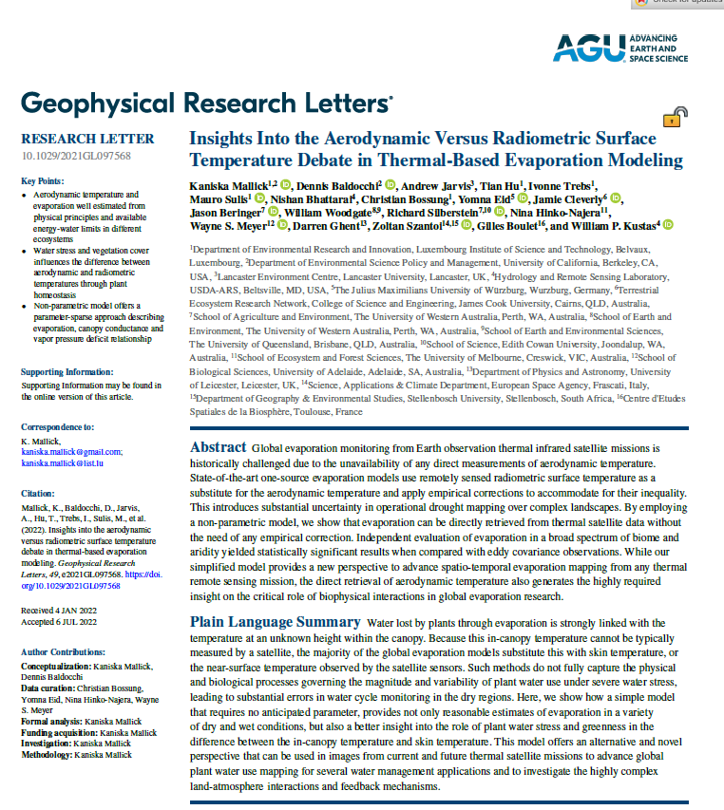
Insights
The inequality between T₀ and T_{r} is primarily regulated by water stress induced variations in g_{cs} and evaporation in water-scarce ecosystems under varying vegetation cover.
Homeostasis in T_{r}.
Interestingly, the substantial difference in surface roughness between these ecosystems apparently had little effect on E and H retrieval through STIC.
No surface roughness and stability correction is needed.

