Slide 1
Validation of LST_cci products
Lluís pérez-Planells, Maria martin, Frank Göttsche
KIT

Slide 2
Introduction
The validation of LST_cci data products is essential to assess the quality of LST products.
It is crucial for users to better understand the data and its limitations.
In LST_CCI, the validation team (lead by KIT) is independent from data producers.
  All in-situ datasets are produced by KIT.
  One year of data for each sensor and site is shared with data producers.
  Regular interactions with data producers to provide feedback from validation.
All data used for the validation is in harmonized format.
The validation is performed implementing the community stablished protocols, e.g.:
  LST Validation Protocol (Schneider et al., 2012)
  CEOS LPV Best Practices (Guillevic et al., 2018)

Slide 3
introduction
Robust statistics (i.e., median of differences and robust standard deviation, RSD) are provided for the statistical results as recommended in Guillevic et al. (2018) to avoid the influence of possible remaining outliers.
KIT’s validation approach consists of two parts:
  In-situ validation against measurements from globally distributed stations representing a broad range of land covers and climates.
    Additionally, the uncertainty of the in-situ validation is also assessed.
  Satellite-satellite inter-comparisons over large areas (continental scale).

Slide 4
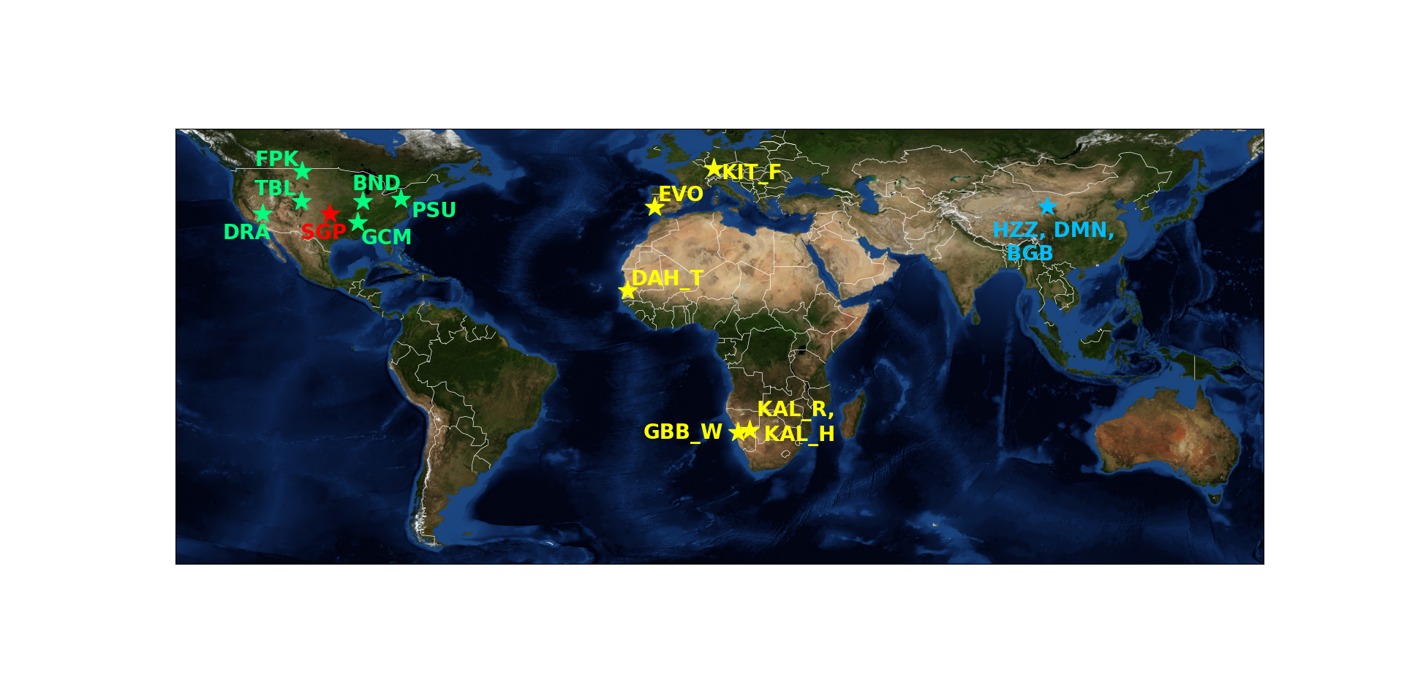
In-situ validation: Sites
The validation period covers from 1995 to 2020.
A total of 16 in-situ stations worldwide distributed were used.
In-situ measurements represent different land covers, regions and elevations.
KIT: since 2009, set up for LST validation, large homogeneous areas and well characterized
SURFRAD: long-term availability since 1995 / 1998, broadband measurements
ARM (SGP): SGP – Narrowband measurements since 2003.
HEIHE: China, broadband measurements. Data from 2013 to 2015.

Slide 5
In-situ validation: Matchups
Spatial matching:
  LEO-IR: All pixels with the same land cover in a 0.05° x 0.05° grid around the station are averaged.
  GEO & LEO-MW: The pixel over the in-situ station is used.
Temporal matching:
  At KIT, SURFRAD and ARM sites, the two closes times to the satellite overpass are linearly interpolated.
    Temporal differences are smaller than 1 minute.
  At HEIHE stations (temporal resolution of 30 min) the closest time to satellite overpass is used.
    Temporal differences are limited to 10 minutes.
16 LST CCI data sets were validated:
  8 LEO data sets:
    6 IR products: Aqua/Terra-MODIS (MODISA/MODIST), ATSR-2 (ATSR_2) , AATSR (ATSR_3), and SLSTR-A (SLSTRA)
    2 MW products: SSMI-13, SSMI-17
  8 GEO data sets:
    GOES12/13/16, SEVIR1-4, MTSAT-2.

Slide 6
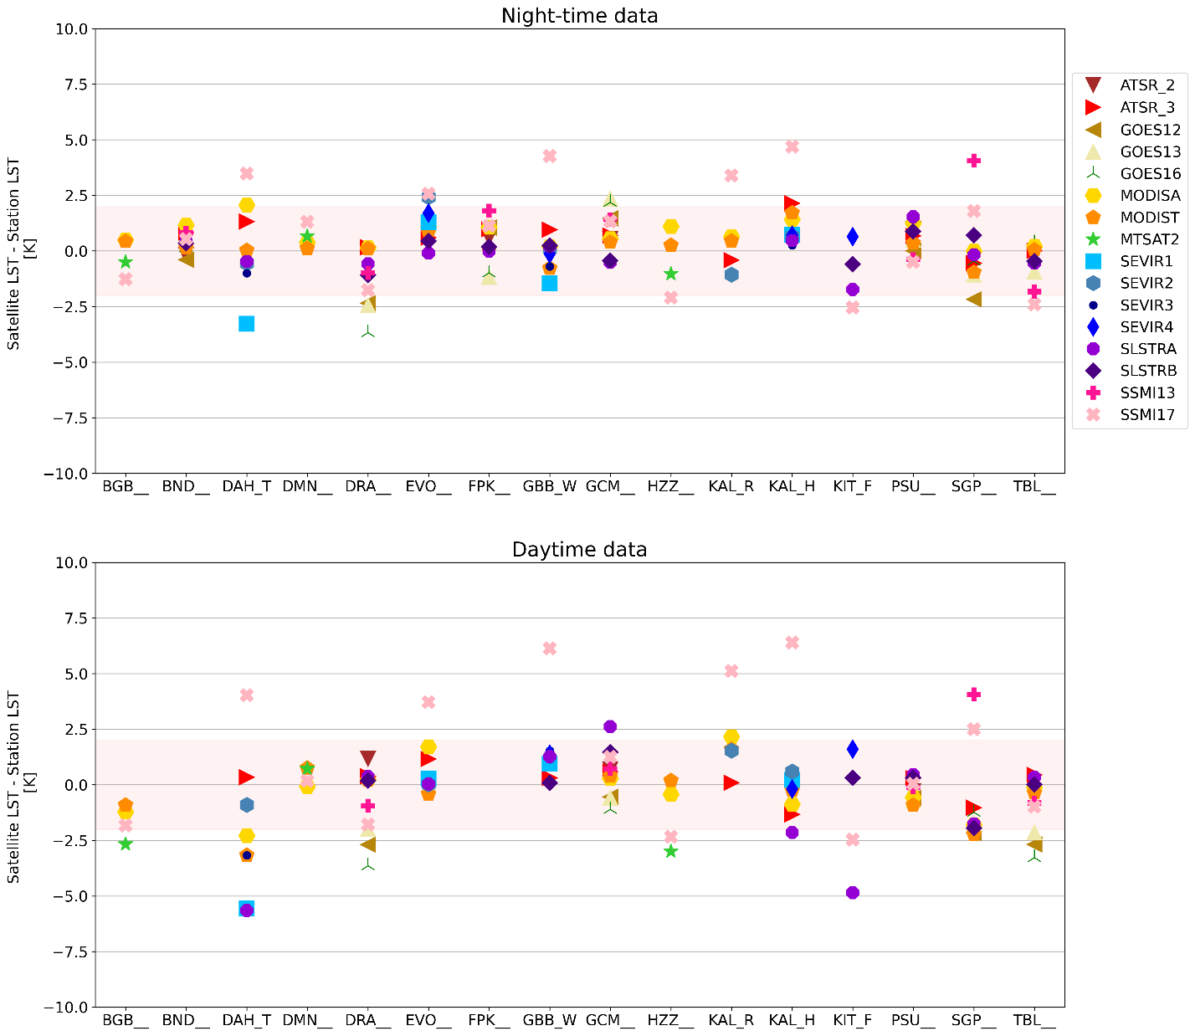
In-situ validation: Bias
Night-time biases are smaller than daytime.
MW data sets show larger biases due to their larger spatial resolution.
GEO: Most biases are within ±2.5 K for most in-situ stations.
IR: biases are within ±1.0 K at most in-situ stations.

Slide 7
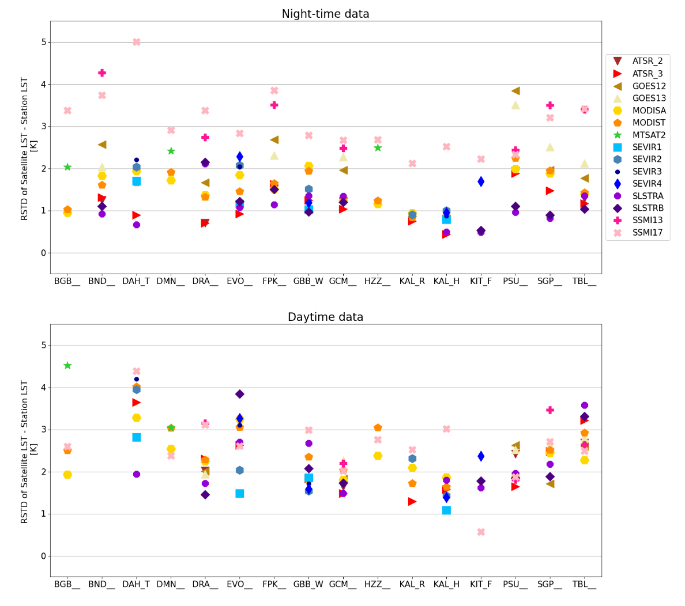
In-situ validation: RSD
Most data sets show RSDs within ±2.5 K for night-time.
Larger RSDs are observed for daytime.
Causes of large RSDs:
  Heterogeneities around in-situ stations.
  Undetected clouds.
  Overpass time close to sunrise/sunset for SSMI sensors.

Slide 8
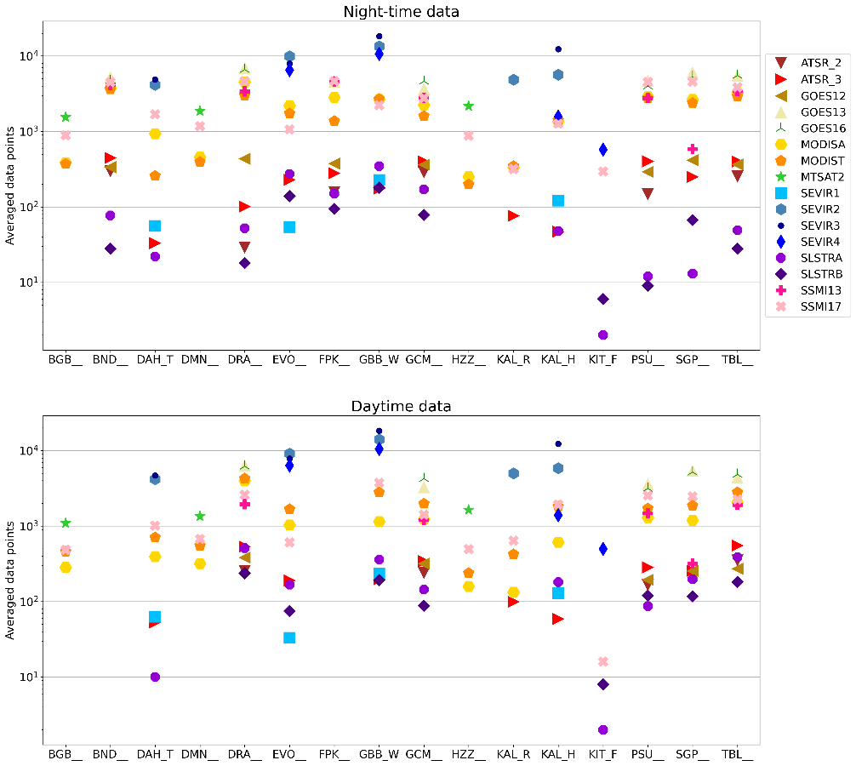
In-situ validation: Data points
MODISA/MODIST have the largest time series and, therefore, a larger number of matchups.
SLSTR sensors have the shortest time series.
GEO sensors have a huge number of matchups due to their temporal resolution.
MW sensors provide LST under cloudy conditions.

Slide 9
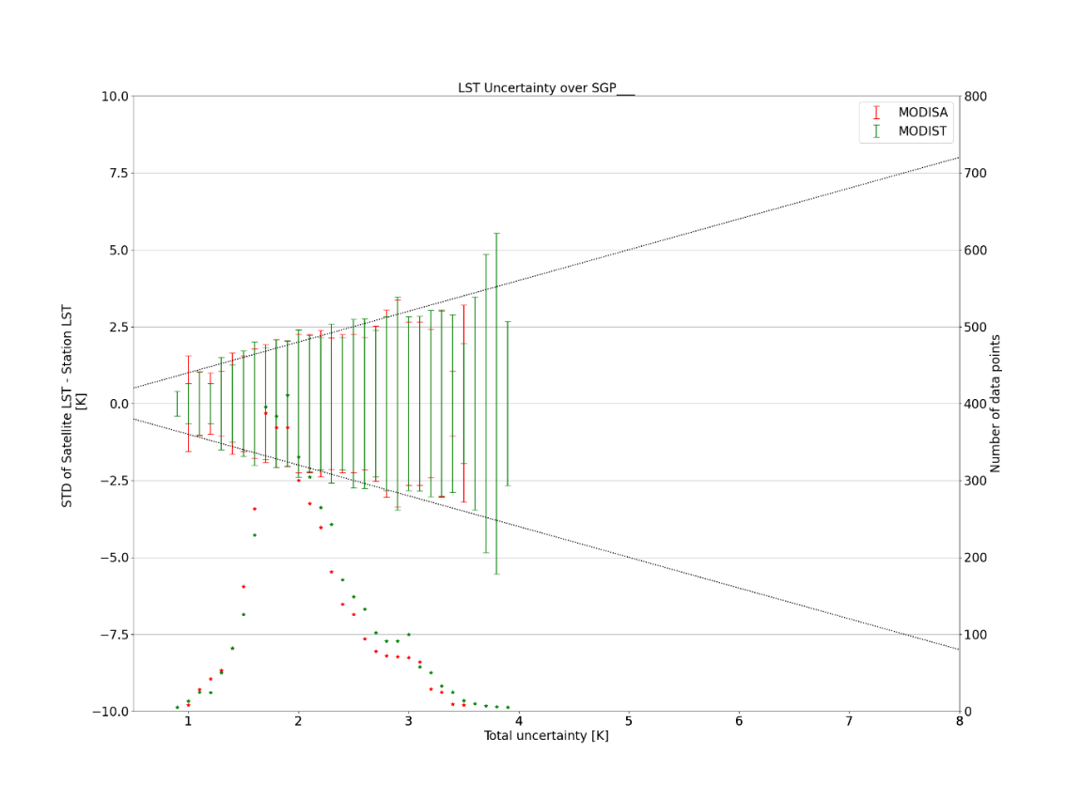

In-situ validation uncertainty
To assess the in-situ validation uncertainty, the total matchup uncertainty is compared against the RSD of satellite and in-situ differences.
The total matchup uncertainty considers:
  Satellite LST uncertainty
  In situ LST uncertainty
  Spatial mismatch uncertainty
  Temporal mismatch uncertainty
$$σ_{total}=\sqrt{σ_{sat}^{2}+σ_{ground}^{2}+σ_{space}^{2}+σ_{time}^{2}}$$

Slide 10
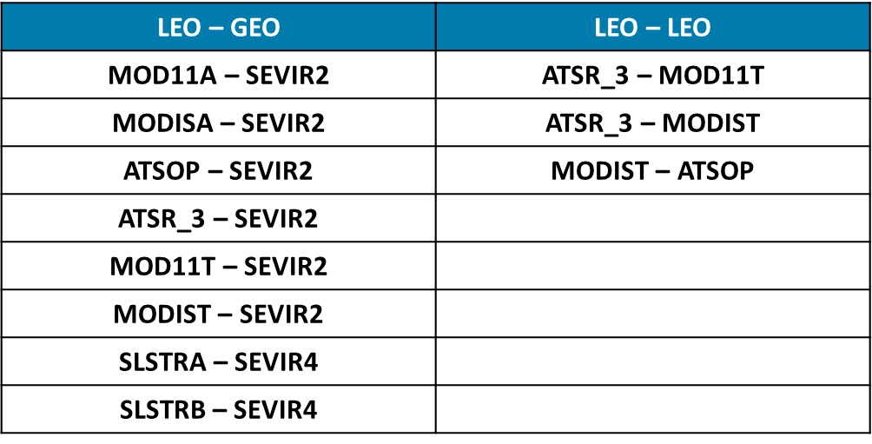
Satellite intercomparison: Satellite pairs
The intercomparison covered the periods between 2008 – 2010 and 2018-2020.
Eleven satellite pairs were intercompared:
  8 LEO – GEO pairs: Over Africa and Europe (SEVIRI disk)
  3 LEO – LEO pairs: Over all continents.

Slide 11
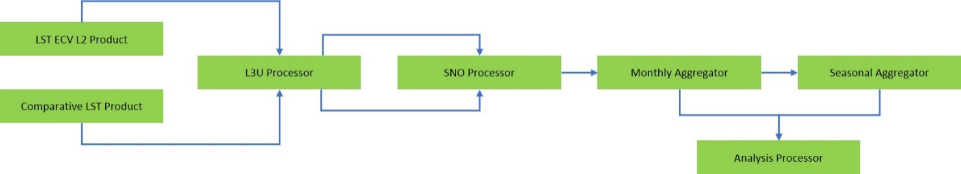
Satellite intercomparison: Approach
Conversion of original Level-2 data to harmonised L3U data
Determination of simultaneous overpasses (±5 min) of the LEO within the reference GEO disk or LEO orbit
Creation of monthly median fields in same L3U format to derive monthly statistics
Aggregation of monthly L3U data to seasonal statistics
Generate results and visualizations

Slide 12
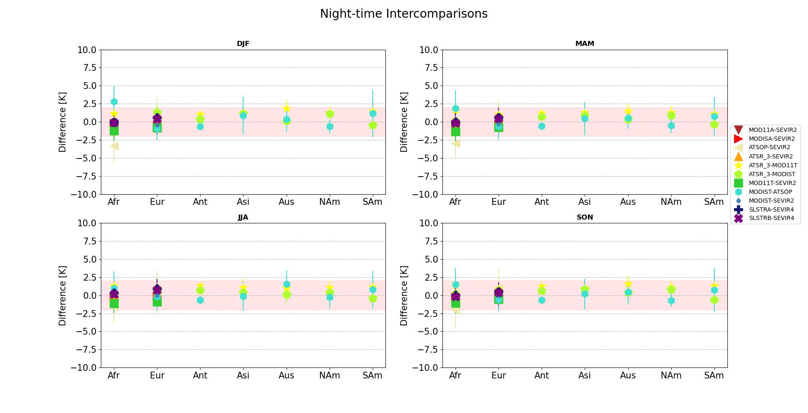
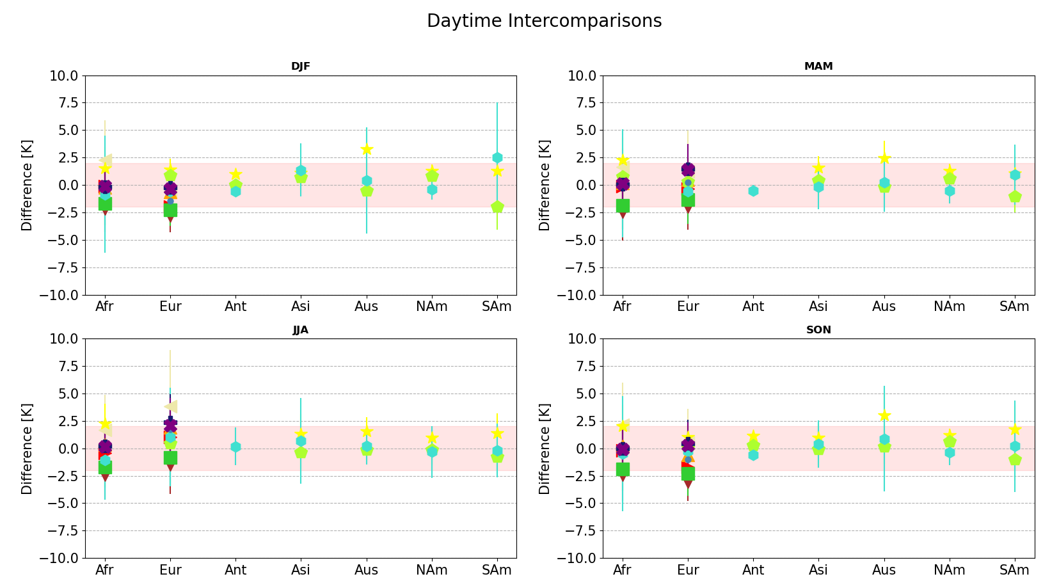
Satellite intercomparison: Bias daytime
MOD11A and MOD11T show more negative differences than the other data pairs.
ATSR_3-MOD11T show the largest differences between LEO-LEO pairs.
All LST_cci data pairs show a good agreement (bias within ±1.5 K).
RSD (error bars) are within ±2 K, except for MODIS-ATSOP.

Slide 13
Satellite intercomparison: Bias night-time
Differences between data pairs are larger in Africa than in Europe.
The largest differences are observed for ATSOP (MODIST-ATSOP and ATSOP-SEVIR2).
For most comparisons, biases and RSDs are slightly smaller than for daytime (<±1.5 and <±2.0 K respectively).

Slide 14
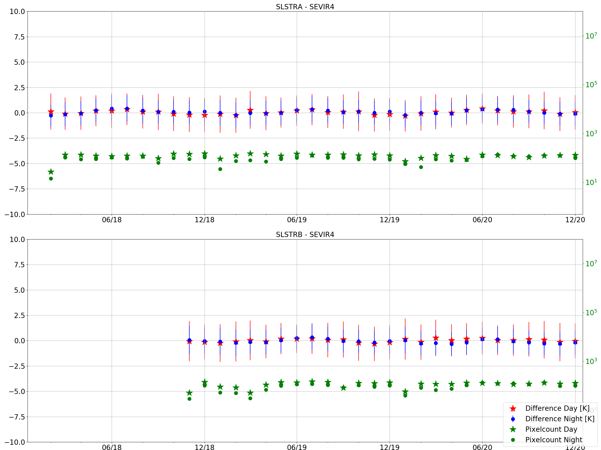
Satellite intercomparison: Time series
SLSTRA – SEVIR4 over AFRICA
The monthly bias show a very slight seasonality.
All bias for both sensors are within ±0.5 K.
RSD for both sensors are lower than ±2.0 K.
Date

Slide 15
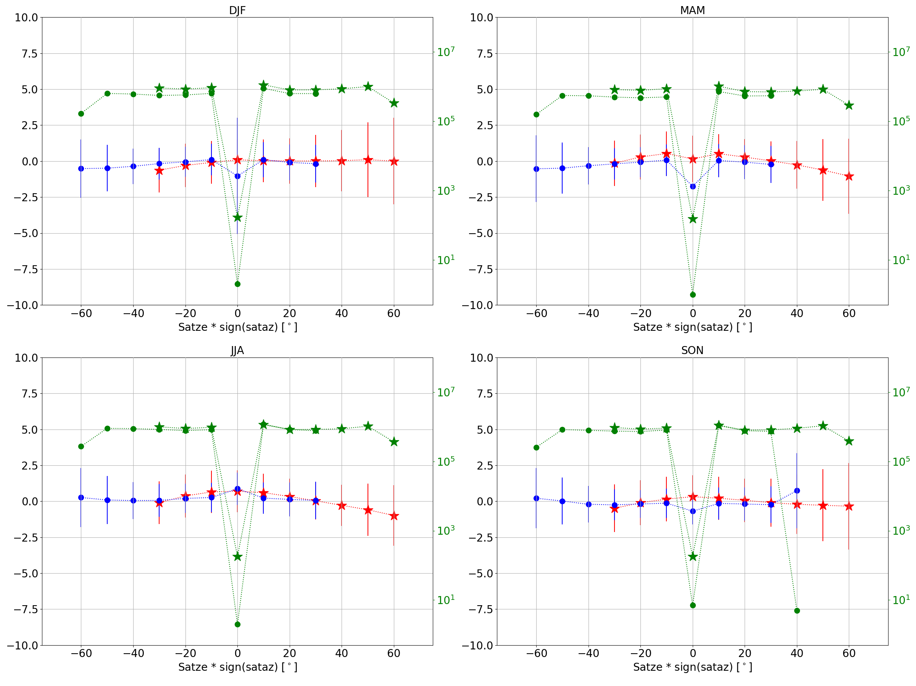
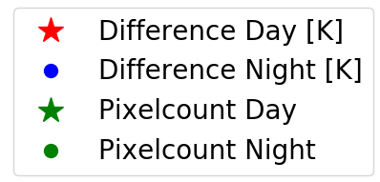
Satellite intercomparison: Angle view
SLSTRA – SEVIR4 over AFRICA
Dew data points are observed for nadir view, more stressed at night-time.
Bias for most data points is within ±1 K.
For daytime, absolute bias increase with angle in MAM and JJA seasons.
RSD increase with angle in all seasons up to ±2.5 K.
SLSTRA - SEVIR4

Slide 16
Summary
In-Situ Validation results:
  16 LST validation stations were used to validate 16 LST_cci products.
  Most LST_cci products showed a bias better than ±2.5 K over most stations.
  For IR products, with higher spatial resolution than MW and GEO, the bias was better than ±1 K for most stations.
  The RSD was within ±2.5 K for most stations, but larger RSDs were observed at some stations and products.
  The insitu validation uncertainty was also assessed showing different performance depending on the site.
Intercomparison results:
  Differences between LST_cci data set pairs were generally better than ±1.0 K.
  Larger differences were observed with Operational MODIS and AATSR LST products.

