Slide 1
GEO IR products
Sofia L. Ermida
IPMA - Instituto Portugues do mar e da atmosfera

Slide 2
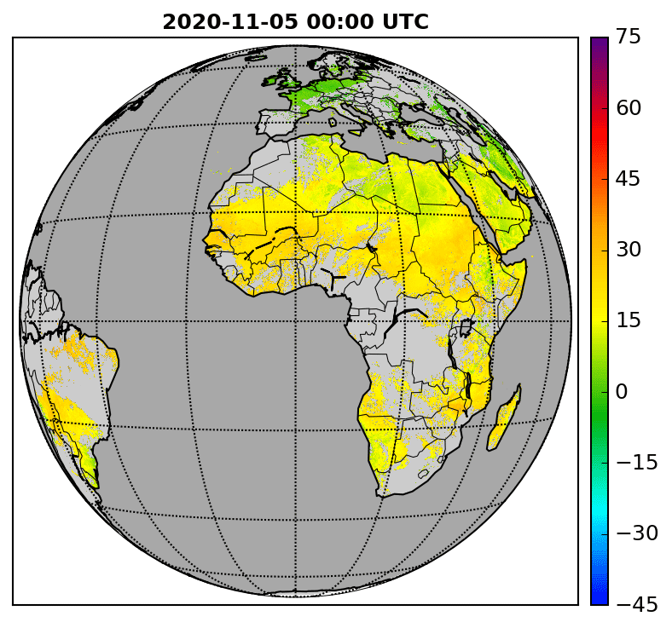
LST from geostationary satellites
Meteosat Second Generation (MSG) series
Spinning Enhanced Visible and InfraRed Imager (SEVIRI)
Spatial resolution: 0.05ºx0.05º
Temporal resolution: 1 hourly (clear-sly)
Algorithm: Generalized Split-Window (2 TIR bands)
Phase 1
Phase 2
MSG1
MSG2
MSG3
MSG4
2004
2007
2013
2018
2021
2023

Slide 3
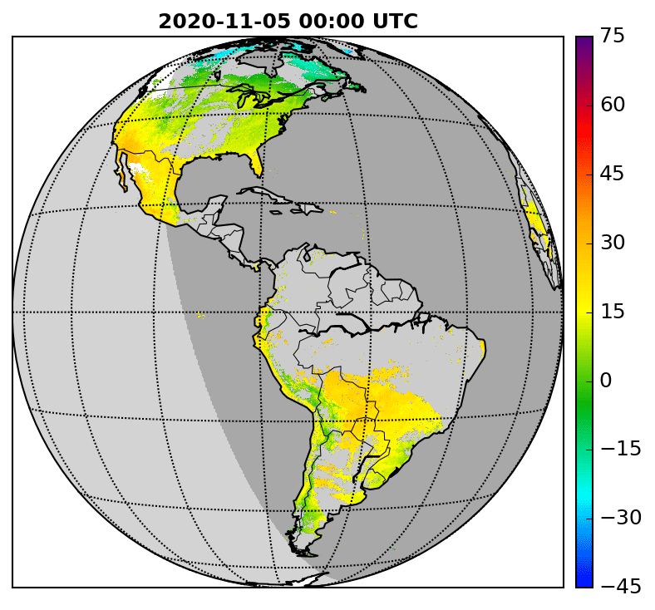
LST from geostationary satellites
Geostationary Operational Environmental Satellite (GOES) series
Imager/ Advanced Baseline Imager (ABI)
Spatial resolution: 0.05ºx0.05º
Temporal resolution:
  Imager: 3 hourly (clear-sly)
  ABI: 1 hourly (clear-sly)
Algorithm:
  Imager: Statistical Mono-Window (1 TIR band)
  ABI: Generalized Split-Window (2 TIR bands)
Phase 2
Phase 1
Phase 2
GOES12
GOES13
GOES16
2004
2009
2010
2018
2021
2023

Slide 4
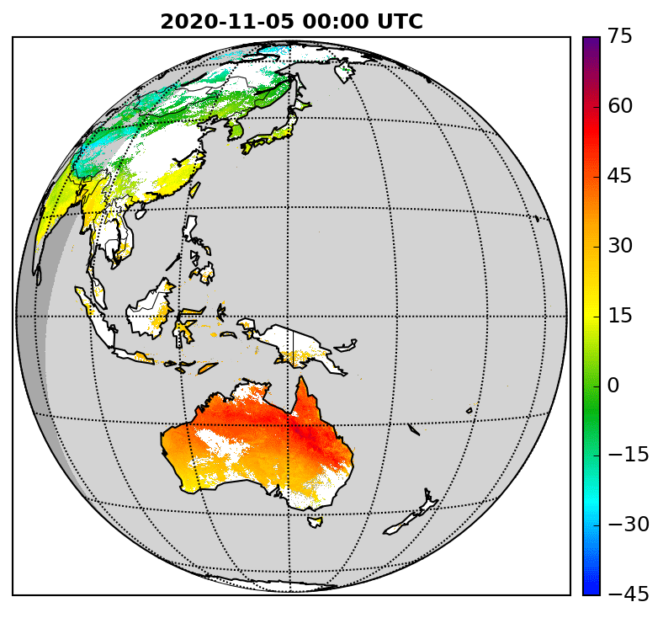
LST from geostationary satellites
Multifunctional Transport Satellites (MTSAT) / Himawari series
Japanese Advanced Meteorological Imager (JAMI) / Advanced Himawari Imager (AHI)
Spatial resolution: 0.05ºx0.05º
Temporal resolution:
  JAMI: 3 hourly (clear-sly)
  AHI: 1 hourly (clear-sly)
Algorithm:
  JAMI: Statistical Mono-Window (1 TIR band)
  AHI: Generalized Split-Window (2 TIR bands)
Phase 1
Phase 2
MTSAT1
MTSAT2
Himawari8
2004
2009
2010
2016
2023

Slide 5
LST from geostationary satellites
Auxiliary datasets:
  Combined ASTER and MODIS Emissivity for Land (CAMEL) emissivity
  Total Column Water Vapour from ERA5
  Cloud mask provided by the LSA-SAF/CGLPS
Full uncertainty propagation using CCI methodology
Algorithm coefficients obtained with the same calibration dataset
Important notes to users:
Sensors are not intercalibrated -> expected discontinuities in the series
Expected changes in accuracy from the single-channel to dual-channel algorithms

Slide 6
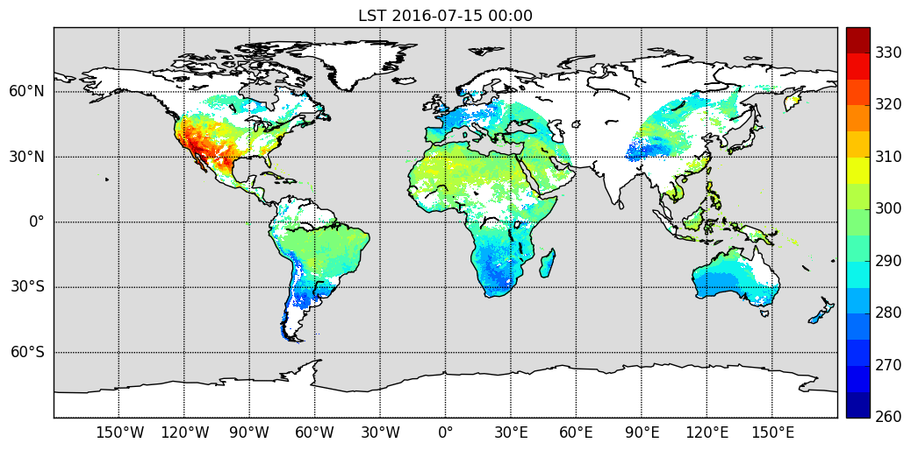
Merged GEO product
Merged Geostationary LST product
Spatial resolution: 0.05ºx0.05º
Temporal resolution: 3 hourly (clear-sly)
Phase 1
Phase 2
Without
Himawari
2009
2016
2021
2023

