Slide 1
Welcome and General Information
Lizzie Good
Met Office Hadley Centre

Slide 2
Welcome
Welcome to the second virtual LST_cci User Workshop!
The workshop is hosted by the Met Office Hadley Centre, with support from the LST_cci project team and ESA.
The organising committee:
Lizzie Good (LST_cci Climate Research Group lead, Met Office Hadley Centre)
Karen Veal (LST_cci Project Team, University of Leicester)
Mike Perry (LST_cci Project Team, University of Leicester)
Darren Ghent (LST_cci Principal Investigator, University of Leicester)
Claire Bulgin (LST_cci Project Team, University of Reading)
Simon Pinnock (LST_cci ESA Technical Officer)

Slide 3
Workshop Overview
Live sessions on ‘Zoom’ (https://zoom.us/): four 1-hour sessions between 11:30 and 17:30 CEST on 27-29 September
‘Offline’ component on Padlet (https://padlet.com/): presentations & posters, discussion threads, links to live session recordings
Live poster viewing session and social event on Gather Town (www.gather.town) on Wednesday 28 September
Live discussions on Zoom with survey questions via Slido (https://www.slido.com/) on Thursday 29 September
  User Requirements
  LST and Climate Modelling
  Climate Services and the Future of Satellite LST
Practical sessions to explore LST_cci data and tools
PLEASE NOTE ALL TIMES IN THE AGENDA ARE IN CEST

Slide 4



Live Session Etiquette
Please keep your microphone muted unless you are presenting, or invited to ask a question
Please turn your video camera off unless you are presenting.
Please only use the Zoom chat to indicate you would like to ask the presenter a question or have a technical issue. Please do not use the Zoom chat for scientific discussion – use Padlet instead.
We are recording all Zoom sessions and will put the recordings on Padlet.
Please email info.lst-cci@acri-st.fr if you do not want your presentation to be recorded.
We plan to make all presentations publicly available on the workshop webpages.
Please email info.lst-cci@acri-st.fr if you do not want your presentation to be made available on the workshop webpages.

Slide 5
Presentations and Questions
The workshop will run strictly to time.
Presenters are asked to respect their time slots.
  Four minutes before the end of the slot, the session chair will give verbal notification to wrap up to allow time for questions.
  Further verbal notifications will be issued every 1-2 minutes
  If a presenter overruns by more than 1 minute, the meeting hosts will stop their screen sharing and mute the presenter.
Please have your presentation open and ready before it is your turn to present. Then share your screen when invited by the chair
If you are unable to share your screen, one of the hosts will share your presentation from Padlet for you; you will need to ask them to move the slides on.

Slide 6
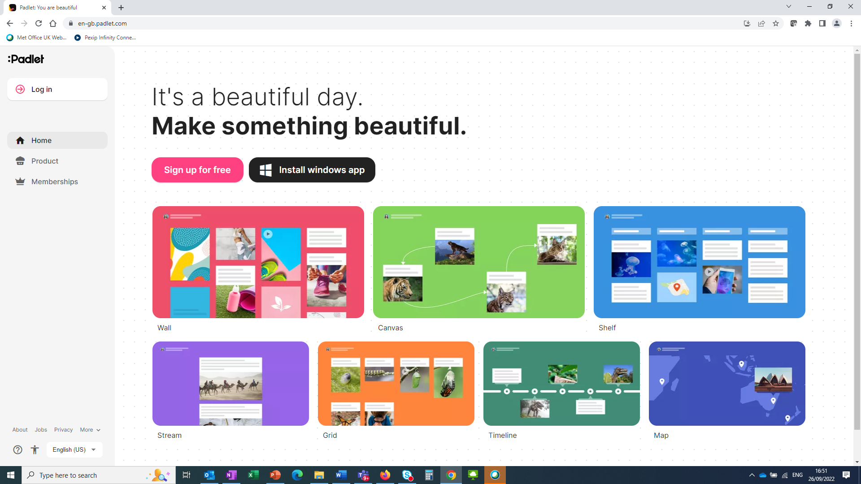
Padlet Overview
Presentations (poster and oral) should now be available on Padlet.
Please use Padlet to make comments and ask questions (if not asked during the live session).
We recommend creating a Padlet account – very quick and easy - otherwise your comments/questions will be anonymous.
www.padlet.com
Sign up for free

Slide 7
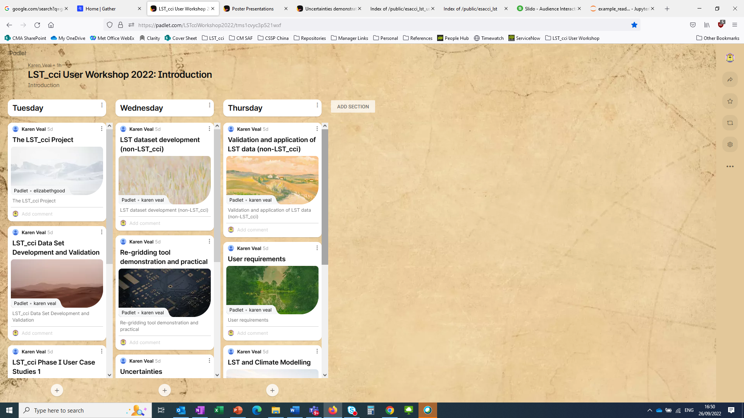
Padlet ‘Landing Page’
https://padlet.com/LSTcciWorkshop2022/tms1cvyc3p521wxf (link in workshop booklet)
Use the scroll bar to see the other sessions on each day
Click here to navigate to individual session page

Slide 8
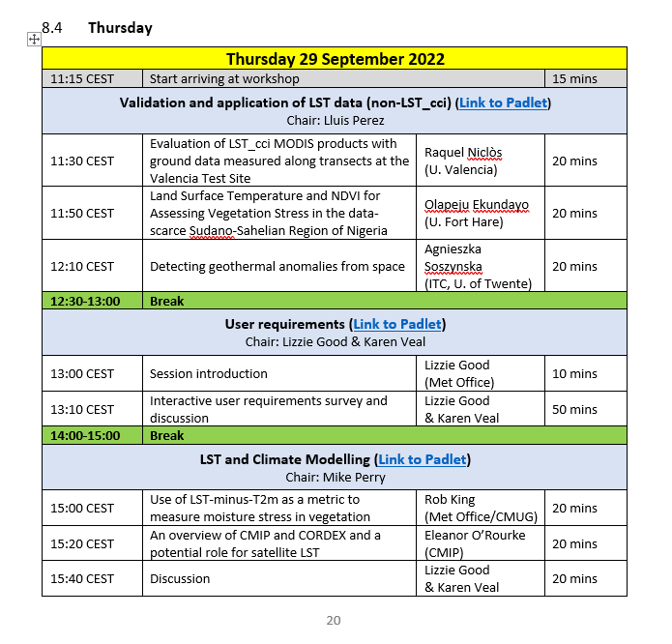
More on Padlet Navigation
Links to all the Padlets are also in the workshop agenda (in the Workshop Information Booklet)
Instructions for Padlet are in the Workshop Information Booklet
Link to Padlet for this session

Slide 9
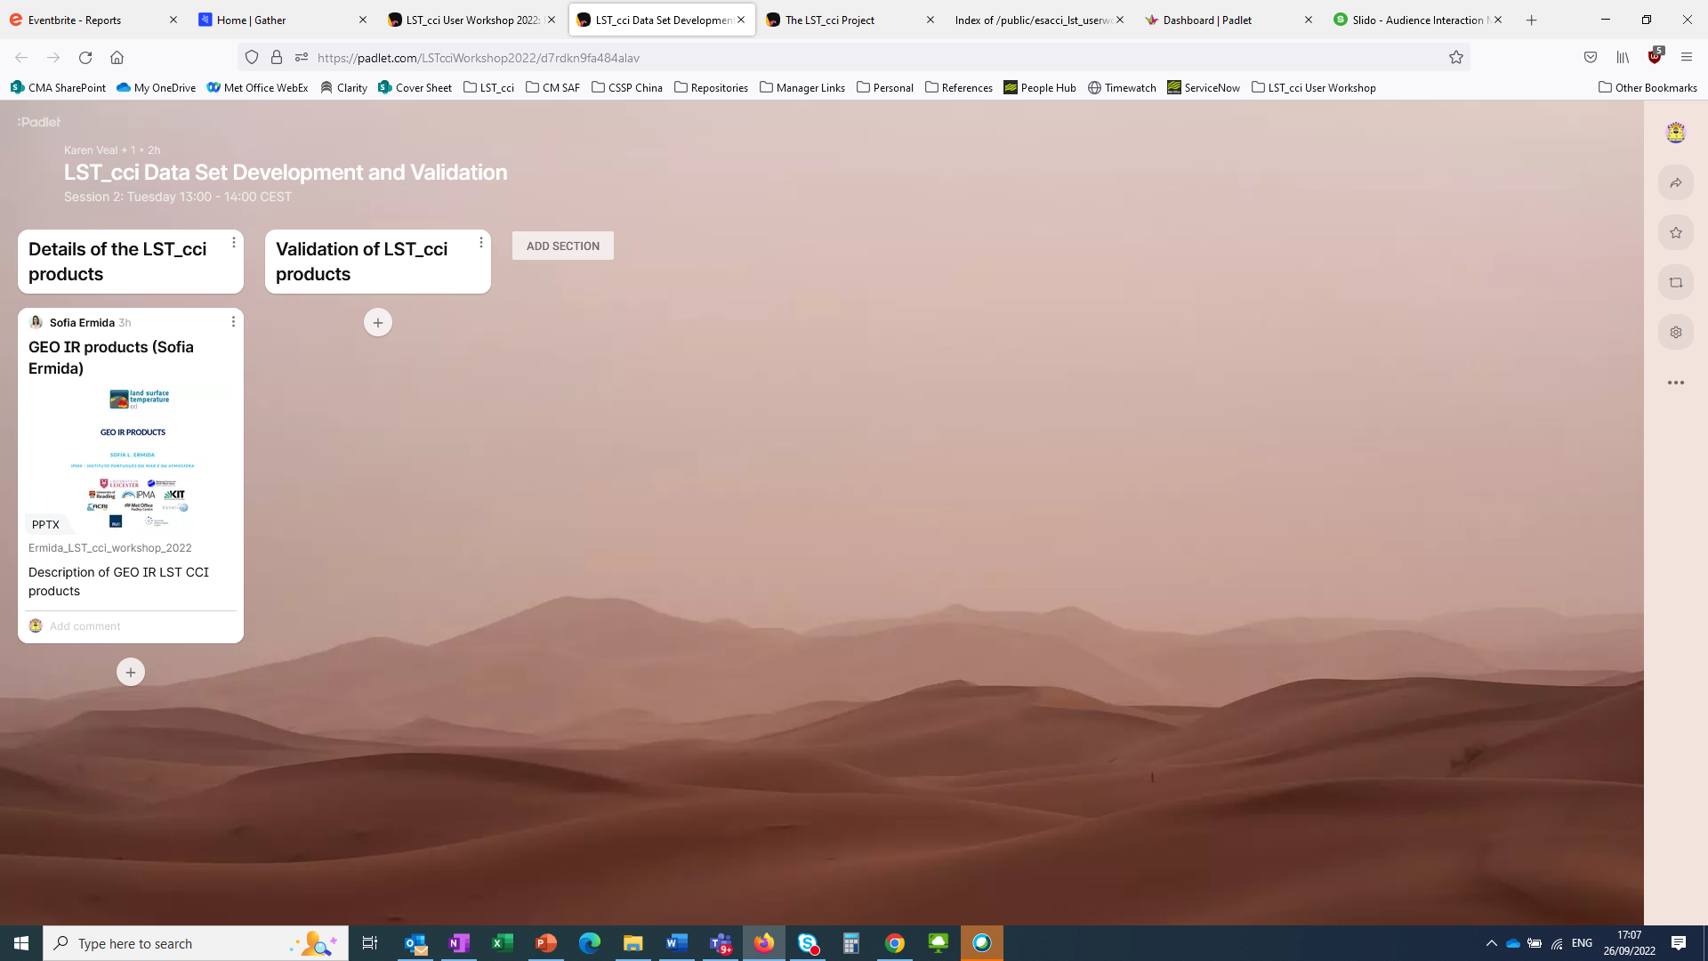
Padlet: Adding Comments & Viewing Presentations
Click here to view the presentation
Click here to add a comment.

Slide 10
Poster Viewing Session & Social Event (1)
We will be holding a poster session and social event on Wednesday 28 September from 16:30 CEST
Detailed information will be provided at the event but in brief:
We would like to invite poster presenters to give a ‘lightening talks’ of 1-2 minutes on their poster.
  Presenters can either just display the poster in plenary or present 1-2 slides on key messages from poster.
Wednesday 28 September 2022
Poster presentations (Link to Padlet) Chair: Karen Veal
16:30 CEST | Instructions for poster session | Lizzie Good | 5 mins
16:35 CEST | Lightening round of poster presentations | Poster presenters, 1-2 minutes per poster | 20 mins
16:55 CEST | Poster viewing on Gather Town |  | 60 mins
 | Social event & bring your own drink!
19:00 | End of day 2

Slide 11
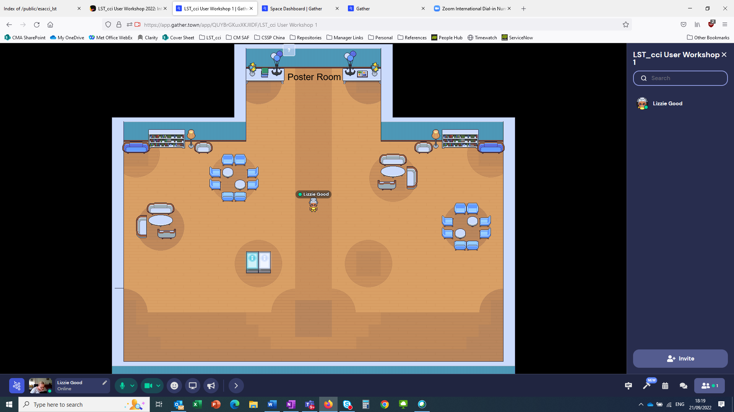
Poster Viewing Session & Social Event (2)
We are using Gather Town for poster viewing and social event

Slide 12
Discussions During the Workshop
Questions & Answers after talks
  Sessions will be recorded for people to view later
‘Offline’ discussions on Padlet, one thread per presentation
  Available throughout and after the workshop (limited time only)
Delegates are free to use Gather Town during the schedule breaks during the workshop – just join via the links in the workshop information booklet
Poster viewing & social event in Gather Town on Wednesday
Dedicated discussion sessions in plenary
  We will also be using Slido to ask for your input and feedback!

Slide 13
Practical Sessions
Feedback from our user surveys and the 2020 workshop:
Users would like more tools and ‘hands on experience’
In response we are running two demonstrations and practical sessions during this workshop
  Regridding tool & exploring LST_cci data sets
  Uncertainties in LST_cci products and why they are important
Both 1-hour sessions (on Wednesday) will include
  Presentation/demonstration by the LST_cci project team
  Break-out sessions for you to explore some tools we have developed
    Regridding tool: To regrid LST_cci datasets onto a user-defined lat/long grid
    Python code: To plot LST_cci data, explore file contents, explore the LST_cci data and their uncertainties, plot maps and transects….
No Python experience necessary and you do not have to install Python! Further information to follow in the sessions…

Slide 14
Finally…
Please use your full name when you join the Zoom meeting.
If you want to change the your name on Zoom, click on the ‘Participants’ button:
Then right-click on your name and select ‘rename’.
Enjoy the workshop!

Slide 15
Questions?

