Slide 1
IS OZONE GOOD OR BAD?
Primary
8–11
The discovery of the Antarctic ozone hole
Notes:
This slide deck supports the education resource pack teacher guide and student worksheets of the same name.
It includes:
Learning objectives for each activity. The objectives have been rewritten in language more appropriate for students and are separated into knowledge (‘What we will learn’) and skills (What we will do’).
An extended key words list for each activity.
Where the teacher guide lists images, animations or videos to support the material on Information sheet 1, these have been included here. Animations and videos are linked to (playing in slide where possible) in order to keep file size reasonable.
Abbreviated versions of key questions and tables from worksheets.
Answers for questions with definite answers (i.e. no answers to discussion questions or questions about practical results).
Abbreviated instructions or/and images showing how to set up some practical activities.
Visual instructions for accessing the appropriate screen(s) of Climate from Space for the final activity, together with a screenshot of the key screen required.
Notes beneath each slide give:
credit for images (along with caption, where relevant)
a description of any animation on the slide
url for any links or embedded material.
Some also provide additional information.

Slide 2
Activity 1: Why does ozone matter?
What we will learn
How a gas called ozone affects life on Earth.
How the effects of ozone change depending on where it is.
How we measure ozone in the atmosphere.
Key words
ozone
atmosphere
air pollution
ultraviolet (UV) radiation
satellite
Dobson units

Slide 3
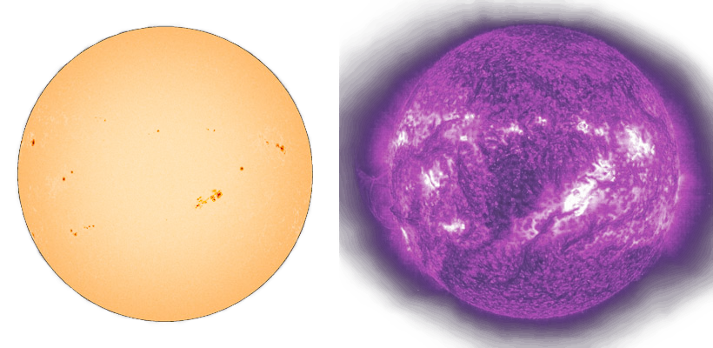
Looking at the Sun in visible and UV light
Antarctic ozone 1979–2019
Notes:
The Sun in visible (left) and ultraviolet light (right), as viewed by the SOHO satellite on February 3, 2002 (ESA/NASA)
The button is a link to https://cfs.climate.esa.int/index.html#/present/story-8/2?globe=SI-16.19I-71.56I22978874.22I360.00I-89.86I0.00I1193961600000.00I0.00Iozone.total_ozone_columnI which will open in your default browser.
This page of the Climate from Space web application story Is ozone good or bad? shows ozone concentration above the Antarctic continent month by month from 1979 to 2019.
You can use the arrow to make the animation run automatically (but slowly), or drag the slider along the bar.

Slide 4
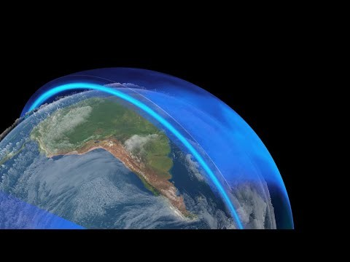
Measuring ozone around the Earth
Notes:
The image on the screen is an embedded link to https://youtu.be/ovDhWNB6-0A
The ESA video on the distribution of ozone will open in the presentation window.
0:18 to 0:33 shows how a satellite collects information for the whole Earth over several days and why there may be a data gap at the poles.
0:33 to 1:20 shows how ozone moves around the planet.
The video has no sound.

Slide 5
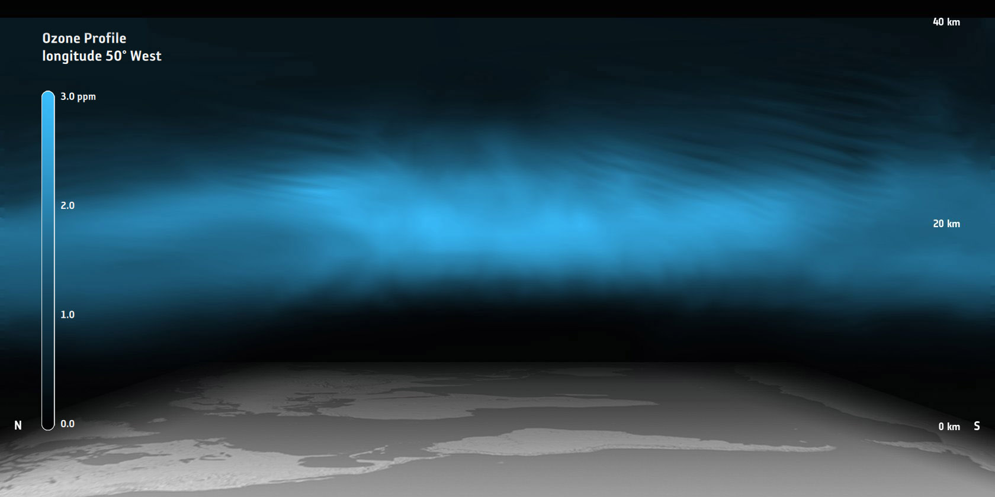
Ozone at different heights in the atmosphere
Notes:
Ozone profile showing a section through the atmosphere from sea level up to a height of 40km, centred on longitude 50°West, with the north pole on the left and the south pole on the right. (Satellite observations assimilated into the chemical transport model TM5.) (Planetary Visions/ESA-CCI)
50°West goes through the North Atlantic, crosses Brazil and then returns to the South Atlantic, Southern ocean and Antarctica.

Slide 6
Is ozone good or bad?
 | Ozone high in the atmosphere | Ozone at the Earth’s surface
How they are different | Created naturally Protects us from UV radiation | Created by pollution Causes lung problems
How they are the same | Same gas Can be measured by satellites
 | Ozone high in the atmosphere | Ozone at the Earth’s surface
How they are different | Created naturally Protects us from UV radiation Good | Created by pollution Causes lung problems Bad
How they are the same | Same gas Can be measured by satellites
 | Ozone high in the atmosphere | Ozone at the Earth’s surface
How they are different
How they are the same
Notes:
Slide shows empty table to start with; all answers (dark text) appear together on click.
‘Good’ and ‘Bad’ appear together on second click.

Slide 7
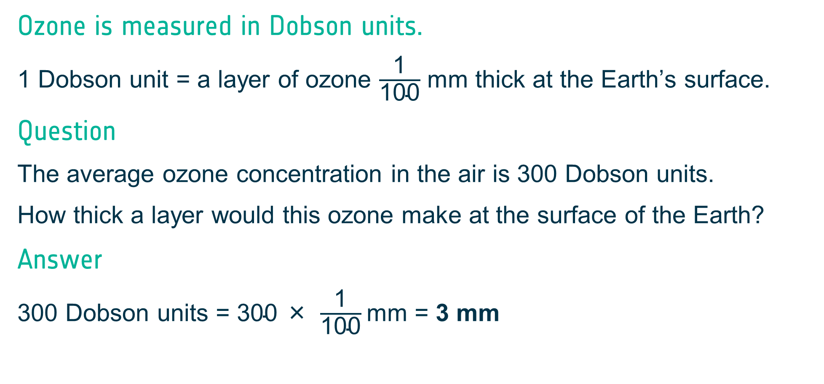
Measuring ozone
Ozone is measured in Dobson units.
1 Dobson unit = a layer of ozone $\frac{\text{1}}{\text{100}}$ mm thick at the Earth’s surface.
Question
The average ozone concentration in the air is 300 Dobson units.
How thick a layer would this ozone make at the surface of the Earth?
Answer
300 Dobson units = $\text{300 }\text{×} \frac{\text{1}}{\text{100}}$mm = 3 mm

Slide 8
Activity 2: How good is my sunscreen?
What we will learn
What scientists mean when they use the word ‘model’.
What we will do
Use a model to investigate how well sunscreen protects us.
Discuss how well our model and investigation represent real life.
Key words
sunscreen
model
ultraviolet (UV) light
SPF
evaluate / evaluation

Slide 9
How do the beads work?
What happens to the beads?
How long does it take for them to get a strong colour?
Making a colour scale
no UV light |  |  |  |  |  |  |  |  | lots of UV light
0 | 1 | 2 | 3 |  | 4 | 5 | 6 | 7 |  | 8 | 9 | 10
Notes:
First question is unfinished to allow you to instruct children to take beads outside / put them in the sun / shine a blacklight torch on them (or watch while you do it).
Second question appears on click; scale heading and example on further click.

Slide 10
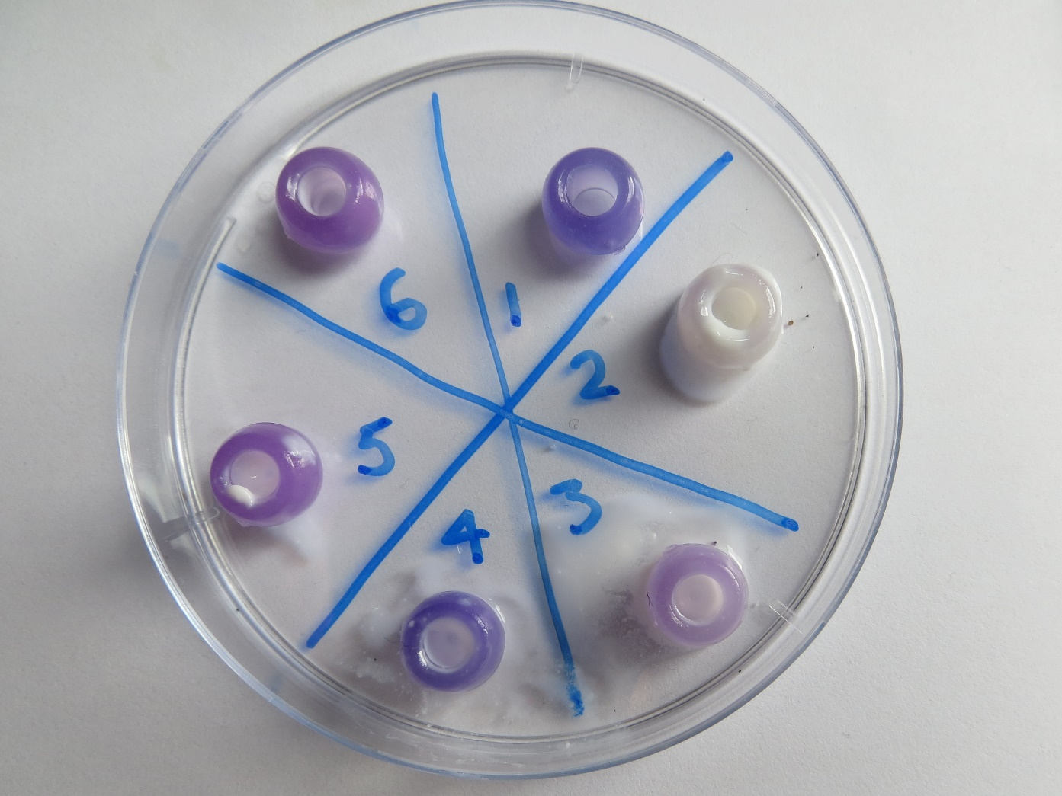
Setting up the investigation
Bead | What to do with it
1 | Nothing (this is the control)
2 | Cover it in sunscreen
3 | Cover it in sunscreen, dip it in the water for 1 second
4 | Cover it in sunscreen, dip it in the water for 5 seconds
5 | Cover it in sunscreen, swoosh it about in the water for 5 seconds
6 | ?
Notes:
Use either this slide or the next.
This is method 1; next slide shows method 2.
Picture: Catherine Fitzsimons/ESA CCI

Slide 11
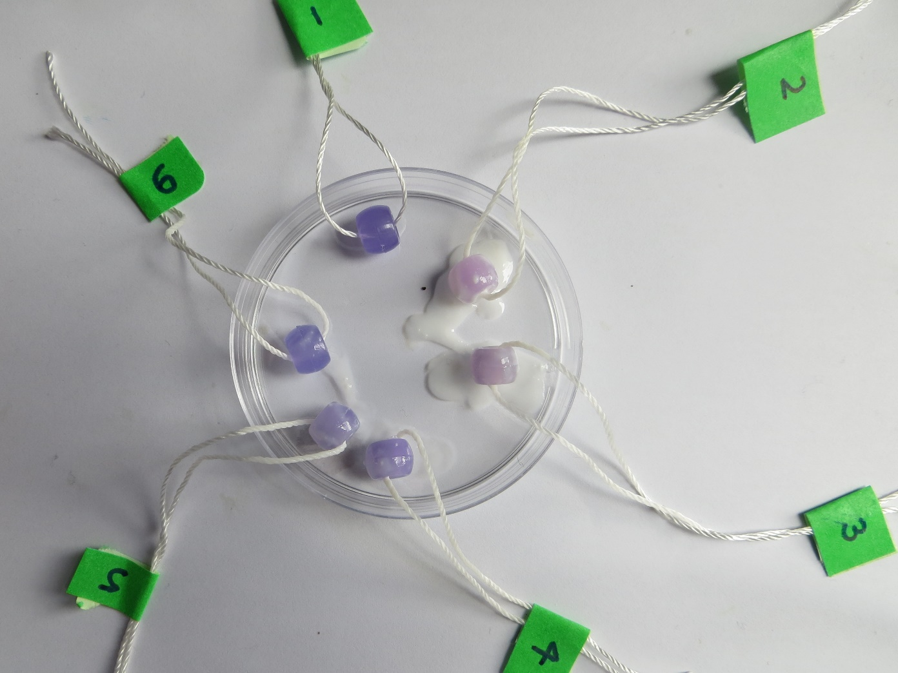
Setting up the investigation
Bead | What to do with it
1 | Nothing (this is the control)
2 | Cover it in sunscreen
3 | Cover it in sunscreen, dip it in the water for 1 second
4 | Cover it in sunscreen, dip it in the water for 5 seconds
5 | Cover it in sunscreen, swoosh it about in the water for 5 seconds
6 | ?
Notes:
Picture: Catherine Fitzsimons/ESA CCI

Slide 12
In the model → In real life
Bead | What to do with it |  | This bead is like …
1 | Nothing (this is the control) |  | me when I’ve been sitting outside for a little while (the sunscreen has worn off a bit)
2 | Cover it in sunscreen |  | me without sunscreen
3 | Cover it in sunscreen, dip it in the water for 1 second |  | me after a swim
4 | Cover it in sunscreen, dip it in the water for 5 seconds |  | me when I’ve been running around in the sun (getting quite sweaty!)
5 | Cover it in sunscreen, swoosh it about in the water for 5 seconds |  | me with sunscreen on
Notes:
Arrows appear one at a time on clicks. The one from bead 3 (which is drawn in on the worksheet) appears first, and others in numerical order.

Slide 13
Comparing results
SPF | Colour-scale number
Why is it important we look at results from the same number bead?
Which bead do you think we should compare?
Why?
We are comparing results for bead number _________
Notes:
Each line appears on a click.

Slide 14
What does the investigation tell us?
The best sunscreen
Which sunscreen was the best at blocking UV light?
How do you know?
Is there anything else that might be important for a good sunscreen?
Evaluating our work
How good are our results?
Why do you think this?
How could we make the investigation better?
How could we make the model better?
Notes:
Each line appears on a click.

Slide 15
Activity 3: The ozone hole
What we will learn
How the amount of ozone in the atmosphere above Antarctica has changed over time.
What we will do
Use different resources to research questions about ozone in the atmosphere.
Make a summary of our research to share with others.
Key words
concentration
Antarctica
CFCs
Dobson units
Montreal Protocol
satellites
Notes:
For ESA video Monitoring ozone, see Slide 4.

Slide 16
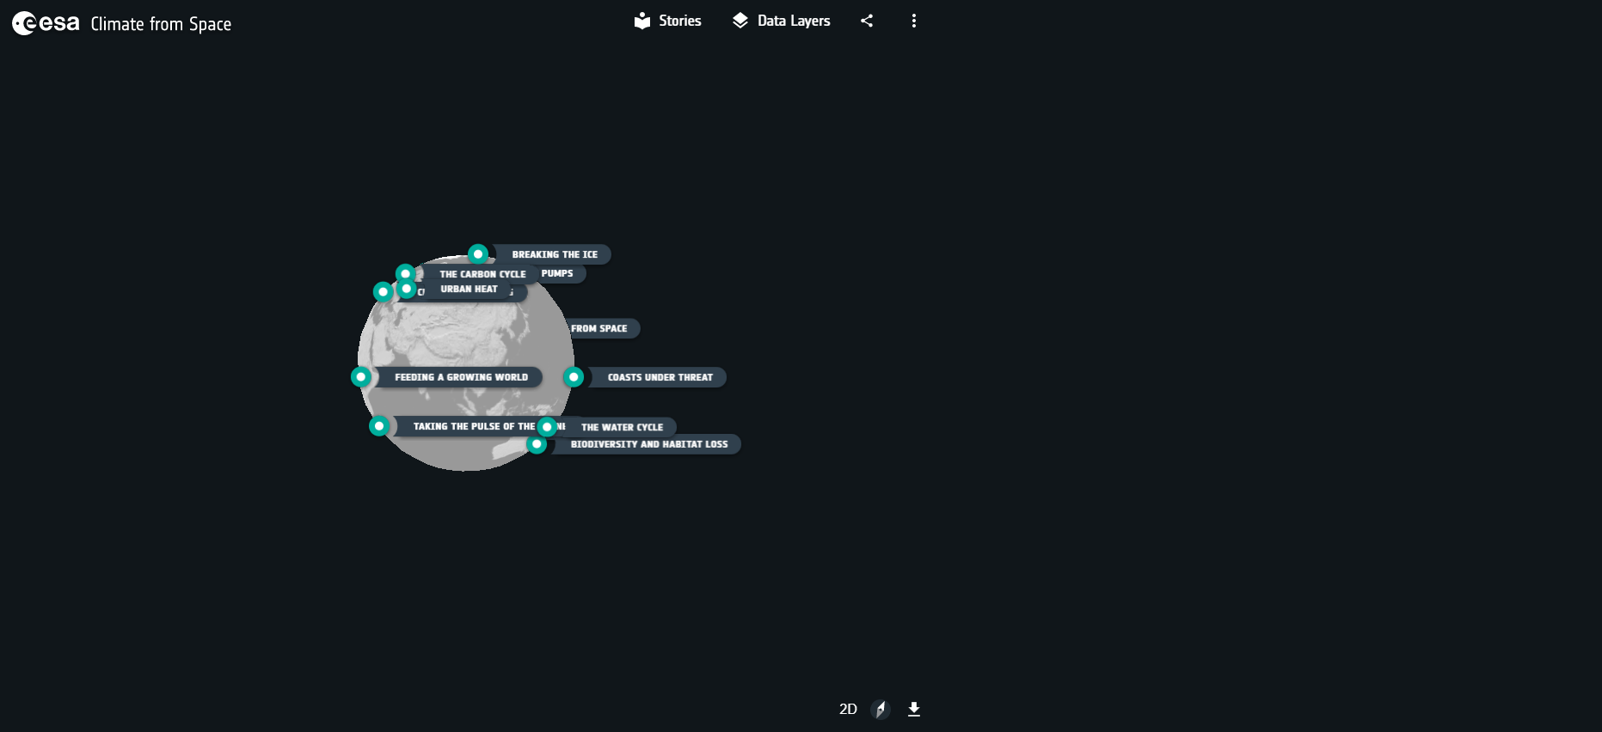

Using Climate from Space
2
1
cfs.climate.esa.int
3
Notes:
Button 1 will open Climate from Space in a browser window if you prefer to demonstrate.
Image of globe and button/arrow 2 appear on first click.
Inset appears on second click.

Slide 17
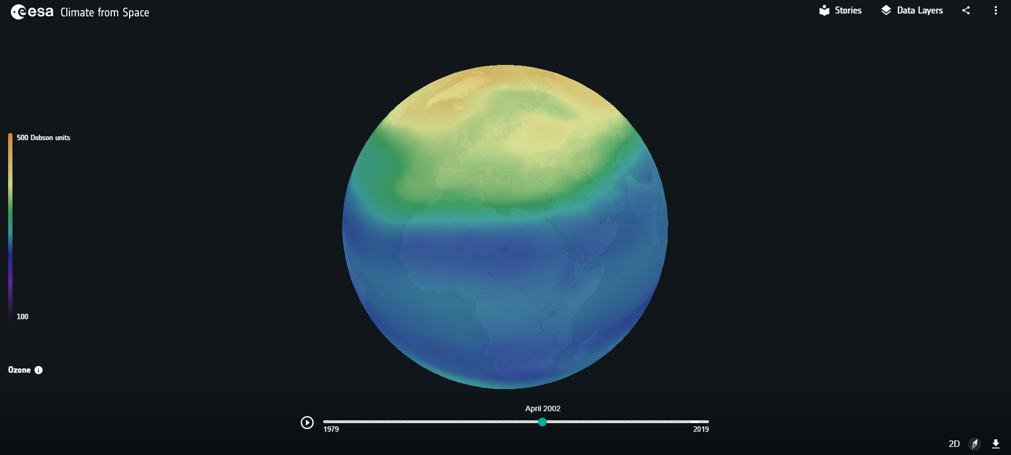
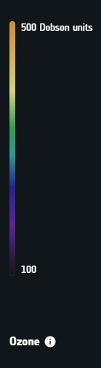
Ozone in Climate from Space

Slide 18
Ozone levels around the world
High ozone
Date
Place
Estimated total ozone
/ Dobson units
Low ozone
Date
Place
Estimated total ozone
/ Dobson units

Slide 19
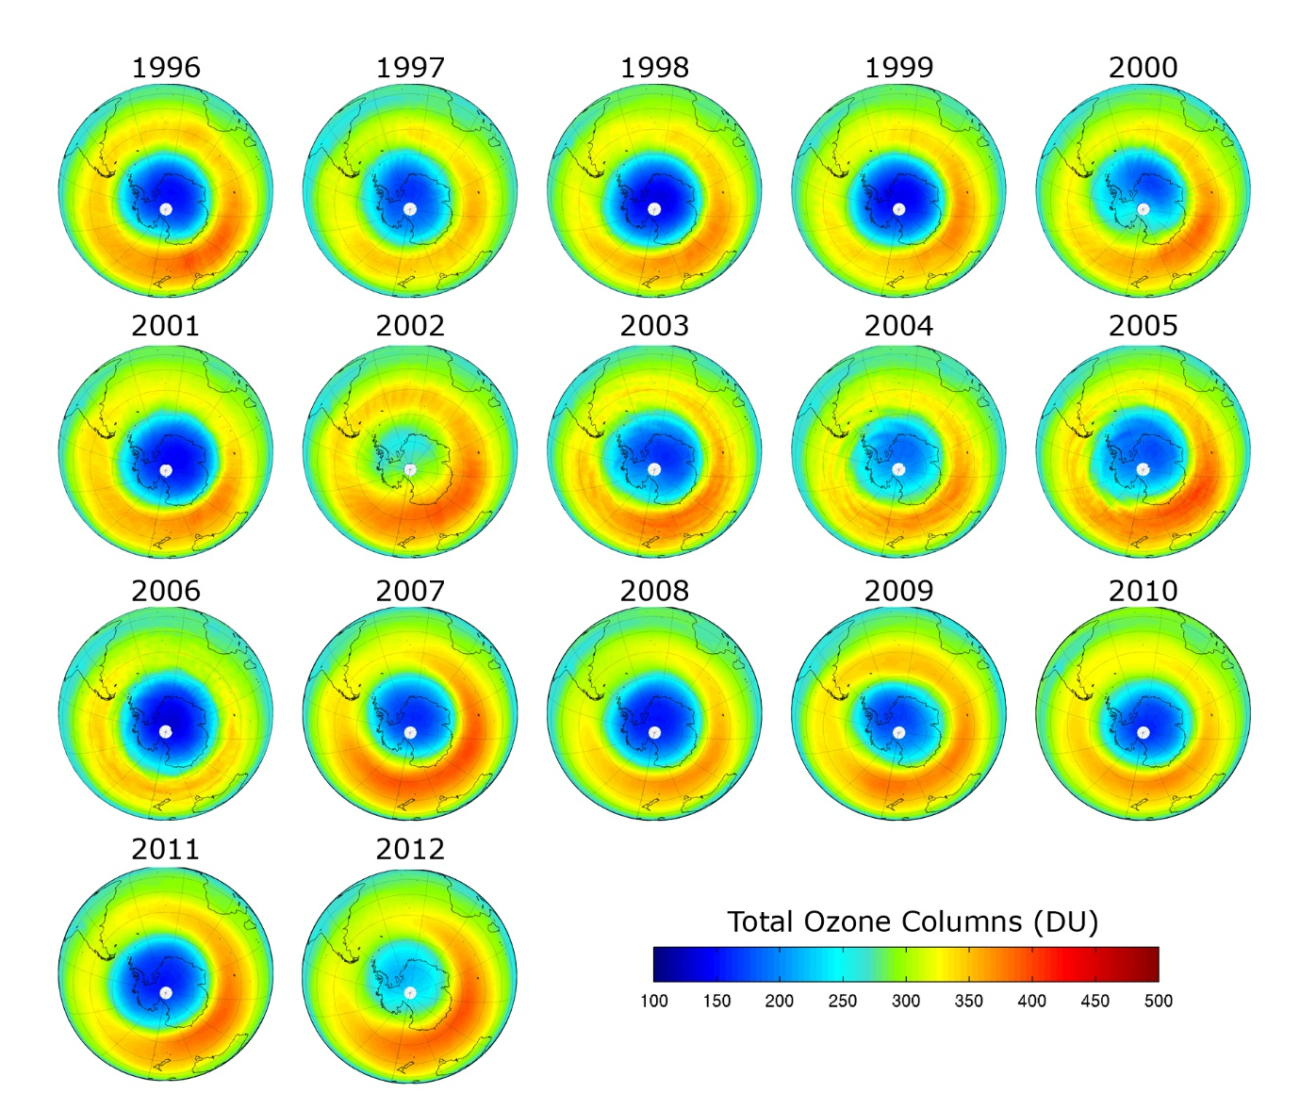
Antarctic ozone
When was the Antarctic ozone hole the largest?
When did it begin to recover?
Notes:
Picture: https://www.esa.int/ESA_Multimedia/Images/2013/02/South_Pole_ozone#.YjH-CbzXqZM.link © BIRA/IASB

Slide 20
Find out more
Use the Internet to do some research into ozone in the atmosphere.
You could investigate one or more of these questions:
Is there an ozone hole over the North Pole?
What are CFCs?
What is the Montreal Protocol?
Which ESA satellites carry instruments that can measure ozone?
Be prepared to present your findings to others in the class.

Slide 21
IS OZONE GOOD OR BAD?

