Slide 1



Satellite observations of climate relations
between LST, drought and biomass burning
Julia Stoyanova (julia.stoyanova@meteo.bg),
Christo Georgiev, Plamen Neytchev, Andrey Kulishev
National Institute of Meteorology and Hydrology (NIMH), Bulgaria
LST CCI User Workshop 2020
UK Met Office, Exeter, 24-26 June 2020
Notes:
1

Slide 2
Outline
  1. Land surface temperature (LST) as a key parameter in land-atmosphere interaction
2. Objective and scientific approach
3. Dataset
4. Results from application of satellite LST /climatic aspect/
4.1. Terrestrial drought assessment
4.2. Link between drought and biomass burning activity
4.3. Temporal variability of LST versus biomass burning
4.4. Statistical modeling: relation between satellite retrievals of LST and biomass burning
  Correlation analyses
  Generalized linear statistical model
5. Concluding remarks
Notes:
2

Slide 3
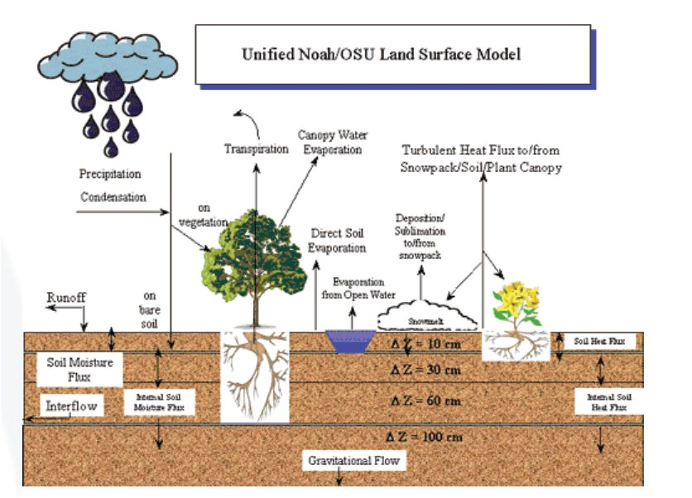
  1. Land surface temperature as a key parameter in land-atmosphere interaction process
Land Surface Temperature (LST) is one of the key variables in the physics of land-surface processes on regional/global scales; As a functional parameter in main biogeophysical processes of energy-water-carbon balances it combines the effects of all surface-atmosphere interactions.
Knowledge of LST behavior on regional and global scales is of importance for model simulations of exchange process and land surface state. This concerns Global Circulation Models, for estimation and parametrization of surface fluxes (e.g. Brutsaert et al, 1993), to monitor drought and estimate soil moisture (e.g. Feldhake et al., 1996), and water budget components (Park et al., 2005), natural hazards like wild fires (e.g. Stoyanova and Georgiev, 2010), and many others.
LST derived by satellite data can be used to adequately respond to the demands of environmental monitoring, drought risk assessment, fire activity management.

Slide 4
2. Objectives
To explore the utility of skin temperature retrievals from infrared observations by the Meteosat geostationary satellite as an indicator (in a climatic context ) for soil moisture dry anomalies and related biomass burning effects.
Specific objectives:
  To propose relevant approaches for LST application as a biogeophysical land surface state indicator.
  To identify the drought prone regions over the target region.
  To link drought and fire activity using satellite information.
  To evaluate spatial-temporal variability of biomass burning and LST distribution.
  To illustrate how satellite LST can contribute to estimate the energy released from biomass burning.

Slide 5
2. Scientific approach
Considering drought indicators linked to the coupling between the energy and water cycles:
  Soil Moisture Availability (SMA) to vegetation land cover quantified by modeling of soil moisture. As a reference SMA calculated in the nearest SYNOP station is used.
  Skin temperature retrieval based on IR satellite information from Meteosat Second Generation, LSASAF LST product.
  Temperature difference between IR skin temperature retrieval and air temperature, (LSASAF LST-T2m).
  Meteosat observations of fire activity and biomass burning effects.
  Numerical comparative analyses of satellite information from Meteosat and drought/fire activity indicators. The consistency in the behavior is evaluated by a stochastic graphical analysis and statistical model has been developed.
4) Comparison is performed over a grid of ECMWF global model for monthly mean LST vs. total number of fires and accumulated FRE according to LSASAF FRPPIXEL product.

Slide 6
3. Dataset
Dataset: Long-term records
LSASAF LST, June-September (2007-2018)
  0900 UTC (12:00 a.m. LT) time slots (±30 min to avoid the limitations of cloudy pixels)
  only values in the 1400 grid points of the ECMWF global NWP model IFS version that cover the region of Bulgaria are used.
Air temperature observations (SYNOP network at 09:00 UTC, 12:00 a.m. LT), T2m
  Soil Moisture Availability Index (SMAI), produced operationally at NIMH since 2010
    Derived as post-processing from surface analysis scheme SVAT_bg of NIMH.
  Inputs from meteorological measurements at 36 synoptic stations of the NIMH operational network.
  SMAI is calculated at 20 cm, 50 cm, 100 cm, and the mean between 05-100 cm soil layers and
  used as a reference to identify dry anomalies.
LSASAF FRPPIXEL product, June-September (2004-2019), Wooster et al., 2015
  The location, timing and fire radiative power (FRP, in MWatts) output of landscape fires ("wildfires") detected every 15 minutes.
  Measuring FRP and integrating it over the lifetime of a fire provides an estimate of the total Fire Radiative Energy (FRE) released, which for landscape fires should be proportional to the total amount of biomass burned.
Satellite
LST_{3x3}
Atmosphere
Parameters
Cloudiness, Atm Pressure,
Abs Humidity
Surface
Properties
LSA SAF FVC, Soil Moisture at 05 cm (SVAT), Drought Index,
‘di’ 20,50,100 cm soil depth
Physical Predictors

Slide 7
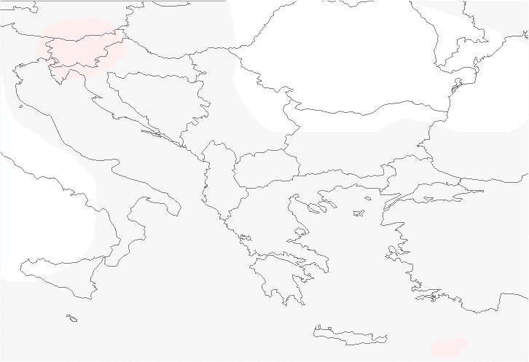
Land Cover map
  ESA-CCI, 300 m resolution
  https://www.esa-landcover-cci.org/?q=node/164
  at this study LC map for 2015 is used
  LC types: Forest, Cultivated, Shrubs
GDAL_grid library is used
  to interpolate soil moisture in the mesoregions and producing maps,
  for georeferenced gridded LST datasets for the region of Bulgaria to produce and visualized maps.
Target region: Bulgaria, SE Europe, Eastern Mediterranean
Notes:
7

Slide 8
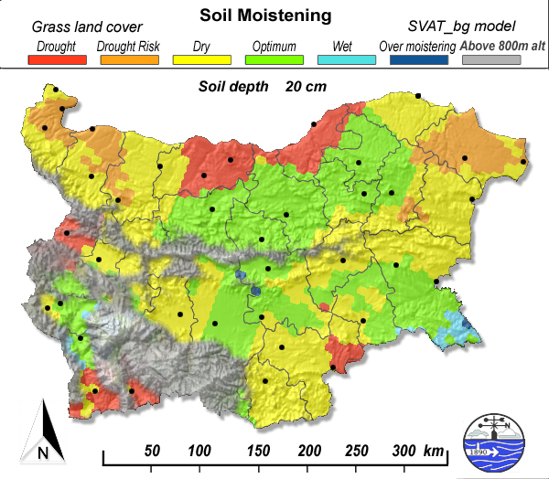
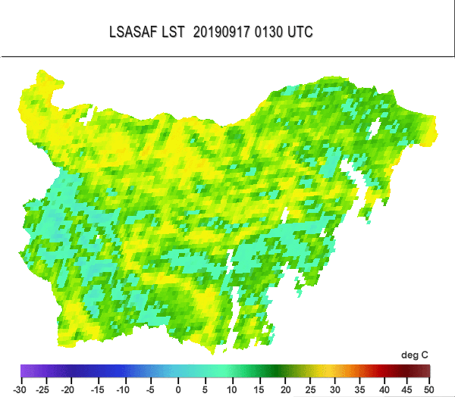
4. Results from application of satellite LST (climatic aspect)
4.1. Terrestrial drought assessment
Drought identification by Soil Moisture Availability Index (SMAI)
SMAI is designed as a 6-level threshold scheme
in digital values ranging from 0 to 5, color-coded
Category | SMAI values | SMAI color-coding
Drought | 0 | Red
Drought risk | 1 | Orange
Dry | 2 | Yellow
Optimum | 3 | Green
Wet | 4 | Light blue
Over-moistening | 5 | Dark blue
(Stoyanova & Georgiev, 2013)
LSA SAF Land Surface Temperature (LST)
the physical temperature of the Earth’s surface
Model & Satellite data used

Slide 9
Spatial variability of biogeophysical indexes SMAI & LST in ‘dry’ and ‘wet’ conditions
Qualitative analyses
Spatial variability of the two biogeophysical parameters are strongly related to the distribution of energy-water cycles across the climate gradient of Bulgaria, thus their evolution is considered for a variety of environmental conditions.
SMAI and LST experimental evolutions
Years/months with dominant sensible heat fluxes are selected: in this case a high energetic loading but limited precipitation leads to depleted SMA and drought occurrence with different levels of severity. Such years/months are classified as ‘dry’ periods.
Years/months with dominant latent heat fluxes are selected: in this case even at a high energetic loading precipitation is above norms, soil becomes saturated (and even over-moistened), and evapotranspiration is undisturbed. Such years/months are classified as ‘wet’ periods.

Slide 10
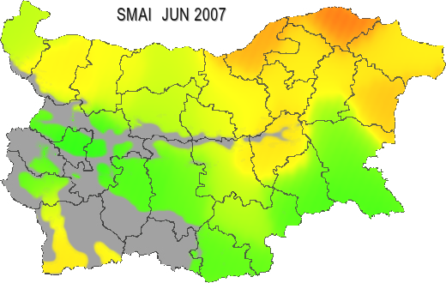
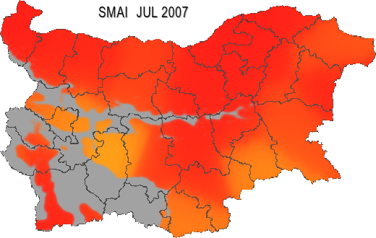
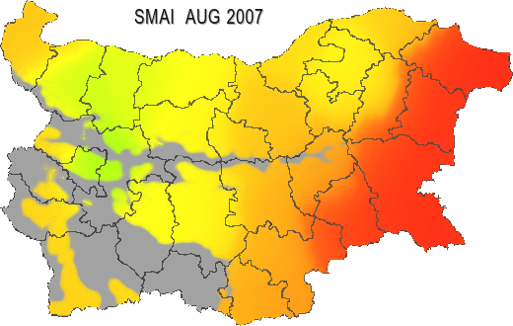
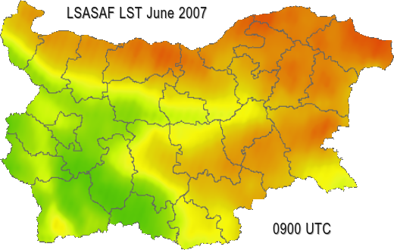
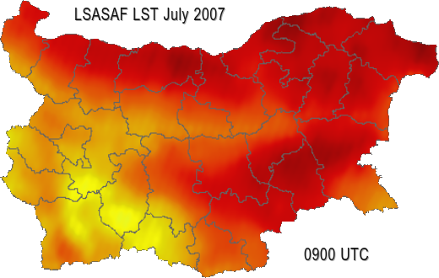
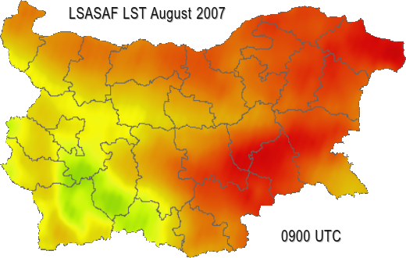
SMAI and LST in dry conditions
Example: 2007 deficient precipitations from April up to the beginning of August, below monthly norms.
(a)
(b)
SMAI
(c)
Qualitative comparison
A good agreement between the spatial distributions of the two indexes:
The lower the SMAI (i.e. increased drought severity) the higher LST.
Accumulated terrestrial drought leads to increased land surface temperature, as in July 2007.
For the regions with lower SMAI indicating dry conditions, higher LST values are obtained by the MSG-based satellite product are.
(d)
(e)
LSASAF LST
(f)
Figure 1. Spatial distribution of monthly mean SMAI (50 cm soil layer) over Bulgaria in 2007 for:
(a) June; (b) July; (c) August, and of LSASAF LST for: (d) June; (e) July; (f) August.
(Stoyanova et al., 2019)

Slide 11
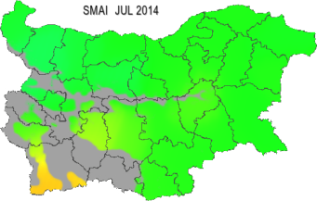
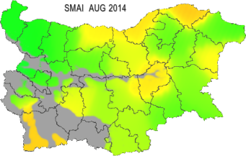
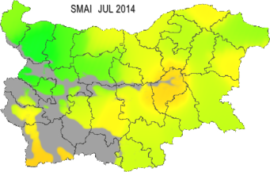
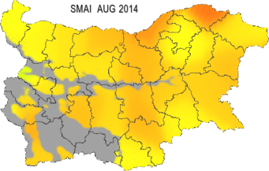
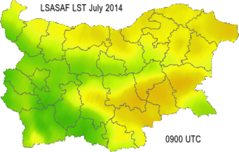
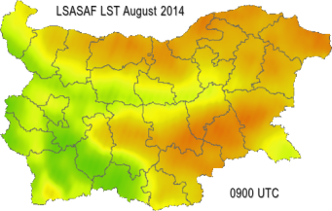
SMAI and LST in wet conditions
Example: 2014, from March to October precipitation is above climatic monthly norm.
(a)
July
SMAI
(b)
August
Qualitative comparison
The LST spatial variability is more closely related to SMAI distribution for 20 cm soil depth than SMA for 50 cm soil depth:
Spatial distribution of SMAI for the 50 cm soil layer indicates optimum soil moisture availability from March to July with a slight decrease in August
Spatial variability of SMAI at 20 cm depth (Fig. 2 c,d) corresponds much better to that of the LST distribution (Figure 2 e,f)
  regions with increasing drought correspond to higher LST values.
50 cm soil depth
(c)
(d)
20 cm soil depth
(e)
(f)
LSASAF LST
Figure 2. Spatial distribution of monthly mean SMAI (50 cm soil layer) over Bulgaria in 2014 for: (a) July; (b) August, and of SMAI (20 cm soil layer) for: (c) July and (d) August; as well as LSASAF LST for: (e) July; (f) August.

Slide 12
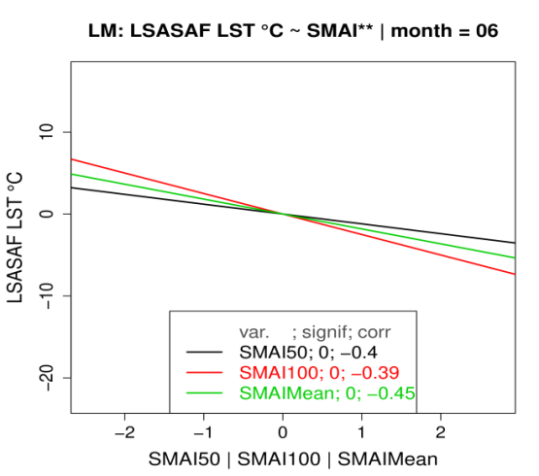
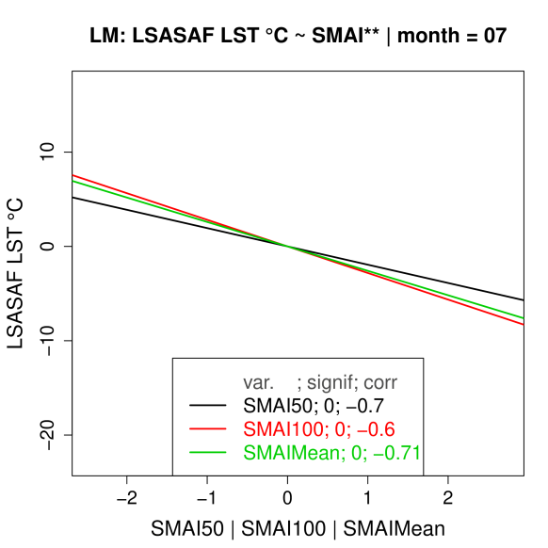
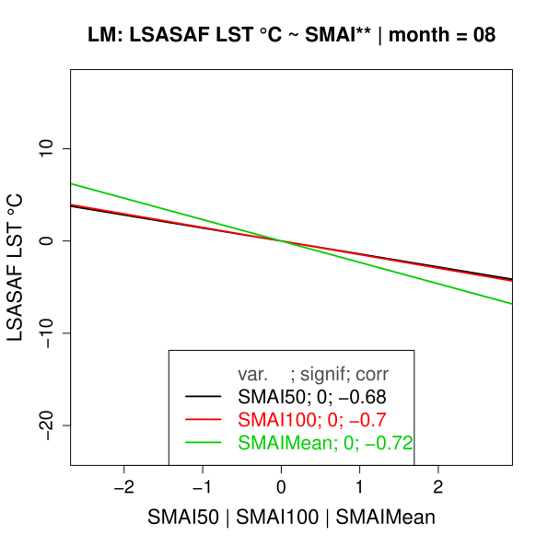
Quantitative analyses: SMA anomalies versus LST anomalies
Utility of LSASAF LST to characterize spatial-temporal variability of dry land surface state anomalies
(a)
(b)
(c)
June
July
Aug
Figure 3. Negative linear regression models of the relationship between LSASAF LST anomalies and SMAI (for 50 cm, black; 100 cm, red; Mean, green) for: (a) June, (b) July, (c) August, over Bulgaria. Monthly mean (2007-2018) are used to calculate the anomalies.
Linear regression models fit the SMA-LST anomalies relations:
  The correlation is minimum in June, r = -0.45 (full vegetation cover, maximum precipitation, high values of SMA, and an undisturbed evaporative cooling effect).
  A strong negative relationship between higher warm LST anomalies and stronger dry SMAI anomalies, occurs for July and August (periods with the most limited rain quantities, a decrease of SMA, mean LST increases significantly, above 45 °C; r = -0.70.
LSA SAF LST can be used as a tool for drought assessment in the critical period of July – August when most frequently severe dry anomalies occur over South Eastern Europe.

Slide 13
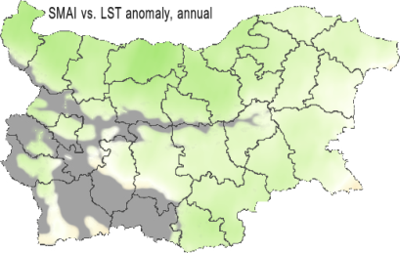
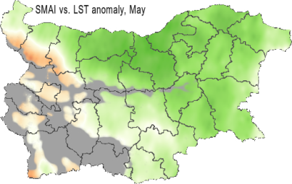
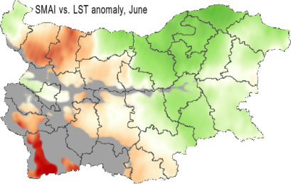
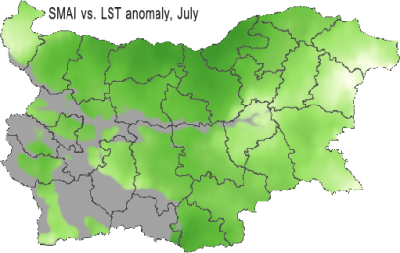
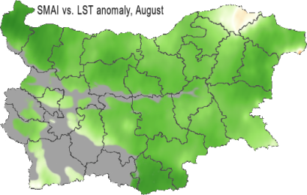
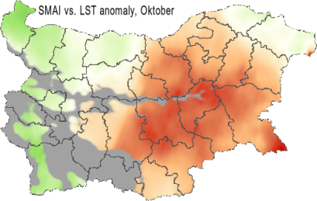
Quantitative analyses:
Spatial variability of correlation between SMAI and LST anomalies
Utility of LSASAF LST to characterize spatial-temporal variability of dry land surface state anomalies
On a mean annual bases (a) the increasing dry anomalies are related to increase of land surface temperature anomalies. The color map indicates correlations above moderate, r = -0.45 on mean annual bases.
A strong correlation between the anomalies of the two indexes in July and August (d), (e) (coefficients mostly around --0.8, maximum -0.84).
The behavior of LST closely corresponds to the drought severity as indicated by SMAI, the lower SMAI, the higher LST. Existing mismatches: due to highly inhomogeneous land cover
growing season
May
June
(a)
(b)
(c)
July
August
October
(d)
(e)
(f)
Figure 5. Spatial distribution over Bulgaria of correlation between the monthly mean anomalies of root zone SMAI and LSASAF LST (MSG retrieval) for: (a) whole growing season; (b) May; (c) June; (d) July; (e) August; (f) October. Anomalies are calculated towards (2007-2018) period. Mountain regions above 800 m altitude are excluded with a mask.
(Stoyanova et al., 2019)

Slide 14
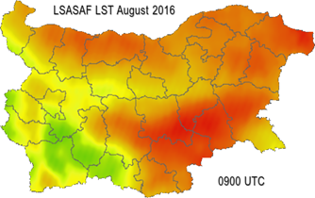
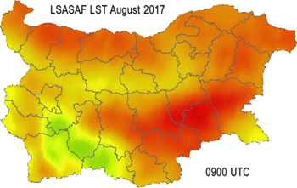
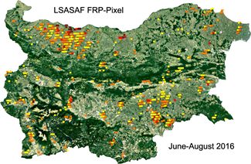
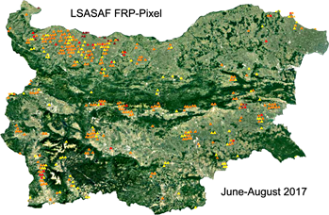
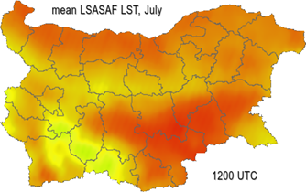
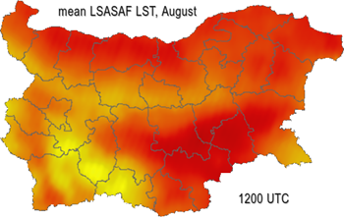
Sensitivity comparative analyses of drought versus fire activity seen in LST and FRP LSASAF products accordingly.
4. Results from application of satellite LST (climatic aspect)
4.2. Link between drought and biomass burning activity
LSASAF LST
(a)
(b)
Fires in Mediterranean are mainly caused by human activities related to agricultural practices.
Identification of regions most vulnerable to biomass burning is of importance regarding some prevention activities.
MSG LST product very well indicates for the most sensitive areas to wild fires:
  Large number of fire detections by LSASAF FRP in the northwestern, southwestern and southeastern parts of Bulgaria correspond to areas of highest LST.
LSASAF FRP
(c)
(d)
LSASAF LST
(e)
(f)
Figure 6. Land surface state and probable fire occurrence: Monthly mean LSASAF LST 0900 UTC for: (a) August 2016; (b) August 2017. Accumulated thermal anomalies detections by LSA SAF FRP-Pixel product for: (c) June-August 2016; (d) June-August 2017. Monthly mean (2007-2018) LSASAF LST 1200 UTC values for: (e) July; (f) August.

Slide 15
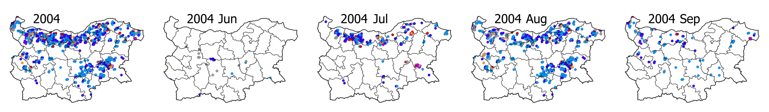
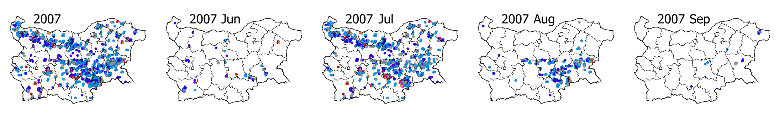
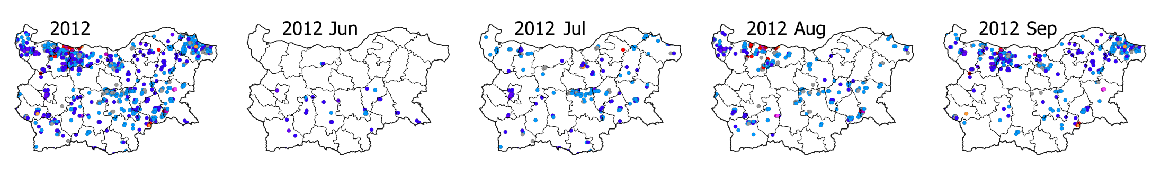
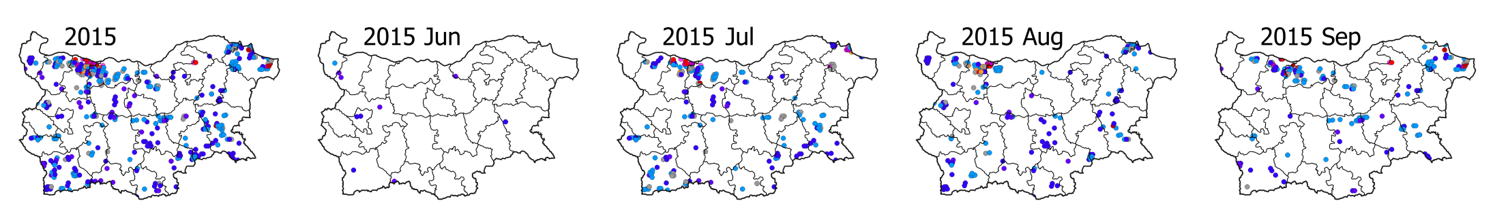
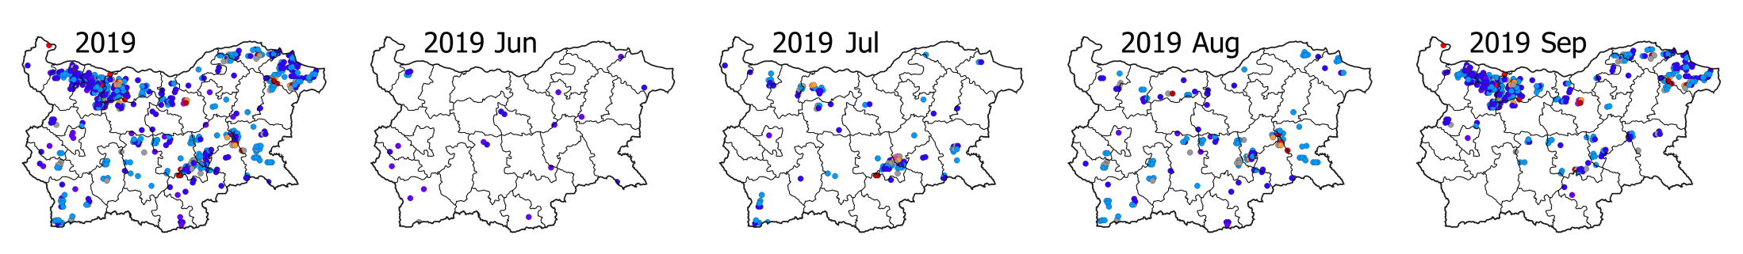
Accumulated LSASAF FRP-Pixel detections over Bulgaria. Spatial-temporal (monthly/annual) distribution maps. 2004-2019 period is considered

Slide 16
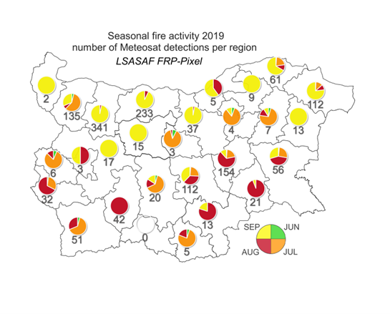
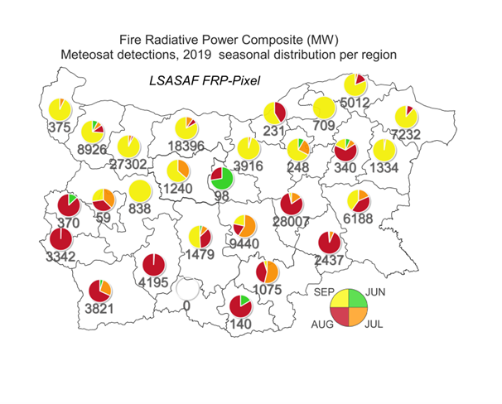
Seasonal (Jun-Sep) distribution of fire activity according LSASAF FRP-Pixel detections
Detections
Fire Radiative Energy
Jun-Sep distribution of biomass burning as detected by FRP-Pixel product, 2004-2019 is evaluated.
The seasonal distribution of fire activity (number, released energy) varies among different years.
The maximum of FRP detections appears to be in July and August for most of the regions.
For most of the regions, the FRP energy released follows the number of detections.
Some exptions of this correspondance are seen.
Among the others, the land cover type is a main reason for these differenches.

Slide 17
4.3. Temporal variability of LST vs. biomass burning: Jun-Sep (2007-2018)
a)
Cultivated LC type
c)
b)
Synchronized behavior in mean (2007-2018) seasonal (Jul-Sep) courses of:
LST and Number of detections
LST and Total FRP released (MW)
(LST-T2m) and Total FRP released (MW)

Slide 18
a)
4.3. Temporal variability of LST vs. biomass burning: Jun-Sep (2007-2018)
Forest LC type
Synchronized behavior in mean (2007-2018) seasonal (Jul-Sep) courses of:
LST and Number of FRP detections at forest LC types
LST and Total FRP (MW) energy released by burning forest biomass
b)
Increase of LST is related to corresponding increase of the number of forest fires (detections by LSASAF FRP-Pixel) and the released energy from biomass burning.

Slide 19
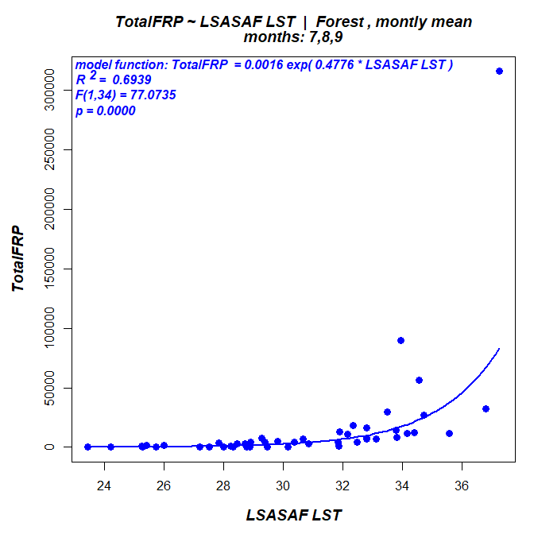
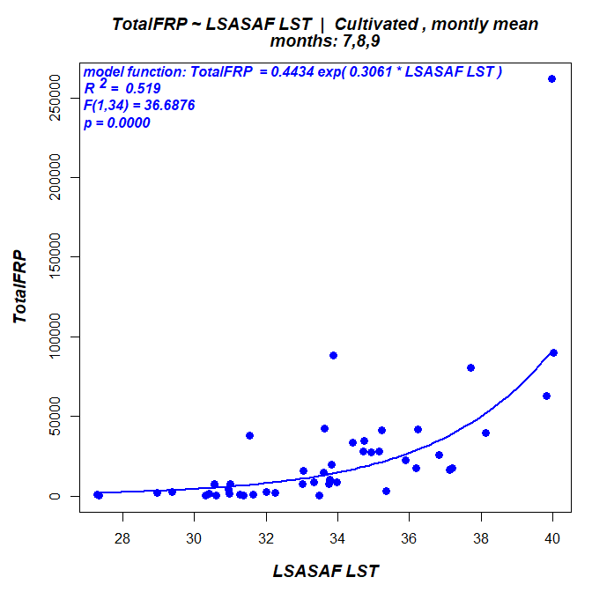
4.4. Correlation analyses: relation between satellite retrievals of LST and biomass burning
Relation between LST and biomass burning (Number, Nb of detections and released energy, FRP in MW) for Jul-Sep (2007-2018) is evaluated by correlation analyses.
High exponential correlation between LST and Nb/FRP- energy is obtained.
Forest LC type
Cultivated LC type

Slide 20
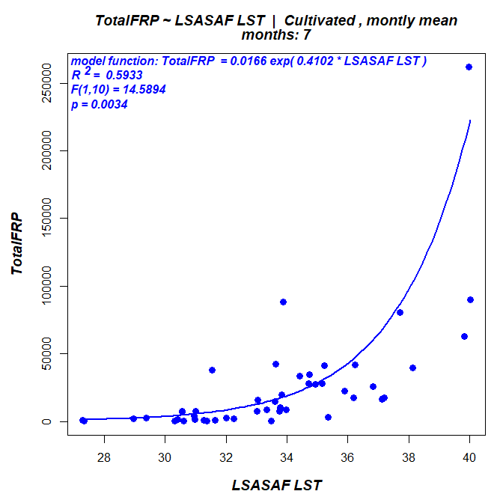
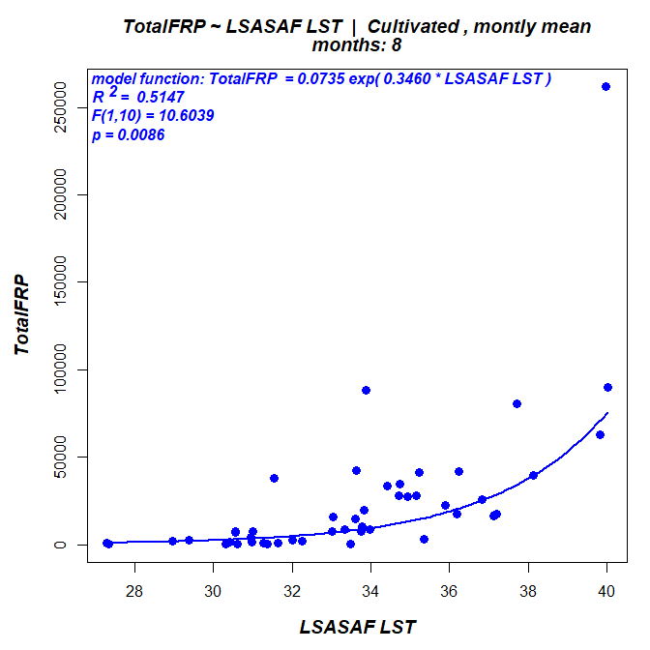

4.4. Correlation analyses: relation between satellite retrievals of LST and biomass burning
Jul
Aug
Sep
Cultivated LC type : R² = 0.59 ÷ 0.51
 | Forest LC, R² |  | Cultivated LC, R²
 | LST vs FRP | LST vs. Fire Nb | LST vs FRP | LST vs. Fire Nb
Jul | 0.8381 | 0.866 | 0.5933 | 0.6611
Aug | 0.5047 | 0.4728 | 0.5147 | 0.4331
Sep | 0.5114 | 0.4199 | 0.5566 | 0.5461

Slide 21
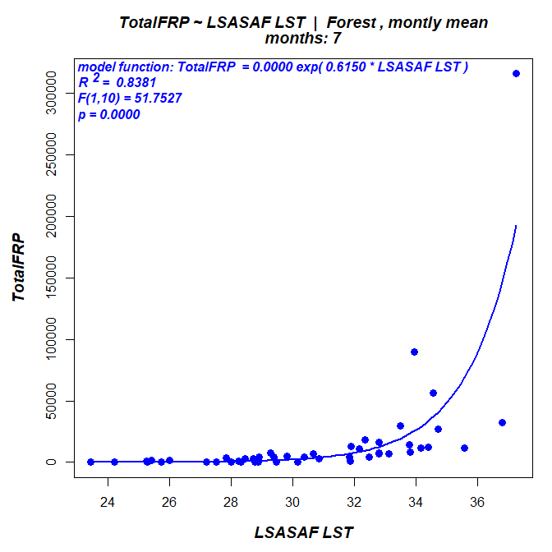

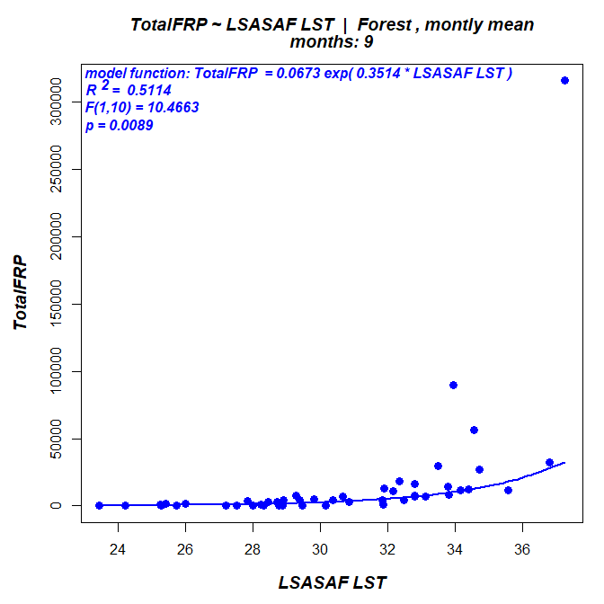
4.4. Correlation analyses: relation between satellite retrievals of LST and biomass burning
Jul
Aug
Sep
Forest LC type : R² = 0.84 ÷ 0.50
 | Forest LC, R² |  | Cultivated LC, R²
 | LST vs FRP | LST vs. Fire Nb | LST vs FRP | LST vs. Fire Nb
Jul | 0.8381 | 0.866 | 0.5933 | 0.6611
Aug | 0.5047 | 0.4728 | 0.5147 | 0.4331
Sep | 0.5114 | 0.4199 | 0.5566 | 0.5461

Slide 22
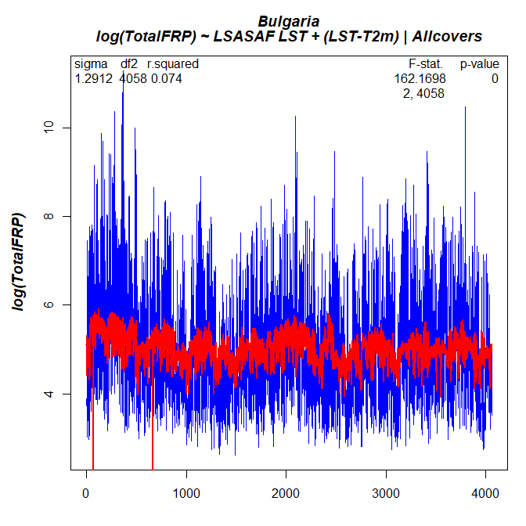
Generalized linear statistical model
4.4. Relation between satellite retrievals of LST and biomass burning:
Jun-Sep (2007-2018). Statistical modeling
Generalized linear statistical model between observation and modeling of FRE (MW) released from biomass burning:
    Observations: FRP detections (2007-2018)
    Model predictors: LSASAF LST and (LST-T2m)
    Logarithmic relations with the predictors
    All LC types
    Whole domain of Bulgaria
There is a good fit between observed energy released from biomass burning according FRP-Pixel and the model.
Blue – Observations (FRP-Pixel thermal anomalies detection)
Red – Model (fitted data)
Estimation procedure: package “lm” from R project, see: R Core Team (2016). R: A language and environment for
statistical computing. R Foundation for Statistical Computing, Vienna, Austria. URL https://www.R-project.org/.

Slide 23
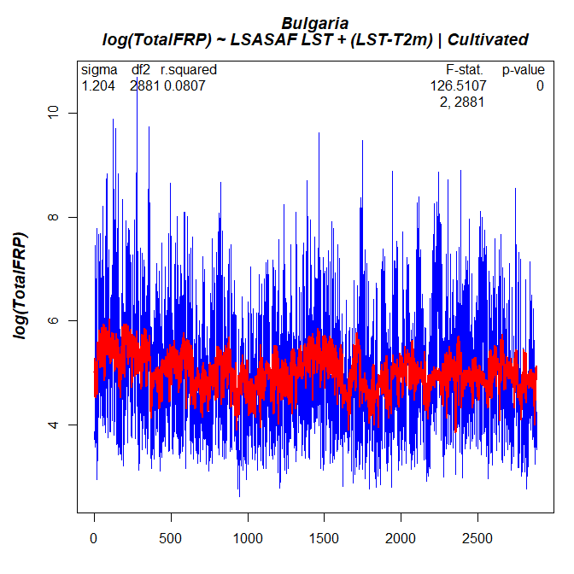
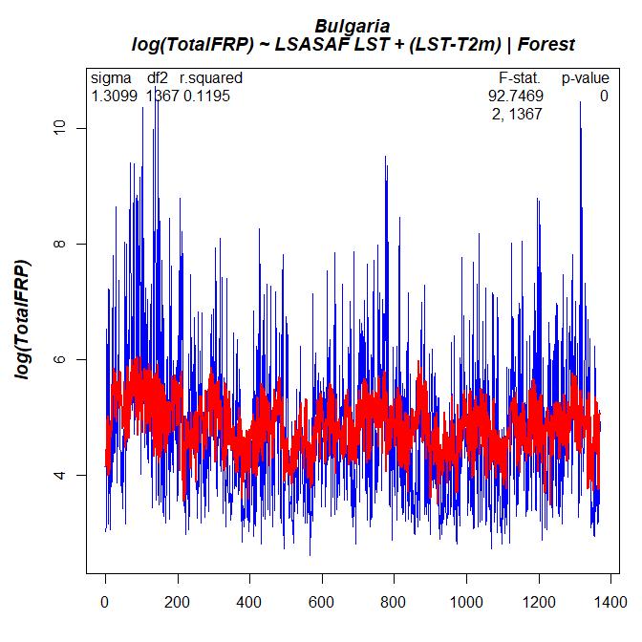
Generalized linear statistical model
(total fire radiative power estimates for whole domain of Bulgaria)
Cultivated LC type
Forest LC type
Blue – Observations Red – Model fitted data
Observations-Model of Cultivated and Forest LC types for whole domain of Bulgaria: There is a good fit between energy released from biomass burning,
.

Slide 24
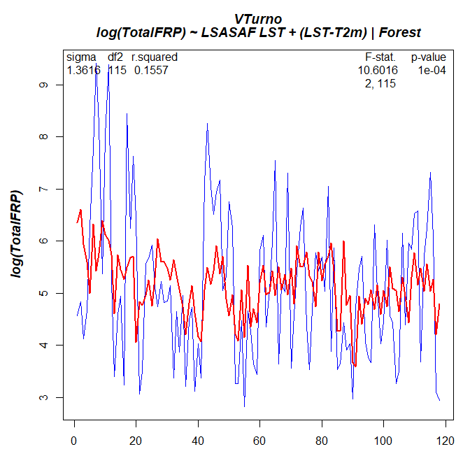
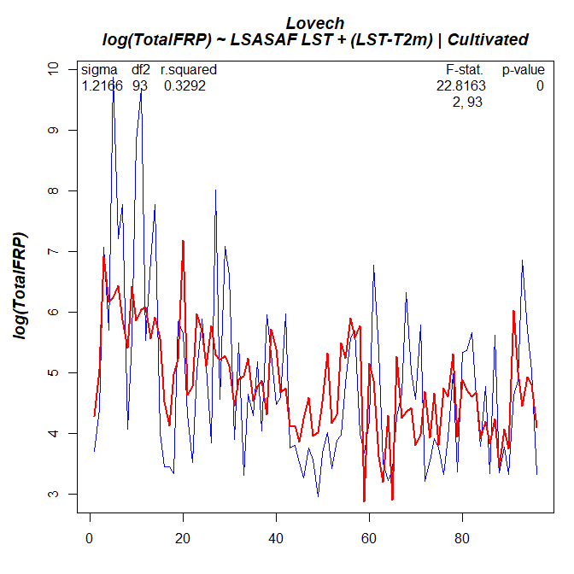
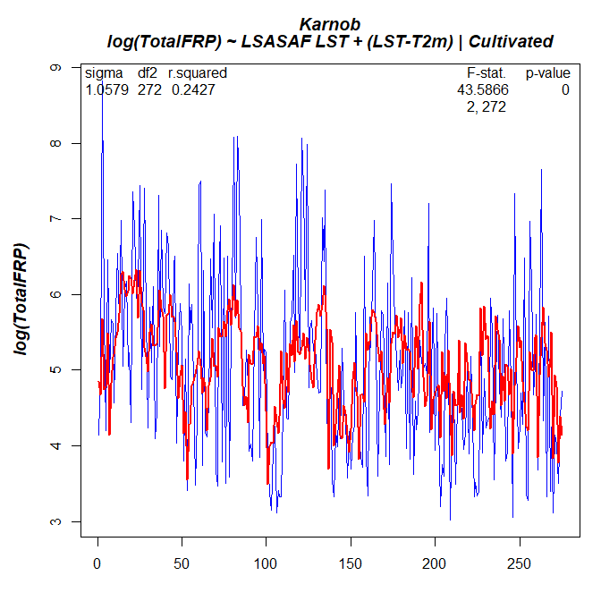

Generalized linear statistical model
(total fire radiative power estimates for specific regions of Bulgaria)
Forest LC type
Cultivated LC type
Linear statistical models are developed for application over local regions of Bulgaria.

Slide 25
5. Concluding remarks
Long-term (2007-2018) monthly mean LSASAF LST data retrieved from geostationary satellite observations are used for climatic analyses of drought occurrence and related fire activity in the region of Eastern Mediterranean:
  As a reference in drought assessment, Soil Moisture Availability to vegetation derived through meteorological ‘SVAT_bg’ model is used.
  The drought effects on fire activity is studied using satellite detections of biomass burning through LSASAF FRP-Pixel products during most fire danger period (Jul-Sep); Long-term (2004-2019) dataset is considered to characterize the spatial-temporal variability of fire activity (number of FRP detections in each MSG pixel and energy released from biomass burning).
Results indicate that:
  MSG IR LST retrievals can be used to designate dry land surface state anomalies, and thus to identify the most drought prone regions on a regional level (Stoyanova et al, 2019).
  A generalized linear statistical model fits the relationship between LST (as a predictor) and the released energy from biomass burning (Total FRP, MW). These first results show that satellite LST can be a source of information in the climatic assessments of the energy release from possible wildfires and to locate the potential “risky spots”.
Identification of drought-prone areas on a regional basis is of importance for the purposes of mitigation activities because fires and biomass burning in the region are not only a natural hazard and can also be a climate change driver.
Work has been initiated in the frame of EUMETSAT SALGEE Project 2019, PO Number/Date 4500017699/22-January-2019 and supported by the EUMETSAT LSASAF CDOP-3 2017-20122 Project.

