Slide 1
Applications of an LST based diagnostic to evaluate soil moisture-surface flux relationships in land surface models
Sonja Folwell¹, Phil Harris¹, Belen Gallego-Elvira², Christopher Taylor¹
¹ UKCEH, ² Agricultural Engineering Department, Technical University of Cartagena, Cartagena, Spain.
LST_CCI Workshop June 2020

Slide 2
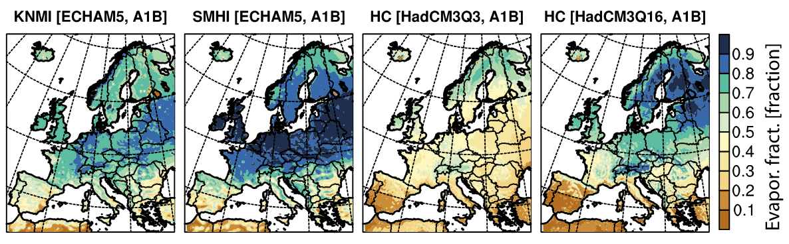
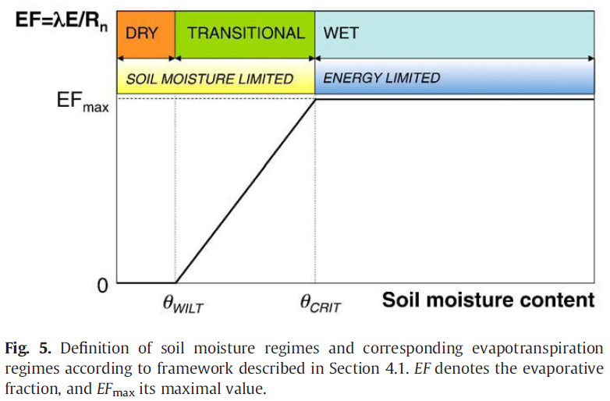
Background
From Seneviratne et al (2010) Earth-Science Rev.
Mean summer evaporative fraction in ENSEMBLES models 1970-1999.
From Fischer et al (2012), GRL

Slide 3
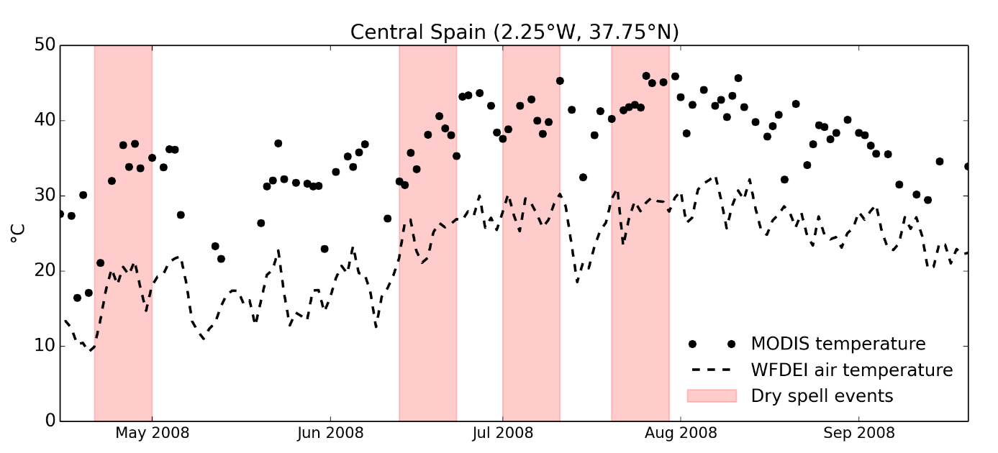
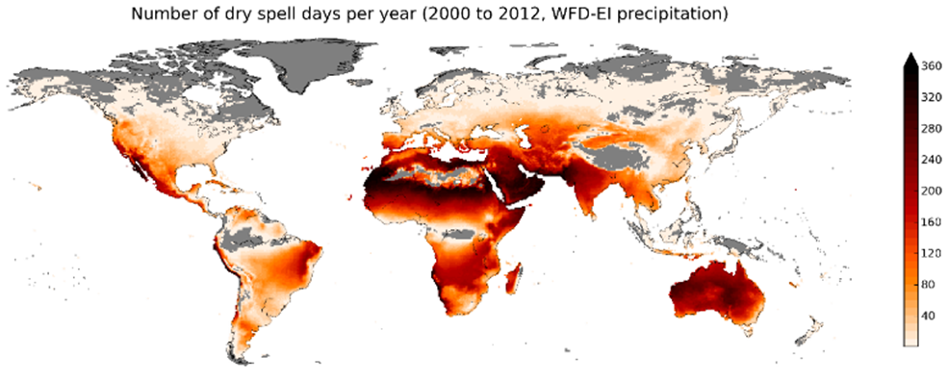
Methodology
MODIS (Terra and Aqua) LST 2000 to 2014 (Collection‐5) regridded to 0.5 degrees
The number of pixel per 0.5 degree observation are used to weight the grid box LST
Identify warm season dry spells from reanalysis or satellite
Dry spell: period of at least 10 days with P < 0.5 mm every day
2 m

Slide 4
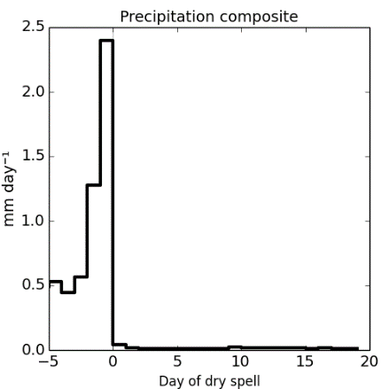
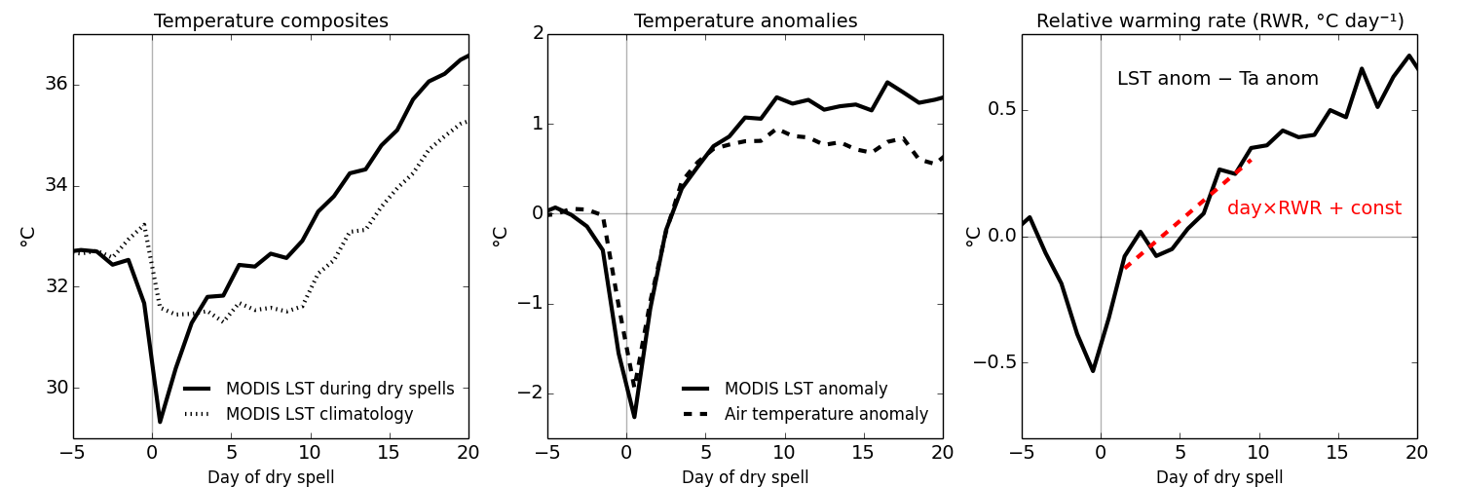
LST and Tair anomalies, RWR
TD = LST anomaly – Tair anomaly
2 m
Folwell et al., JHM, 2016; Gallego‐Elvira, B. et al., GRL, 2016

Slide 5
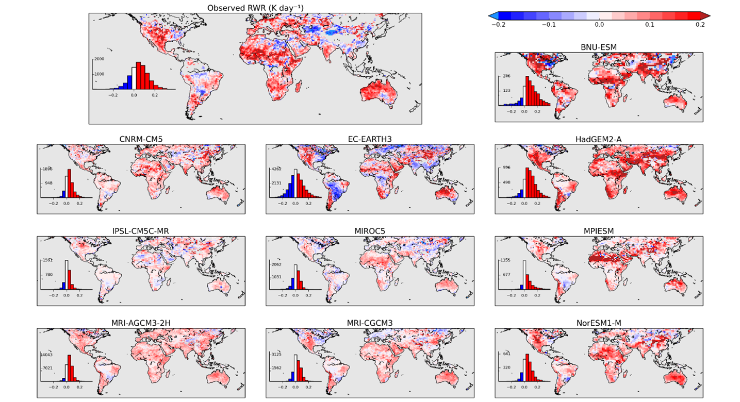
Mapping RWR globally
Positive RWR
73% of the land warms faster than the atmosphere.
EF reducing, and increasing H during dry spells
Negative RWR
Available water during dry spells (forests, irrigated land, wetlands)
Very dry land (mid-latitude deserts)
RWR – how much faster is the land warming than the air
Gallego‐Elvira, B. et al., GRL, 2019

Slide 6
Assessing model behaviour
Models sampled on clear sky days only
(SW > 0.9 SWmax)
Gallego‐Elvira, B. et al., GRL, 2019

Slide 7
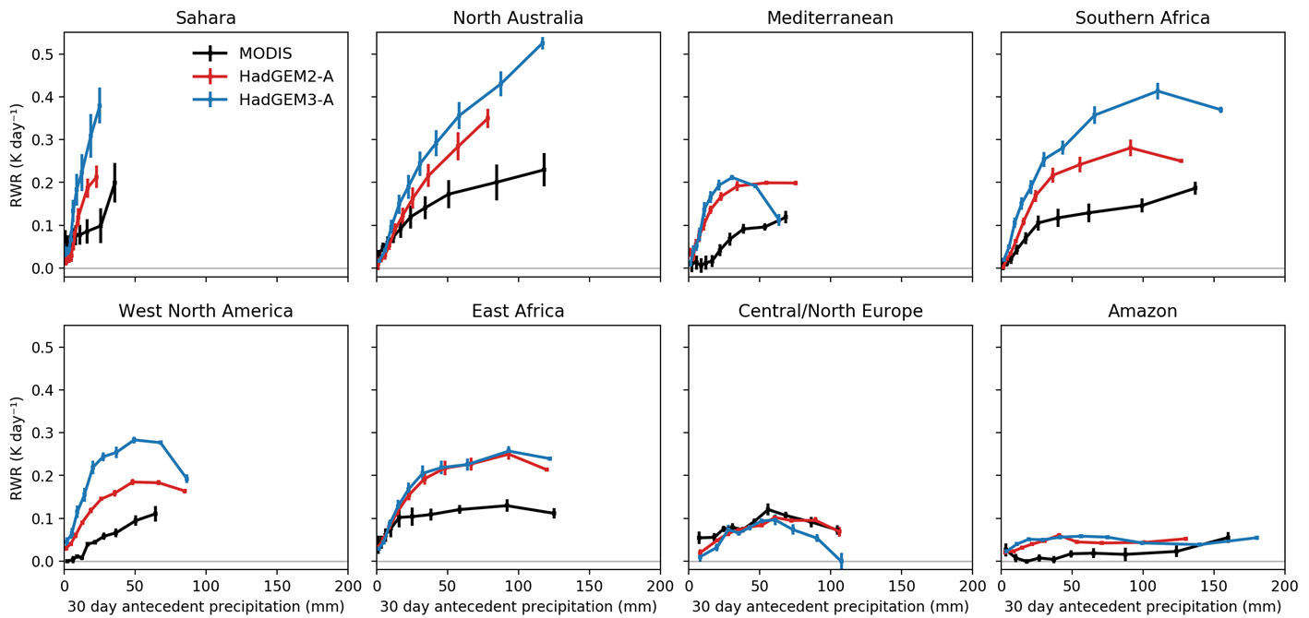
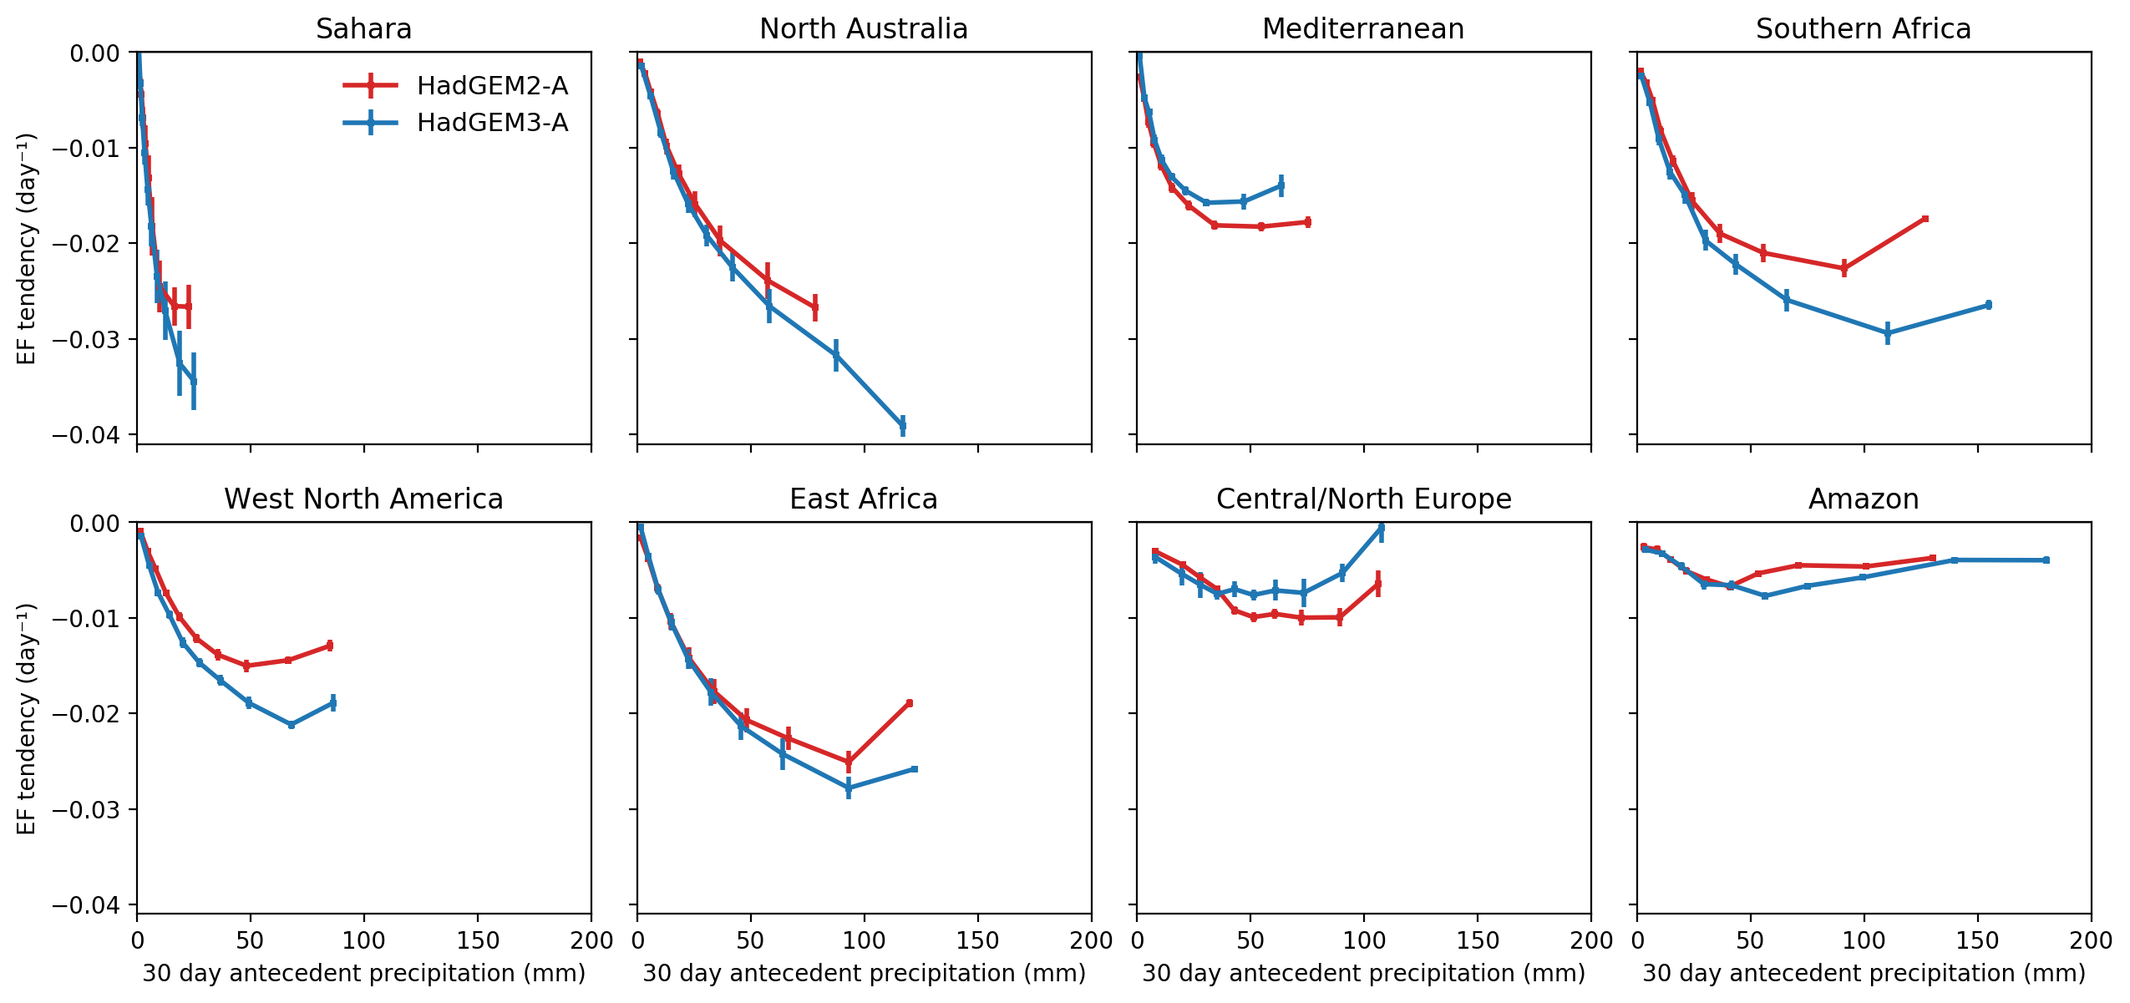
RWR vs antecedent rainfall
7

Slide 8
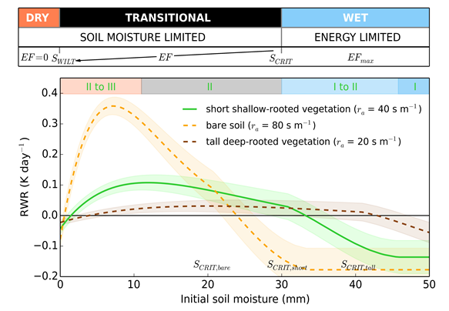
RWR vs antecedent rainfall
Southern Africa
Central Europe

Slide 9
Model summary
Correlations between observed and modelled RWR across CMIP5 models
Green: good agreement in arid areas
Red: poor agreement, typically in areas with high levels of irrigation
Models struggle over continental climates
Gallego‐Elvira, B. et al., GRL, 2019

Slide 10
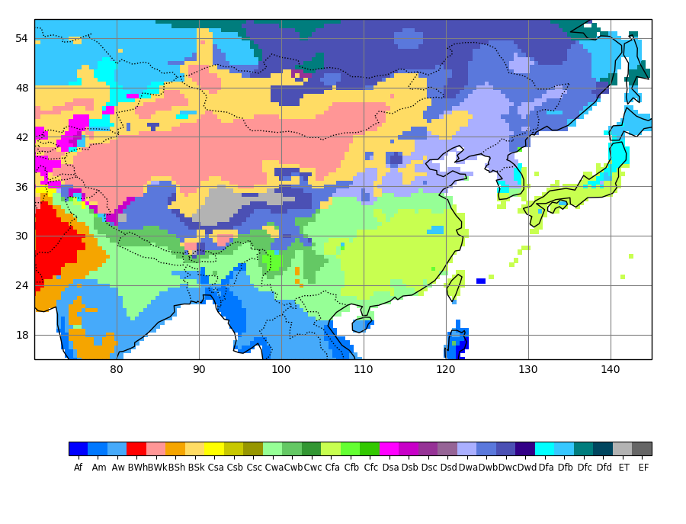
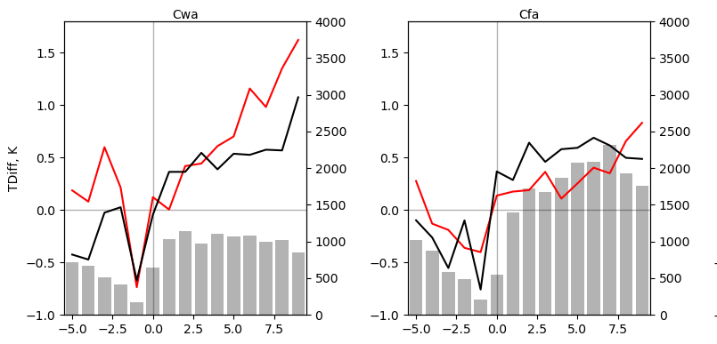
Regional analysis in JULES
Dry-winter subtropical
Humid subtropical
Observed
JULES
This version of JULES shows overly strong sensitivity of surface fluxes to soil moisture in Cwa region
Ongoing work to assess role of soil parameters and representation of irrigation

Slide 11
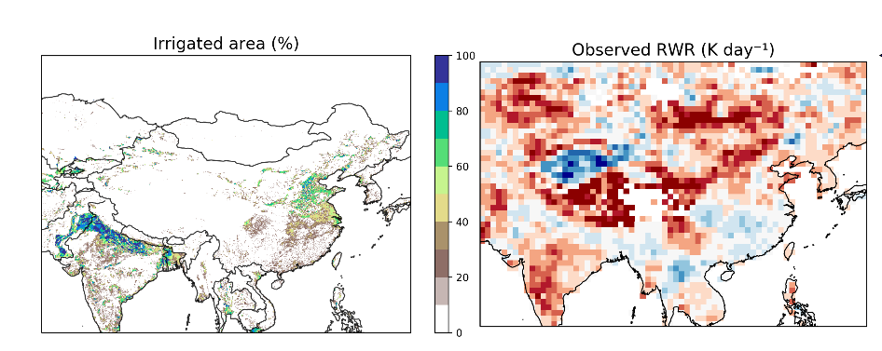
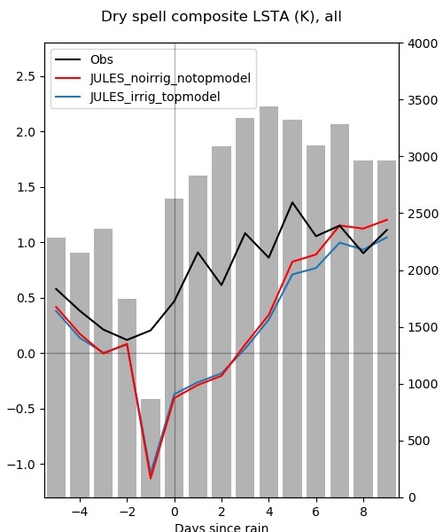
Impact of irrigation
The impact of irrigation on mean RWR show some low and negative values of RWR.
Disaggregating by antecedent rainfall will show this more clearly but the signal becomes limited by numbers of observations.

Slide 12
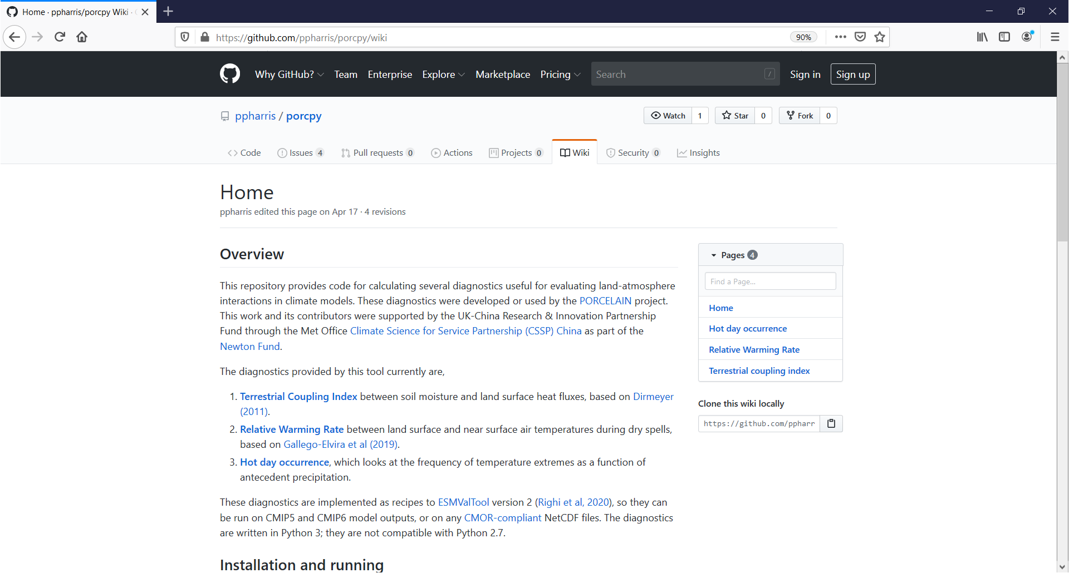
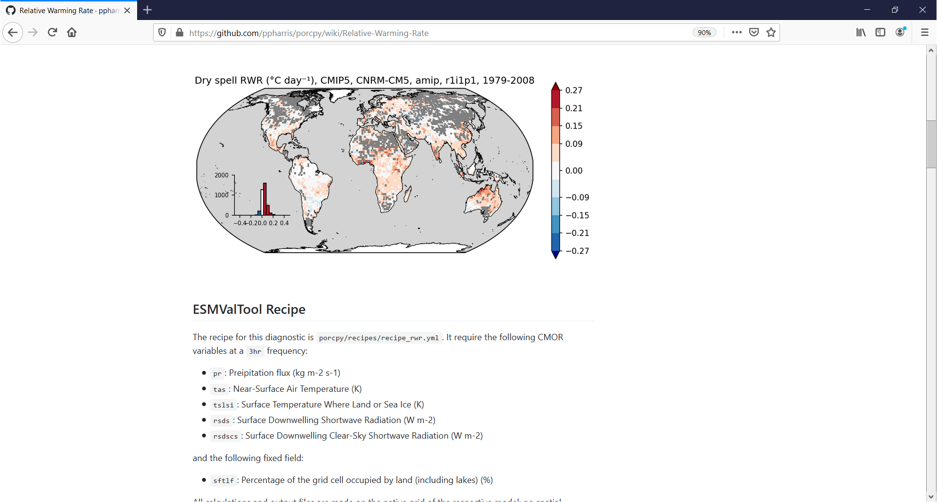
RWR code repository
https://github.com/ppharris/porcpy

Slide 13
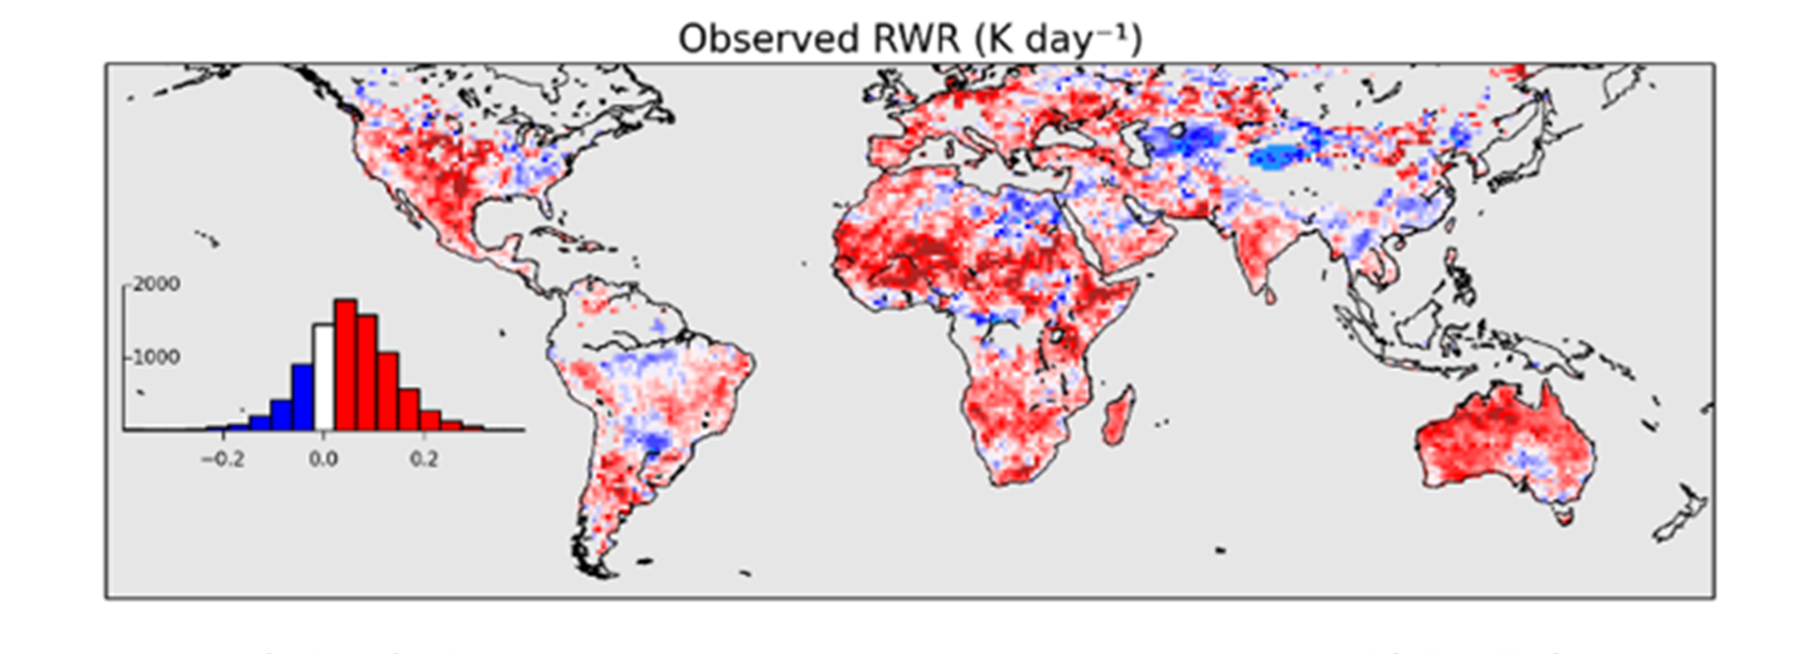
Summary
The evolution of daytime LST and Tair anomalies contain important soil moisture and can represent the changing ET dynamic during a dry spell
RWR provides information on model SM-ET during 10-day dry spells
Some areas are difficult to resolve due to clouds e.g. (Amazon) or short timescales involved.
Longer LST records would allow for greater disaggregation of the signal e.g. land cover and rainfall
Future plans include adapting this methodology for higher resolution convection permitting models.
https://github.com/ppharris/porcpy
ssf@ceh.ac.uk

Slide 14
Folwell et al (2015) “Large-scale surface responses during European dry spells diagnosed from land surface temperature”, J. Hydromet., 17(3), 975-993, doi:10.1175/jhm-d-15-0064.1
Gallego-Elvira et al. (2016) “Global observational diagnosis of soil moisture control on the land surface energy balance”, Geophys. Res. Lett., 43, doi:10.1002/2016GL068178
Gallego‐Elvira, B., Taylor, C. M., Harris, P. P., & Ghent, D. (2019). Evaluation of regional‐scale soil moisture‐surface flux dynamics in Earth system models based on satellite observations of land surface temperature. Geophysical Research Letters, 46, 5480–5488. https://doi.org/10.1029/2019GL082962
https://github.com/ppharris/porcpy

